Slide 1

Introduction to ArrayLists
(based on Ch. 4, Objects First with Java - A Practical Introduction using BlueJ, © David J. Barnes, Michael Kölling)
Produced by:
Ms. Mairéad Meagher
Dr. Siobhán Drohan
Ms Siobhan Roche
Department of Computing and Mathematics
http://www.setu.ie/

Slide 2
Topic list
Grouping Objects
  Developing a basic personal notebook project using Collections
  e.g. ArrayList
Indexing within Collections
  Retrieval and removal of objects
Generic classes
  e.g. ArrayList
Iteration
  Using the for loop
  Using the while loop
  Using the for each loop
Next SlideDeck:
coding a Shop Project that stores an ArrayList of Products.

Slide 3
The requirement to group objects
Many applications involve collections of objects:
  Personal organizers.
  Library catalogs.
  Student-record system.
The number of items to be stored varies:
  Items added.
  Items deleted.

Slide 4

Example: Personal Note Keeper
Notes may be stored.
Individual notes can be viewed.
There is no limit to the number of notes.
It generally tells you how many notes are stored.

Slide 5
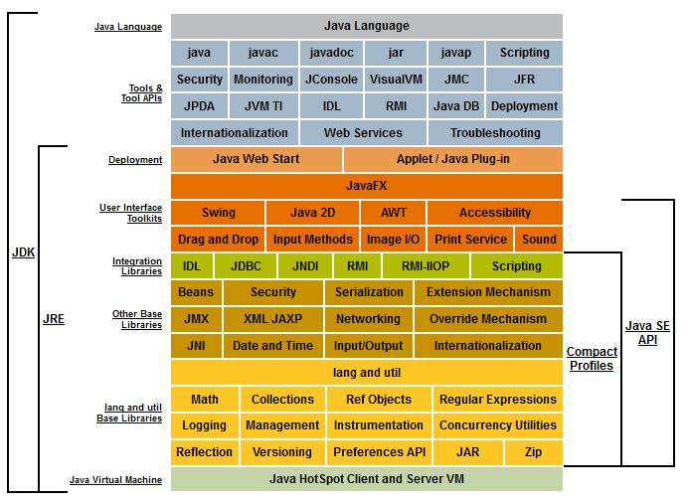
Java API – The Class Library
Many useful classes.
We don’t have to write everything from scratch.
Java calls its libraries, packages.
Packages contain individual
classes
https://www.oracle.com/java/technologies/platform-glance.html

Slide 6
Java API – The Class Library
Grouping objects is a recurring requirement.
  The java.util package contains classes for doing this
  …the Collections Framework
https://www.oracle.com/java/technologies/platform-glance.html

Slide 7
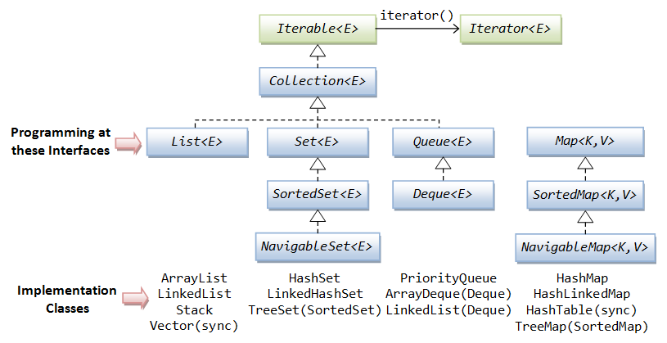
Java’s Collection Framework

Slide 8
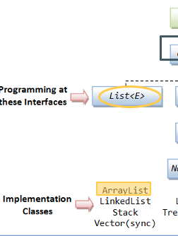
Lists
What properties do lists have?
Order – this may be chronological (in the order the elements were added);
You can access any element in a list;
You can add or remove any element in the list;
You can have duplicates in a list.
We will look at ArrayLists

Slide 9
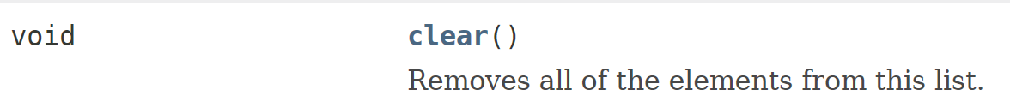
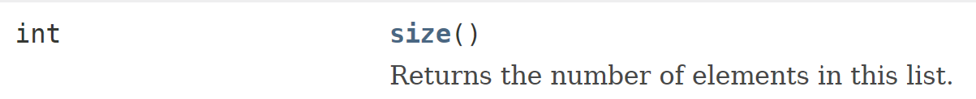
ArrayList – methods we will use
ArrayList implements list functionality:

Slide 10
ArrayList Collection
We specify:
  the type of collection
    e.g.: ArrayList
  the type of objects it will contain
    e.g.: <String>
We say
  “ArrayList of String”
Notes:
The type must be an object…it cannot store primitive types.

Slide 11
import java.util.ArrayList;
public class Notebook
{
// Storage for an arbitrary number of notes.
private ArrayList <String> notes;
// Perform any initialization required for the notebook.
public Notebook()
{
notes = new ArrayList <String>();
}
}

Slide 12
import java.util.ArrayList;
public class Notebook
{
// Storage for an arbitrary number of notes.
private ArrayList <String> notes;
// Perform any initialization required for the notebook.
public Notebook()
{
notes = new ArrayList <String>();
}
}
import the ArrayList package

Slide 13
import java.util.ArrayList;
public class Notebook
{
// Storage for an arbitrary number of notes.
private ArrayList <String> notes;
// Perform any initialization required for the notebook.
public Notebook()
{
notes = new ArrayList <String>();
}
}
declares notes as a private
“ArrayList of <String>”

Slide 14
import java.util.ArrayList;
public class Notebook
{
// Storage for an arbitrary number of notes.
private ArrayList <String> notes;
// Perform any initialization required for the notebook.
public Notebook()
{
notes = new ArrayList <String>();
}
}
notes is initialised by calling
the constructor using new
Note new and ()

Slide 15
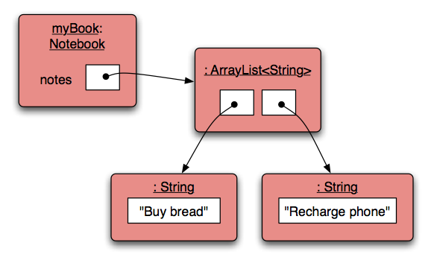
Object structures with ArrayList

Slide 16
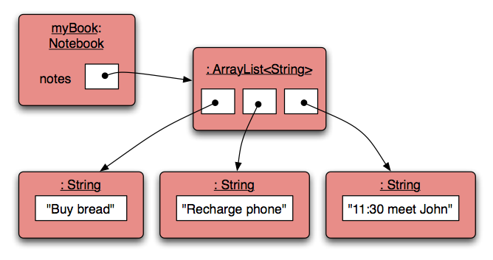
Adding a third note

Slide 17
Features of the ArrayList Collection
It increases its capacity as necessary.
It keeps a private count
  size() accessor.
It keeps the objects in order.
?
Details of how all this is done are hidden.
  Does that matter?
  Does not knowing how, prevent us from using it?
Notes:
ANSWER = NO

Slide 18
import java.util.ArrayList;
public class Notebook
{
private ArrayList <String> notes;
public Notebook(){
notes = new ArrayList <String> ();
}
public void storeNote(String note){
notes.add(note);
}
public int numberOfNotes(){
return notes.size();
}
}
Adding a new note
of type String
Returning the
number of notes

Slide 19
Topic list
Grouping Objects
  Developing a basic personal notebook project using Collections
  e.g. ArrayList
Indexing within Collections
  Retrieval and removal of objects
Generic classes
  e.g. ArrayList
Iteration
  Using the for loop
  Using the while loop
  Using the for each loop
Next SlideDeck:
coding a Shop Project that stores an ArrayList of Products.

Slide 20

ArrayList: Index numbering

Slide 21
Retrieving an object – showNote()
public void showNote (int noteNumber)
{
if(noteNumber < 0) {
// This is not a valid note number.
}
else if(noteNumber < numberOfNotes()) {
System.out.println(notes.get(noteNumber));
}
else {
// This is not a valid note number.
}
}
Index
validity
checks
Retrieve and
print the note

Slide 22
Removing an object
public void removeNote(int noteNumber)
{
if(noteNumber < 0) {
// This is not a valid note number, so do nothing.
}
else if(noteNumber < numberOfNotes()) {
// This is a valid note number.
notes.remove(noteNumber);
}
else {
// This is not a valid note number, so do nothing.
}
}
Index
validity
checks
Delete the note at
the specific index

Slide 23
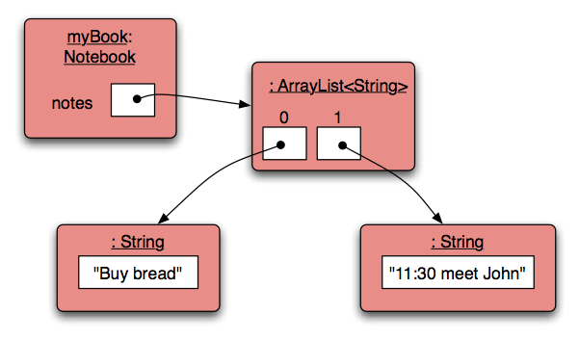
Removal may affect numbering

Slide 24
Removal may affect numbering
BEFORE
AFTER
1
2
3
1
2
NOTE the change in numbering

Slide 25

Questions?

