Slide 1

Test Driven Development
Introduction to TDD
Produced
by:
Dr. Siobhán Drohan
Mairead Meagher
Eamonn de Leastar
Siobhan Roche
Department of Computing and Mathematics
http://www.setu.ie/

Slide 2
Topic List
Types of Testing
What is Test Driven Development?
What is Unit Testing?
The JUnit Framework.

Slide 3
Types of Software Testing
Software testing is categorized into different levels based on scope and purpose:
Unit Testing
Tests individual components (methods/classes) in isolation.
Typically automated using frameworks like JUnit.
Ensures correctness of small, self-contained code units.
Integration Testing
Tests interactions between integrated components (e.g., multiple classes or modules).
Ensures data flows correctly between units.
May involve database connections, APIs, or third-party services.

Slide 4
Types of Software Testing contd.
System Testing
Tests the entire application as a whole.
Verifies that the complete system meets requirements.
Often includes performance, security, and usability testing.
Acceptance Testing
Validates the software against business requirements.
Ensures it meets user expectations.
Can be manual (user acceptance testing) or automated.

Slide 5
Topic List
Types of Testing
What is Test Driven Development?
What is Unit Testing?
The JUnit Framework.

Slide 6
Test Driven Development
Tests are written before you write the program code.
A test framework is used so that automated testing can be done after every small change to the code.
This may be as often as every 5 or 10 minutes.
This approach must be learned and practiced.

Slide 7
Why bother with Test Driven Development?
It makes your designs better.
Fewer bugs; drastically reduces the amount of time spent debugging code.
More maintainable code.
During development, the program always works—it may not do everything required, but what it does, it does right.
Your new philosophy (axiom):
‘Code that isn’t tested doesn’t work’

Slide 8
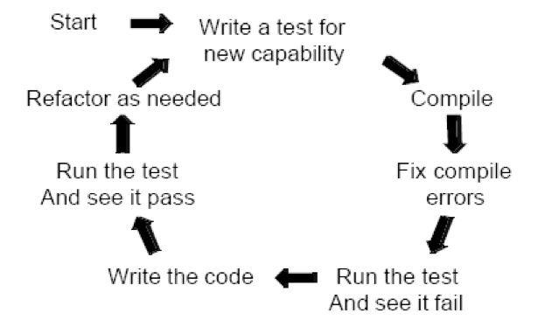
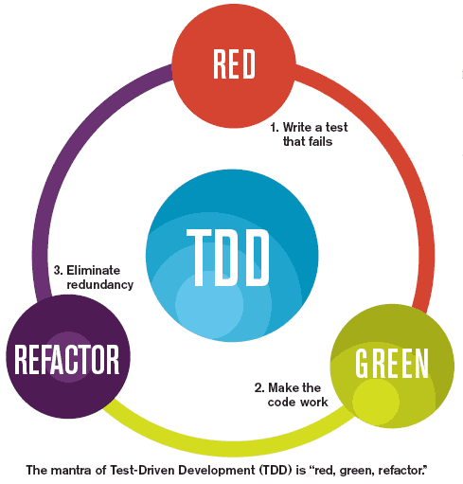
Test-driven development.

Slide 9
Topic List
Types of Testing
What is Test Driven Development?
What is Unit Testing?
The JUnit Framework.

Slide 10
What is Unit Testing?
A unit test is a piece of code written by a developer that tests (exercises) a very small, specific area of functionality of the code being tested.
Usually a unit test exercises some particular method in a particular context.

Slide 11
What is Unit Testing?
A unit test is a piece of code written by a developer that tests (exercises) a very small, specific area of functionality of the code being tested.
Usually a unit test exercises some particular method in a particular context.
Unit tests are performed to prove that a piece of code does what the developer thinks it should do.
The question remains open as to whether that's the right thing to do according to the customer or end-user:
that is acceptance testing

Slide 12
What does Unit Testing Accomplish ?
Does the code do what was expected?
i.e. is the code fulfilling the intent of the developer?
Does the code do what was expected all the time?
exceptions get thrown, disks get full, network lines drop, buffers overflow - is the code still performing as expected?
Can the code be depended upon?
Need to know for certain both its strengths and its limitations.

Slide 13
How is Unit Testing carried out?
Step 1: Decide how to test the method in question before writing the code itself.
Step 2: Write the test code itself, either before or concurrently with the implementation code.
Step 3: Run the test itself, and probably all the other tests in that part of the system.
Key Feature of executing tests: need to be able to determine at a glance whether all tests are succeeding/failing.

Slide 14
Topic List
Types of Testing
What is Test Driven Development?
What is Unit Testing?
The JUnit Framework.

Slide 15
JUnit
JUnit is a unit testing framework for the Java programming language.
JUnit has been important in the development of test-driven development, and is one of a family of unit testing frameworks collectively known as xUnit.
http://www.tutorialspoint.com/junit/junit_overview.htm

Slide 16
JUnit Features
Open source framework used for writing & running tests.
Provides Annotations to identify the test methods.
Provides Assertions for testing expected results.
Provides Test runners for running tests.
JUnit tests can be run automatically and they check their own results and provide immediate feedback. There's no need to manually comb through a report of test results.
Junit shows test progress in a bar that is green if test is going fine and it turns red when a test fails.
http://www.tutorialspoint.com/junit/junit_overview.htm

Slide 17
“Good programmers write code, great programmers write tests”
“Never, in the field of programming, have so many owed so much to so few”
- Martin Fowler on the developers behind JUnit

Slide 18

Any Questions?

