Slide 1

Test Driven Development
Using JUnit to Test Product.java
Produced
by:
Dr. Siobhán Drohan
Mairead Meagher
Siobhan Roche
Department of Computing and Mathematics
http://www.setu.ie/

Slide 2
Let’s first write a complete test class and then we will discuss the theory behind it.
Testing Product.java

Slide 3
Product.java
package models; import utils.Utilities; public class Product { private String productName = ""; private int productCode = -1; private double unitCost = 0; private boolean inCurrentProductLine = false; public Product(String productName, int productCode, double unitCost, boolean inCurrentProductLine) { this.productName = Utilities.truncateString(productName, 20); setProductCode(productCode); this.unitCost = unitCost; this.inCurrentProductLine = inCurrentProductLine; } public String toString() { return "Product description: " + productName + ", product code: " + productCode + ", unit cost: " + unitCost + ", currently in product line: " + Utilities.booleanToYN(inCurrentProductLine); } }

Slide 4
Product.java
public void setProductCode(int productCode) { if (Utilities.validRange(productCode, 1000, 9999)) { this.productCode = productCode; } } public void setProductName(String productName) { if (Utilities.validateStringLength(productName, 20)) { this.productName = productName; } } public void setUnitCost(double unitCost) { this.unitCost = unitCost; } public void setInCurrentProductLine(boolean inCurrentProductLine) { this.inCurrentProductLine = inCurrentProductLine; }
package models; import utils.Utilities; public class Product { private String productName = ""; private int productCode = -1; private double unitCost = 0; private boolean inCurrentProductLine = false; public Product(String productName, int productCode, double unitCost, boolean inCurrentProductLine) { this.productName = Utilities.truncateString(productName, 20); setProductCode(productCode); this.unitCost = unitCost; this.inCurrentProductLine = inCurrentProductLine; } public String toString() { return "Product description: " + productName + ", product code: " + productCode + ", unit cost: " + unitCost + ", currently in product line: " + Utilities.booleanToYN(inCurrentProductLine); } }
public String getProductName(){ return productName; }
public double getUnitCost(){ return unitCost; } public int getProductCode() { return productCode; } public boolean isInCurrentProductLine() { return inCurrentProductLine; }

Slide 5
Utilities.java
public class Utilities {
public static double toTwoDecimalPlaces(double number){ return (int) (number * 100 ) / 100.0; } public static boolean YNtoBoolean(char charToConvert){ return ((charToConvert == 'y') || (charToConvert == 'Y')); } public static char booleanToYN(boolean booleanToConvert){ return booleanToConvert ? 'Y' : 'N'; } public static String truncateString(String stringToTruncate, int length){ if (stringToTruncate.length() <= length) { return stringToTruncate; } else{ return stringToTruncate.substring(0, length); } } public static boolean validateStringLength(String strToCheck, int maxLength){ return strToCheck.length() <= maxLength; } public static boolean validRange(int numberToCheck, int min, int max) { return ((numberToCheck >= min) && (numberToCheck <= max)); } }
Some of these utility methods are used in the Product class:

Slide 6
Creating a Test Source Directory…

Slide 7
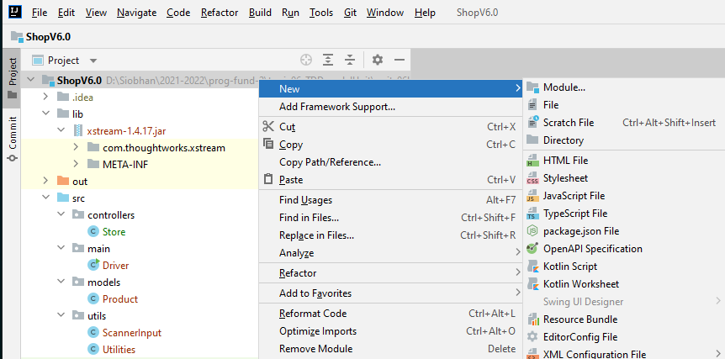
In IntelliJ, create a new directory and call it test

Slide 8
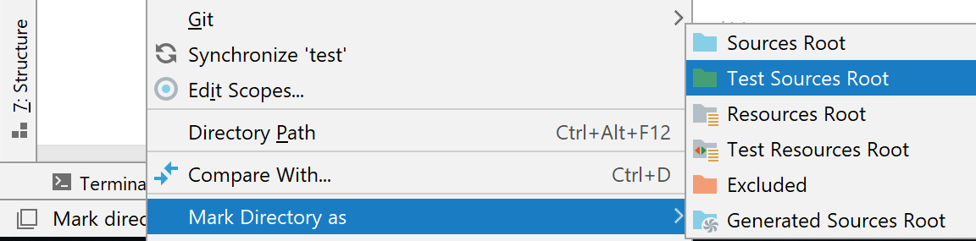
Then “mark” this new directory as a Test Sources Root directory

Slide 9
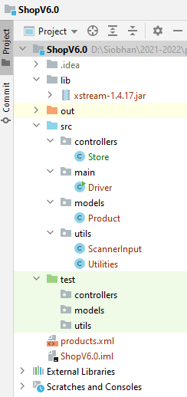
Then “mark” this new directory as a Test Sources Root directory
Create three packages in the test folder.

Slide 10
Generating a test class for Product.Java …

Slide 11
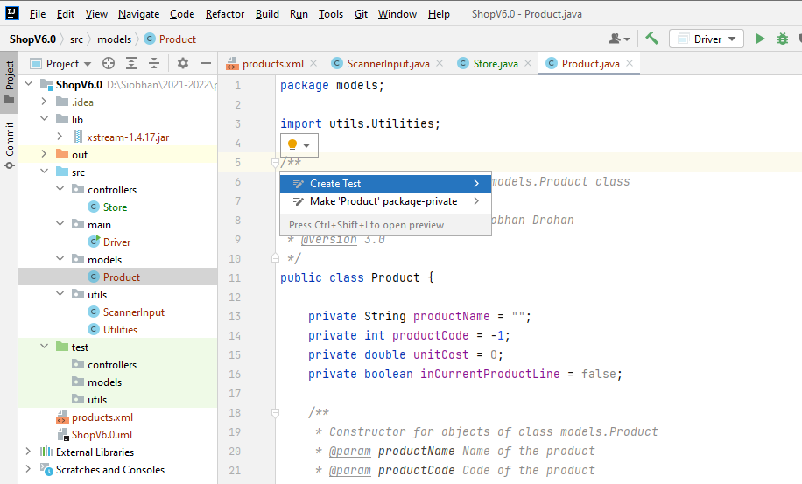
1
Click above the Product class declaration, then click on the light bulb…select Create Test

Slide 12
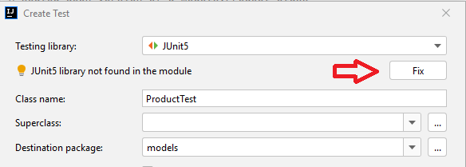
2
Choose JUnit5
3
Click the Fix button…

Slide 13
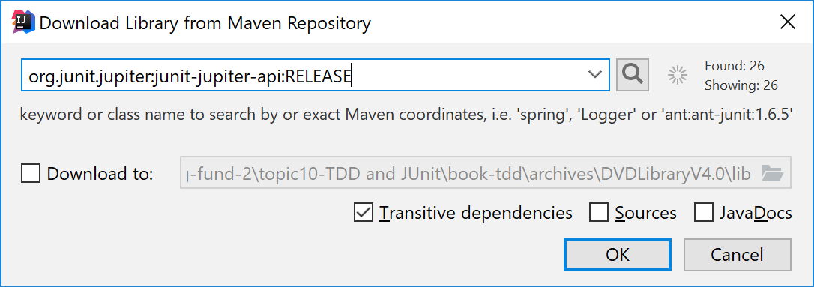
4
…and click the OK button do download JUnit5 from Maven

Slide 14
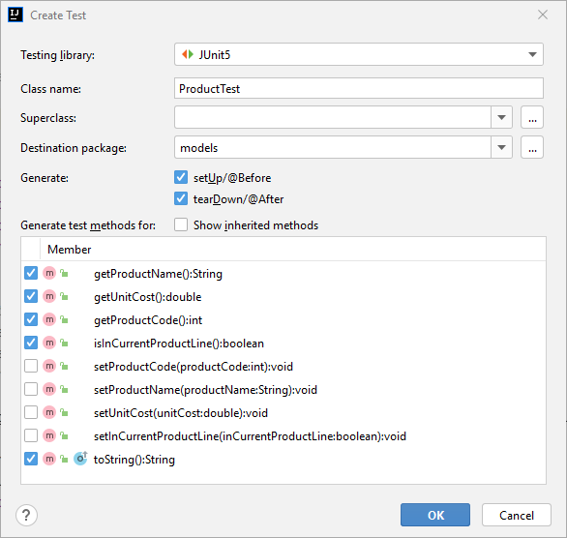
5
Now that JUnit5 is downloaded…select the checkboxes as shown to generate test methods.
Note the class name is set to ProductTest.

Slide 15
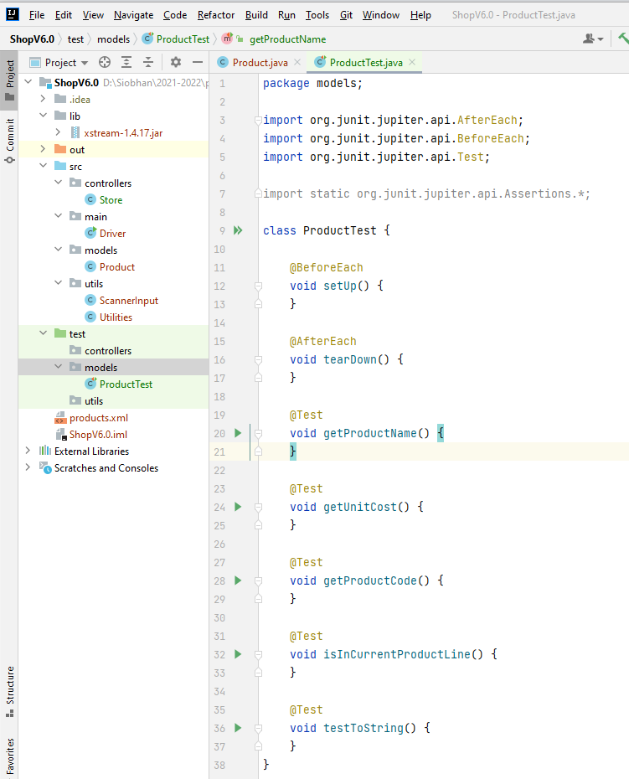
6
ProductTest.java is generated with starting code.

Slide 16
ProductTest.Java Testing a Getter Method: getProductName()

Slide 17
Extract of Product.java
public class Product { private String productName = ""; private int productCode = -1; private double unitCost = 0; private boolean inCurrentProductLine = false; public Product(String productName, int productCode, double unitCost, boolean inCurrentProductLine) { this.productName = Utilities.truncateString(productName, 20); setProductCode(productCode); this.unitCost = unitCost; this.inCurrentProductLine = inCurrentProductLine; }
public String getProductName(){ return productName; }
public void setProductName(String productName) { if (Utilities.validateStringLength(productName, 20)) { this.productName = productName; } }
//Code Omitted
}

Slide 18
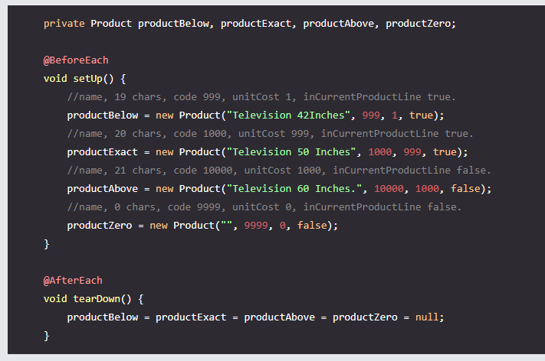
ProductTest.java
Add four Product objects and instantiate them with the details shown.

Slide 19
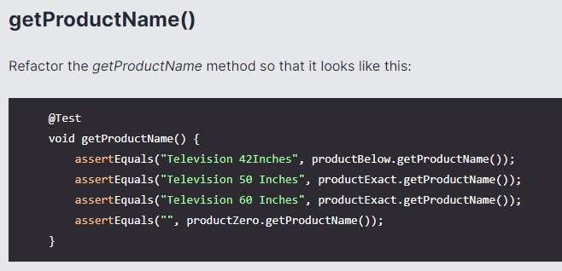
ProductTest.java
Include four assertions to test the getProductName() method

Slide 20
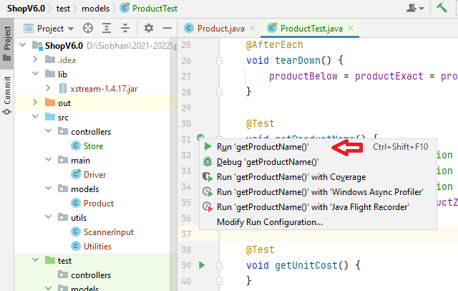
Run the test method:

Slide 21
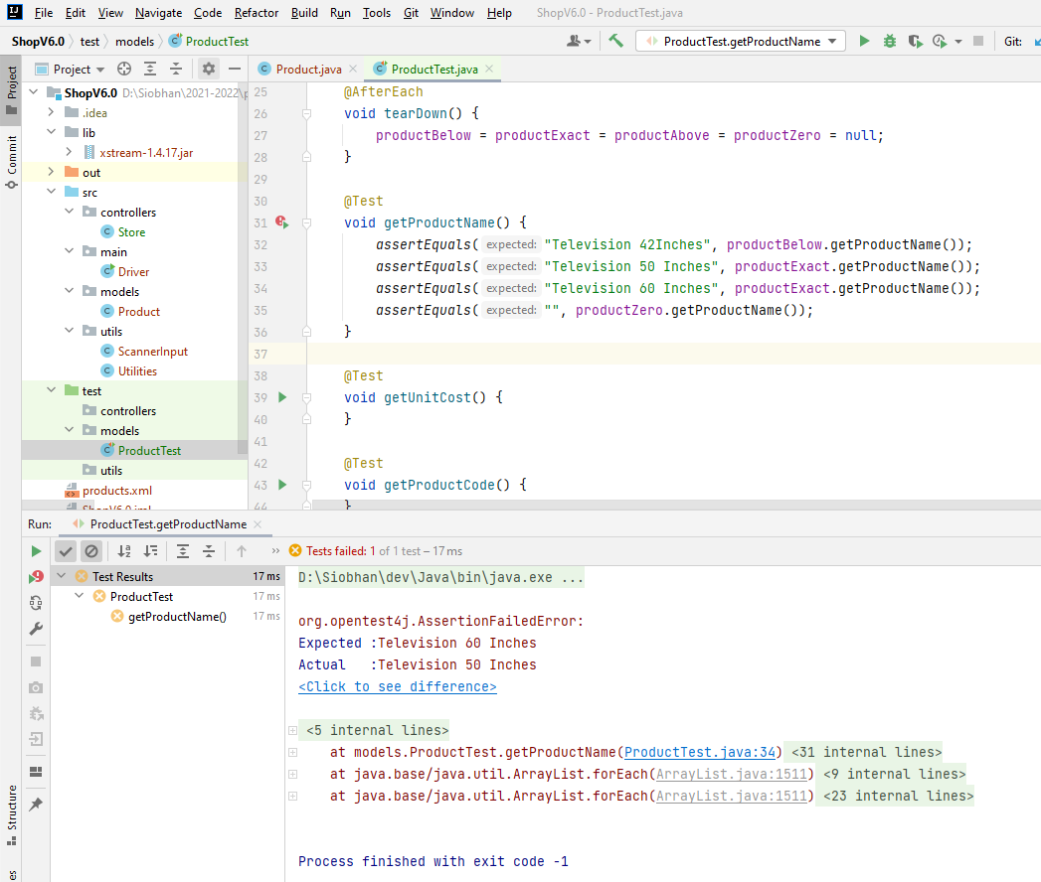
The method has failed

Slide 22
The error is in the third assertion…it should have been the productAbove object and not the productExact one.

Slide 23
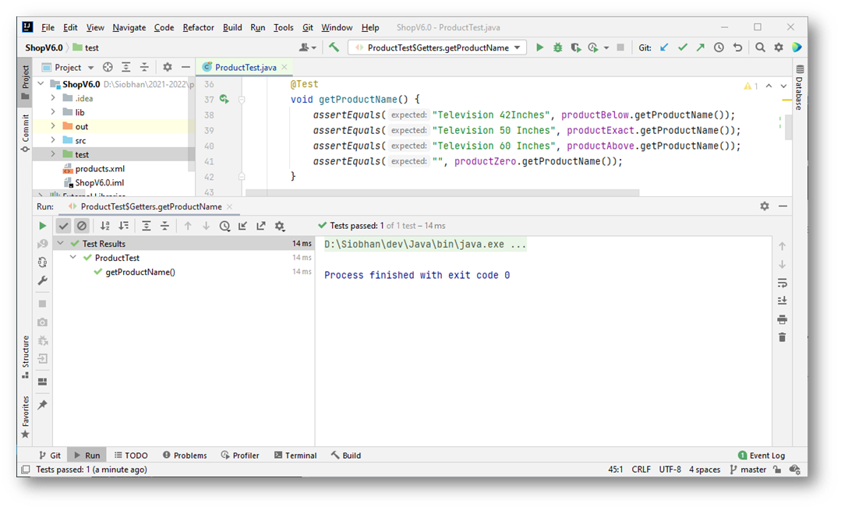
Fixing the error and running the test again, results in a green tick (success).

Slide 24
JUnit Interface

Slide 25
Number of tests that ran and status
Assertion Error
Class name and line of code causing the assertion failure.
Itemised tests and their individual result.
Green = Pass
Orange - Failure

Slide 26
Number of tests that ran and status
Exit Code 0 – Success
Itemised tests and their individual result.
Green = Pass
Orange - Failure

Slide 27
ProductTest.Java Testing a Setter Method: setProductName()

Slide 28
Extract of Product.java
public class Product { private String productName = ""; private int productCode = -1; private double unitCost = 0; private boolean inCurrentProductLine = false; public Product(String productName, int productCode, double unitCost, boolean inCurrentProductLine) { this.productName = Utilities.truncateString(productName, 20); setProductCode(productCode); this.unitCost = unitCost; this.inCurrentProductLine = inCurrentProductLine; }
public String getProductName(){ return productName; }
public void setProductName(String productName) { if (Utilities.validateStringLength(productName, 20)) { this.productName = productName; } }
//Code Omitted
}

Slide 29
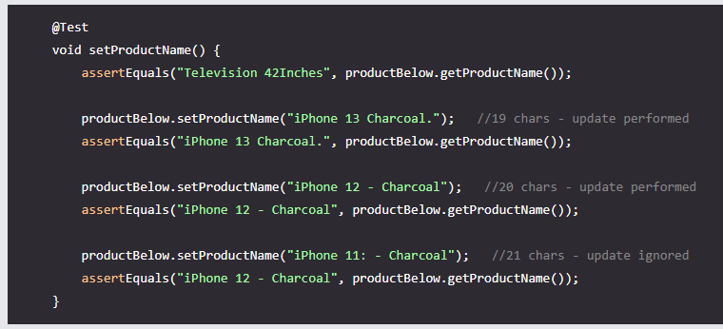

Slide 30
ProductTest.Java Testing the toString Method

Slide 31
Extract of Product.java
public class Product { private String productName = ""; private int productCode = -1; private double unitCost = 0; private boolean inCurrentProductLine = false; public Product(String productName, int productCode, double unitCost, boolean inCurrentProductLine) { this.productName = Utilities.truncateString(productName, 20); setProductCode(productCode); this.unitCost = unitCost; this.inCurrentProductLine = inCurrentProductLine; }
public String toString() { return "Product description: " + productName + ", product code: " + productCode + ", unit cost: " + unitCost + ", currently in product line: " + Utilities.booleanToYN(inCurrentProductLine); }
//Code Omitted
}

Slide 32
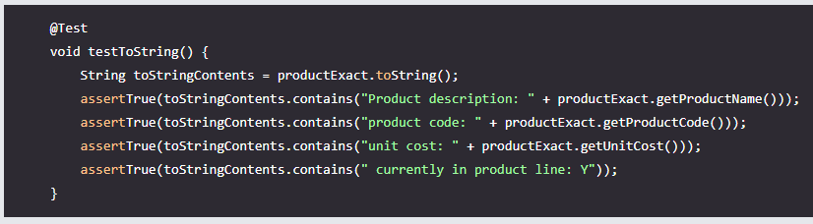

Slide 33
Tidying up the JUnit Interface

Slide 34
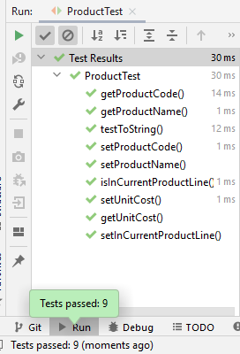
As you add and run more tests to ProductTest.java, they are displayed under the ProductTest heading.

Slide 35
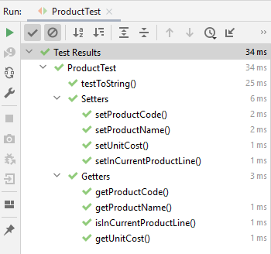
As you add and run more tests to ProductTest.java, they are displayed under the ProductTest heading.
But this layout would be much easier to read…especially as more and more test methods are added...

Slide 36
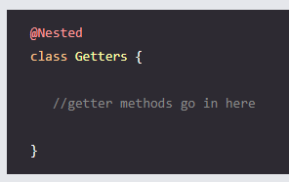
To get this layout, we will need to use the @Nested class approach WITHIN ProductTest e.g.
But this layout would be much easier to read…especially as more and more test methods are added...

Slide 37
class ProductTest {
@Nested class Getters { @Test void getProductName() { assertEquals("Television 42Inches", productBelow.getProductName()); assertEquals("Television 50 Inches", productExact.getProductName()); assertEquals("Television 60 Inches", productAbove.getProductName()); assertEquals("", productZero.getProductName()); } @Test void getUnitCost() { assertEquals(1, productBelow.getUnitCost()); assertEquals(999, productExact.getUnitCost()); assertEquals(1000, productAbove.getUnitCost()); assertEquals(0, productZero.getUnitCost()); } @Test void getProductCode() { assertEquals(-1, productBelow.getProductCode()); assertEquals(1000, productExact.getProductCode()); assertEquals(-1, productAbove.getProductCode()); assertEquals(9999, productZero.getProductCode()); } @Test void isInCurrentProductLine() { assertTrue(productBelow.isInCurrentProductLine()); assertTrue(productExact.isInCurrentProductLine()); assertFalse(productAbove.isInCurrentProductLine()); assertFalse(productZero.isInCurrentProductLine()); } }
}
To get this layout, we will need to use the @Nested class approach WITHIN ProductTest e.g.

Slide 38
ProductTest.Java Have we tested everything in Product.java?

Slide 39
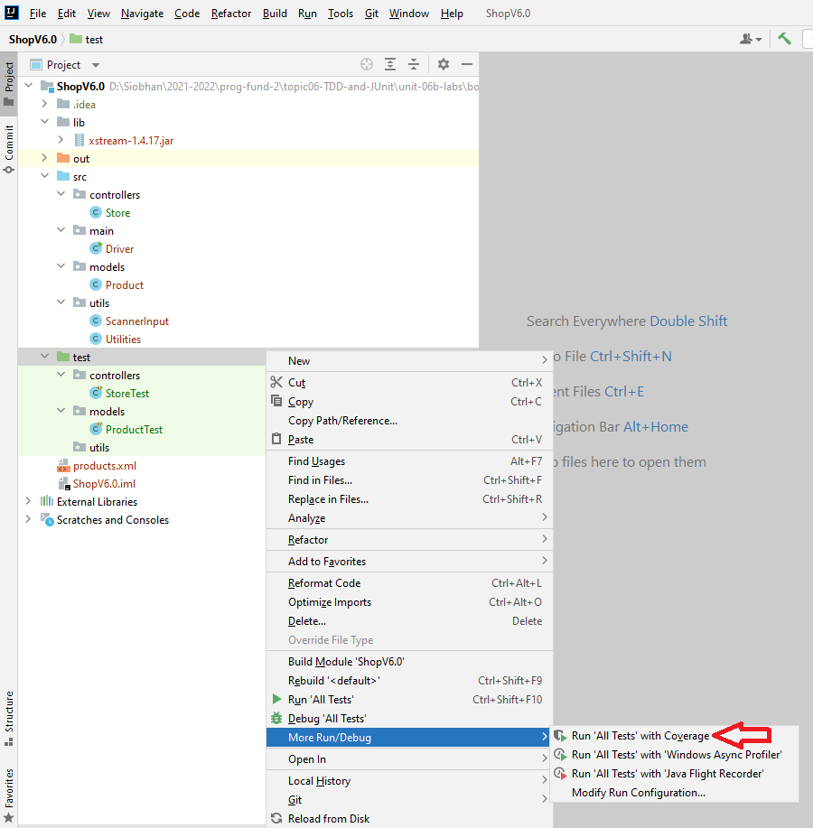
We can run a Coverage Report with our tests to see what code is tested and what isn’t.

Slide 40
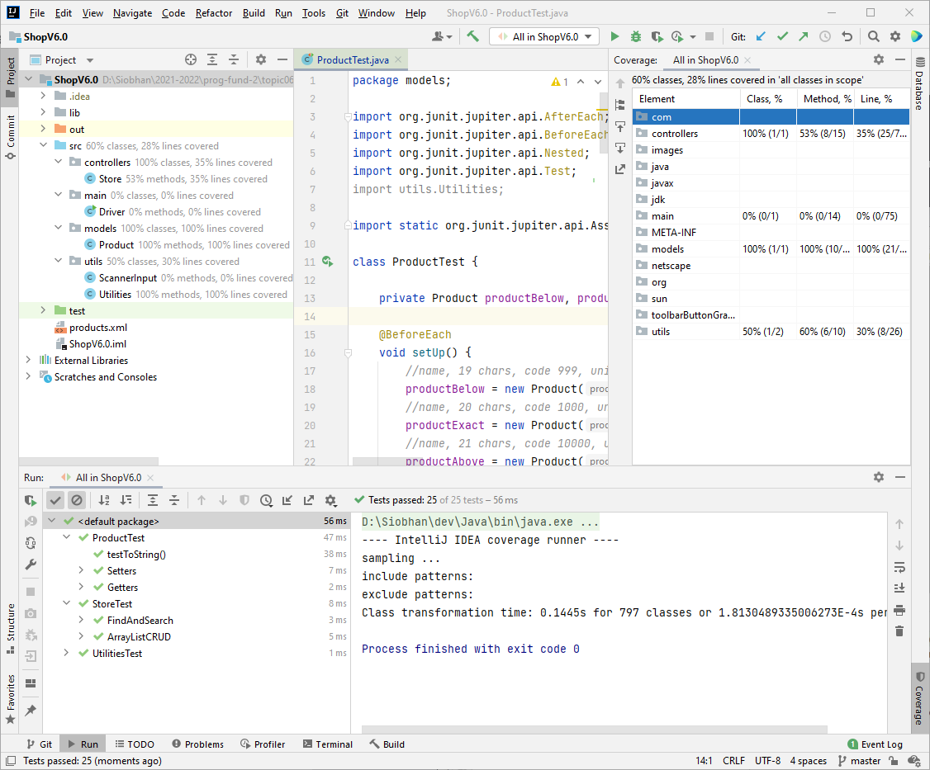
Percentages are applied to each class.

Slide 41
Percentages are applied to each class.

Slide 42
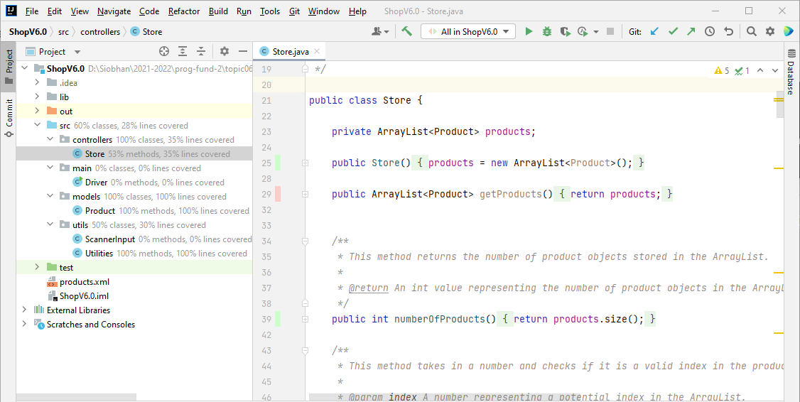
Viewing the java code will give you a visual as to what code has been tested and what hasn’t.

Slide 43

Any Questions?

