Slide 1

JUnit Framework
Terminology: assertions, annotations, fixtures
Produced
by:
Dr. Siobhán Drohan
Mairead Meagher
Siobhan Roche
Department of Computing and Mathematics
http://www.wit.ie/

Slide 2
Topic List
General Terminology
Assertions
Annotations
Fixtures

Slide 3
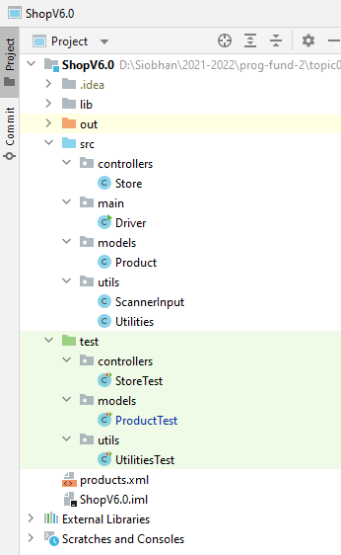
JUnit Test Class / Test Case

Slide 4
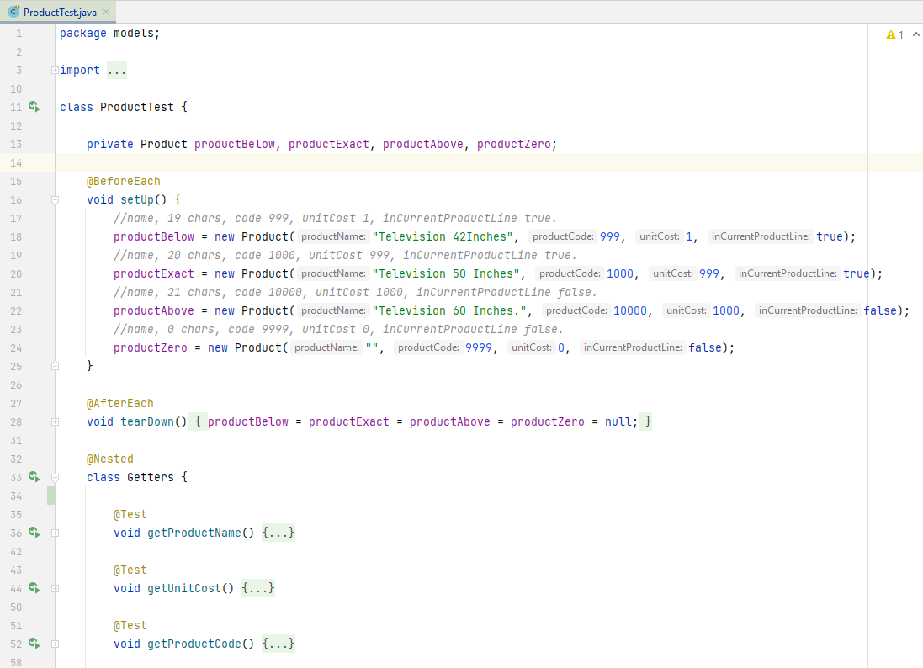
JUnit 5
Setting up the test fixture
Tearing down the test fixture
Nesting similar tests together
Test Methods

Slide 5
Topic List
General Terminology
Assertions
Annotations
Fixtures

Slide 6
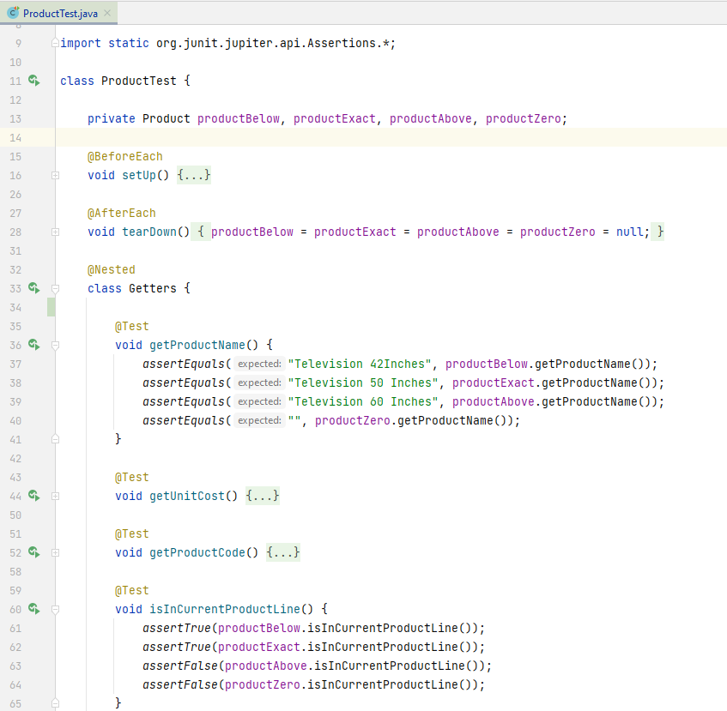
JUnit 5
First you import the Assertions class from org.junit…
Test Methods then contain assertions

Slide 7
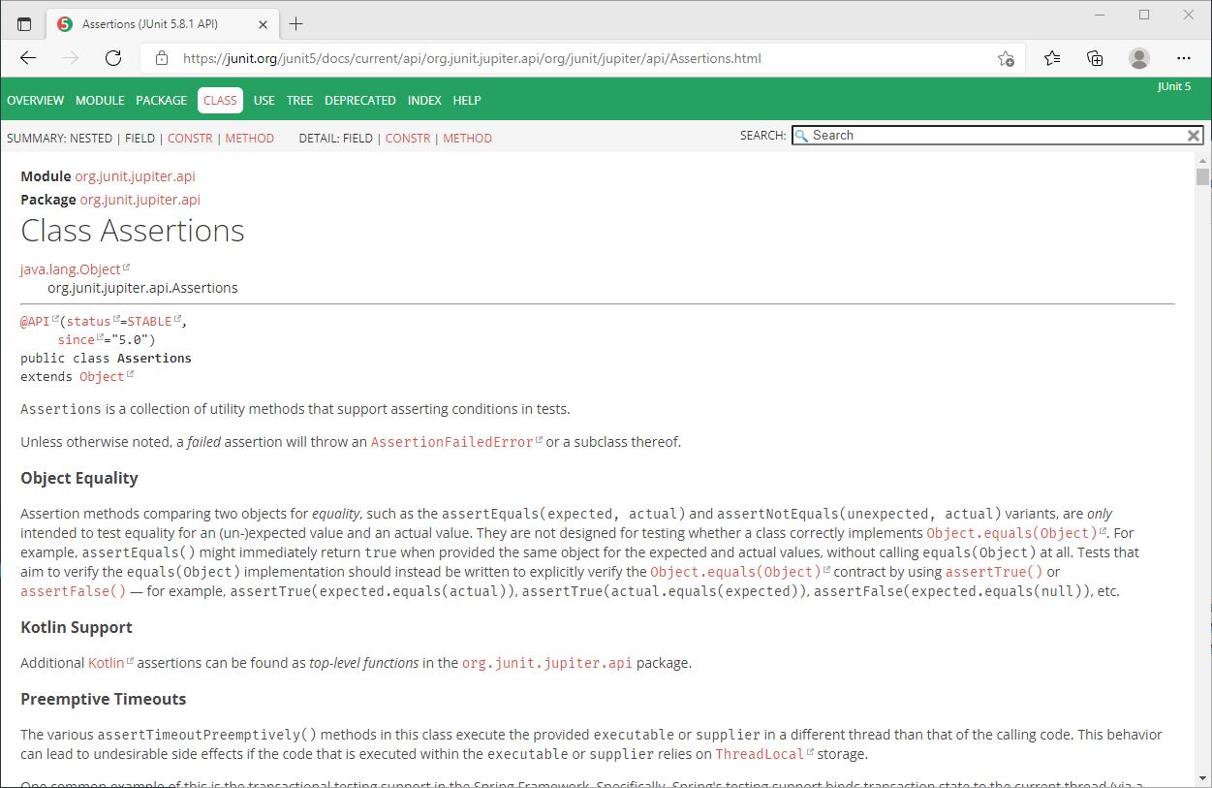
JUnit 5
Assertions (JUnit 5.8.1 API)

Slide 8
The Assertions Class
JUnit 5
To check if code is behaving as you expect, you use an assertion.
An assertion is a simple method call that verifies that something is true.
The Assertions class Contains a set of assertion methods useful for writing JUnit tests.
Only failed assertions are recorded i.e. an AssertionFailedError is thrown and handled by JUnit.

Slide 9
The Assertions Class
JUnit 5
These methods can be used directly:
Assertions.assertEquals(...);
However, they read better if they are referenced through a static import:
import static org.junit.jupiter.api.Assertions.*;
//some code
assertEquals(...);
We will use this approach.

Slide 10
Some common Assert methods (1)
Method Summary
static void | assertEquals(double expected, double actual, double delta) Asserts that two doubles are equal to within a positive delta.
static void | assertEquals(long expected, long actual) Asserts that two longs are equal.
static void | assertEquals(Object expected, Object actual) Asserts that two objects are equal.
static void | assertNotEquals(double unexpected, double actual, double delta) Asserts that two doubles are not equal to within a positive delta.
static void | assertNotEquals(Object unexpected, Object actual) Asserts that two objects are not equals.
static void | assertNotSame(Object unexpected, Object actual) Asserts that two objects do not refer to the same object.
static void | assertSame(Object expected, Object actual) Asserts that two objects refer to the same object.
Assertions (JUnit 5.8.1 API)

Slide 11
Some common Assert methods (2)
Method Summary
static void | assertNotNull(Object object) Asserts that an object isn't null.
static void | assertNotNull(String message, Object object) Asserts that an object isn't null.
static void | assertNull(Object object) Asserts that an object is null.
static void | assertFalse(boolean condition) Asserts that a condition is false.
static void | assertTrue(String message, boolean condition) Asserts that a condition is true.
static void | fail() Fails a test with no message.
static void | fail(String message) Fails a test with the given message.
Assertions (JUnit 5.8.1 API)

Slide 12
JUnit 5
assertEquals
assertTrue
assertFalse

Slide 13
Topic List
General Terminology
Assertions
Annotations
Fixtures

Slide 14
JUnit 5
These methods have Annotations
@someword

Slide 15
What are Annotations?
Annotations provide data about a program that is not part of the program itself. They have no direct effect on the operation of the code they annotate.
Annotations can be applied to a program's declarations of classes, fields, methods, and other program elements.

Slide 16
What are Annotations?
Annotations have a number of uses, among them:
Information for the compiler — Annotations can be used by the compiler to detect errors or suppress warnings.
Compiler-time and deployment-time processing — Software tools can process annotation information to generate code, XML files, and so forth.
Runtime processing — Some annotations are available to be examined at runtime.

Slide 17
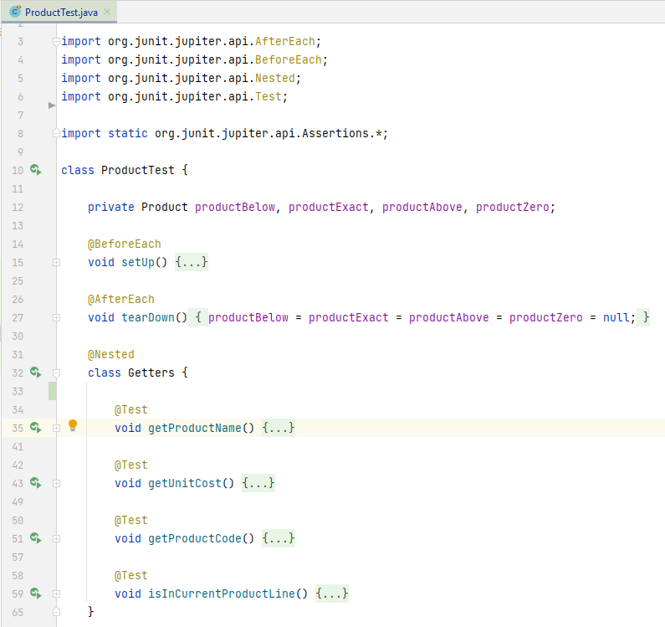
JUnit 5 Annotations
Import the required Annotation class(es) from org.junit.
@BeforeEach runs the method before each test.
@AfterEach
runs the method after each test.
@Nested
Groups together a series of methods into a nested class.
@Test
identifies that a method is a test method.

Slide 18
Other Useful JUnit5 Annotations
@BeforeAll public void method() | Will execute the method once, before the start of all tests in the current class.
@AfterAll public void method() | Will execute the method once, after all tests in the current class have finished.
@Disabled public void method() | Used to disable a test class or test method.

Slide 19
Topic List
General Terminology
Assertions
Annotations
Fixtures

Slide 20
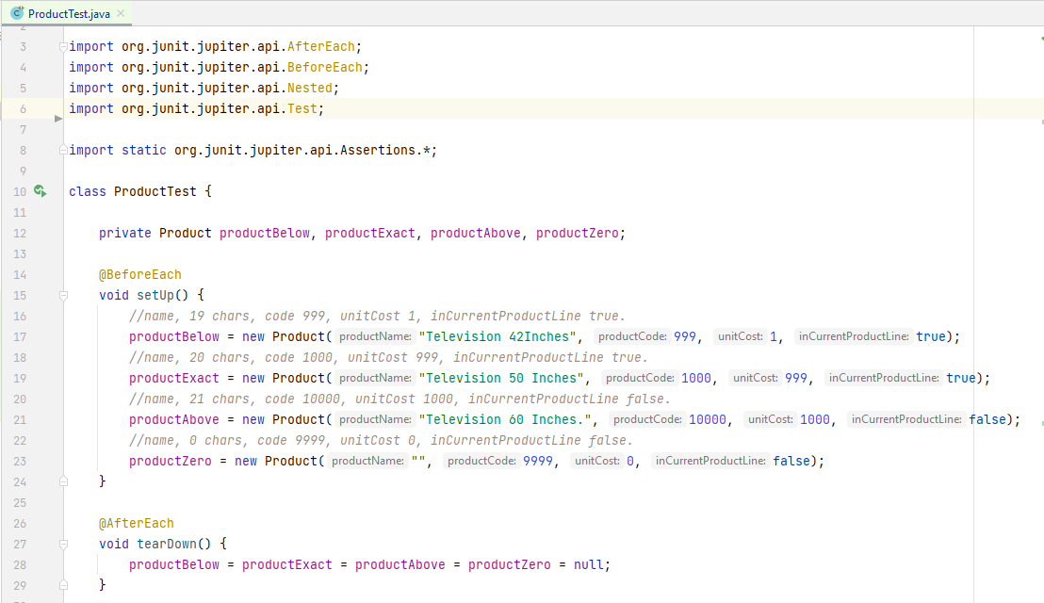
JUnit 5
Test fixture fields.
Setting up the test fixture.
Tearing down the test fixture.

Slide 21
Fixtures
A Fixture is a fixed state of a set of objects used as a baseline for running tests.
Test fixtures allow tests to share common test data.
The purpose of a test fixture is to ensure that there is a fixed environment in which tests are run so that results are repeatable.
It includes:
setUp() method which runs before every test method.
tearDown() method which runs after every test method.
http://www.tutorialspoint.com/junit/junit_test_framework.htm

Slide 22

Any Questions?

