Slide 1

JUnit Framework
Four Phase Test and Test Planning
Produced
by:
Mairead Meagher
Dr. Siobhán Drohan
Eamonn de Leastar
Siobhan Roche
Department of Computing and Mathematics
http://www.setu.ie/

Slide 2
Topic List
Four Phase Test.
Planning a more complicated Test Case.

Slide 3
Four Phase Test
How do we structure our test logic to make what we are testing obvious?
We structure each test with four distinct phases executed in sequence.
Setup
Exercise
Verify
Teardown

Slide 4
How it works
Setup | We set up the test fixture (the “before” picture) so that we are in a position to exercise the tests. This could be objects that we need to create, values we need to set, other methods we need to call, etc.
Exercise | We interact with the system we are testing.
Verify | We do whatever is necessary to determine whether the expected outcome has been obtained.
Teardown | We tear down the test fixture to put the world back into the state in which we found it.

Slide 5
class DVDTest { private DVD dvd1, dvd2, dvd3; @BeforeEach void setUp() { dvd1 = new DVD("The Hobbit(Director)"); //title with 20 characters dvd2 = new DVD("The Steve Jobs Film"); //title with 19 characters dvd3 = new DVD("Avatar: Directors Cut"); //title with 21 characters } @AfterEach void tearDown() { dvd1 = dvd2 = dvd3 = null; } @Test void setTitle() { } @Test void getTitle() { assertEquals("The Hobbit(Director)", dvd1.getTitle()); assertEquals("The Steve Jobs Film", dvd2.getTitle()); assertEquals("Avatar: Directors", dvd3.getTitle()); } @Test void testToString() { } }
Setup
Teardown
Exercise
Verify

Slide 6
Topic List
Four Phase Test.
Planning a more complicated Test Case.

Slide 7
Planning JUnit Tests
Method to test: A static method designed to return the largest number in a primitive array of int.
Suggested tests: The following tests would seem to make sense:
[7, 8, 9] → 9
[8, 9, 7] → 9
[9, 7, 8] → 9
[supplied test data] → expected result
public static int largest (int[] list)
{
...
}

Slide 8
More Test Data
Already planned tests with this data:
[7, 8, 9] → 9
[8, 9, 7] → 9
[9, 7, 8] → 9
What about this set of values:
[7, 9, 8, 9] → 9
[1] → 1
[-9, -8, -7] → -7
[supplied test data] → expected result

Slide 9
More Test Data
public static int largest (int[] list)
{
int index;
int max = Integer.MAX_VALUE;
for (index = 0; index < list.length - 1; index++)
{
if (list[index] > max)
{
max = list[index];
}
}
return max;
}
Already planned tests with this data:
[7, 8, 9] → 9
[8, 9, 7] → 9
[9, 7, 8] → 9
What about this set of values:
[7, 9, 8, 9] → 9
[1] → 1
[-9, -8, -7] → -7
[supplied test data] → expected result

Slide 10
Writing the Test
This is a TestCase called TestLargest
import org.junit.jupiter.api.Test; import static org.junit.jupiter.api.Assertions.assertEquals; public class TestLargest { @Test public void testOrder() { int[] arr = new int[3]; arr[0] = 8; arr[1] = 9; arr[2] = 7; assertEquals(9, Largest.largest(arr)); } }
It has one Unit Test - to verify the behaviour of the largest method.

Slide 11
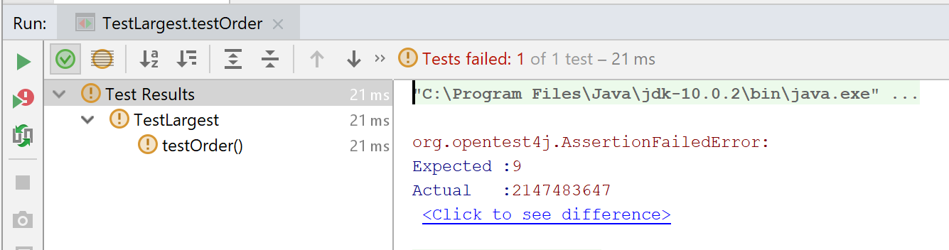
Running the Test
Why did it return such a huge number instead of our 9?
Where could that very large number have come from?

Slide 12
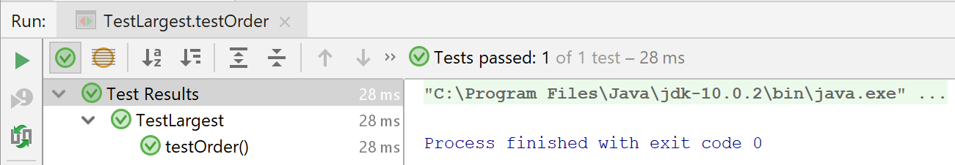
Bug
public class Largest { public static int largest (int[] list) { int index; //int max = Integer.MAX_VALUE; int max = 0; for (index = 0; index < list.length - 1; index++) { if (list[index] > max) { max = list[index]; } } return max; } }
We should initialize max to zero, not MAX_VALUE.

Slide 13
Further Tests
What happens when the largest number appears in different places in the list - first or last, and somewhere in the middle?
Bugs most often show up at the “edges”.
In this case, edges occur when the largest number is at the start or end of the array that we pass in.
Aggregate into a single unit test:
@Test
public void testOrder ()
{
assertEquals(9, Largest.largest(new int[] { 9, 8, 7 }));
assertEquals(9, Largest.largest(new int[] { 8, 9, 7 }));
assertEquals(9, Largest.largest(new int[] { 7, 8, 9 }));
}

Slide 14
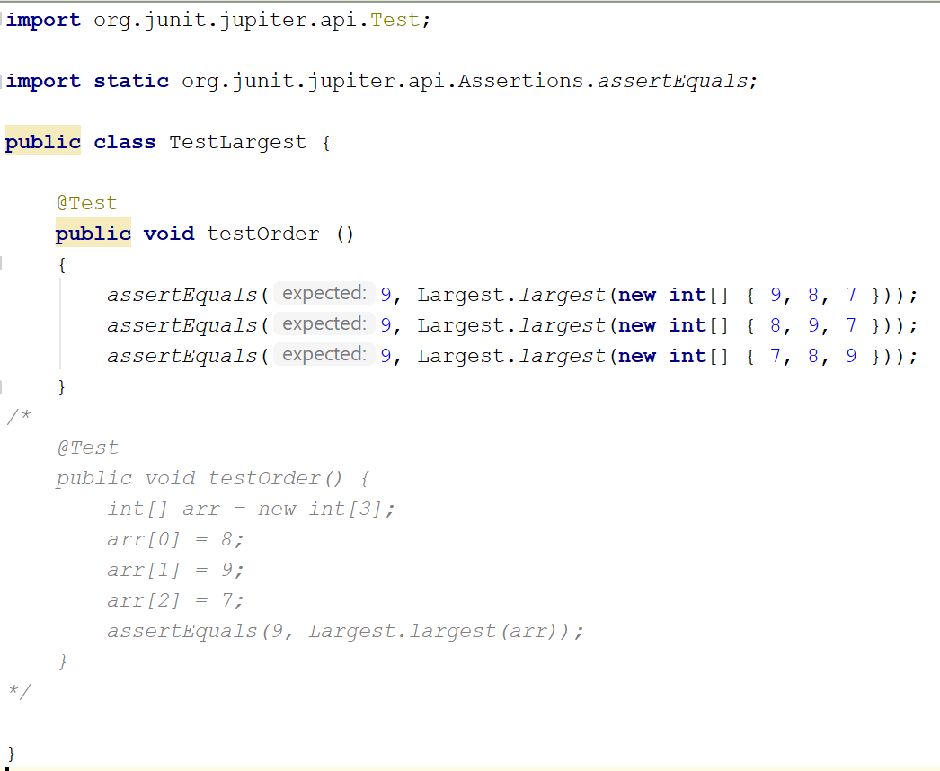
Refactored testOrder() method

Slide 15
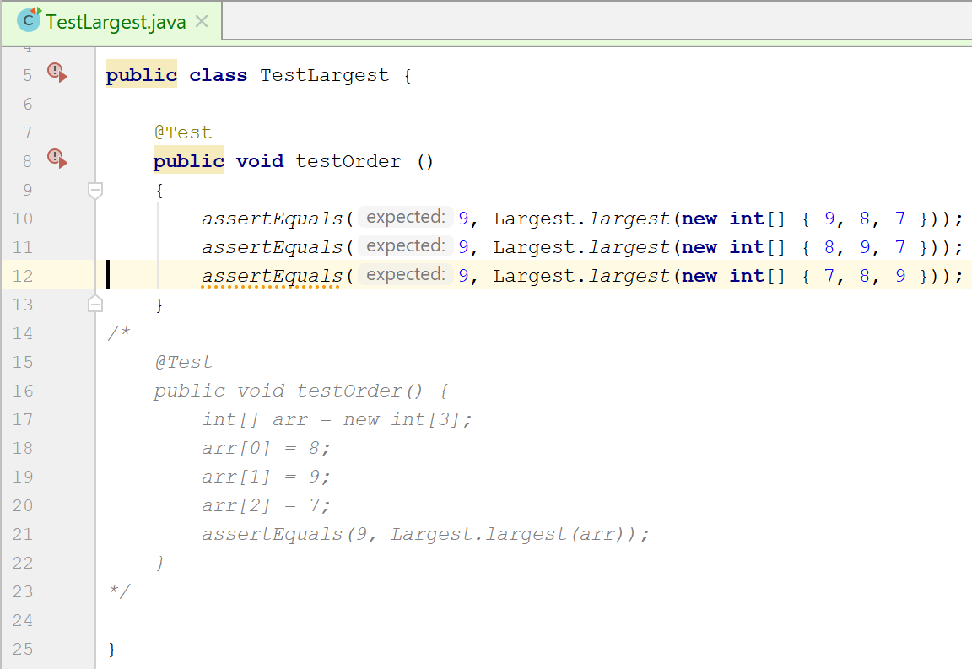
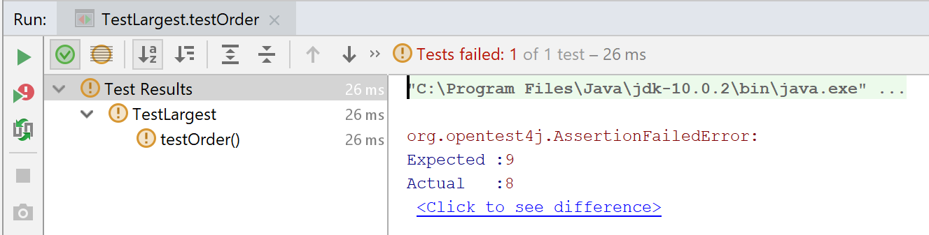
testOrder() failed

Slide 16
public class Largest { public static int largest (int[] list) { int index; //int max = Integer.MAX_VALUE; int max = 0; //for (index = 0; index < list.length - 1; index++) for (index = 0; index < list.length; index++) { if (list[index] > max) { max = list[index]; } } return max; } }
Code Fix

Slide 17
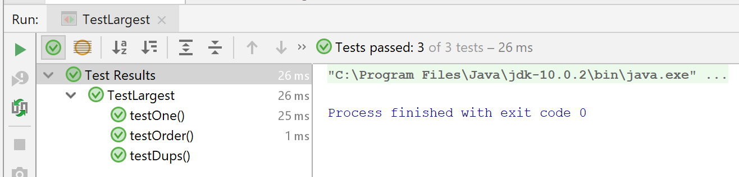
Further Boundary Conditions
Exercising More Tests
@Test
public void testDups ()
{
assertEquals(9, Largest.largest(new int[] { 9, 7, 9, 8 }));
}
@Test
public void testOne ()
{
assertEquals(1, Largest.largest(new int[] { 1 }));
}

Slide 18
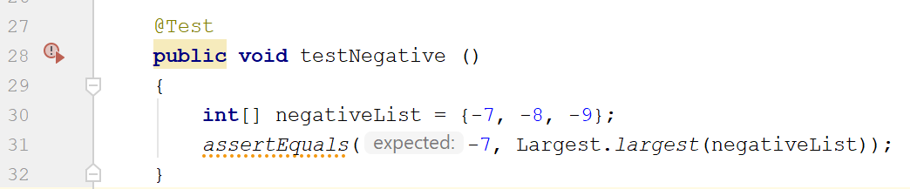
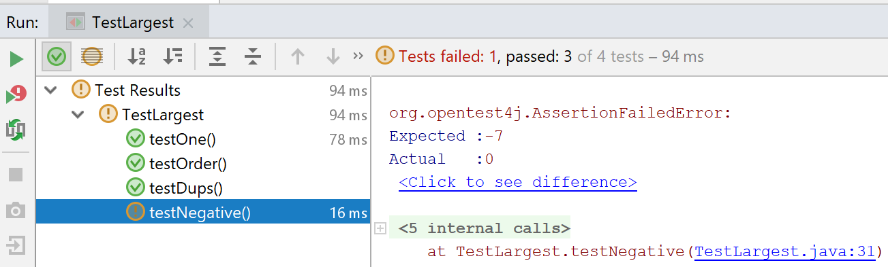
Failure on testNegative

Slide 19
fix testNegative
public class Largest { public static int largest (int[] list) { int index; //int max = Integer.MAX_VALUE; int max = Integer.MIN_VALUE; //for (index = 0; index < list.length - 1; index++) for (index = 0; index < list.length; index++) { if (list[index] > max) { max = list[index]; } } return max; } }
Choosing 0 to initialize max was a bad idea…should have been MIN VALUE, so as to be less than all negative numbers as well.

Slide 20
Is there a better approach for setting the max value?
public static int largest (int[] list)
{
int index = 0;
int max = list[0];
for (index = 0; index < list.length; index++)
{
if (list[index] > max)
{
max = list[index];
}
}
return max;
}
Maybe instead of the MIN VALUE, we set max to be the first element in the list array.
Would that work?

Slide 21
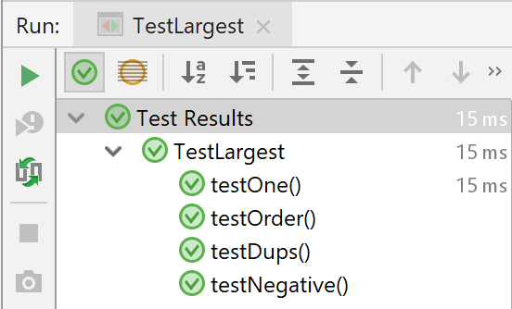
Yes and this is the preferred approach!
public class Largest { public static int largest (int[] list) { int index; int max = list[0]; for (index = 0; index < list.length; index++) { if (list[index] > max) { max = list[index]; } } return max; } }

Slide 22

Any Questions?

