Slide 1

Test Driven Development
More JUnit Tests for the Shop app
Produced
by:
Dr. Siobhán Drohan
Mairead Meagher
Siobhan Roche
Department of Computing and Mathematics
http://www.setu.ie/

Slide 2
Topic List
Product and ProductTest.java
JUnit Testing of Store.java
Testing Driver.java

Slide 3
Product.java
public void setProductCode(int productCode) { if (Utilities.validRange(productCode, 1000, 9999)) { this.productCode = productCode; } } public void setProductName(String productName) { if (Utilities.validateStringLength(productName, 20)) { this.productName = productName; } } public void setUnitCost(double unitCost) { this.unitCost = unitCost; } public void setInCurrentProductLine(boolean inCurrentProductLine) { this.inCurrentProductLine = inCurrentProductLine; }
package models; import utils.Utilities; public class Product { private String productName = ""; private int productCode = -1; private double unitCost = 0; private boolean inCurrentProductLine = false; public Product(String productName, int productCode, double unitCost, boolean inCurrentProductLine) { this.productName = Utilities.truncateString(productName, 20); setProductCode(productCode); this.unitCost = unitCost; this.inCurrentProductLine = inCurrentProductLine; } public String toString() { return "Product description: " + productName + ", product code: " + productCode + ", unit cost: " + unitCost + ", currently in product line: " + Utilities.booleanToYN(inCurrentProductLine); } }
public String getProductName(){ return productName; }
public double getUnitCost(){ return unitCost; } public int getProductCode() { return productCode; } public boolean isInCurrentProductLine() { return inCurrentProductLine; }

Slide 4
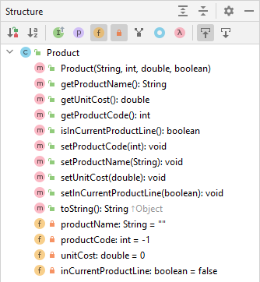
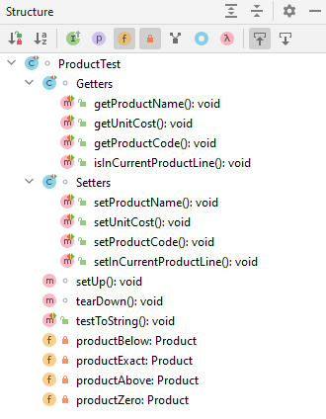
Product.java
ProductTest.java

Slide 5
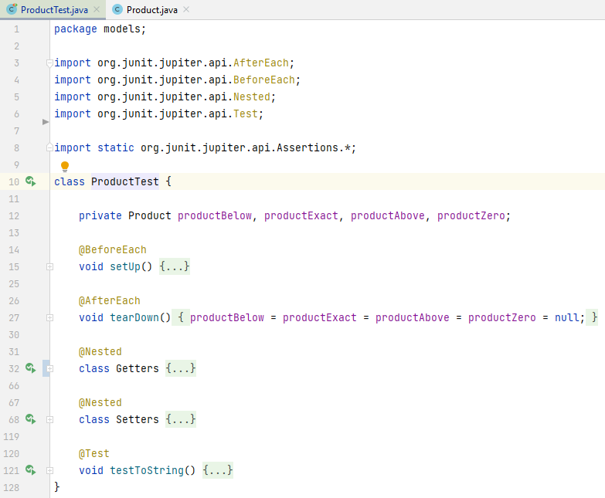
ProductTest.java

Slide 6
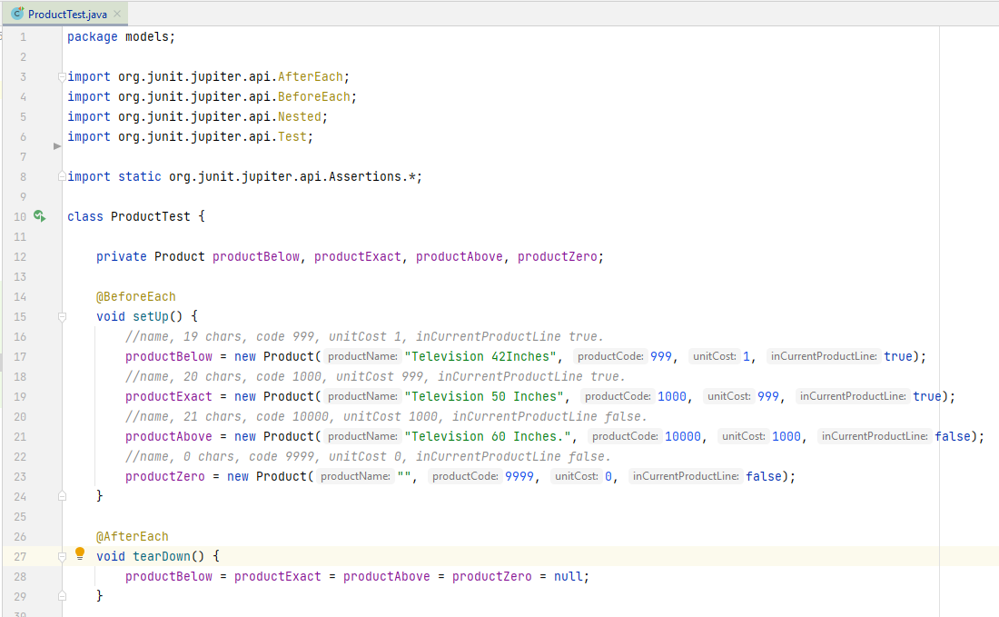

Slide 7
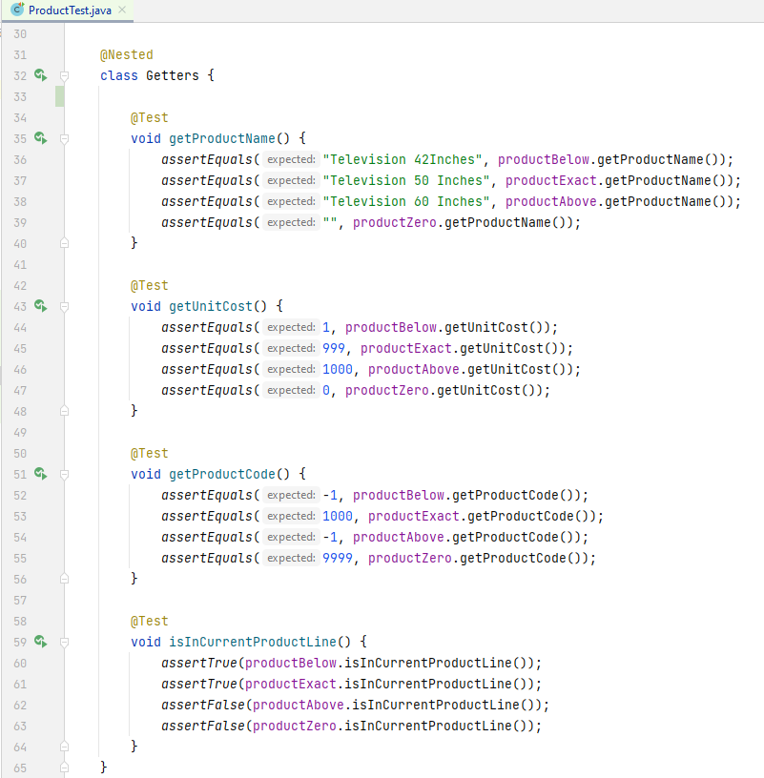

Slide 8
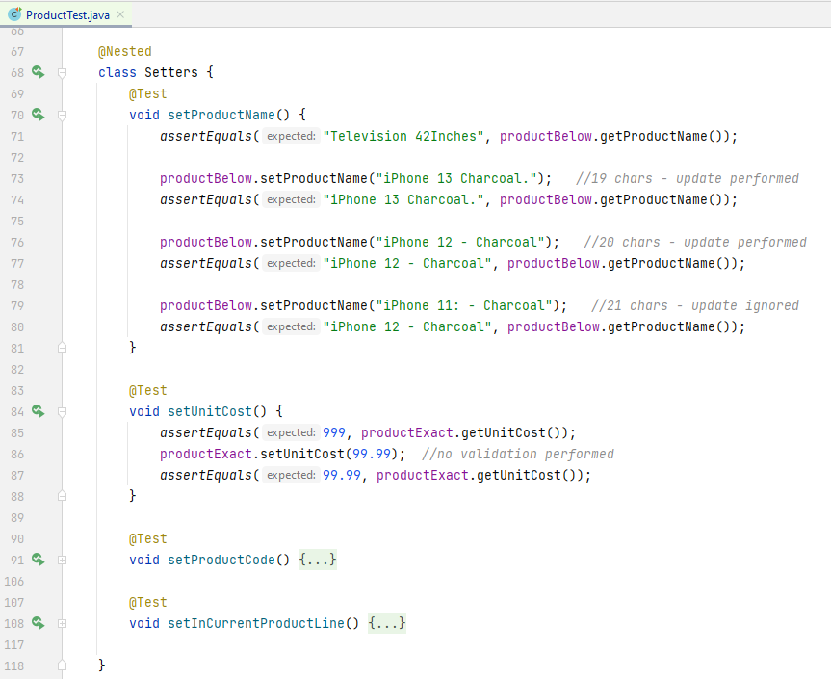

Slide 9
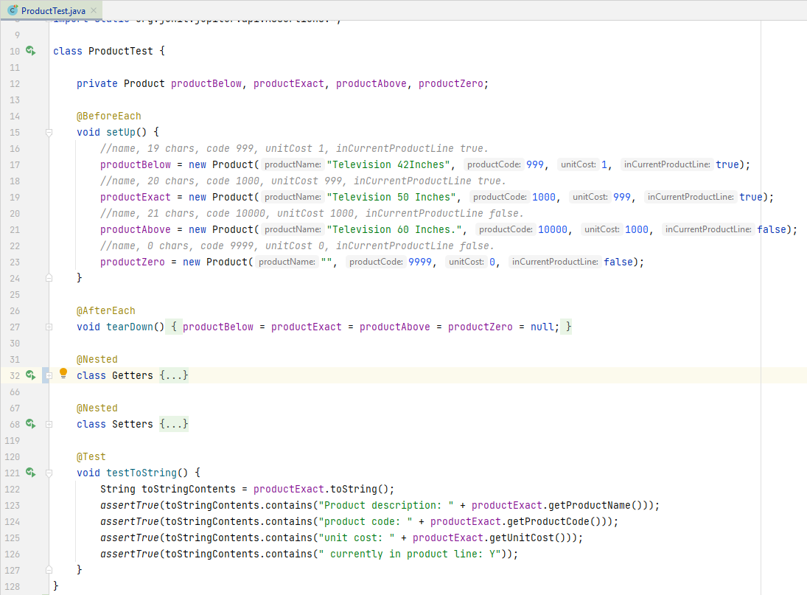

Slide 10
Topic List
Product and ProductTest.java
JUnit Testing of Store.java
Testing Driver.java

Slide 11
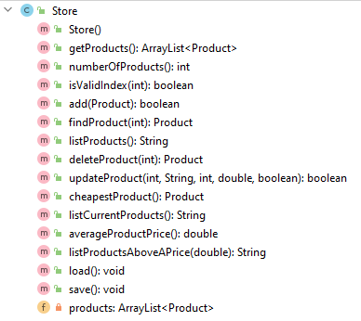
Store.java
We will look at writing tests for a few of these methods.

Slide 12
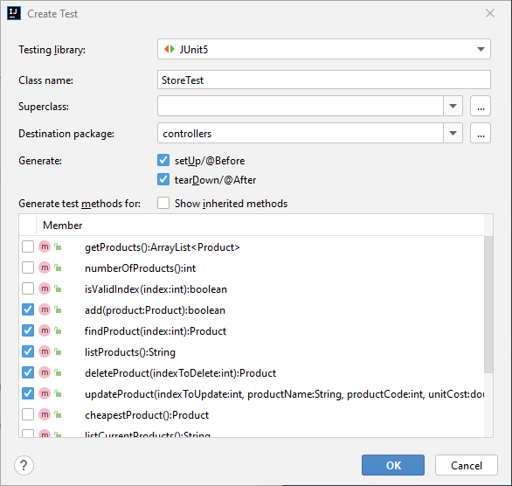
Open Store.java and call “Create Test”
Call the test class, StoreTest
Generate the default setUp() and tearDown() methods and also generate test methods for selected member methods.

Slide 13
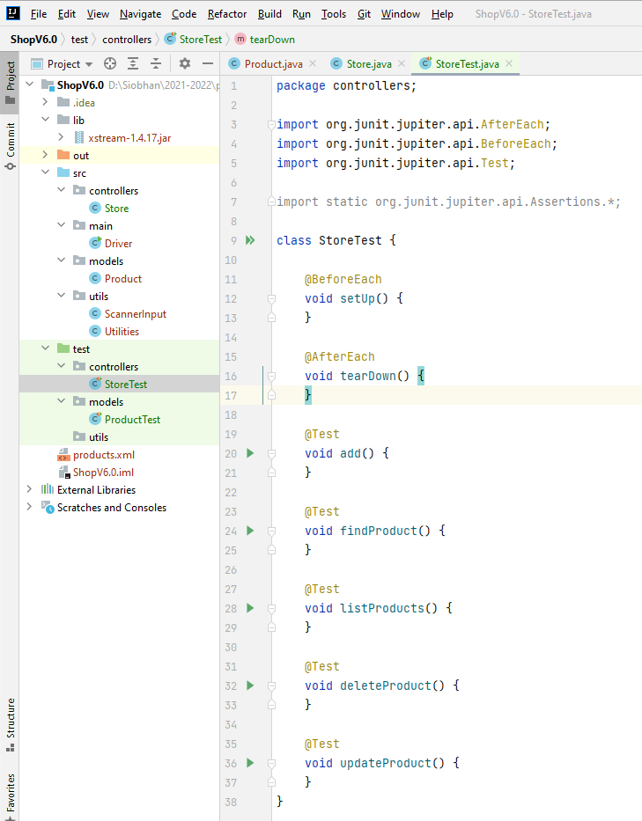
Generated StoreTest.java

Slide 14
Store.java – testing add(Product)
public boolean add (Product product){ return products.add (product); }

Slide 15
class StoreTest { private Product productBelow, productExact, productAbove, productZero; private Store storeWithProducts = new Store(); private Store storeEmpty = new Store(); @BeforeEach void setUp() { //name, 19 chars, code 999, unitCost 1, inCurrentProductLine true. productBelow = new Product("Television 42Inches", 999, 1, true); //name, 20 chars, code 1000, unitCost 999, inCurrentProductLine true. productExact = new Product("Television 50 Inches", 1000, 999, true); //name, 21 chars, code 10000, unitCost 1000, inCurrentProductLine false. productAbove = new Product("Television 60 Inches.", 10000, 1000, false); //name, 0 chars, code 9999, unitCost 0, inCurrentProductLine false. productZero = new Product("", 9999, 0, false); storeWithProducts.add(productBelow); storeWithProducts.add(productExact); storeWithProducts.add(productAbove); } @AfterEach void tearDown() { productBelow = productExact = productAbove = productZero = null; storeEmpty = storeWithProducts = null; }
testing add(Product)
@Test void addingToAnArrayListThatHasProductsIsSuccessful() { assertEquals(3, storeWithProducts.numberOfProducts()); assertTrue(storeWithProducts.add(productZero)); assertEquals(4, storeWithProducts.numberOfProducts()); assertEquals(productZero, storeWithProducts.findProduct(3)); } @Test void addingToAnArrayListThatHasNoProductsIsSuccessful() { assertEquals(0, storeEmpty.numberOfProducts()); assertTrue(storeEmpty.add(productZero)); assertEquals(1, storeEmpty.numberOfProducts()); assertEquals(productZero, storeEmpty.findProduct(0)); }

Slide 16
Store.java – testing deleteProduct(Product)
public Product deleteProduct(int indexToDelete) { if (isValidIndex(indexToDelete)) { return products.remove(indexToDelete); } return null; }

Slide 17
class StoreTest { private Product productBelow, productExact, productAbove, productZero; private Store storeWithProducts = new Store(); private Store storeEmpty = new Store(); @BeforeEach void setUp() { //name, 19 chars, code 999, unitCost 1, inCurrentProductLine true. productBelow = new Product("Television 42Inches", 999, 1, true); //name, 20 chars, code 1000, unitCost 999, inCurrentProductLine true. productExact = new Product("Television 50 Inches", 1000, 999, true); //name, 21 chars, code 10000, unitCost 1000, inCurrentProductLine false. productAbove = new Product("Television 60 Inches.", 10000, 1000, false); //name, 0 chars, code 9999, unitCost 0, inCurrentProductLine false. productZero = new Product("", 9999, 0, false); storeWithProducts.add(productBelow); storeWithProducts.add(productExact); storeWithProducts.add(productAbove); } @AfterEach void tearDown() { productBelow = productExact = productAbove = productZero = null; storeEmpty = storeWithProducts = null; }
testing deleteProduct(Product)
@Test void deletingAProductThatDoesNotExistReturnsNull(){ assertNull(storeEmpty.deleteProduct(0)); assertNull(storeWithProducts.deleteProduct(-1)); assertNull(storeWithProducts.deleteProduct(3)); } @Test void deletingAProductThatExistsDeletesAndReturnsDeletedObject(){ assertEquals(3, storeWithProducts.numberOfProducts()); assertEquals(productAbove, storeWithProducts.deleteProduct(2)); assertEquals(2, storeWithProducts.numberOfProducts()); }

Slide 18
Store.java – testing updateProduct

Slide 19
Store.java – testing updateProduct
public boolean updateProduct(int indexToUpdate, String productName, int productCode, double unitCost, boolean inCurrentProductLine) { //find the product object by the index number Product foundProduct = findProduct(indexToUpdate); //if the product exists, use the details passed in the updateDetails parameter to //update the found product in the ArrayList. if (foundProduct != null) { foundProduct.setProductName(productName); foundProduct.setProductCode(productCode); foundProduct.setUnitCost(unitCost); foundProduct.setInCurrentProductLine(inCurrentProductLine); return true; } //if the product was not found, return false, indicating that the update was not successful return false; }

Slide 20
class StoreTest { private Product productBelow, productExact, productAbove, productZero; private Store storeWithProducts = new Store(); private Store storeEmpty = new Store(); @BeforeEach void setUp() { //name, 19 chars, code 999, unitCost 1, inCurrentProductLine true. productBelow = new Product("Television 42Inches", 999, 1, true); //name, 20 chars, code 1000, unitCost 999, inCurrentProductLine true. productExact = new Product("Television 50 Inches", 1000, 999, true); //name, 21 chars, code 10000, unitCost 1000, inCurrentProductLine false. productAbove = new Product("Television 60 Inches.", 10000, 1000, false); //name, 0 chars, code 9999, unitCost 0, inCurrentProductLine false. productZero = new Product("", 9999, 0, false); storeWithProducts.add(productBelow); storeWithProducts.add(productExact); storeWithProducts.add(productAbove); } @AfterEach void tearDown() { productBelow = productExact = productAbove = productZero = null; storeEmpty = storeWithProducts = null; }
testing updateProduct
@Test void updatingANoteThatExistsReturnsTrueAndUpdates(){ //check product index 2 exists and check the contents assertEquals(productAbove, storeWithProducts.findProduct(2)); assertEquals("Television 60 Inches", storeWithProducts.findProduct(2).getProductName()); assertEquals(-1, storeWithProducts.findProduct(2).getProductCode()); assertEquals(1000, storeWithProducts.findProduct(2).getUnitCost()); assertFalse(storeWithProducts.findProduct(2).isInCurrentProductLine()); //update product 2 with new information and ensure contents updated successfully assertTrue(storeWithProducts.updateProduct(2, "Updating Product", 2000, 19.99, true)); assertEquals("Updating Product", storeWithProducts.findProduct(2).getProductName()); assertEquals(2000, storeWithProducts.findProduct(2).getProductCode()); assertEquals(19.99, storeWithProducts.findProduct(2).getUnitCost()); assertTrue(storeWithProducts.findProduct(2).isInCurrentProductLine()); } @Test void updatingAProductThatDoesNotExistReturnsFalse(){ assertFalse(storeWithProducts.updateProduct(3, "Updating Product", 2, 19.99, false)); assertFalse(storeWithProducts.updateProduct(-1, "Updating Product", 1002, 14.49, true)); assertFalse(storeEmpty.updateProduct(0, "Updating Product", 1003, 199.99, false)); }

Slide 21
Store.java – testing listProduct()
public String listProducts() { if (products.isEmpty()) { return "No products in the store"; } else { String listOfProducts = ""; for (int i = 0; i < products.size(); i++) { listOfProducts += i + ": " + products.get(i) + "\n"; } return listOfProducts; } }

Slide 22
class StoreTest { private Product productBelow, productExact, productAbove, productZero; private Store storeWithProducts = new Store(); private Store storeEmpty = new Store(); @BeforeEach void setUp() { //name, 19 chars, code 999, unitCost 1, inCurrentProductLine true. productBelow = new Product("Television 42Inches", 999, 1, true); //name, 20 chars, code 1000, unitCost 999, inCurrentProductLine true. productExact = new Product("Television 50 Inches", 1000, 999, true); //name, 21 chars, code 10000, unitCost 1000, inCurrentProductLine false. productAbove = new Product("Television 60 Inches.", 10000, 1000, false); //name, 0 chars, code 9999, unitCost 0, inCurrentProductLine false. productZero = new Product("", 9999, 0, false); storeWithProducts.add(productBelow); storeWithProducts.add(productExact); storeWithProducts.add(productAbove); } @AfterEach void tearDown() { productBelow = productExact = productAbove = productZero = null; storeEmpty = storeWithProducts = null; }
testing listProduct()
@Test void listProductsReturnsNoProductsStoredWhenArrayListIsEmpty() { assertEquals(0, storeEmpty.numberOfProducts()); assertTrue(storeEmpty.listProducts().toLowerCase().contains("no products")); } @Test void listProductsReturnsProductsWhenArrayListHasProductsStored() { assertEquals(3, storeWithProducts.numberOfProducts()); String productsString = storeWithProducts.listProducts(); assertTrue(productsString.contains("Television 42Inches")); assertTrue(productsString.contains("Television 50 Inches")); assertTrue(productsString.contains("Television 60 Inches")); }

Slide 23
Store.java – testing findProduct(int)
public Product findProduct(int index) { if (isValidIndex(index)) { return products.get(index); } return null; }

Slide 24
class StoreTest { private Product productBelow, productExact, productAbove, productZero; private Store storeWithProducts = new Store(); private Store storeEmpty = new Store(); @BeforeEach void setUp() { //name, 19 chars, code 999, unitCost 1, inCurrentProductLine true. productBelow = new Product("Television 42Inches", 999, 1, true); //name, 20 chars, code 1000, unitCost 999, inCurrentProductLine true. productExact = new Product("Television 50 Inches", 1000, 999, true); //name, 21 chars, code 10000, unitCost 1000, inCurrentProductLine false. productAbove = new Product("Television 60 Inches.", 10000, 1000, false); //name, 0 chars, code 9999, unitCost 0, inCurrentProductLine false. productZero = new Product("", 9999, 0, false); storeWithProducts.add(productBelow); storeWithProducts.add(productExact); storeWithProducts.add(productAbove); } @AfterEach void tearDown() { productBelow = productExact = productAbove = productZero = null; storeEmpty = storeWithProducts = null; }
testing findProduct(int)
@Test void findProductReturnsProductWhenIndexIsValid() { assertEquals(3, storeWithProducts.numberOfProducts()); assertEquals(productBelow, storeWithProducts.findProduct(0)); assertEquals(productAbove, storeWithProducts.findProduct(2)); } @Test void findProductReturnsNullWhenIndexIsInValid() { assertEquals(0, storeEmpty.numberOfProducts()); assertNull(storeEmpty.findProduct(0)); assertEquals(3, storeWithProducts.numberOfProducts()); assertNull(storeWithProducts.findProduct(-1)); assertNull(storeWithProducts.findProduct(3)); }

Slide 25
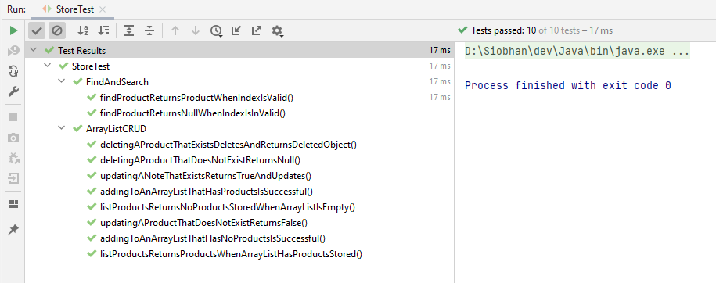


Slide 26
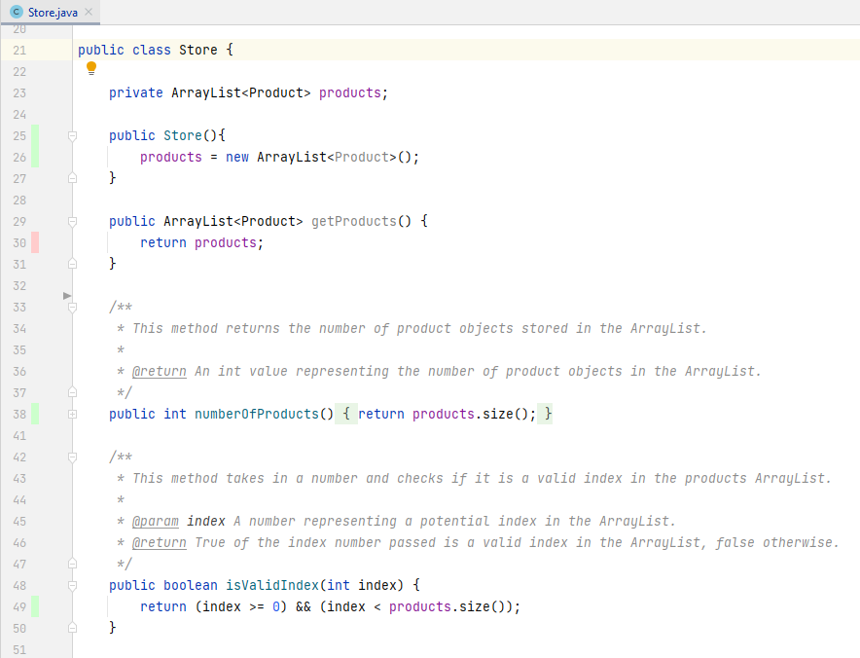

Slide 27
Topic List
Product and ProductTest.java
JUnit Testing of Store.java
Testing Driver.java

Slide 28
Driver.java (and ScannerInput.java)
JUnit is not used to test the class that takes input from the console.
Why do you think this is?

Slide 29

Any Questions?

