Slide 1

Inheritance
Subtyping, substitution and polymorphic collections & variables.
Produced
by:
Dr. Siobhán Drohan
Ms. Mairéad Meagher
Ms Siobhan Roche
Department of Computing and Mathematics
http://www.setu.ie/

Slide 2
Topic List
Subtyping and Substitution
Polymorphic Variables
Polymorphic Collections
Includes
Casting
Wrapper classes
Autoboxing
Unboxing

Slide 3


RECAP - Social Network V4.0 – NO Inheritance
Driver
NewsFeed
MessagePost
PhotoPost
Notes:
class diagram is simple (ArrayList not shown in BlueJ)

Slide 4
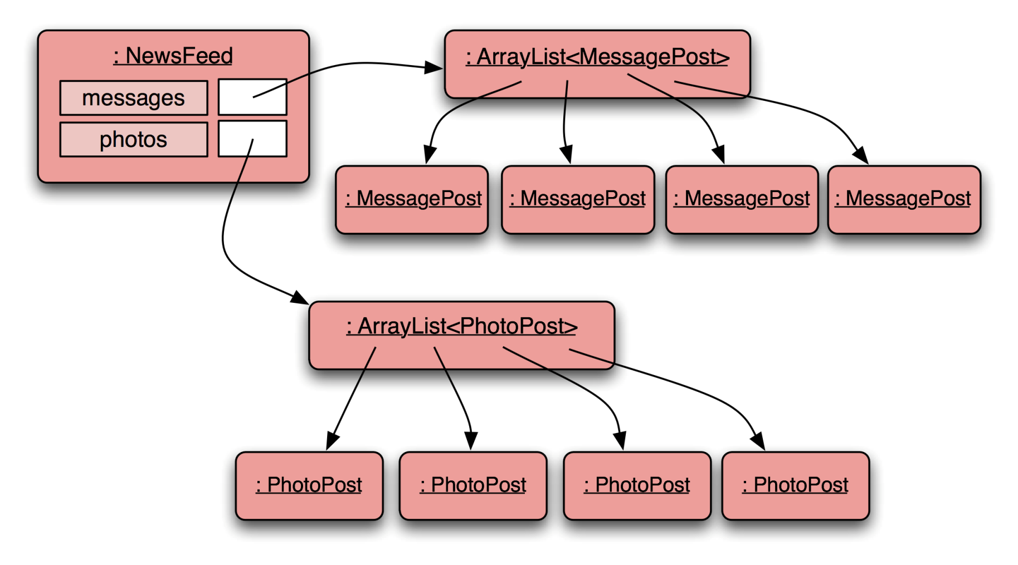
RECAP - Social Network V4.0 – TWO ArrayLists
Notes:
Newsfeed object will hold two collections: one for MessagePosts, one for PhotoPosts

Slide 5
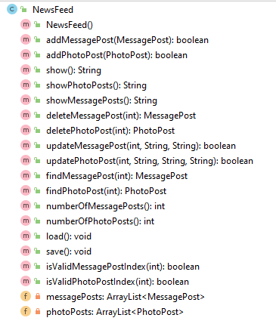
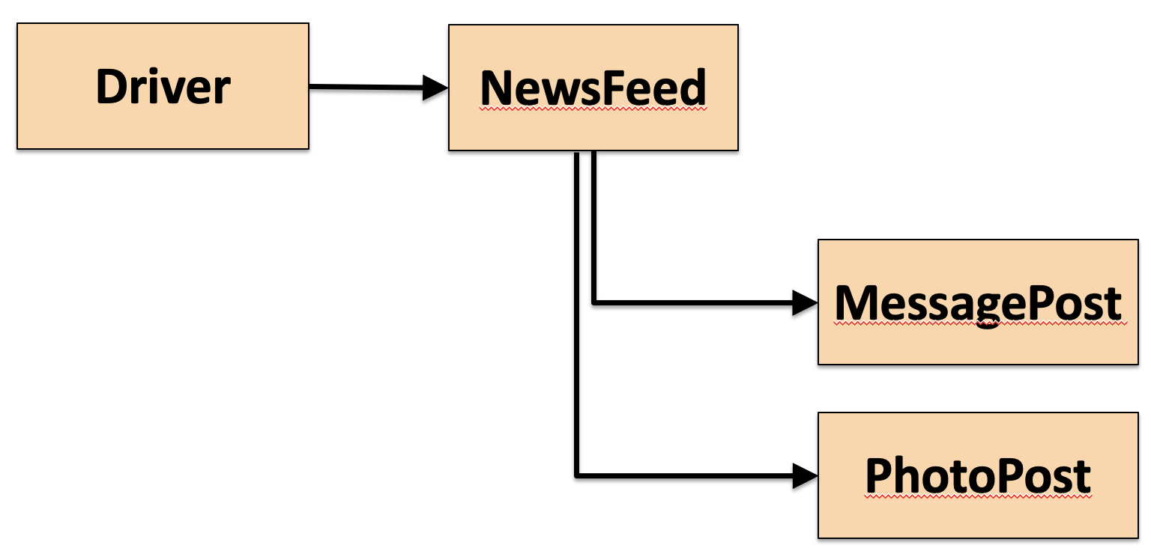
RECAP - Social Network V4.0
In V4.0, we had (no inheritance):
public void addMessagePost(MessagePost message)
public void addPhotoPost(PhotoPost photo)

Slide 6
RECAP - Social Network V5.0 – Inheritance
Driver
NewsFeed
Post
MessagePost
PhotoPost
Notes:
class diagram is simple (ArrayList not shown in BlueJ)

Slide 7
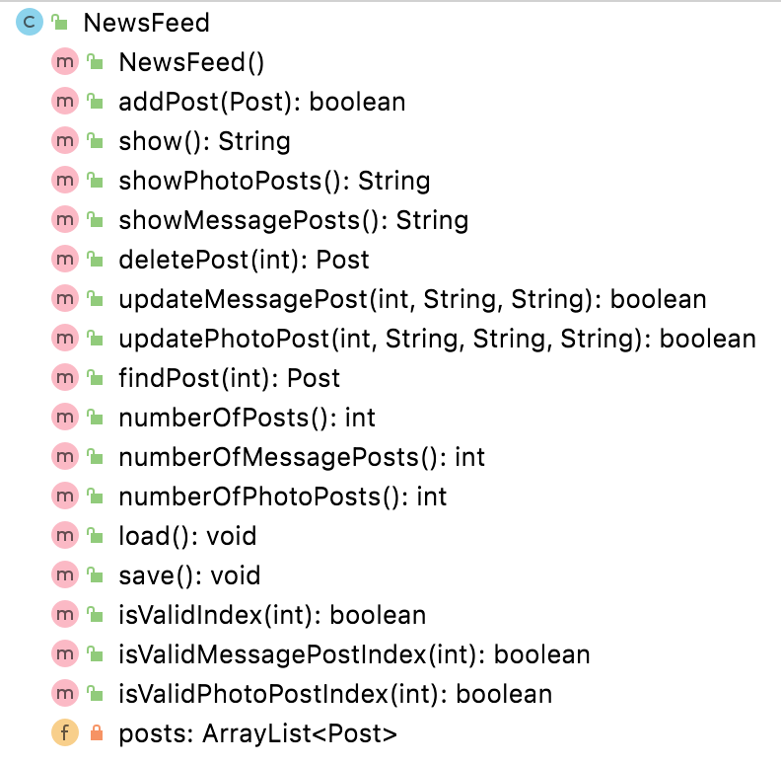
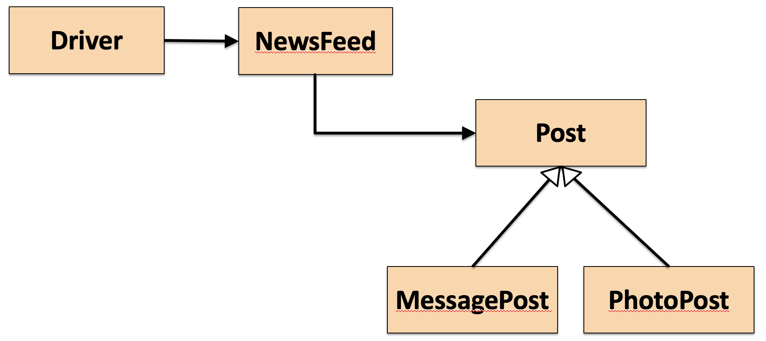
RECAP - Social Network V5.0
V5.0 had inheritance:
public void addPost(Post post)
We call this method with:
PhotoPost myPhoto = new PhotoPost(...);
newsFeed.addPost(myPhoto);

Slide 8
Subtyping
V4.0 had no inheritance:
public void addMessagePost(MessagePost message)
public void addPhotoPost(PhotoPost photo)
V5.0 has inheritance:
public void addPost(Post post)
We call this method with:
PhotoPost myPhoto = new PhotoPost(...);
newsFeed.addPost(myPhoto);
Notes:
i.e. we pass in a sub type

Slide 9
Subclasses and subtyping
Classes define types.
Subclasses define subtypes.
Substitution:
objects of subclasses can be used where objects of supertypes are required.
Notes:
i.e. is-a relationship comes in here….a subtype is-a supertype (follow the direction of the inheritance arrows)

Slide 10
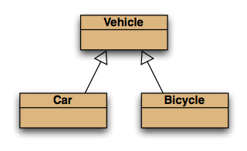
Subtyping and assignment
subclass objects may be assigned to superclass variables
Vehicle v1 = new Vehicle();
Vehicle v2 = new Car();
Vehicle v3 = new Bicycle();

Slide 11
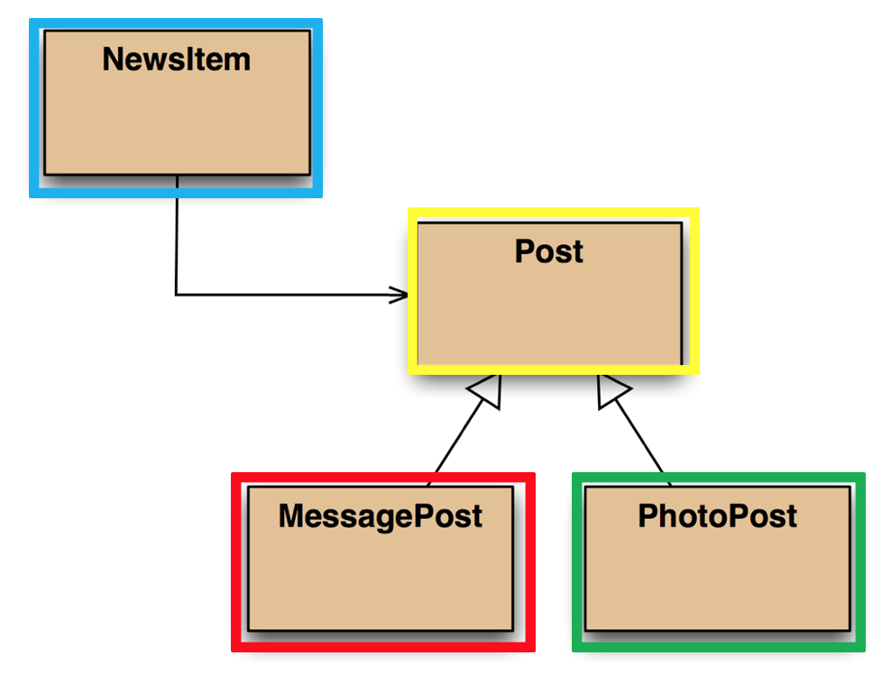
Subtyping and parameter passing
public class NewsFeed
{
public boolean addPost(Post post)
{
...
}
}
PhotoPost photo = new PhotoPost(...);
MessagePost message = new MessagePost(...);
newsFeed.addPost(photo);
newFeed.addPost(message);
subclass objects
may be used as actual parameters
when a superclass is required.

Slide 12
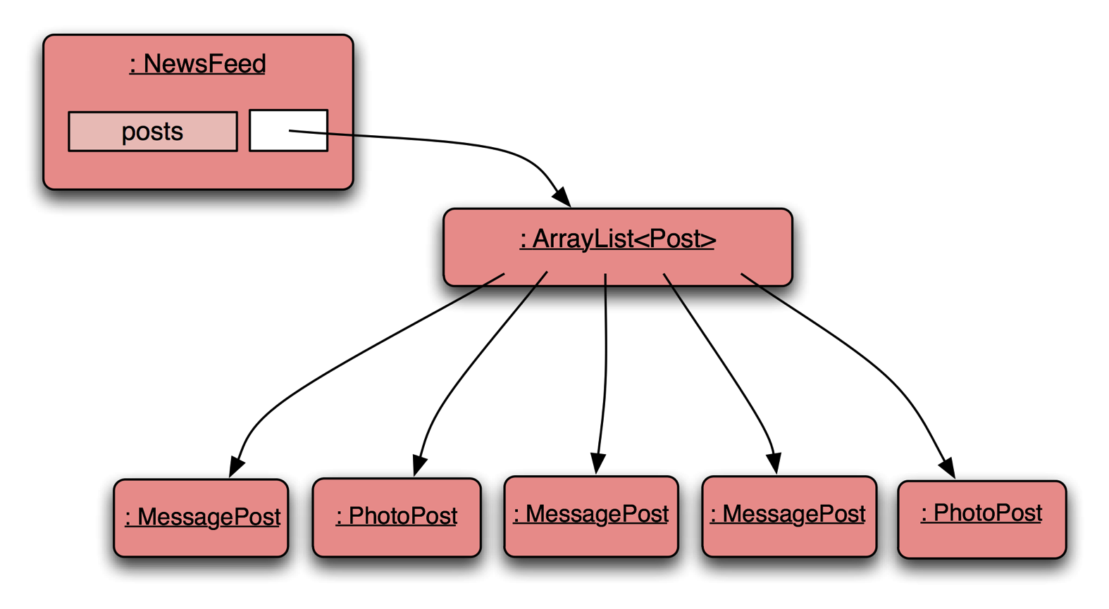
Social Network V5.0 - Object diagram
NewsFeed object holds a single mixed collection
Notes:
NewsFeed object will hold a single, mixed collection

Slide 13
Topic List
Subtyping and Substitution
Polymorphic Variables
Polymorphic Collections
Includes
Casting
Wrapper classes
Autoboxing
Unboxing

Slide 14
Polymorphic variables
Object variables in Java are polymorphic
they can hold objects of more than one type
of the declared type
or of subtypes of the declared type.

Slide 15
Social Network V5.0 – polymorphic ArrayList of Post
Notes:
NewsFeed object will hold a single, mixed collection

Slide 16
Casting
We can assign subtype to supertype (note arrow direction)!
But we cannot assign a supertype to subtype (cannot go against the arrows)!
Vehicle v; Car c = new Car();
v = c; // correct (car is-a vehicle)
Without (CASTING)
c = v; // compile-time error!
c = (Car) v; //casting…correct (only if the vehicle really is a Car!)

Slide 17
Casting
An object type in parentheses.
Used to overcome 'type loss'.
The object is not changed in any way.
A runtime check is made to ensure the object really is of that type:
ClassCastException if it isn't!
Use it sparingly.

Slide 18
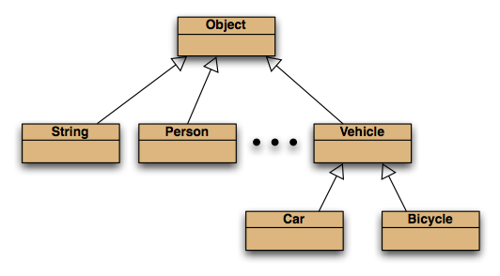
The Object class
All classes inherit from Object.

Slide 19
Topic List
Subtyping and Substitution
Polymorphic Variables
Polymorphic Collections
Includes
Casting
Wrapper classes
Autoboxing
Unboxing

Slide 20
Polymorphic collections
All collections are polymorphic.
The elements could simply be of type Object. public void add(Object element) public Object get(int index)
Usually avoided…
we typically use a type parameter with the collection.

Slide 21
Polymorphic collections
With a type parameter the degree of polymorphism: ArrayList<Post>
is limited.
Without a type parameter,
ArrayList<Object>
is implied.
Likely to get an “unchecked or unsafe operations” warning.
More likely to have to use casts.

Slide 22
Collections and primitive types
Potentially, all objects can be entered into collections
because collections can accept elements of type Object
and all classes are subtypes of Object.
Great! But what about the primitive types: int, boolean, etc.?

Slide 23
Wrapper classes
Primitive types are not object types. Primitive-type values must be wrapped in objects to be stored in a collection!
Wrapper classes exist for all primitive types:
primitive type
int
float
char
...
wrapper class
Integer
Float
Character
...
Note that there is no simple mapping rule from primitive name to wrapper name!

Slide 24
Wrapper classes
wrap the value
int value = 18;
Integer iwrap = new Integer(value);
unwrap it
…
int value = iwrap.intValue();
In practice, autoboxing and unboxing mean we don't often have to do this explicitly

Slide 25
Autoboxing and unboxing
private ArrayList<Integer> markList;
…
public void storeMark(int mark)
{
markList.add(mark);
}
autoboxing
i.e. we don’t have to worry about explicitly wrapping mark above
int firstMark = markList.get(0);
unboxing
Or explicitly unwrapping the first mark in the list markList.get(0)

Slide 26
Review
Inheritance allows the definition of classes as extensions of other classes.
Inheritance
avoids code duplication
allows code reuse
simplifies the code
simplifies maintenance and extending
Variables can hold subtype objects.
Subtypes can be used wherever supertype objects are expected (substitution).

Slide 27

Any Questions?

