Slide 1

Persistence
An Introduction to XML and Serialization
Produced
by:
Dr. Siobhán Drohan
Ms. Mairéad Meagher
Ms Siobhan Roche
Department of Computing and Mathematics
http://www.setu.ie/

Slide 2
Persistence
“the continued existence of something”
Dali – “Persistence of memory”

Slide 3
Persistence – lack of (volatility - volatile)

Slide 4
Persistence - Topic List
Introduction to XML:
XML versus HTML
Example of XML
XML does not “do” anything
Object Serialization.

Slide 5
XML versus HTML
XML was designed to describe data,
focus on what the data is.
XML is about carrying information.
<note> <to>Donald Duck</to> <from>Minnie Mouse</from> <heading>Reminder</heading> <body>Meeting at 10am today</body> </note>
Notes:
Source: http://www.w3schools.com/xml/xml_whatis.asp

Slide 6
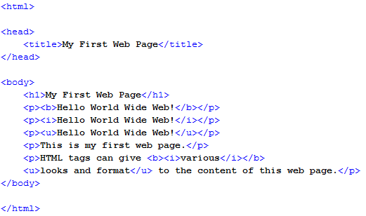
XML versus HTML
HTML was designed to display data,
focus on how the data looks.
HTML is about displaying information.

Slide 7
XML is NOT a replacement for HTML
<note> <to>Donald Duck</to> <from>Minnie Mouse</from> <heading>Reminder</heading> <body>Meeting at 10am today</body> </note>
!=

Slide 8
XML…
Extensible
Extensible markup language
Markup
Like HTML
Describes Data
Not for displaying data HTML
Define your own tags
Not predefined
Self Descriptive

Slide 9
Persistence - Topic List
Introduction to XML:
XML versus HTML
Example of XML
XML does not “do” anything
Object Serialization.

Slide 10
XML example
<note> <to>Donald Duck</to> <from>Minnie Mouse</from> <heading>Reminder</heading> <body>Meeting at 10am today</body> </note>
A note to Donald Duck, from Minnie Mouse, stored as XML
It has sender <to> and receiver <from> information
It also has a heading and a message body.
The XML is self descriptive.

Slide 11
Persistence - Topic List
Introduction to XML:
XML versus HTML
Example of XML
XML does not “do” anything
Object Serialization.

Slide 12

Our Shop App
Shop V4.0
implemented the CRUD process
Problem: All entered data is lost if we close our application
Shop V5.0
use XML to make our data persistent beyond the life of our app
Solution: Store our objects from memory to XML files.

Slide 13
XML does not “do” anything
XML is just information wrapped in <tags>.
Someone must write a piece of software to send, receive or display it.
We will write Java code to:
SEND objects TO an XML file on the hard disk.
READ objects FROM an XML file on the hard disk.
This is called Object Serialization
Source: http://www.w3schools.com/xml/xml_whatis.asp

Slide 14
Persistence - Topic List
Introduction to XML:
XML versus HTML
Example of XML
XML does not “do” anything
Object Serialization.

Slide 15
Java Serialization
Persistent Storage
DB
Volatile Storage
OBJECT
1011 0101
1000 0101
1011 1000
File
Stream Of Bytes
Memory Card

Slide 16
Java De-Serialization
Persistent Storage
DB
Volatile Storage
OBJECT
1011 0101
1000 0101
1011 1000
File
Stream Of Bytes
Memory Card

Slide 17
Object Serialization
An object can be represented as a sequence of bytes that includes the object's data
as well as information about the object's type
and the types of data stored in the object.

Slide 18
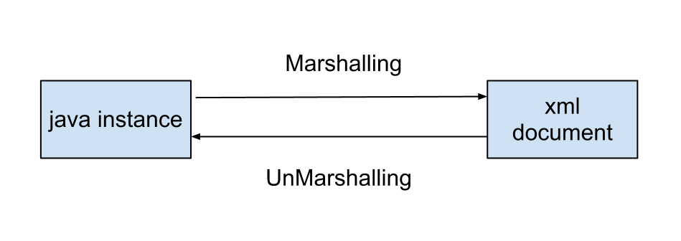
Serialization process involves Marshalling
Marshalling is the process of converting the objects & data into a stream.

Slide 19
Serialization process involves Marshalling and unMarshalling
Marshalling is the process of converting the objects & data into a stream.
UnMarshalling is the reverse process of converting the stream back to their original objects & data.

Slide 20
Self Study Questions
What does Persistence mean?
We use HTML for carrying data (T/F)?
We use XML for displaying data (T/F)?
XML is a replacement for HTML (T/F)?
When power is lost the data in a program is lost. What one word describes this?
Writing Java objects to a file is called?
Reading a file of data into Java objects is called?
Converting objects to a data stream is called?

Slide 21

Any Questions?

