Slide 1

Persistence
Saving and retrieving objects to/from XML files
Produced
by:
Ms. Mairéad Meagher
Dr. Siobhán Drohan
Ms Siobhan Roche
Department of Computing and Mathematics
http://www.setu.ie/

Slide 2


Slide 3

Our Shop App
Shop V4.0 - implemented the CRUD process
Problem: All entered data is lost if we close our application
Shop V5.0
use XML to make our data persistent beyond the life of our app
Solution: Store our objects from memory to XML files.

Slide 4
Shop V5.0 (using XML)
V5 - XML
For our XML persistence, we will use a component called XStream.
XStream
is a simple library to serialize objects to XML and back again.
is called a component and we must download the jar file it is stored in, and incorporate it into our project.
http://x-stream.github.io/index.html

Slide 5
Shop V5.0 (using XML) - STEPS
V5 - XML
Download the xstream-1.4.21.jar component
Add it to your Shop project.
Store Class
Write the load(), save() methods.
Driver Class
include extra load and save functionality to the menu.

Slide 6
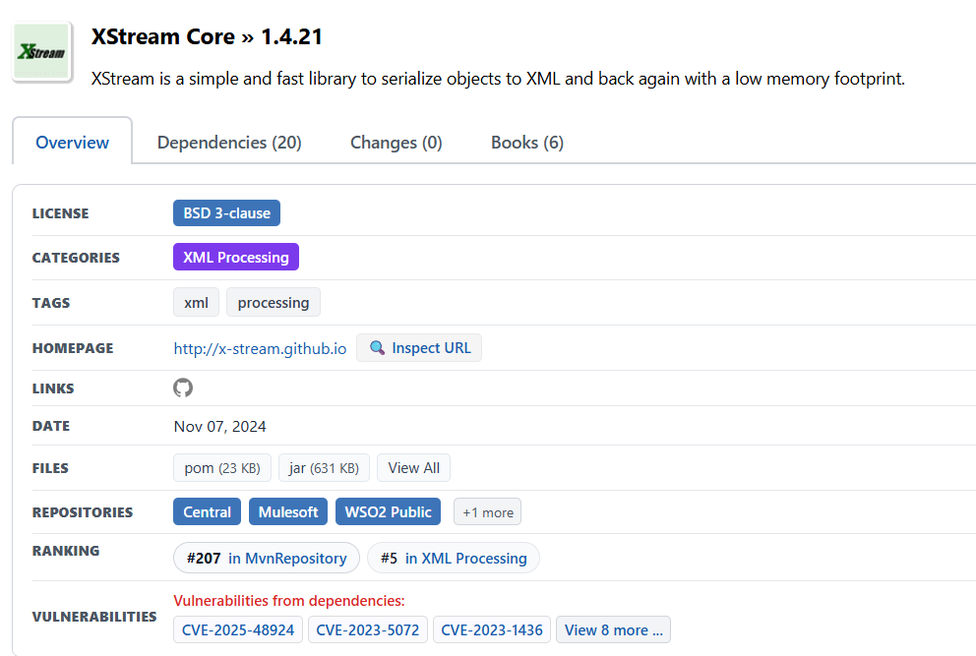
Download the component
Download the xstream-1.4.21.jar component.
https://mvnrepository.com/artifact/com.thoughtworks.xstream/xstream/1.4.21

Slide 7
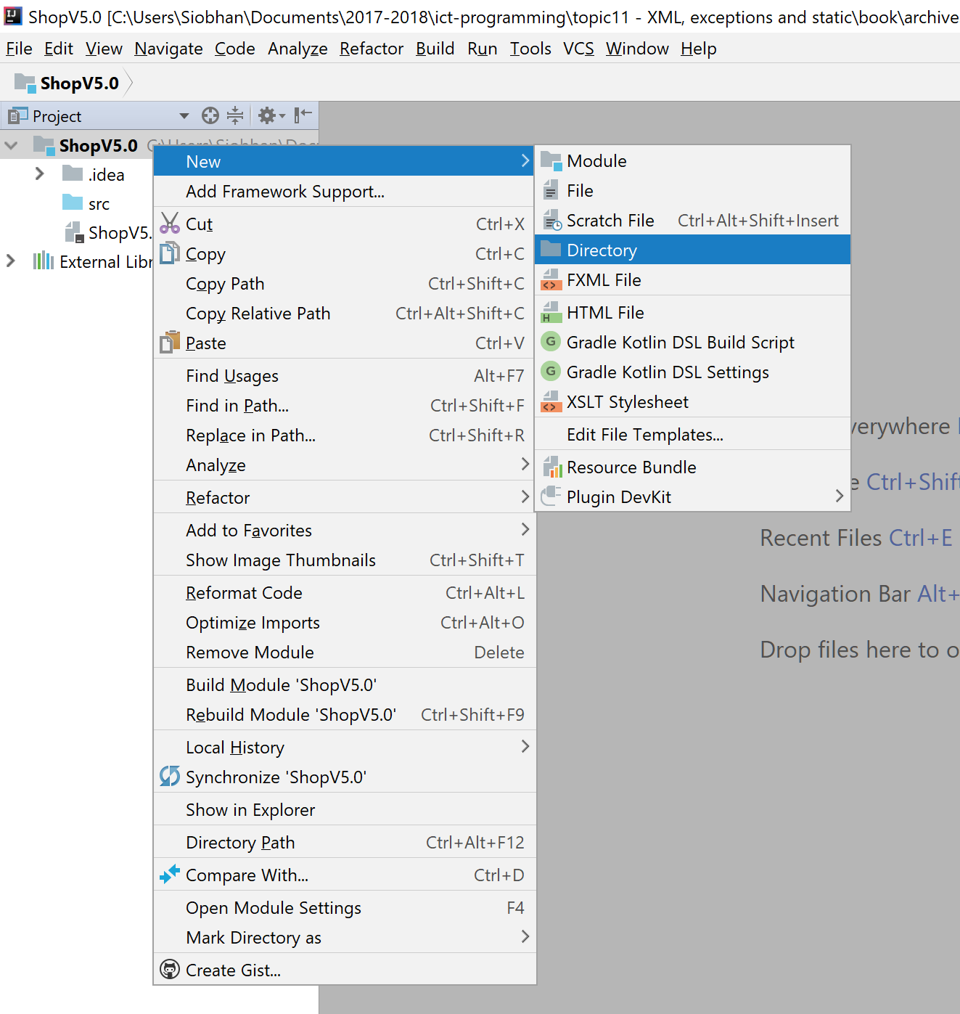
Adding a component to the lib folder -1
On the ShopV5.0 project…
right click
select “New”
then “Directory”.

Slide 8
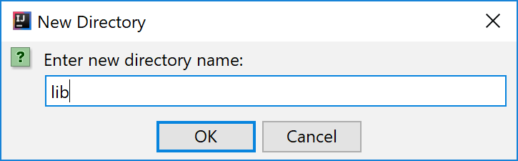
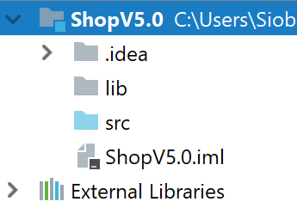
Adding a component to the lib folder - 2
Call the new directory “lib”.

Slide 9
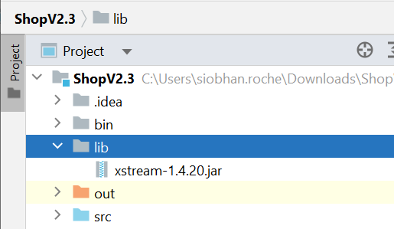
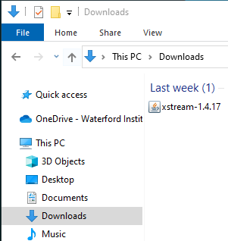
Adding a component to the lib folder - 3
Drag the
xstream-1.4.21.jar
file into the lib folder.

Slide 10
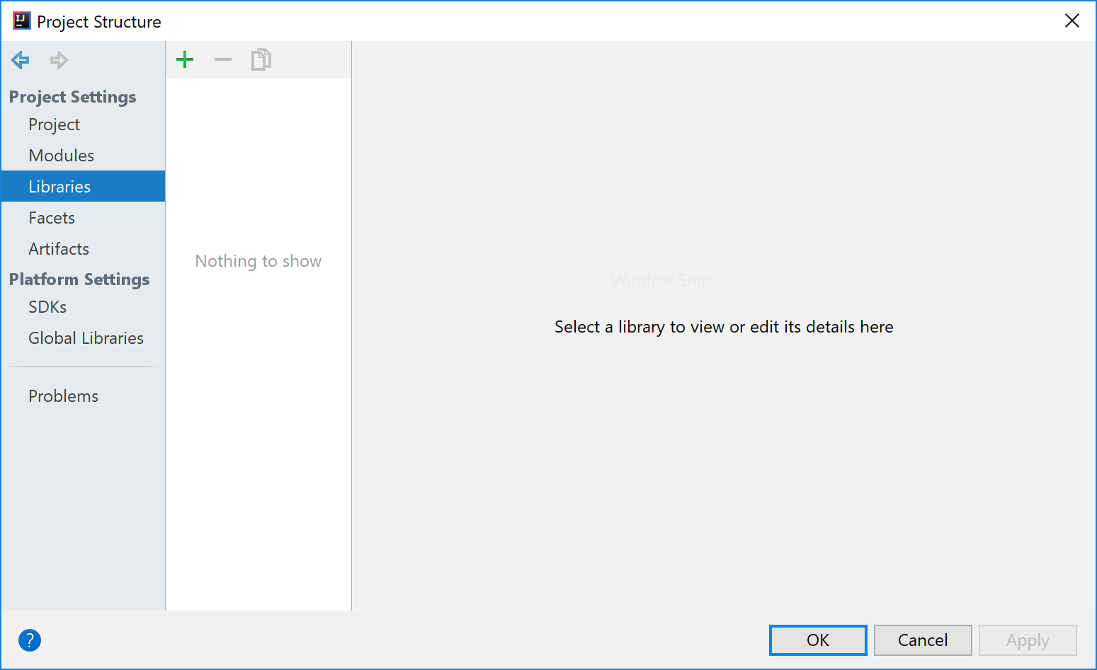
Adding the component to your build path - 1
From File menu, select Project Structure. Click on Libraries.

Slide 11
Adding the component to your build path - 2
To add a library to your build path: click on the +

Slide 12
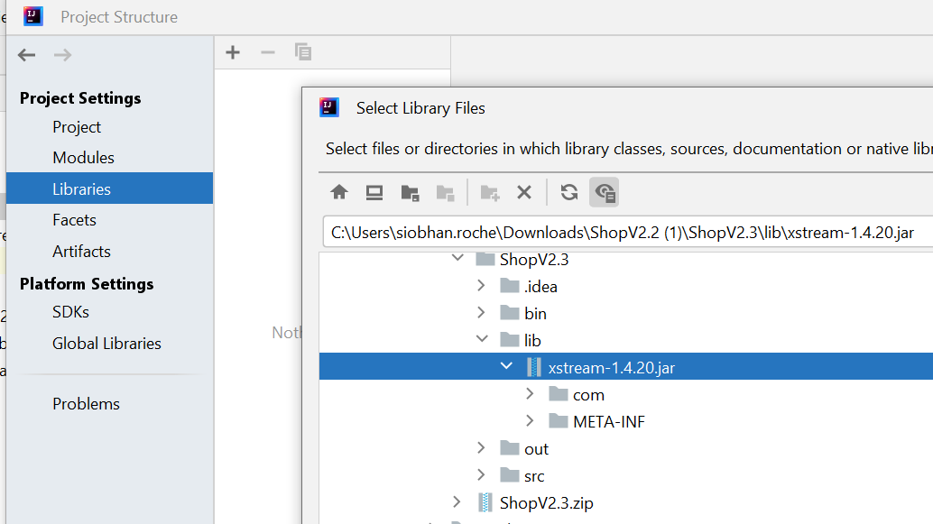
Adding the component to your build path - 3
Select Java and locate your library…click OK (a few times!)

Slide 13
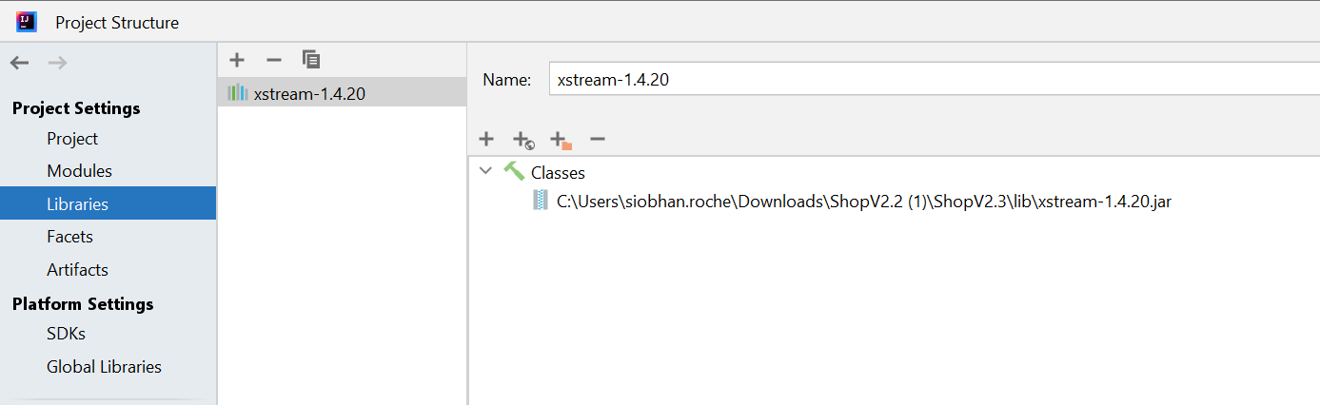
Adding the component to your build path - 4
XStream is now added as a library – this means the compiler can find it!

Slide 14
Shop V5.0 (using XML) - STEPS
V5 - XML
Download the xstream-1.4.21.jar component
Add it to your Shop project.
Store Class
Write the load(), save() methods.
Driver Class
include extra load and save functionality to the menu.

Slide 15
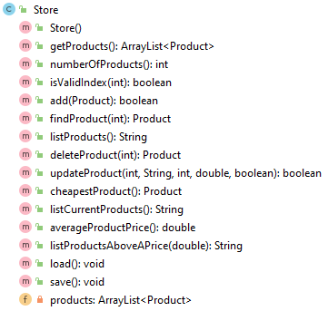
// 1. Initialize an XStream object variable
// 2. Use it to initialize an ObjectOutputStream to a specific file
// 3. Write out the objects you want saved e.g. products
// 4. Close the stream / file
public void save() throws Exception
{ XStream xstream = new XStream(new DomDriver()); //1 ObjectOutputStream out =
xstream.createObjectOutputStream(new FileWriter("products.xml")); //2 out.writeObject(products); //3 out.close(); //4 }

Slide 16
// 1. Provide a list of classes that you want to serialise
// 2. Initialise an XStream object and set up security rules
// 3. Use XStream object to initialize an ObjectInputStream from a specific file
// 4. Call the is.readObject() method to assign values to the object e.g. products
// 5. Close the stream / file
@SuppressWarnings("unchecked") public void load() throws Exception { //list of classes that you wish to include in the serialisation, separated by a comma Class<?>[] classes = new Class[] { Product.class }; //1 //setting up the xstream object with default security and the above classes XStream xstream = new XStream(new DomDriver()); XStream.setupDefaultSecurity(xstream); //2 xstream.allowTypes(classes); //doing the actual serialisation to an XML file ObjectInputStream is = xstream.createObjectInputStream(new FileReader("products.xml")); //3 products = (ArrayList<Product>) is.readObject(); //4 is.close(); //5 }

Slide 17
To use the load() & save() code in another project, change:
load()
the class type in the list of classes to serialise.
the name of the xml file.
the type of object stored in the ArrayList.
the name of the ArrayList object.
save()
the name of the xml file.
the name of the ArrayList object.

Slide 18
Required Packages
import com.thoughtworks.xstream.XStream; import com.thoughtworks.xstream.io.xml.DomDriver; import java.io.FileReader; import java.io.FileWriter; import java.io.ObjectInputStream; import java.io.ObjectOutputStream;
Note: you need to import these additional packages.

Slide 19
Shop V5.0 (using XML) - STEPS
V5 - XML
Download the xstream-1.4.17.jar component
Add it to your Shop project.
Store Class
Write the load(), save() methods.
Driver Class
include extra load and save functionality to the menu.

Slide 20
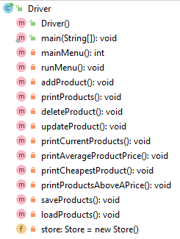
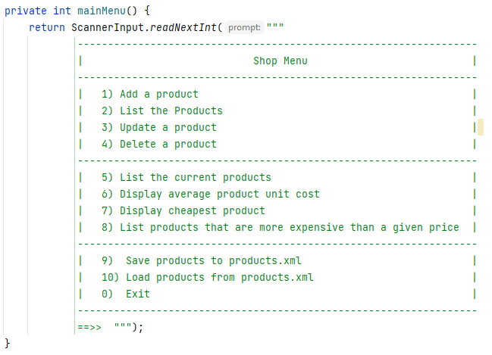
Adding Save and Load functionality to the menu.

Slide 21
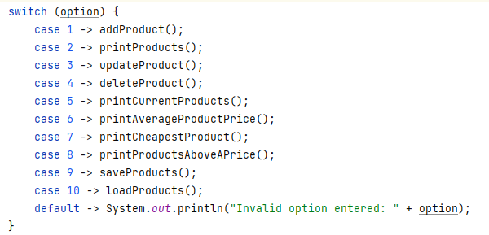
Adding Save and Load functionality to the menu.

Slide 22
Adding Save and Load functionality to the menu.
//save all the products in the store to a file on the hard disk private void saveProducts() { try { store.save(); } catch (Exception e) { System.err.println("Error writing to file: " + e); } }

Slide 23
Adding Save and Load functionality to the menu.
//save all the products in the store to a file on the hard disk private void saveProducts() { try { store.save(); } catch (Exception e) { System.err.println("Error writing to file: " + e); } }
//load all the products into the store from a file on the hard disk private void loadProducts() { try { store.load(); } catch (Exception e) { System.err.println("Error reading from file: " + e); } }

Slide 24
try/catch
The save() and load() methods in the Store class can throw an Exception. So, if we want to use, say, the load(), method, we need to write code to “handle” an Exception being thrown. This is where try/catch comes in and we will look at this construct in the next slide deck.
//load all the products into the store from a file on the hard disk private void loadProducts() { try { store.load(); } catch (Exception e) { System.err.println("Error reading from file: " + e); } }

Slide 25
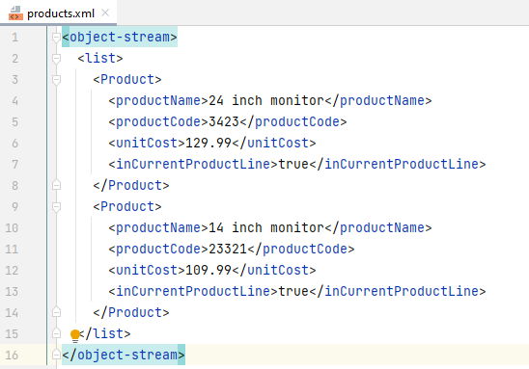
When the save option is selected from the menu, this XML file is created
The XML file is located in your root project directory.

Slide 26
Self Study Questions
What is persistence?
What file type do we store Java objects in?
Which Java component did we use for serializing objects?
What 2 methods do we have to write to use this component?

Slide 27

Questions?

