Slide 1

Exception Handling
Handling invalid user input
Produced
by:
Dr. Siobhán Drohan
Ms. Mairéad Meagher
Ms Siobhan Roche
Department of Computing and Mathematics
http://www.setu.ie/

Slide 3
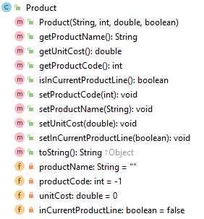
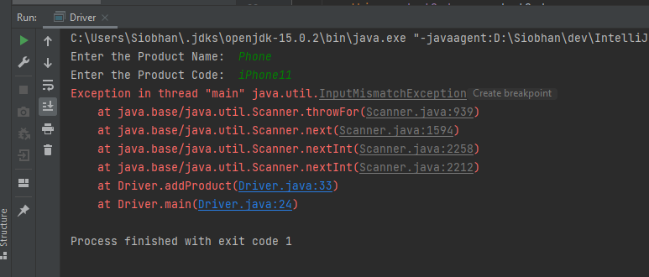
Lab01b, Step 3 – InputMismatch Exceptions
Do you remember, in our first week, we crashed our ShopV1.0 project with an InputMismatchException:

Slide 4
Lab01b, Step 3 – InputMismatch Exceptions
The program crashed because we were expecting the user to type in an int for Product Code, however they typed in a String, iPhone11.
We used a Scanner method nextInt() to read this input but as the input was a String, the program couldn't handle it, so it crashed.

Slide 5
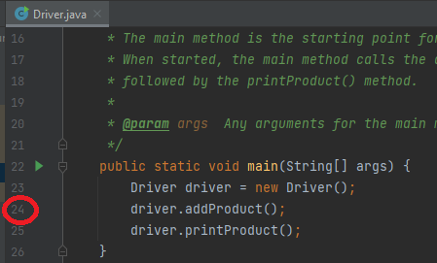
Lab01b, Step 3 – InputMismatch Exceptions

Slide 6
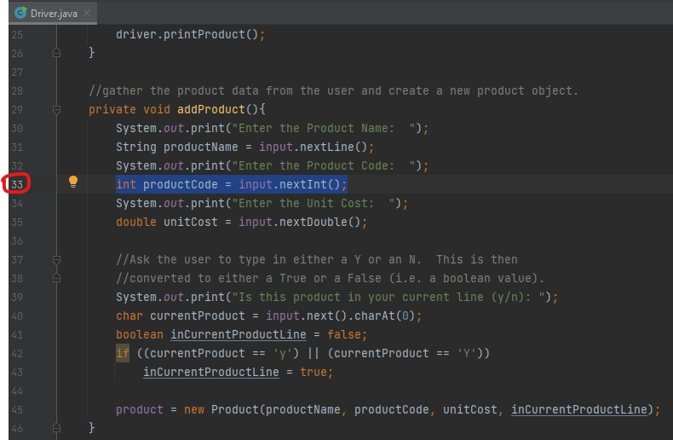

Slide 7
What are Exceptions?
An Exception is an object that signals that some unusual condition has occurred while the program is executing.
Exceptions are intended to be detected and handled, so that the program can continue in a sensible way if at all possible.
Java has many predefined Exception objects.

Slide 8
When an exception occurs…
...the normal flow of execution is disrupted and transferred to code, which can handle the exception condition.
The exception mechanism is a lot cleaner than having to check an error value after every method call that could potentially fail.
Notes:
© Judith Bishop(2001), Java Gently, Third Edition, Addison-Wesley

Slide 9
A RuntimeException…
is a subclass of the Exception class.
encompasses all exceptions which can ordinarily happen at run-time.
these exceptions can be thrown by any java statement or a method call.
can be avoided through good programming practices!
RuntimeException | Example Causes
ArithmeticException | Can be caused by dividing by zero.
ArrayIndexOutOfBoundsException | Referencing an array index number of 7 when only 5 exist in the array.
NullPointerException | Trying to access an object that has no memory allocated yet.
InputMismatchException | Caused by passing invalid input (wrong type).
Notes:
NullPointerException ().

Slide 10
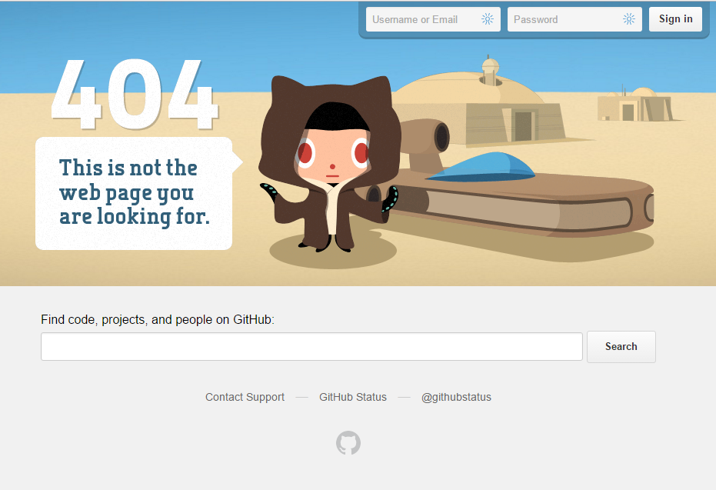

Catching Exceptions - handlers
Catching an exception means declaring that you can handle exceptions of a particular class from a particular block of code.
You specify the block of code and then provide handlers for various classes of exception.
If an exception occurs then execution transfers to the corresponding piece of handler code.

Slide 11
try and catch
To catch exceptions, you surround a block of code with a "try, catch" statement.
try{
// The try clause is the piece of code which you want to try to execute.
// it contains statements in which an exception could be raised
}
catch (Exception e){
// The catch clauses are the handlers for the various exceptions.
// it contains code to handle Exception and recover
}

Slide 12
try and catch - example
try{
myMethod();
}
catch (Exception e){
System.err.println(“Caught Exception: “ + e)
}
The parameter e is of type Exception. We can use e to print out what exception occurred.
Notes:
© Judith Bishop(2001), Java Gently, Third Edition, Addison-Wesley

Slide 13
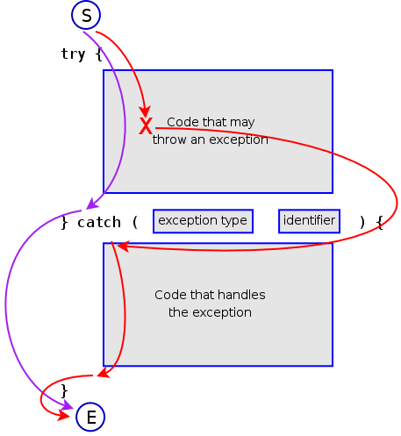
Flow of control in Exception Handing
S = Start
E = End
Purple path = everything ok
Red path = exception is caught and handled
Notes:
S = start
E = end

Slide 14
Returning to our – InputMismatch Exception

Slide 15
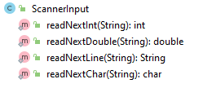
Lab03: ScannerInput Class is Introduced
The ScannerInput class:
has four methods for reading four different data types.
creates a new Scanner object in each method, thereby getting rid of the Scanner bug (where the buffers are not flushed properly after each int/double/float read).
Uses the try/catch construct to handle any InputMismatchExceptions and to stop them crashing our program (i.e. recover from them).
is a “utility” class that we can reuse in all our projects.

Slide 16
ScannerInput Class - try/catch example
readNextInt:
This method takes in a String prompt and prints it to the console (e.g. of a prompt would be "Please enter the product code").
The user input is then read and it is checked to see if what the user entered is ACTUALLY an int.
If the value:
is an int, the value is returned.
isn't an int, then the prompt is printed again to the user and the validation of the input continues until the user enters a valid int.

Slide 17
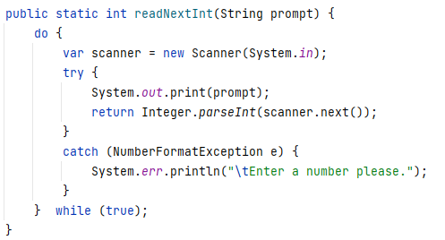
ScannerInput Class - try/catch example

Slide 18
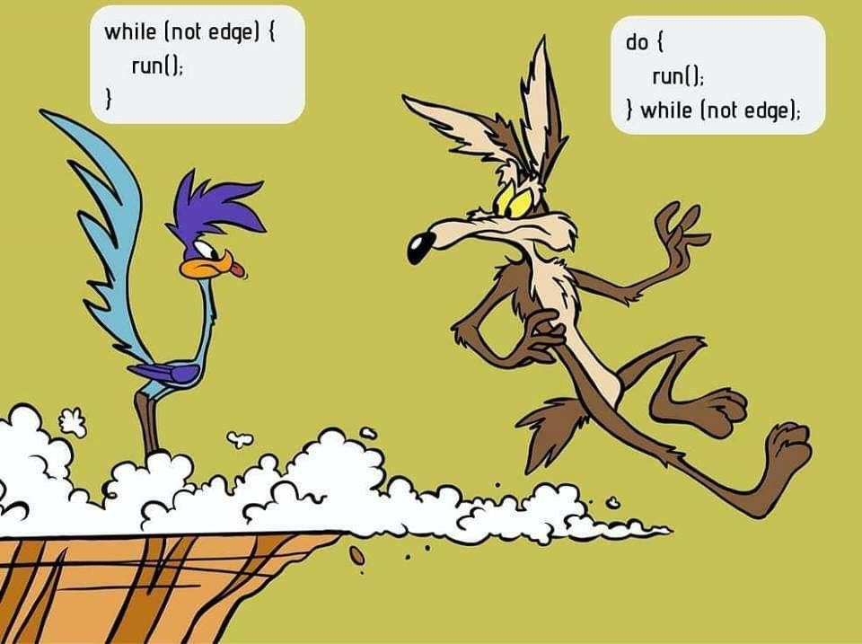

Slide 19
ScannerInput Class - try/catch example

Slide 20
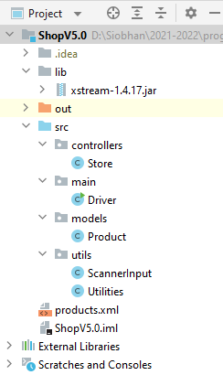
XStream and Exceptions
In the last slide deck, we covered using the XStream component to save and load XML data to/from the harddisk. Now we will look in more detail at the Exception Handling.

Slide 21
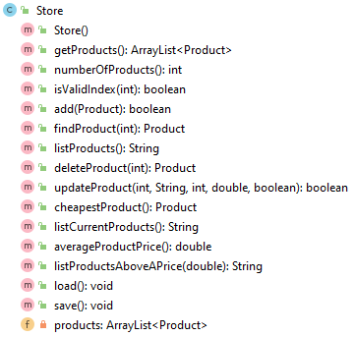
@SuppressWarnings("unchecked") public void load() throws Exception { //list of classes that you wish to include in the serialisation, separated by a comma Class<?>[] classes = new Class[] { Product.class }; //setting up the xstream object with default security and the above classes XStream xstream = new XStream(new DomDriver()); XStream.setupDefaultSecurity(xstream); xstream.allowTypes(classes); //doing the actual serialisation to an XML file ObjectInputStream is = xstream.createObjectInputStream(new FileReader("products.xml"));
products = (ArrayList<Product>) is.readObject(); is.close(); }
public void save() throws Exception { XStream xstream = new XStream(new DomDriver()); ObjectOutputStream out =
xstream.createObjectOutputStream(new FileWriter("products.xml")); out.writeObject(products); out.close(); }

Slide 22
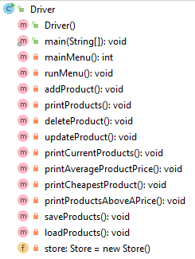
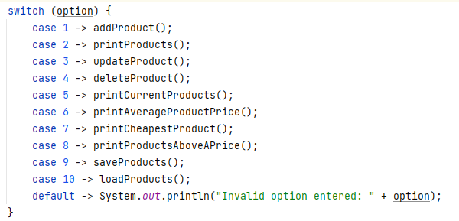
Adding Save and Load functionality to the menu.

Slide 23
Adding Save and Load functionality to the menu.
//save all the products in the store to a file on the hard disk private void saveProducts() { try { store.save(); } catch (Exception e) { System.err.println("Error writing to file: " + e); } }
//load all the products into the store from a file on the hard disk private void loadProducts() { try { store.load(); } catch (Exception e) { System.err.println("Error reading from file: " + e); } }

Slide 24
Summary
Crash v Exceptions
Detect and Handle
Enables program to continue
Java’s predefined Exception objects
try / catch block
Introduction to
do while loop
Always runs once
Condition is test at the end

Slide 25

Questions?

