Slide 1


Inheritance
Introduction
Mr. Dave Hearne
Dr. Siobhán Drohan
Mr. Colm Dunphy
Ms. Mairéad Meagher
Ms Siobhan Roche
Mr Pete Windle
Produced
by:

Slide 2


Agenda
Inheritance Hierarchies
Social Network v5
Sub and Super Classes

Slide 3
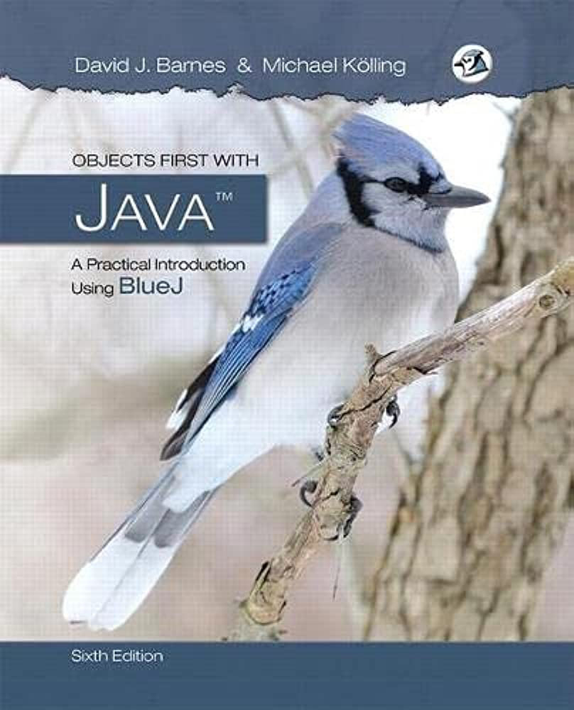
Lectures & Labs
This weeks lectures and labs are based on examples in:
Objects First with Java - A Practical Introduction using BlueJ, © David J. Barnes, Michael Kölling

Slide 4
Inheritance Hierarchies

Slide 5
Inheritance hierarchies
Animal
Mammal
Bird
Is-a
Dog
Cat
Chicken
Robin
Poodle
Pug
Notes:
inheritance hierarchies are nothing unusual. we see them all the time.
(a masters student is a students is a person...)

Slide 6
Inheritance hierarchies
MusicFormat
AnalogFormat
DigitalFormat
Is-a
Cassette
Vinyl
DCC
DAT
MD
CD
Audio File
.MP3
.AAC
single
album
single
album
7”
12”
Notes:
inheritance hierarchies are nothing unusual. we see them all the time.
(a masters student is a students is a person...)

Slide 7
Social Network v5

Slide 8

Social Network v4 Recap – Class Diagram
NewsFeed
MessagePost
just setting up my twttr
First post
PhotoPost

Slide 9
Critique of Social Network v4
Code duplication:
MessagePost and PhotoPost classes very similar (large parts are identical)
makes maintenance difficult/more work
introduces danger of bugs through incorrect maintenance
Code duplication in NewsFeed class as well.
Notes:
we note a lot of code duplication.
this is one problem with this solution (there are others)

Slide 10
Social Network v5 Class Diagram
NewsFeed
Post
MessagePost
PhotoPost
Notes:
NewsFeed now only knows about Post rather than the subclasses.

Slide 11
Social Network v5 - Classes
Post
username
timestamp
likes
comments
_________________
like
unlike
addComment
getTimestamp
display
PhotoPost
filename
caption
_________________
getImageFile
getCaption
MessagePost
message
_________________
getText
Notes:
add the obvious methods (getters and setters); not complete here - just examples

Slide 12
Social Network v5 - Classes
Superclass
Post
Common Attributes
username
timestamp
likes
comments
_________________
like
unlike
addComment
getTimestamp
display
Inherit superclass attributes
and add their own specific attributes
Subclass
Inherits
Inherits
PhotoPost
Subclass
filename
caption
_________________
getImageFile
getCaption
MessagePost
message
_________________
getText
Notes:
add the obvious methods (getters and setters); not complete here - just examples

Slide 13
Social Network v5 – Inheritance summary
define one superclass
Post
define subclasses for
MessagePost
PhotoPost
the superclass
defines common attributes (via fields)
the subclasses
inherit the superclass attributes (fields)
add other specific attributes (fields)

Slide 14
Super and Sub classes - code

Slide 15
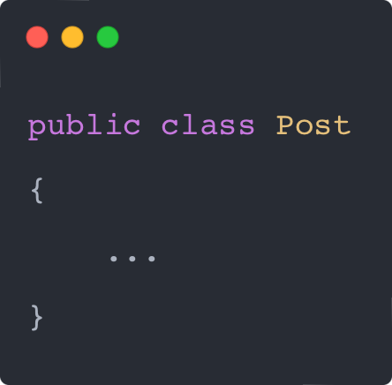
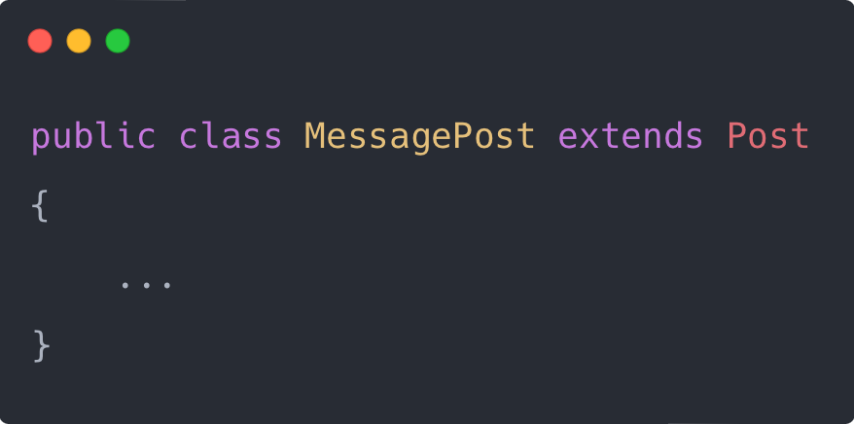
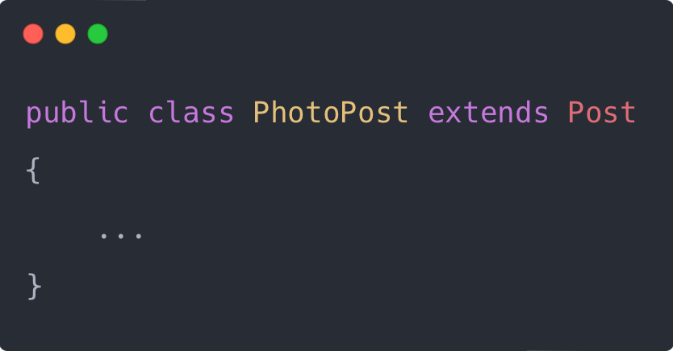
Inheritance in Java
No changes
Change here
Notes:
syntax for inheritance: ‘extends’ keyword

Slide 16
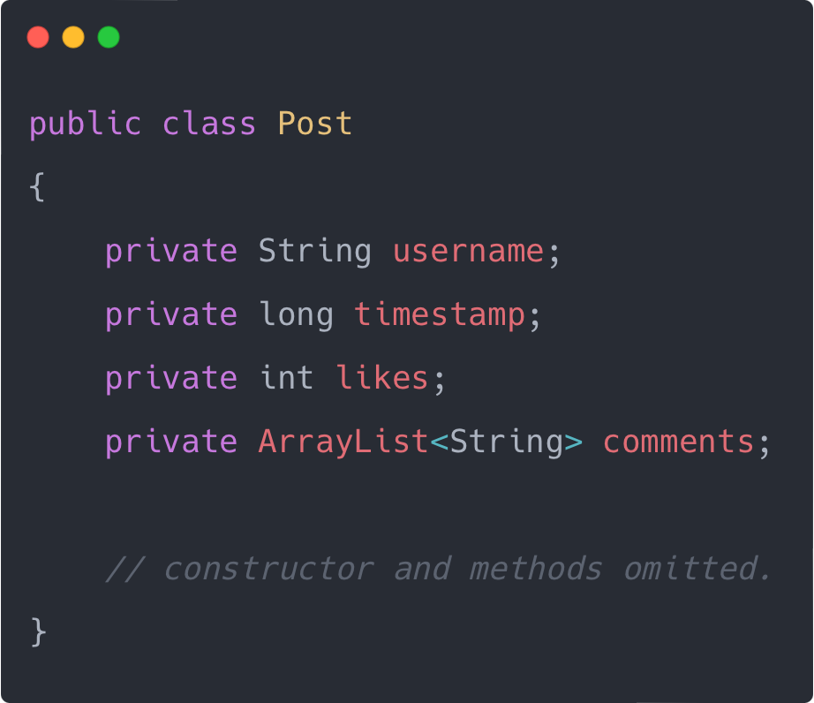
Superclass
Common Fields
Notes:
we define common fields in superclass

Slide 17
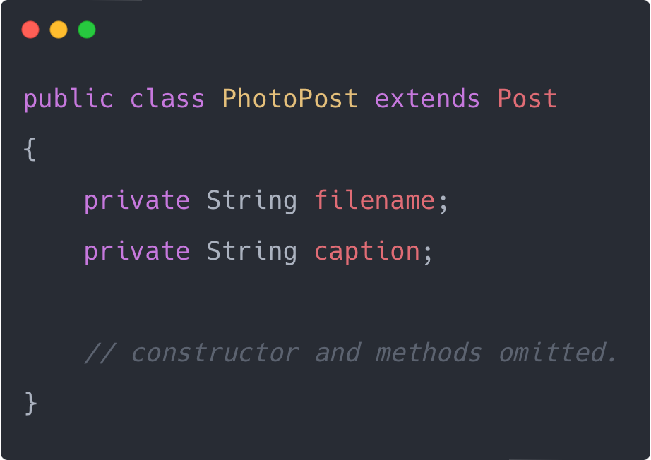
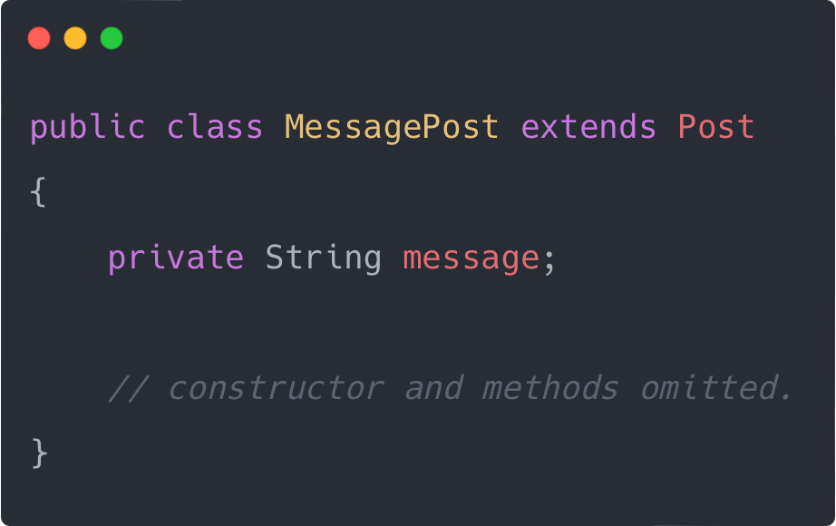
Subclasses
Subclass fields are unique to that subclass
Subclass objects inherit all fields from the superclass
Notes:
we add subclass fields; inherit superclass fields
subclass objects will have all fields

Slide 18
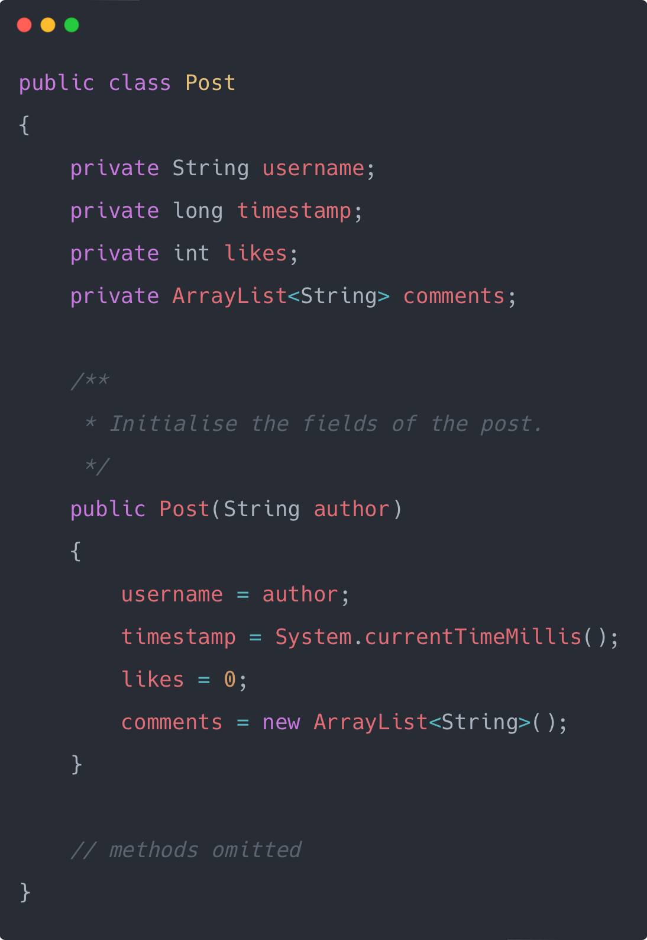
Inheritance & Constructors - superclass
Nothing unusual in the superclass
Notes:
how do we initialise the fields?
superclass: nothing unusual.

Slide 19
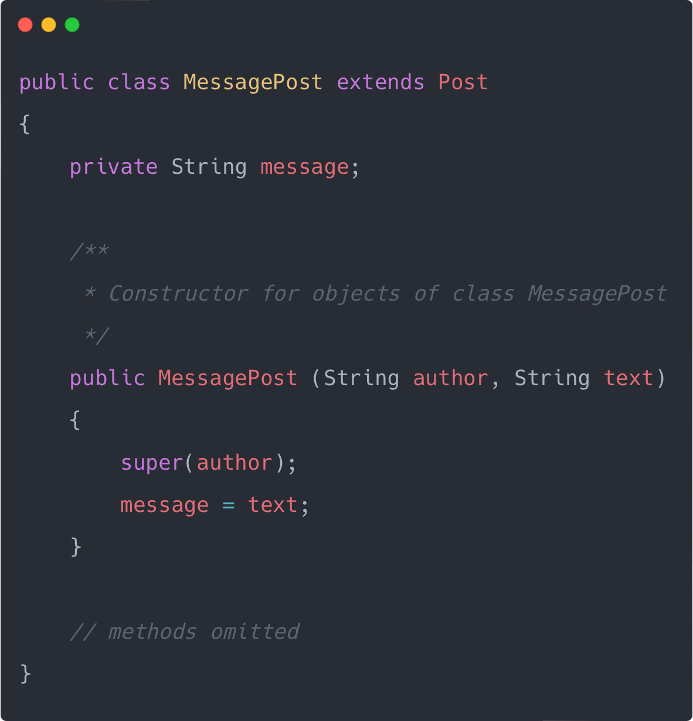
Inheritance & Constructors - subclass
Must extend the superclass
Must call the superclass constructor
Notes:
subclass: must call superclass constructor!
Must take values for all fields that we want to initialise.

Slide 20
Superclass constructor call
Subclass constructors must always contain a super call.
If none is written, the compiler inserts one (without parameters)
works only, if the superclass has a constructor without parameters
super call must be the first statement in the subclass constructor.

Slide 21
Questions?
Notes:
Next we will look at inheritance hierarchies and version 2 of social network

