Slide 1
Erlang

Slide 2
Introducing Erlang
“Erlang” is a contraction of “Ericsson Language,” named for the Ericsson company that makes telephone switching equipment
Erlang began as a set of extensions to Prolog
Erlang was created by Dr. Joe Armstrong
Erlang is a functional language which is important for two things:
  It supports extremely high concurrency
  It supports extreme reliability

Slide 3
Running Erlang
Double-click on the Erlang icon, or type erl into a terminal (cmd) window
  You can try short pieces of code from here, but you cannot import code or define functions
  Use
  c(module.erl).
  (no quote marks) to compile a module named module from the file module.erl.
    To use a function func defined in module.erl, use module:func(args)
  Use
  f().
  to clear (forget) previous associations.
  Use the up and down arrows to choose a previous entry.
  Use control-C to exit the shell.

Slide 4
Directives
An Erlang program should begin with
-module(filename).
where filename.erl is the name of the file it is on
To use functions defined in another file, use
-import(filename, [function1/arity1, ..., functionN/arityN]).
  Imported methods may be called without a filename: prefix.
To provide functions defined in this file to other programs, use either of
  -export(filename, [function1/arity1, ..., functionN/arityN]).
  -compile(export_all).

Slide 5
Names
Variables begin with a capital letter or an underscore
  The special variable _ is the “don’t care” variable
  Variables are either bound (have a value) or unbound; once bound, they cannot be changed
Function names and atoms begin with a lowercase letter
  An atom is a word that stands for itself

Slide 6
Data types
Integers, of unlimited size: 1112223344455666777888999000
Floats: 1234.5678, 6.0221415e23
Strings, enclosed in double quotes: "This is a string."
  A string is implemented as a list of ASCII (integer) values
Atoms: atom1, 'Atom 2'
  Begin with a lowercase letter, or are enclosed in single quotes
Lists: [abc, 123, "pigs in a tree"]
Tuples: {abc, 123, "pigs in a tree"}
Binaries: <<0, 255, 128, 128>>, <<"hello">>, <<X:3, Y:7, Z:6>>
  Binaries exactly specify bits
  The number of bits in a binary must be a multiple of 8.

Slide 7
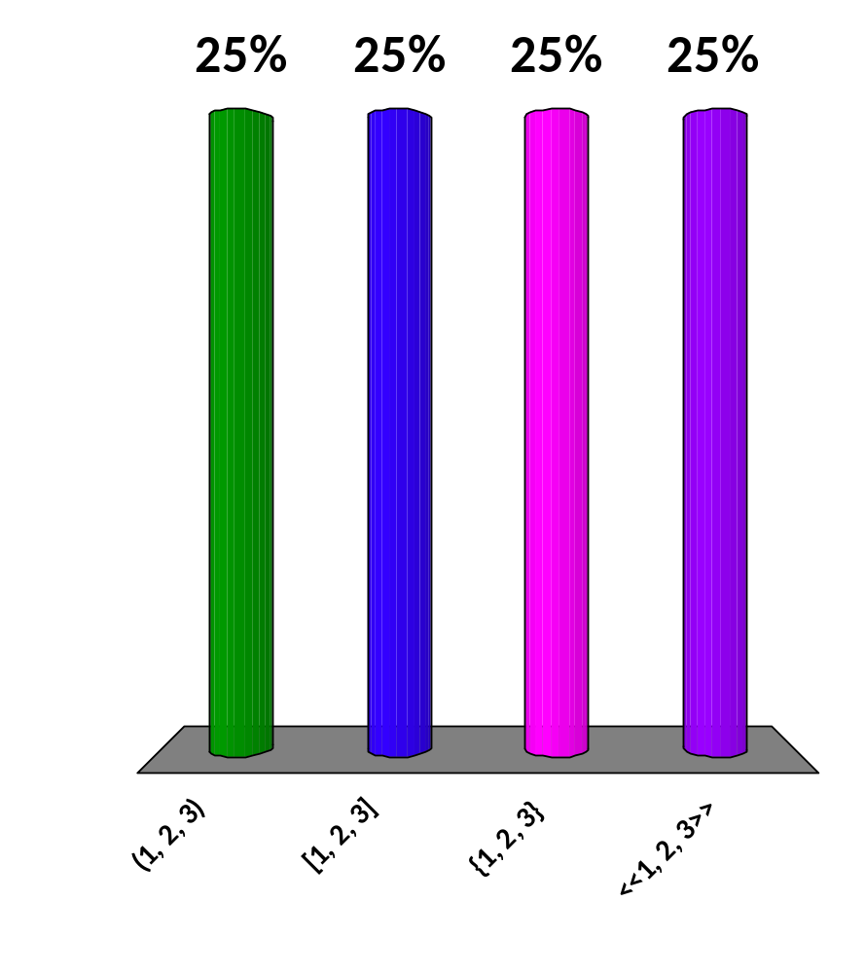
What is the syntax for a tuple?
(1, 2, 3)
[1, 2, 3]
{1, 2, 3}
<<1, 2, 3>>
25

Slide 8
Operations
Arithmetic:
+X -X X * Y X / Y X div Y X rem Y X + Y X - Y
Comparison:
X < Y X =< Y X =:= Y X =/= Y X >= Y X > Y
  Only for comparing integers and floats: X == Y X /= Y
  5 == 5 and 5 == 5.0 are true; 5 =:= 5.0 is false.
Boolean:
not X X and Y X or Y X andalso Y X orelse Y
Bitwise:
bnot X X band Y X bor Y X bxor Y X bsl Y X bsr Y

Slide 9
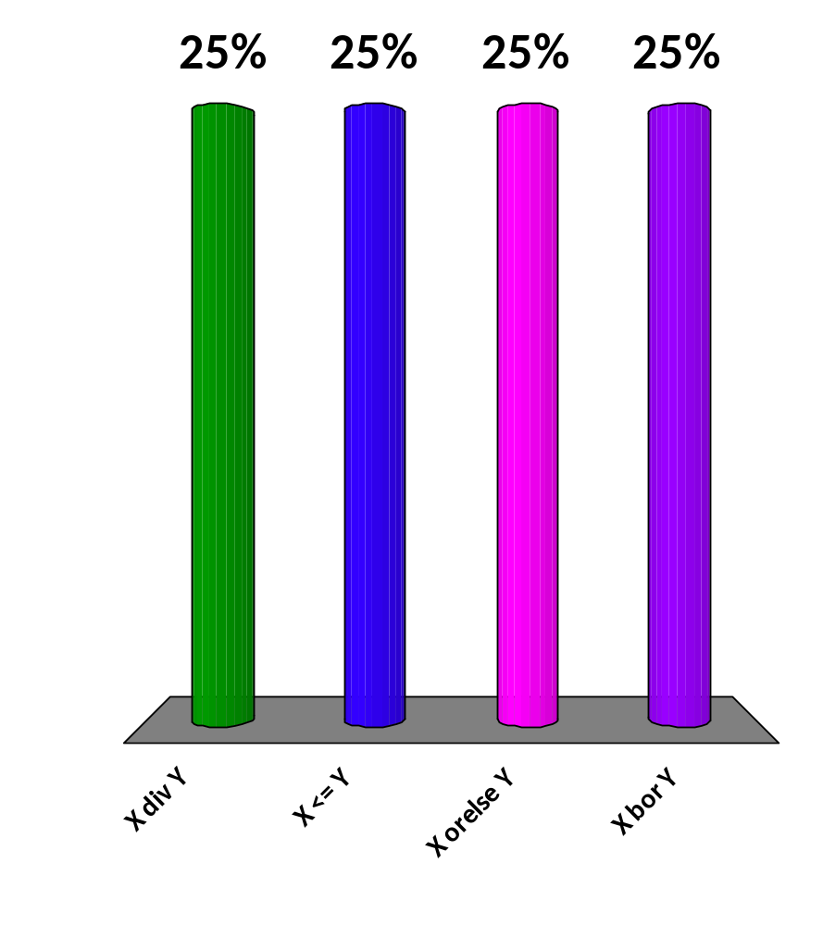
Which of these is not a legal operation?
X div Y
X <= Y
X orelse Y
X bor Y
25

Slide 10
Pattern matching
Pattern matching looks like assignment:
pattern = expression
The pattern may be a constant, a bound or unbound variable, or a structure (such as a list or tuple) containing these
  Example: {ok, Stream} = file:open(FileName, write)
Although pattern matching isn’t assignment, Erlang is one of a number of so-called “single assignment” languages

Slide 11
Case expressions
case Expression of
Pattern1 when Guard1 -> Expression_sequence1;
Pattern2 when Guard2 -> Expression_sequence2;
...
PatternN when GuardN -> Expression_sequenceN
end
The when Guard parts are optional boolean tests
An expression sequence is a sequence of expressions separated by commas
  The value of a case expression is the value of the (one) expression sequence evaluated
  The value of an expression sequence is the value of the last expression evaluated
Semicolons must be exactly as shown: Required after every case except the last, not allowed after the last case

Slide 12
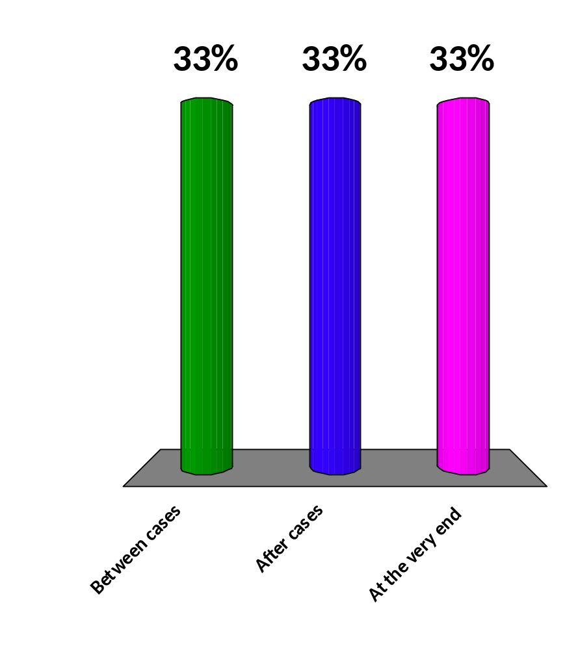
In case expressions, semicolons are used:
Between cases
After cases
At the very end
25

Slide 13
If expressions
if
Guard1 -> Expression_sequence1;
Guard2 -> Expression_sequence2;
...
GuardN -> Expression_sequenceN
end
The value of an if expression is the value of the (one) expression sequence evaluated
In Erlang, every statement must have a value, or it is an error
  Frequently true is used as the last guard
  However, it is good style to use something more explicit than true , if you can easily do so

Slide 14
Guards
Guards may not have side effects
  You cannot use a user-defined function in guards
  You can use type tests, boolean operators, bitwise operators, arithmetic operators, relational operators
  Here is the complete list of functions you can use in guards:
  abs(Number) hd(List)
  node(X) size(TupleOrBinary) element(Integer, Tuple) length(List)
  round(Number) trunc(Number)
  float(Number) node()
  self() tl(List)

Slide 15
Anonymous functions
The syntax for an anonymous function is
fun(Patterns1) -> Body1;
(Patterns2) -> Body2;
...
(PatternsN) -> BodyN
end
Anonymous functions are frequently used as parameters to other functions
Because a function is a value, it can be assigned to a name:
MyFunction = fun … end.

Slide 16
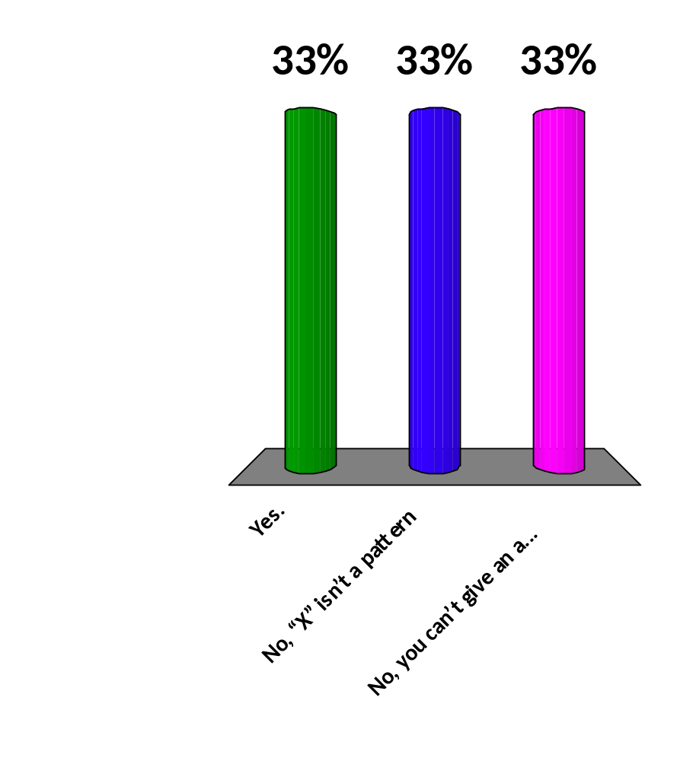
Is the following legal?
Double = fun(X) -> 2 * X.
Yes.
No, “X” isn’t a pattern
No, you can’t give an anonymous function a name.
25

Slide 17
Named functions
The syntax for a named function is a series of one or more clauses:
name(Patterns1) -> Expression_sequence1;
name(Patterns2) -> Expression_sequence2;
...
name(PatternsN) -> Expression_sequenceN.
where
  The name and the arity are the same for each clause
  Clauses are tried in order until one of the parameter lists (sequence of patterns) matches, then the corresponding expression sequence is evaluated
  The value of the function is the value of the expression sequence that is evaluated
  It is an error if no parameter list matches.

Slide 18
List operations
The following list operations are predefined:
  hd(List) -> Element
    Returns the first element of the list
  tl(List) -> List
    Returns the list minus its first element
  length(List) -> Integer
    Returns the length of the list
To use other list functions, either:
  List the functions in an import directive, or
  Prefix each function name with lists:

Slide 19
More list operations
seq(From, To) -> Seq
  Returns a sequence of integers from From to To, inclusive
map(Fun, List1) -> List2
  Takes a function from As to Bs, and a list of As and produces a list of Bs by applying the function to every element in the list
  The evaluation order is implementation dependent
  Example: lists:map(fun(X) -> 2 * X end, [1, 2, 3]). % Result is [2,4,6]
filter(Pred, List1) -> List2
  List2 is a list of all elements Elem in List1 for which Pred(Elem) returns true
  Example: lists:filter(fun(X) -> X =< 3 end, [3, 1, 4, 1, 6]). % Result is [3,1,1]
foldl(Fun, Acc0, List) -> Acc1
  Calls Fun(Elem, AccIn) on successive elements A of List, starting with AccIn == Acc0
  Fun/2 must return a new accumulator which is passed to the next call
  The function returns the final value of the accumulator, orAcc0 is returned if the list is empty
  Example: lists:foldl(fun(X, Y) -> X + 10 * Y end, 0, [1, 2, 3, 4, 5]). % Result is 12345

Slide 20
List comprehensions
A list comprension has the syntax
[Expression || Generator, GuardOrGenerator, ..., GuardOrGenerator]
where
  The Expression typically makes use of variables defined by a Generator
  A Generator provides a sequence of values; it has the form Pattern <- List
  A Guard is a test that determines whether the value will be used in the Expression
  At least one Generator is required; Guards and additional Generators are optional
  Example list comprehension:
  N = [1, 2, 3, 4, 5].
  L = [10 * X + Y || X <- N, Y <- N, X < Y].
  % Result is [12,13,14,15,23,24,25,34,35,45]

Slide 21
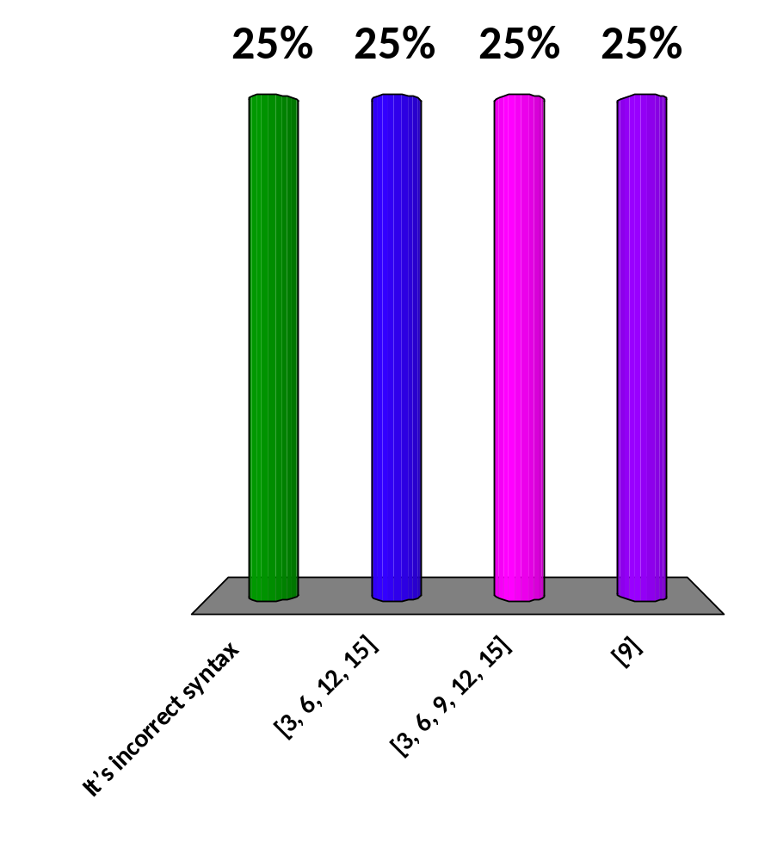
What is the result of
[3 * X || X <- [1, 2, 3, 4, 5], X =/= 3]
?
It’s incorrect syntax
[3, 6, 12, 15]
[3, 6, 9, 12, 15]
[9]
25

Slide 22
Input/Output
Input from the console:
  Line = io:get_line(Prompt).
    An atom is best used as a prompt; returns a string ending in \n
  Term = io:read(Prompt).
    Reads in one Erlang term, which must be terminated with a period
Output to the console:
  io:format(StringToPrint).
  io:format(FormatString, ListOfData).
Input from a file:
  {ok, Stream} = file:open(FileName, read),
  Line = io:get_line(Stream, ''), % May return eof
  file:close(Stream).
Output to a file:
  {ok, Stream} = file:open(FileName, write),
  io:format(Stream, FormatString, ListOfData),
  file:close(Stream).

Slide 23
Format strings
On output, data is interpolated (inserted) into the FormatString at the following locations (excluding ~n):
  ~s Print as a string
  ~w Print any value in "standard syntax“
    Strings are printed as lists of integers
  ~p Pretty print any value (breaking lines, indenting, etc.)
  ~n Print a newline (you can also use \n)
Comments begin with a % and extend to the end of the line

Slide 24
A first example
-module(ex).
-compile(export_all).
factorial(1) -> 1;
factorial(N) -> N * factorial(N - 1).
3> c(ex.erl).
{ok,ex}
4> ex:factorial(10).
3628800
5> ex:factorial(100).
93326215443944152681699238856266700490715968264381621468592963895217599993229915608941463976156518286253697920827223758251185210916864000000000000000000000000
6>

Slide 25
Useful URLs
The Erlang reference manual:
http://www.erlang.org/doc/reference_manual/users_guide.html
OTP Reference Page Index:
http://www.erlang.org/doc/man/
Learn You Some Erlang for Great Good
http://learnyousomeerlang.com/

Slide 26
Header stuff, defining a list
-module(listStuff).
-import(lists, [any/2, map/2, seq/2, seq/3, foldl/3, filter/2, member/2, takewhile/2, dropwhile/2]).
-compile(export_all).
fruit() -> [{apple, red}, {banana, yellow}, {cherry, red}, {pear, yellow},{plum, purple}, {orange, orange}].
24> c(‘listStuff').
  {ok,listStuff}
25> listStuff:fruit().
  [{apple,red},
  {banana,yellow},
  {cherry,red},
  {pear,yellow},
  {plum,purple},
  {orange,orange}]
Program code is in blue
Commands entered in shell are black
Output results are brown

Slide 27
filter
26> lists:filter(fun(X) -> X rem 3 =:= 0 end,
lists:seq(1, 50)).
  [3,6,9,12,15,18,21,24,27,30,33,36,39,42,45,48]
fruit_by_color(Color) ->
filter(fun({_, C}) -> C =:= Color end, fruit()).
28> listStuff:fruit_by_color(red).
  [{apple,red},{cherry,red}]

Slide 28
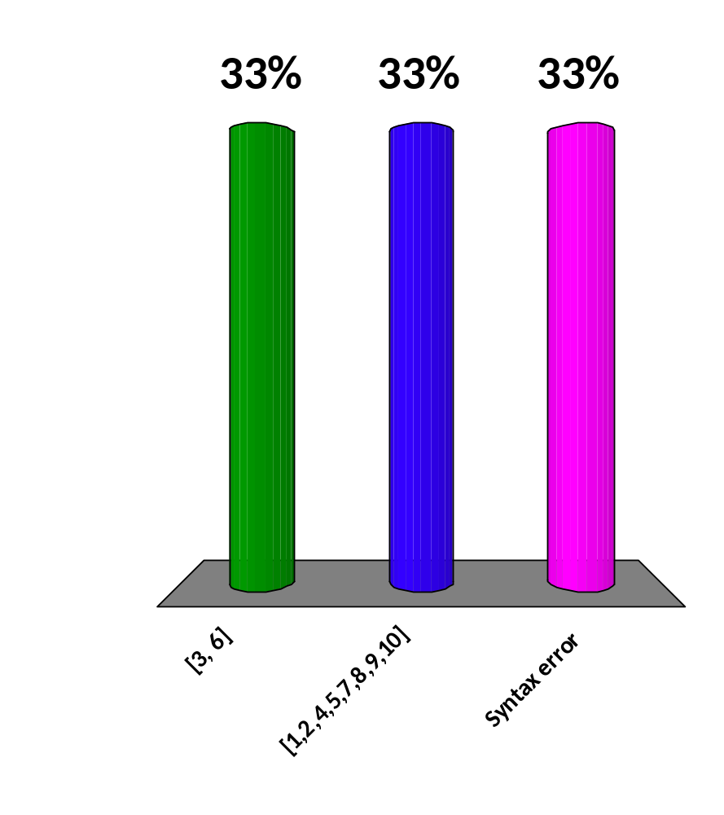
What is the result of: lists:filter(fun(X) -> (X /= 3) and (X /= 6) end, lists:seq(1, 10)).
?
[3, 6]
[1,2,4,5,7,8,9,10]
Syntax error
25

Slide 29
map
extract_fruit() ->
map(fun({F, _}) -> F end, fruit()).
30> listStuff:extract_fruit().
  [apple,banana,cherry,pear,plum,orange]
31> List = listStuff:fruit().
  [{apple,red}, ..., {orange,orange}]
extract_fruit(List) ->
map(fun({F, _}) -> F end, List).
32> listStuff:extract_fruit(List).
  [apple,banana,cherry,pear,plum,orange]

Slide 30
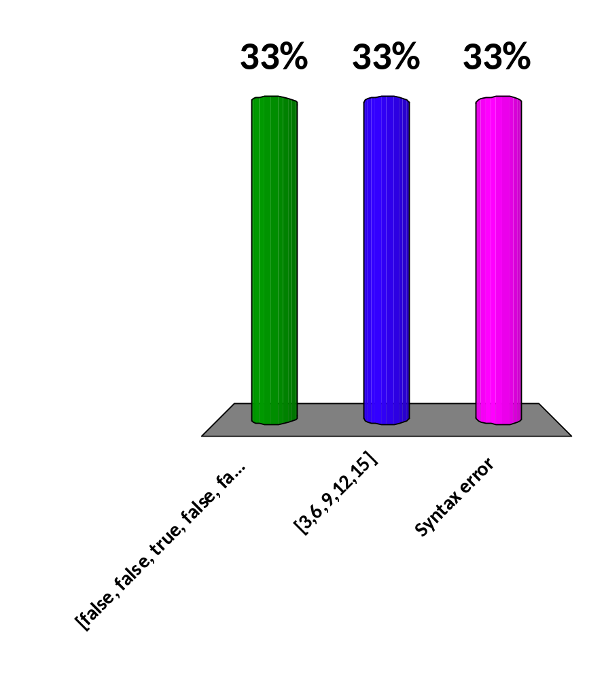
What is the result of: lists:map(fun(X) -> 3 * X end, lists:seq(1, 5))
?
[false, false, true, false, false]
[3,6,9,12,15]
Syntax error
25

Slide 31
filter and map
red_fruit() ->
extract_fruit(fruit_by_color(red)).
33> listStuff:red_fruit().
  [apple,cherry]
yellow_fruit() ->
Yellows = filter(fun({_, C}) -> C =:= yellow end, fruit()),
map(fun({F, _}) -> F end, Yellows).
35> listStuff:yellow_fruit().
  [banana,pear]
orange_fruit() ->
map(fun({F, _}) -> F end,
filter(fun({_, C}) -> C =:= orange end, fruit())).
39> listStuff:orange_fruit().
  [orange]

Slide 32
Using previously defined functions
is_red({_, red}) -> true;
is_red(_) -> false.
Using is_red from within the program:
get_red() -> filter(fun is_red/1, fruit()).
Using is_red from the Erlang shell:
51> lists:filter(fun listStuff:is_red/1, List).
Either way, the result is
[{apple,red},{cherry,red}]

Slide 33
List comprehensions
3> List = listStuff:fruit().
  [{apple,red}, ..., {orange,orange}]
4> [F || {F, _} <- List].
  [apple,banana,cherry,pear,plum,orange]
6> [F || {F, C} <- List, C =:= yellow].
  [banana,pear]
7> [F || {F, C} <- List, C =/= yellow, C =/= red].
[plum,orange]

Slide 34
Numeric list comprehensions
Reminder: Strings are stored as lists of ASCII values
9> [Ch || Ch <- lists:seq(65, 70)].
  "ABCDEF"
13> [X || X <- lists:seq(10, 120, 10)].
  [10,20,30,40,50,60,70,80,90,100,110,120]
15> [X || X <- lists:seq(40, 120, 10)].
  "(2<FPZdnx"

Slide 35
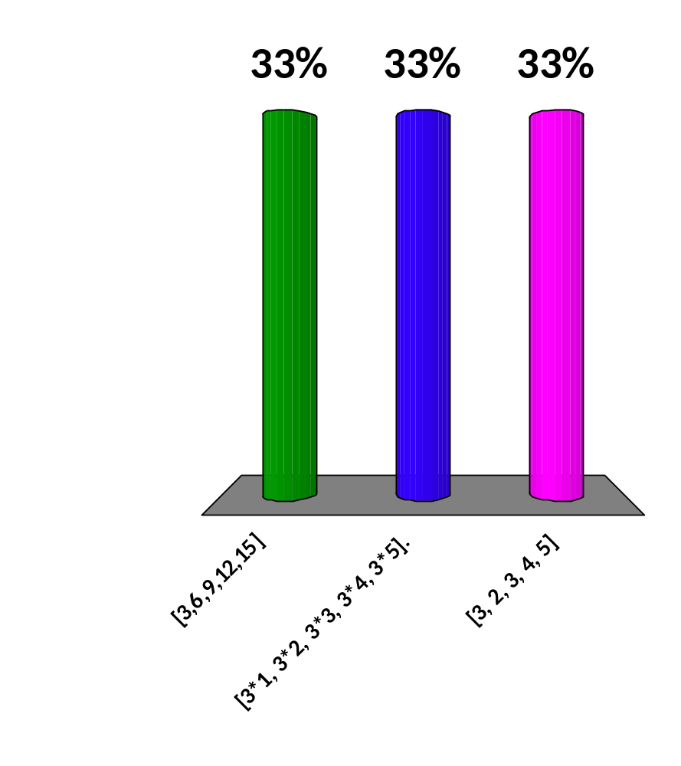
What is the result of
[3 * X || X <- lists:seq(1, 5)].
?
[3,6,9,12,15]
[3*1, 3*2, 3*3, 3*4, 3*5].
[3, 2, 3, 4, 5]
25

Slide 36
More list comprehensions
16> [X * X || X <- lists:seq(1, 5)].
  [1,4,9,16,25]
17> [[X, X * X] || X <- lists:seq(1, 5)].
  [[1,1],[2,4],[3,9],[4,16],[5,25]]
20> [[X, X * X] || X <- lists:seq(1, 5)].
  [[1,1],[2,4],[3,9],[4,16],[5,25]]
21> [[X, X * X] || X <- lists:seq(6, 10)].
  [[6,36],[7,49],"\b@","\tQ","\nd"]

Slide 37
Multiple generators
1> [[X, Y] || X <- lists:seq(1, 3),
Y <- lists:seq(2, 4)].
  [[1,2],[1,3],[1,4],[2,2],[2,3],[2,4],[3,2],[3,3],[3,4]]
3> [[X, Y] || X <- lists:seq(1, 3),
Y <- lists:seq(1, 5), Y > X].
  [[1,2],[1,3],[1,4],[1,5],[2,3],[2,4],[2,5],[3,4],[3,5]]

Slide 38
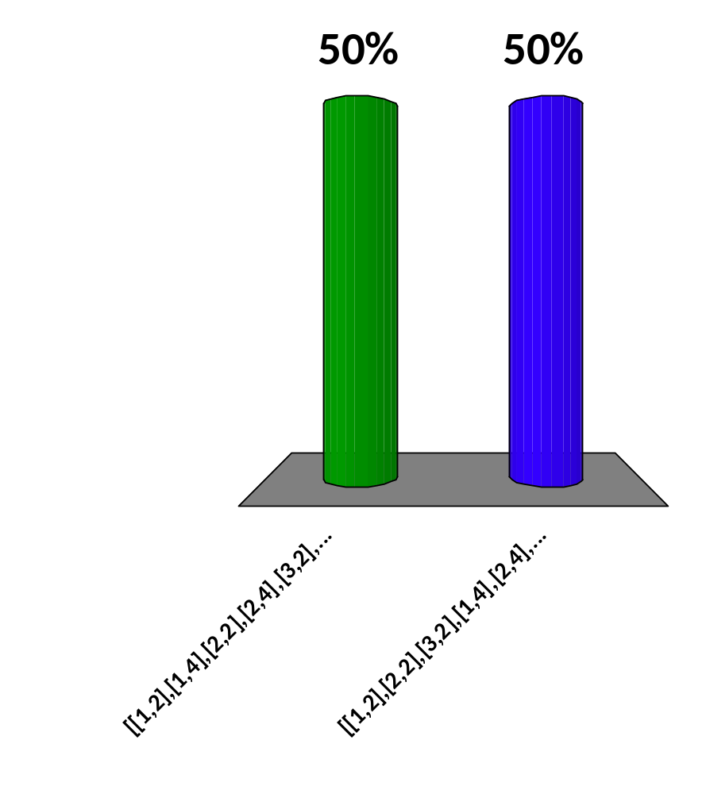
What is the result of
[[X, Y] || X <- lists:seq(1, 3),
Y <- lists:seq(2, 4),
Y /= 3].
?
[[1,2],[1,4],[2,2],
[2,4],[3,2],[3,4]]
[[1,2],[2,2],[3,2],
[1,4],[2,4],[3,4]]
25

Slide 39
List functions I
3> List = lists:seq(1, 10).
  [1,2,3,4,5,6,7,8,9,10]
4> hd(List).
  1
5> tl(List).
  [2,3,4,5,6,7,8,9,10]
6> length(List).
  10
7> lists:all(fun(X) -> X rem 2 =:= 0 end, List).
  false
8> lists:any(fun(X) -> X rem 2 =:= 0 end, List).
  true

Slide 40
List functions II
9> lists:append(List, [abc, xyz]).
  [1,2,3,4,5,6,7,8,9,10,abc,xyz]
11> lists:takewhile(fun(X) -> X =< 5 end, List).
  [1,2,3,4,5]
12> lists:dropwhile(fun(X) -> X =< 5 end, List).
  [6,7,8,9,10]
13> lists:zip(List, "abcdefg").
  ** exception error: no function clause matching lists:zip("\b\t\n",[])
  in function lists:zip/2
14> lists:zip(List, "abcdefghij").
  [{1,97},
  {2,98},
  {3,99},
  {4,100},
  {5,101},
  {6,102},
  {7,103},
  {8,104},
  {9,105},
  {10,106}]

Slide 41
List functions III
15> lists:partition(fun(X) -> X < 5 end, List).
  {[1,2,3,4],[5,6,7,8,9,10]}
16> lists:partition(fun(X) -> X rem 2 =:= 0 end, List).
  {[2,4,6,8,10],[1,3,5,7,9]}
17> lists:reverse(List).
  [10,9,8,7,6,5,4,3,2,1]
18> lists:foldl(fun(X, Y) -> X + Y end, 0, List).
  55
19> lists:foldl(fun(X, Y) -> X * Y end, 1, List).
  3628800

Slide 42
Loops vs. higher-order functions I
Suppose you want to test whether all the elements of a list of integers are odd
  Java:
  boolean allOdd = true;
  for (int i : mylist) {
  if (i % 2 == 0) {
  allOdd = false;
  break;
  }
  }
  Erlang:
  lists:all(fun(X) -> X rem 2 /= 0 end, mylist).
Now suppose you want to test whether all the list elements are less than 100
  Java: Repeat the logic
  Erlang: Replace the function

Slide 43
Loops vs. higher-order functions II
Suppose you want collect all the positive integers at the beginning of a list, stopping at the first zero or negative number
  Java:
  List<Integer> atFront = new LinkedList<>();
  for (int i : list) {
  if (i > 0) {
  atFront.add(i);
  } else break;
  }
  Erlang:
  lists:takewhile(fun(X) -> X > 0 end, mylist).

Slide 44
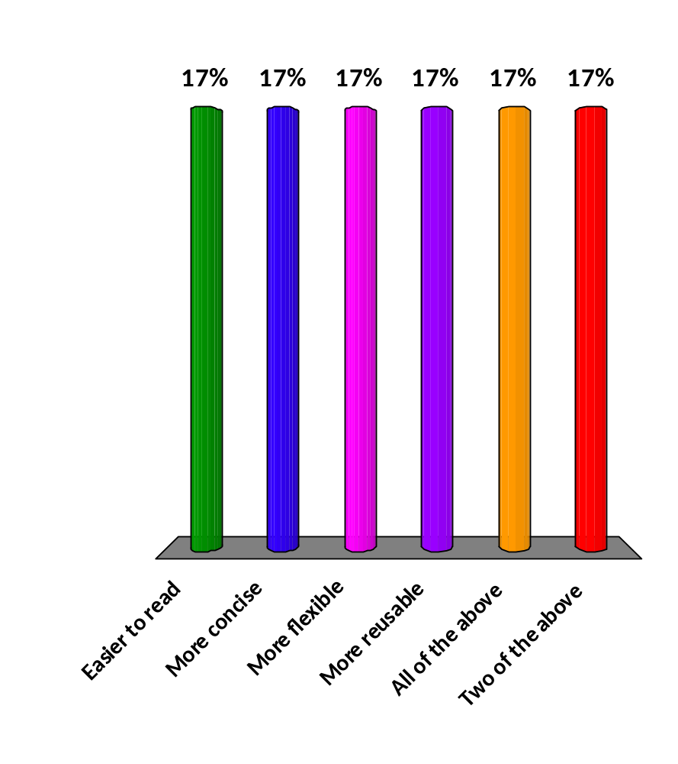
Where possible, loops should be replaced by calls to higher-order functions, because higher-order function calls are:
Easier to read
More concise
More flexible
More reusable
All of the above
Two of the above
25

Slide 45
Quicksort
-module(qsort).
-import(lists, [append/2]).
-compile(export_all).
quicksort([]) -> [];
quicksort([H | T]) ->
quicksort( [ X || X <- T, X < H ]) ++
[H] ++
quicksort([ X || X <- T, X >= H ]).
9> qsort:quicksort([3, 1, 4, 1, 5, 9, 2, 6, 5, 3, 6]).
  [1,1,2,3,3,4,5,5,6,6,9]

Slide 46
Messages
The state of a program is the set of globally accessible variables which may be modified as the program runs
A major source of errors in concurrent programs is shared state—variables that may be modified by more than one thread
Erlang has no state—no global variables—so all these problems go away
In Erlang, concurrency is done by passing messages between actors (very lightweight processes)

Slide 47
spawn
Pid = spawn(Function) creates and starts a new process whose job it is to evaluate the given function
  Pid is a process identifier
  The Function may be an anonymous function
    fun(args) -> expressions end
  The Function may be a named function
    fun FunctionName/Arity
Pid = spawn(Module, Function, Arguments) creates and starts a new process whose job it is to evaluate the function from the named module with the given arguments

Slide 48
!
To send a message to a process, use the “send” primitive, !
  Pid ! message
  The message is sent asynchronously, that is, the sending process does not wait for a reply, but continues execution
  The message will (eventually) be received by the process Pid, if and when it executes a receive statement
If a response is required, this is done by having the other process send a message back, to be received by this process
  For this to happen, the other process must know the Pid of this process
  The self() method returns the Pid of the executing process
  Thus, it is common to include one’s own Pid in the message
    Pid ! {self(), more_message}

Slide 49
receive
The syntax of receive is similar to that of case
case Expression of
Pattern1 when Guard1 -> Expression_sequence1;
Pattern2 when Guard2 -> Expression_sequence2;
...
PatternN when GuardN -> Expression_sequenceN
end
receive
Pattern1 when Guard1 -> Expression_sequence1;
Pattern2 when Guard2 -> Expression_sequence2;
...
PatternN when GuardN -> Expression_sequenceN
end
In both case and receive, the guards are optional
In both case and receive, the final pattern may be an _ “wildcard”

Slide 50
Receiving messages
Each process has a “mailbox” into which messages are put, in the order in which they are received
When a process executes a receive command,
  If its mailbox is empty, it will block and wait for a message
  If the mailbox is not empty, it will take the first message, find the first pattern that matches that message, and execute the corresponding code
  If no pattern matches the message, the receive statement blocks waiting for the next message
    The unmatched message is set aside for future use
    Message ordering in this case is slightly complicated; you can avoid the complications by ensuring that every message is matched

Slide 51
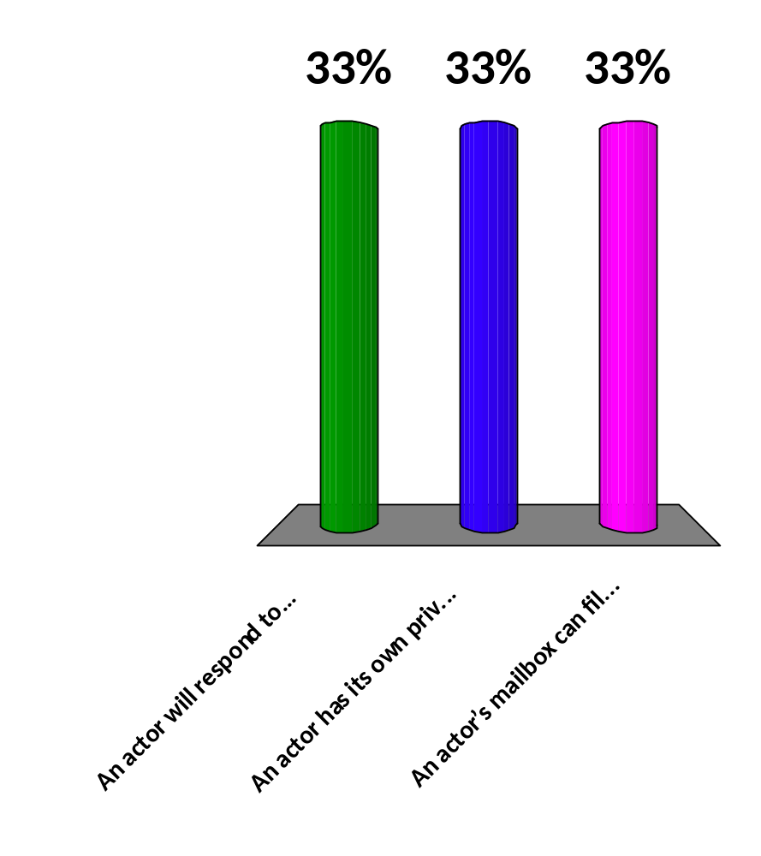
Which of the following statements is not true?
An actor will respond to messages in the order they were sent
An actor has its own private storage
An actor’s mailbox can fill up with unhandled messages
25

Slide 52
An area server
-module(area_server0).
-export([loop/0]).
loop() ->
receive
{rectangle, Width, Ht} ->
io:format("Area of rectangle is ~p~n",[Width * Ht]),
loop();
{circle, R} ->
io:format("Area of circle is ~p~n", [3.14159 * R * R]),
loop();
Other ->
io:format("I don't know what the area of a ~p is ~n",[Other]),
loop()
end.
6> c(area_server0).
{ok,area_server0}
7> Pid = spawn(fun area_server0:loop/0).
<0.54.0>
8> Pid ! {rectangle, 6, 10}.
Area of rectangle is 60
    From: Programming Erlang, Joe Armstrong, p. 135

Slide 53
An improved area server
-module(area_server2).
-export([loop/0, rpc/2]).
rpc(Pid, Request) ->
Pid ! {self(), Request},
receive
{Pid, Response} ->
Response
end.
loop() ->
receive
{From, {rectangle, Width, Ht}} ->
From ! {self(), Width * Ht},
loop();
{From, {circle, R}} ->
From ! {self(), 3.14159 * R * R},
loop();
{From, Other} ->
From ! {self(), {error,Other}},
loop()
end.
    From: Programming Erlang, Joe Armstrong, p. 139
17> c(area_server2).
{ok,area_server1}
18> Pid = spawn(fun area_server2:loop/0).
<0.84.0>
19> area_server2:rpc(Pid, {circle, 10}).
314.159

Slide 54
Ping pong
-module(tut15).
-export([start/0, ping/2, pong/0]).
ping(0, Pong_PID) ->
Pong_PID ! finished,
io:format("ping finished~n", []);
ping(N, Pong_PID) ->
Pong_PID ! {ping, self()},
receive
pong ->
io:format("Ping received pong~n",
[])
end,
ping(N - 1, Pong_PID).
pong() ->
receive
finished ->
io:format("Pong finished~n", []);
{ping, Ping_PID} ->
io:format("Pong received ping~n",
[]),
Ping_PID ! pong,
pong()
end.
start() ->
Pong_PID = spawn(tut15, pong, []),
spawn(tut15, ping, [3, Pong_PID]).
From: http://www.erlang.org/doc/getting_started/conc_prog.html

Slide 55
Using the ping-pong program
11> c(tut15).
{ok,tut15}
12> tut15:start().
Pong received ping
<0.65.0>
Ping received pong
Pong received ping
Ping received pong
Pong received ping
Ping received pong
ping finished
Pong finished

Slide 56
A misuse of Erlang
-module(abuse).
-compile(export_all).
start() ->
Pid = spawn(abuse, accumulate, [0]),
Pid ! {add, 3},
Pid ! {add, 4},
Pid ! {add, 1},
Pid ! print.
accumulate(X) ->
io:format("In accumulate/1 with ~p.~n", [X]),
receive
{add, N} -> accumulate(X + N);
print -> io:format("I got: ~p~n", [X])
end.
20> c(abuse).
{ok,abuse}
21> abuse:start().
In accumulate/1 with 0.
print
In accumulate/1 with 3.
In accumulate/1 with 7.
In accumulate/1 with 8.
I got: 8

Slide 57
Getting an answer back
-module(abuse).
-compile(export_all).
start() ->
Pid = spawn(abuse, accumulate, [0]),
Pid ! {self(), add, 3},
Pid ! {self(), add, 4},
Pid ! {self(), add, 1},
Pid ! {self(), result},
receive
Sum -> io:format("I got: ~p~n", [Sum])
end.
accumulate(X) ->
io:format("In accumulate/1 with ~p.~n", [X]),
receive
{_, add, N} -> accumulate(X + N);
{Pid, result} -> Pid ! X
end.
15> c(abuse).
{ok,abuse}
16> abuse:start().
In accumulate/1 with 0.
In accumulate/1 with 3.
In accumulate/1 with 7.
In accumulate/1 with 8.
I got: 8
ok

Slide 58
receive with timeout
receive
Pattern1 [when Guard1] -> Expression_sequence1;
Pattern2 [when Guard2] -> Expression_sequence2;
...
PatternN [when GuardN] -> Expression_sequenceN
after Timeout ->
TimeoutExpressionSequence
end
  A positive Timeout will cause Erlang to execute the TimeoutExpressionSequence if no message is received within that number of milliseconds.
  A zero Timeout will cause Erlang to handle a matching message, if any, then immediately execute the TimeoutExpressionSequence.
  A Timeout of the atom infinity will cause the TimeoutExpressionSequence to never be executed.
  If there are no patterns between receive and after, the statement "sleeps" for the given number of milliseconds.

Slide 59
Example with timeout
-module(speak_up).
-export([start/0]).
start() ->
Pid = spawn_link(fun listen/0),
talk(Pid).
talk(Pid) ->
Line = io:get_line('Say something: '),
Pid ! Line,
talk(Pid).
listen() ->
receive
"quit\n" -> exit('You said to quit!');
Words -> io:format("You said: ~s", [Words])
after 10000 ->
io:format("You didn't say anything.~n")
end,
listen().
10> c(speak_up).
{ok,speak_up}
11> speak_up:start().
Say something: Hello.
You said: Hello.
Say something: Yada yada
You said: Yada yada
You didn't say anything.
Say something: Go away!
You said: Go away!
Say something: quit
** exception exit: 'You said to quit!'

Slide 60
Registering processes
You can register a Pid, making it globally available
  register(AnAtom, Pid) -- gives the Pid a globally accessible “name,” AnAtom
  unregister(AnAtom) -- removes the registration; if a registered process dies, it is automatically unregistered
  whereis(AnAtom) -> Pid | undefined -- gets the Pid of a registered process, or undefined if no such process
  registered() -> [AnAtom :: atom()] -- returns a list of all registered processes

Slide 61
try...catch
Erlang has a try...catch statement...
receive FunctionOrExpressionSequence of
Pattern1 when Guard1 -> Expression_sequence1;
Pattern2 when Guard2 -> Expression_sequence2;
...
PatternN when GuardN -> Expression_sequenceN
catch
ExceptionType: ExPattern1 when ExGuard1 -> ExExpressions1;
...
ExceptionType: ExPatternN when ExGuardN -> ExExpressionsN
after
AfterExpressions
end
...but it isn’t used much

Slide 62
Linking processes
You can link two processes--this means, if one process dies, the other receives an exit signal
  Linking is symmetric; if A is linked to B, B is linked to A
  If a “normal” process receives an exit signal, it too will exit
You can make a process into a system process by calling process_flag(trap_exit, true)
  A system process receives an exit signal as an ordinary message of the form {‘EXIT’, Pid, Reason}
  Exception: if the Reason is kill, the receiving process will also die, even if it is a system process
    This is to make it possible to delete “rogue” processes

Slide 63
How to link processes
link(Pid) will link the current process to the existing process Pid
  unlink(Pid) will remove the link
Pid = spawn_link(Function) will create a new process and link it to the current process
exit(Reason) will terminate the current process with the given reason; an exit signal is sent to linked processes
exit(Pid, Reason) will send an exit to the given process, but does not terminate the current process
If you want a process to be a system process, you should call process_flag(trap_exit, true) before linking it to another process, because that other process may be “Dead on Arrival”

Slide 64
“Let it crash”
Erlang programs can achieve extreme reliability, not by never crashing, but by recovering after crashes
  spawn(Function) creates a process, and “doesn’t care” if that process crashes
  spawn_link(Function) creates a process, and exits if that process crashes with a non-normal exit
  process_flag(trap_exit, true), spawn_link(Function) creates a process, and receives an exit message if that process crashes
This is the mechanism usually used instead of try...catch

Slide 65
Recursion
As Erlang has no loops, recursion is used heavily
A server process usually has this form:
  loop() ->
  receive
  Something ->
  Take_some_action,
  loop();
  Something_else ->
  Take_some_other_action,
  loop();
  end.
Notice that the recursive call is always the last thing done in the function
  When this condition holds, the function is tail recursive

Slide 66
Supporting recursion
factorial(1) -> 1;
factorial(N) -> N * factorial(N - 1).
If you call X = factorial(3), this enters the factorial method with N=3 on the stack
| factorial calls itself, putting N=2 on the stack
| | factorial calls itself, putting N=1 on the stack
| | factorial returns 1
| factorial has N=2, computes and returns 2*1 = 2
factorial has N=3, computes and returns 3*2 = 6
Eventually, a recursion can use up all available memory and crash

Slide 67
Why tail recursion?
The compiler can replace tail recursion with a loop (but you can’t)
loop() ->
receive
Something ->
Take_some_action,
loop();
Something_else ->
Take_some_other_action,
loop();
end.
loop() ->
while (true) {
receive
Something ->
Take_some_action;
Something_else ->
Take_some_other_action;
end
}
With tail recursion, you never run out of stack space, so the above kind of “infinite loop” is okay

Slide 68
Making functions tail recursive
There is a simple trick for making many functions tail recursive
  The idea is to use a second, helper function with an “accumulator” parameter
% Usual definition, no tail recursion
factorial(1) -> 1;
factorial(N) -> N * factorial(N - 1).
% Improved version, tail recursion
tail_factorial(N) -> tail_factorial(N,1).
tail_factorial(0, Acc) -> Acc;
tail_factorial(N, Acc) when N > 0 ->
tail_factorial(N - 1, N * Acc).
However, the “improvement” seriously reduces readability!
Learn You Some Erlang for Great Good has an excellent section on introducing tail recursion

Slide 69

Questions?

