Slide 1

J . P . M O R G A N C H A S E A N D C O L U M B I A C O M S W 4 1 5 6
Ewan Lowe
Ewan@cs.Columbia.Edu
September 2016

Slide 2
This presentation was prepared exclusively for the benefit and internal use of the J.P. Morgan client to whom it is directly addressed and delivered (including such client’s subsidiaries, the “Company”) in order to assist the Company in evaluating, on a preliminary basis, the feasibility of a possible transaction or transactions and does not carry any right of publication or disclosure, in whole or in part, to any other party. This presentation is for discussion purposes only and is incomplete without reference to, and should be viewed solely in conjunction with, the oral briefing provided by J.P. Morgan. Neither this presentation nor any of its contents may be disclosed or used for any other purpose without the prior written consent of J.P. Morgan.
The information in this presentation is based upon any management forecasts supplied to us and reflects prevailing conditions and our views as of this date, all of which are accordingly subject to change. J.P. Morgan’s opinions and estimates constitute J.P. Morgan’s judgment and should be regarded as indicative, preliminary and for illustrative purposes only. In preparing this presentation, we have relied upon and assumed, without independent verification, the accuracy and completeness of all information available from public sources or which was provided to us by or on behalf of the Company or which was otherwise reviewed by us. In addition, our analyses are not and do not purport to be appraisals of the assets, stock, or business of the Company or any other entity. J.P. Morgan makes no representations as to the actual value which may be received in connection with a transaction nor the legal, tax or accounting effects of consummating a transaction. Unless expressly contemplated hereby, the information in this presentation does not take into account the effects of a possible transaction or transactions involving an actual or potential change of control, which may have significant valuation and other effects.
Notwithstanding anything herein to the contrary, the Company and each of its employees, representatives or other agents may disclose to any and all persons, without limitation of any kind, the U.S. federal and state income tax treatment and the U.S. federal and state income tax structure of the transactions contemplated hereby and all materials of any kind (including opinions or other tax analyses) that are provided to the Company relating to such tax treatment and tax structure insofar as such treatment and/or structure relates to a U.S. federal or state income tax strategy provided to the Company by J.P. Morgan. J.P. Morgan's policies on data privacy can be found at http://www.jpmorgan.com/pages/privacy.
J.P. Morgan’s policies prohibit employees from offering, directly or indirectly, a favorable research rating or specific price target, or offering to change a rating or price target, to a subject company as consideration or inducement for the receipt of business or for compensation. J.P. Morgan also prohibits its research analysts from being compensated for involvement in investment banking transactions except to the extent that such participation is intended to benefit investors.
IRS Circular 230 Disclosure: JPMorgan Chase & Co. and its affiliates do not provide tax advice. Accordingly, any discussion of U.S. tax matters included herein (including any attachments) is not intended or written to be used, and cannot be used, in connection with the promotion, marketing or recommendation by anyone not affiliated with JPMorgan Chase & Co. of any of the matters addressed herein or for the purpose of avoiding U.S. tax-related penalties.
J.P. Morgan is the marketing name for the Corporate and Investment Banking activities of JPMorgan Chase Bank, N.A., JPMS (member, NYSE), J.P. Morgan PLC authorized by the Prudential Regulation Authority and regulated by the Financial Conduct Authority and the Prudential Regulation Authority and their investment banking affiliates.
This presentation does not constitute a commitment by any J.P. Morgan entity to underwrite, subscribe for or place any securities or to extend or arrange credit or to provide any other services.
Copyright 2014 JPMorgan Chase & Co. All rights reserved.
J . P . M O R G A N C H A S E A N D C O L U M B I A C O M S W 4 1 5 6

Slide 3




Quick Introduction
Head of Architecture for Macro @ J.P. Morgan
Software Engineer
J . P . M O R G A N C H A S E A N D C O L U M B I A C O M S W 4 1 5 6
Strava addict
1

Slide 4
Motivation
Why is this course one of the most important experiences of a computer science education?
Software is [still] eating the world
Producing beautiful product is intensely rewarding
… but not without its challenges
1
2
J . P . M O R G A N C H A S E A N D C O L U M B I A C O M S W 4 1 5 6
3
2

Slide 5
Agenda
✓
Electronic Trading Introduction
Engineering Challenges
Rewarding
Group Project
J . P . M O R G A N C H A S E A N D C O L U M B I A C O M S W 4 1 5 6
3

Slide 6

Electronic Trading: Markets
Will convince you that you are already trading experts
Market = Structure + Transactions + Participants
‘Market Data’ (prices + transactions)
Market place
J . P . M O R G A N C H A S E A N D C O L U M B I A C O M S W 4 1 5 6
Requests
Participants
Rules
Transactions
4

Slide 7
Electronic Trading
Capital Markets: manage flow of capital from those with excess to those with productive uses
‘Market Data’ (prices + transactions)
Market place
J . P . M O R G A N C H A S E A N D C O L U M B I A C O M S W 4 1 5 6
Requests
Clients
Participants
Rules
Transactions
5

Slide 8
Agenda
Electronic Trading Introduction
✓
Engineering Challenges
Rewarding
Group Project
J . P . M O R G A N C H A S E A N D C O L U M B I A C O M S W 4 1 5 6
6

Slide 9
Sample Engineering Challenges
Methodology
Requirements
Architecture
Availability
Testing
Production
Data Engineering
J . P . M O R G A N C H A S E A N D C O L U M B I A C O M S W 4 1 5 6
7

Slide 10
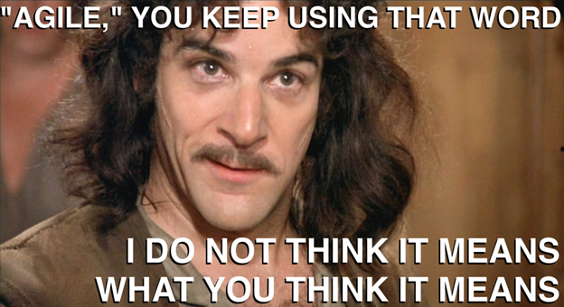
Quick word on ‘Bad Agile’
J . P . M O R G A N C H A S E A N D C O L U M B I A C O M S W 4 1 5 6
8

Slide 11

Testing
J . P . M O R G A N C H A S E A N D C O L U M B I A C O M S W 4 1 5 6
9

Slide 12
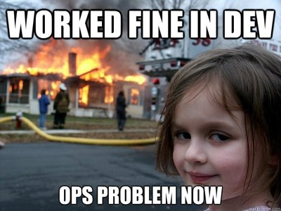
Operations
J . P . M O R G A N C H A S E A N D C O L U M B I A C O M S W 4 1 5 6
10

Slide 13

Welcome to life in software engineering …
Touched upon a few topics
Many many more …
Technology and sociology keep evolving
J . P . M O R G A N C H A S E A N D C O L U M B I A C O M S W 4 1 5 6
Develop fundamental understanding to apply / tailor to different projects
11

Slide 14
Agenda
Electronic Trading Introduction
Engineering Challenges
✓
Rewarding
Group Project
J . P . M O R G A N C H A S E A N D C O L U M B I A C O M S W 4 1 5 6
12

Slide 15
Why is it rewarding?
Interesting Problem Domain
Impact
Engineering Challenges
Team
J . P . M O R G A N C H A S E A N D C O L U M B I A C O M S W 4 1 5 6
13

Slide 16
Agenda
Electronic Trading Introduction
Engineering Challenges
Rewarding
✓
Group Project
J . P . M O R G A N C H A S E A N D C O L U M B I A C O M S W 4 1 5 6
14

Slide 17
J.P. Morgan Group Project
J.P. Morgan are supplying a group project with the aim of providing a realistic experience and support/mentoring
We will Provide
Experience/Opportunity
Electronic trading business problem
Some source code
Simulate the customer
Overview of electronic trading
Mentoring on software engineering
Very realistic experience
‘Customer’ & requirements elicitation
Learn a problem domain
10 weeks to build a solution over 2/3 development iterations
Build a functional product
Present to set of senior technologists
Awards for best project
J . P . M O R G A N C H A S E A N D C O L U M B I A C O M S W 4 1 5 6
15

Slide 18
Key Dates
Introduction
Red / blue pill offer
Setup time to answer questions
Work together on building product
15th Sept
15th -22nd Sept
22nd Sept
22nd Sept to 12th Dec
12th Dec
J . P . M O R G A N C H A S E A N D C O L U M B I A C O M S W 4 1 5 6
Choose enrollment in the J.P. Morgan group project
Demo day to senior technologists from J.P. Morgan
Awards to the top team(s) (JPM & self directed projects)
16

Slide 19
Questions
J . P . M O R G A N C H A S E A N D C O L U M B I A C O M S W 4 1 5 6
17

