Slide 1
Final capstone presentation 2023
New York University Shanghai
Kexin Deng
Double Major Business & Finance and Data Science
The Impact of the COVID-19 Pandemic on Chinese Mutual Funds Investors
Presented by Kexin Deng
Mentored by Yiqing Lv
Notes:
Hello everyone welcome to my senior capstone project positioning presentation my name is Kexin Deng and my capstone research is The Impact of the COVID-19 Pandemic on Chinese Mutual Funds Investors.

Slide 2
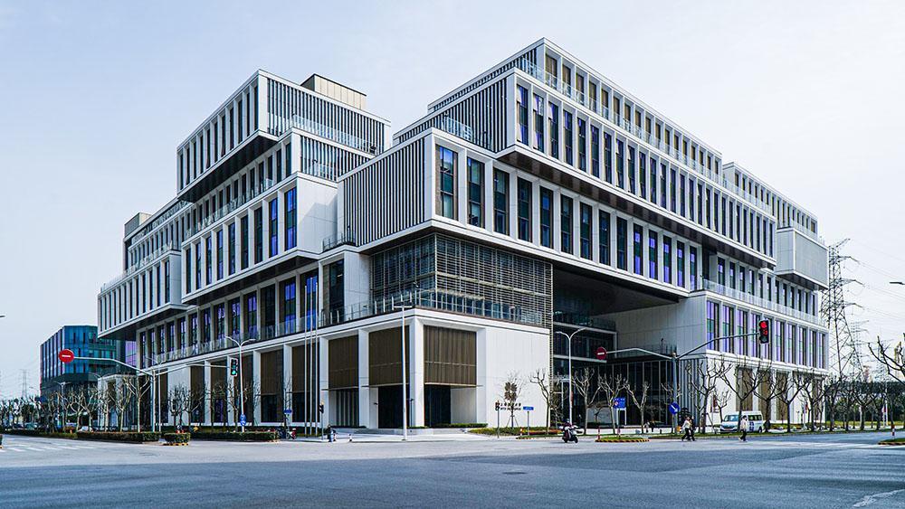
Motivation and research question
Motivation:
Limited prior research on how COVID-19 affects investment and consumption behavior, especially for individual investors.
Understanding these dynamics is crucial for addressing the current pandemic and improving decision-making in the face of future shocks.
Research question:
Do investors’ consumption and reinvestment responses differ before and after the pandemic?
Do these responses also vary across investors of different wealth levels before and after the pandemic, and considering city-wise pandemic severity?
Motivation and research question
Data and Methodology
Key related works
Key findings
Significance
Q&A
Notes:
The impact of COVID-19 spans various aspects of our lives, and its influence
on investment and consumption behavior, particularly for individual investors,
remains to be seen by the public with limited prior research. However, under-
standing these dynamics is crucial for addressing the current pandemic and
enhancing decision-making in the face of future shocks. In this data science
capstone project, I explore consumption and investment responses during the
COVID-19 pandemic and their profound influence on the behavior of Chinese
mutual fund investors. This research aims to address the following research
questions. Do investors’ consumption and reinvestment responses differ before
and after the pandemic? The question can be broken down to each type of
response, like netflow, turnover, rebalancing, timing, etc. Do these responses
also vary across investors of different wealth levels/ holdings before and after
the pandemic? Using retail investors’ data on the Alipay platform, we con-
nect the investment and consumption from a micro-level investor perspective
that unravels the connections between financial literacy and investor behavior,
considering geographical and temporal dimensions. This project makes up for
the gap in the current literature landscape. It is the first to deal with such a
question; thus, the results are meaningful to Alipay, policy-makers, and the
broader academic and industry realm.

Slide 3

Data and Methodology
Data Source and variables:
Many thanks to data from the Alipay AntFin Open Research Laboratory.
Data across 200,000 investors
Spanning 2019 to 2020
Including report month, fund code, account ID, fund holding amounts, capital gains, dividends, and investors’ monthly consumption amounts.
Methodology:
Employed two-way fixed effects and difference-in-differences analyses
Motivation and research question
Data and Methodology
Key related works
Key findings
Significance
Q&A
Notes:
The impact of COVID-19 spans various aspects of our lives, and its influence
on investment and consumption behavior, particularly for individual investors,
remains to be seen by the public with limited prior research. However, under-
standing these dynamics is crucial for addressing the current pandemic and
enhancing decision-making in the face of future shocks. In this data science
capstone project, I explore consumption and investment responses during the
COVID-19 pandemic and their profound influence on the behavior of Chinese
mutual fund investors. This research aims to address the following research
questions. Do investors’ consumption and reinvestment responses differ before
and after the pandemic? The question can be broken down to each type of
response, like netflow, turnover, rebalancing, timing, etc. Do these responses
also vary across investors of different wealth levels/ holdings before and after
the pandemic? Using retail investors’ data on the Alipay platform, we con-
nect the investment and consumption from a micro-level investor perspective
that unravels the connections between financial literacy and investor behavior,
considering geographical and temporal dimensions. This project makes up for
the gap in the current literature landscape. It is the first to deal with such a
question; thus, the results are meaningful to Alipay, policy-makers, and the
broader academic and industry realm.

Slide 4
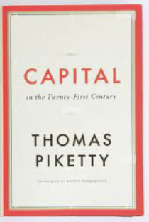
Motivation and research question
Data and Methodology
Key related works
Key findings
Significance
Q&A
Key Related Work
Income Inequality, Consumption and Investment Inequality
COVID-19 Pandemic and Financial Market Impact
Epidemiology and policy
Antras et al. SIR model
These two foundational works of epidemiology and social policy in COVID-19 lay background for my study in extensive and persistence of risk
Capital in the Twenty-First Century - Thomas Piketty
Emphasizes how capital endowments exacerbate income inequality, closely tied to this capstone
When capital returns outstrip GDP growth, wealth accumulates faster for the affluent
Causes social and economic instability
Lai’s NPI model
Pandemic on consumption
CEIC’s Chinese consumption
cautious consumer behavior during pandemic, key aspect of my capstone
Eichenbaum from global side
consumption’s macroeconomic link to recessions
- “COVID-19 does not discriminate” overlooks increased vulnerability of the socially and economically deprived. [Patel 2020]
- Wealthier countries, higher COVID-19 mortality [Ferreira et al. 2021].
- International income inequality decreased country-by-country. population-weighted inequality increased as expected [Deaton 2021].
- Economic downturns have lasting effects on consumers, particularly among younger cohorts. reduced spending on both food and overall consumption in subsequent years [Malmendier and Shen 2018].
- The capstone complements existing literature on Chinese mutual fund consumers by examining how pandemic introduces complexities that could exacerbate wealth disparities and stock-driven inequality.
Galiani from sector side
Hindered supply, demand and non-essential, helpful for my sector study
Pandemic on investment
Chinese investment trend
V-shaped pattern for gov and corporate bonds
Al-Awadhi et al
negative correlation between stock returns and the confirmed cases and deaths growth
Interaction
heightened market volatility due to media coverage
Motivation and research question
Data and Methodology
Key related works
Key findings
Significance
Q&A
Notes:
Unlike many cs and ds capstone projects that deals with algorithmic applications, my research is pioneering and unique in being a rigorous econometrics and econ/finance research. Instead of duplicating existing work, I leverage literature review to explore four different aspects, forging connections to enhance my understanding in works that came before me.

Slide 5
Motivation and research question
Data and Methodology
Key related works
Key findings
Significance
Q&A
Key Related Work
Investor Theory and Financial Literacy
Mutual Fund Investing and Investor Demographics
Agency problem
agency interest conflicts between mutual fund companies and individual investors [Chevalier and Ellison 1997].
Grossman and Stiglitz
1980
Odean 1998
Gervais and Odean 1998
Barber and Odean 2020
performance correlates with fund managers skill level; managers heterogeneity leads to performance variations [Berk and Green 2004].
rational expectation framework
Overconfidence leads to detrimental decisions
Active trading leads to poor performance
Heterogeneity
institutional investor
My Capstone
Andersen et al. 2019
Firms with substantial institutional ownership actively collaborate with management who mitigate pandemic-related risk [Ataullah et al. 2022]
Formulation of my hypothesis, indicating that overconfidence and gambling incentives may be more pronounced in less wealthy investors. When combined with potentially poor timing, these factors can result in their difference in transaction abilities.
Financial crisis leads to risk aversion
demographic factors
Indonesia study show that age and education are influential factors while demographics like gender, income, job, marriage, and experience have no significant impact on investment decisions during the pandemic [Wahyuni and Astuti 2021]
Motivation and research question
Data and Methodology
Key related works
Key findings
Significance
Q&A

Slide 6
Key findings
Turnover and Flow Patterns:
Wealthier individuals have increased their turnover increase, unit net flow decrease.
Unit inflow and outflow suggest cashing out and reduced investments.
Absolute inflow and outflow amounts increase — higher overall investment levels among wealthier individuals after the pandemic.
Disposition Effect, Capital Gains and Sensitivity Shift:
The disposal effect means the higher the gain, the easier it is to sell. Yet, my research around redemption signifies the disposition effect reduced after the pandemic.
I discovered a shift in sensitivity to market conditions among different wealth groups.
Less wealthy groups tended to be momentum investors before the pandemic, buying when gains were up;
wealthier groups acted as contrarian investors, buying when gains were down;
Interestingly, both tendencies were downgraded after the pandemic.
Motivation and research question
Data and Methodology
Key related works
Key findings
Significance
Q&A

Slide 7
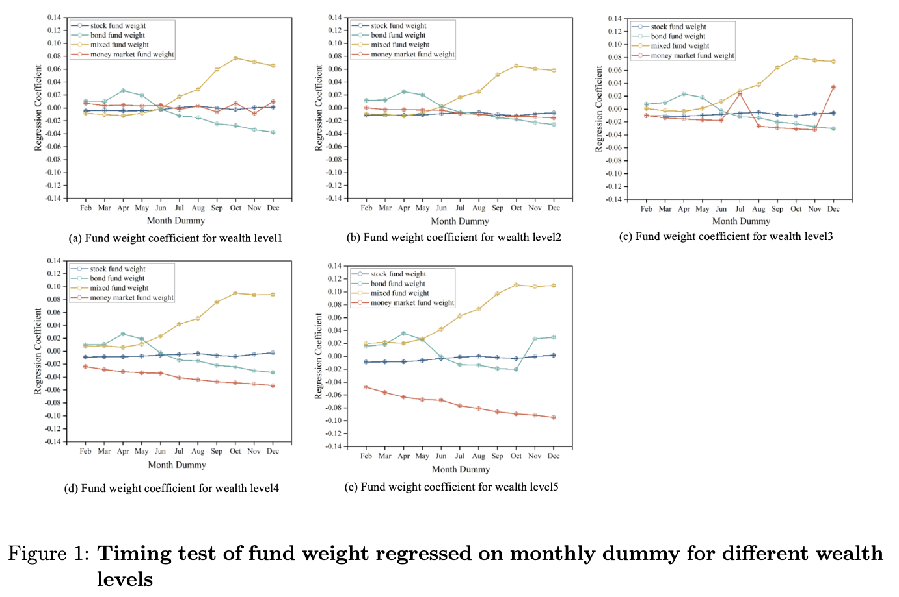
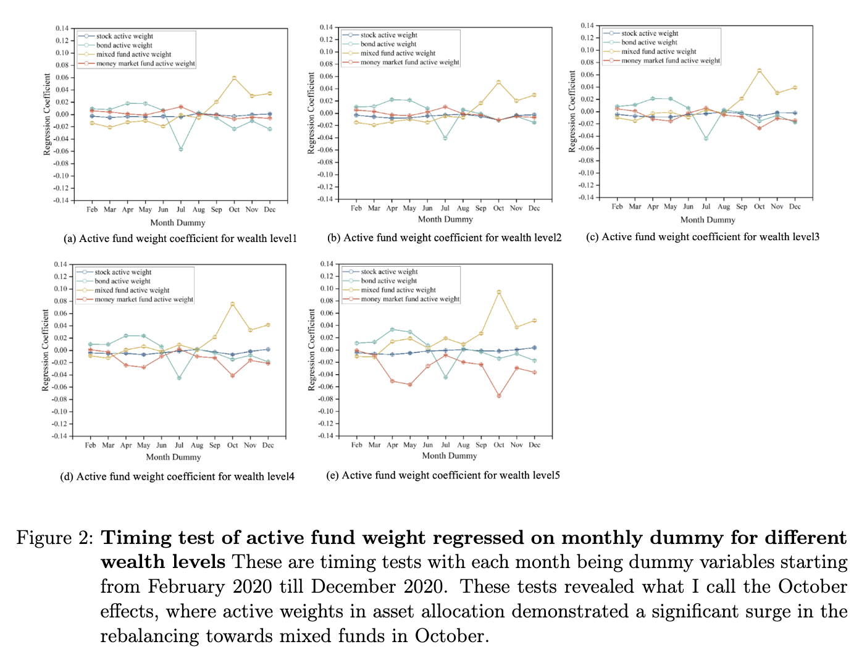
Key findings
Portfolio Rebalancing and Timing Test:
Rebalancing: Wealthier individuals shifted their portfolio weight from money market funds to mixed funds following the pandemic.
Timing: monthly dummy revealed October effects
Motivation and research question
Data and Methodology
Key related works
Key findings
Significance
Q&A

Slide 8
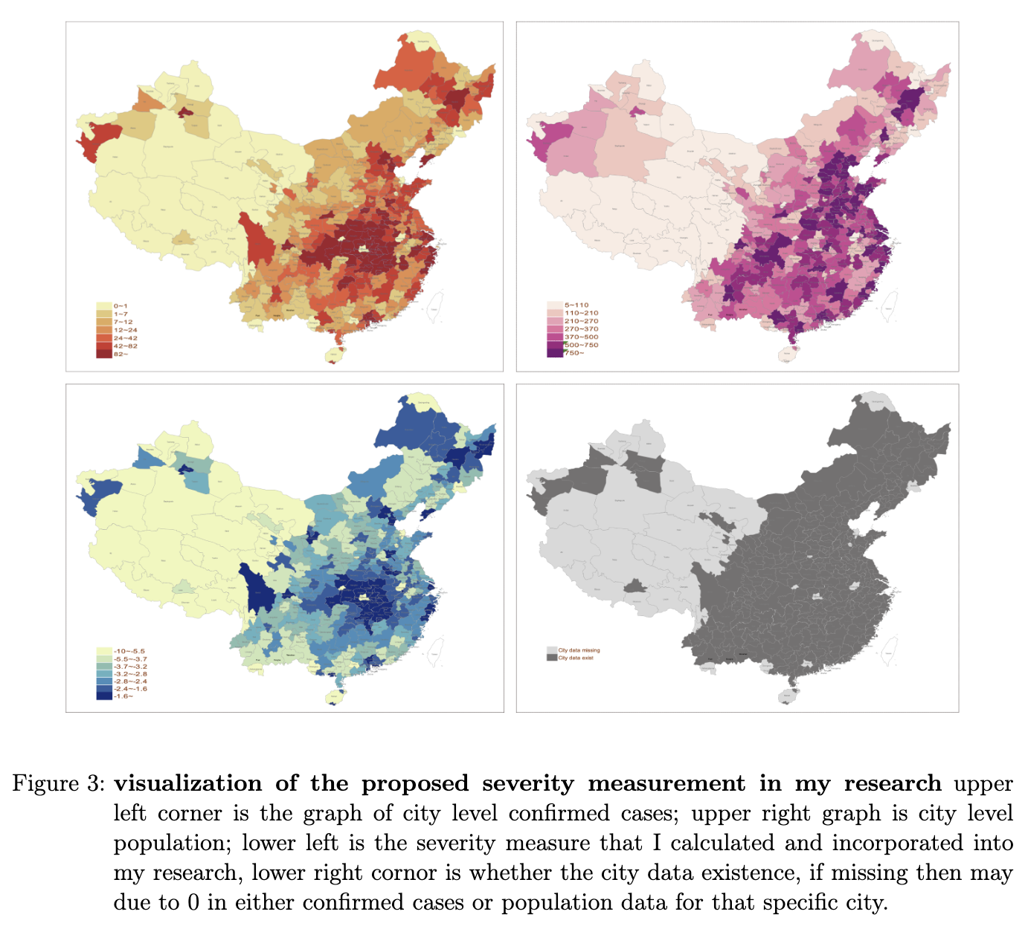
Key findings
The CAPM and Alpha Risk:
Capital Asset Pricing Model
Alpha represented by the pandemic dummy and the beta with the market risk premium
Alpha for wealthier group increased.
Pandemic Severity and Mutual Funds:
turnover and netflow in mutual funds increased with pandemic severity, while unit netflow decreased
Rebalancing of different types of mutual funds
Stock and mixed funds favored during severe pandemic conditions
Money market funds were less favored
Triple Interaction and Consumption Response:
For severity to increase by 1%, consumption’s response to capital gain sensitivity increases by 0.0069 * 1%.
More severe places, stronger response of consumption to capital gain
Motivation and research question
Data and Methodology
Key related works
Key findings
Significance
Q&A

Slide 9
Significance
This project makes up for the gap in the current literature landscape
the first to deal with such setting
Results will be reported to Alipay
Offers valuable insights for scholars, industry leaders, and policymakers, and provide a venue to assess the financial market’s reaction to the COVID-19 pandemic and similar public health safety events.
Motivation and research question
Data and Methodology
Key related works
Key findings
Significance
Q&A

Slide 10
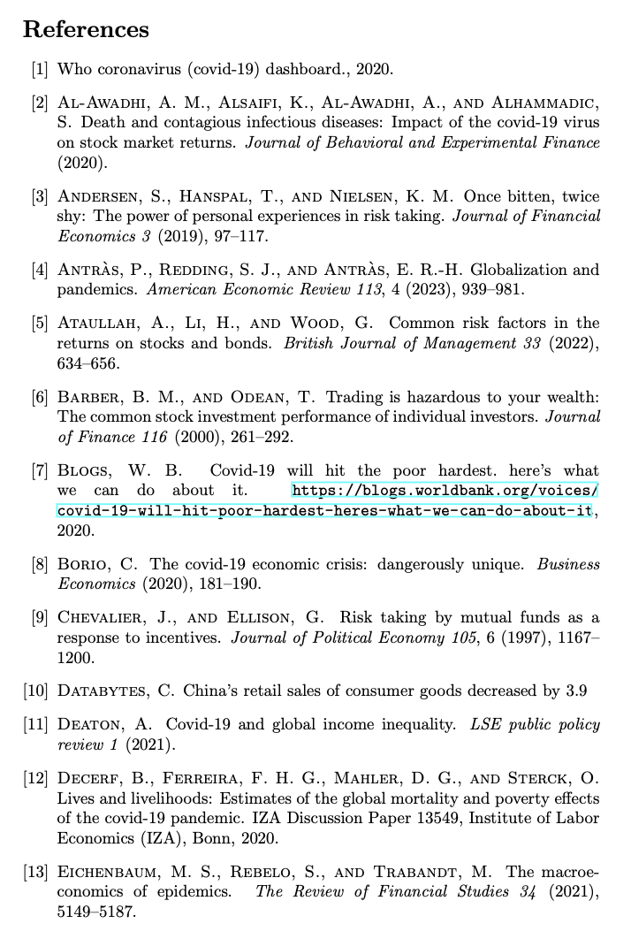
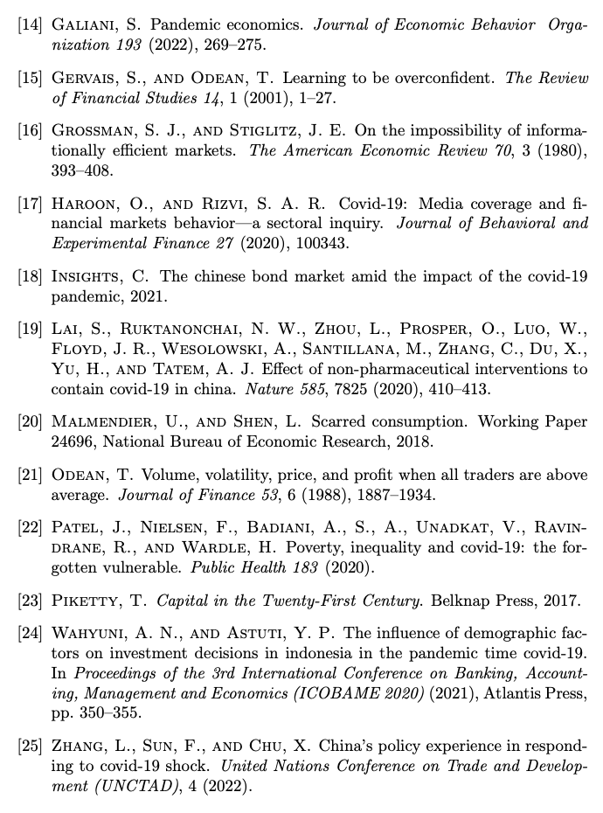

BIBLIOGRAPHY
Thanks!
Kexin Deng

