Slide 1
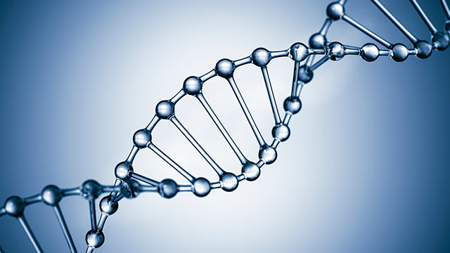
Programming life 2016 - Pantzerfaust

Slide 2
Overview
Features (1 – 9)
Strengths
Outlook
Demo

Slide 3
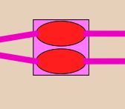
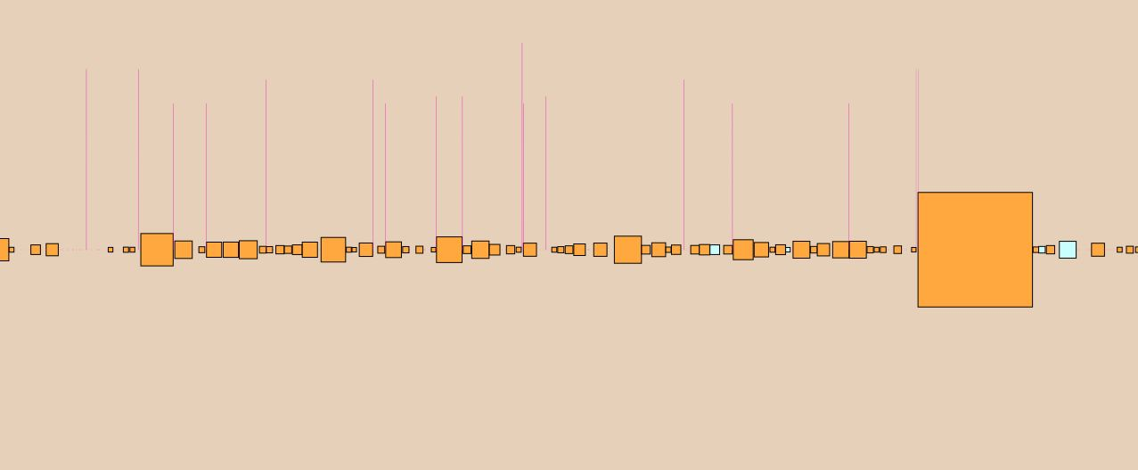
Features – part 1
Interactively explore a sequence graph
Highest level – nucleotide level
Legend
Search functionalities
328 genomes easy

Slide 4
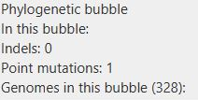
Features – part 2
Semantic zooming
Intuitive
Meaningful sizing of nodes and edges
Meaningful nodes in context
Clickable nodes

Slide 5
Features – part 3
Evolutionary relationship
Full integration with phylogenetic tree
Selection device
Highlighting
Zoom-in on phylogenetic tree
Phylogeny-based bubbles
Group mutations based on evolutionary closeness

Slide 6

Features – part 4
Mutations in the context of gene annotations
Annotations present for reference genome
Searching functionalities

Slide 7
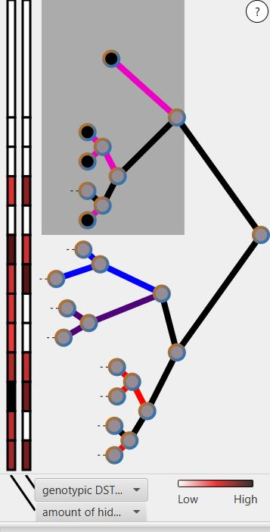
Features – part 5
Visual representation of metadata
Filter & search options
Heatmap for phylogeny

Slide 8
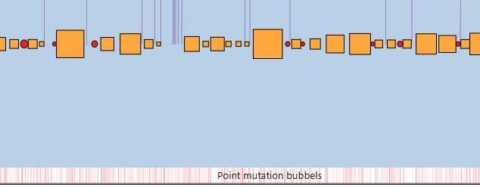
Features – part 6
Visual encodings for classes of mutations
In/del, point mutation, (straight sequence – only point and indel mutations)
Heatmap under graph

Slide 9
Features – part 7
Identify mutations
Together with the visuals
Heatmaps

Slide 10
Features – part 8
Convergent evolution
Smart selection of graphs
Making use of the highlighting
Possible, but difficult to find by eye

Slide 11
Features – part 9
Linking external resources
Loose coupling of modules – easy to add

Slide 12
Strengths
Comparing two graphs
Integration with phylogeny
Performance
Fast loading, smooth zooming
Innovative visualization
Realistic data presentation
Ready for the big datasets?

Slide 13
Outlook
Better integration with the needs of the end user
Convergent evolution
Automatically recognizing interesting parts of the data
Vertical-scaling

Slide 14
Questions?

Slide 15
Demonstration of the final product
Thanks for listening
Demonstration next, demo video is more or less the same

