Slide 1
Pantzerfaust
ProgrammingLife 2016 - Technical Customer Reflection

Slide 2
Overview
Application architecture
Internal data representation
Visual components and scalability
Semantic zoom strategy
Technology stack
General recommendations

Slide 3
Application architecture
GUI
Parser
Data storage
Core

Slide 4
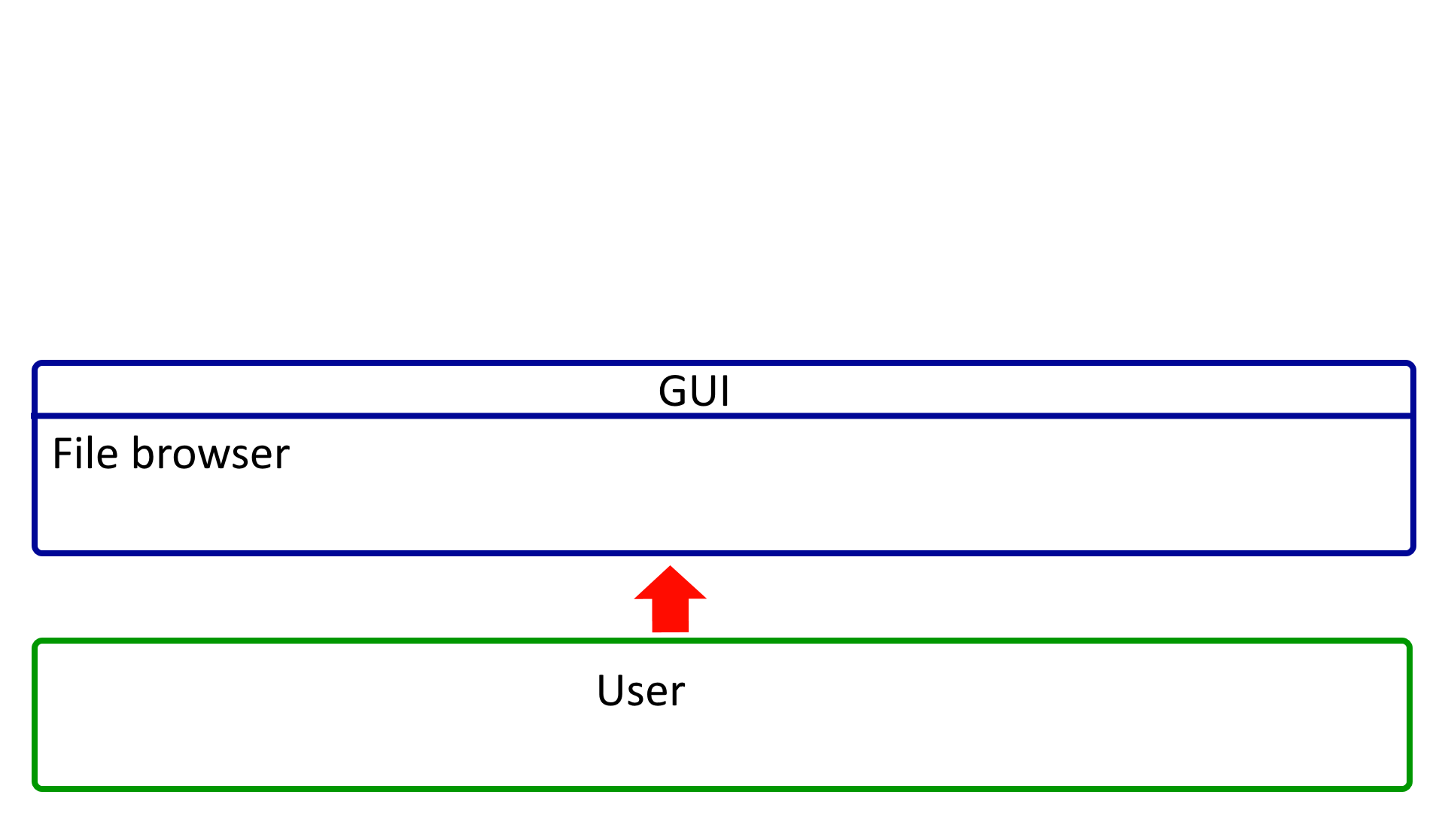
Notes:
Startup

Slide 5
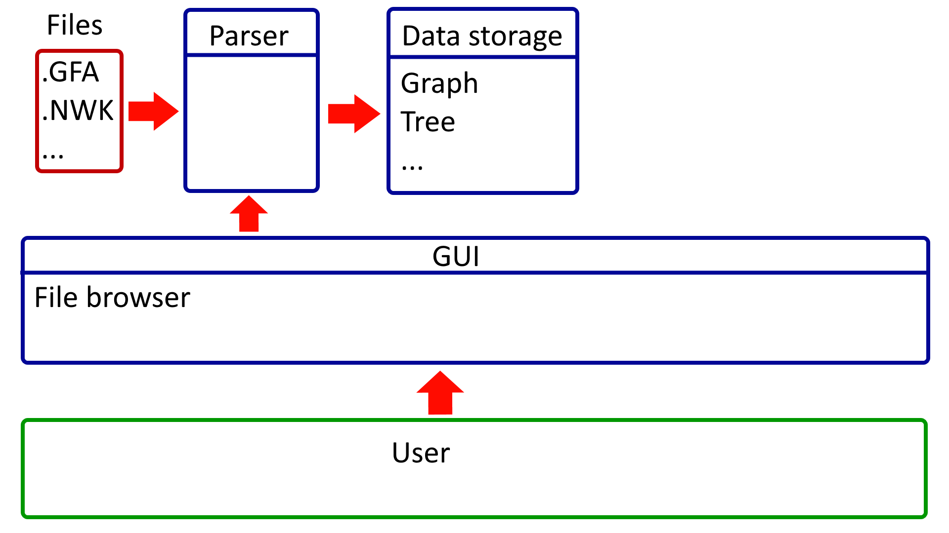
Notes:
Parsing file

Slide 6
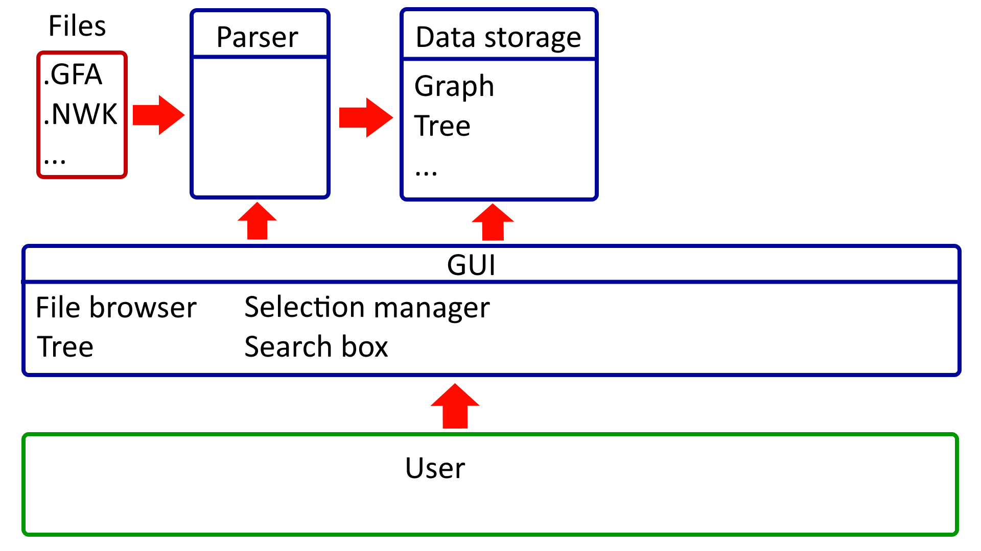
Notes:
Files loaded

Slide 7
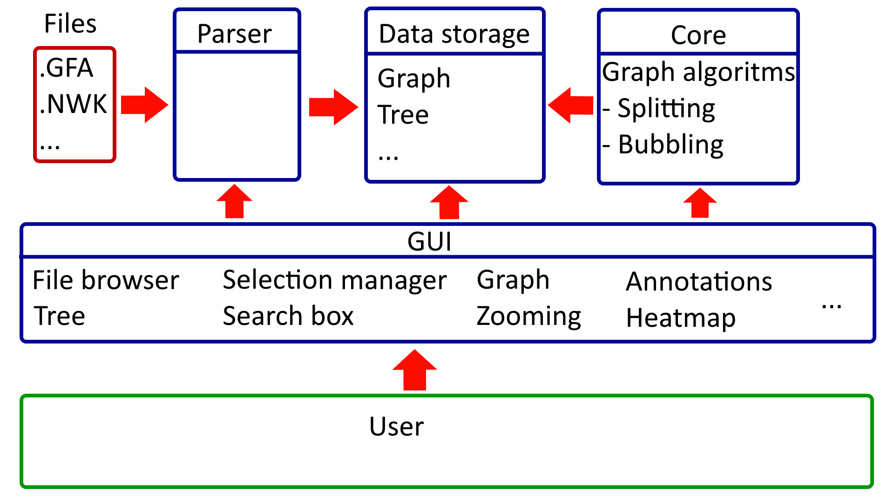
Notes:
User selected genomes to draw

Slide 8
Application architecture
Good
Could be improved
Simplicity
Loosely coupled modules
Some of our GUI files have a high complexity. It would’ve been better to make them smaller

Slide 9
Internal data representation
Metadata
Annotations
Phylogenetic tree
Genome graph

Slide 10
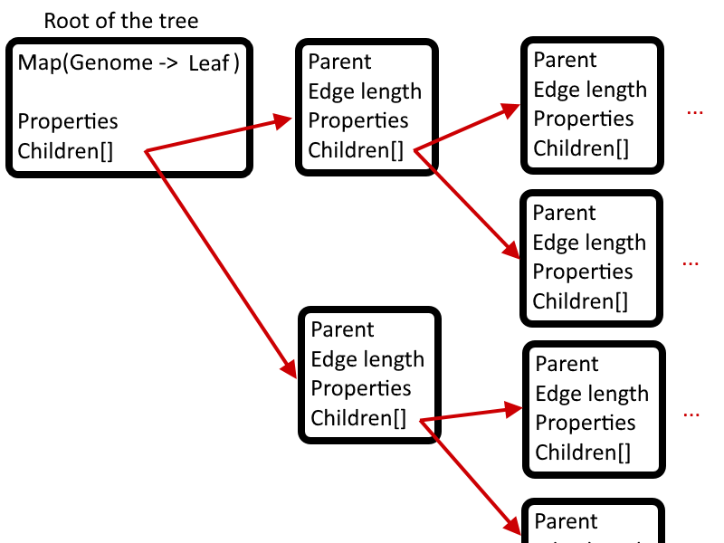
Phylogenetic tree

Slide 11
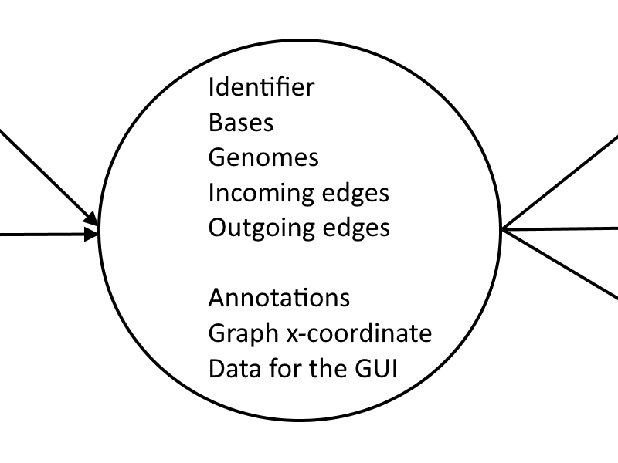
Graph - Node Object
Node of the graph

Slide 12
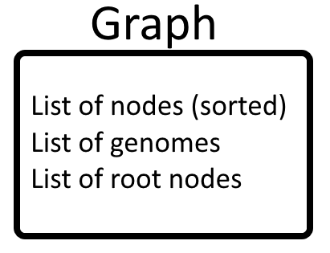
Graph - Graph Object

Slide 13
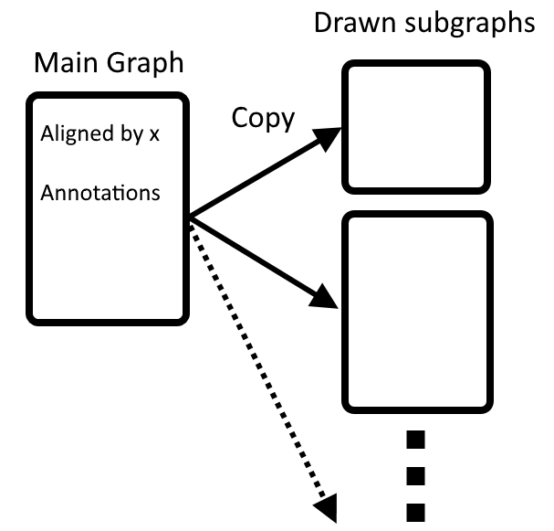
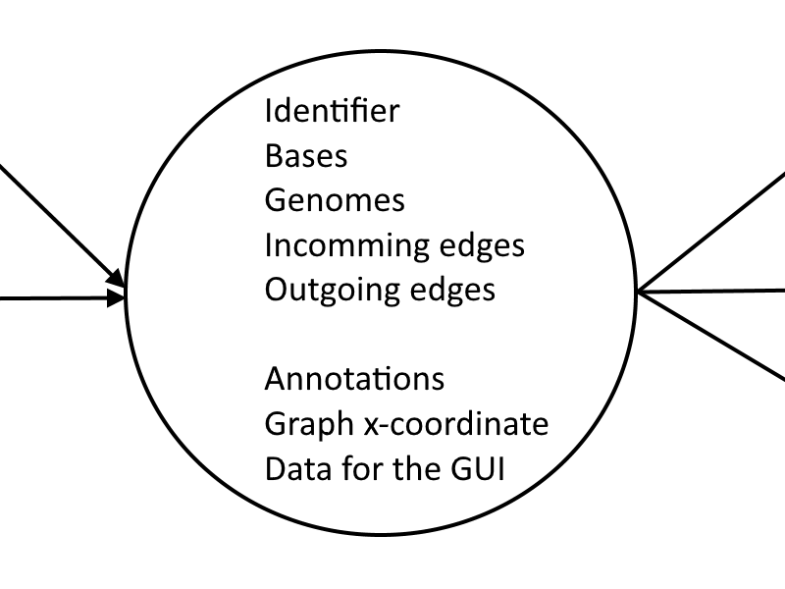
Graph - Main Graph
Sorted by x-coordinate
Annotations

Slide 14
Graph - Optimizations
Memory
Genomes - id instead of string
Bases - 3 bits encoding*
Performance
Use hashmaps/hashsets
Sort lists which will be compared often
Main tradeoff:
HashMap (36 bytes/value***) VS ArrayList (4 bytes/value**)
* https://github.com/ProgrammingLife2016/PL2-2016/blob/dev/PL2/PL2-shared/src/main/java/nl/tudelft/pl2016gr2/model/graph/data/BaseSequence.java
** http://java-performance.info/memory-consumption-of-java-data-types-1/
*** http://java-performance.info/memory-consumption-of-java-data-types-2/

Slide 15
Internal data representation
Good
Could be improved
Don’t create objects for each edge - storing edges is very expensive
Do most computations on the main graph and copy the computed values when drawing a subgraph
Store genomes as efficiently as possible for each node
Store bases as efficiently as possible
Use a profiler to check the memory consumption
Use HashSets/HashMaps if the memory increase isn’t too high
Sort lists which will often be checked for equality. Comparing two sorted lists takes O(n) time while comparing unsorted lists takes O(n2) time.
Genomes could have been stored for each edge in a node instead of for the node itself. This doesn’t cost much more memory and calculating which genomes travel over which edges is expensive.
Data could be written to a database, so less RAM is needed. This is however pretty complex to implement efficiently and should only be needed for very large datasets. Simply using a powerfull desktop with 128GBs of RAM should be enough to load around 40K-100K genomes (performance would have to be improved though).

Slide 16
Visual components and scalability
Our performance (328 graph):
Nodes drawn: around 50 - 600
Edges drawn: around 2,000 - 16,000
FPS: 20 - 60 while zooming*
CPU: below 20% while zooming*
Memory: around 500MB
* With an i7-5820K (6-Core @3.3GHz) and GeForce GTX 960
See the resources for a profiling session

Slide 17
Drawing - Scalability
Only draw nodes which you can see
Redraw instead of moving
Precompute complex computations
Edges -> canvas

Slide 18
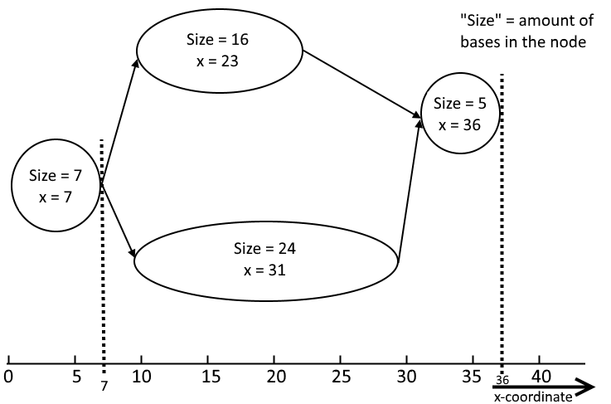
Drawing - horizontal position
Linear scale
Custom coordinate system, see picture
Easy to precompute

Slide 19
Visual components and scalability
Good
Could be improved
Draw non-interactive components in a canvas (edges)
Only create JavaFX object for elements which can be seen
Don’t use complex visual elements (such as gaussian blurs)
A linear coordinate system makes things easier (in our case)
Better memory management of JavaFX objects: remembering and reusing old JavaFX objects will make the life of the garbage collector a lot easier.

Slide 20
Semantic zoom strategy
Semantic -> Bubbles
Phylogenetic
Graph (source - sink pairs)
Point mutation
Indel
Non-Semantic -> change x-coordinates

Slide 21
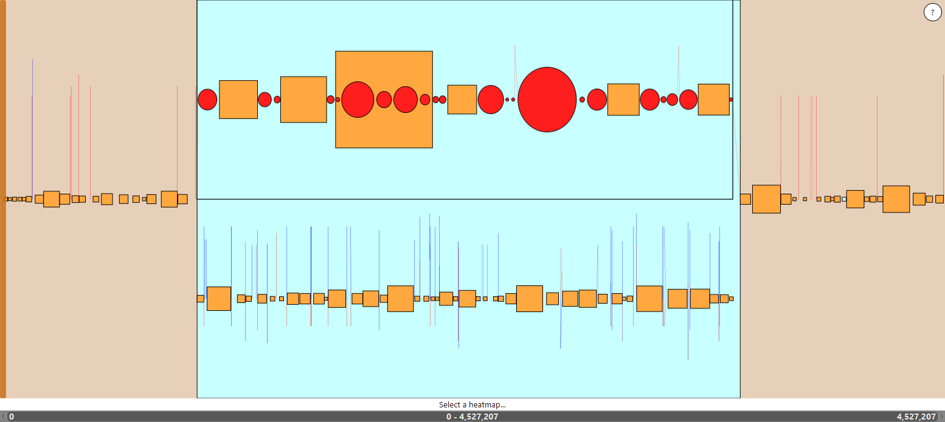
Bubble - Phylogenetic

Slide 22
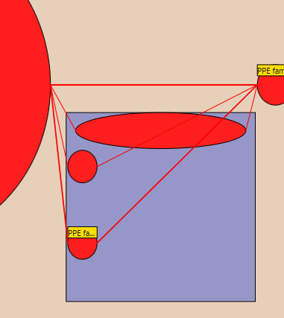
Bubble - Graph (source-sink pairs)

Slide 23
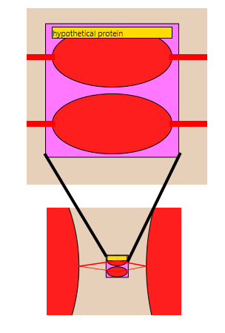
Bubble - Point mutation
Zoomed in:
Zoomed out:

Slide 24
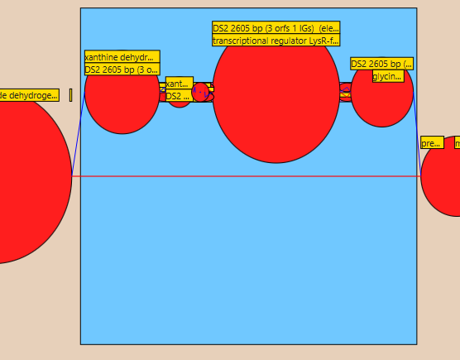
Bubble - Indel

Slide 25
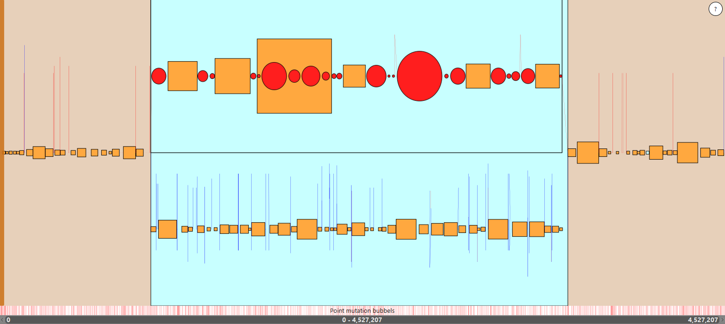
Point mutation heatmap

Slide 26
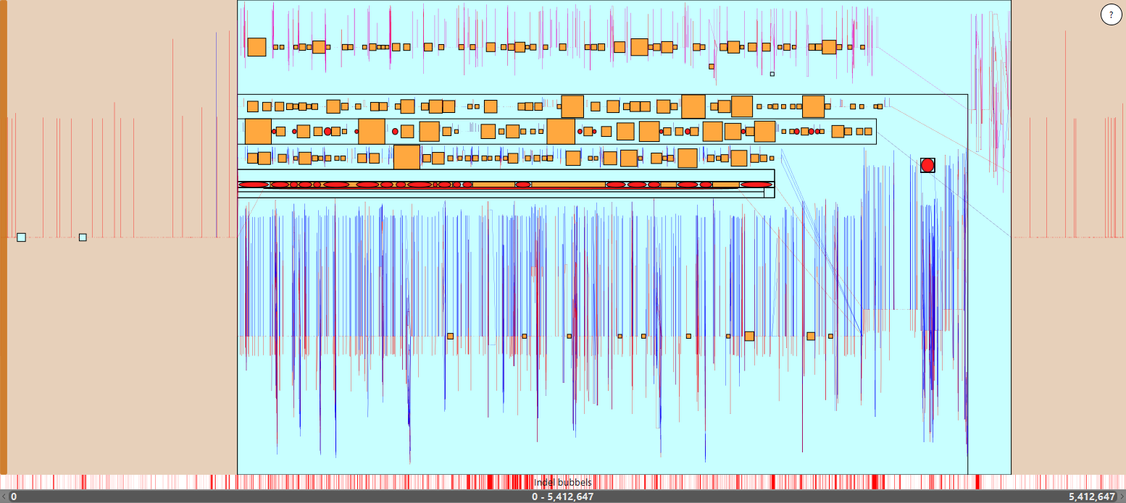
328 graph with indel heatmap

Slide 27
Non-Semantic Zoom
Change range of drawn x coordinates

Slide 28
Semantic zoom strategy
Good
Could be improved
Smooth zooming
Smooth semantic zooming
Easy to identify mutations
Nice graph heatmap integration
Very small nodes (with fewer than 150 bases) are drawn larger, thus they overlap.
When zoomed in a logarithmic scale might be more useful. This could be done by implementing a way to toggle between linear and logarithmic scaling.

Slide 29
Technology stack
Java
JavaFX

Slide 30
Technology stack
Good
Could be improved
Everyone was familiar with the used technologies
Very few different components: easy to test/debug
No communication overhead between different technologies
A database could be used to store parts of the memory which aren’t required at the moment. This would reduce the used RAM.
Some computations could be executed in lower level languages, or even on the GPU, to improve performance.

Slide 31
General recommendations
First focus on the horizontal alignment (topological)
Don’t start too late with the vertical alignment of the graph
Smooth zooming + popping requires a linear x-scale (?)
Start with the phylogenetic tree
Select based on tree
Use tree to search
Learn how to use a profiler to profile CPU and memory usage (see resources)

Slide 32
Resources

Slide 33
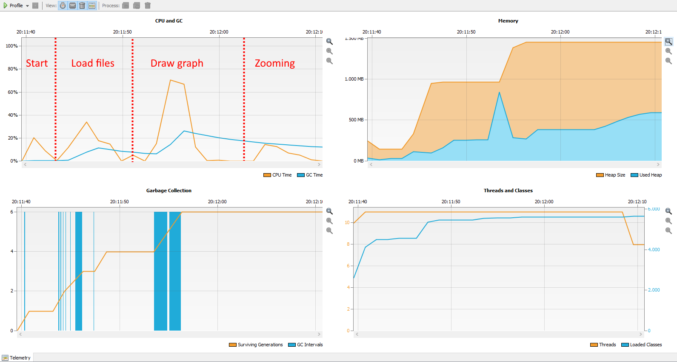
Profiler - CPU usage when loading and drawing the 328 graph (netbeans profiler)

Slide 34
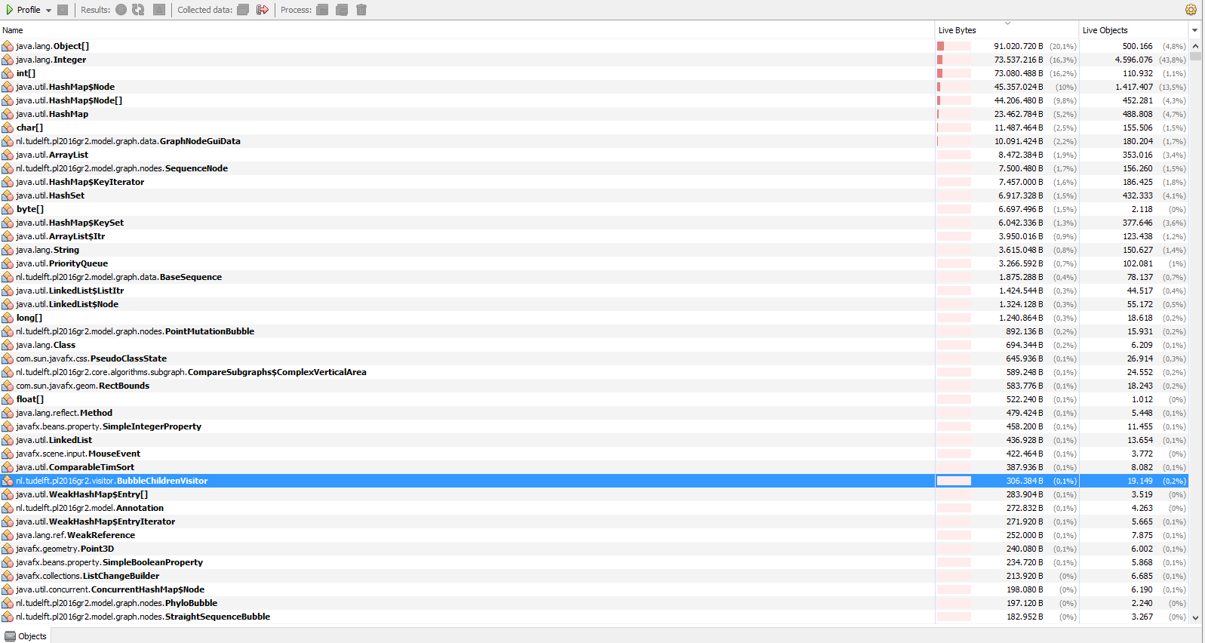
Profiler - memory usage with 328 graph loaded & drawn (default netbeans profiler)

Slide 35
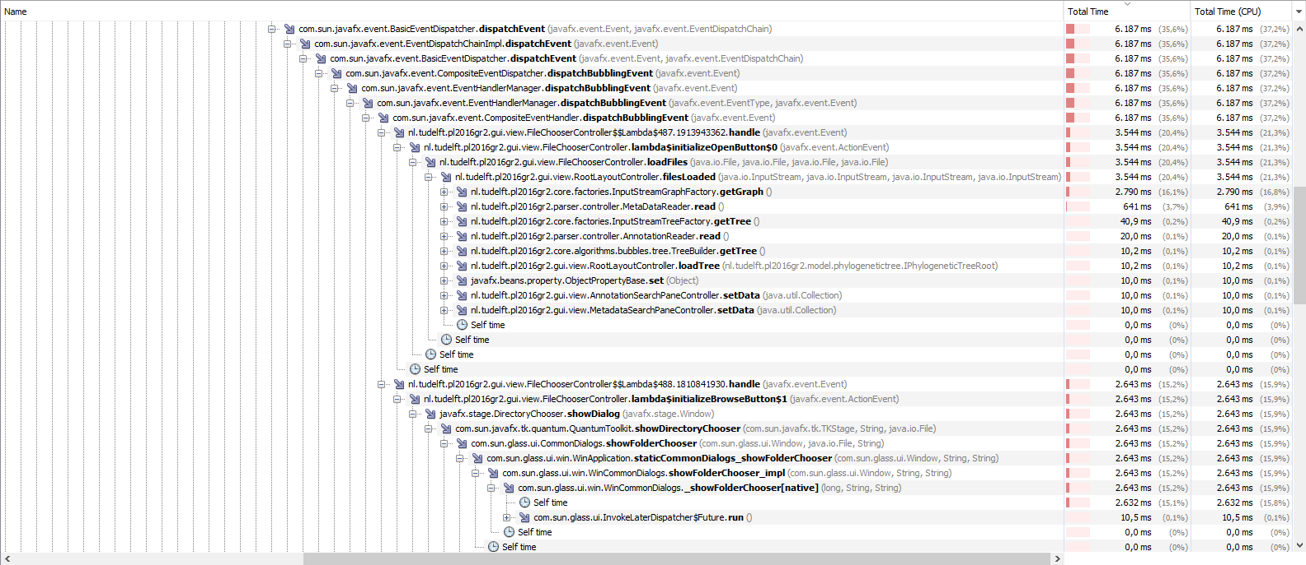
Profiler - time spent in each method (default netbeans profiler)

