Slide 1


IOT
Co2 Live Data

Slide 2


Title
Hardware Used
Software Used
Connection
Workflow
Explanation

Slide 3
Software Used
Hardware Used
Node Mcu ESP8266
MQ135 Sensor
Arduino IDE
Azure IOT Hub
Stream Analytics Job
SQL Database

Slide 4
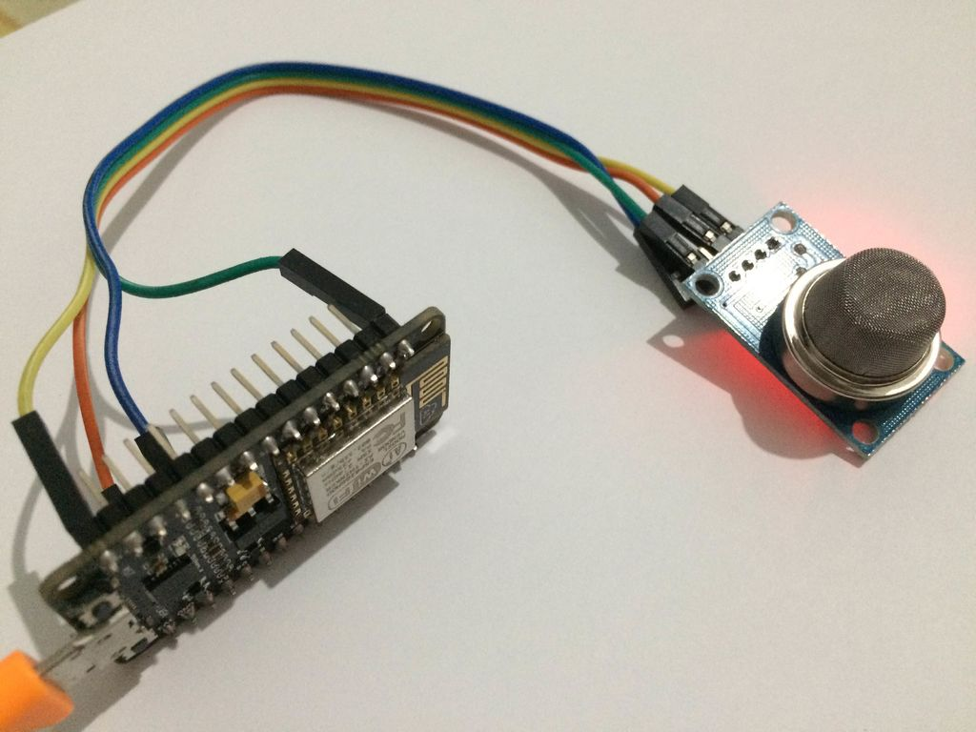
NodeMCu connection with MQ135 gas sensor

Slide 5
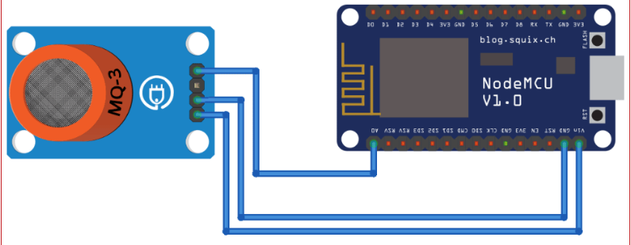
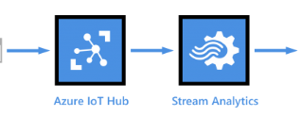

Workflow

Slide 6
Explanation
First, we need to write code based on our requirements & flash into Nodemcu memory.
MQ135 sensor read Co2 level from atmosphere and send it to Nodemcu device.
Nodemcu send Co2 value to Azure IOT hub.
By using Stream Analytics Job, we are sending our data to SQL database.
Using Restful Api, we are fetching Co2 data to our webpage

