Slide 1
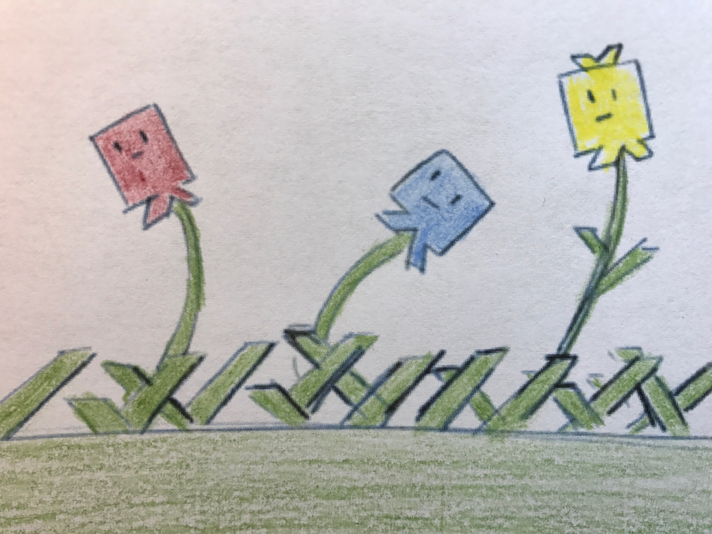
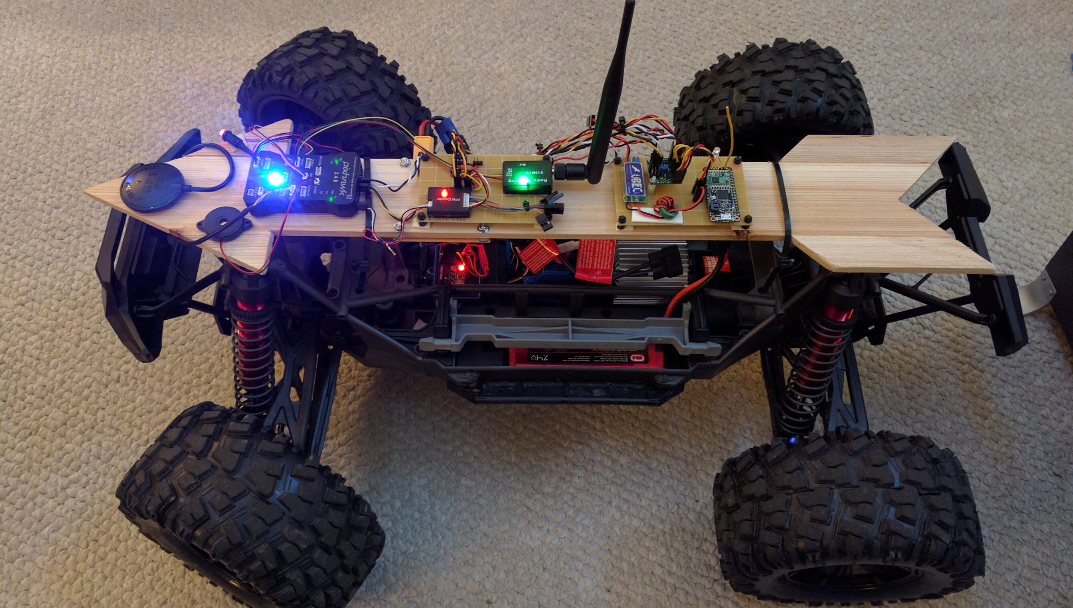


Magellan Program
JOIN NOW!
JOIN TODAY!
SIGNUP!!!
http://www.robotgarden.org/get-involved/
Notes:
What brought you to this class? Did you have something in mind to make?

