Slide 1

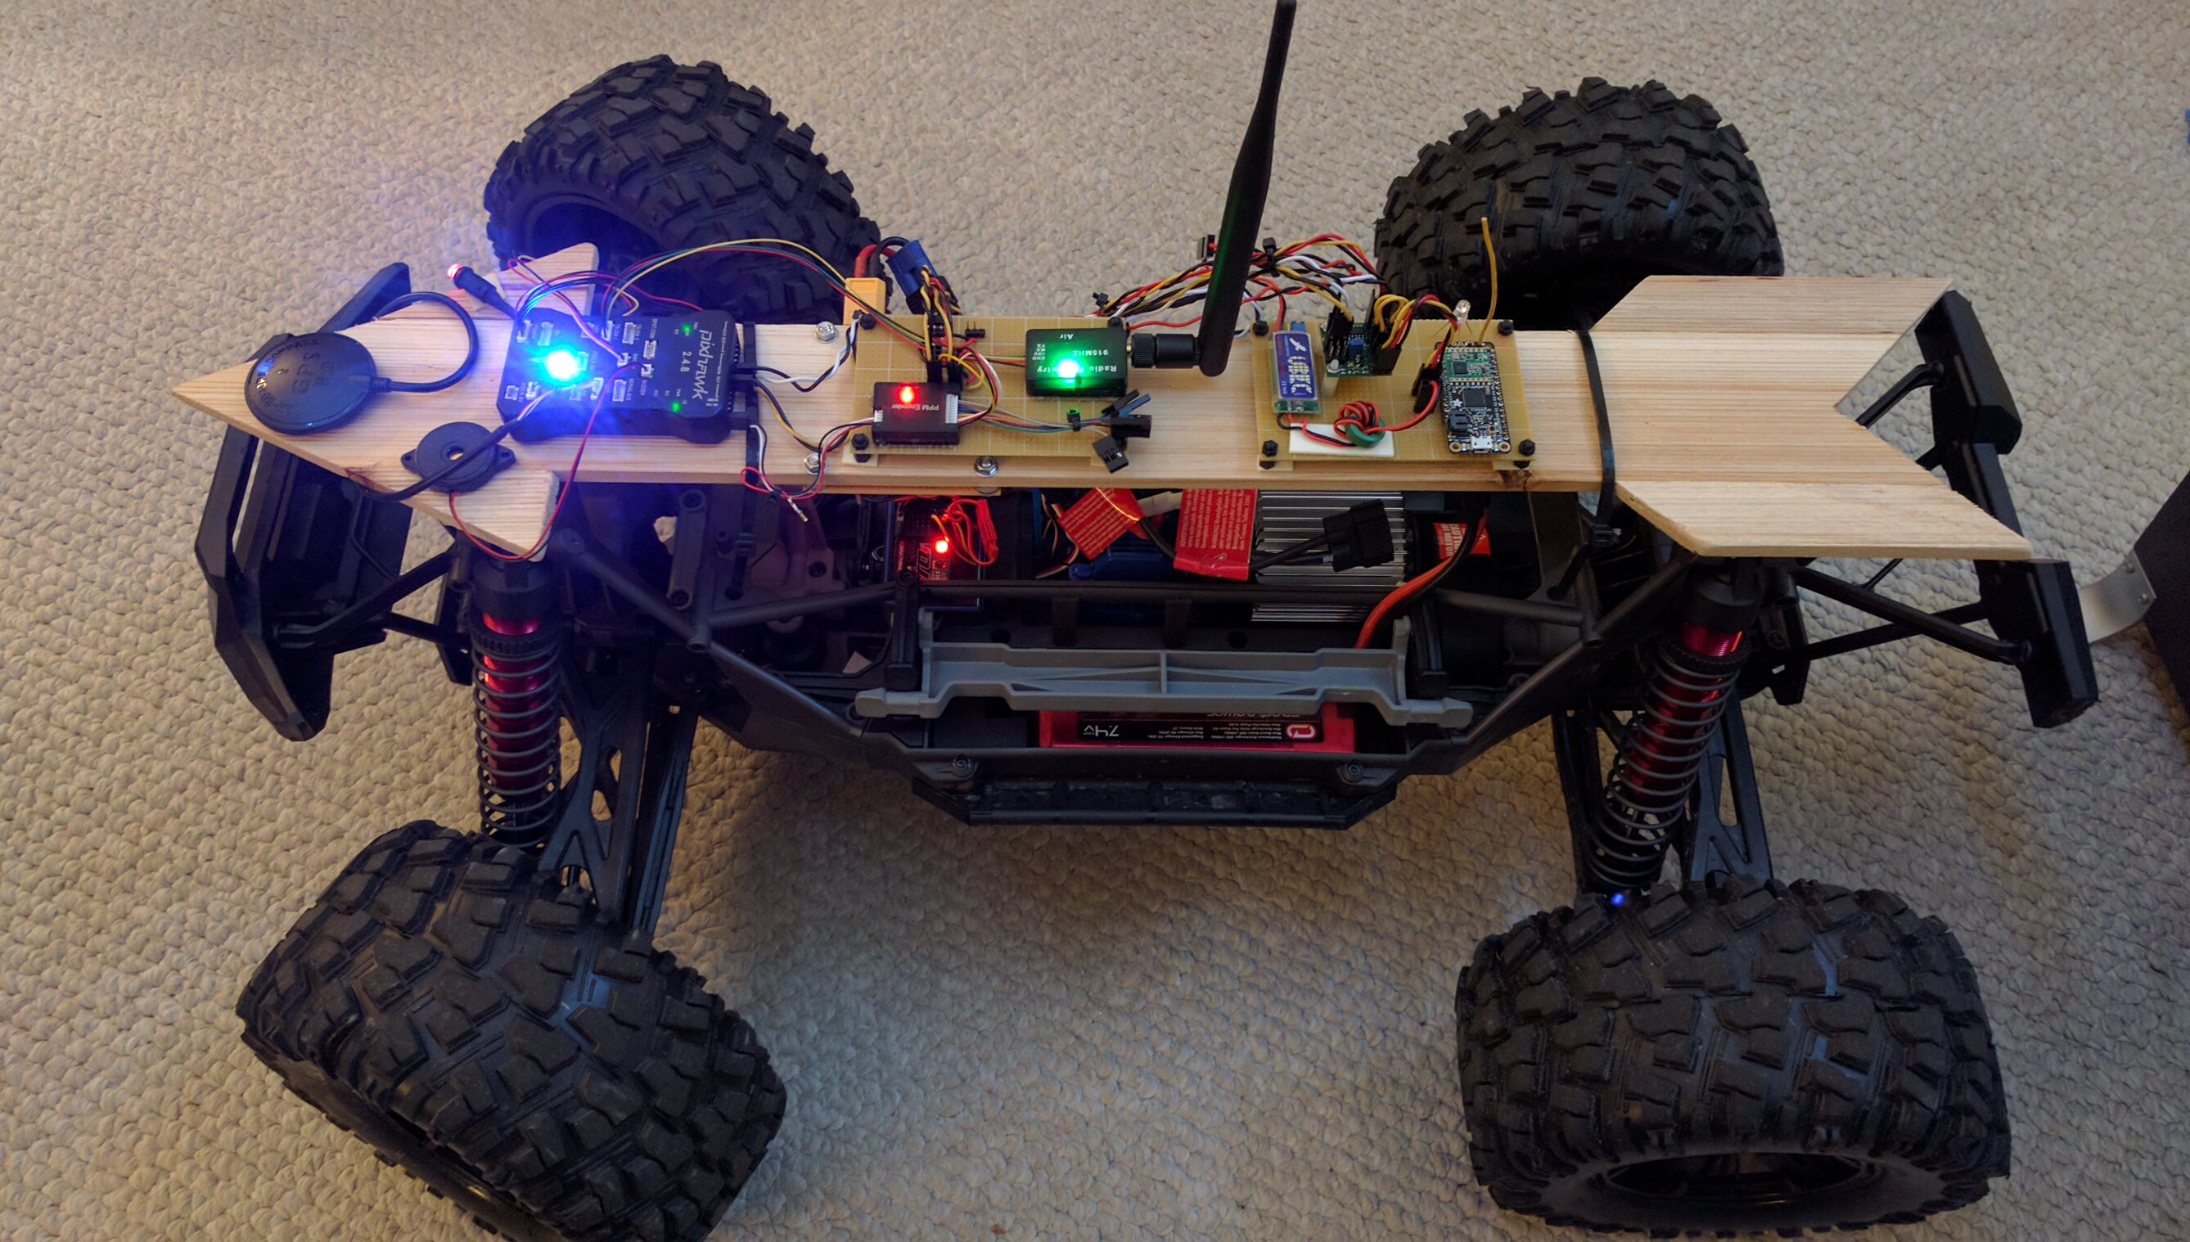

Robot Garden Presents...
Another in our series of informational
talks

Slide 2

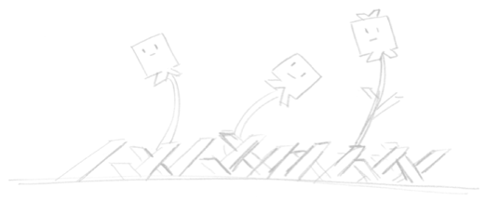


Magellan Program
Brought to you by:
Robot Garden
www.robotgarden.org
Notes:
What brought you to this class? Did you have something in mind to make?

Slide 3


Robot Garden Marquee Program
Robot Garden started 3 programs in 2016, each named after an adventurer:
  Magellan Program encourages building of autonomous robots
  Cousteau Program is about aquatic discovery
  Lindberg Program is Aviation Explorer post #997, now forming. Flying robots? Maybe...

Slide 4
What is the Magellan Program?
Explore Autonomous Navigation Robotics
Support Competition Entrants
Create a reference platform
Explore use in search and rescue
Support individuals and the community with resources and RC2Robot SIG

Slide 5
RC2Robot SIG
RC2Robot is a robotics Special interest Group for builders of autonomous rovers (robots)
Team Robot Garden, sponsored by Robot Garden, hosts this event
Find our weekly meeting schedule on Robot Garden's event Calendar
Team members are focused on building robots for RoboMagellan

Slide 6

RoboMagellan
RoboMagellan is a outdoor competition and is a bit like the Darpa Grand Challenge.
Our Rovers will compete in RoboMagellan at Robogames in Pleasanton April 21-23, 2017

Slide 7
Recap
Magellan Project is Robot Garden's Navigation Robotics
Robot Garden Sponsor's Team Robot Garden and their Bot, Victoria
RC2Robot is Robot Garden's SIG event
And RoboMagellan is the first contest

Slide 8

The Plan
Design/Select a Vehicle/Chassis
Select Processor Board and Sensors
Design and build electronics
Build Sensor platform and other hardware
Develop the software, test and win!

Slide 9
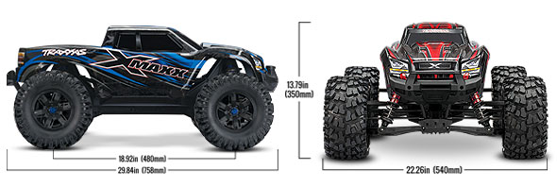


RC Chassis Selection
We elected to use an RC vehicle as they are rugged and purpose built. The large size comes in handy when curb climbing.
Traxxas X-Maxx
+ Size 19 pounds, 30” long, 20” wide
+ Large - 1/5th scale
+ Heavy –
+ >35mph, TONS OF FUN!
- Price
Stampede
+ Inexpensive
+ good sensor test platform
- Insufficient for urban obstacles, but
Notes:
list here is from the vantage of home or hobby level 3D printers. 3D printers can be much bigger, more detailed in it’s prints, faster, more rugged, extend to greater materials but it all comes at a cost. Also looking at the high end – many cheaper from these and other mfgs and even DIY kits that can come very cheap
* Form 1+/2 - Stereolithographic printer. Cost is just under 2000 for 1+, 3500 for the 2. Great for prototyping, not great for finished parts – only one material, messy with post cleanup required
* Ultimaker 3rd extrusion type printer. Definitely considered a top end home/hobbyist printer selling at 3500 for their base model. Ultimaker 2 is still available on the market at 2500
* Replicator+ - similar to the Ultimaker 2 in capability and similar in price at about $2000
RepRap is humanity’s first general-purpose self-replicating manufacturing machine. You can print the printer! Open-source philosophy – many kits based on RepRap
* Rostock Max v3 – it’s a DIY kit that you have to assemble. Also one of the unique delta arm printers. Kit is $1000
* Taz 6 – nearly fully assembled printer, personal favorite – I own the previous version Taz 4 – but pricier coming in at $2500
* Printrbot sells both kits and fully assembled. Their highest end fully assembled Plus is $1100

Slide 10
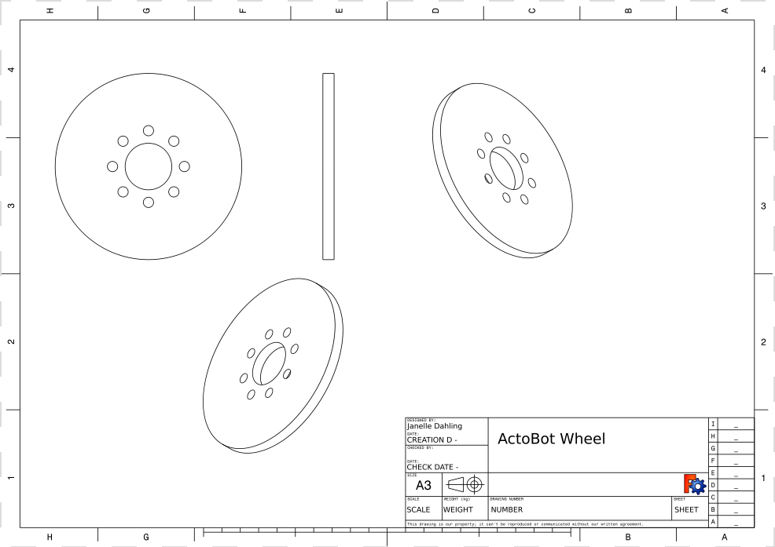
Robot Electronic Hardware
UP Board
RealSense and USB Camera
PixHawk, GPS, compass, IMU, barometer and ultrasonic sensors
Safety switch

Slide 11
Robot Software
ArduPilot/Mission Planner
Linux
ROS: MavROS and custom nodes
Cone Identification Software
Custom sensor control and data acquisition software
Safety Switch

Slide 12
Victoria Block Diagram

Slide 13

2017 RoboMagellan RC2Robot Entrants
Entdecker 2
  X-Maxx Chassis
Victoria
  X-Maxx Chassis
D?
  Actobotics from ServoCity

Slide 14
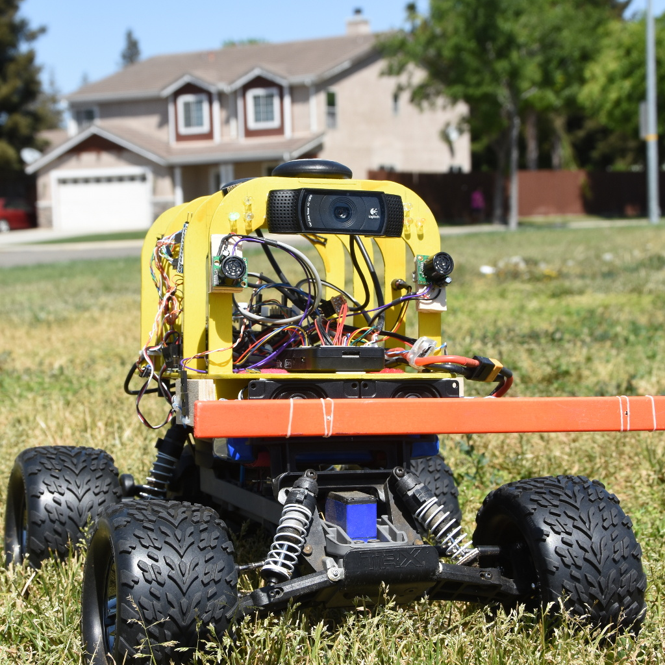
Entdecker
2016 2nd place regional
Built by a member of Robot Garden
1/10th Scale Stampede Radio Controlled Car
Hybrid ArduPilot and ROS
GPS, PixHawk, Camera,

Slide 15


Questions?
This presentation is available at:
https://github.com/PRSG/ ?
Notes:
This slidedeck is in LibreOffice and PDF format and a copy can be obtained at the Robot Garden github site, located here at the url listed on this page. The QR code to the right will take you to the same location: https://github.com/RobotGarden/cad_intro
This material is considered Free and Open Source material. We ask only that you preserve the Robot Garden attributions and would prefer if any derivative work preserve the Apache 2 or similarly open license.
There is an appendix to this document that anyone interested more in this topic might want to reference for additional information including the license under which this material is copyrighted.

Slide 16
Appendix
Notes:
As I mentioned, there are many applications that benefit from CAD. Listed on this page are some, but by no means all of them. As you can imagine, this is a very empowering technology used in many technical fields. In fact I’ve spoken with educators who say that students that have had some exposure to CAD have a leg up when they go to college. Listed here are some that I will describe in case you don’t know what I’m referring to.
* Part Design – just as it sounds – you have a part or solid you need to model and create. Think knobs, gears, brackets and the likes
* Landscaping and Building architecture are probably familiar to most people but if not, please just ask.
* Mechanical designing is where parts come together to make working machines – imagine a set of gears coming together and rotating
* Electronics schematics are used anytime you have a piece of electronics and need to design circuits and the likes.
* Yes even Animation is a form of CAD and there are softwares out there to aid in creating tese
* Even more beyond this!

Slide 17

License/Copyright
The materials for this class are licensed under the Apache license. See the file LICENSE for details.
Copyright 2016 J Dahling
Licensed under the Apache License, Version 2.0 (the "License"); you may not use this file except in compliance with the License. You may obtain a copy of the License at http://www.apache.org/licenses/LICENSE-2.0.
Unless required by applicable law or agreed to in writing, software distributed under the License is distributed on an "AS IS" BASIS, WITHOUT WARRANTIES OR CONDITIONS OF ANY KIND, either express or implied. See the License for the specific language governing permissions and limitations under the License.
Notes:
The list here is by no means exhaustive, nor does it cover the spectrum of applications we just went through. If you’re truly interested in CAD, you should spend a little time researching the type of CAD program that would meet your needs best. Let me talk a little bit to each of these programs
* Fusion 360 – best suited for parts and mechanical design – can also do CAM. Free for inventors, but quite pricey if you intend to use it for commercial application
* SolidWorks – best suited for parts and mechanical design. Major competitor to Fusion 360 – takes into account materials and their properties
* CorelCAD – parts and mechanical design, but at a much lower cost than Autodesk or Solidworks softwares
* Eagle CAD is commercial CAD designed specifically for circuit/electronics design
* Adobe Illustrator is a vector graphics software used for 2D manufacturing such as laser cutting and engraving
* Autodesk has an offering in nearly every CAD application and their vector graphics software is called Maya
* TinkerCAD – geared for easy adoption with an intuitive interface. Often used for kids and mostly in the parts design space
* Sketchup is 3D CAD geared more towards room and building designs
* FreeCAD is largely a parts design tool, although it is actively being developed to do more in the future
* OpenSCAD brings a development based UI to parts design. You literally write the code that makes the objects
* Blender is a software for creating Animations
* KiCAD is a competitor to Eagle CAD and is used in electronics/electrical schematics
* InkScape is a free and open source vector graphics software similar to Illustrator

Slide 18

Additional References
The Manufacturers
Commercial
Autodesk, Fusion 360 and Maya: http://www.autodesk.com/
Fusion 360 can be obtained for free so long as it is not used in a commercial endeavor
Solidworks: http://www.solidworks.com/
CorelCAD: http://www.coreldraw.com/en/product/corel-cad/
EagleCAD: https://cadsoft.io/
Adobe Illustrator: http://www.adobe.com/products/illustrator.html
Free or Free and Open Source
TinkerCAD - Free but not Open Source: https://www.tinkercad.com/
Sketchup - Free but not Open Source: http://www.sketchup.com/
FreeCAD - Free and Open Source:http://www.freecadweb.org/
OpenSCAD - Free and Open Source: http://www.openscad.org/
Blender - Free and Open Source: https://www.blender.org/
KiCAD - Free and Open Source: http://kicad-pcb.org/
Inkscape - Free and Open Source: https://inkscape.org/
Online Resources
Wikipedia: https://en.wikipedia.org/wiki/Computer-aided_design
Maker Culture/Movement Wiki: https://en.wikipedia.org/wiki/Maker_culture
Notes:
Although CAD is strictly part of the design phase, it is still important to keep in mind the materials that are being targeted for what you’re creating since it can impact the process. For example, in 3d printing through a common extrusion style printer where there is a nozzle ejecting melted material in layers to form an object, if you design something with sharply overhanging faces, you might have troubles, so the best orientation of the part may be laying on it’s side or even upside down!
It’s also important to think about the type of manufacturing you will be utilizing. Additive as in the 3d printing example or subtractive where you might be using a CNC Mill, laser cutter or similar technology.
Finally the process of CAM should be a consideration – complexity goes up as more dimensions come into play – 2D is very simple for example on a laser cutter or simple CNC milling. 2.5D greatly simplifies the process of creating a part with a CNC mill over 3D and of course true 3D with curves and the likes is the most complicated CAM process.

Slide 19
Attributions
Special thanks to Robot Garden for providing the content and branding of this presentation http://robotgarden.org/
Special thanks to the Free and Open Source platforms upon which much of the original art in this presentation were made:
FreeCAD
GIMP
Kazam Desktop video software
OpenShot video editor
And of course our friends at Canonical for making the Ubuntu distribution this document was authored on
Notes:
Now I’m going to shift gears and bring up some videos I’ve made while creating and manipulating objects in FreeCAD to give you a sense of how the tool works and then I’ll give you a chance to ask any questions you have.

