Slide 1
What is JDBC?
JDBC (Java Database Connectivity) is a Java API that allows Java programs to connect to and interact with databases. It provides a standard interface for executing SQL statements, retrieving results, and performing database operations.
In the context of JDBC, the term API does not refer to fetching data from server endpoints or REST APIs. Instead, it stands for Application Programming Interface, which is a set of classes, interfaces, and methods provided by Java for interacting with relational databases (e.g., MySQL, PostgreSQL, Oracle).

Slide 2
Key Components of JDBC as an API:
Connection: Establishes a connection with the database.
Statement and PreparedStatement: Executes SQL queries.
ResultSet: Retrieves the data returned by the database.
DriverManager: Manages database drivers.
Does JDBC Fetch Data from API Endpoints?
No, JDBC is designed to interact directly with databases through SQL.
It does not fetch data from server APIs or REST endpoints. If you need to fetch data from APIs or endpoints, you would typically use libraries like HttpURLConnection, HttpClient, or frameworks like Spring Web.

Slide 3
Key Difference: JDBC vs. REST APIs
Aspect | JDBC | REST API
Purpose | Connects to databases to execute SQL queries. | Fetches data from web server endpoints.
Communication | Communicates with databases via SQL. | Communicates with APIs using HTTP methods.
Data Format | Works with relational database tables. | Typically exchanges data in JSON or XML.
Usage | For database operations (CRUD). | For accessing web-based services or APIs.

Slide 4
Key Features of JDBC:
Database Independence: JDBC provides a uniform interface to interact with various databases (MySQL, Oracle, PostgreSQL, etc.).
SQL Execution: It enables developers to execute SQL queries and updates directly from Java programs.
ResultSet Handling: JDBC allows reading and manipulating the results of SQL queries through the ResultSet object.
Connection Management: It provides mechanisms for establishing and managing database connections.
Prepared Statements: JDBC supports prepared statements to execute parameterized queries and improve performance.

Slide 5
Why JDBC?
Database Communication: JDBC acts as a bridge between Java applications and relational databases, enabling database operations.
Direct SQL Execution: Developers can write and execute SQL queries directly in Java programs.
Standard API: It provides a consistent API for accessing various databases, regardless of the database vendor.
Core for Database Integration: JDBC is the foundational technology for Java database integration and is used by advanced frameworks like Hibernate and JPA.
Customization and Flexibility: It allows developers to write custom SQL queries for complex database interactions.

Slide 6
Why Hibernate?
Hibernate is used to overcome the of limitations of JDBC like:
If working with JDBC, changing of Database in middle of the project is very costly.
JDBC code is not portable code across the multiple database software.
In JDBC, Exception handling is mandatory. Here We can see that we are handling lots of Exception for connection.
JDBC code is dependent upon the Database software being used i.e. our persistence logic is dependent, because of using JDBC. Here we are inserting a record into Employee table but our query is Database software-dependent i.e. Here we are using MySQL. But if we change our Database then this query won’t work.

Slide 7
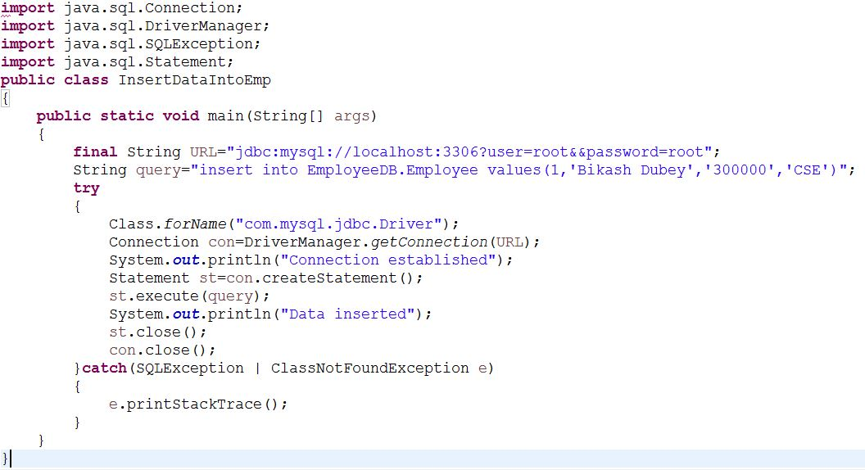

Slide 8
While working with JDBC, There is no support Object-level relationship.
To overcome the above problems we use ORM tool i.e. Hibernate framework. By using Hibernate we can avoid all the above problems and we can enjoy some additional set of functionalities.

Slide 9
What is ORM?
ORM refers to the Object-Relational Mapping. It is a programming technique for converting data between incompatible type systems like relational databases and object oriented programming languages like java.
What is Hibernate?
Hibernate is a Java-based Object-Relational Mapping (ORM) tool that simplifies database interactions by allowing developers to work with Java objects rather than SQL statements. Hibernate abstracts the complexities of JDBC and automates many database operations.

Slide 10
Key Features of Hibernate:
Object-Relational Mapping (ORM): Maps Java objects to database tables, making it easier to manage data as objects.
HQL (Hibernate Query Language): Provides a powerful query language that works with Java objects instead of tables.
Caching: Built-in support for first-level and second-level caching to enhance performance and speeds up query execution.
Database Independence: Hibernate can work with multiple database systems without requiring code changes.
Lazy Loading: Fetches data on demand, reducing unnecessary database interactions making it suitable for large-scale applications.
Automatic Schema Generation: Hibernate can automatically generate database schemas based on Java entity classes.
Minimizes Boilerplate Code: It eliminates the need for repetitive JDBC code for tasks like establishing connections, handling transactions, and managing result sets.
Transaction Management: Hibernate integrates seamlessly with JTA (Java Transaction API) and provides support for handling transactions easily.
Integration with Frameworks: Hibernate integrates well with other popular frameworks like Spring. The Spring-Hibernate combination is widely used in enterprise-level applications.

Slide 11
JDBC vs Hibernate: Conclusion: JDBC is the core API for database interactions in Java, providing flexibility and direct control over SQL operations. However, for complex, scalable, and maintainable applications, Hibernate is preferred due to its ORM capabilities, reduced development effort, and performance optimization features. Together, they cater to different needs and can complement each other in modern Java applications.
Aspect | JDBC | Hibernate
Abstraction | Low-level API, requires manual SQL coding. | High-level ORM, abstracts database details.
Development Effort | Requires more code for queries and mapping. | Reduces boilerplate code significantly.
Portability | Limited; requires SQL changes for new DB. | Highly portable across databases.
Performance | No built-in caching, manual optimization. | Built-in caching and optimization features.
Query Language | Plain SQL | HQL and Criteria API.
Learning Curve | Easier to start for simple queries. | Steeper due to ORM concepts.

Slide 12
Position of Hibernate in the Technology Stack
Note: The persistence layer in an application refers to the part of the system responsible for managing and storing data, typically in a database. It ensures that an application's data is preserved (or persisted) even after the application stops running.
Hibernate acts as the persistence layer within an application architecture, sitting between the business logic and the database. The persistence layer is the layer of the application that interacts with the database to handle tasks like:
Storing data: Saving objects in the database.
Retrieving data: Fetching objects from the database.
Updating data: Modifying existing data in the database.
Deleting data: Removing data from the database.
Hibernate is a Java-based ORM tool that provides a framework for mapping Java objects to database tables and vice versa. It simplifies the implementation of the persistence layer by eliminating the need to write complex SQL queries for CRUD (Create, Read, Update, Delete) operations.

Slide 13
How Hibernate Integrates with Other Frameworks
Spring Framework:
Hibernate is often used with Spring ORM or Spring Data JPA to simplify persistence management.
Spring provides dependency injection and transaction management, while Hibernate handles object persistence.
REST APIs:
Hibernate is used in RESTful services to manage data persistence. For example, a Spring Boot REST API may use Hibernate to fetch or save data to a database.
Microservices:
In microservices architecture, Hibernate can be used as the persistence layer within individual services.

Slide 14
Visual Representation of Hibernate in the Stack
Frontend: React / Angular / HTML / CSS
|
Backend: Spring Boot / Spring Framework
|
Persistence Layer: Hibernate (ORM Tool)
|
Database: MySQL / PostgreSQL / Oracle / MongoDB
Hibernate bridges the gap between the object-oriented world of Java and the relational database world, making it a key part of the persistence layer in Java application development.

Slide 15
Hibernate Architecture
There are 4 layers in hibernate architecture
Java application layer
Hibernate framework layer
Backend API layer
Database layer.
Internal API used by Hibernate
JDBC (Java Database Connectivity)
JTA (Java Transaction API)
JNDI (Java Naming Directory Interface)
How a Java Application Connects with Hibernate Using Persistent Objects
In a Hibernate-based Java application, persistent objects are Java objects that Hibernate manages and synchronizes with a database. These objects represent rows in the database and are tied to a Hibernate Session.

Slide 16
