Slide 1
What is JDBC?
JDBC (Java Database Connectivity) is a Java API that allows Java programs to connect to and interact with databases. It provides a standard interface for executing SQL statements, retrieving results, and performing database operations.
In the context of JDBC, the term API does not refer to fetching data from server endpoints or REST APIs. Instead, it stands for Application Programming Interface, which is a set of classes, interfaces, and methods provided by Java for interacting with relational databases (e.g., MySQL, PostgreSQL, Oracle).

Slide 2
Key Components of JDBC as an API:
Connection: Establishes a connection with the database.
Statement and PreparedStatement: Executes SQL queries.
ResultSet: Retrieves the data returned by the database.
DriverManager: Manages database drivers.
Does JDBC Fetch Data from API Endpoints?
No, JDBC is designed to interact directly with databases through SQL.
It does not fetch data from server APIs or REST endpoints. If you need to fetch data from APIs or endpoints, you would typically use libraries like HttpURLConnection, HttpClient, or frameworks like Spring Web.

Slide 3
Key Difference: JDBC vs. REST APIs
Aspect | JDBC | REST API
Purpose | Connects to databases to execute SQL queries. | Fetches data from web server endpoints.
Communication | Communicates with databases via SQL. | Communicates with APIs using HTTP methods.
Data Format | Works with relational database tables. | Typically exchanges data in JSON or XML.
Usage | For database operations (CRUD). | For accessing web-based services or APIs.

Slide 4
Key Features of JDBC:
Database Independence: JDBC provides a uniform interface to interact with various databases (MySQL, Oracle, PostgreSQL, etc.).
SQL Execution: It enables developers to execute SQL queries and updates directly from Java programs.
ResultSet Handling: JDBC allows reading and manipulating the results of SQL queries through the ResultSet object.
Connection Management: It provides mechanisms for establishing and managing database connections.
Prepared Statements: JDBC supports prepared statements to execute parameterized queries and improve performance.

Slide 5
Why JDBC?
Database Communication: JDBC acts as a bridge between Java applications and relational databases, enabling database operations.
Direct SQL Execution: Developers can write and execute SQL queries directly in Java programs.
Standard API: It provides a consistent API for accessing various databases, regardless of the database vendor.
Core for Database Integration: JDBC is the foundational technology for Java database integration and is used by advanced frameworks like Hibernate and JPA.
Customization and Flexibility: It allows developers to write custom SQL queries for complex database interactions.

Slide 6
Why Hibernate?
Hibernate is used to overcome the of limitations of JDBC like:
If working with JDBC, changing of Database in middle of the project is very costly.
JDBC code is not portable code across the multiple database software.
In JDBC, Exception handling is mandatory. Here We can see that we are handling lots of Exception for connection.
JDBC code is dependent upon the Database software being used i.e. our persistence logic is dependent, because of using JDBC. Here we are inserting a record into Employee table but our query is Database software-dependent i.e. Here we are using MySQL. But if we change our Database then this query won’t work.

Slide 7
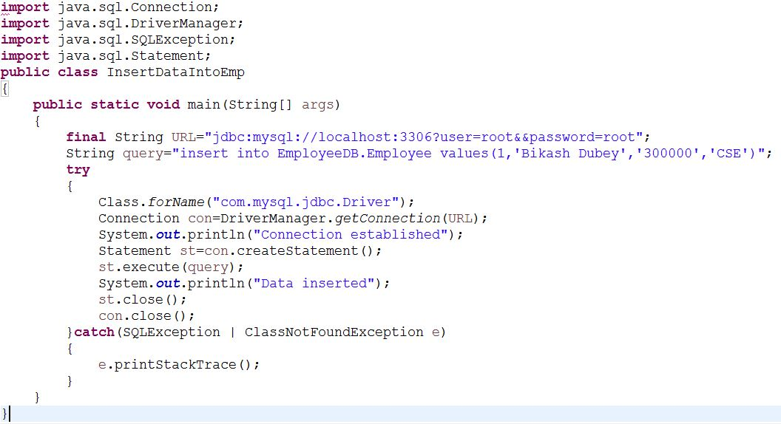

Slide 8
While working with JDBC, There is no support Object-level relationship.
To overcome the above problems we use ORM tool i.e. Hibernate framework. By using Hibernate we can avoid all the above problems and we can enjoy some additional set of functionalities.

Slide 9
What is ORM?
ORM refers to the Object-Relational Mapping. It is a programming technique for converting data between incompatible type systems like relational databases and object oriented programming languages like java.
What is Hibernate?
Hibernate is a Java-based Object-Relational Mapping (ORM) tool that simplifies database interactions by allowing developers to work with Java objects rather than SQL statements. Hibernate abstracts the complexities of JDBC and automates many database operations.

Slide 10
Key Features of Hibernate:
Object-Relational Mapping (ORM): Maps Java objects to database tables, making it easier to manage data as objects.
HQL (Hibernate Query Language): Provides a powerful query language that works with Java objects instead of tables.
Caching: Built-in support for first-level and second-level caching to enhance performance and speeds up query execution.
Database Independence: Hibernate can work with multiple database systems without requiring code changes.
Lazy Loading: Fetches data on demand, reducing unnecessary database interactions making it suitable for large-scale applications.
Automatic Schema Generation: Hibernate can automatically generate database schemas based on Java entity classes.
Minimizes Boilerplate Code: It eliminates the need for repetitive JDBC code for tasks like establishing connections, handling transactions, and managing result sets.
Transaction Management: Hibernate integrates seamlessly with JTA (Java Transaction API) and provides support for handling transactions easily.
Integration with Frameworks: Hibernate integrates well with other popular frameworks like Spring. The Spring-Hibernate combination is widely used in enterprise-level applications.

Slide 11
JDBC vs Hibernate: Conclusion: JDBC is the core API for database interactions in Java, providing flexibility and direct control over SQL operations. However, for complex, scalable, and maintainable applications, Hibernate is preferred due to its ORM capabilities, reduced development effort, and performance optimization features. Together, they cater to different needs and can complement each other in modern Java applications.
Aspect | JDBC | Hibernate
Abstraction | Low-level API, requires manual SQL coding. | High-level ORM, abstracts database details.
Development Effort | Requires more code for queries and mapping. | Reduces boilerplate code significantly.
Portability | Limited; requires SQL changes for new DB. | Highly portable across databases.
Performance | No built-in caching, manual optimization. | Built-in caching and optimization features.
Query Language | Plain SQL | HQL and Criteria API.
Learning Curve | Easier to start for simple queries. | Steeper due to ORM concepts.

Slide 12
Position of Hibernate in the Technology Stack
Note: The persistence layer in an application refers to the part of the system responsible for managing and storing data, typically in a database. It ensures that an application's data is preserved (or persisted) even after the application stops running.
Hibernate acts as the persistence layer within an application architecture, sitting between the business logic and the database. The persistence layer is the layer of the application that interacts with the database to handle tasks like:
Storing data: Saving objects in the database.
Retrieving data: Fetching objects from the database.
Updating data: Modifying existing data in the database.
Deleting data: Removing data from the database.
Hibernate is a Java-based ORM tool that provides a framework for mapping Java objects to database tables and vice versa. It simplifies the implementation of the persistence layer by eliminating the need to write complex SQL queries for CRUD (Create, Read, Update, Delete) operations.

Slide 13
How Hibernate Integrates with Other Frameworks
Spring Framework:
Hibernate is often used with Spring ORM or Spring Data JPA to simplify persistence management.
Spring provides dependency injection and transaction management, while Hibernate handles object persistence.
REST APIs:
Hibernate is used in RESTful services to manage data persistence. For example, a Spring Boot REST API may use Hibernate to fetch or save data to a database.
Microservices:
In microservices architecture, Hibernate can be used as the persistence layer within individual services.

Slide 14
Visual Representation of Hibernate in the Stack
Frontend: React / Angular / HTML / CSS
|
Backend: Spring Boot / Spring Framework
|
Persistence Layer: Hibernate (ORM Tool)
|
Database: MySQL / PostgreSQL / Oracle / MongoDB
Hibernate bridges the gap between the object-oriented world of Java and the relational database world, making it a key part of the persistence layer in Java application development.

Slide 15
Hibernate Architecture
There are 4 layers in hibernate architecture
Java application layer
Hibernate framework layer
Backend API layer
Database layer.
Internal API used by Hibernate
JDBC (Java Database Connectivity)
JTA (Java Transaction API)
JNDI (Java Naming Directory Interface)
How a Java Application Connects with Hibernate Using Persistent Objects
In a Hibernate-based Java application, persistent objects are Java objects that Hibernate manages and synchronizes with a database. These objects represent rows in the database and are tied to a Hibernate Session.

Slide 16
Key States of Objects in Hibernate
Transient Object:
Not associated with any database or Hibernate session.
Exists in Java memory, but no database representation.
Example:
Student student = new Student();
student.setName("John");
student.setEmail("john@example.com");

Slide 17
2. Persistent Object:
Associated with a Hibernate session and database.
Any changes are tracked by Hibernate and updated in the database automatically.
An instance of a Java class that represents a table row in a database.
Example:
Session session = HibernateUtil.getSessionFactory().openSession();
session.beginTransaction();
session.save(student); // 'student' becomes persistent
student.setName("John Doe"); // Tracked by Hibernate, will update DB
session.getTransaction().commit();
session.close();
3. Detached Object:
Previously a persistent object, but its session is closed.
No longer tracked by Hibernate.

Slide 18
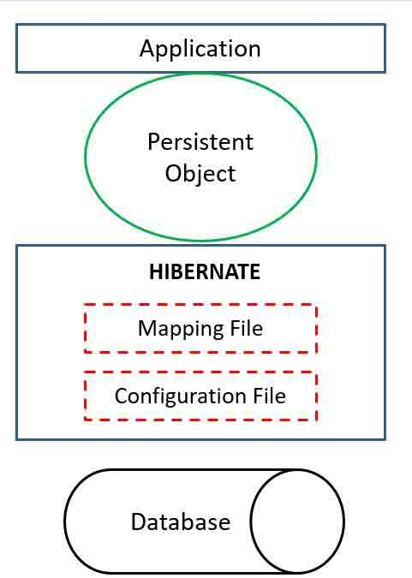
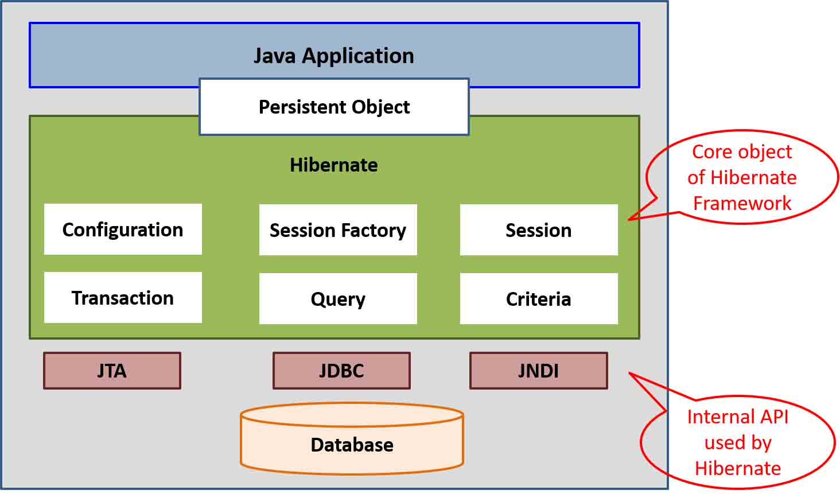

Slide 19
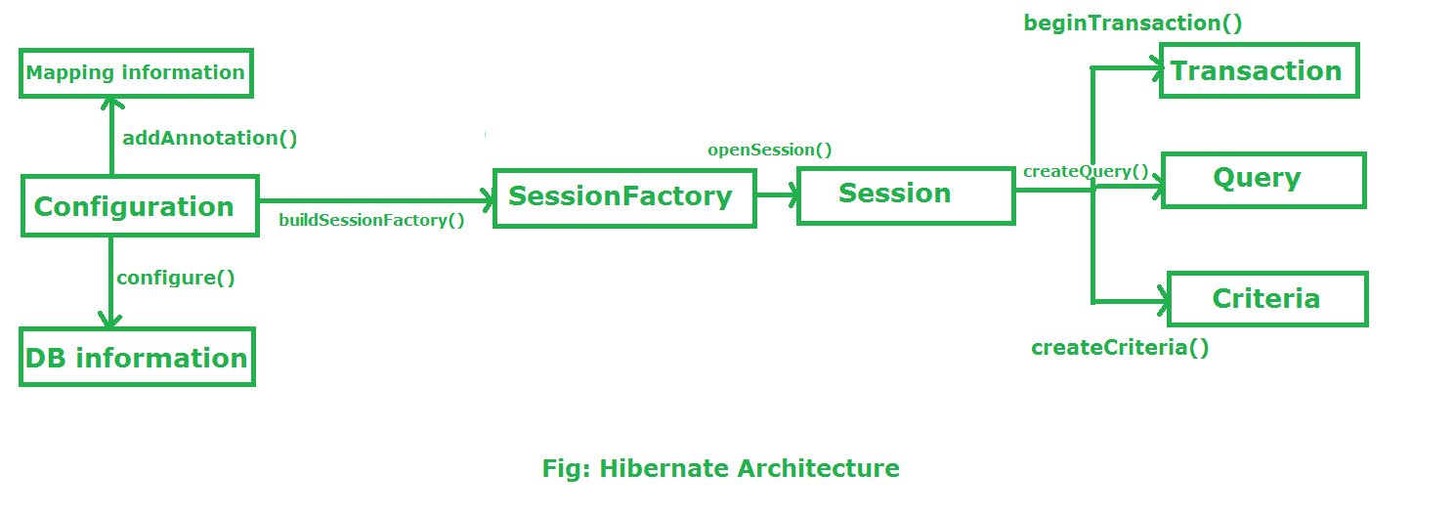
More About Hibernate Architecture:

Slide 20
Configuration:
Configuration is a class which is present in org.hibernate.cfg package. It activates Hibernate framework. It reads both configuration file and mapping files.
It activate Hibernate Framework
Configuration cfg=new Configuration();
It read both cfg file and mapping files
cfg.configure();
It checks whether the config file is syntactically correct or not.
If the config file is not valid then it will throw an exception. If it is valid then it creates a meta-data in memory and returns the meta-data to object to represent the config file.

Slide 21
Example :
<hibernate-configuration>
<session-factory>
<property name="hibernate.connection.driver_class">com.mysql.cj.jdbc.Driver</property>
<property name="hibernate.connection.url">jdbc:mysql://localhost:3306/mydb</property>
<property name="hibernate.connection.username">root</property>
<property name="hibernate.connection.password">password</property>
<property name="hibernate.dialect">org.hibernate.dialect.MySQLDialect</property>
<property name="hibernate.hbm2ddl.auto">update</property>
</session-factory>
</hibernate-configuration>
Hibernate's configuration is defined in the hibernate.cfg.xml or hibernate.properties file.
It specifies the database connection details, Hibernate properties, and mappings for entity classes.

Slide 22
SessionFactory:
SessionFactory is an Interface which is present in org.hibernate package and it is used to create Session Object (A SessionFactory is a factory for creating Session objects).
It is immutable and thread-safe in nature and should be instantiated only once per application.
buildSessionFactory() method gathers the meta-data which is in the cfg Object.
From cfg object it takes the JDBC information and create a JDBC Connection.
SessionFactory factory=cfg.buildSessionFactory();
It is a heavyweight object that manages database connections and is created once for the application.
Example: SessionFactory sessionFactory = new Configuration()
.configure("hibernate.cfg.xml")
.buildSessionFactory();

Slide 23
Session:
Session is an interface which is present in org.hibernate package for interacting with the database.
Session object is created based upon SessionFactory object i.e. factory.
It opens the Connection/Session with Database software through Hibernate Framework.
It is a light-weight object and it is not thread-safe.
Session object is used to perform CRUD operations.
Session session=factory.openSession();
It acts as a persistence context for managing entities and their lifecycle (transient, persistent, detached).
It is not thread-safe and should be created per transaction or request.
Example: Session session = sessionFactory.openSession();
Transaction transaction = session.beginTransaction();
// Perform CRUD operations
transaction.commit();
session.close();

Slide 24
Transaction:
Transaction object is used whenever we perform any operation and based upon that operation there is some change in database.
Transaction object is used to give the instruction to the database to make the changes that happen because of operation as a permanent by using commit() method.
Transaction tx=session.beginTransaction();
tx.commit();
Example: Transaction transaction = session.beginTransaction();
try {
// Database operations
transaction.commit();
} catch (Exception e) {
transaction.rollback();
}

Slide 25
Query:
Hibernate provides the Query and Criteria API for executing database queries.
Query is an interface that present inside org.hibernate package.
A Query instance is obtained by calling session.createQuery().
This interface exposes some extra functionality beyond that provided by Session.iterate() and Session.find():
A particular page of the result set may be selected by calling setMaxResults(), setFirstResult().
Named query parameters may be used.
Query query=session.createQuery();
You can write HQL (Hibernate Query Language) or native SQL queries to fetch and manipulate data.
Example using HQL: Query<Student> query = session.createQuery("FROM Student WHERE name = :name", Student.class);
query.setParameter("name", "Alice");
List<Student> students = query.list();

Slide 26
Criteria:
Criteria is a simplified API for retrieving entities by composing Criterion objects.
The Session is a factory for Criteria. Criterion instances are usually obtained via the factory methods on Restrictions.
Criteria criteria=session.createCriteria();
The Criteria API is used to build dynamic queries programmatically without writing HQL.
Example:
CriteriaBuilder cb = session.getCriteriaBuilder();
CriteriaQuery<Student> cr = cb.createQuery(Student.class);
Root<Student> root = cr.from(Student.class);
cr.select(root).where(cb.equal(root.get("name"), "Alice"));
Query<Student> query = session.createQuery(cr);
List<Student> results = query.getResultList();

Slide 27
Entity:
Entities are plain old Java objects (POJOs) annotated with Hibernate or JPA annotations to map them to database tables.
Example:
@Entity
@Table(name = "students")
public class Student {
@Id
@GeneratedValue(strategy = GenerationType.IDENTITY)
private int id;
@Column(name = "name")
private String name;
@Column(name = "email")
private String email;
// Getters and setters
}

Slide 28
Persistent Context
The persistence context is the runtime environment where Hibernate manages persistent objects.
It is tied to the lifecycle of a Session and ensures that changes made to objects in memory are synchronized with the database.
HQL (Hibernate Query Language)
HQL is an object-oriented query language, similar to SQL but focused on entity objects rather than database tables.
Example:
List<Student> students = session.createQuery("FROM Student WHERE name = 'Alice'", Student.class).list();

Slide 29
Hibernate Dialect
Hibernate uses dialects to generate database-specific SQL queries.
Examples include:
org.hibernate.dialect.MySQLDialect (for MySQL)
org.hibernate.dialect.PostgreSQLDialect (for PostgreSQL)
org.hibernate.dialect.SQLServerDialect (for SQL Server)
Caching
Hibernate supports first-level caching (enabled by default) and second-level caching for optimizing database performance.
First-level cache: Scoped to the Hibernate session.
Second-level cache: Shared across sessions (requires external cache providers like Ehcache).

Slide 30
What’s the difference between .hbm and annotation in hibernate ?
In Hibernate, .hbm files and annotations are two ways to map Java objects (entities) to database tables.
Definition and Approach
.hbm Files:
Stands for Hibernate Mapping files.
These are XML-based configuration files where mappings between Java classes and database tables are defined.
Typically have the extension .hbm.xml.
Annotations:
Use Java's annotation feature (@Annotation) to define the mapping directly in the Java entity classes.
Introduced in Hibernate 3.0 to reduce the need for external XML files.

Slide 31
Ease of Use
.hbm Files:
Require maintaining separate XML files, which increases the effort of keeping mappings in sync with the code.
Can become tedious in large projects with many entities.
Annotations:
Are part of the entity class, so the mapping information is co-located with the class definition.
Easier to manage and read because all the mapping details are in the same file as the class.

Slide 32
Example Comparison
.hbm.xml Mapping:
<hibernate-mapping>
<class name="com.example.Student" table="student">
<id name="id" column="student_id">
<generator class="increment"/>
</id>
<property name="name" column="student_name"/>
<property name="age" column="student_age"/>
</class>
</hibernate-mapping>

Slide 33
Annotation-Based Mapping:
@Entity
@Table(name = "student")
public class Student {
@Id
@GeneratedValue(strategy = GenerationType.IDENTITY)
@Column(name = "student_id")
private int id;
@Column(name = "student_name")
private String name;
@Column(name = "student_age")
private int age;
// Getters and Setters
}

Slide 34
Summary
Aspect | .hbm Files | Annotations
Location | Separate XML files | In the Java entity class
Simplicity | More verbose | Cleaner and simpler
Flexibility | Better for legacy systems | Tightly coupled with code
Performance | Slightly slower (XML parsing) | Faster (no XML parsing)
Portability | Independent of source code | Bound to the source code

Slide 35
JPA - Introduction
JPA (Java Persistence API) is a Java specification that makes it easier to work with relational databases. It lets you map Java classes (entities) to database tables and manage data using simple APIs instead of writing complex SQL.
In short, JPA acts as a bridge between Java objects and database records, simplifying database operations in Java applications.

Slide 36
@GeneratedValue(strategy = GenerationType.<?>)
The annotation @GeneratedValue(strategy = GenerationType.<?>) is used in Java Persistence API (JPA) to specify how the primary key of an entity should be automatically generated.
Common Use Case
Used with databases like MySQL, PostgreSQL, or SQL Server, which support auto-incrementing columns.
JPA provides four main strategies for generating primary key values via the @GeneratedValue annotation.

Slide 37
Here's a breakdown of each GenerationType:
GenerationType.IDENTITY
How it works: Relies on the database's auto-increment feature.
Best for: MySQL, SQL Server.
GenerationType.SEQUENCE
How it works: Uses a database sequence object to generate unique IDs.
Best for: Oracle, PostgreSQL.

Slide 38
GenerationType.TABLE
How it works: Uses a separate table to maintain and generate primary
key values.
Best for: Databases without native sequence or identity support.
GenerationType.AUTO
How it works: JPA chooses the most appropriate strategy based on the
database dialect.
Best for: General use when you want JPA to decide.

