Slide 1
Project 0
By
Selena Fears

Slide 2
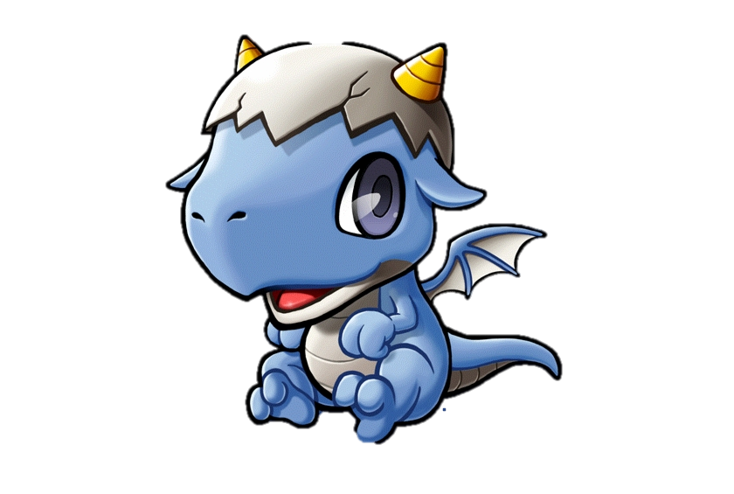


A Scala Game
Pet
Or
Do Not Pet
That Is The Question

Slide 3
Tech Stacks Used
Scala 2.11.12
SQL 8.0.19
SBT 1.5.4
VS Code
GitHub (https://github.com/ProgrammingWithCybineer/Project_0_Scala_Game)

