Slide 1

Streams
Lambdas
Peter Borovanský
KAI, I-18
borovan 'at' ii.fmph.uniba.sk
http://dai.fmph.uniba.sk/courses/JAVA/

Slide 2
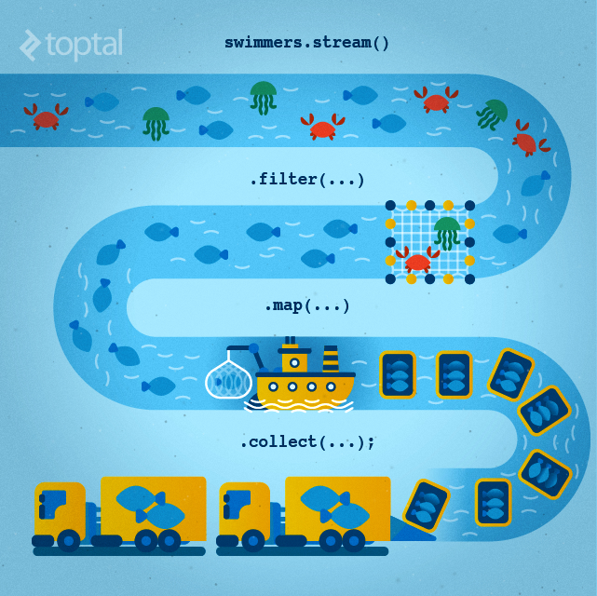
Java Collections
dnes bude:
Cvičenie (bohužiaľ nemáme):
Slajd < Java 8
(všade)
Slajd = Java 8
(v terminálke)
Slajd = Java 9
(v LISTe)
Slajd = Java 10
(v LISTe)
http://en.proft.me/2016/11/13/tutorial-lambda-expression-and-stream-api-java-8/

Slide 3
Anonymné funkcie v Jave
(lambdas)
(double a, double b) -> { return Math.sqrt(a*a+b*b); }
Typová inferencia typov parametrov
(a, b) -> { return Math.sqrt(a*a+b*b); }
(a, b) -> { Math.sqrt(a*a+b*b) }
(a, b) -> Math.sqrt(a*a+b*b)
n -> n*n
Lambda notácia fungujú s funkcionálnym interface = má jednu metódu
anotácia pre FI je @FunctionalInterface

Slide 4
Príklad
(anonymné lambdy)
public class Example {
interface BinOp { double operation(double a, double b); }
public static void main(String args[]){
BinOp plus = (a, b) -> a + b;
BinOp vector =
(double a, double b) -> {return Math.sqrt(a*a + b*b); };
System.out.println("3 + 4 = " + plus.operation(3, 4));
System.out.println("vector(3,4) = "+vector.operation(3,4));
}
}
Example.main(null);

Slide 5
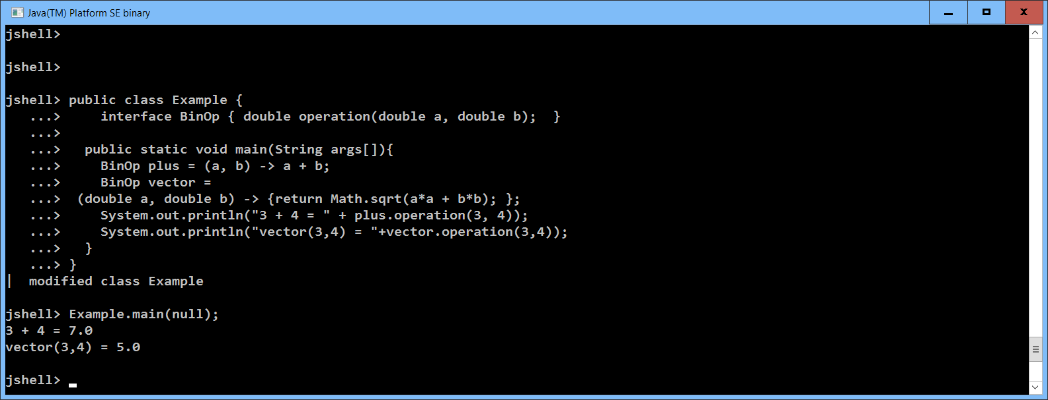

Jshell
(Java 9)

Slide 6

JDK8 - funkcionálny interface
interface FunkcionalnyInterface { // koncept funkcie v J8
public void doit(String s); // jediná “procedúra”
}
// „procedúra“ ako argument
public static void foo(FunkcionalnyInterface fi) {
fi.doit("hello");
}
// „procedúra“ ako hodnota, výsledok
public static FunkcionalnyInterface goo() {
return (String s) -> System.out.println(s + s);
}
foo(goo())
"hellohello"
Funkcie.java

Slide 7

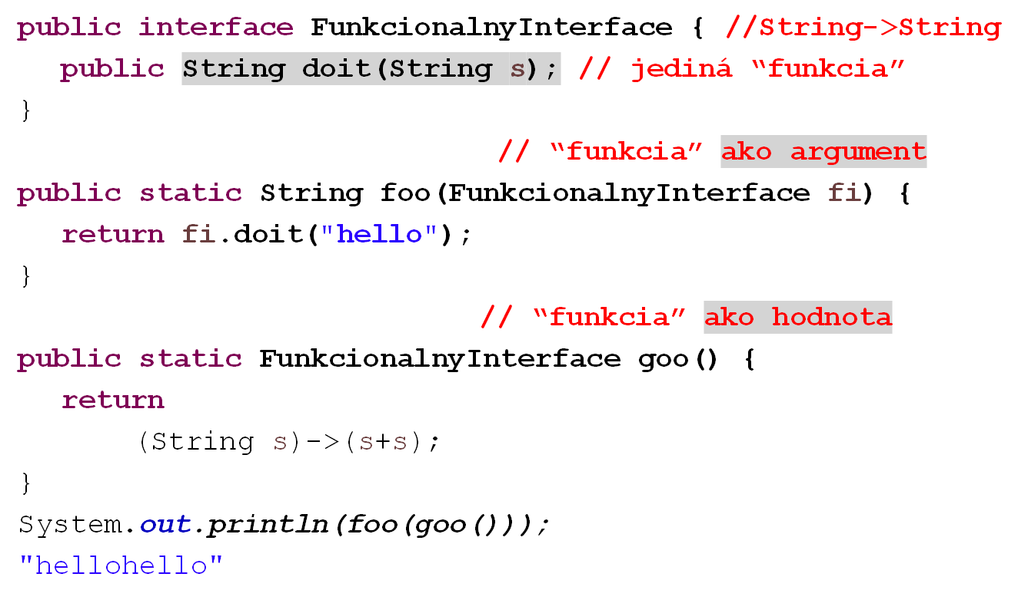
JDK8 - funkcionálny interface
Funkcie.java

Slide 8
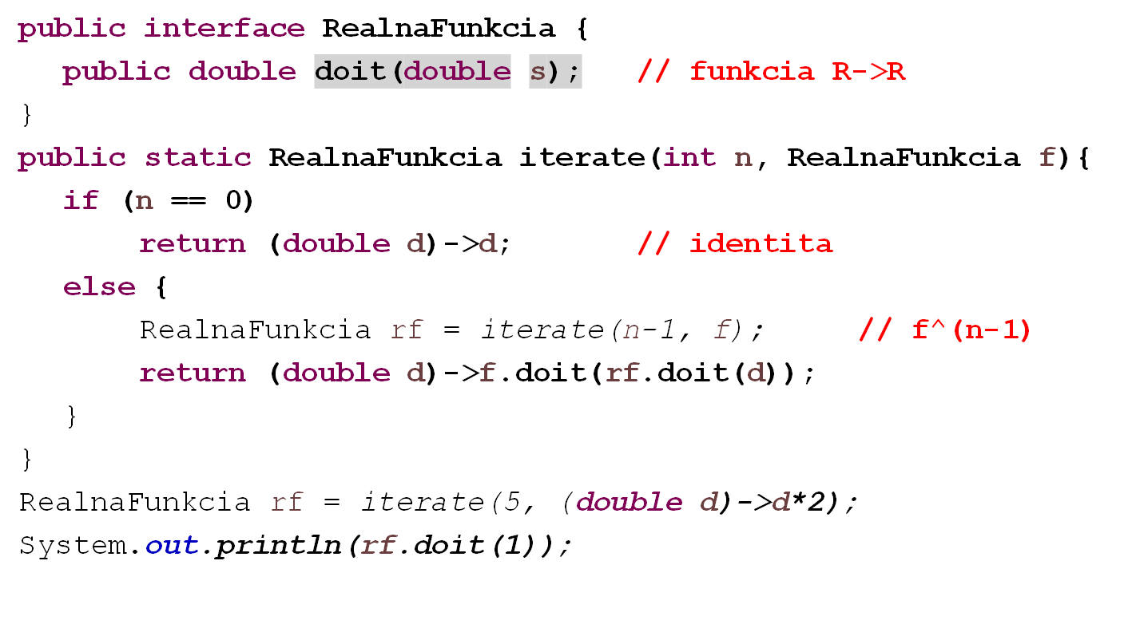
JDK8 - funkcionálny interface
Funkcie.java

Slide 9
JDK8 - funkcionálny interface
java.lang.Runnable void run()
java.util.concurrent.Callable
java.io.FileFilter boolean accept(File pathname)
java.util.Comparator<T> int compare(<T> o1, <T> o2)
Function<T,R> <R> apply(<T>)
Predicate<T> boolean test(<T>)
Príklady:
Function<Double,Double> celsius2Fahrenheit = x -> ((x*9/5)+32);
Function<Double,Double> rad2Deg = r -> ((r/Math.PI)*180);
Function<String, Integer> string2Int = x -> Integer.valueOf(x);
Function<Integer, String> int2String = x -> String.valueOf(x);
System.out.println("C->F: "+celsius2Fahrenheit.apply(30.0)); // 86.0
System.out.println("rad2Deg: "+rad2Deg.apply(Math.PI)); // 180
System.out.println(" string2Int: " + string2Int.apply("4")); // 4
System.out.println(" int2String: " + int2String.apply(123)); // "123"

Slide 10
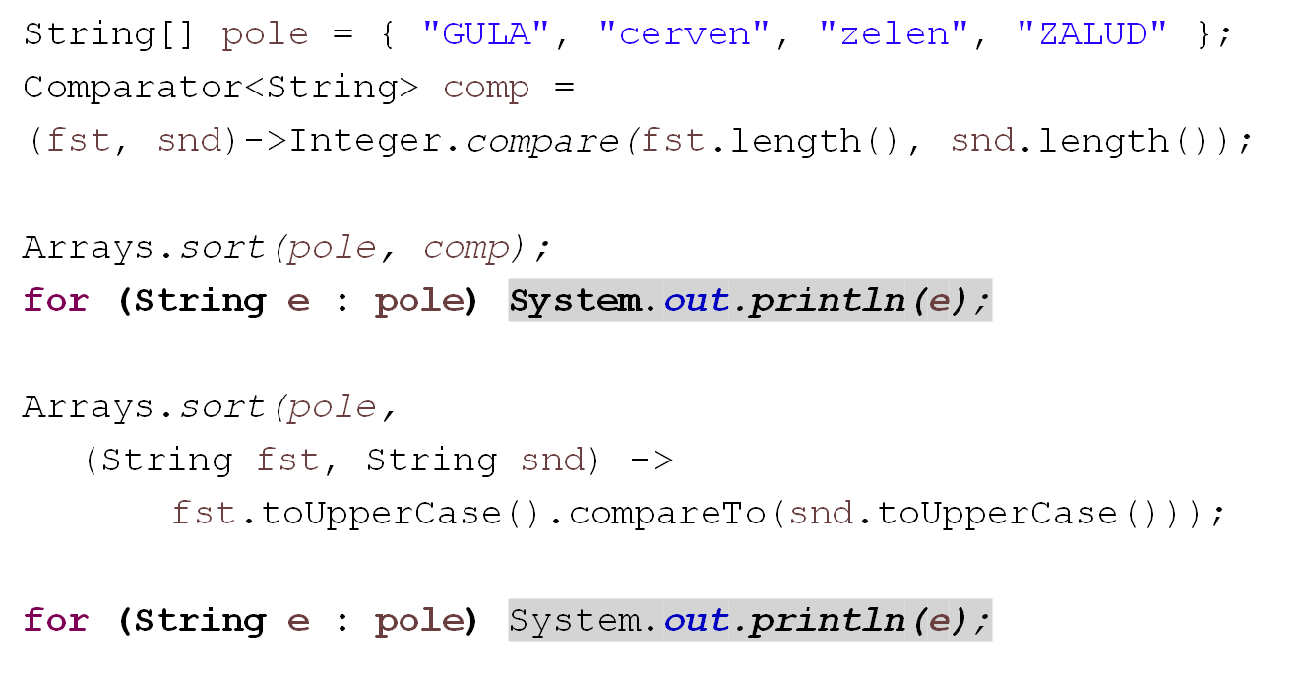
Java 8
GULA
zelen
ZALUD
cerven
cerven
GULA
ZALUD
zelen
Funkcia.java

Slide 11
forEach, map, filter v Java8
class Karta {
int hodnota;
String farba;
public Karta(int hodnota, String farba) { … }
public void setFarba(String farba) { … }
public int getHodnota() { … }
public void setHodnota(int hodnota) { … }
public String getFarba() { … }
public String toString() { … }
}
List<Karta> karty = new ArrayList<Karta>();
karty.add(new Karta(7,"Gula"));
karty.add(new Karta(8,"Zalud"));
karty.add(new Karta(9,"Cerven"));
karty.add(new Karta(10,"Zelen"));
MapFilter.java

Slide 12
forEach, map, filter v Java8
karty.forEach(k -> k.setFarba("Cerven"));
Stream<Karta> vacsieKartyStream =
karty.stream().filter(k -> k.getHodnota() > 8);
List<Karta> vacsieKarty = vacsieKartyStream.collect(Collectors.toList());
List<Karta> vacsieKarty2 = karty
.stream()
.filter(k -> k.getHodnota() > 8)
.collect(Collectors.toList());
[Gula/7, Zalud/8, Cerven/9, Zelen/10]
[Cerven/7, Cerven/8, Cerven/9, Cerven/10]
[Cerven/9, Cerven/10]
[Cerven/9, Cerven/10]
MapFilter.java

Slide 13
forEach, map, filter v Java8
List<Karta> vacsieKarty3 = karty
.stream()
.map(k->new Karta(k.getHodnota()+1,k.getFarba()))
.filter(k -> k.getHodnota() > 8)
.collect(Collectors.toList());
List<Karta> vacsieKarty4 = karty
.stream()
.parallel()
.filter(k -> k.getHodnota() > 8)
.sequential()
.collect(Collectors.toList());
[Cerven/9, Cerven/10, Cerven/11]
[Cerven/9, Cerven/10]
MapFilter.java

Slide 14
Kolekcie
(a práca s nimi – ako to poznáme)
List<Integer> lst = new ArrayList<Integer>();
List<Integer> lst = new ArrayList<>();
for (int i = 0; i < 100; i++)
lst.add(i);
// explicitná inicializácia
List<Integer> lst1 = Arrays.asList(0,1,2,3,4,5,6,7,8,9);
// Nová syntax Java 9
List<Integer> list = List.of(0, 1, 2, 3, 4, 5, 6, 7, 8, 9);
Set<Integer> set = Set.of(0, 1, 2, 3, 4, 5, 6, 7, 8, 9);
Map<String,Integer> map = Map.of("Jano",1, "Palo",3, "Igor", 0);
for (Integer value : lst) // foreach cyklus
System.out.println(value);
lst.forEach(System.out::println); // foreach metóda
lst.forEach(e -> System.out.println(e+e));

Slide 15
JAVA 8 Stream API
(sekvenčný a paralelný)
lst.stream().forEach(e -> System.out.println(e+e));
// stream() prerobí kolekciu na java.util.stream
Stream<Integer> stream = lst.stream();
stream.count() // 100
Stream<Integer> stream = lst.stream();
stream.forEach(System.out::println);
stream.forEach(System.out::println); // !!!
// Excetion: stream has already been operated upon or closed
// toto už nedostaneme v poradí 0, 1, ...
lst.parallelStream().forEach(e -> System.out.println(e+e));

Slide 16
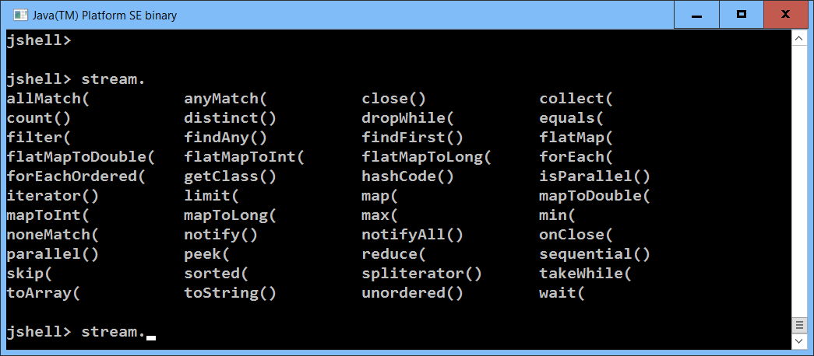
Jshell pozná autocompletion
Kliknite na TAB

Slide 17
map/filter
(existuje/neexistuje/pre všetky)
lst.
stream().
filter(e -> (e % 2 == 0)).
forEach(System.out::print); // 02468101214161820222…
lst.
stream().
map(e -> e*e).
forEach(System.out::print); // 01491625364964 …
lst.stream().anyMatch(e -> (e == 51)) // true
lst.stream().anyMatch(e -> (e * e == e)) // true
lst.stream().noneMatch(e -> (e > 100)) // true
lst.stream().noneMatch(e -> (e + e == e)) // false
lst.stream().allMatch(e -> e>0 ) // false
lst.stream().filter(e -> e>0 ).count() // 99

Slide 18
Optional
(buď existuje alebo neexistuje)
lst.stream().findFirst() // Optional[0]
lst.stream().findFirst().get() // 0
lst.parallelStream().findAny().get() // 56,65,… nejednoznačné
lst.stream().min(Integer::compare).get() // 0
lst.stream().min(Integer::compare).isPresent() // true
lst.stream().max(Integer::compare).get() // 99
lst.stream().map(i->i%10).sorted().forEach(System.out::print);
0000000000111111111122222222223333333333444444444455555555556666
666666777777777788888888889999999999
lst.stream().map(i->i%10).distinct().forEach(System.out::print);
0123456789

Slide 19
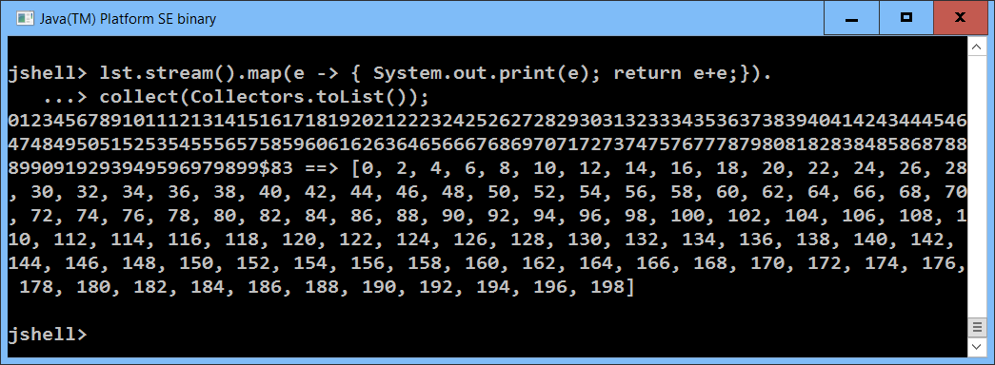
Lenivosť
(laziness)
lst.stream().map(e -> { System.out.print(e); return e+e;})
lst.stream().filter(e -> {System.out.print(e);return true;});
lst.stream().map(e -> { System.out.print(e); return e+e;}).
findFirst().get() // 0
lst.stream().map(e -> { System.out.print(e); return e+e;}).
collect(Collectors.toList());

Slide 20
ParallelStream
(komutatívnosť)
lst.parallelStream().
map(e -> e+e).
filter(e -> (e % 3 > 0)).
forEach(e -> System.out.println(e))
lst.parallelStream().
filter(e -> (e % 3 > 0)).
map(e -> e+e).
forEach(e -> System.out.println(e))
lst.parallelStream().
map(e -> e+e).
filter(e -> (e % 3 > 0)).
collect(Collectors.toList()).size() // koľko je výsledok

Slide 21
ParallelStream
(skladanie funkcií)
lst.parallelStream().
map(e -> f1(e)). // čo vieme povedať o kompozícii ?
map(e -> f2(e)).
collect(Collectors.toList())
lst.parallelStream().
map(e -> f2(f1(e))). // čo vieme povedať o kompozícii ?
collect(Collectors.toList())
static Integer f1(Integer e) { return e+e; }
static Integer f2(Integer e) { return 5*e; }

Slide 22
ParallelStream
(funkcie so side-effect)
Funkcie poznáme slušné a iné:
Slušná funkcia (referenčne transparentná) vždy pre rovnaký vstup vráti rovnaký
výsledok, t.j. nerobí žiaden side-effect, nepoužíva globálnu premennú, súbor, ...
Programovací jazyk je slušný, ak v ňom môžete písať len slušné funkcie.
Príklad (neslušný):
lst.parallelStream().
map(e->funWithSideEffect(e)).
filter(e -> (e % 3 > 0)).
sorted().
collect(Collectors.toList());
Integer globalVariable = 0;
Integer funWithSideEffect(Integer n) {
return n+n + (++globalVariable);
}

Slide 23
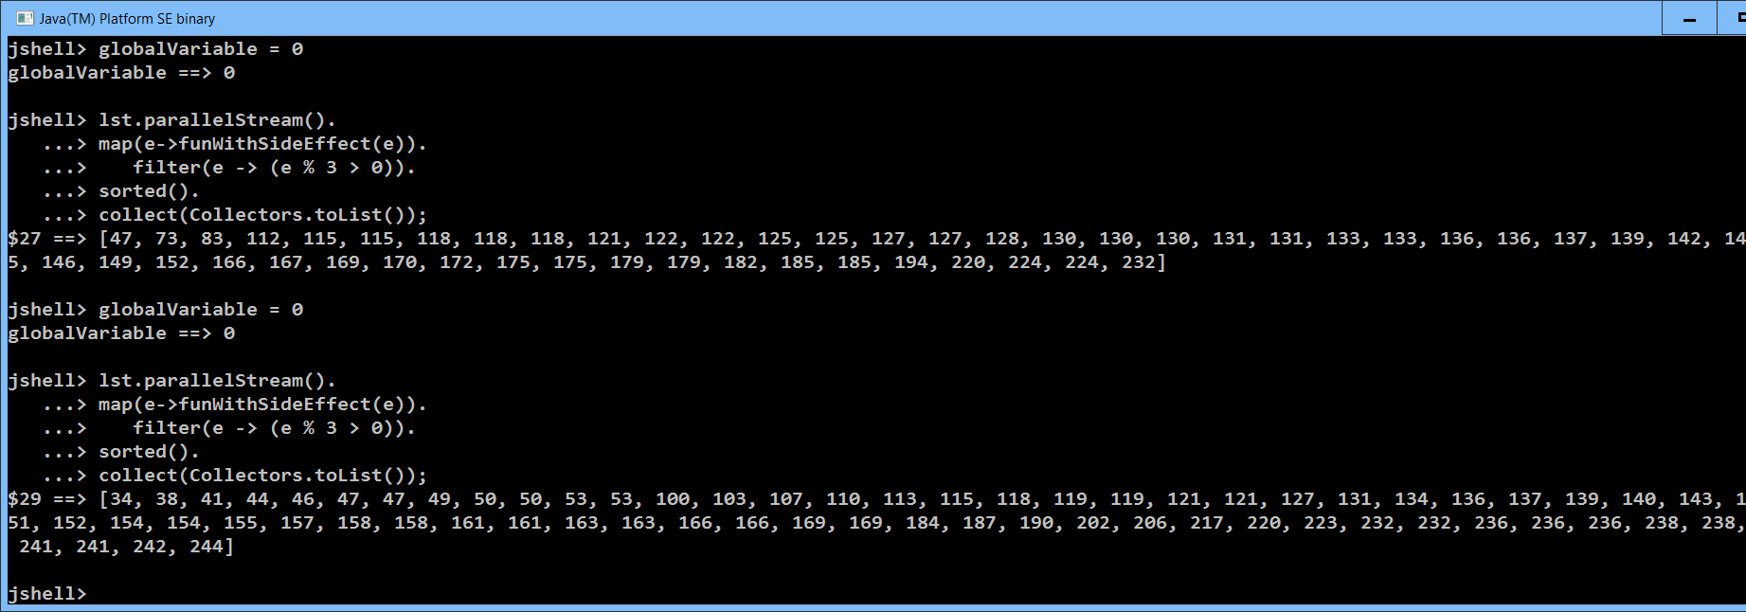
Globálne premenné
(sú identifikovaná smrť)

Slide 24
Trochu novej syntaxe
Stream.of(0,1,2,3,4,5,6,7,9).collect(Collectors.toList())
[0, 1, 2, 3, 4, 5, 6, 7, 9]
Stream.of("Palo", "Peter", "Jano", "Jana").collect(Collectors.toList())
[Palo, Peter, Jano, Jana]
Arrays.stream(new Integer[]{0,1,2,3,4,5,6,7,8,9}).collect(Collectors.toList())
[0, 1, 2, 3, 4, 5, 6, 7, 9]
IntStream.range(0,100).forEach(e -> System.out.print(e));
0123456789101112131415161718192021222324…
Map<Integer, List<Integer>>mapa = lst.parallelStream().collect(
Collectors.groupingBy( e -> (String.valueOf(e).length()) ));
{1=[0, 1, 2, 3, 4, 5, 6, 7, 8, 9], 2=[10, 11, 12, ... , 94, 95, 96, 97, 98, 99]}
mapa.forEach((len, list) -> System.out.println(len + ", "+ list));
1, [0, 1, 2, 3, 4, 5, 6, 7, 8, 9]
2, [10, 11, 12, 13, 14, 15, 16, 17, 18, 19, 20, 21, 22, 23, 24, 25, 26, 27, 28, …

Slide 25
mapToObj
IntStream.range(0,10).mapToObj(e -> (char)(64+e)).
forEach(System.out::print);
@ABCDEFGHI
IntStream.range(0,10).
mapToObj(e -> IntStream.range(0, e)).
forEach(r -> System.out.print(r.count()));
0123456789
IntStream.range(0,10).
mapToObj(e -> IntStream.range(0, e)).
forEach(r -> System.out.println(
r.boxed().collect(Collectors.toList())));
[]
[0]
[0, 1]
[0, 1, 2]
[0, 1, 2, 3]
[0, 1, 2, 3, 4]
[0, 1, 2, 3, 4, 5]
[0, 1, 2, 3, 4, 5, 6]
[0, 1, 2, 3, 4, 5, 6, 7]
[0, 1, 2, 3, 4, 5, 6, 7, 8]

Slide 26
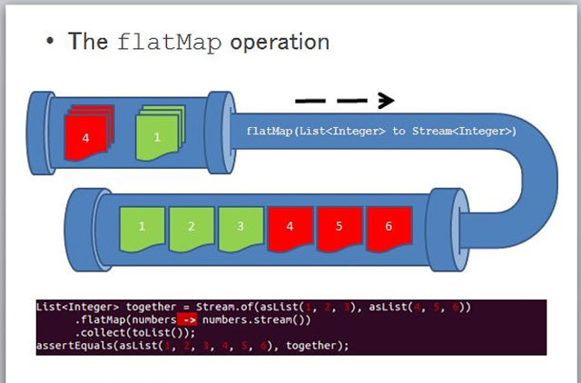
flatMap
List<List<String>> l2 = List.of(
List.of("Palo", "Jana"),
List.of("Peter", "Kamil", "Martina"));
[[Palo, Jana], [Peter, Kamil, Martina]]
l2.stream().flatMap(lst ->lst.stream()).
collect(Collectors.toList());
[Palo, Jana, Peter, Kamil, Martina]
http://www.java67.com/2016/03/how-to-use-flatmap-in-java-8-stream.html

Slide 27
flatMap
IntStream.range(0,10).
flatMap(e -> IntStream.range(0, e)).
forEach(System.out::print);
001012012301234012345012345601234567012345678
IntStream.range(0,10).
flatMap(e -> IntStream.range(0, e).
filter(i->i%2==0)).
forEach(System.out::print);
0002020240240246024602468

Slide 28
Binárne vektory {0,1}
(klasické riešenie)
List<String> binaries(int n) {
if (n == 0) {
return Arrays.asList("");
} else {
List<String> result = new ArrayList<>();
for (String s : binaries(n-1)) {
result.add(s + "0");
result.add(s + "1");
}
return result;
}
}
binaries(4)
[0000, 0001, 0010, 0011, 0100, 0101, 0110, 0111, 1000, 1001, 1010, 1011, 1100, 1101, 1110, 1111]
Počet = 2^{n}

Slide 29
Binárne vektory {0,1}
(streamové riešenie)
Stream<String> binaries1(int n) {
if (n == 0) {
return Stream.of("");
} else {
return
binaries1(n-1).
flatMap(s -> Stream.of(s + "0", s + "1"));
}
}
binaries1(4).collect(Collectors.toList())
[0000, 0001, 0010, 0011, 0100, 0101, 0110, 0111, 1000, 1001, 1010, 1011, 1100, 1101, 1110, 1111]
Počet = 2^{n}

Slide 30
Permutácie
perms(4).collect(Collectors.toList())
[4321, 3421, 3241, 3214, 4231, 2431, 2341, 2314, 4213, 2413, 2143, 2134, 4312, 3412, 3142, 3124, 4132, 1432, 1342, 1324, 4123, 1423, 1243, 1234]
Stream<String> perms(int n) {
if (n <= 0) {
return Stream.of("");
} else {
return
perms(n-1).
flatMap(s->IntStream.range(0, n).
mapToObj(i -> insert(i, n, s)) );
}
}
String insert(int i, int n, String s) {
return s.substring(0,i) +
String.valueOf(n) +
s.substring(i, s.length());
}
Počet = n!

Slide 31
Kombinácie bez opakovania
Stream<String> kbo(int k, int n) {
if (k > n) {
return Stream.of();
} else if (k == 0) {
return Stream.of("");
} else {
return Stream.concat(
kbo(k, n-1),
kbo(k-1, n-1).map(s -> s + String.valueOf(n-1)));
}
}
kbo(3,6).collect(Collectors.toList())
[012, 013, 023, 123, 014, 024, 124, 034, 134, 234, 015, 025, 125, 035, 135, 235, 045, 145, 245, 345]
Počet = n nad k

Slide 32
Kombinácie s opakovaním
Stream<String> kso(int k, int n) {
if (n == 0) {
return Stream.of();
} else if (k == 0) {
return Stream.of("");
} else {
return Stream.concat(
kso(k, n-1),
kso(k-1, n).map(s -> s + String.valueOf(n-1)));
}
}
kso(2,6).collect(Collectors.toList())
[01, 11, 02, 12, 22, 03, 13, 23, 33, 04, 14, 24, 34, 44, 05, 15, 25, 35, 45, 55]
Počet = (n+k-1) nad k

Slide 33
Variácie s opakovaním
Stream<String> kso(int k, int n) {
if (k > n) {
return Stream.of();
} else if (k == 0) {
return Stream.of("");
} else {
return Stream.concat(
kso(k, n-1),
kso(k-1, n).map(s -> s + String.valueOf(n-1)));
}
}
kso(2,6).collect(Collectors.toList())
[01, 11, 02, 12, 22, 03, 13, 23, 33, 04, 14, 24, 34, 44, 05, 15, 25, 35, 45, 55]
Počet = n^{k}

Slide 34
Variácie bez opakovania
Stream<String> vbo(int k, int n) {
if (k > n) {
return Stream.of();
} else if (k == 0) {
return Stream.of("");
} else {
return Stream.concat(
vbo(k, n-1),
vbo(k-1, n-1).
flatMap(s -> IntStream.range(0, k).
mapToObj(i -> insert(i, n-1, s))));
}
}
vbo(3,4).collect(Collectors.toList())
[210, 120, 102, 201, 021, 012, 310, 130, 103, 301, 031, 013, 320, 230, 203, 302, 032, 023, 321, 231, 213, 312, 132, 123]
Počet = n(n-1)…(n-k+1)

Slide 35
Bonmot
Ak by vám (v 1.semestri) neprezradili priradenie (=) a cyklus (for/while),
tak tu máme spústu šikovných funkcionálnych programátorov...

