Slide 1


Streams
&
Lambdas
Peter Borovanský
KAI, I-18
borovan 'at' ii.fmph.uniba.sk
http://dai.fmph.uniba.sk/courses/JAVA/

Slide 2
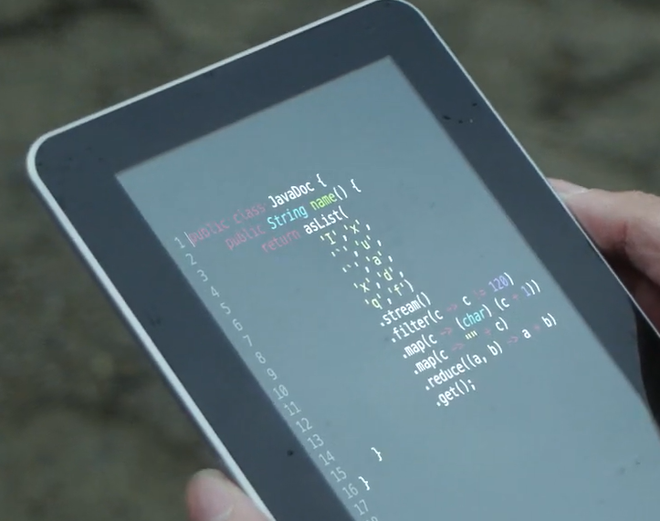
Javaberg…
System.out.println(
asList(
'I', 'x',
'`', 'u',
'`', 'a',
'x', 'd',
'q', 'f')
.stream()
.filter( c-> c != 120)
.map(c -> (char) (c+1))
.map(c -> ""+c)
.reduce((a,b) -> a+b)
.get());
Javaberg
Anders Hejlsberg - well-known programming language designer (Turbo Pascal, Delphi, and later C# at Microsoft), and he played a key role in introducing lambda expressions into C# (starting with C# 3.0 and LINQ).
Notes:
https://www.youtube.com/watch?v=DGa6MAibjzA

Slide 3
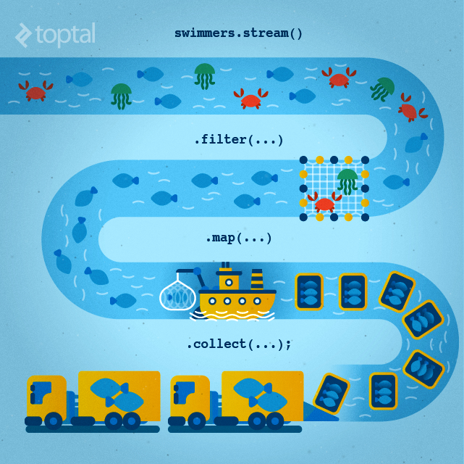
Streams & λ’s
API Java 8
dnes bude:
iný pohľad na prácu s kolekciami,
ochutnávka tzv. funkcionálneho programovania,
malý výlet do kombinatoriky, ako ju nepoznáte
Cvičenie:
práca s kolekciami, Stream API
< Java 8
Java 8
Java 9
Java 10
http://en.proft.me/2016/11/13/tutorial-lambda-expression-and-stream-api-java-8/

Slide 4
Kolekcie
(a práca s nimi – ako to poznáme)
List<Integer> lst = new ArrayList<Integer>();
List<Integer> lst = new ArrayList<>();
ArrayList<Integer> lst = new ArrayList<>();
for (int i = 0; i < 100; i++)
lst.add(i);
// explicitná inicializácia
List<Integer> lst1 = Arrays.asList(0,1,2,3,4,5,6,7,8,9);
for (Integer value : lst) // foreach cyklus
System.out.println(value);
lst.forEach(System.out::println); // <Class name>::<method name>
lst.forEach(e -> System.out.println(e+e)); // foreach metóda
// Nová syntax Java 9
List<Integer> list = List.of(0, 1, 2, 3, 4, 5, 6, 7, 8, 9);
Set<Integer> set = Set.of(0, 1, 2, 3, 4, 5, 6, 7, 8, 9);
Map<String,Integer> map = Map.of("Jano",1, "Palo",3, "Igor",0);

Slide 5
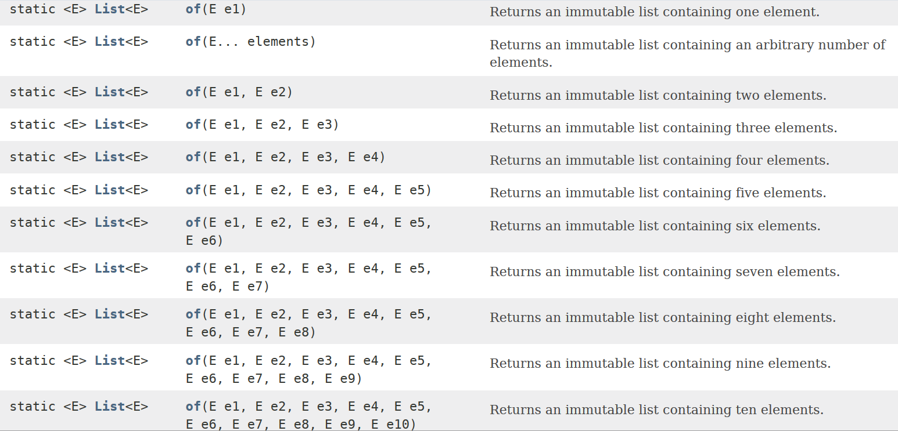

List interface – statický .of

Slide 6

Otázka od Juraja
Set<Integer[]> set3 = Set.of(new Integer[] { 4 }, new Integer[] { 4 });
// Ideal, ale asi nie je mozne
// Workaround 1
Set<Integer[]> set5 = Set.of(new Integer[][]{{4}});
// Workaround 2
Integer[] value = {6}; Set<Integer[]> set6 = Set.of(value, value);
redundancia medzi Set.of(E elements) a Set.of(E e1)
takze preto toto ide (lebo tam sa Set.of(E elements) nechyta).
syntax .<typ>
Set<Integer[]> set = Set.<Integer[]>of(new Integer[] { 5 });
Notes:
var set = Set.of(new Integer[]{4}, new Integer[]{5});
set.forEach(x -> System.out.println(Arrays.deepToString(x)))
var set = Set.of(new Integer[]{4});
Set<Integer> set = Set.of(new Integer[]{4});
Set<Integer[]> set = Set.<Integer[]>of(new Integer[]{4});

Slide 7
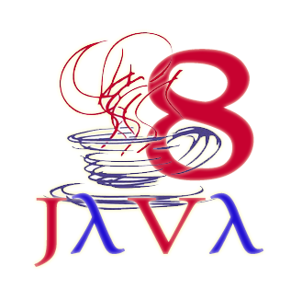
Anonymné funkcie v Jave
(lambdas)
Plná syntax pre zápis anonymnej funkcie:
(double a, double b) -> { return Math.sqrt(a*a+b*b); }
Typová inferencia parametrov
odvodenie typu bez nutnosti typ explicitne uviesť
(a, b) -> { return Math.sqrt(a*a+b*b); }
Syntax sugar, výsledkom je príjemná funkcionálna syntax:
(a, b) -> { Math.sqrt(a*a+b*b) }
(a, b) -> Math.sqrt(a*a+b*b)
n -> n*n
import math
fcia = lambda a,b: math.sqrt(a*a + b*b)
print(fcia(3,4))
5.0

Slide 8
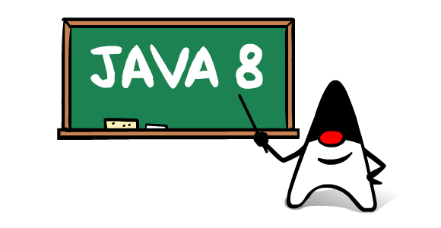
Funkcionálny interface
Funkcionálnym interface je interface, ktorý má jedinú metódu
Nepovinná anotácia pre FI je @FunctionalInterface
@FunctionalInterface
interface BinOp { double operation(double a, double b); }
BinOp plus = (a, b) -> a + b;
System.out.println("3 + 4 = " + plus.operation(3, 4));
BinOp vector = (double a, double b) -> {return Math.sqrt(a*a + b*b); };
BinOp vector = (a,b) -> Math.sqrt(a*a + b*b);
System.out.println("vector(3,4) = " + vector.operation(3,4));
System.out.println("vector(3,4) = "+
((BinOp)(a, b) -> Math.sqrt(a*a + b*b)).operation(3,4));
3 + 4 = 7.0
vector(3,4) = 5.0
Example.java
Notes:
@FunctionalInterface
interface BinOp { double operation(double a, double b); }
BinOp plus = (a, b) -> a + b;
System.out.println("3 + 4 = " + plus.operation(3, 4));
BinOp vector = (double a, double b) -> {return Math.sqrt(a*a + b*b); };
BinOp vector = (a,b) -> Math.sqrt(a*a + b*b);
System.out.println("vector(3,4) = " + vector.operation(3,4));
System.out.println("vector(3,4) = "+
((BinOp)(a, b) -> Math.sqrt(a*a + b*b)).operation(3,4));
BinOp[] xs = { (a,b)->a*b, (a,b)->a-b };
xs[1].operation(5,2)

Slide 9

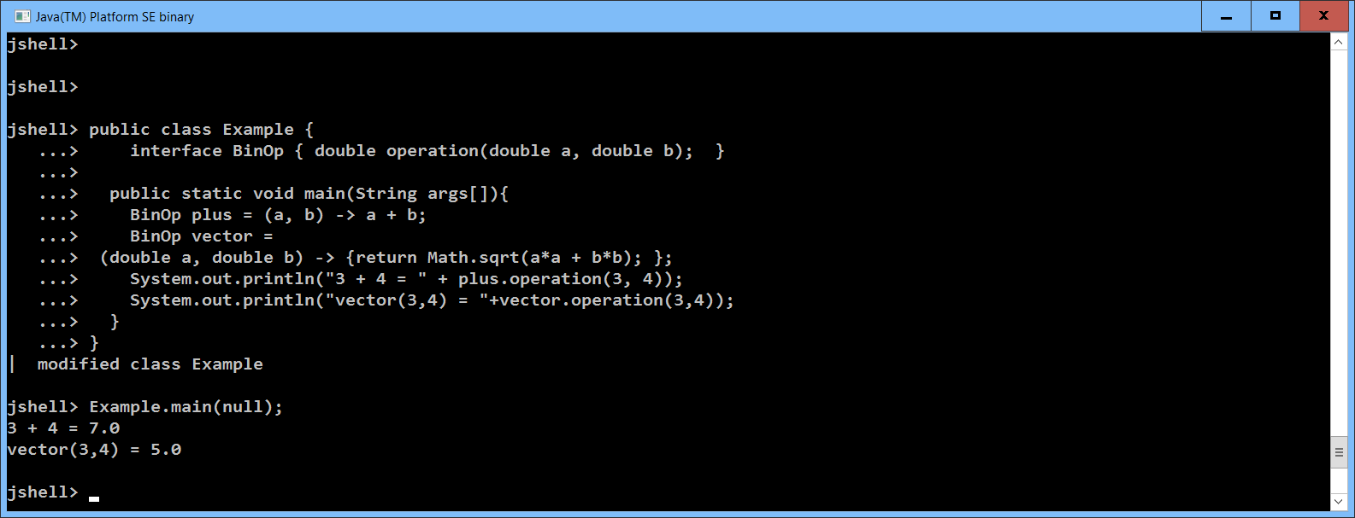
Jshell
(Java 9)
It’s cool, just use it !
Notes:
BinOp[] xs = { (a,b)->a*b, (a,b)->a-b };
xs[1].operation(5,2)

Slide 10

Funkcionálny interface
(interface a void metóda = procedúra)
@FunctionalInterface
interface FunkcionalnyInterface { // koncept funkcie v JDK8
public void doit(String s); // jediná “procedúra”
}
// metóda foo má procedúru ako argument
public static void foo(FunkcionalnyInterface fi) {
fi.doit("hello");
}
// metóda goo vráti procedúru ako výsledok
public static FunkcionalnyInterface goo() {
return (String s) -> System.out.println(s + s);
resp.
return s -> System.out.println(s + s);
}
foo(goo())
"hellohello"
Funkcie.java

Slide 11
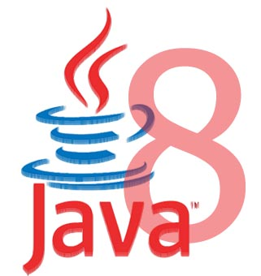
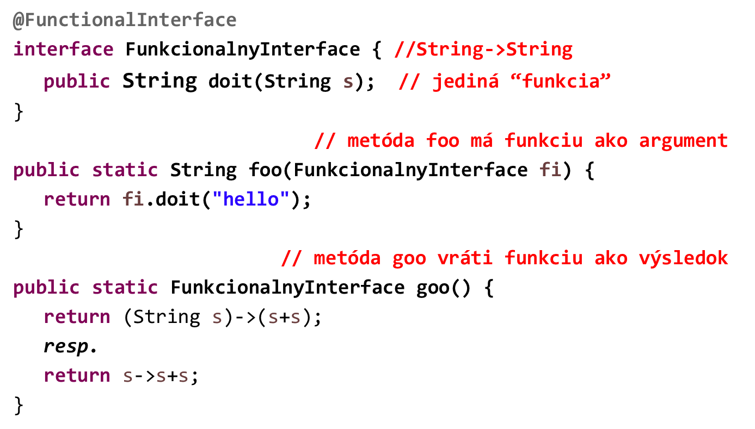
Funkcionálny interface
(interface a NEvoid metóda = funkcia)
foo(goo())
"hellohello"
Funkcie.java

Slide 12
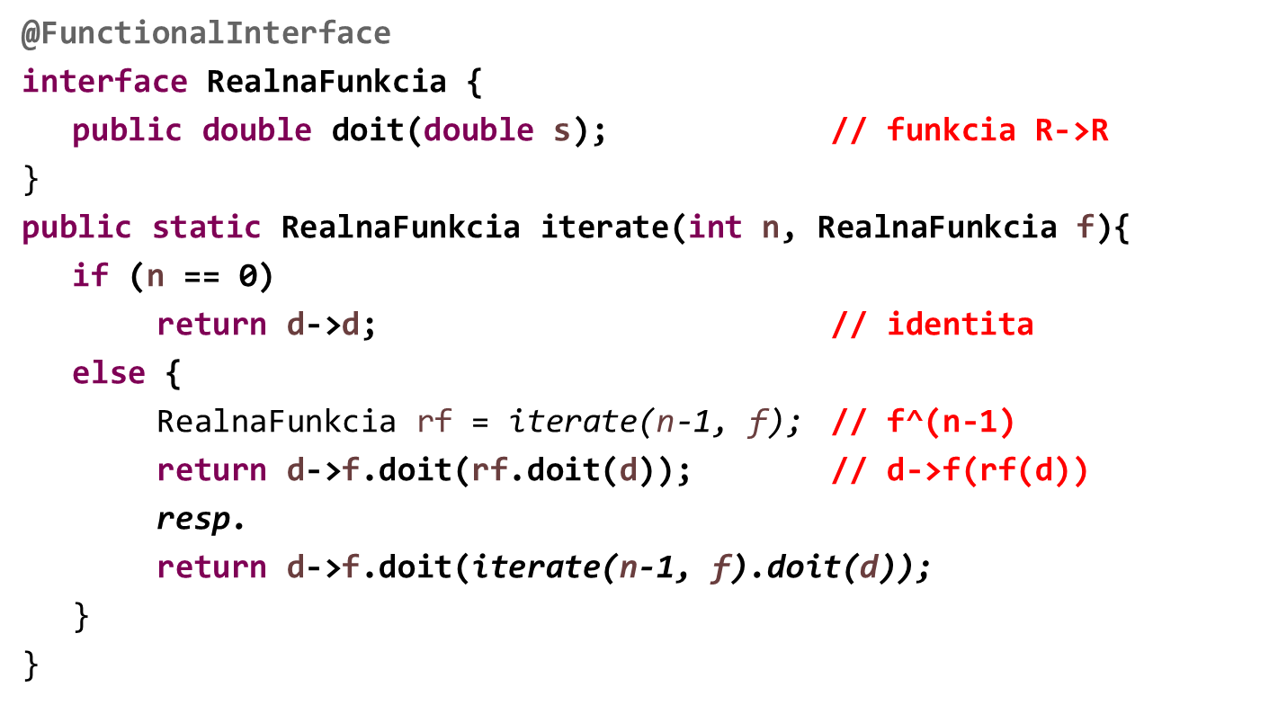
Funkcionálny interface
(interface a reálna funkcia)
identita, n=0
f^{n} =
f, n=1
f˳f^{n-1}
f^{n}
RealnaFunkcia rf = iterate(5, (double d)->d*2);
System.out.println(rf.doit(1));
Funkcie.java
Notes:
interface RealnaFunkcia {
public double doit(double s); // funkcia R->R
}
public static RealnaFunkcia iterate(int n, RealnaFunkcia f){
if (n == 0)
return d->d; // identita
else {
RealnaFunkcia rf = iterate(n-1, f); // f^(n-1)
return d->f.doit(iterate(n-1, f).doit(d));
}
}
RealnaFunkcia rf = iterate(5, (double d)->d*2);
System.out.println(rf.doit(1));

Slide 13

Existujúce @FunctionalInterface
miesto doit() apply(), test()
java.util.function.Function<T,R> <R> apply(<T>) // funkcia T -> R
java.util.function.Predicate<T> boolean test(<T>) // T ->boolean
Príklady:
Function<Double,Double>
celsius2Fahrenheit = x -> (x*9/5)+32,
rad2Deg = r -> (r/Math.PI)*180;
Function<String, Integer>
string2Int = x -> Integer.valueOf(x);
Function<Integer, String>
int2String = x -> String.valueOf(x);
Predicate<Integer>
odd = n -> n % 2 > 0;
Predicate<Integer>
isSquare = n ->
Math.pow(Math.floor(Math.sqrt(n)),2)==n;
celsius2Fahrenheit.apply(30.0) 86.0
rad2Deg.apply(Math.PI) 180
string2Int.apply("4") 4
int2String.apply(123)) "123"
odd.test(5)); true
odd.test(4)); false
isSquare.test(9)); true
isSquare.test(8)); false
Funkcie.java
Notes:
Function<Double,Double> rad2Deg = r -> (r/Math.PI)*180;
rad2Deg.apply(Math.PI)
Predicate<Integer> isSquare = n -> Math.pow(Math.floor(Math.sqrt(n)),2)==n;
Predicate<Integer> isSquare = n -> Math.pow(Math.floor(Math.sqrt(n)),2)==n;
isSquare.test(5)

Slide 14

Iné existujúce @FunctionalInterface
java.lang.Runnable void run()
java.util.concurrent.Callable<E> E call() throws Exception
java.util.Comparator<T> int compare(<T> o1, <T> o2)
Príklady:
OLD STYLE < Java 8
Runnable r = new Runnable() {
public void run() {
// Run Forest, Run !
};
};
ArrayList<String> l = new ArrayList<>(Arrays.asList(
"Xenia", "Jan", "Peter", "Zora", "Pavel", "Jana"));
l.sort(new Comparator<String>() {
@Override
public int compare(String o1, String o2) {
return Integer.compare(o1.length(), o2.length());
}});
NEW STYLE = Java 8
Runnable r1 = ()->{
Run Forest, Run !
};
l.sort((o1, o2) ->
Integer.compare(
o1.length(),
o2.length()));
Funkcie.java

Slide 15
Comparator
String[] pole = { "GULA", "cerven", "zelen", "ZALUD" };
Comparator<String> comp =
(fst, snd)->Integer.compare(fst.length(), snd.length());
Arrays.sort(pole, comp);
Arrays.sort(pole,
(fst,snd)-> fst.toUpperCase().compareTo(snd.toUpperCase()));
class Karta {
int hodnota;
String farba; // konštruktor, gettery, settery...
... }
List<Karta> karty = List.of(
new Karta(7,"Gula"), new Karta(8,"Zalud"),
new Karta(9,"Cerven"), new Karta(10,"Zelen"));
GULA
zelen
ZALUD
cerven
cerven
GULA
ZALUD
zelen
[Gula/7, Zalud/8,
Cerven/9, Zelen/10]
MapFilter.java

Slide 16




forEach, map, filter
[Gula/7, Zalud/8, Cerven/9, Zelen/10]
karty.forEach(k -> k.setFarba("Cerven"));
Stream<Karta> vacsieKartyStream =
karty.stream().filter(k -> k.getHodnota() > 8);
List<Karta> vacsieKarty = vacsieKartyStream.toList();
List<Karta> vacsieKarty2 = karty
.stream()
.filter(k -> k.getHodnota() > 8)
.toList();
[Cerven/7, Cerven/8, Cerven/9, Cerven/10]
[Cerven/9, Cerven/10]
[Cerven/9, Cerven/10]
MapFilter.java

Slide 17
stream()-collect()
[Cerven/7, Cerven/8, Cerven/9, Cerven/10]
List<Karta> vacsieKarty3 = karty
.stream()
.map(k->new Karta(k.getHodnota()+1,k.getFarba()))
.filter(k -> k.getHodnota() > 8)
.toList();
List<Karta> vacsieKarty4 = karty
.stream()
.parallel()
.filter(k -> k.getHodnota() > 8)
.sequential()
.toList();
[Cerven/9, Cerven/10, Cerven/11]
[Cerven/9, Cerven/10]
MapFilter.java

Slide 18
Sekvenčný a paralelný stream
IntStream je stream interface pre celočíselné hodnoty (Integer)
// range (0,100) vyrobí stream obsahujúci 0..99
Stream<Integer> stream = IntStream.range(0, 100).boxed();
// boxed() je konverzia IntStream -> Stream
Každá z týchto operácií prebehne stream a vyčerpá ho:
List<Integer> lst = stream.toList();
System.out.println(stream.count());
stream.forEach(e -> System.out.println(e+e));
stream.forEach(System.out::println);
preto, ak urobíte dve na tom istom streame, výsledná chyba je
Exception: stream has already been operated upon or closed
// toto už nedostaneme v poradí 0, 1, ...
stream.parallel().forEach(e -> System.out.println(e+e));
100
130
132
134
124
126
128
62
...
MapFilter.java
Notes:
Stream<Integer> stream = IntStream.range(0, 100).boxed();
List<Integer> lst = stream.toList();
System.out.println(stream.count());
stream.forEach(e -> System.out.println(e+e));
stream.parallel().forEach(e -> System.out.println(e+e));

Slide 19
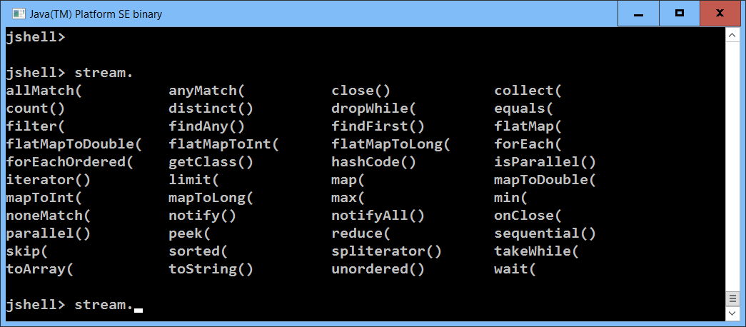
Aké metódy ma Stream
(Jshell pozná autocompletion)
Kliknite na TAB

Slide 20
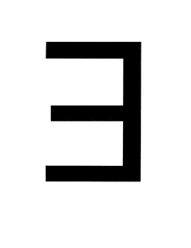
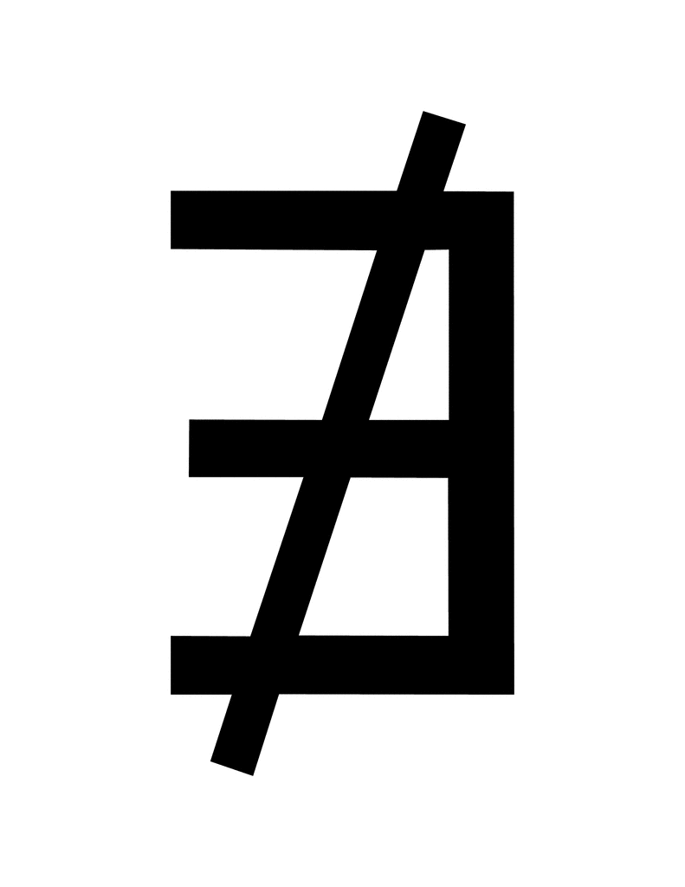

map/filter
(existuje/neexistuje/pre všetky)
z predošlého príkladu:
List<Integer> lst = 0, 1, … 99
lst.
stream().
filter(e -> (e % 2 == 0)).
forEach(System.out::print); // 02468101214161820222…
lst.
stream().
map(e -> e*e).
forEach(System.out::print); // 01491625364964 …
lst.stream().anyMatch(e -> (e == 51)) // true
lst.stream().anyMatch(e -> (e * e == e)) // true
lst.stream().noneMatch(e -> (e > 100)) // true
lst.stream().noneMatch(e -> (e + e == e)) // false
lst.stream().allMatch(e -> e>0 ) // false
lst.stream().filter(e -> e>0 ).count() // 99
MapFilter.java
Notes:
List<Integer> lst = IntStream.range(0, 100).boxed().toList();
Predicate<Integer>isSquare = n -> Math.pow(Math.floor(Math.sqrt(n)),2)==n;
lst.stream().filter(isSquare).toList()

Slide 21
Optional
(buď existuje alebo neexistuje)
z predošlého príkladu:
List<Integer> lst = 0, 1, … 99
lst.stream().findFirst() // Optional[0]
lst.stream().findFirst().isPresent() // true
lst.stream().findFirst().get() // 0
lst.parallelStream().findAny().get() // 56,65,… nejednoznačné
lst.stream().min(Integer::compare).get() // 0
lst.stream().min(Integer::compare).isPresent() // true
lst.stream().max(Integer::compare).get() // 99
lst.stream().map(i->i%10).sorted().forEach(System.out::print);
0000000000111111111122222222223333333333444444444455555555556666
666666777777777788888888889999999999
lst.stream().map(i->i%10).distinct().forEach(System.out::print);
0123456789
MapFilter.java
Notes:
List<Integer> lst = IntStream.range(0, 100).boxed().toList();
lst.stream().filter(isSquare).max(Integer::compare)
lst.stream().filter(isSquare).toList()
List<Integer> lst = IntStream.range(0, 100).boxed().toList();
lst.stream().map(i->i%10).sorted().forEach(System.out::print);
lst.stream().map(i->i%10).distinct().forEach(System.out::print);

Slide 22
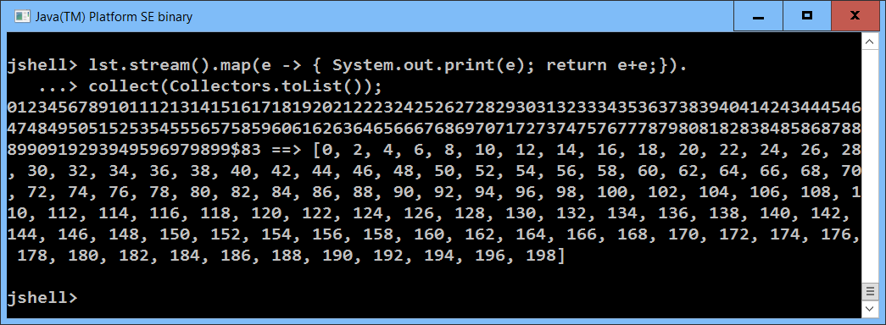
Lenivosť
(laziness)
z predošlého príkladu:
List<Integer> lst = 0, 1, … 99
lst.stream().map(e -> { System.out.print(e); return e+e;});
lst.stream().filter(e -> {System.out.print(e);return true;});
lst.stream().map(e -> { System.out.print(e); return e+e;}).
findFirst().get();
lst.stream().map(e -> { System.out.print(e); return e+e;}).
toList();
0
MapFilter.java
Notes:
List<Integer> lst = IntStream.range(0, 100).boxed().toList();
lst.stream().map(e->{System.out.println(e); return e;}).collect(Collectors.toSet())

Slide 23
ParallelStream
(komutatívnosť)
z predošlého príkladu:
List<Integer> lst = 0, 1, … 99
lst.parallelStream().
map(e -> e+e). // zdvojí čísla
filter(e -> (e % 3 > 0)). // nedeliteľné 3
forEach(e -> System.out.println(e))
lst.parallelStream().
filter(e -> (e % 3 > 0)). // nedeliteľné 3
map(e -> e+e). // zdvojí čísla
forEach(e -> System.out.println(e))
lst.parallelStream().
map(e -> e+e). // zdvojí čísla
filter(e -> (e % 3 > 0)). // nedeliteľné 3
collect(Collectors.toList()).size() // koľko je výsledok
MapFilter.java
Notes:
List<Integer> lst = IntStream.range(0, 100).boxed().toList();
lst.parallelStream().map(e -> e+e).filter(e -> (e % 3 > 0)) .toList().size()

Slide 24
ParallelStream
(skladanie funkcií)
z predošlého príkladu:
List<Integer> lst = 0, 1, … 99
lst.parallelStream().
map(e -> f1(e)). // čo vieme povedať o kompozícii ?
map(e -> f2(e)).
toList()
lst.parallelStream().
map(e -> f2(f1(e))). // čo vieme povedať o kompozícii ?
toList()
Integer f1(Integer e) { return e+e; }
Integer f2(Integer e) { return 5*e; }
MapFilter.java
Notes:
List<Integer> lst = IntStream.range(0, 100).boxed().toList();
Integer f1(Integer e) { return e+e; }
Integer f2(Integer e) { return 5*e; }
lst.parallelStream().map(e -> f1(e)). map(e -> f2(e)).toList()
lst.parallelStream().map(e -> f2(f1(e))).toList()

Slide 25
ParallelStream
(funkcie so side-effect)
z predošlého príkladu:
List<Integer> lst = 0, 1, … 99
Funkcie poznáme slušné a iné:
Slušná funkcia (referenčne transparentná) vždy pre rovnaký vstup vráti rovnaký
výsledok, t.j. nerobí žiaden side-effect, nepoužíva globálnu premennú, súbor, ...
Programovací jazyk je slušný, ak v ňom môžete písať len slušné funkcie.
Príklad (neslušný):
lst.parallelStream().
map(e->funWithSideEffect(e)).
filter(e -> (e % 3 > 0)).
sorted().
toList();
Integer globalVariable = 0;
Integer funWithSideEffect(Integer n) {
return n+n + (++globalVariable);
}
MapFilter.java
Notes:
List<Integer> lst = IntStream.range(0, 100).boxed().toList();
Integer globalVariable = 0;
Integer funWithSideEffect(Integer n) {
return n+n + (++globalVariable);
}
lst.parallelStream().map(e->funWithSideEffect(e)).filter(e -> (e % 3 > 0)).sorted().toList();

Slide 26
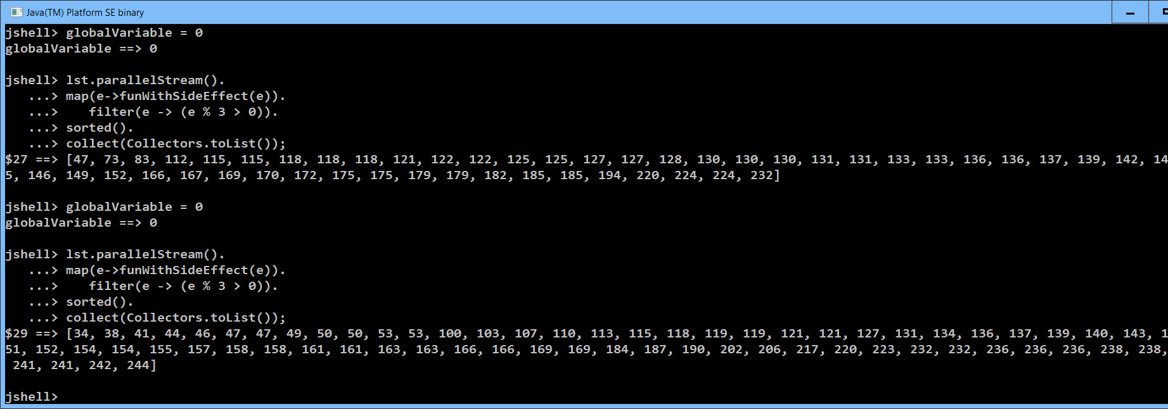
Globálne premenné
(sú identifikovaná smrť)
V praxi: funkcia sa môže javiť ako slušná, a pri tom ňou nie je ... ☹

Slide 27
Trochu novej syntaxe
(pripomína Java collections syntax sugar JDK9)
Stream obsahujúci pár hodnôt
Stream.of(0,1,2,3,4,5,6,7,9).toList()
[0, 1, 2, 3, 4, 5, 6, 7, 9]
Stream.of("Palo", "Peter", "Jano", "Jana").toList()
[Palo, Peter, Jano, Jana]
Konverzia poľa na Stream
Arrays.stream(new Integer[]{0,1,2,3,4,5,6,7,8,9}).toList()
[0, 1, 2, 3, 4, 5, 6, 7, 9]
IntStream a range
IntStream.range(0,100).forEach(e -> System.out.print(e));
0123456789101112131415161718192021222324…
MapFilter.java
Notes:
IntStream.range(0,100).boxed().collect(Collectors.toSet())
lst.stream().collect(Collectors.groupingBy(e -> e % 2));
lst.stream().collect(Collectors.groupingBy(e -> e % 2)).forEach((x,y)->System.out.println(x+","+y));
lst.stream().collect(Collectors.groupingBy(e -> e % 2 == 0));
lst.stream().collect(Collectors.partitioningBy(e -> e % 2 == 0)).forEach((x,y)->System.out.println(y ));

Slide 28
mapToObj
IntStream.range(0,10).mapToObj(e -> (char)('@'+e)).
forEach(System.out::print);
@ABCDEFGHI
IntStream.range(0,10).
mapToObj(e -> IntStream.range(0, e)).
forEach(row -> System.out.print(row.count()));
0123456789
IntStream.range(0,10).
mapToObj(e -> IntStream.range(0, e)).
forEach(row -> System.out.println(
row.boxed().toList());
Konverzie IntStream <-> Stream<Integer>
Stream<Integer> intStream.boxed()
IntStream stream.mapToInt(e-> …)
[]
[0]
[0, 1]
[0, 1, 2]
[0, 1, 2, 3]
[0, 1, 2, 3, 4]
[0, 1, 2, 3, 4, 5]
[0, 1, 2, 3, 4, 5, 6]
[0, 1, 2, 3, 4, 5, 6, 7]
[0, 1, 2, 3, 4, 5, 6, 7, 8]
MapFilter.java
Notes:
IntStream.range(0,10).mapToObj(e -> (char)('@'+e)).forEach(System.out::print);
IntStream.range(0,10).mapToObj(e -> IntStream.range(0, e)).forEach(row -> System.out.print(row.count()));
IntStream.range(0,10).mapToObj(e -> IntStream.range(0, e)).forEach(row -> System.out.println(row.boxed().toList()));

Slide 29
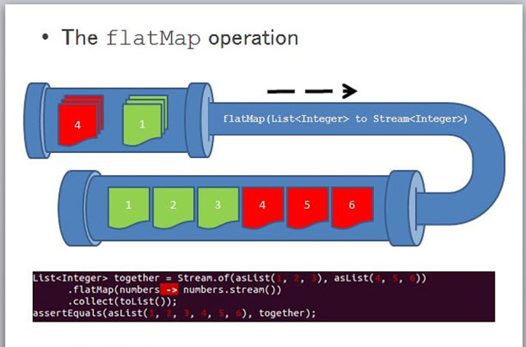
flatMap
[[Palo, Jana], [Peter, Kamil, Martina]]
l2.stream().flatMap(lst -> lst.stream()).
toList();
[Palo, Jana, Peter, Kamil, Martina]
List<List<String>> l2 = List.of(
List.of("Palo", "Jana"),
List.of("Peter", "Kamil", "Martina"));
http://www.java67.com/2016/03/how-to-use-flatmap-in-java-8-stream.html
Notes:
Stream.of(Stream.of(1,2,3,4),Stream.of(5,6,7),Stream.of()).flatMap(s -> s).toList()
Stream.of(List.of(1,2,3,4),List.of(5,6,7),List.of()).flatMap(s -> s.stream()).toList()
Stream.of(4,5,3).flatMap(n -> IntStream.range(0,n).boxed()).toList()

Slide 30
flatMap
IntStream.range(0,10).
flatMap(e -> IntStream.range(0, e)).
forEach(System.out::print);
001012012301234012345012345601234567012345678
IntStream.range(0,10).
flatMap(e -> IntStream.range(0, e).
filter(i->i%2==0)).
forEach(System.out::print);
0002020240240246024602468
MapFilter.java
Notes:
IntStream.range(0,10).flatMap(e -> IntStream.range(0, e)).forEach(System.out::print);
IntStream.range(0,10).flatMap(e -> IntStream.range(0, e).filter(i->i%2==0)).forEach(System.out::print);

Slide 31
Collectors
(groupingBy, partitioningBy, reducing)
z predošlého príkladu:
List<Integer> lst = 0, 1, … 99
Map<Integer, List<Integer>>map = lst.parallelStream().collect(
Collectors.groupingBy( e -> (String.valueOf(e).length()) ));
{1=[0, 1, 2, 3, 4, 5, 6, 7, 8, 9], 2=[10, 11, 12, ... , 94, 95, 96, 97, 98, 99]}
map.forEach((len, list) -> System.out.println(len + ", "+ list));
1, [0, 1, 2, 3, 4, 5, 6, 7, 8, 9]
2, [10, 11, 12, 13, 14, 15, 16, 17, 18, 19, 20, 21, 22, 23, 24, 25, 26, 27, 28, …
Map<Boolean, List<Integer>>partitions = lst.parallelStream().
collect(Collectors.partitioningBy( e-> e % 3 == 0) );
{false=[1, 2, 4, 5, 7, 8, 10, ...], true=[0, 3, 6, 9, 12, 15, 18, ...]}
Long count = lst.parallelStream().collect(
Collectors.reducing(0L, e -> 1L, Long::sum)); // 100
Long sum = lst.parallelStream().collect(
Collectors.reducing(0L, e -> new Long(e), Long::sum)); // 4950
int sumInt = lst.parallelStream().reduce(0, Integer::sum); //4950
Notes:
List<Integer> lst = IntStream.range(0, 100).boxed().toList();
BinaryOperator<Integer> product = (a,b)->a*b;
lst.parallelStream().map(e -> e+1).reduce(1, Integer::sum);
IntStream.range(1,10).boxed().map(e -> e+1).reduce(1, (a,b)->a*b);
lst.stream().reduce(1, (n1,n2)->n1*n2);

Slide 32
Collectors toSet, toMap
z predošlého príkladu:
List<Integer> lst = 0, 1, … 99
List<Integer> zoznam = lst.stream()
.map(x -> x%10).collect(Collectors.toSet())
[0, 1, 2, 3, 4, 5, 6, 7, 8, 9]
lst.stream().collect(Collectors.toMap(x -> x, x -> x))
{0=0, 1=1, 2=2, …, 98=98, 99=99}
lst.stream().collect(Collectors.toMap(
x -> Integer.toBinaryString(x), // Integer::toBinaryString,
x -> Integer.toBinaryString(x).length() ))
{1001111=7, 0=1, 1010001=7, 1=1, 1010000=7, 1101=4, 1100=4, …}
lst.stream().collect(Collectors.toMap( x -> x % 10, x -> x ))
Duplicate key 0 (attempted merging values 0 and 10)
Notes:
List<Integer> lst = IntStream.range(0, 100).boxed().toList();
BinaryOperator<Integer> product = (a,b)->a*b;
lst.parallelStream().map(e -> e+1).reduce(1, Integer::sum);
IntStream.range(1,10).boxed().map(e -> e+1).reduce(1, (a,b)->a*b);
lst.stream().reduce(1, (n1,n2)->n1*n2);

Slide 33
Grouping
z predošlého príkladu:
List<Integer> lst = 0, 1, … 99
lst.stream().collect(Collectors.groupingBy(
e -> Integer.toString(e).length(),
Collectors.averagingInt(x->x)) )
{1=4.5, 2=54.5}
lst.stream().collect(Collectors.groupingBy(
e -> Integer.toString(e).length(),
//Collectors.maxBy((o1,o2)->Integer.compare(o1,o2)
Collectors.maxBy(Integer::compare)) )
{1=Optional[9], 2=Optional[99]}
lst.stream().collect(Collectors.groupingBy(
e -> e/10,
Collectors.counting()) )
{0=10, 1=10, 2=10, 3=10, 4=10, 5=10, 6=10, 7=10, 8=10, 9=10}

Slide 34
Reducing
z predošlého príkladu:
List<Integer> lst = 0, 1, … 99
lst.stream().reduce(0, Integer::sum)
lst.stream().reduce(0, (a,b) -> a+b)
lst.stream().mapToLong(e -> e).reduce(0L, (a, b) -> a + b)
4950
lst.stream().reduce( Integer::max)
Optional[99]
lst.stream()
.map(x -> Integer.toString(x))
.reduce( "vysledok", (acc, x) -> acc+x)
vysledok0123456789101112..9899
lst.stream()
.map(x -> Integer.toString(x))
.reduce( (acc, x) -> acc+x)
Optional[0123456789101112..9899]

Slide 35
Stream.iterate
Stream.iterate("", s -> "a"+s).limit(10).toList()
[, a, aa, aaa, aaaa, aaaaa, aaaaaa, aaaaaaa, aaaaaaaa, aaaaaaaaa]
Stream.iterate(1L, n -> 2*n).takeWhile(n -> n < 1_000_000).toList()
Stream.iterate(1L, n -> n < 1_000_000, n -> 2*n).toList()
[1, 2, 4, 8, 16, 32, 64, 128, 256, 512, 1024, 2048, 4096, 8192, 16384, 32768, 65536, 131072, 262144, 524288]
Stream.iterate(918972645, n -> n > 0, n -> n/10).toList()
[918972645, 91897264, 9189726, 918972, 91897, 9189, 918, 91, 9]
Stream.iterate(918972645, n -> n > 0, n -> n/10).map(n -> n%10).toList()
[5, 4, 6, 2, 7, 9, 8, 1, 9]
Stream.iterate(918972645, n -> n > 0, n -> n/10)
.map(n -> n%10)
.reduce((a,y) -> 10*a+y)
resp.
.reduce(0,(a,y) -> 10*a+y)
Optional[546279819], resp. 546279819
Notes:
Stream.iterate(918972645, n -> n > 0, n -> n/10).toList()

Slide 36
Collectors
(rozdeliť stream na úseky, kde neplatí predikát)
z predošlého príkladu:
List<Integer> lst = 0, 1, … 99
[0, 1, 2, 3, 4, 5, 6, 7, 8, 9, 10, 11, 12, 13, 14, 15, 16, 17, 18, 19, 20
static boolean isPrime(Integer n) {
return IntStream.range(2, 1+(int)Math.floor(Math.sqrt(n)))
.allMatch(i -> n % i != 0);
}
[[4], [6], [8, 9, 10], [12], [14, 15, 16], [18], [20, 21, 22], ...
int[] splitters = Stream.of(
IntStream.of(-1),
IntStream.range(0,lst.size()).filter(i->isPrime(lst.get(i))),
IntStream.of(lst.size()))
.flatMapToInt(s -> s).toArray(); //[-1, 0,1,2,3,5,7,11,13,17,19, 100]
List<List<Integer>> chunks =
IntStream.range(0, splitters.length - 1)
.mapToObj(i -> lst.subList(splitters[i]+1, splitters[i+1]))
.filter(chunk -> chunk.size() > 0)
.toList(); // [[4], [6], [8, 9, 10], [12], [14, 15, 16], [18], [20, 21, 22], ...
MapFilter.java
Notes:
List<Integer> lst = IntStream.range(0, 100).boxed().toList();
static boolean isPrime(Integer n) {
return IntStream.range(2, 1+(int)Math.floor(Math.sqrt(n))).allMatch(i -> n % i != 0);
}
Stream.of(IntStream.of(-1), IntStream.range(0,10), IntStream.of(10)).flatMapToInt(s->s).toArray()
Stream.of(IntStream.of(-1), IntStream.range(0,100).filter(i -> isPrime(i)), IntStream.of(10)).flatMapToInt(s->s).toArray()

Slide 37
EntrySet
List<Student> db = List.of(
new Student(1, "C1", 2),
new Student(1, "C2", 1),
new Student(1, "C3", 3),
new Student(2, "C1", 1),
new Student(2, "C2", 5),
new Student(3, "C1", 1),
new Student(3, "C2", 1),
new Student(3, "C3", 1),
new Student(4, "C1", 4),
new Student(4, "C2", 3),
new Student(4, "C3", 2)
);
record Student(Integer studentID, String courseID, Integer grade) {}
db.stream().collect(Collectors.groupingBy(Student::studentID,
Collectors.averagingDouble(Student::grade)))
{1=2.0, 2=3.0, 3=1.0, 4=3.0}
-- priemery jednotlivých študentov
db.stream().collect(Collectors.groupingBy(Student::courseID,
Collectors.maxBy(Comparator.comparingInt(Student::grade))))
{C3=Optional[Student[studentID=1, courseID=C3, grade=3]],
C1=Optional[Student[studentID=4, courseID=C1, grade=4]],
C2=Optional[Student[studentID=2, courseID=C2, grade=5]]}
-- najhorší študent daného kurzu
db.stream().collect(Collectors.groupingBy(Student::courseID,
Collectors.averagingDouble(Student::grade)))
.entrySet().stream()
//.max((o1,o2) -> Double.compare(o1.getValue(), o2.getValue()))
.max(Comparator.comparingDouble(Map.Entry::getValue))
.get()
.getKey() // resp. getValue()
C2 // resp. 2.5
-- kurz s najhorším priemerom a jeho priemer

Slide 38
Binárne vektory {0,1}
(klasické riešenie)
List<String> binaries(int n) {
if (n == 0) {
return Arrays.asList("");
} else {
List<String> result = new ArrayList<>();
for (String s : binaries(n-1)) {
result.add(s + "0");
result.add(s + "1");
}
return result;
}
}
binaries(4)
[0000, 0001, 0010, 0011, 0100, 0101, 0110, 0111, 1000, 1001, 1010, 1011, 1100, 1101, 1110, 1111]
Počet = 2^{n}
Kombinatorika.java

Slide 39
Binárne vektory {0,1}
(streamové riešenie)
Stream<String> binaries1(int n) {
if (n == 0) {
return Stream.of("");
} else {
return
binaries1(n-1).
flatMap(s -> Stream.of(s + "0", s + "1"));
}
}
Stream<String> binaries1(int n) {
return (n == 0)?Stream.of(""):
binaries1(n-1).flatMap(s -> Stream.of(s + "0", s + "1"));
}
binaries1(4).toList()
[0000, 0001, 0010, 0011, 0100, 0101, 0110, 0111, 1000, 1001, 1010, 1011, 1100, 1101, 1110, 1111]
Počet = 2^{n}
Kombinatorika.java

Slide 40
Permutácie
perms(4).toList()
[4321, 3421, 3241, 3214, 4231, 2431, 2341, 2314, 4213, 2413, 2143, 2134, 4312, 3412, 3142, 3124, 4132, 1432, 1342, 1324, 4123, 1423, 1243, 1234]
Stream<String> perms(int n) {
if (n <= 0) {
return Stream.of("");
} else {
return
perms(n-1).
flatMap(s->IntStream.range(0, n).
mapToObj(i -> insert(i, n, s)) );
}
}
String insert(int i, int n, String s) {
return s.substring(0,i) +
String.valueOf(n) +
s.substring(i, s.length());
}
Počet = n!
Kombinatorika.java

Slide 41
Kombinácie bez opakovania
Stream<String> kbo(int k, int n) {
if (k > n) {
return Stream.of();
} else if (k == 0) {
return Stream.of("");
} else {
return Stream.concat( // zreťazenie dvoch streamov
kbo(k, n-1),
kbo(k-1, n-1).map(s -> s + String.valueOf(n-1)));
}
}
kbo(3,6).toList()
[012, 013, 023, 123, 014, 024, 124, 034, 134, 234, 015, 025, 125, 035, 135, 235, 045, 145, 245, 345]
Počet = n nad k
Kombinatorika.java

Slide 42
Kombinácie s opakovaním
Stream<String> kso(int k, int n) {
if (n == 0) {
return Stream.of();
} else if (k == 0) {
return Stream.of("");
} else {
return Stream.concat( // zreťazenie dvoch streamov
kso(k, n-1),
kso(k-1, n).map(s -> s + String.valueOf(n-1)));
}
}
kso(2,6).toList()
[01, 11, 02, 12, 22, 03, 13, 23, 33, 04, 14, 24, 34, 44, 05, 15, 25, 35, 45, 55]
Počet = (n+k-1) nad k
Kombinatorika.java

Slide 43
Variácie s opakovaním
Počet = k^{n}
static Stream<String> vso(int n, int k) {
if (n == 0) {
return Stream.of("");
} else {
return vso(n-1, k)
.flatMap(s -> IntStream.range(0, k)
.mapToObj(i -> s + String.valueOf(i)) );
}
}
Kombinatorika.java

Slide 44
Variácie bez opakovania
Stream<String> vbo(int k, int n) {
if (k > n) {
return Stream.of();
} else if (k == 0) {
return Stream.of("");
} else {
return Stream.concat(
vbo(k, n-1),
vbo(k-1, n-1).
flatMap(s -> IntStream.range(0, k).
mapToObj(i -> insert(i, n-1, s))));
}
}
vbo(3,4).toList()
[210, 120, 102, 201, 021, 012, 310, 130, 103, 301, 031, 013, 320, 230, 203, 302, 032, 023, 321, 231, 213, 312, 132, 123]
Počet = n(n-1)…(n-k+1)
Kombinatorika.java

Slide 45

Bonmot
Ak by vám (v 1.semestri) neprezradili priradenie (=) a cyklus (for/while),
tak tu máme spústu šikovných funkcionálnych programátorov...

