Slide 1
Hammingova postupnosť
http://rosettacode.org/wiki/Hamming_numbers
pridali sme *7^{m}
zisťovali, či v prvočíselnom rozklade sú len 2,3,5,7 (0.5)
java-collection väčšinou nepadli na čase (2)
public static long nty(int n) {
TreeSet<Long> tree = new TreeSet<Long>();
tree.add((long) 1);
long el = 0;
for (int i = 2; i <= n + 1; i++) {
el = tree.first(); // vyber najmenší prvok z množiny
tree.remove(el); // odstráň ho a pridaj el*2, …, *9
for (int j = 2; j <= 9; j++) tree.add(el * j); }
return el; }
http://dai.fmph.uniba.sk/courses/JAVA/sources/PremiaMnozinova/TreeSet

Slide 2
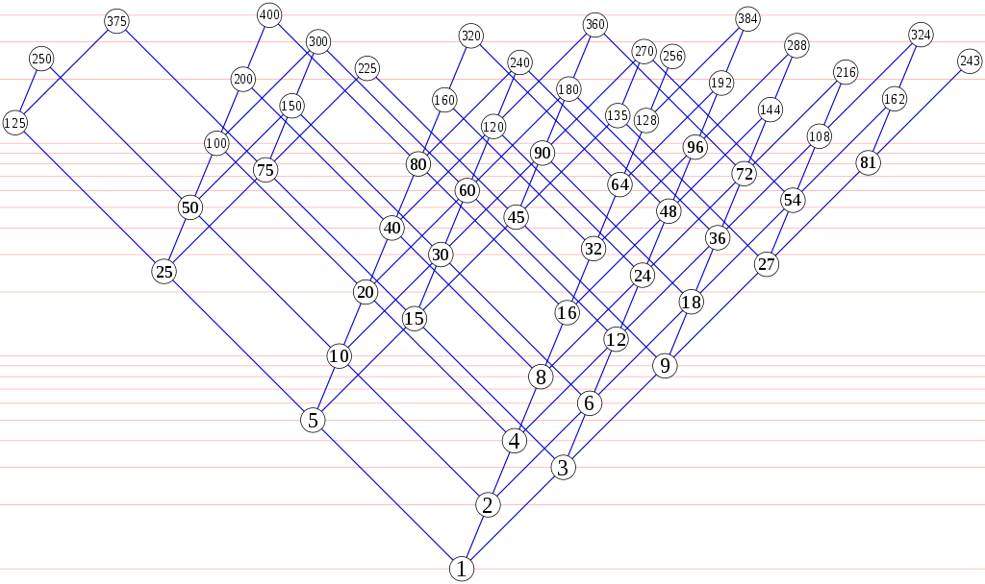

http://en.wikipedia.org/wiki/Regular_number

Slide 3
Hammingova finta
{ 1 ,
2 ,
3 ,
4 ,
5 ,
6 ,
*
2
*
3
*
5
*
7

Slide 4
Množinová prémia
public static long nty(int k) {
int i2 = 0, i3 = 0, i5 = 0, i7 = 0;
long A[] = new long[k]; A[0] = 1;
for (int i = 1; i < k; i++) {
long min = A[i2] * 2; // hľadáme min(2*A[i2],3*A[i3],5*A[i5],7*A[i7])
min = (min <= A[i3] * 3) ? min : A[i3] * 3;
min = (min <= A[i5] * 5) ? min : A[i5] * 5;
min = (min <= A[i7] * 7) ? min : A[i7] * 7;
A[i] = min; // zoberieme min a posunieme index zodpovedajúci min
if (min == A[i2] * 2) i2++;
if (min == A[i3] * 3) i3++;
if (min == A[i5] * 5) i5++;
if (min == A[i7] * 7) i7++;
}
return A[k - 1];
}
http://dai.fmph.uniba.sk/courses/JAVA/sources/PremiaMnozinova/

Slide 5
Výsledky
(získané vlastnou hlavou, array+BigInteger)
[0ms.]10-ty clen:10
[0ms.]100-ty clen:450
[0ms.]1000-ty clen:385875
[0ms.]2014-ty clen:7350000
[15ms.]10000-ty clen:63221760000
100.000-ty clen:-2984935566748111312 ... long overfloat -> BigInteger
[94ms.]100.000-ty clen:123093144973968750000
[1.453ms.]1.000.000-ty clen:4157409948433216829957008507500000000
[17s.]10.000.000-ty clen: 1037754506929393275846369194817675812165052808572460991244140544000
[254s.]100.000.000-ty clen: 19740298131032654812472710905349395789786394159462319333658845201548773240496359449025476351380348205566406250000000000
Doping: zväčšený heap size na GB
RunConfig/Arguments/VM -Xmx1024m
http://dai.fmph.uniba.sk/courses/JAVA/sources/PremiaMnozinova/MnozinaBig

Slide 6
Výsledky
(upravené riešenie , PriorityQueue+BigInteger)
[0ms.]10-ty clen:10
[0ms.]100-ty clen:450
[16ms.]1.000-ty clen:385875
[15ms.]2014-ty clen:7350000
[32ms.]10.000-ty clen:63221760000
[640ms.]100.000-ty clen:123093144973968750000
[14 s.]1.000.000-ty clen: 4157409948433216829957008507500000000
[232s.]10.000.000-ty clen: 1037754506929393275846369194817675812165052808572460991244140544000
[3.446s.]100.000.000-ty clen: 19740298131032654812472710905349395789786394159462319333658845201548773240496359449025476351380348205566406250000000000
http://rosettacode.org/wiki/Hamming_numbers#Java
Doping: zväčšený heap size na GB
RunConfig/Arguments/VM -Xmx1024m
http://dai.fmph.uniba.sk/courses/JAVA/sources/PremiaMnozinova/MnozinaPriorityQueue

