Slide 1
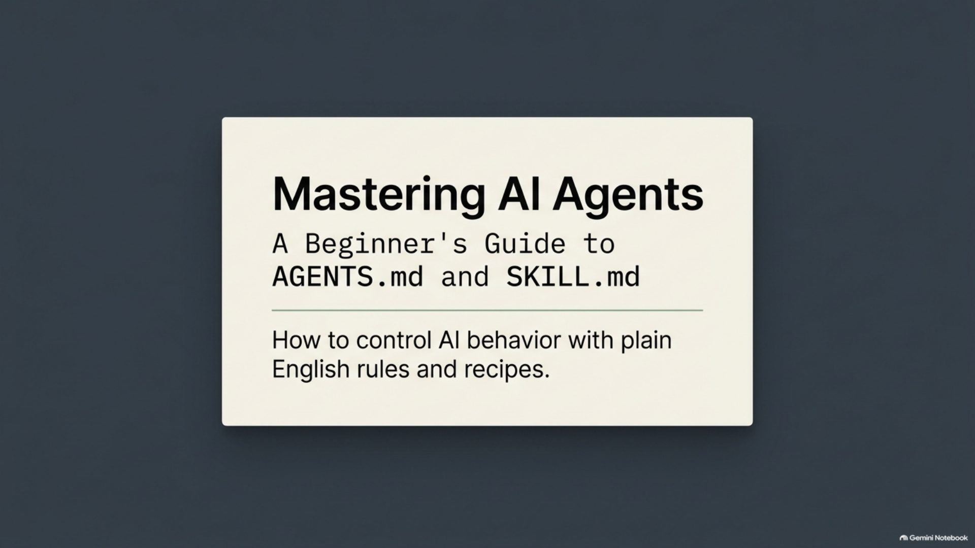
Notes:
Mastering AI Agents: a beginner's guide to AGENTS.md and SKILL.md

Slide 2
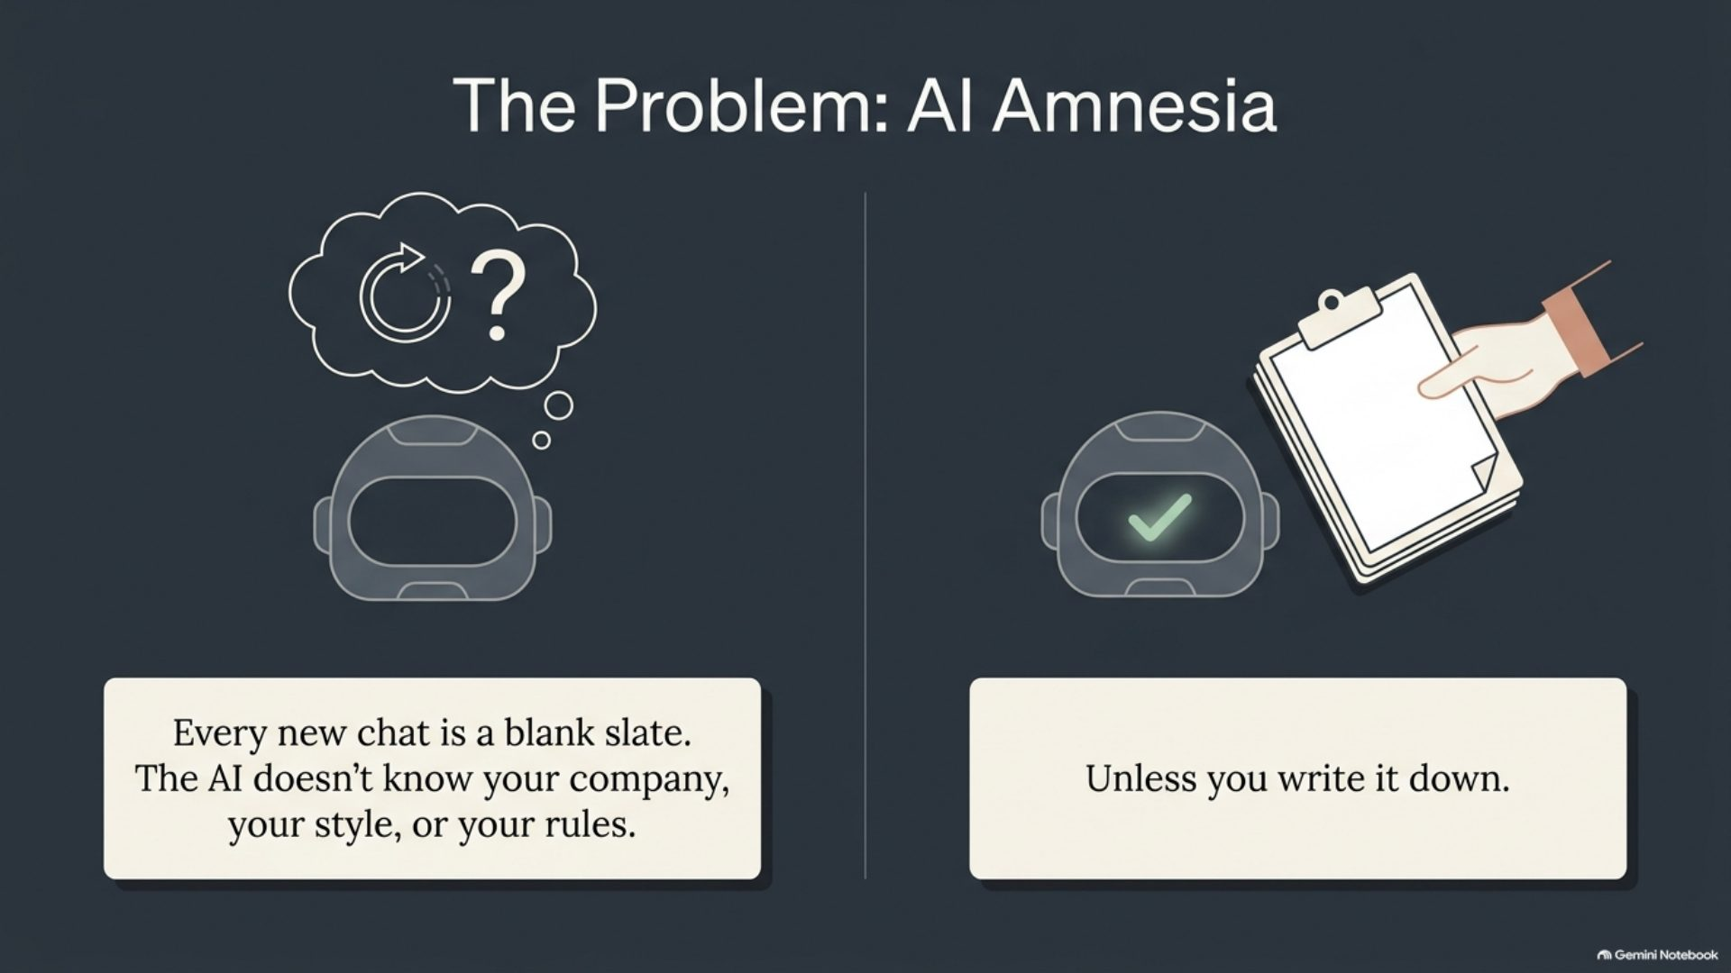
Notes:
The problem: AI amnesia

Slide 3
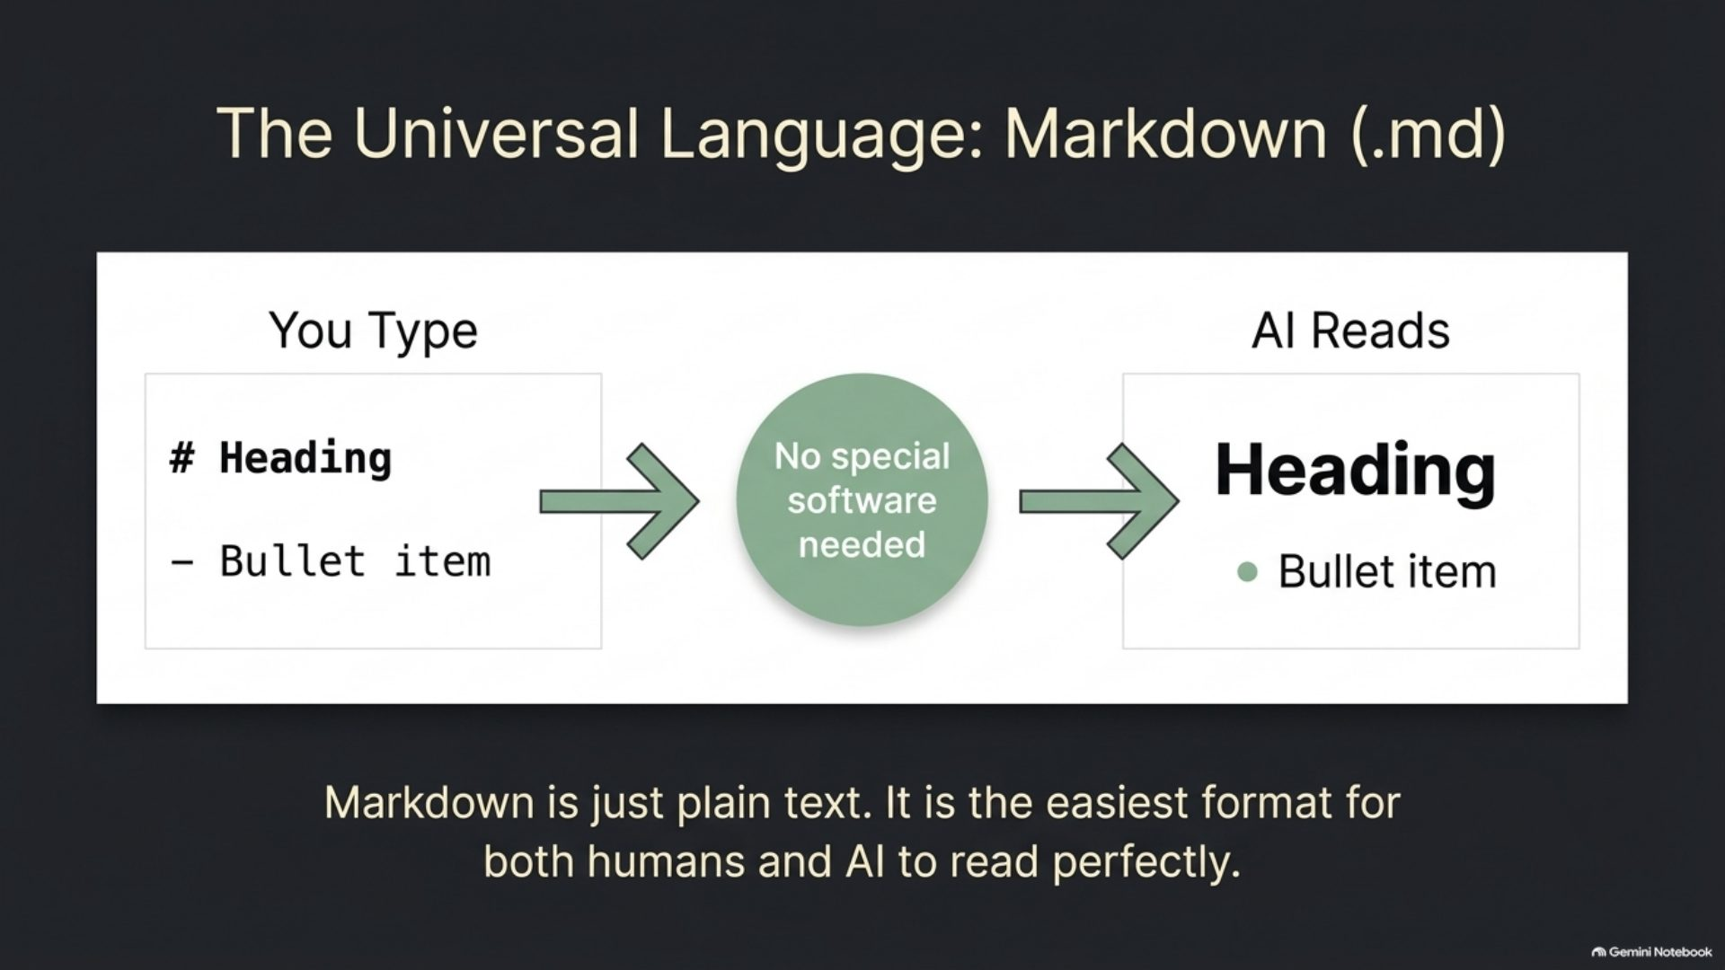
Notes:
The universal language: Markdown (.md)

Slide 4
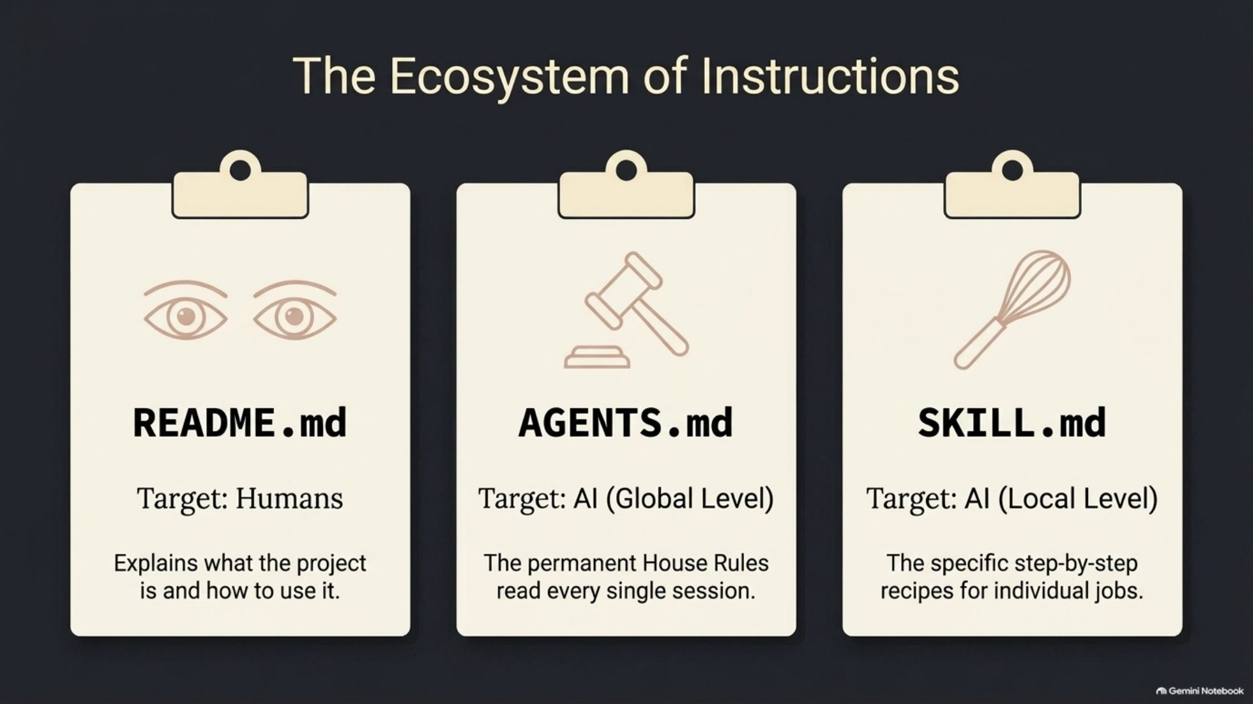
Notes:
The ecosystem of instructions

Slide 5
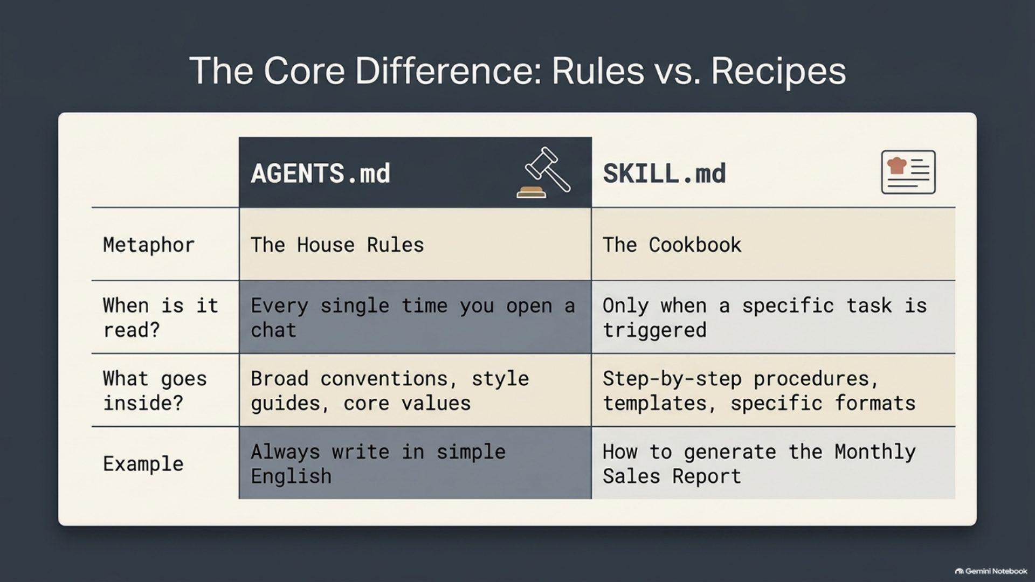
Notes:
The core difference: rules vs. recipes

Slide 6
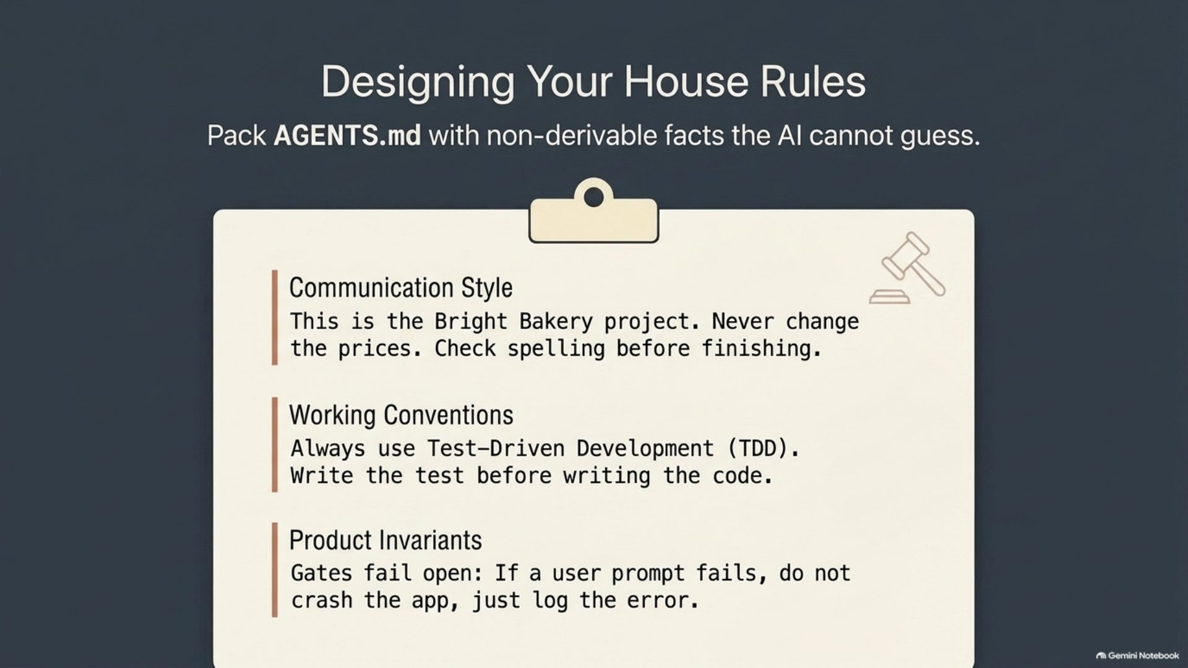
Notes:
Designing your house rules

Slide 7
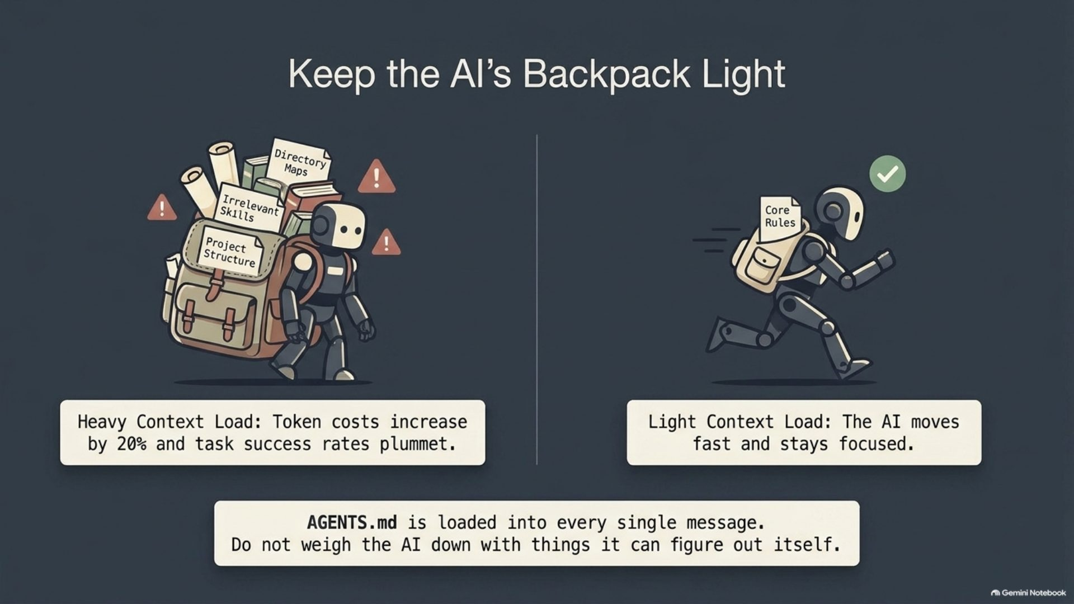
Notes:
Keep the AI's backpack light

Slide 8
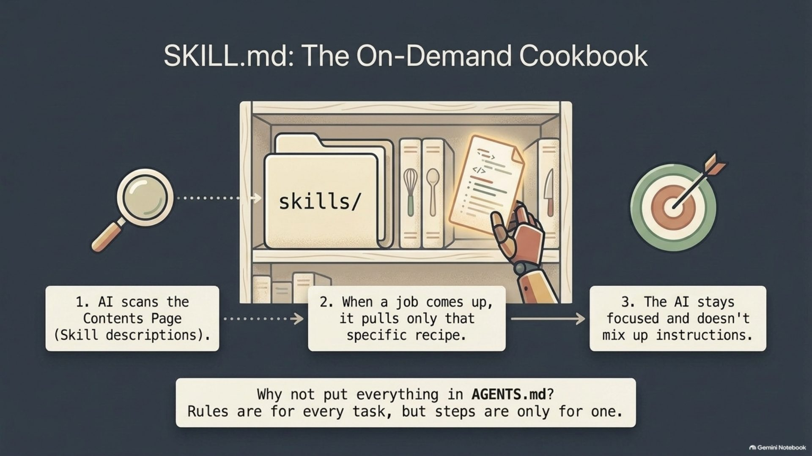
Notes:
SKILL.md: the on-demand cookbook

Slide 9
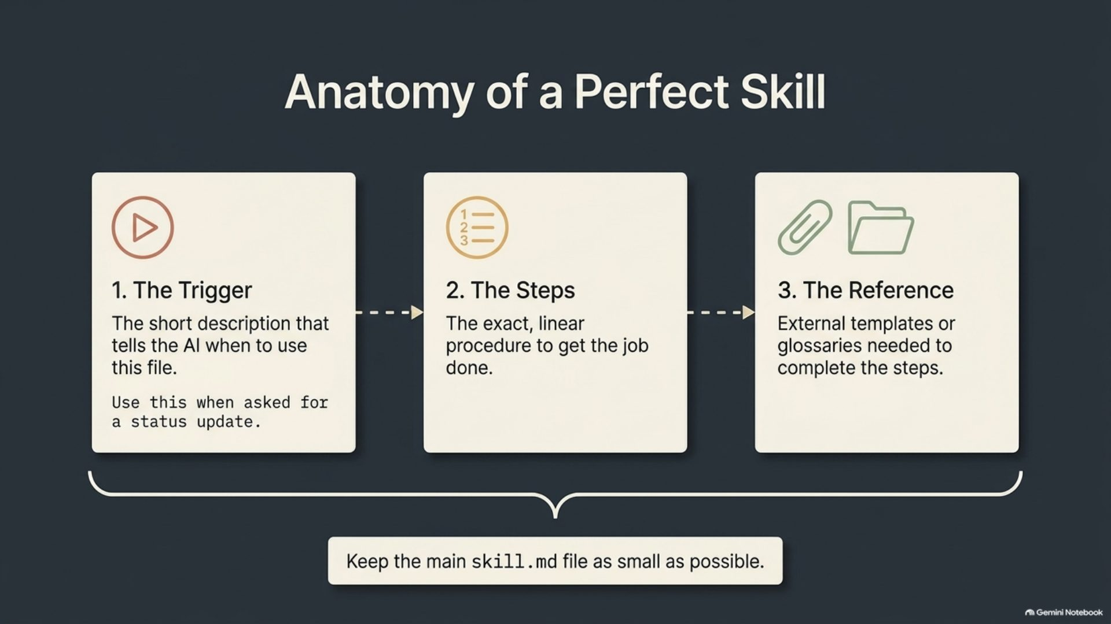
Notes:
Anatomy of a perfect skill

Slide 10
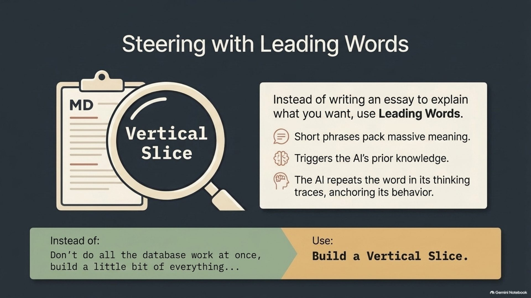
Notes:
Steering with leading words

Slide 11
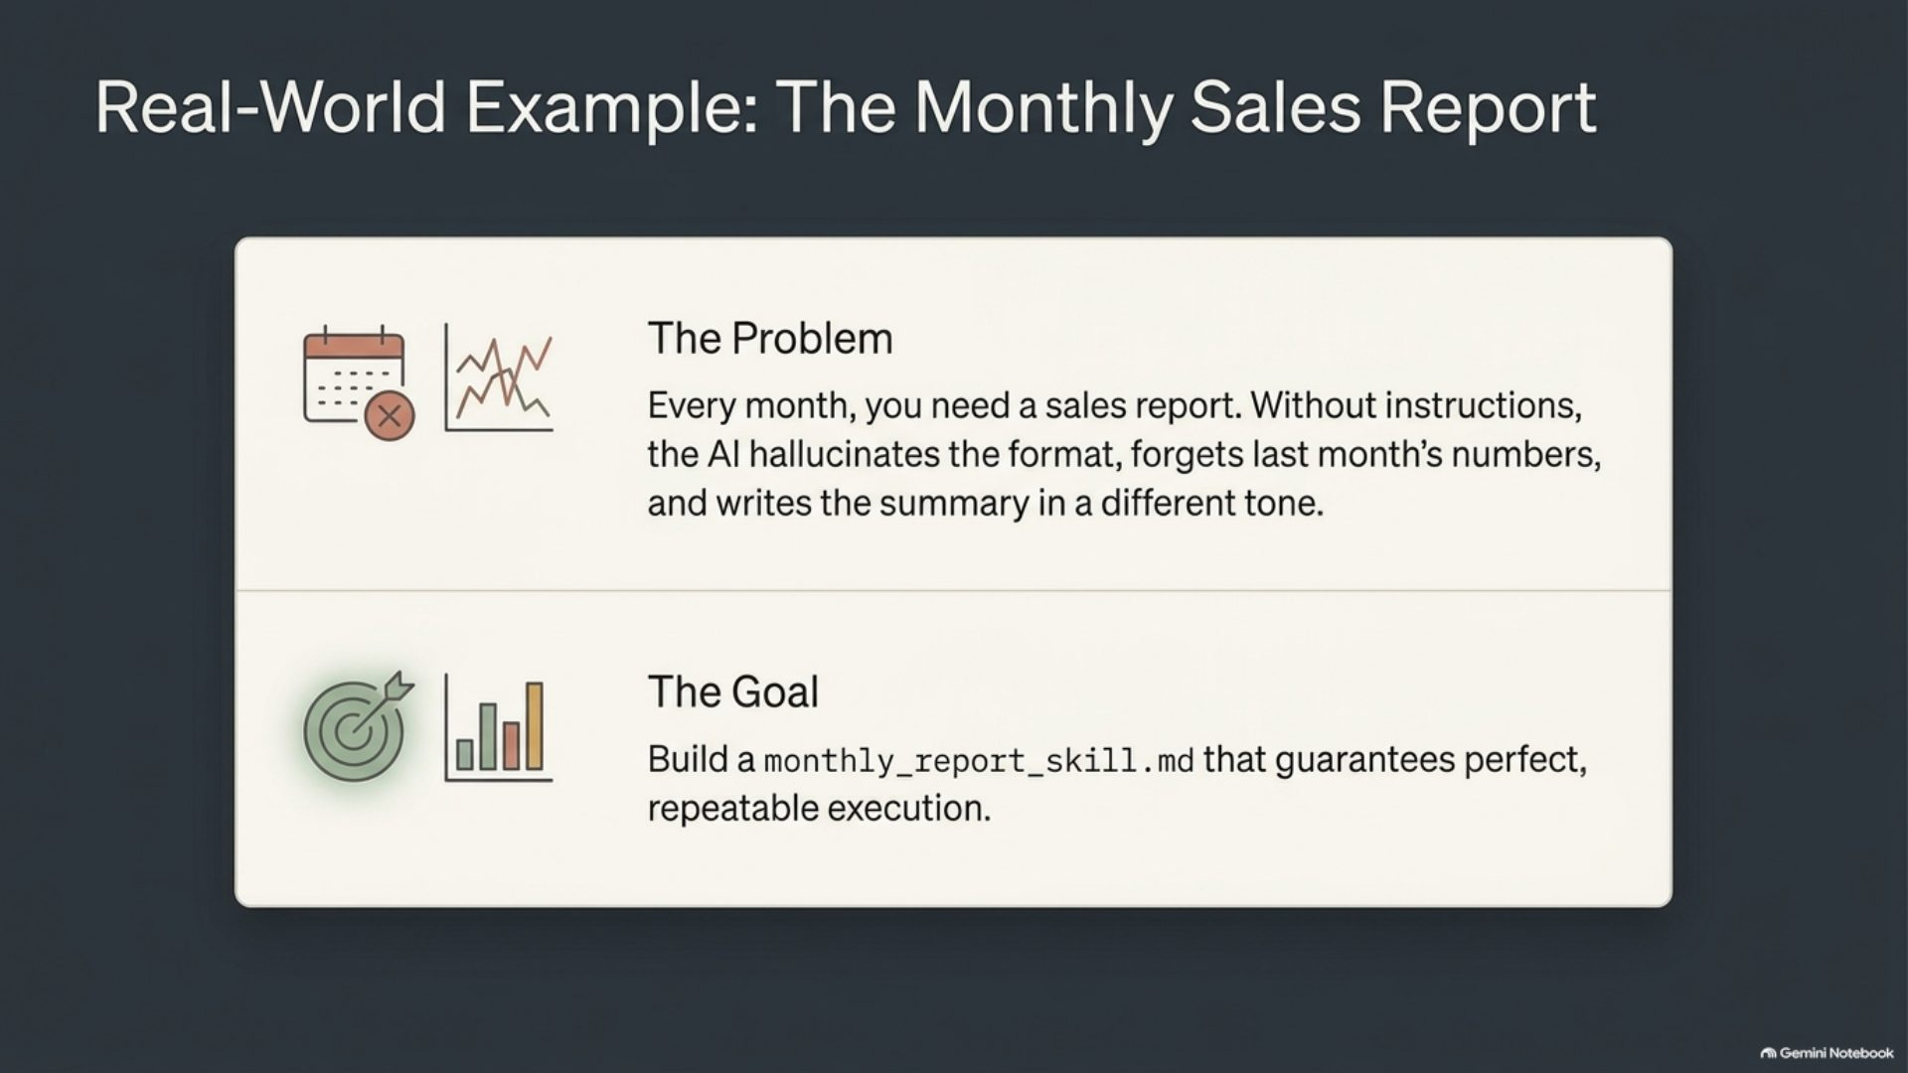
Notes:
Real-world example: the monthly sales report

Slide 12
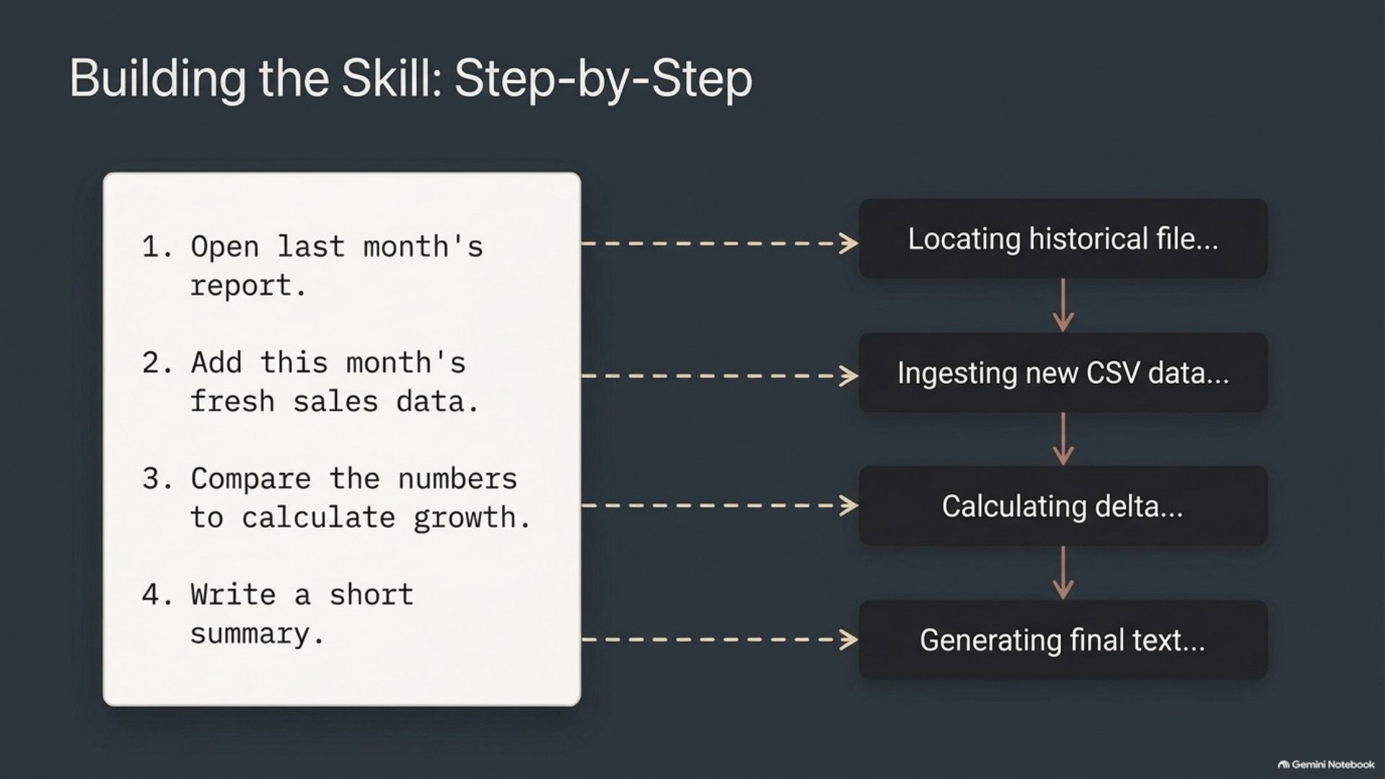
Notes:
Building the skill: step by step

Slide 13
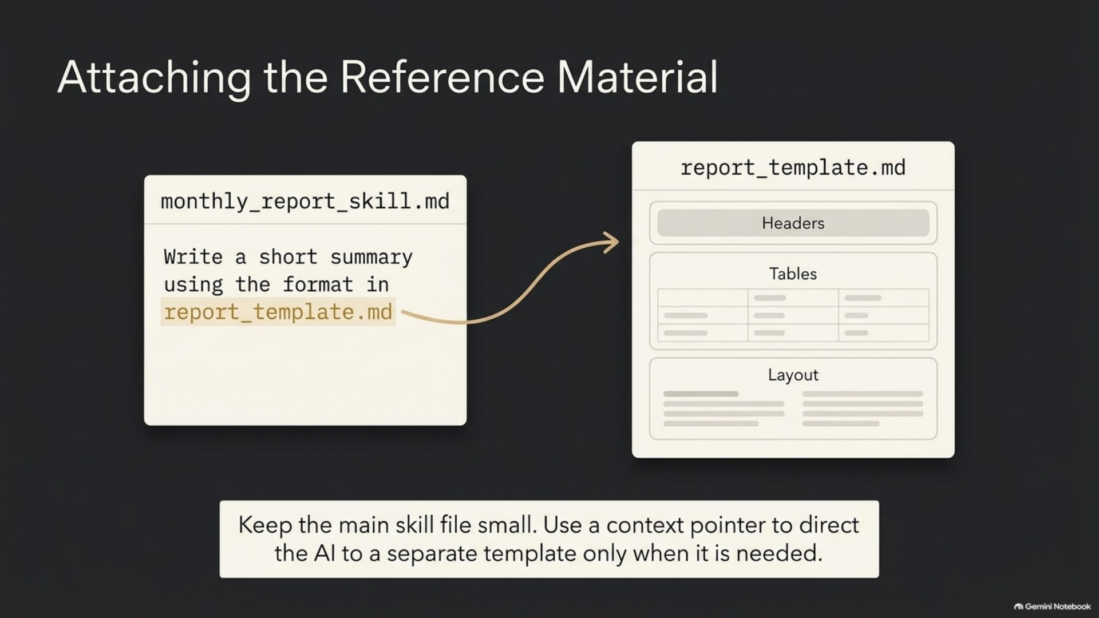
Notes:
Attaching the reference material

Slide 14
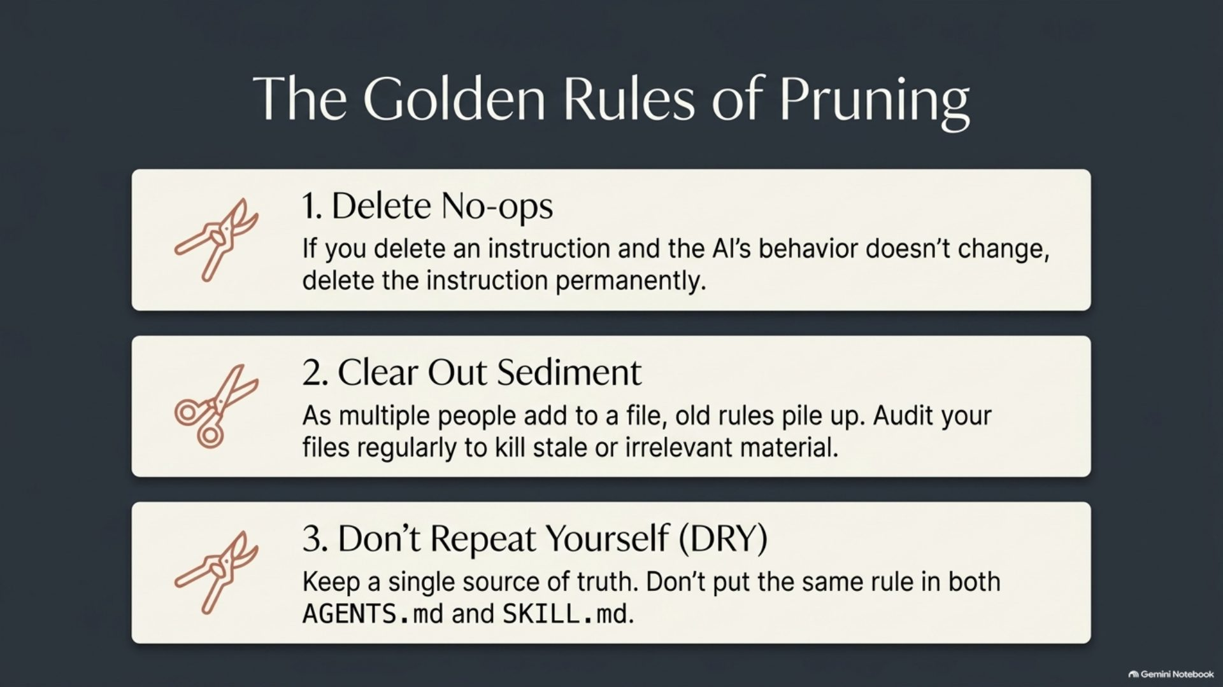
Notes:
The golden rules of pruning

Slide 15
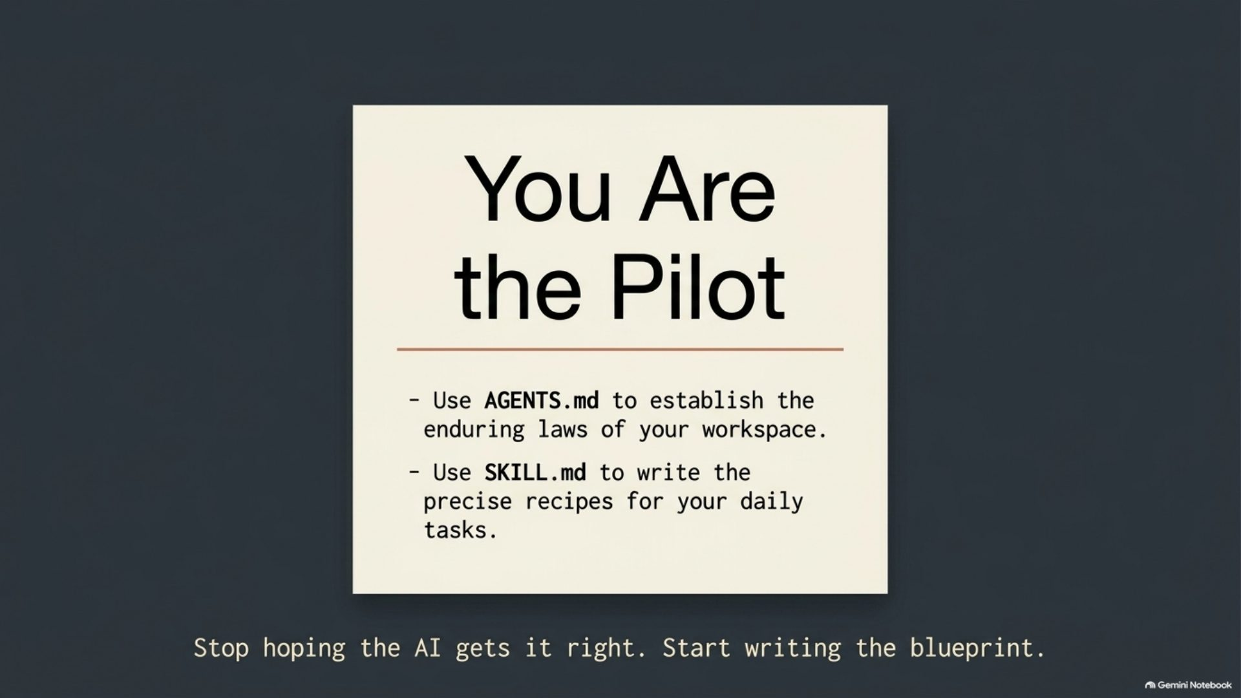
Notes:
You are the pilot

