Slide 1
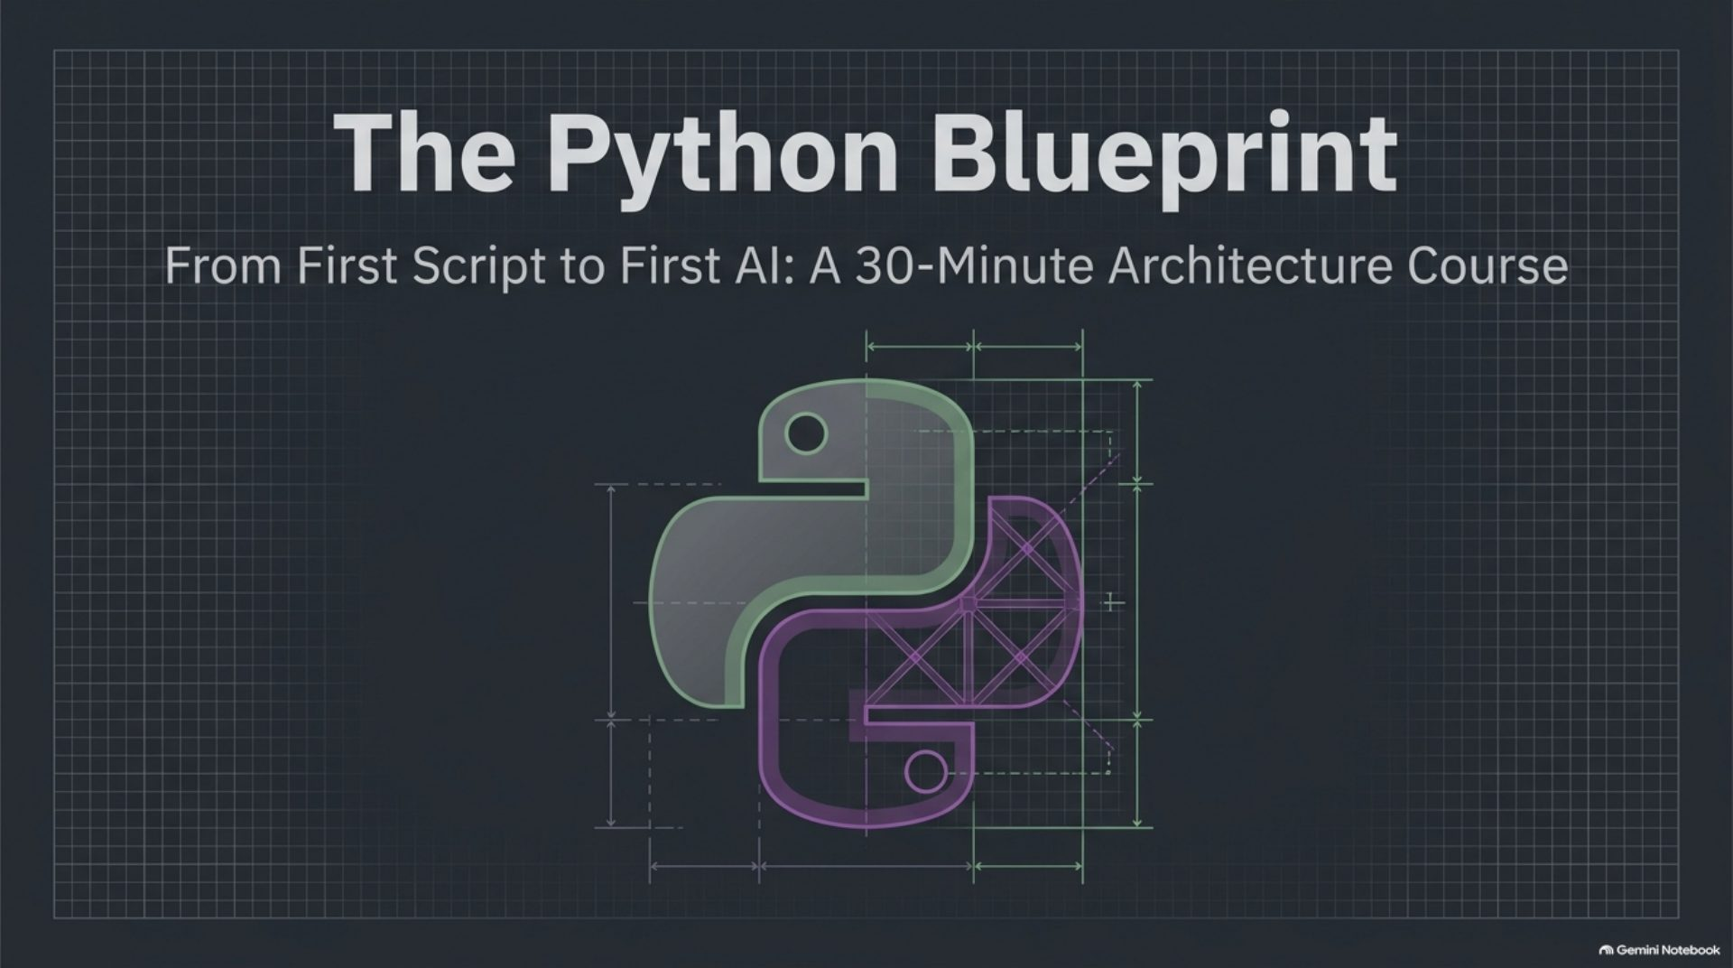
Notes:
The Python Blueprint: from first script to first AI

Slide 2
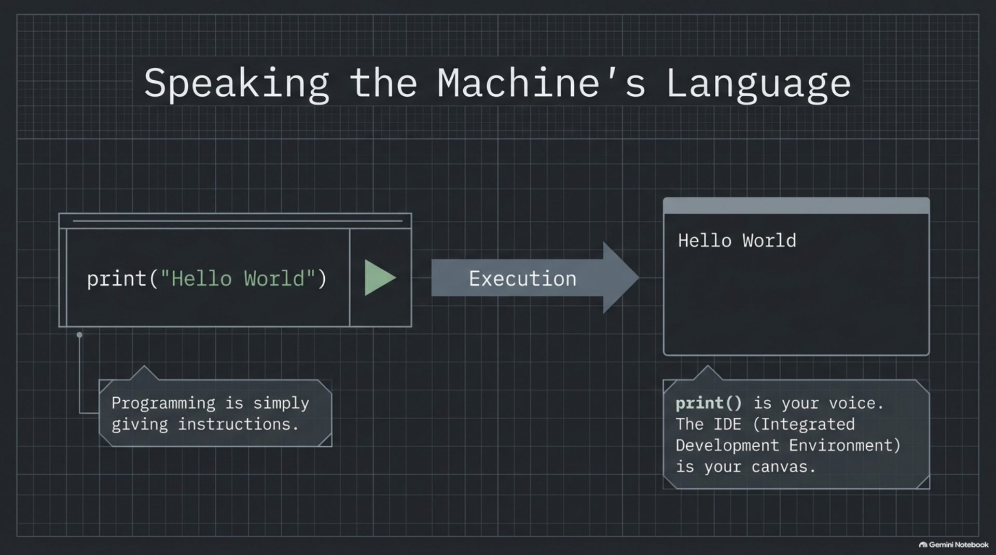
Notes:
Speaking the machine's language

Slide 3
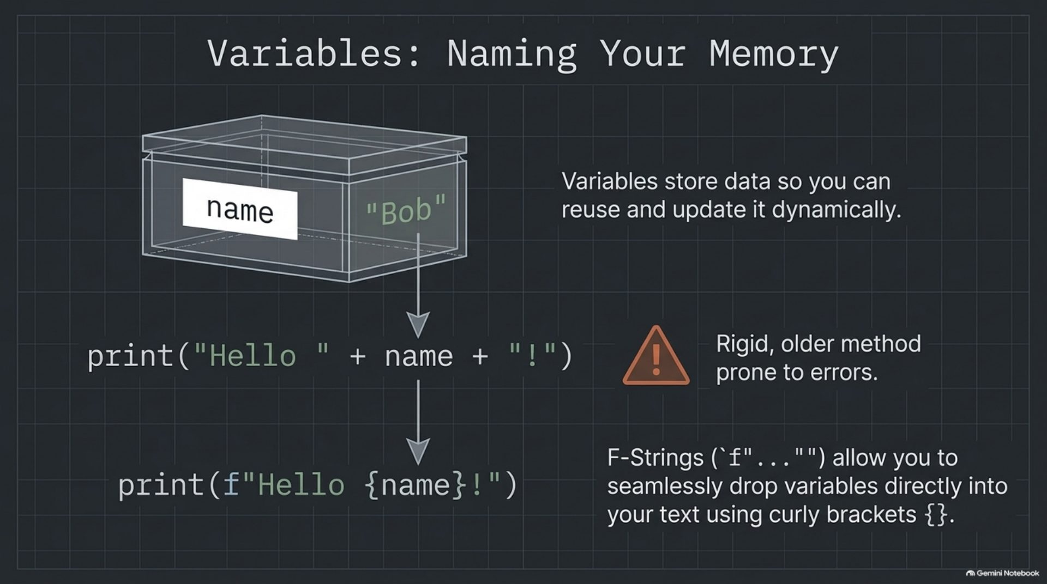
Notes:
Variables: naming your memory

Slide 4
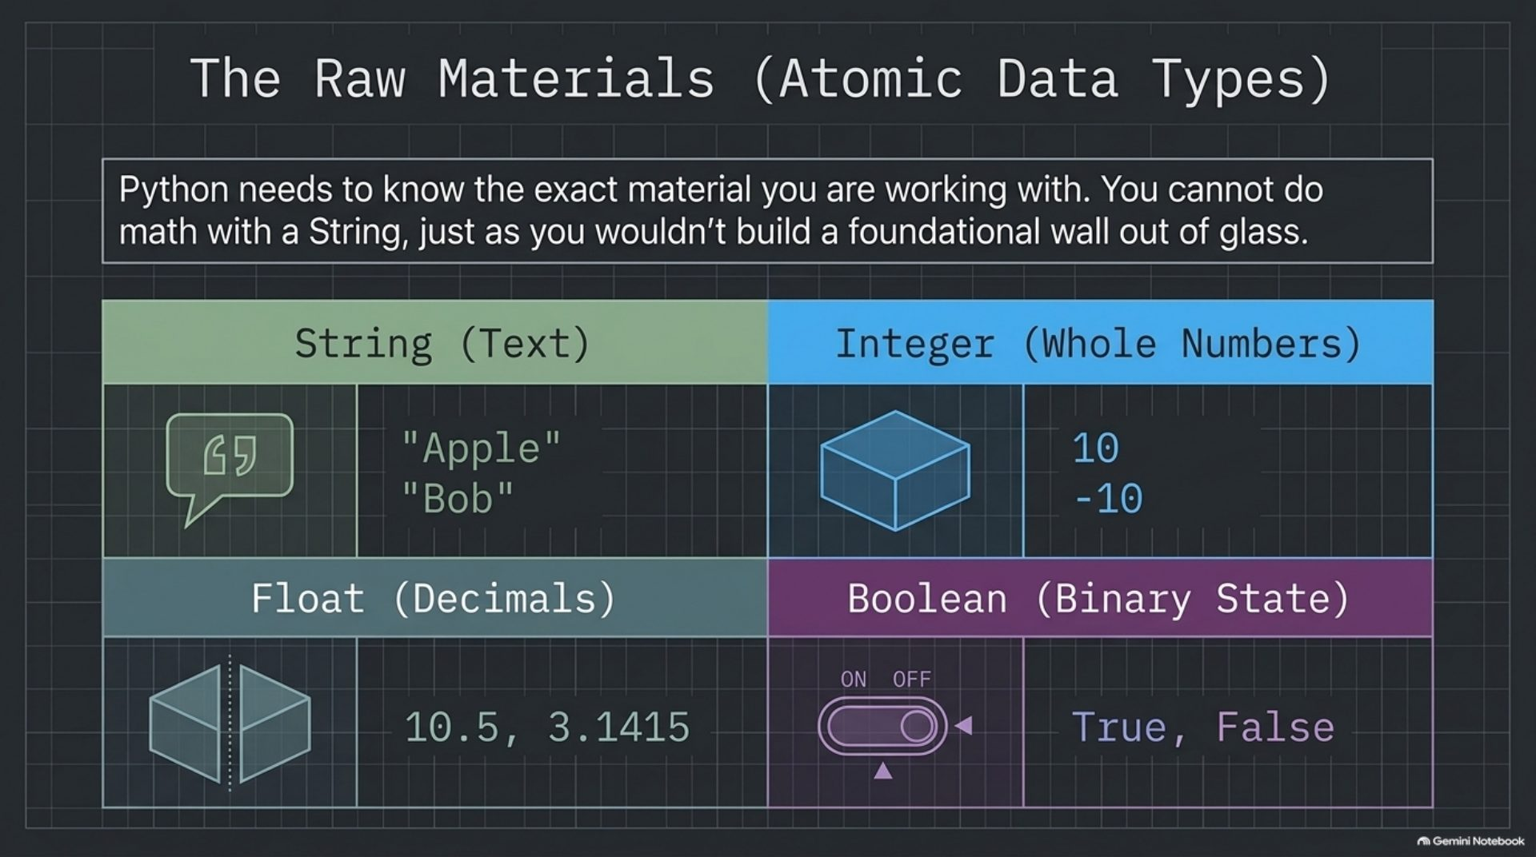
Notes:
The raw materials (atomic data types)

Slide 5
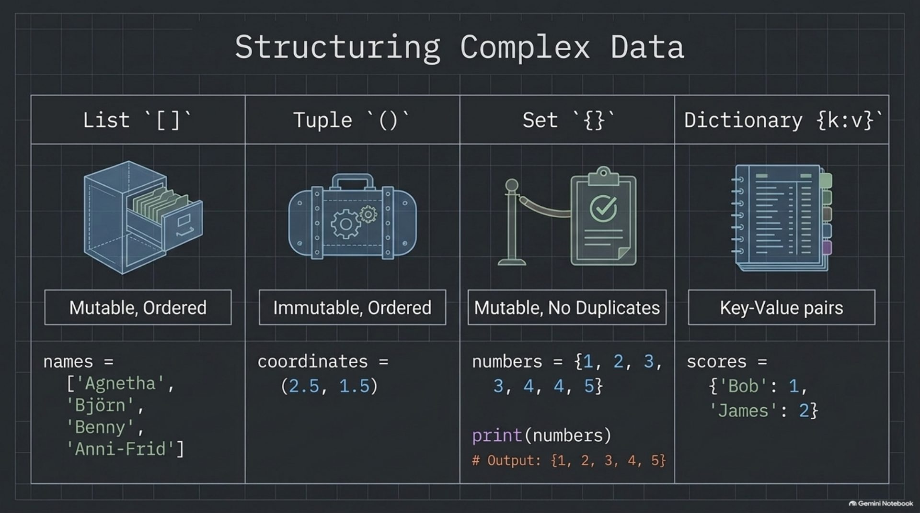
Notes:
Structuring complex data

Slide 6
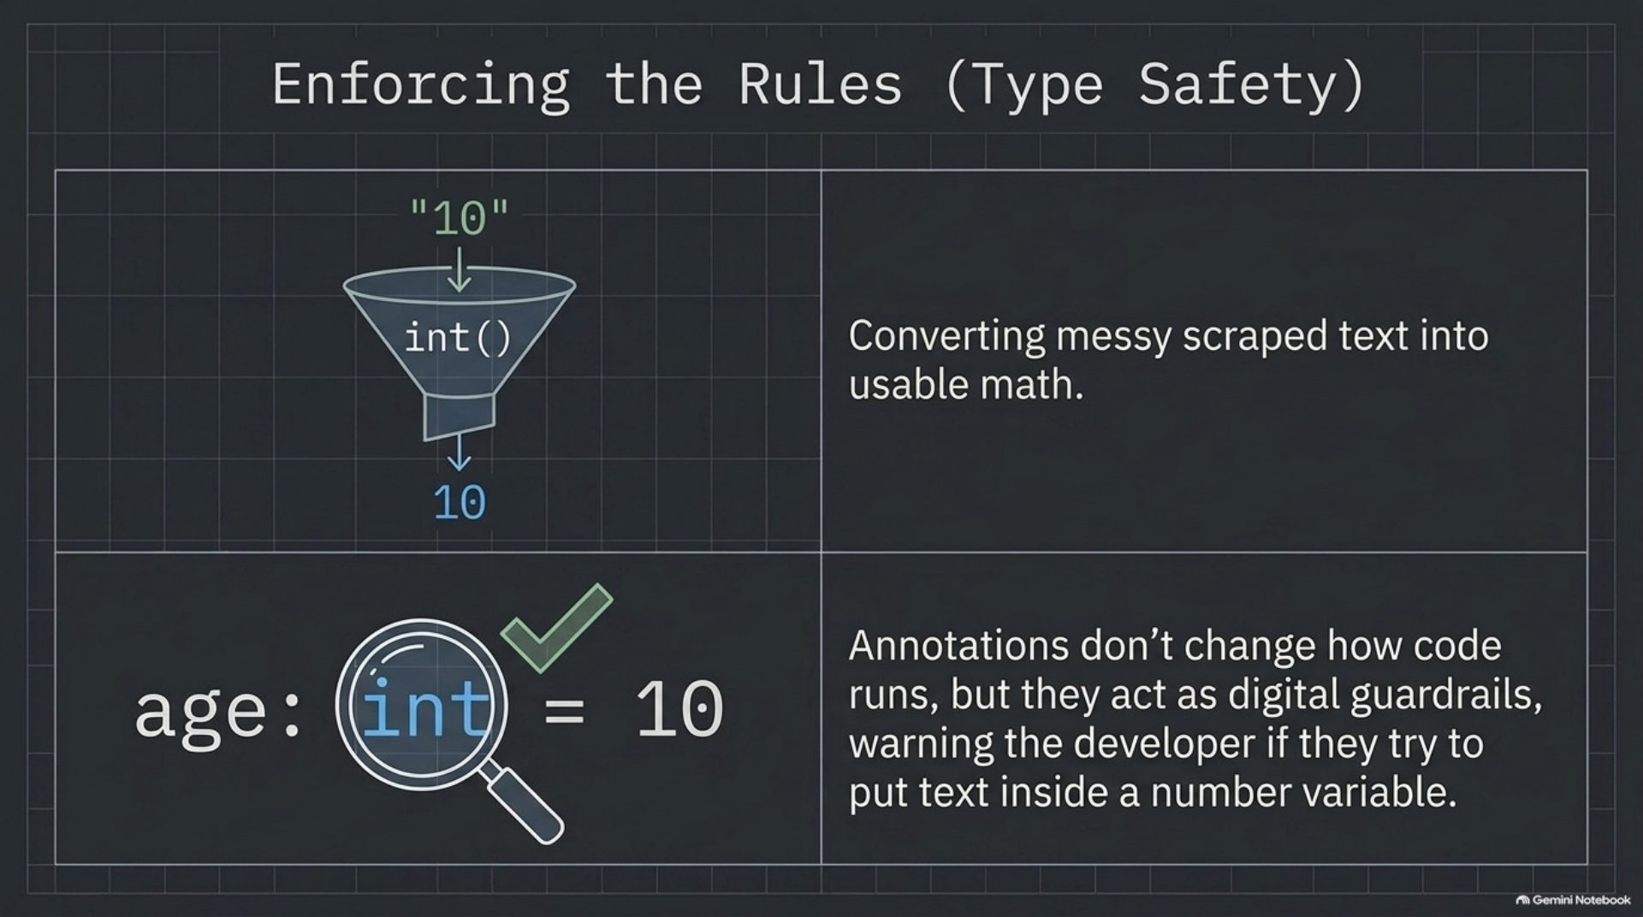
Notes:
Enforcing the rules (type safety)

Slide 7
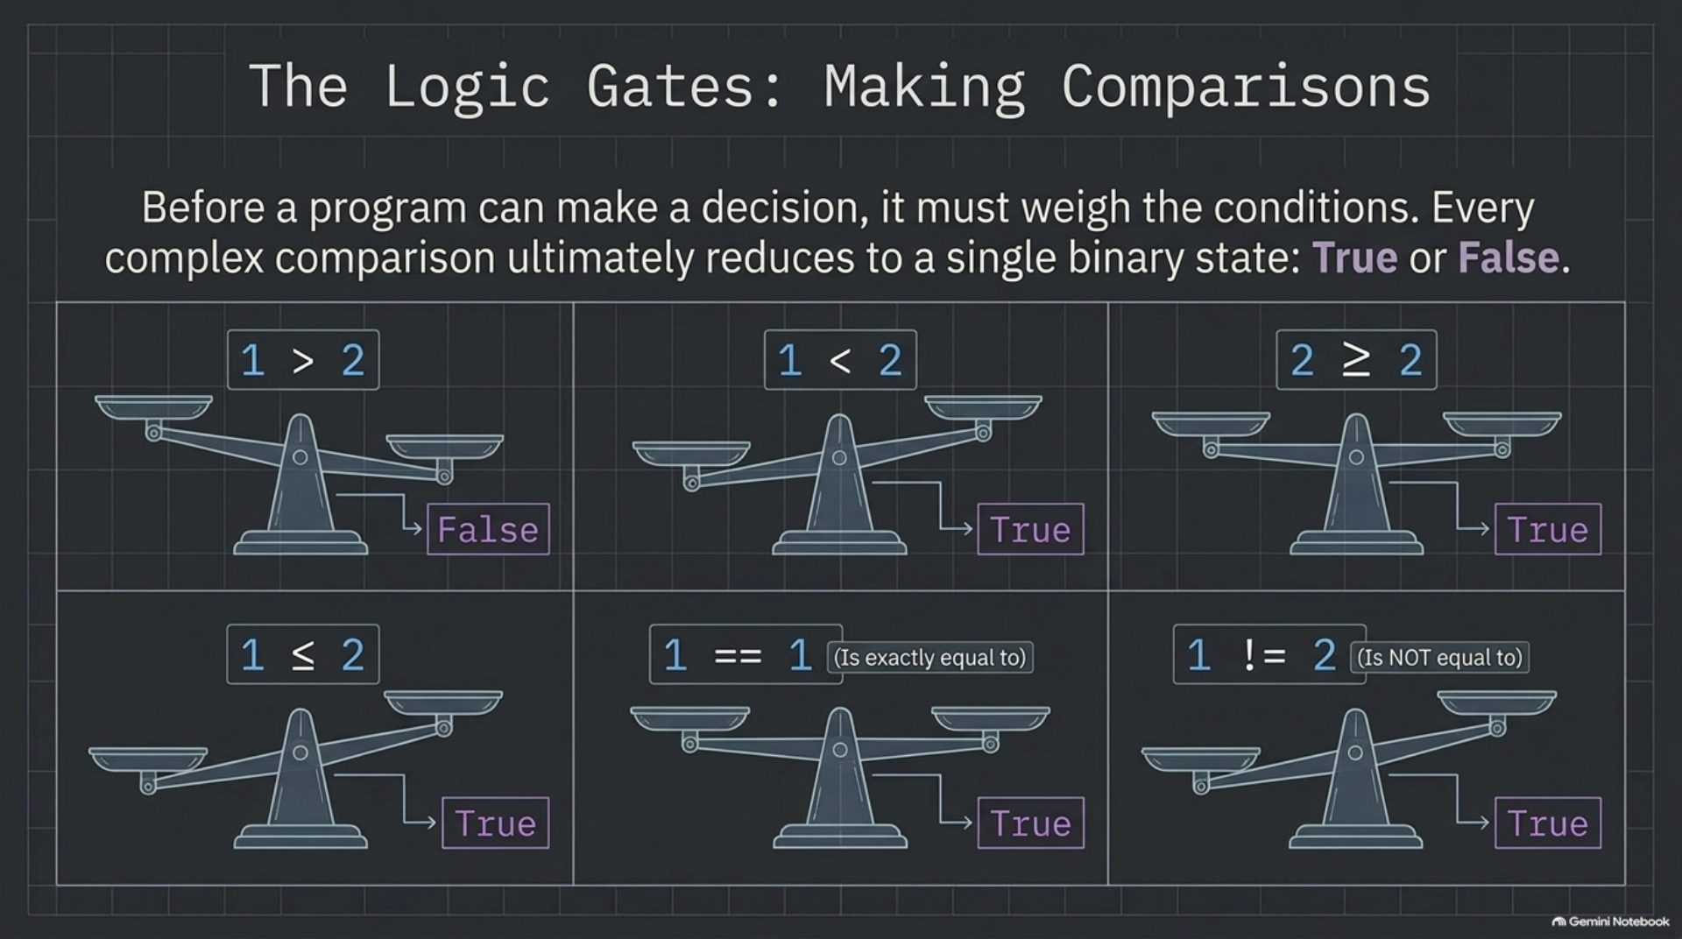
Notes:
The logic gates: making comparisons

Slide 8
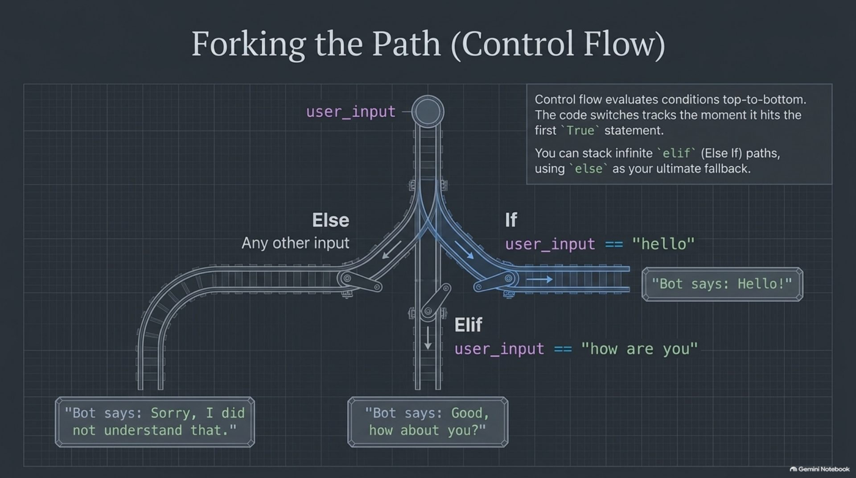
Notes:
Forking the path (control flow)

Slide 9
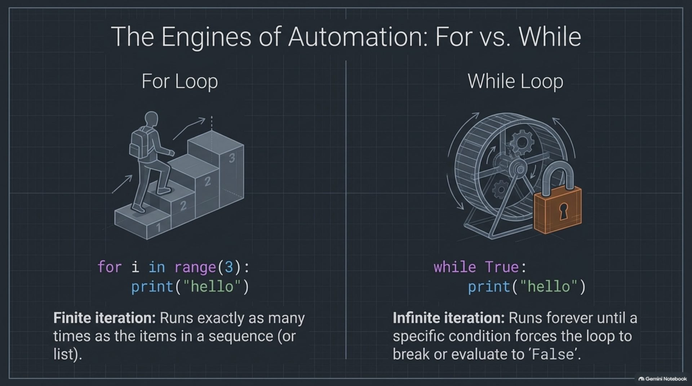
Notes:
The engines of automation: for vs. while

Slide 10
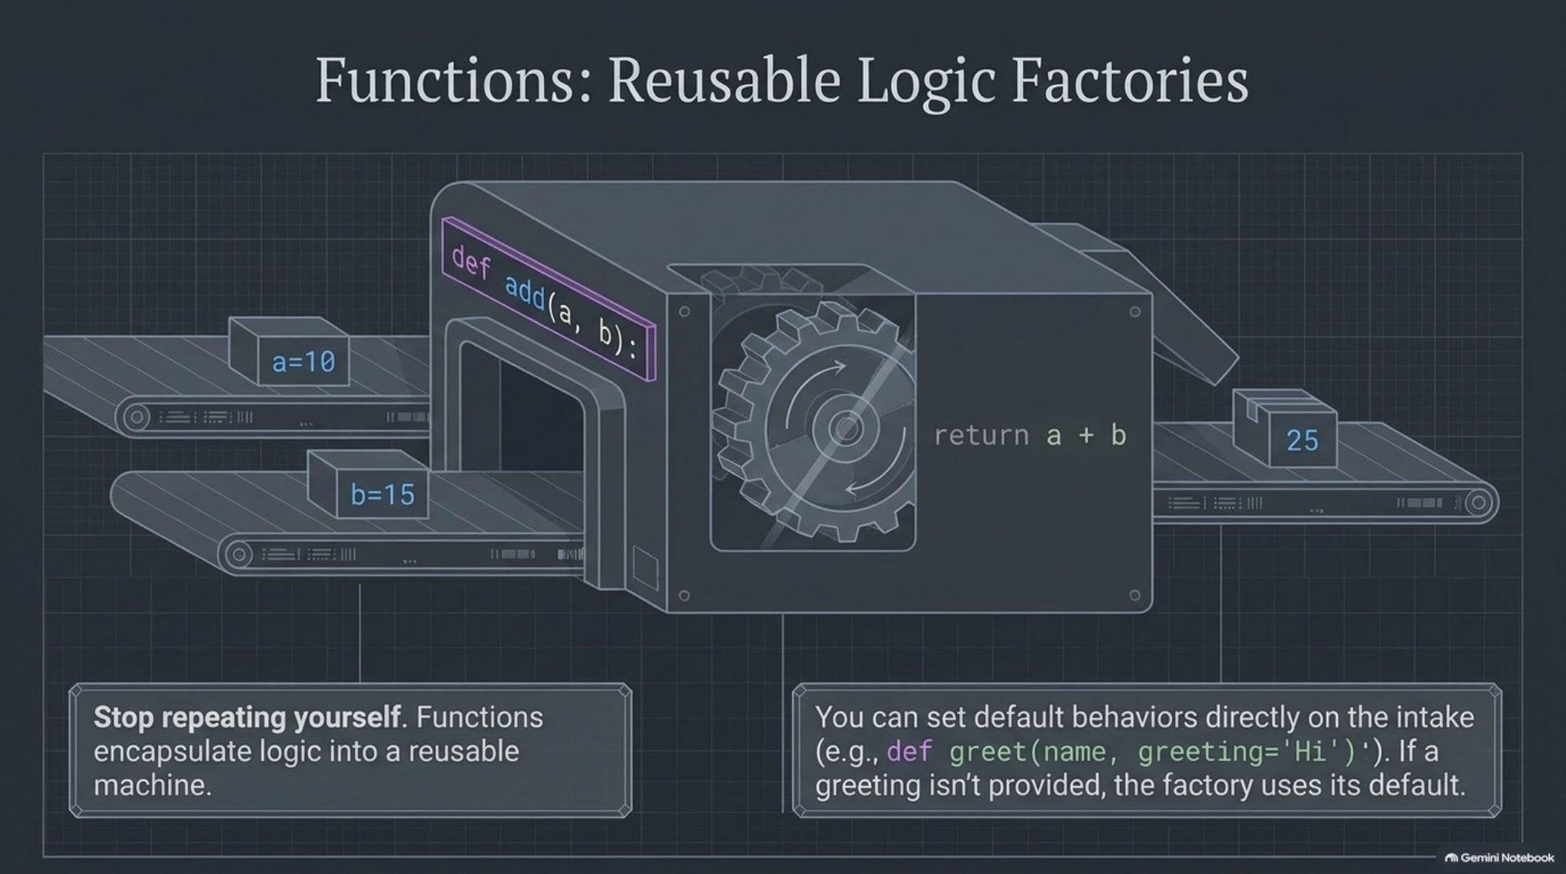
Notes:
Functions: reusable logic factories

Slide 11
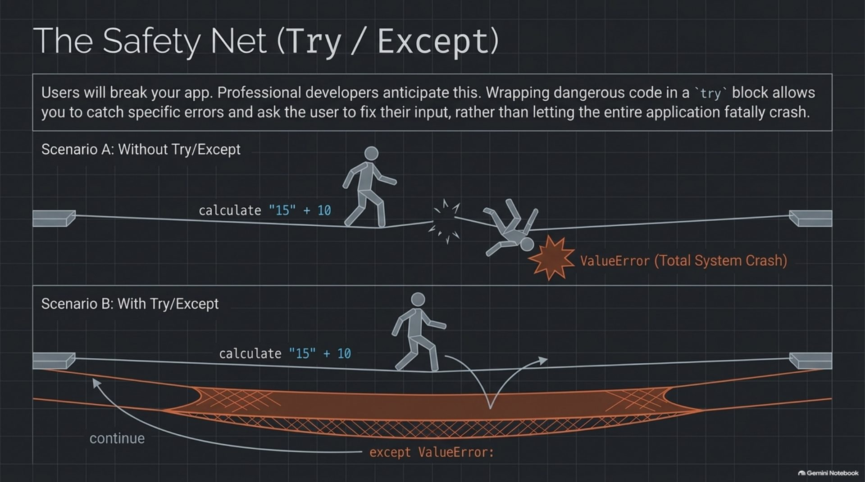
Notes:
The safety net (try / except)

Slide 12
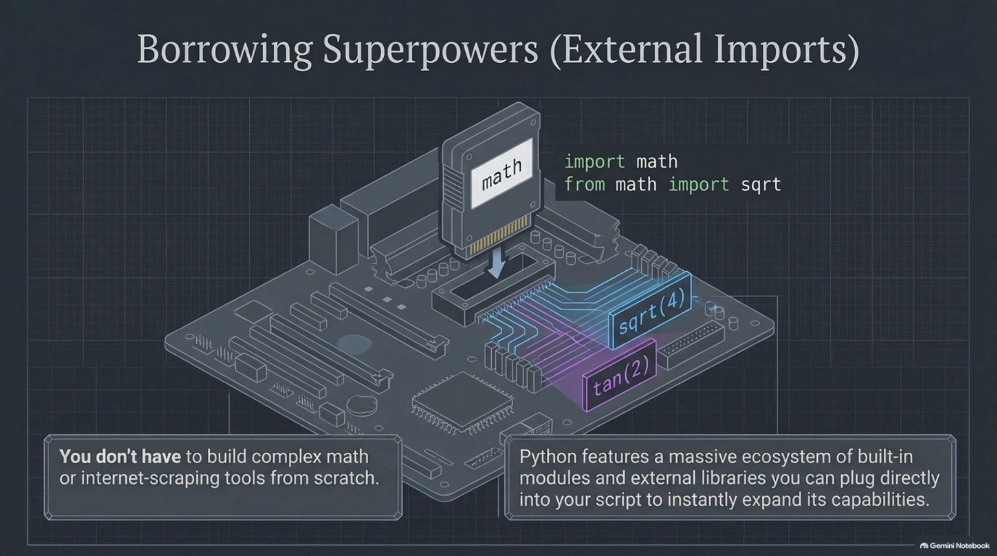
Notes:
Borrowing superpowers (external imports)

Slide 13
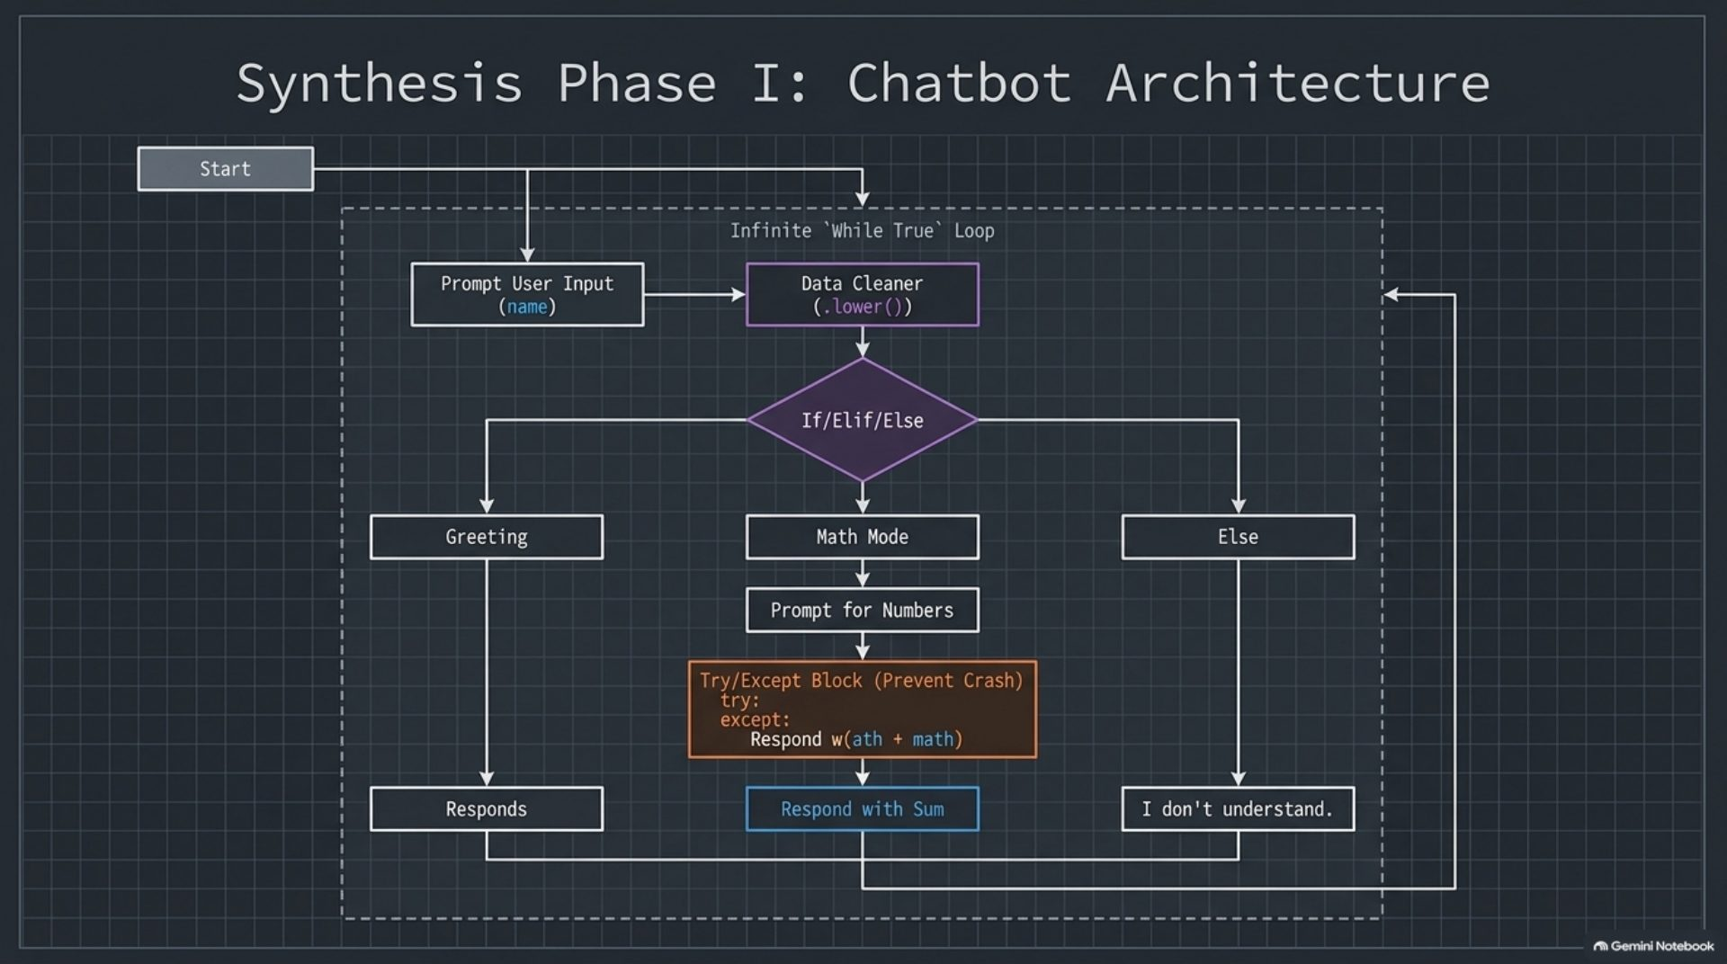
Notes:
Synthesis phase I: chatbot architecture

Slide 14
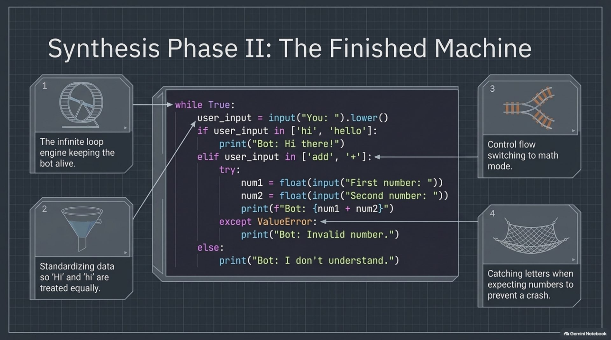
Notes:
Synthesis phase II: the finished machine

Slide 15
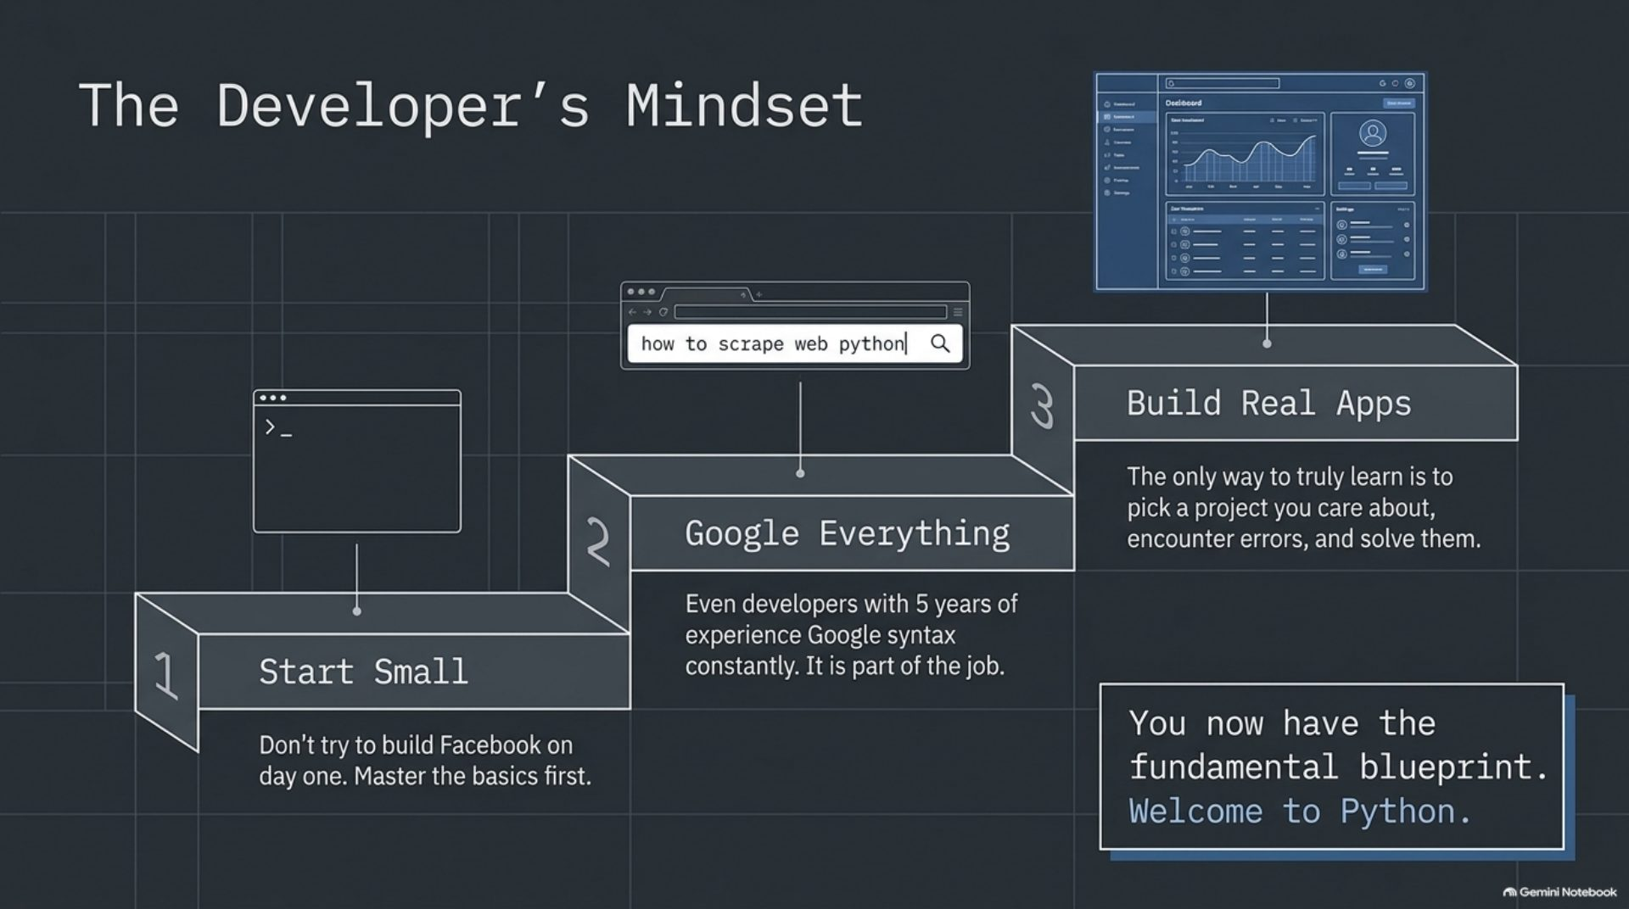
Notes:
The developer's mindset

