Slide 1
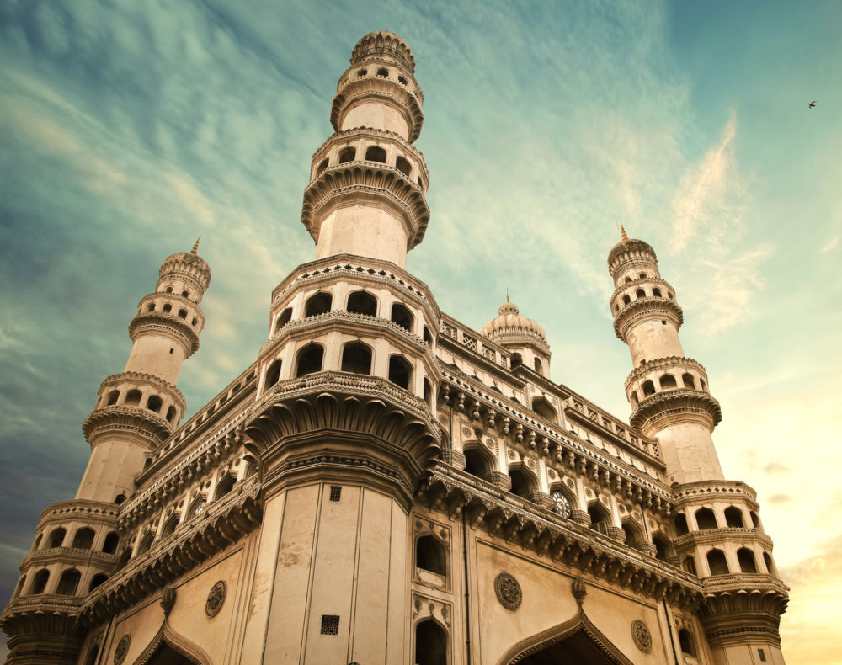
Telangana Tourism

Slide 2

Objective
Telangana is one of India’s leading states and has published its tourism data under its open data policy.
As a data analyst to find the patterns in the given data, do additional research, and give data-informed recommendations to the Telangana government which can be used to increase their revenue by improving administrative operations.
Telangana Government wants to increase their revenue by improving administrative operations.
The idea is to find the patterns in the given data, do additional research, and give data-informed recommendations to the Telangana government.

Slide 3




Tools

Slide 4
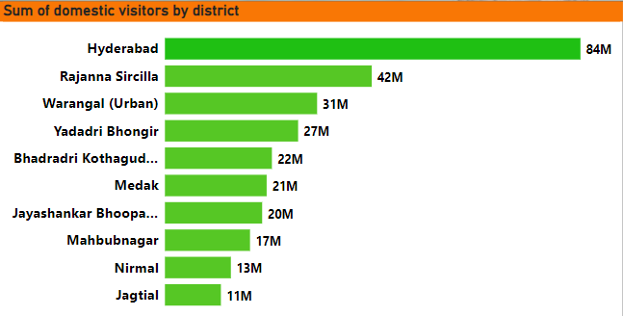
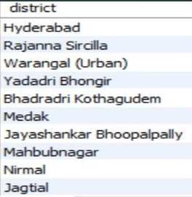
1. List down the top 10 districts that have the highest number of domestic visitors overall (2016-2019)
Insights
Hyderabad has the highest number of domestic visitors in Telangana, with over 84 million visitors from 2016 to 2019

Slide 5
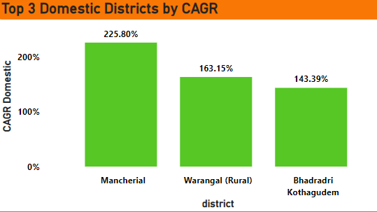
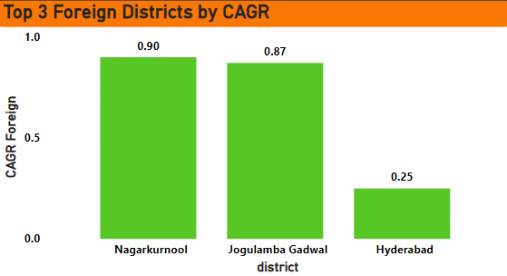
2. Top 3 districts based on compounded annual growth rate(CAGR) of Visitors between(2016-2019)
Insights
The CAGR of Mancherial district is Highest of 225.80% in Domestic visitors followed by Warangal(Rural) and Bhadradri Kothagudem.
Foreign visitors Nagarkurnool has the highest CAGR of 90.03% followed by Jogulamba gadwal and Hyderabad.

Slide 6
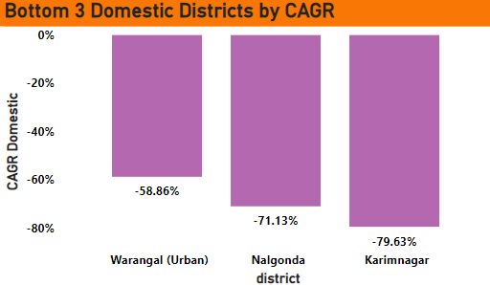
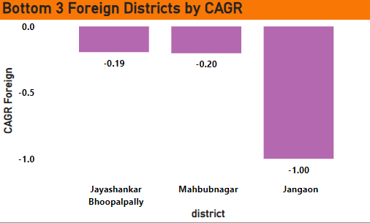
3. Bottom 3 districts based on compounded annual growth rate(CAGR) of Visitors between(2016-2019)
Insights
Karimnagar has the least growth with - 79 .63 % CAGR followed by Nalgonda and Warangal(Urban) with -71 .13 % and -58 .86 % CAGR respectively in Domestic Visitors .
Similarly for Foreign Visitors Jangaon has the least CAGR -100 % followed by Mahbubnagar and Jayashankar Bhoopalpally .
Govt . can look into some factors like proper transportation, Lodging facilities, and basic attractions like Malls ,Restaurants, Markets should be there with a variety of options .

Slide 7
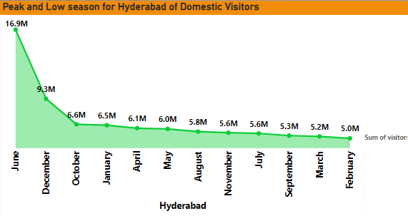
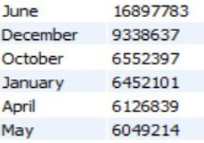
4. The peak and low seasons months of Hyderabad based on the data from 2016-2019 for Domestic Visitors
Insights
June is the Peak season of Hyderabad for Domestic Visitors 16 .90 M followed by December which has 9 .34 M as in India it is the vacation time so most of the families plan tour in these months .
The low seasons months of Hyderabad for Domestic Visitors are February, March, September.

Slide 8
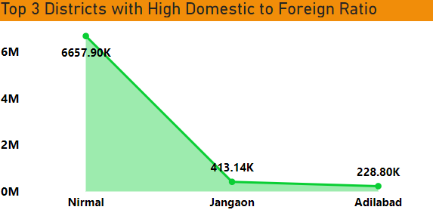
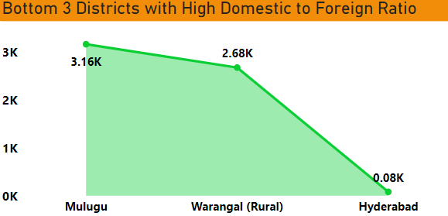
5. The top and bottom 3 districts with high domestic to foreign tourist ratio
Insights
Nirmal has the highest Domestic to Foreign Ratio i . e . 6 .66 M which means that less Foreign tourist visits in these district followed by Janagaon and Adilabad with 0 .41 M and 0 .23M respectively .
Hyderabad has least Ratio of 0 .08 K which means in this district the foreign tourist visits more followed by Warangal(Rural) and Mulugu with 2 .68 K and 3 .16K respectively .
Government may focus in districts with high ratio with some events, can open wildlife if possible, include cultural programme which attracts the foreign tourist and which results in a good revenue generation.

Slide 9
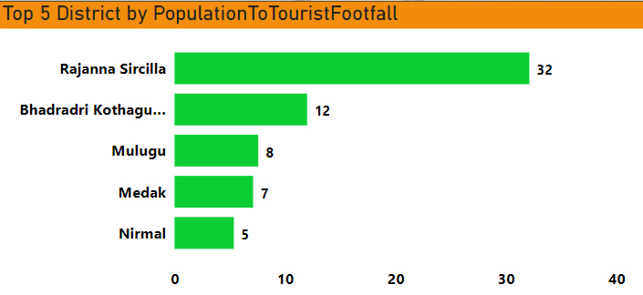
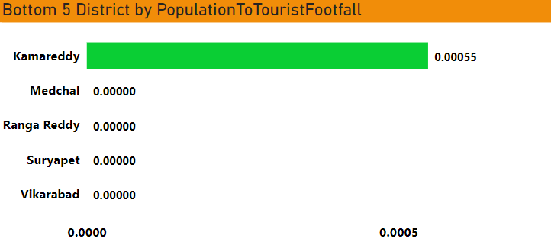
6.The Top and Bottom 5 districts based on population to tourist footfall ratio in 2019
Insights
Rajanna Sircila has the highest ratio of 32 % followed by Bhadradri Kothagudem and Mulugu with 12 % and 8 % respectively means in these district visitors came more than the population .
Kamareddy has the lowest ratio and Medchal, Ranga Reddy, Suryapet ,Vikarabad has 0 visitors, Govt should introduce temples, malls, Restaurants , amusement parks to attract tourist to these places as well .

Slide 10
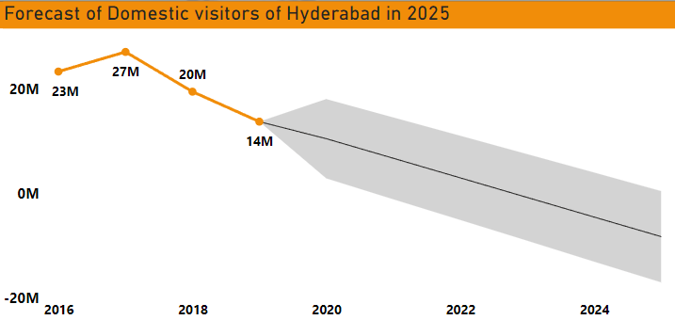
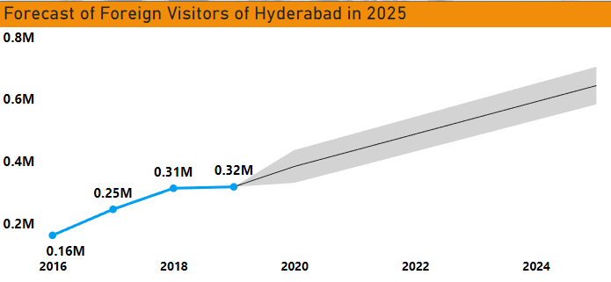
7. The projected number of Domestic and Foreign tourists in Hyderabad in 2025 based on growth rate from previous years
Insights
Domestic visitors by the 2025 will be decreases.
Foreign visitors by the 2025 will be increases. Expected number of visitors near 42000.

Slide 11
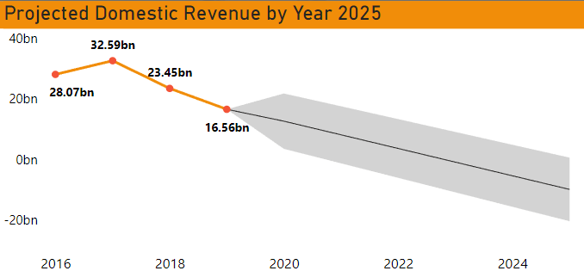
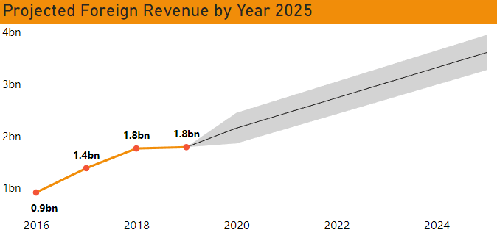
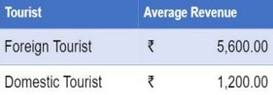
8.Estimate the projected revenue for Hyderabad in 2025 based on average spend per tourist.
Insights
The number of domestic visitors for Hyderabad decrease based on growth rate of previous years, the total revenue would be a great loss.
The number of foreign visitors for Hyderabad increase based on growth rate of previous years, the total revenue would be increase to be spent by the government.

Slide 12
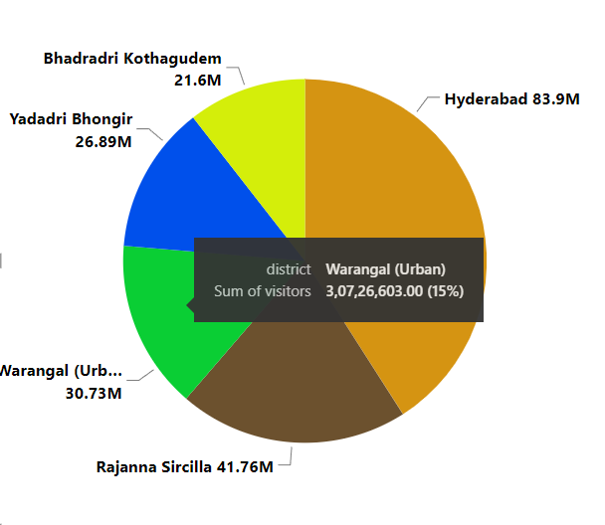
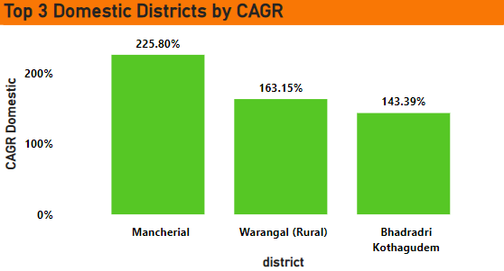
9. Which districts has the highest potential for tourism growth and what actions government can take
Insight
Hyderabad has the highest potential for both domestic and Foreign Tourism .
Rajanna Sircilla , Warangal(Urban), Yadadri Bhongir and Bhadradri Kothagudem are also having high potential for tourism growth .
Also the districts with High CAGR i . e . Mancherial , Warangal(Rural and Bhadradri Kothagudem has the high potential of Tourism growth . In these district Government can improve the infrastructure, market availability.

Slide 13
10.Cultural/Corporate Events to boost tourism
What kind of events the government can conduct?
Which month(s)?
Which districts?
Insights
Sports
Parties
Food
Arts
Exhibition
Business Conference Seminar
Award Functions Education and job fairs
City:
Hyderabad:
Education and Job fairs Events in Month of April. 2.Arts,Exhibition,food,Sports events in Month of May, June and
November, December.
Warangal(Urban):
Arts, Exhibition, foods, events from September to April.
Medak:
Arts, Exhibition, foods, Jatra events from October to March

Slide 14
11.Dubai has made itself a business hub and enjoys massive business tourism. Can Hyderabad emulate the Dubai Model? Provides insights based on your research.
Insights:
Hyderabad can emulate the Dubai Model to enjoy massive business tourism by implementing the following recommendations:
Tax relief for start-ups
Building world class shopping malls, airport, metro station, hotels.
Sports events :Tennis, Golf, Formula 1, Marathon, Cricket, Rugby, Sailing, and Sky Diving.
Culture events during festivals.
Culture parks for showing our culture.
Theme Parks, underwater parks etc.
Heritage Museum.
Modern Science Museum.
Attractive lyrics fountain.

Slide 15
12.Provides all other recommendations that can boost the Telangana tourism, particularly Hyderabad.
Hyderabad is rich in Culture and Art & Music therefore more Events should be organized here based on these during peak seasons.
• Hyderabad has historical monuments and forts which are the main attraction of Tourism providing their visit with an affordable tourist package and guide. • Organizing Food festivals with a variety of options and tastes.
• Hyderabad has Film city can organize International Film Festivals as they plays a major role in boosting the tourism .
• Making use of Natural beauty can Introduce more waterfalls, wildlife parks, picnic spots. • Sports Events can be organized on a large scale which attracts a large amount of visitors.
• Basic facilities like transportation facility, connectivity, Lodging facility, Hotels, Restaurants and Markets should be well maintained for providing a comfortable tourism.
Increase Advertisements at nation and global level.

Slide 16
THANK YOU

