Slide 1
ASP.NET CORE API
JWT Authentication
Deeksha Srivastava

Slide 2
Topics
Introduction and Journey of .NET Core
REST API: Brief Intro
JWT : The Concept
Why JWT
Token Security and Flow
Demo
Notes:
Agenda

Slide 3
.Net Core:
.NET Core is a cross-platform(that can run on Windows, Linux, Mac ) , high-performance, open source framework for building modern, cloud-based, Internet-connected applications and many more.
With .NET Core you can build, Web apps and services , and mobile backends.
It is smaller set/sub-set of .Net Framework (Full), that maintained by Microsoft & the .NET community on GitHub.
.Net Core Facilities:
Cross-platform that runs on Windows, macOS and Linux.
Open source.
Built-in dependency injection features.
Compatible with .NET Framework, Xamarin and Mono, via the .NET Standard Library.
Flexible deployment.
With release of .NET 6, This makes the all-platform code sharable.
Notes:
Variables, Operators & Loops

Slide 4
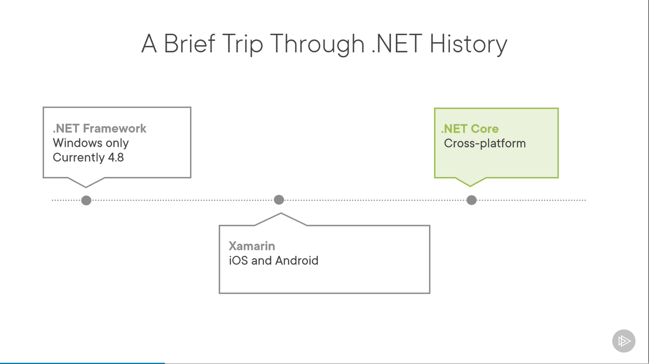
Road to .NET Core
Tool | Year
ASP.NET Web Forms | 2002
ASP.NET MVC | 2008
ASP.NET Core 1.0 | 2016
ASP.NET Core 2.0 | 2018
ASP.NET Core 2.1 & 2.2 | 2018
ASP.NET Core 3.0 & 3.1 (LTS) | 2019
.NET 5 | 2020

Slide 5
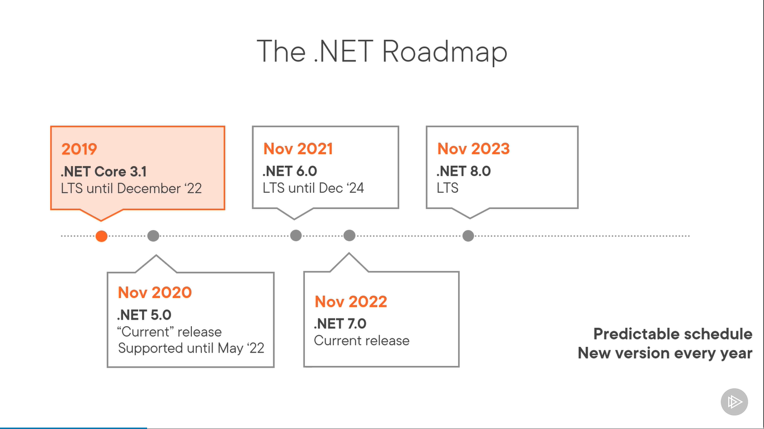

Slide 6
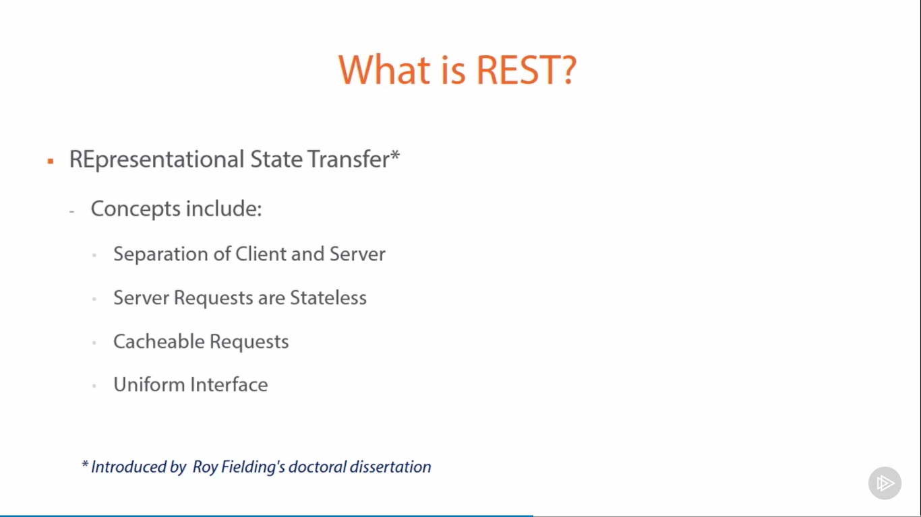

Slide 7
Traditional Authentication Systems!
Traditional Authentication Systems
User logs in, server checks creds
Session stored in server, cookie created
Send session data to access endpoints
Server
Client

Slide 8
Issues with traditional systems!
Sessions: Record needs to be stored on server.
Scalability: With sessions in memory, load increases drastically in a distributed system.
CORS: When using multiple devices grabbing data via AJAX requests, we may run into forbidden requests.

Slide 9
Session vs Token
Drawbacks of Sessions
Scaling is hard
Doesn’t work with mobile
Advantages of Tokens
Stateless!
Works on both web and mobile
Flexible

Slide 10

APIs & Security

Slide 11
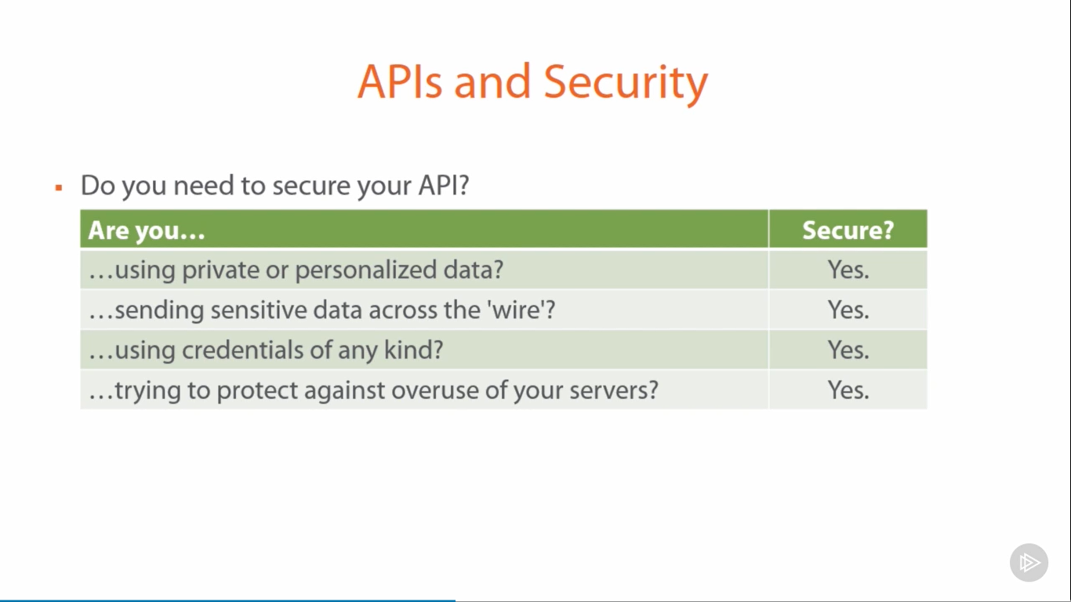

Slide 12
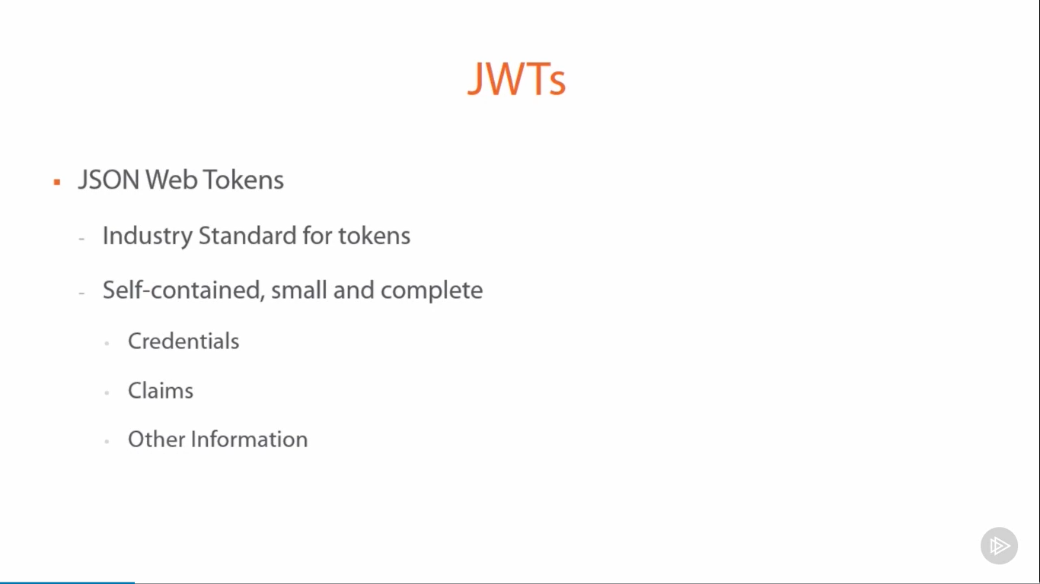

Slide 13
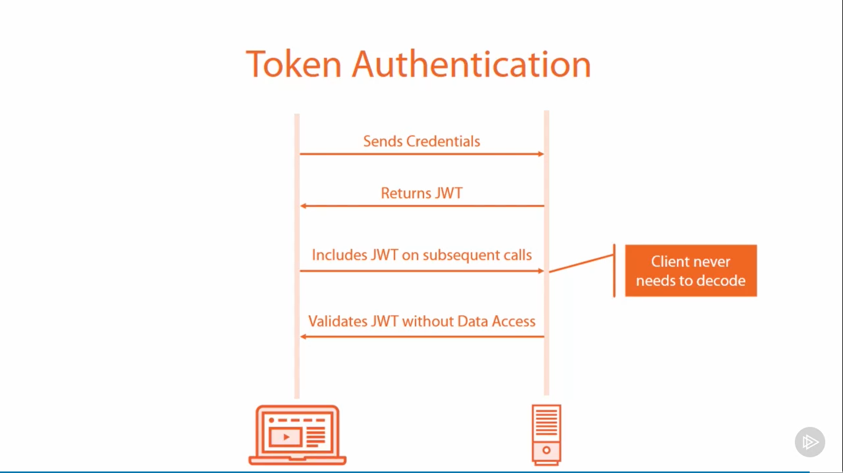

Slide 14
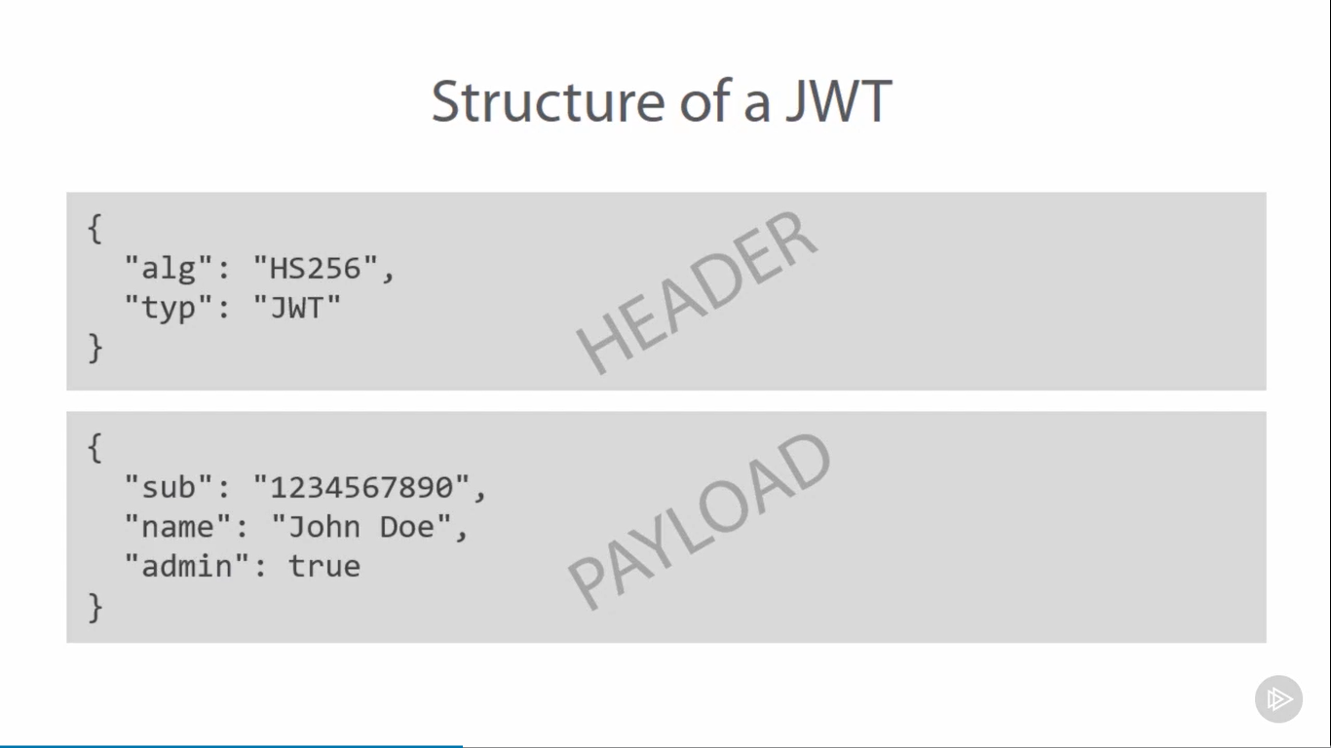

Slide 15
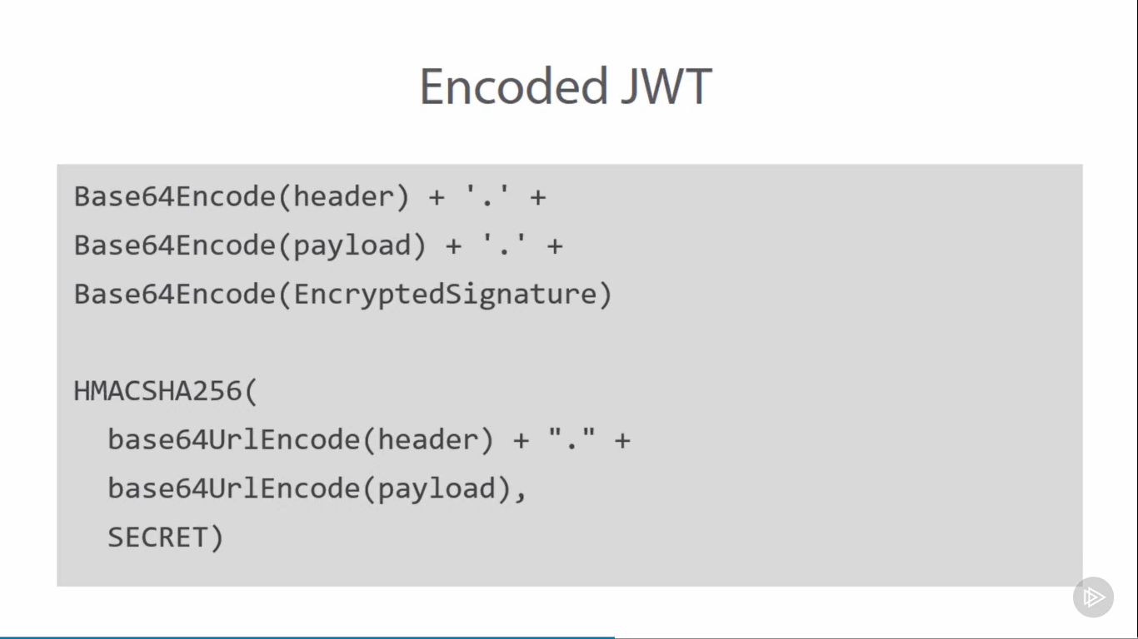

Slide 16
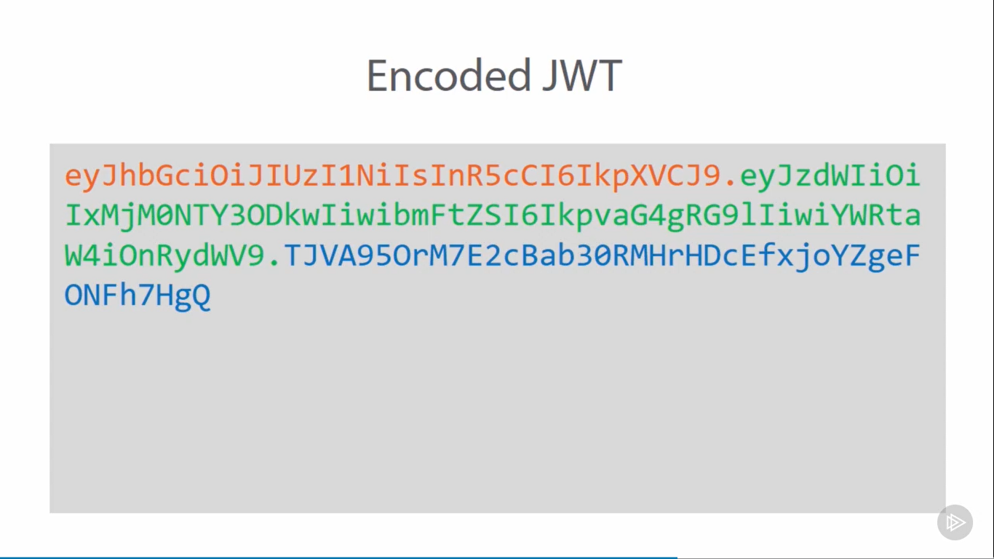
Red = Header
Green = Payload (“claims”)
Blue = Cryptographic signature

Slide 17
JWT Payload (Claims)
Reserved: Predefined, recommended, interoperable terms.
Public: Customs claims that may be set at will.
Private: Agreed upon claims between two parties

Slide 18
Reserved Claims!
iss (issuer): The person that issued the token
sub (subject) : The subject of the token.
aud (audience) : Audience the token is intended for.
exp (expiration time) : Expiration time of the token.
nbf (not before) : Starting time token is available.
iat (issued at) : When the token was issued.
jti (JWT ID) : Unique identifier for the token.

Slide 19
Token Security
Cryptographically signed by the server
Signature guarantees it hasn’t been forged or altered
Token expiration (exp claim) and not-before (nbf claim) Optional token revocation using a nonce (jti claim)
Use HTTPS (TLS) everywhere!
Store tokens securely

Slide 20
Where to store Tokens
On mobile: local device storage, sent via HTTP headers
On the web: cookies, or HTML5 web storage (via HTTP headers)

Slide 21
DEMO TIME!

Slide 22
Visual Studio 2019
Tooling :
.NET Core SDK (For Development)
.NET Core Runtime (Hosting)
https://dotnet.microsoft.com/download
IDE or Editor with C# plugins
Notes:
ASP .NET 5.0

Slide 23

Your Support is appreciated
…
Notes:
Additional Topics

