Slide 1
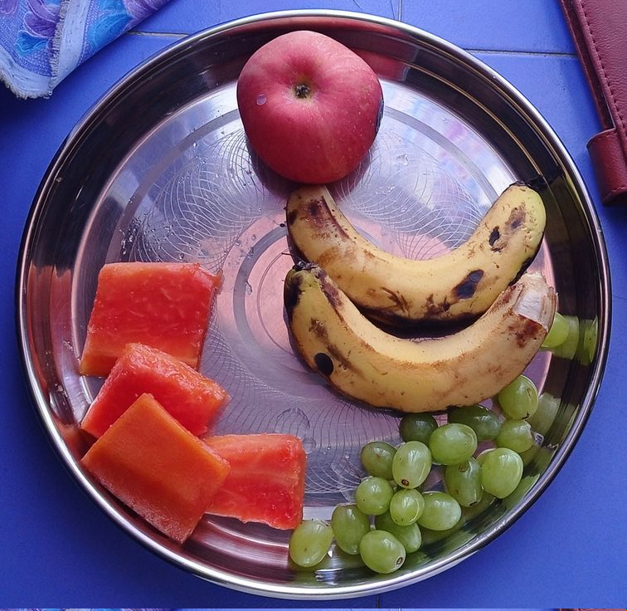
Project title: Weigh My Plate(Team no. 03)
Team Members: Archit Tiwari(2023202025)
Aritra Sarkar(2023201010)
Arpit Shaw(2023201068)
Aryan Verma(2023201066) Date: 03/12/2023
Credit: google images

Slide 2
Introduction & Overview
In a society dominated by hectic schedules and a prevalence of quick dining options, "Weigh My Plate" stands as a pivotal undertaking, shedding light on the path to improved well-being by encouraging thoughtful food selections.
Beyond merely scrutinizing the contents of your plate, this endeavor is a catalyst for individuals, granting them the ability to make conscientious and influential decisions for their own health and the broader community.
Join us as we explore the core of the "Weigh My Plate" initiative, understanding its purpose, and the profound positive changes it aspires to instigate in our personal lives and communities alike.

Slide 3
Objective
Upload a photo of a plate with food.
Detect the food items in the plate first.
Estimate the quantity
Predict the total calories and other nutritional information such as proteins, carbs, fats etc.

Slide 4

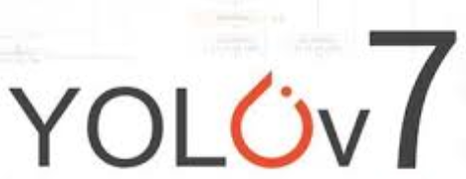
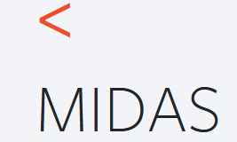

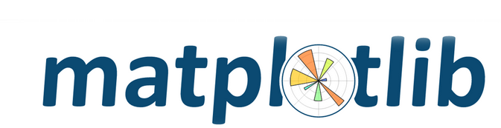


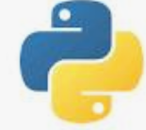
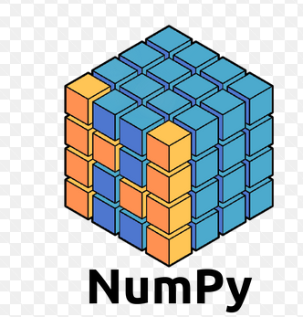
Technology Stack
Credit: Google images

Slide 5
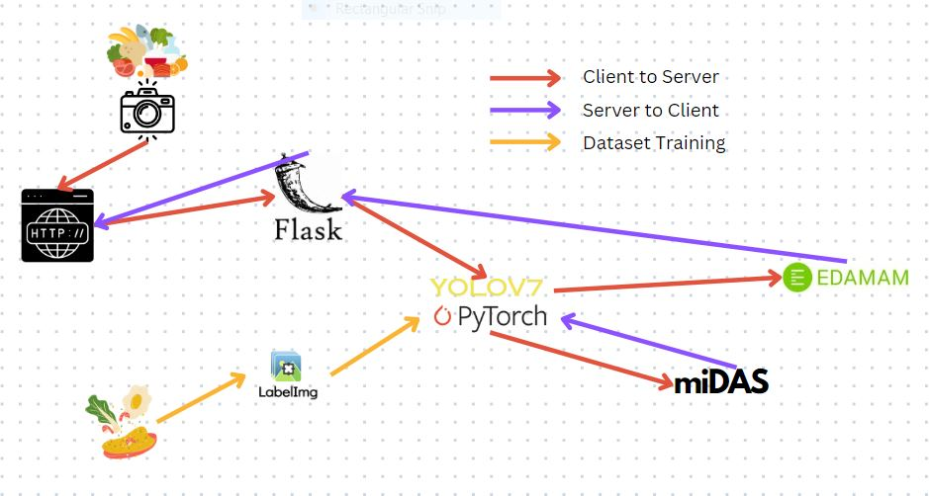
Project Architecture

Slide 6
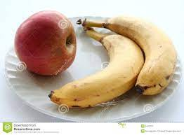
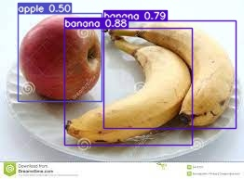
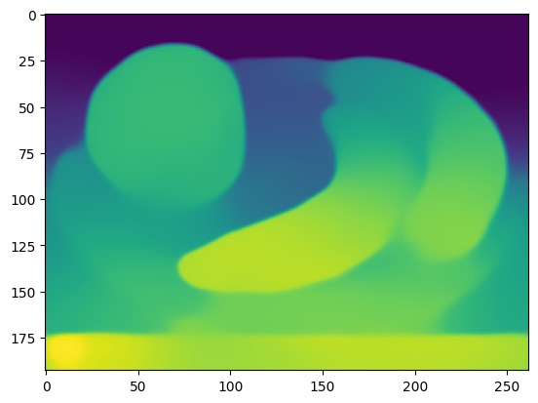
Input Image
Output by YOLOv7
Output by MiDaS

Slide 7

Object Detection Model – YOLOv7
YOLOv7, represents a significant advancement in object detection models. It follows the YOLO (You Only Look Once) architecture, focusing on real-time and accurate identification of objects in images.
We have used YOLOv7 to train the model, it is a powerful and versatile object detection model that combines speed, accuracy, and adaptability, making it a preferred choice for our problem statement.

Slide 8
Creation of Custom Dataset
Creating a custom dataset is a fundamental step in training machine learning models tailored to specific tasks.
Custom dataset creation involves assembling a collection of images annotated with corresponding labels to teach the model to recognize and identify specific objects.
We have run the specific python script to download the images of various food items. For each food item, we have annotated around 40 images.
For annotation, we have used the LabelImg application software.

Slide 9
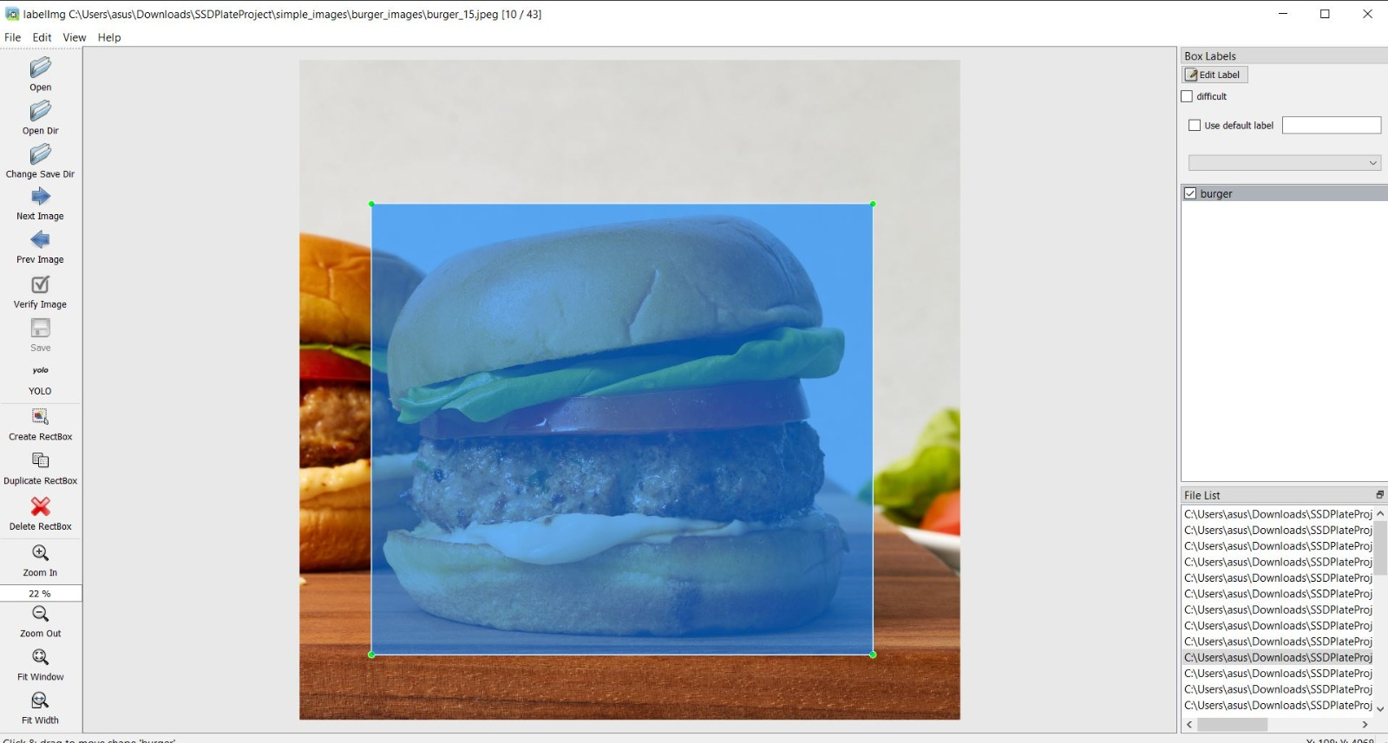
LabelImg application

Slide 10
Nutritional Analysis: Edamam API, Retrieving Nutritional values
Edamam API integration: This project of ours integrated the API to retrieve the comprehensive nutritional information for food items detected using the YOLOv7 model.
Retrieving Nutritional value: The API configuration enabled the retrieval of nutritional information such as fats, carbs, calories and proteins for each food item detected.
HTTP Request Workflow: The nutritional information for the food items was obtained through a structured HTTP request process, allowing seamless integration with Edamam API.

Slide 11

MiDaS(Monocular Depth Estimation)
MiDaS(Multiple Depth Estimation Accuracy with Single Network) is a machine learning model that estimates depth from an arbitrary input image.
The repository provides multiple models that cover different use cases ranging from a small, high-speed model to a very large model that provide the highest accuracy.

Slide 12
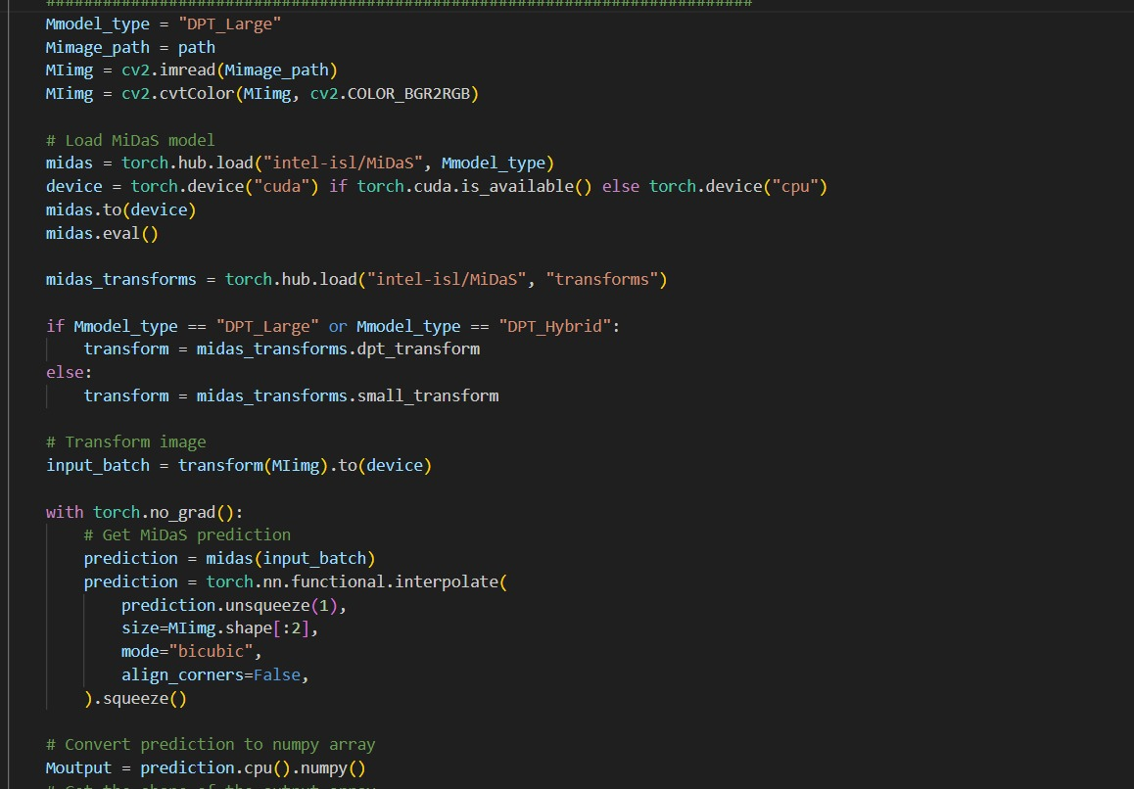
Here we have loaded the MiDaS model.
MiDaS transforms, transformation we are using is DPT_Large.
The image will be further transformed and loaded to the MiDaS prediction model
The prediction is to obtain depth predictions.
The predictions are resized to match the original image size.
The final depth map is converted to NumPy array.
Now, to get the absolute distances of all the objects in the image we need to map the depth matrix to absolute distance of a reference.
MiDaS estimates the distance from camera to object

Slide 13
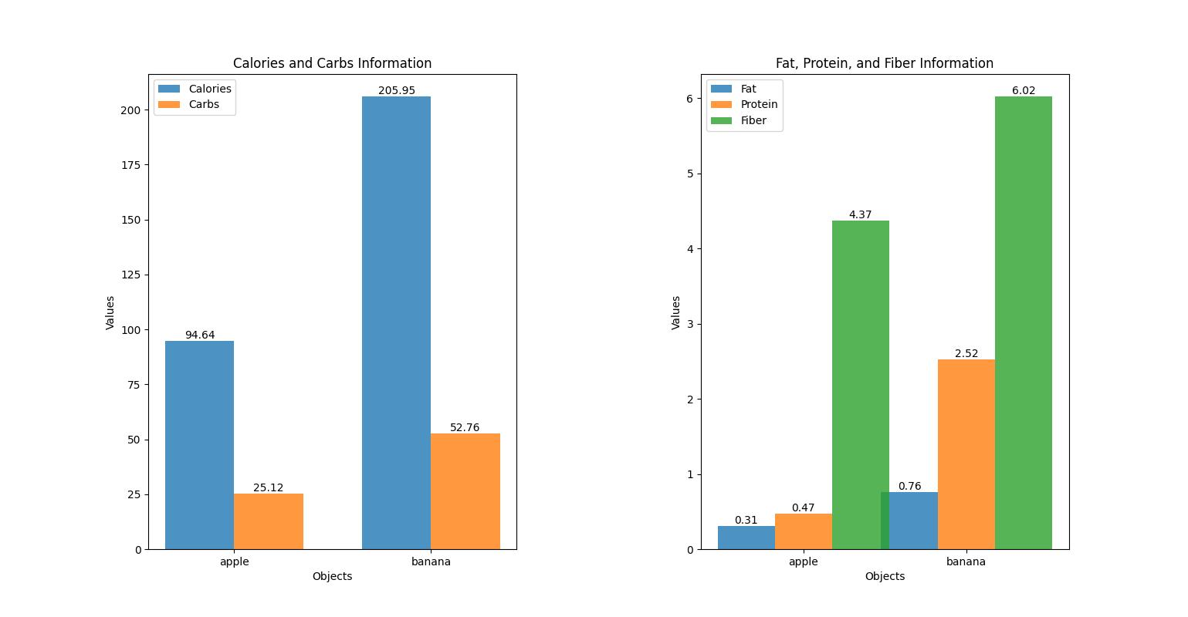
Nutritional Value Plots

Slide 14
Conclusions
As we conclude the "Weigh My Plate" project, we recognize its transformative potential not only in personal nutrition management but also in broader contexts. The success of our initiative opens doors to various future applications, such as:
Fitness and Wellness Apps
Educational Initiatives
Healthcare IoT Integration
Restaurant and Food Industry Adoption

