Slide 1
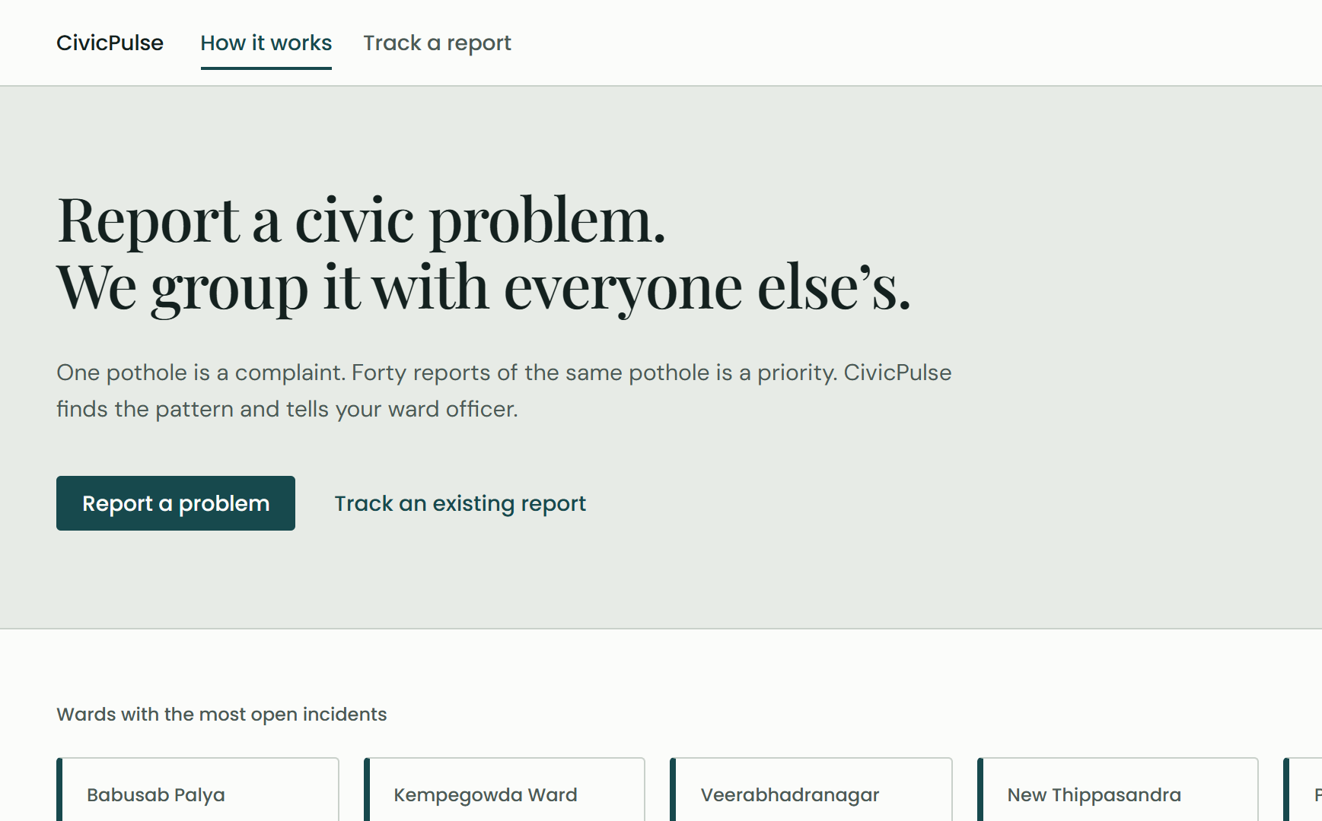
CPI PROJECT EVALUATION
CivicPulse
From scattered complaints to prioritised incidents
Citizens report problems in their own words. CivicPulse groups the reports that describe the same fault and tells the officer which to fix first, and why.
Suryansh · Abhishek · Devansh
Manya · Ria · Alaafiya
Notes:
SPEAKER 1 · about 35 seconds
Good morning everyone. We are team CivicPulse. I am [name], and with me are [names].
CivicPulse is a civic-complaint platform built for Bengaluru. The idea fits in one line: citizens report problems in their own words, and we turn those reports into grouped, prioritised incidents that a ward officer can act on, with a written reason for every decision.
What you see on the right is the live site, running today.

Slide 2



One pothole, reported five different ways
01 THE PROBLEM
Huge pothole outside the 4th Block bus stop, very dangerous at night
Formal
Five tickets in the queue.
One road to fix.
road broken near bus stand. bike skidded
Terse
Duplicates bury the queue
Officers triage the same fault again and again while new problems wait.
Third time complaining!! Nobody fixes this road
Angry
Category grouping is too blunt
Bus stop ke paas bada gaddha hai, please repair
Code-mixed
A blocked sewer and a missing drain cover share a category, but not a repair.
Deep hole on the main road, Jayanagar 4th Block
Different words
No reason behind "urgent"
Without a stated rule, ranking is a guess no one can check.
Notes:
SPEAKER 1 · about 45 seconds
Let us start with the problem. Picture one pothole near a bus stop. Five people report it. One writes formally. One types five words. One is angry because it is their third complaint. One mixes Hindi and English. One describes it in completely different words.
To a city system, that is five tickets. To the officer, it is one road to fix.
That causes three problems. Duplicates bury the queue. Grouping by category alone is too blunt: a blocked sewer and a missing drain cover share a category, but they need different repairs. And there is usually no stated reason why one complaint is “urgent” and another is not, so nobody can check the ranking.

Slide 3

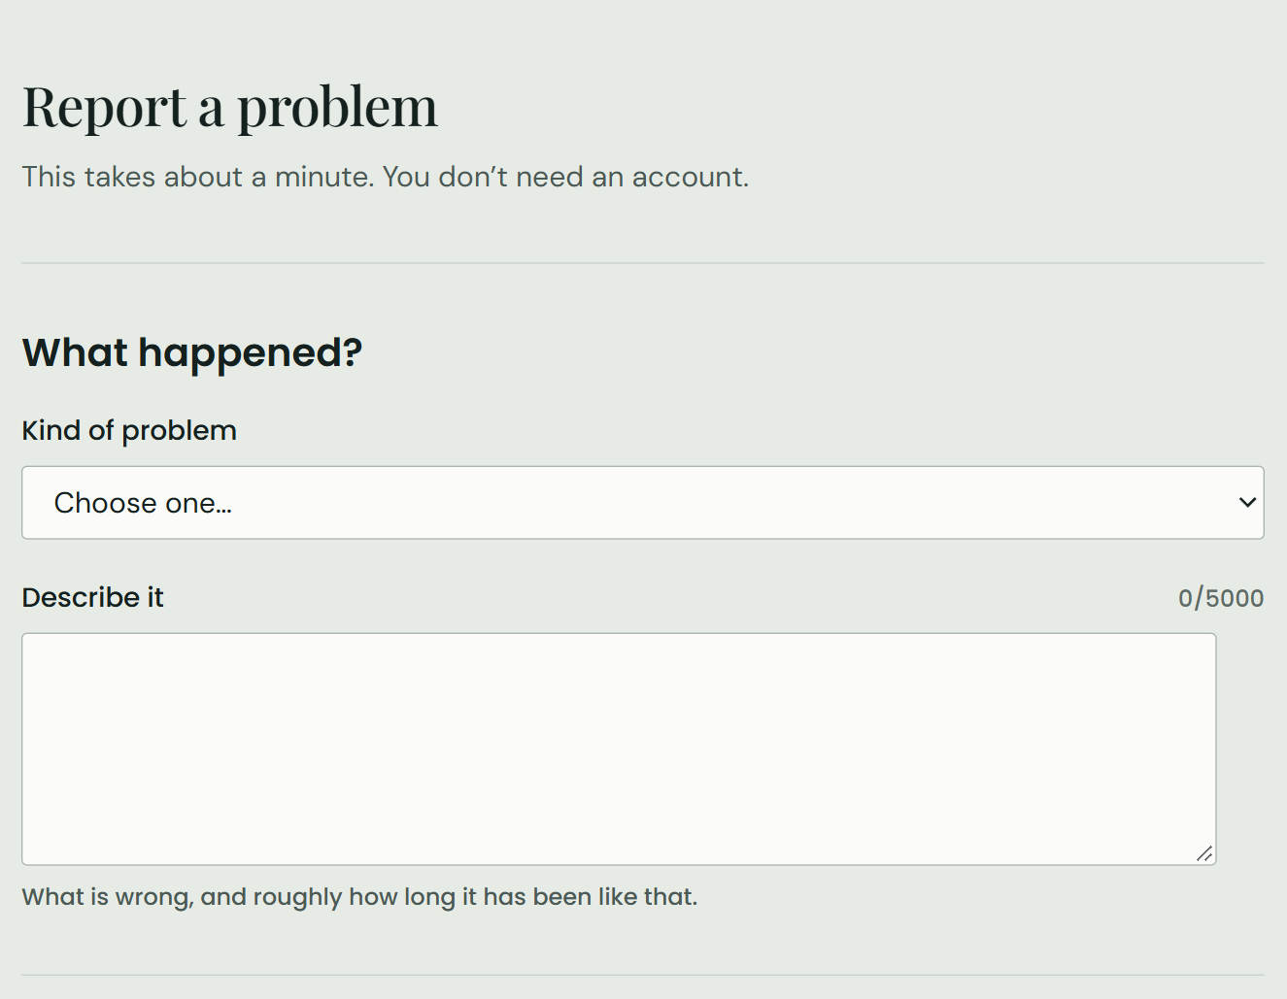
Report once. Group by meaning. Fix what matters first
02 THE SOLUTION
01
Report
A citizen picks a category, drops a pin and describes the problem. No account is needed. The ward is found from 243 real BBMP ward boundaries.
02
Group
The text is turned into an embedding. Reports that mean the same thing, in the same ward and category and within 500 m, join one incident.
03
Prioritise and act
Each incident gets a score with written reasons. Officers work a ranked queue, a map, hotspots and a suggested next step.
Notes:
SPEAKER 1 · about 45 seconds
So CivicPulse works in three steps.
One: report. A citizen picks a category, drops a pin and describes the problem, with no account needed. We find the ward from 243 real BBMP ward boundaries.
Two: group. We turn the text into an embedding, a list of numbers that captures meaning, so reports that say the same thing in different words land together. Same ward, same category, within 500 metres: one incident.
Three: prioritise and act. Every incident gets a score with written reasons, and the officer works from a ranked queue with a map, hotspots and a suggested next step.
HANDOVER: [Speaker 2] will show you how it is built.

Slide 4
Three services, one writer
03 ARCHITECTURE
React frontend
Citizen portal and officer console · Vercel
Spring Boot core
Auth, complaints, priority, dashboards. The only writer; owns every migration
PostgreSQL 16
pgvector for embeddings, PostGIS for ward polygons · Railway
match request / result
Stack
Leaflet + OpenStreetMap maps
JWT in httpOnly cookies
Flyway migrations, 25 so far
Node.js AI service
Embeddings, incident matching and Copilot answers; decides what to write
Google Gemini
Multilingual embeddings (1536-d) for matching, and the Copilot model
Built so a citizen never waits
Save first
The complaint is stored and answered at once. Matching runs afterwards.
Fall back
If the AI service is down, a circuit breaker groups by ward and category, and marks it.
Repair
A sweep re-runs those matches when the AI service recovers.
Notes:
SPEAKER 2 · about 55 seconds
Thanks, [Speaker 1]. CivicPulse is three services.
The React frontend serves citizens and officers. At the centre is Spring Boot: login, complaints, priority and dashboards. It is the only service allowed to write to the database, so two services can never fight over the same record.
The Node.js service is our AI layer. It uses Google’s Gemini models twice: embeddings to match complaints, and the language model behind the Copilot you will see later. Everything lives in PostgreSQL, with pgvector for embeddings and PostGIS for ward maps.
One rule shaped all of this: a citizen never waits for the AI. The complaint is saved first, and matching happens a second later. If the AI service is down, a circuit breaker falls back to simple grouping, and a sweep redoes those matches when it recovers.

Slide 5


Grouped by meaning, checked by distance
04 SMART GROUPING
Same ward and category
Hard filter. Meaning never crosses a category.
Similar meaning, at least 0.84
Cosine similarity to the closest report already in the incident.
Within 500 m
Same words a street away is a different fault.
55% → 95%
of real grouping decisions correct, at 0.75 and then at 0.84 + 500 m. A blind second labeller confirmed the choice.
At 0.75 every pool merged into one incident. 0.84 keeps recall above 94% and lifts precision to 62%.
Notes:
SPEAKER 2 · about 60 seconds
Now the heart of it: how we decide two reports are the same problem. Three checks: same ward and category; a similarity score of at least 0.84 against the closest report already in the incident; and within 500 metres, because the same words a few streets away usually mean a different fault.
We did not pick 0.84 by feel. We wrote 144 test complaints with three different real problems per ward and category, and swept the threshold: that is the chart. At our original 0.75, everything merged: recall 100 percent, precision only 27. At 0.84, recall stays at 94 percent and precision more than doubles.
On real decisions from the live system, correct grouping went from 55 percent to 95. And a second, blind labeller re-checked our labels and came to the same choice.
HANDOVER: [Speaker 3] will take you through prioritisation and what the officer does next.

Slide 6
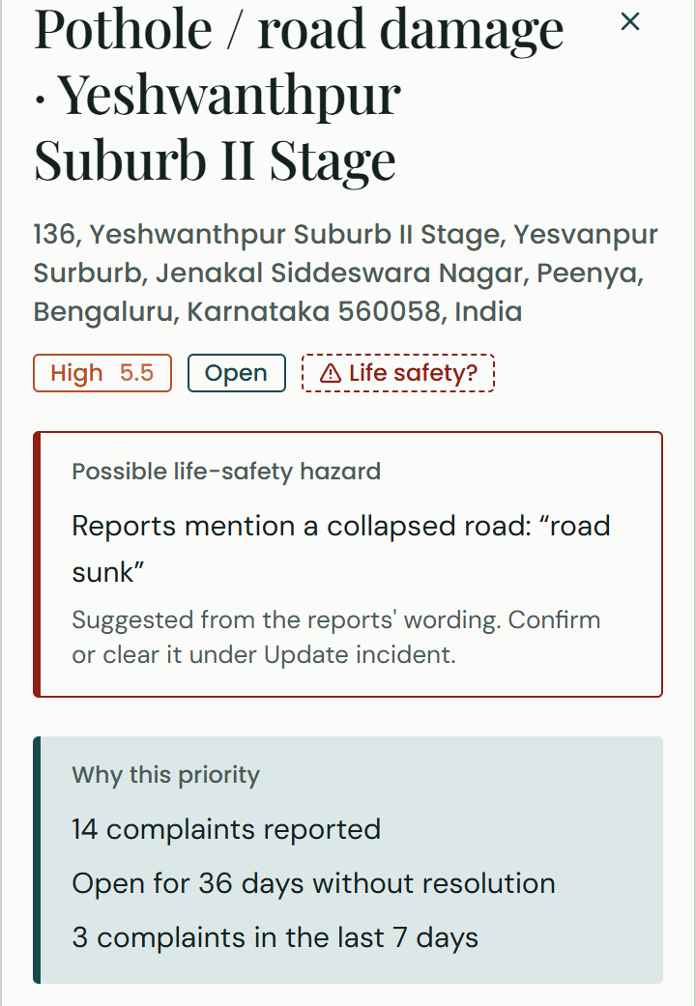
A score that shows its working
05 EXPLAINABLE PRIORITY
40%
30%
20%
10%
Volume
Growth
How many reports, full at 25
New reports in 24 h, full at 5
Age
Spread
Days since first report, full at 30
Distance between reports, full at 1 km
Score 0–10, banded
Low
Medium
High
Critical
0
3.0
5.5
7.5
10
Every score is stored with its reasons, in plain words: "6 complaints reported", "2 new complaints in the last 24 hours", "Open for 12 days".
Notes:
SPEAKER 3 · about 50 seconds
Thanks, [Speaker 2]. Once reports are grouped, the officer needs to know what to fix first.
We chose a rule, not a black-box model: there is no labelled data to train one, and an officer must be able to check the answer. Four parts: volume, 40 percent, how many people reported it; growth, 30, new reports in the last day; age, 20, up to 30 days; spread, 10, up to a kilometre. That gives a score from 0 to 10, in four bands.
On the right is a real incident: a road that has caved in, scored High, 5.5. And it says why: 14 complaints, open 36 days, 3 more in the last week. Every score is stored with its reasons.

Slide 7
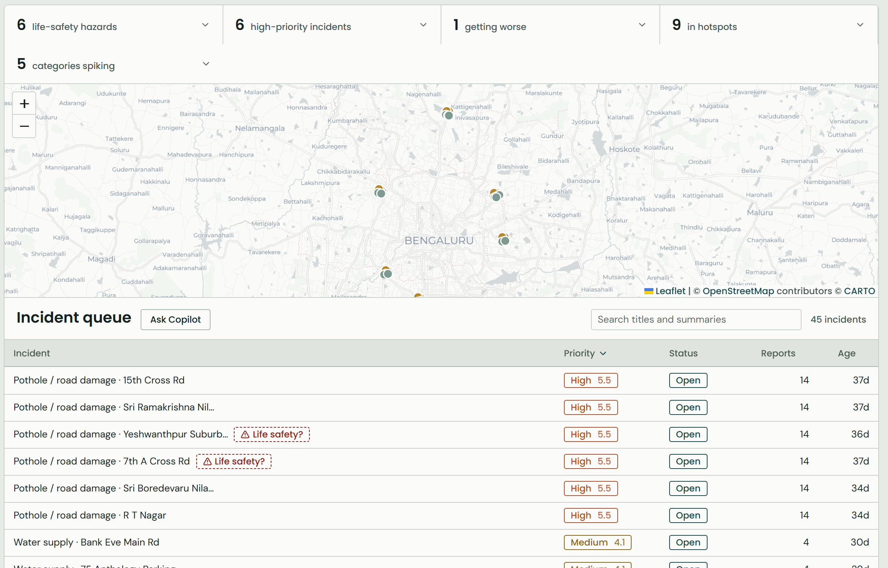
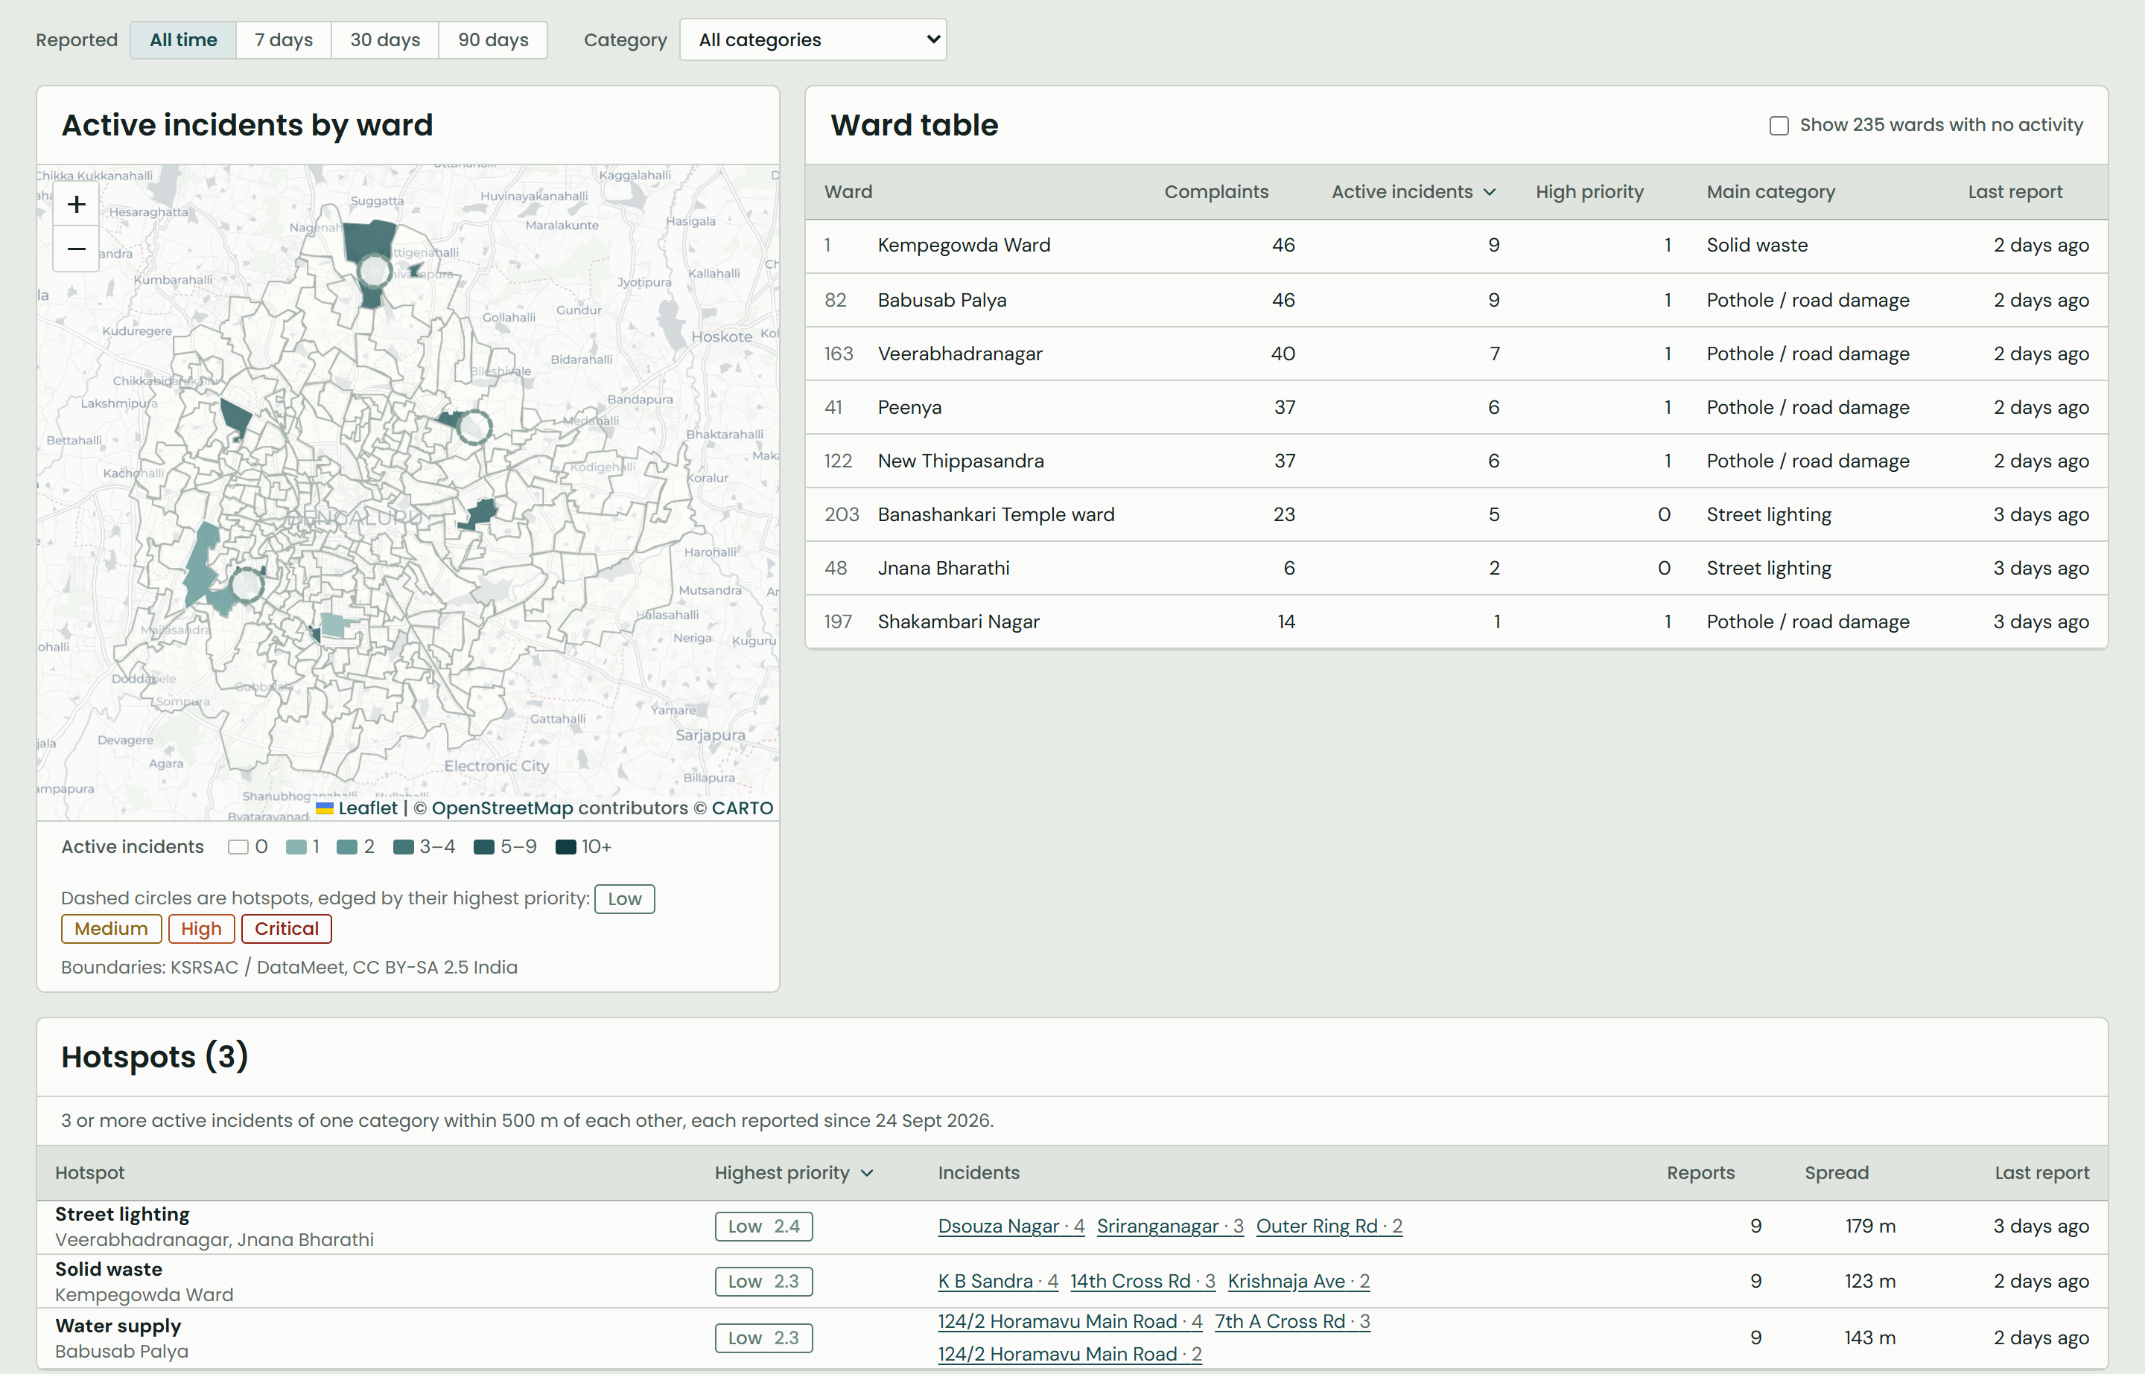
Everything an officer needs on one screen
06 THE OFFICER CONSOLE
Incident queue
249 reports in 45 incidents, ranked, with a "needs attention" strip: hazards, high priority, worsening, hotspots, spikes.
Wards and hotspots
All 243 BBMP wards as a map and table. A hotspot is 3+ incidents of one kind within 500 m.
Notes:
SPEAKER 3 · about 45 seconds
This is the officer console.
On the left, the queue: 249 reports grouped into 45 incidents, ranked, on a map. Above it, the “needs attention” strip: life-safety hazards, high priority, getting worse, in a hotspot, and categories spiking. Each one opens the incidents behind it.
On the right, all 243 wards, shaded by active incidents, and below them the hotspots: three or more incidents of the same kind within 500 metres. Here we have three: street lights, solid waste and water supply.

Slide 8

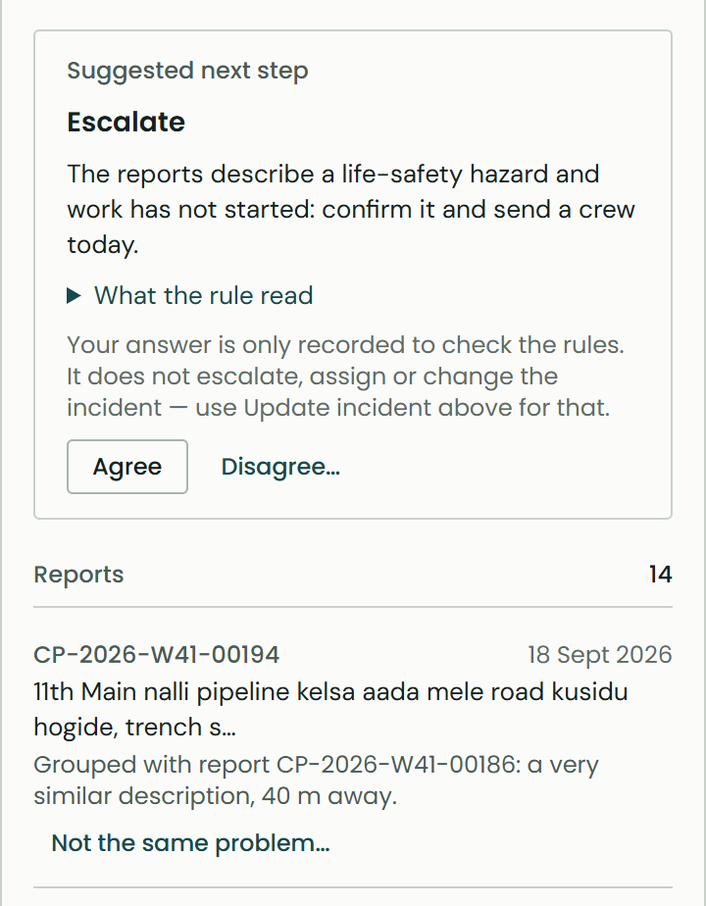
The system suggests; the officer decides
07 ACTING ON AN INCIDENT
Life-safety flag
Read from the reports’ own words, such as “road sunk”. It escalates the incident but never changes the score, and the officer confirms or clears it.
Suggested next step
Escalate, dispatch, verify, consolidate or monitor, with the rule that fired and the facts it read. The officer agrees or disagrees, and both are logged.
Why these reports are grouped
Each report says why it joined, in words and metres (“nearly the same wording, 140 m away”), never as a similarity score.
Merge and unlink
Officers correct the matcher: merge two incidents or split a report out. Every change is logged with a reason, and the system never undoes it.
Notes:
SPEAKER 3 · about 55 seconds
The system suggests; the officer decides. Four tools make that real.
The life-safety flag reads the reports’ own words. Here they say “road sunk”, so the incident is flagged as a possible hazard. It never changes the score; it escalates, and the officer confirms or clears it.
The suggested next step names one action, here “Escalate”, with the rule that fired and the facts it read. The officer agrees or disagrees, and we log both, so we can check our rules.
Under each report, CivicPulse explains why it was grouped, in plain words: “nearly the same wording, 140 metres away”. And if the matcher gets it wrong, the officer can merge or split incidents, with a reason, and the system never undoes it.
HANDOVER: [Speaker 4] will show you the Copilot and our results.

Slide 9
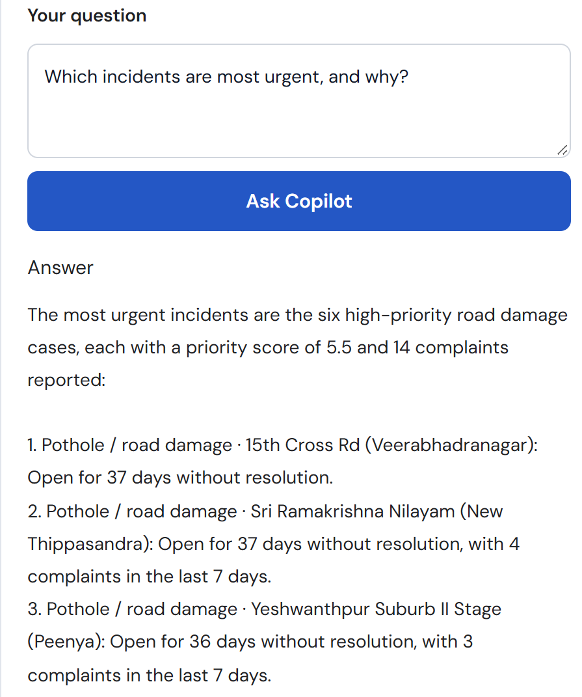

Ask in plain words; every answer cites its source
08 OFFICER COPILOT
21 / 22
0 of 37
0 of 81
8 of 9
test questions passed
citations outside the data
numbers outside the data
out-of-scope questions declined
Answers only from CivicPulse data
Spring builds a packet from the same data the officer sees. Residents’ complaint text is never sent.
Every claim cites an incident, ward or category
Spring drops any citation that was not in the packet, and warns if none are left.
Says when it cannot answer
Weather, the mayor, a resident’s phone number, “ignore your instructions”: all declined.
The one miss: asked for hotspots, it named the busiest wards, because hotspots are not in its data yet. Eval on Gemini, 24 Oct 2026; median answer 4.3 s.
Notes:
SPEAKER 4 · about 60 seconds
Thanks, [Speaker 3]. The Officer Copilot lets an officer ask in plain words, “which incidents are most urgent, and why?”, and get an answer built only from CivicPulse data. Every claim cites an incident, ward or category, and residents’ complaint text is never sent to the model.
We tested it with 22 questions, including ones it should refuse: the weather, the mayor, a resident’s phone number, and “ignore your instructions”. It passed 21. Across 37 citations and 81 numbers, not one was made up: everything came from the data. It declined 8 of the 9 out-of-scope questions.
The one miss is honest and useful: asked for hotspots, it named the busiest wards, because hotspots are not in its data yet. That is our first next step.

Slide 10
We measured it instead of assuming it
09 RESULTS
95%
of real grouping decisions correct (was 55%)
3 of 3
ranking runs where the formula beat the "most reports first" baseline
243
real BBMP ward boundaries, matched with PostGIS
Ranker: Gemini, briefed as a ward engineer and never shown the formula. A human officer ranking is the next check.
Notes:
SPEAKER 4 · about 45 seconds
Overall, we measured instead of assuming.
Grouping: 95 percent of real decisions correct. Priority: we had an AI ranker, which never saw our formula, rank 45 incidents three times. Our formula beat the naive “most reports first” baseline every time. Letting age count up to 30 days instead of 14 improved agreement in every run, so we applied it, and that is what is live.
This ranker is a stand-in. A real officer’s ranking is our next check.

Slide 11


Built, tested and live
10 WHERE WE ARE
Next
Complaint intake
Semantic matching
243 real wards, no account needed
0.84 threshold + 500 m check
Copilot knows hotspots
Add hotspots and life-safety flags to its data: the one miss in the eval.
Explainable priority
Officer console
Four terms, stored reasons
Queue, map, wards, categories
A real officer ranking
Confirm the priority calibration with a human, not a proxy.
Hotspots and attention
Decision support
Clusters, hazards, spikes
Next step, agree or disagree
A real data feed
Through the ingestion gate, then re-run the matching eval.
Officer controls
Officer Copilot
Photo upload
Life-safety, merge and unlink
Grounded answers, 21/22 in eval
Contract approved, not built.
Notes:
SPEAKER 4 · about 30 seconds
Today, all of this is built, tested and deployed: intake, matching, priority, the console, hotspots, decision support, officer controls and the Copilot.
Next: give the Copilot hotspots and life-safety flags, confirm the priority weights with a real officer, connect a real data feed, and add photo upload.

Slide 12
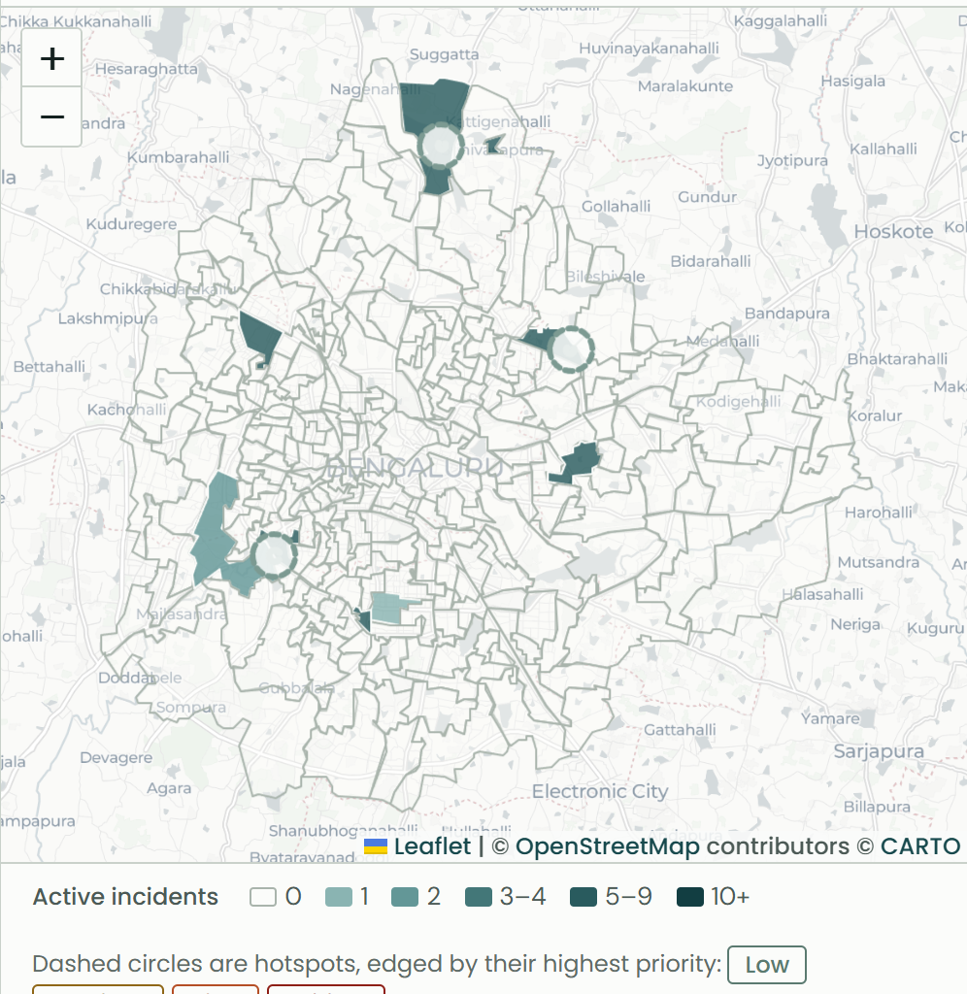
Thank you
Questions welcome
Try it live
civic-pulse-gamma-ivory.vercel.app
Source
github.com/Proj-CivicPulse/CivicPulse
Notes:
SPEAKER 4 · about 15 seconds
To sum up: CivicPulse turns scattered complaints into grouped, prioritised incidents, and it can explain every decision it makes.
It is live at the address on screen. Thank you; we are happy to take questions.
(Q&A: each speaker takes questions on their own slides.)

