Slide 1
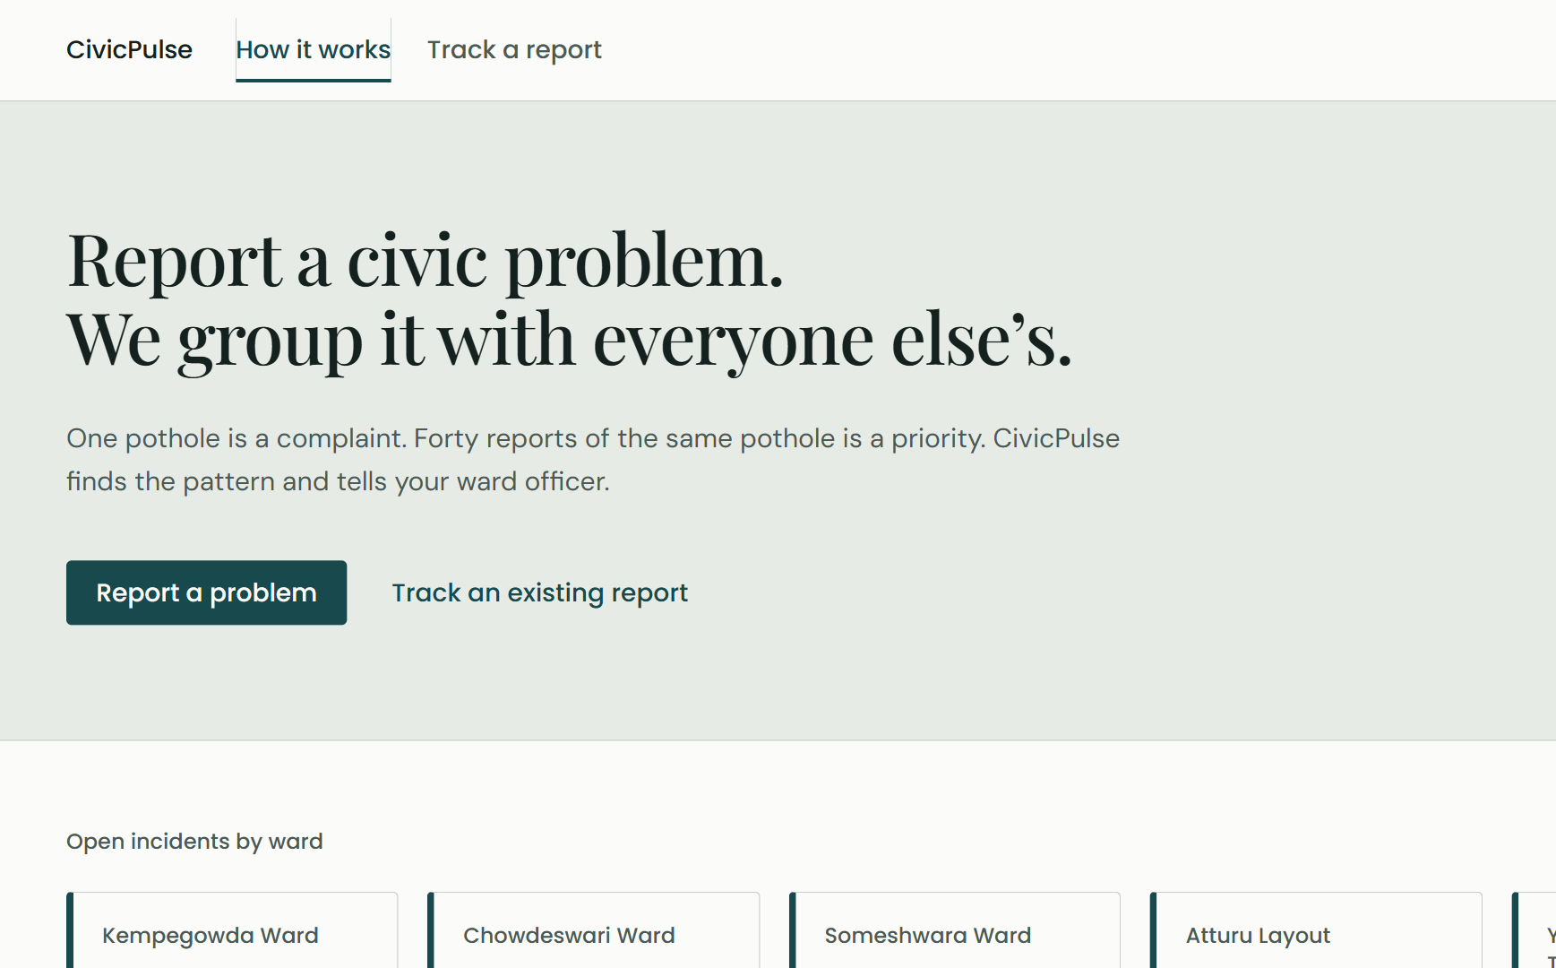
TEAM PROJECT · BENGALURU · 2026
CivicPulse
From scattered complaints to prioritised incidents
Citizens report problems in their own words. CivicPulse groups the reports that describe the same fault and tells the officer which to fix first, and why.
Suryansh · Abhishek · Devansh
Manya · Ria · Alaafiya
Notes:
SPEAKER 1 · about 35 seconds
Good morning everyone. We are team CivicPulse. I am [name], and with me are [names].
CivicPulse is a civic-complaint platform built for Bengaluru. The idea fits in one line: citizens report problems in their own words, and we turn those reports into grouped, prioritised incidents that a ward officer can act on, with a written reason for every ranking.
What you see on the right is not a mock-up. It is the live site, running today.

Slide 2



One pothole, reported five different ways
01 THE PROBLEM
Huge pothole outside the 4th Block bus stop, very dangerous at night
Formal
Five tickets in the queue.
One road to fix.
road broken near bus stand. bike skidded
Terse
Duplicates bury the queue
Officers triage the same fault again and again while new problems wait.
Third time complaining!! Nobody fixes this road
Angry
Category grouping is too blunt
Bus stop ke paas bada gaddha hai, please repair
Code-mixed
A blocked sewer and a missing drain cover share a category, but not a repair.
Deep hole on the main road, Jayanagar 4th Block
Different words
No reason behind "urgent"
Without a stated rule, ranking is a guess no one can check.
Notes:
SPEAKER 1 · about 45 seconds
Let us start with the problem. Picture one pothole near a bus stop. Five people report it. One writes formally. One types five words. One is angry because it is their third complaint. One mixes Hindi and English. One describes it in completely different words.
To a city system, that is five tickets. To the officer, it is one road to fix.
That causes three problems. First, duplicates bury the queue: officers triage the same fault again and again while new problems wait. Second, grouping by category alone is too blunt: a blocked sewer and a missing drain cover share a category, but they need different repairs. Third, there is usually no stated reason why one complaint is “urgent” and another is not, so nobody can check the ranking.

Slide 3

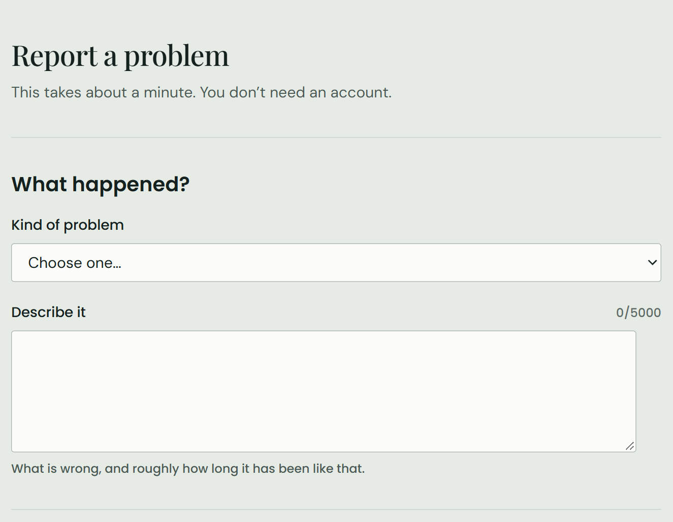
Report once. Group by meaning. Fix what matters first
02 THE SOLUTION
01
Report
A citizen picks a category, drops a pin and describes the problem. No account is needed. The ward is found from 243 real BBMP ward boundaries.
02
Group
The text is turned into an embedding. Reports that mean the same thing, in the same ward and category and within 500 m, join one incident.
03
Prioritise and act
Each incident gets a score with written reasons. Officers work a ranked queue, a map, hotspots and a suggested next step.
Notes:
SPEAKER 1 · about 50 seconds
So here is what CivicPulse does, in three steps.
One: report. A citizen picks a category, drops a pin and describes the problem. No account is needed, and it takes about a minute. That is the real form on the right. We find the ward automatically from 243 real BBMP ward boundaries.
Two: group. We turn the text into an embedding, a list of numbers that captures meaning, so reports that say the same thing in different words land close together. If they are in the same ward and category, and within 500 metres, they join one incident.
Three: prioritise and act. Every incident gets a score with written reasons, and the officer works from a ranked queue on a map.
HANDOVER: [Speaker 2] will now show you how it is built.

Slide 4
Three services, one writer
03 ARCHITECTURE
React frontend
Citizen portal and officer console · Vercel
Spring Boot core
Auth, complaints, priority, dashboards. The only writer; owns every migration
PostgreSQL 16
pgvector for embeddings, PostGIS for ward polygons · Railway
match request / result
Stack
Leaflet + OpenStreetMap maps
JWT in httpOnly cookies
Flyway migrations, 22 so far
Node.js AI service
Embeddings and incident matching; decides what to write
Gemini embeddings
gemini-embedding-001, 1536 dimensions, multilingual
Built so a citizen never waits
Save first
The complaint is stored and answered at once. Matching runs afterwards.
Fall back
If the AI service is down, a circuit breaker groups by ward and category, and marks it.
Repair
A sweep re-runs those matches when the AI service recovers.
Notes:
SPEAKER 2 · about 60 seconds
Thanks, [Speaker 1]. CivicPulse is three services.
The React frontend on Vercel serves both citizens and officers. At the centre is Spring Boot. It handles login, complaints, priority and the dashboards, and it is the only service allowed to write to the database. That is deliberate: with one writer, two services can never fight over the same record.
The Node.js service is our AI layer. It sends complaint text to Google’s Gemini embedding model, finds the matching incident, and asks Spring to write the result. Everything lives in PostgreSQL, with pgvector for the embeddings and PostGIS for the ward maps.
One rule shaped all of this: a citizen should never wait for the AI. So the complaint is saved and confirmed first, and matching happens a second later in the background. If the AI service is down, a circuit breaker falls back to simple ward-and-category grouping and marks it, and a sweep redoes those matches once the service is back.

Slide 5


Grouped by meaning, checked by distance
04 SMART GROUPING
Same ward and category
Hard filter. Meaning never crosses a category.
Similar meaning, at least 0.84
Cosine similarity to the closest report already in the incident.
Within 500 m
Same words a street away is a different fault.
55% → 95%
of real grouping decisions correct: at the old 0.75 threshold, then at 0.84 with the 500 m check
At 0.75 every pool merged into one incident. 0.84 keeps recall above 94% and lifts precision to 62%.
Notes:
SPEAKER 2 · about 65 seconds
Now the heart of it: how we decide that two reports are the same problem. Three checks.
First, same ward and same category. That is a hard filter. Second, the meaning must be similar: a similarity score of at least 0.84 against the closest report already in the incident. Third, it must be within 500 metres, because the same words a few streets away usually mean a different fault.
We did not pick 0.84 by feel. We wrote 144 test complaints in which every ward and category had three different real problems, and we swept the threshold. That is the chart. At our original setting of 0.75, everything merged into one incident: recall was 100 percent, but precision only 27. At 0.84 we keep 94 percent recall, and precision more than doubles.
Then we checked real decisions from our live system. Before, 55 percent of grouping decisions were correct. With 0.84 and the distance check, it is 95 percent.
HANDOVER: [Speaker 3] will take you through how we prioritise.

Slide 6
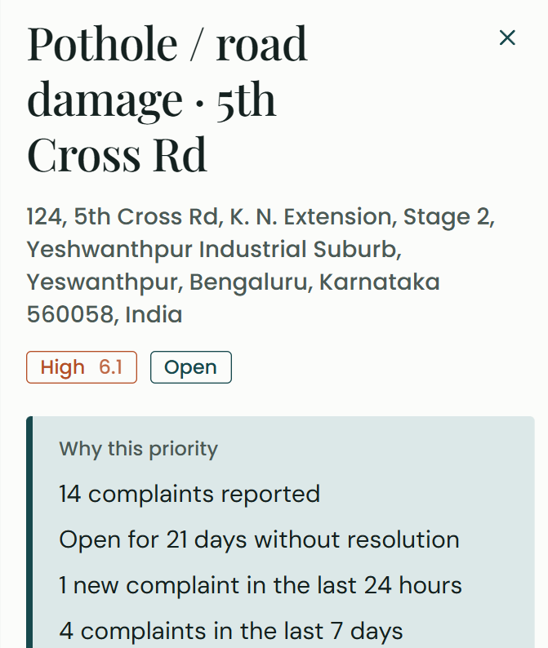
A score that shows its working
05 EXPLAINABLE PRIORITY
40%
30%
20%
10%
Volume
Growth
How many reports, full at 25
New reports in 24 h, full at 5
Age
Spread
Days since first report, full at 30
Distance between reports, full at 1 km
Score 0–10, banded
Low
Medium
High
Critical
0
3.0
5.5
7.5
10
Every score is stored with its reasons, in plain words: "6 complaints reported", "2 new complaints in the last 24 hours", "Open for 12 days".
Notes:
SPEAKER 3 · about 60 seconds
Thanks, [Speaker 2]. Once reports are grouped, the officer needs to know what to fix first.
We chose a rule, not a black-box model, for two reasons: there is no labelled data to train a model on, and an officer must be able to check the answer.
The score has four parts. Volume, 40 percent: how many people reported it. Growth, 30 percent: new reports in the last 24 hours, so a problem that is getting worse rises fast. Age, 20 percent: how long it has been open, up to 30 days. Spread, 10 percent: how far apart the reports are, up to a kilometre. That gives a score from 0 to 10, banded as low, medium, high and critical.
The important part is on the right. This is a real incident from the live system: a pothole on 5th Cross Road, scored High, 6.1. And it says why: 14 complaints, open for 21 days, one new complaint in the last day. Every score is stored with its reasons, in plain words.

Slide 7
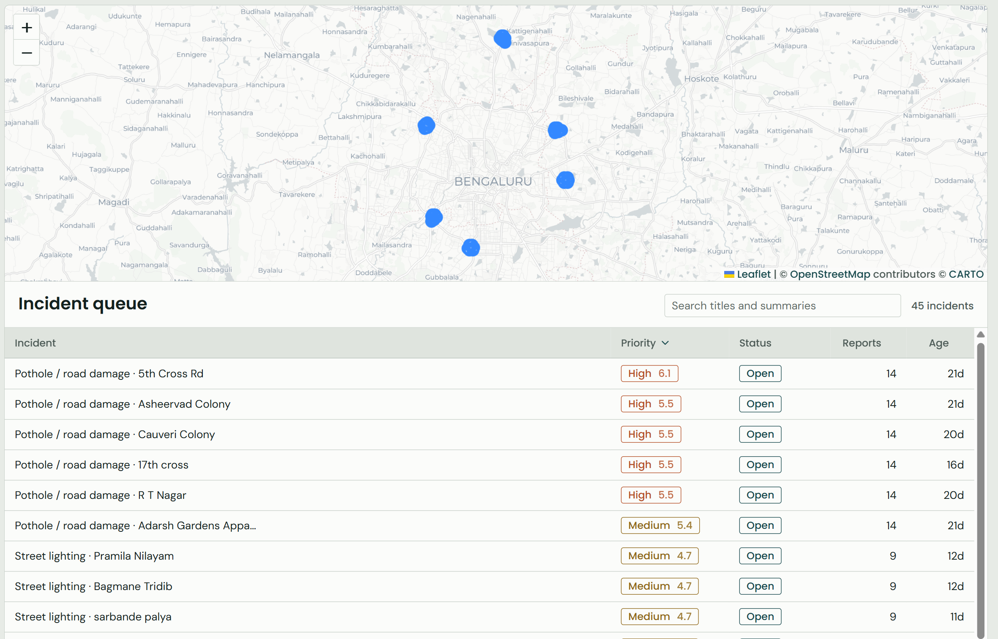
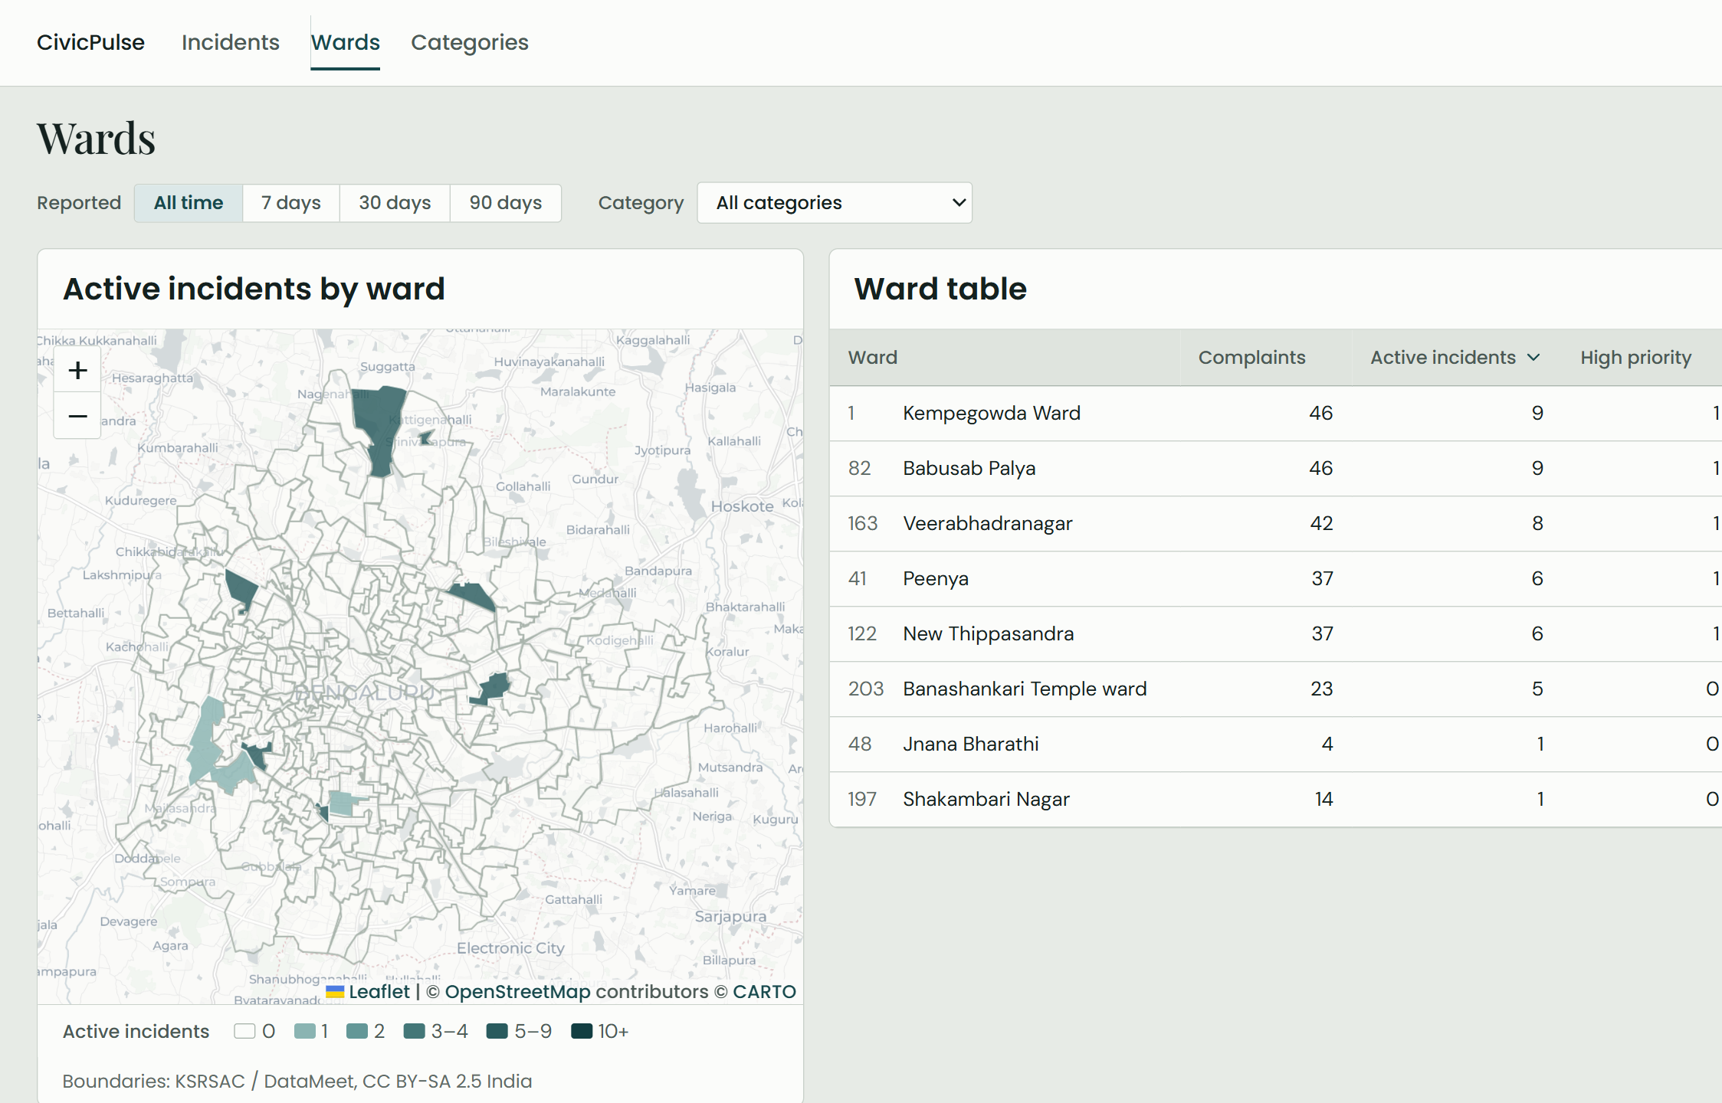
Everything an officer needs on one screen
06 THE OFFICER CONSOLE
Incident queue
249 demo reports grouped into 45 incidents, ranked by priority on a live map. Each opens with its reports and reasons.
Ward explorer
Active incidents across 243 BBMP wards as a map, with a sortable table of complaints, incidents and the main category.
Notes:
SPEAKER 3 · about 50 seconds
This is the officer console, live.
On the left is the incident queue. Our demo data has 249 reports, and CivicPulse has grouped them into 45 incidents, sorted by priority, each one placed on the map. Click a row and it opens with its member complaints and its reasons, and the officer can update its status.
On the right is the ward explorer: all 243 BBMP wards, shaded by how many active incidents each one has, next to a sortable table. An officer or a supervisor can see at a glance which wards are under pressure.
We have also built hotspot detection and a “needs attention” strip. They go live with our next backend deploy.
HANDOVER: [Speaker 4] will now show you whether any of this actually works.

Slide 8
We measured it instead of assuming it
07 RESULTS
95%
of real grouping decisions correct (was 55%)
3 of 3
ranking runs where the formula beat the "most reports first" baseline
243
real BBMP ward boundaries, matched with PostGIS
Ranker: Gemini, briefed as a ward engineer and never shown the formula. A human officer ranking is the next check.
Notes:
SPEAKER 4 · about 60 seconds
Thanks, [Speaker 3]. We wanted evidence, not assumptions, so we measured both halves of the system.
For grouping, you have already seen it: 95 percent of real grouping decisions are correct, up from 55.
For priority, no officer had ranked our queue yet, so we used a stand-in. We gave Gemini the same sheet an officer would see (reports, age, spread) but never our formula or our scores, and asked it to rank 45 incidents as a ward engineer would, three separate times. Then we measured how closely each method agreed with it.
The light bars are the naive approach: most reports first. The middle bars are our formula as first shipped, and it beat the naive baseline in all three runs. The dark bars show one change: letting age count up to 30 days instead of 14. That improved agreement in every run, so we applied it, and that is what is live now.
This ranker is a proxy. A real officer ranking is our next check.

Slide 9





Live today, and what comes next
08 WHERE WE ARE
Next
Complaint intake
Semantic matching
Anonymous reports, ward lookup, reference numbers
Embeddings, 0.84 threshold, 500 m check
Officer Copilot
Ask "what is urgent in Ward 48?" and get an answer that cites its incidents. Backend live; panel in progress.
Explainable priority
Officer console
Research paper
Four terms, stored reasons, refreshed every 5 min
Queue, map, incident detail, status changes
Matching and priority evaluation, written up.
Photo upload
Contract approved, not built.
Hotspots and attention
Decision support
Clusters, worsening and spiking signals
Suggested next step, accept or override, logged
Life-safety flag
Open drains, exposed wiring: escalate regardless of score.
Notes:
SPEAKER 4 · about 40 seconds
So where are we today?
Everything on the left is built and tested: complaint intake, semantic matching, explainable priority, the officer console, hotspots and attention signals, and decision support, which is a suggested next step the officer can accept or override, and every decision is logged.
Next is the Officer Copilot. An officer asks something like “what is urgent in Ward 48?” and gets an answer built only from our data, with every claim citing its source. The backend for it is already live. After that come our research paper, photo upload, and a life-safety flag, so things like open drains or exposed wiring escalate regardless of score.

Slide 10
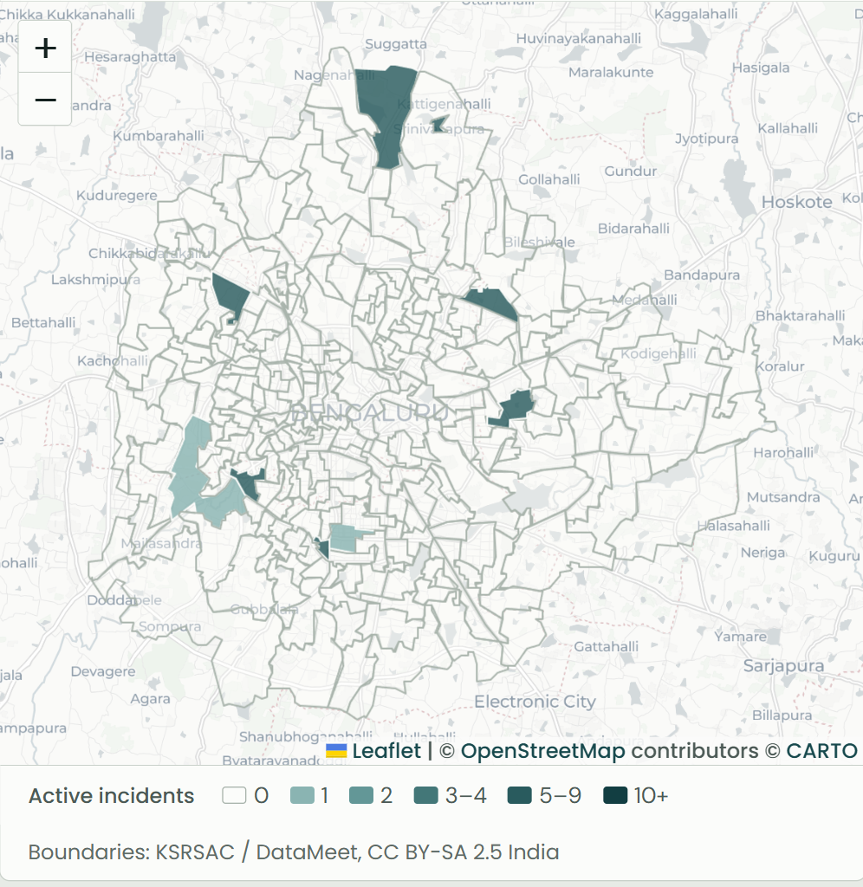
Thank you
Questions welcome
Try it live
civic-pulse-gamma-ivory.vercel.app
Source
github.com/Proj-CivicPulse/CivicPulse
Notes:
SPEAKER 4 · about 20 seconds
To sum up: CivicPulse turns scattered complaints into grouped, prioritised incidents, and it can explain every decision it makes.
It is live at the address on screen, and you are welcome to try it.
Thank you. We are happy to take questions.
(Q&A: each speaker takes questions on their own slides.)

