Slide 1
CNMS Advising Website
Steven Guo
Stephen Lin
Andrew McLamb
Khadijah Wali
Sarah Yake

Slide 2
Overview
Use Cases
Improvements
On the Advisor Side
On the Student Side
Live Demos
Questions

Slide 4
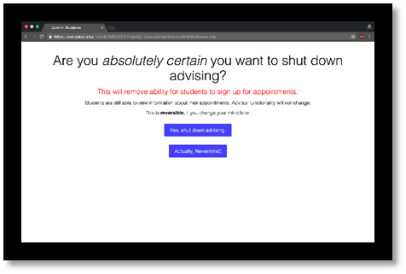
Improvements on the Advisor Side
Printable tables for the meetings
Multiple ways to manage appointments
Activate/Deactivate buttons to open/close appointment creation

Slide 5
Live Demo

Slide 6
Improvements on the Student Side
Searching for appointments
Applying for appointments
Editing Information
Displaying Information for the Students’ Scheduled Appointments on Student Homepage
Password Reset
Back buttons on some pages
Added a preferred name field
Preventing a student from cancelling a meeting less than 12 hours before the appointment
The ‘other’ major option

Slide 7
Live Demo

Slide 8
Questions?
Steven Guo (yiguo1@umbc.edu)
Stephen Lin (lin14@umbc.edu)
Andrew McLamb (andrew56@umbc.edu)
Khadijah Wali (kwali2@umbc.edu)
Sarah Yake (syake1@umbc.edu)

