Slide 1



Accessible Flash Cards A Multi-platform flashcard solution for persons with cognitive/learning disabilities
Notes:
Welcome, Thank you for coming out to our presentation. We are honored to be here.
My name is …. Continue with names
We represent CSUN with A Multi-platform Accessible flash card project that focuses on people with cognitive/learning disabilities

Slide 2
Agenda
Requirements
Technologies and Principles Used
Challenges and Innovation
Proof of Concept
Maintainability and Documentation
Future Plans
Notes:
We will begin with
an introduction to our project and its requirement's
We will then cover technologies and principles used
We will cover challenges we faced and how we solved them with innovative solutions
After that we will jump into proof of concept where we will present our
website and an android application
Following POC we will cover our plan Mainta and documentation and a future successful sustainable project
Future plans

Slide 3
Requirements
Create a web-app that is Multi-platform.
Accessible to assistive technology
Support standard text and math equations
Make flashcards self-voicing (text-to-speech)
Notes:
1. What it means to be multi-platform
2.Barak talk about what is assistive technology and what we used to make sure this was supported
3.
5. How do we minimize reducing functionality and ease of use and enforce requirement 1,2??
6.
7.We want this project to be sustainable
8.
Mention to keep an eye on how this was solved

Slide 4



Technologies & Principles used
Festival Speech Synthesis (TTS)
FreeBSD, Ubuntu Server, PHP, Apache, MySQL
JavaScript and jQuery
Android SDK and Java
LaTeX
Mimetex
A LaTeX to Image Converter
Web Content Accessibility (WCA) and xHTML Standards

Slide 5
Web Challenges
Cross-Browser Compatibility
Learning jQuery
Website Accessibility without JavaScript
Creating social-network like features

Slide 6
Challenge: Cross-Browser Compatibility
Individual browsers render pages differently.
Multiple browser testing was used to combat this challenge.
To overcome a previous challenge with this issue, we used jQuery, which was a language new to all the members of the group.

Slide 7
Challenge: Website Accessibility
Since screen readers limit the functionality of a website, we wanted to make sure we didn’t limit our user’s functionality.
We made sure the website was still fully accessible when disabling JavaScript.
If a feature relied heavily on JavaScript, we made sure to include ways to use a similar feature without JavaScript.
For Example: The “Speech” button when viewing a flashcard relies on JavaScript, but the user is still able to download an audible wav file.

Slide 8
Challenge: Creating Social Network-like Features
Many of us are accustomed to the features of social networking sites such as FaceBook and Twitter.
While the features may seem simple to the user, recreating similar features became a task.
Through trial and error and insight of other group members we were able to create the social network-like features.

Slide 9
Features
Twitter Integration
Network of flashcards
Group Management
Festival Text-To-Speech
Native Android Application

Slide 10
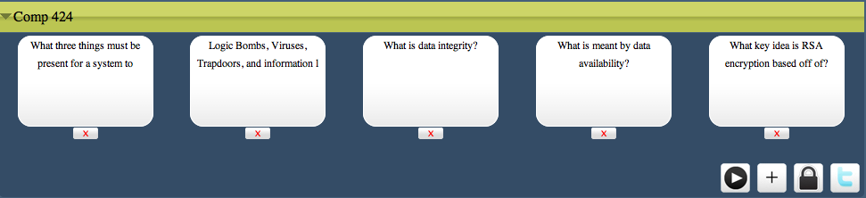
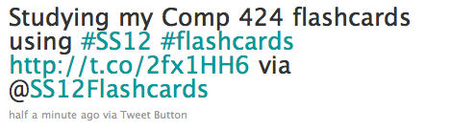
Twitter Integration
Tweet to your twitter followers the flashcards that you’re currently studying!
Also provides a link so that your followers can study the same flashcards.

Slide 11
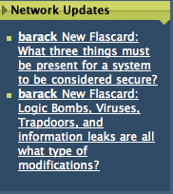
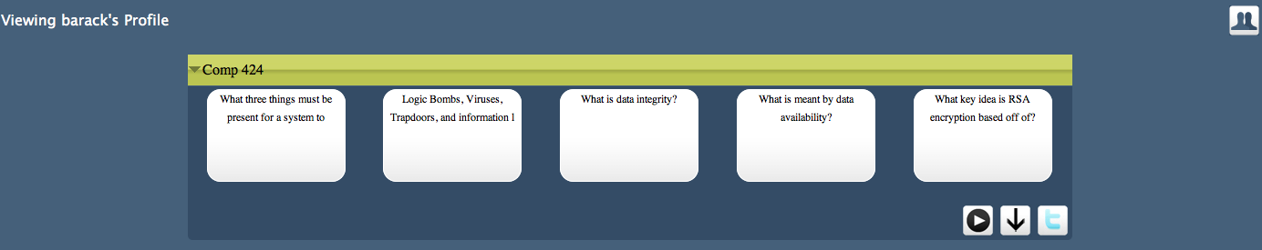
Network of Flashcards
Making flashcards public allows other user’s new functionality such as:
Viewing and studying other flashcards besides their own
Importing groups of public flashcards
Searching for other user’s related flashcards

Slide 12
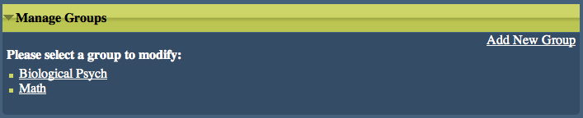
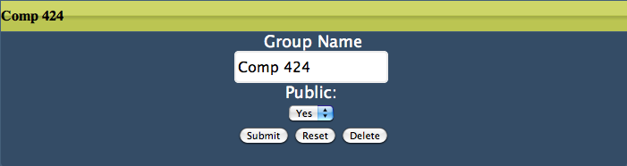
Group Management
Easily modify, create, and delete groups and their flashcards.

Slide 13
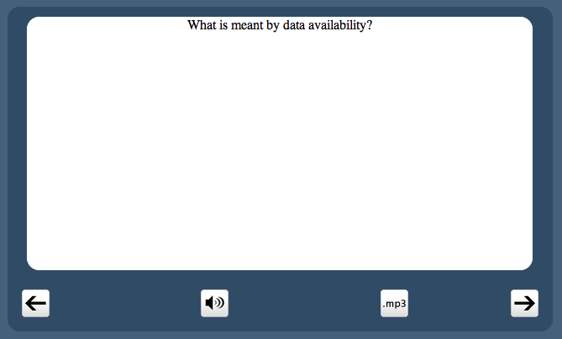
Festival Text-To-Speech
Better functionality and cross-browser compatibility
Allows users to download an audible wav file of their flashcard.

Slide 14
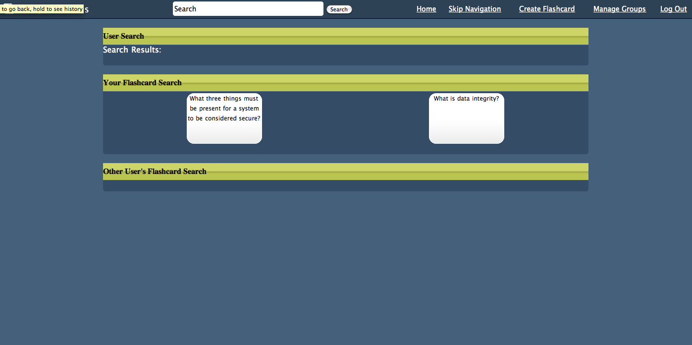
Search Function

Slide 15
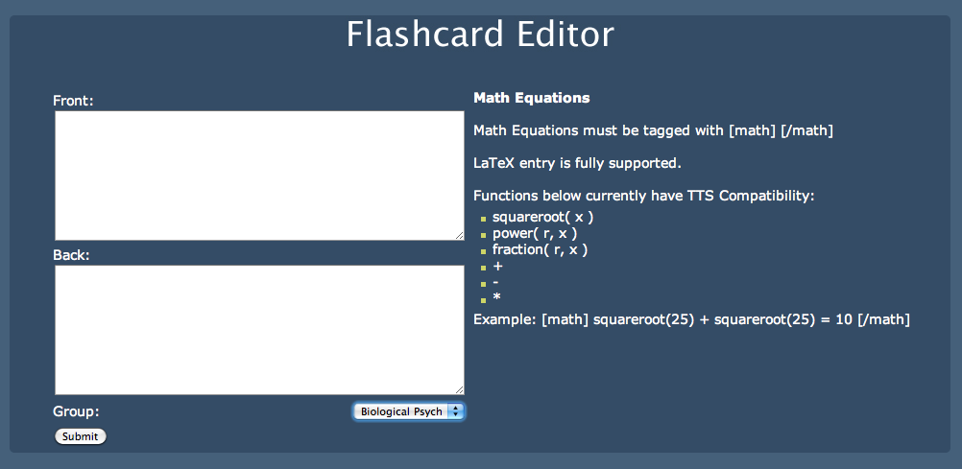
Flashcard Editor

Slide 16
Equation Challenges
1. MathML not cross-platform
2. The syntax of MathML and LaTeX is complicated to learn.
Created our own parsers and interpreters to make inserting mathematical equations easy relative to LaTeX and MathML
3. Found no speech to text program that could render mathematical equations and meet our requirements
Created parsers and interpreters to allow interpretation of mathematical images to speech

Slide 17
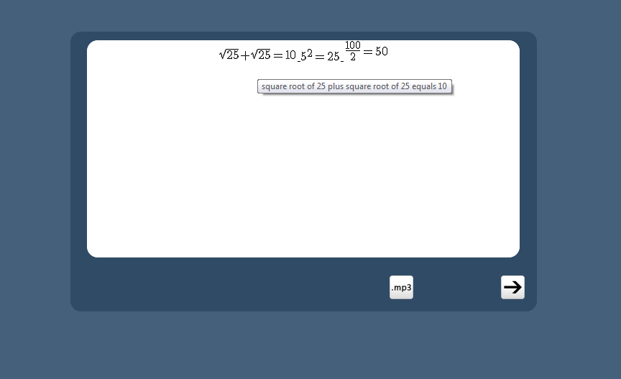
Equation Example

Slide 18
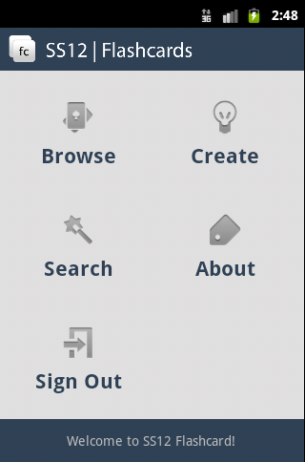
Android Companion Application
Built for maximum compatibility
Android Donut(1.6) to Honeycomb(3.0)
Mobile way to browse flashcards
New way to create flashcards
Synchronizes with website
Features
Create, modify, and delete flashcards
Search
Gestures
Swipe left or right to browse menu
Swipe to browse flashcards
Circle gestures select item
Text to Speech
All functions, flashcards and buttons are read
Haptic feedback
Confirms selected item

Slide 19
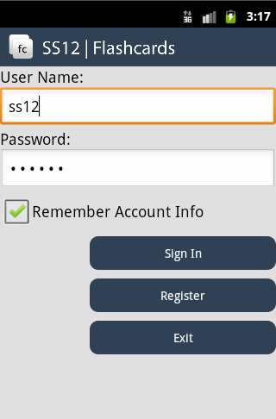
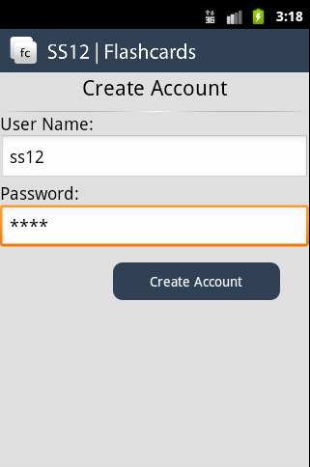
Android Companion Application
Creating an account is fast, free and easy.
One account to use with Android and website.
All information is stored in same database.

Slide 20
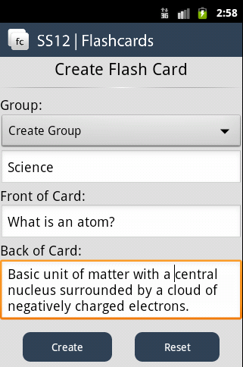
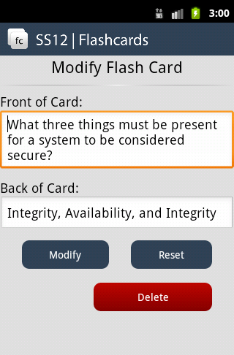
Android Companion Application
Creating, Modifying, and Deleting Flashcards
Categorize cards by custom groups
Front of card
Back of card
Supported syntax:
Math syntax support
LaTeX
Synchronize every card with server

Slide 21
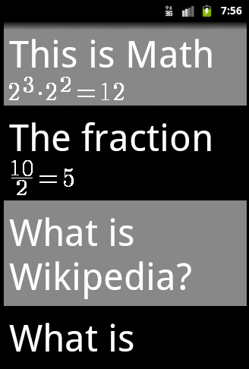
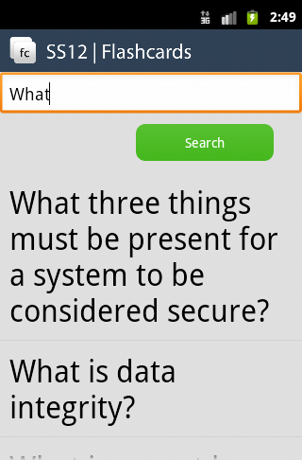
Android Companion Application
Browsing your created flashcards
Browse all the cards
Text to Speech
Read math equations
Read flashcards
Gestures
Search cards for keywords
Browse results

Slide 22

Android Companion Application
Challenges & Difficulties
Connecting to MySQL Database server
Gestures
Linking gestures with specific views
Math Equations
Not supported by Android

Slide 23
Maintainability and Documentation
Created getting started tutorial
3 independent components
Easy Entry points
Well documented code

Slide 24
Future Enhancements
Improve on mathematical equations input concept by providing visual equations, and easy text to equation input
Expand our mathematical parsers and interpreters
Release Latex to English, English to Latex as an independent package
Improve the user interface of Android application

