Slide 1

Team Members
Christina Chu Cynthia Lee Janice Leung Tal Levy Kevin Mak

Slide 2
What is aRdio?
Accessible interface for music streaming
Built on Rdio free music service
Social integration features
Cross-platform compatibility

Slide 3
The Challenge
Build accessible interface for a music streaming service
Follow WAI/WCAG2 guidelines
Advanced features as time permits

Slide 4
Technical Implementation
Rdio Playback/Web Service API
Speech API
PHP5/Ajax/jQuery
HTML/CSS

Slide 5
Accessibility Points
Large Fonts and Buttons
Keyboard Control
Visual Cues
Voice Commands
TTS
Screen Reader Compatibility

Slide 6
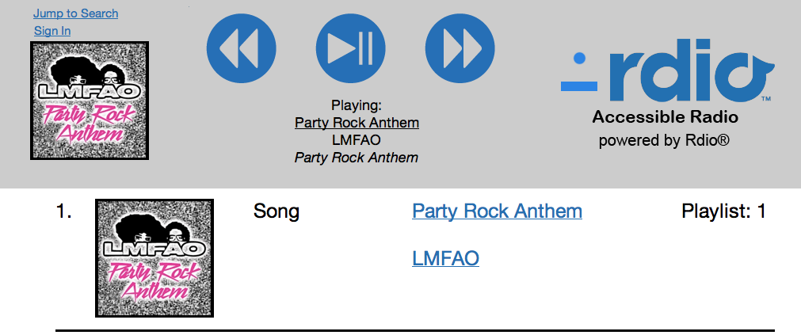
Large Fonts and Buttons

Slide 7










Keyboard Control

Slide 8







Visual Cues
Default
Mouse Rollover

Slide 9


Voice Commands
Press to Speak Button
Play Song
Pumped Up Kicks
Foster the People
Torches

Slide 10
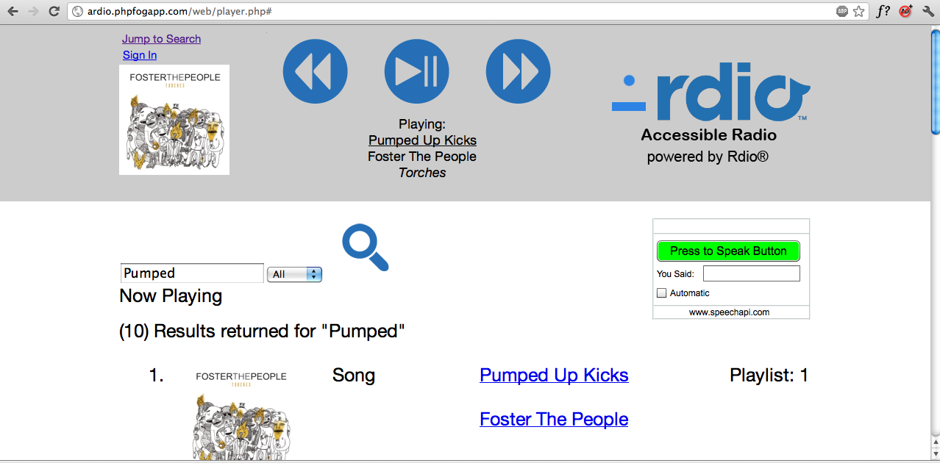
Screen Reader Compatibility
Forward

Slide 11
Demo
http://ardio.phpfogapp.com/

Slide 12
Future Features
Playlist creation
Social Network Integration
Responsive Webdesign
ARIA Tags
Screen Change Notification

