Slide 1

Community Captioner

Slide 2
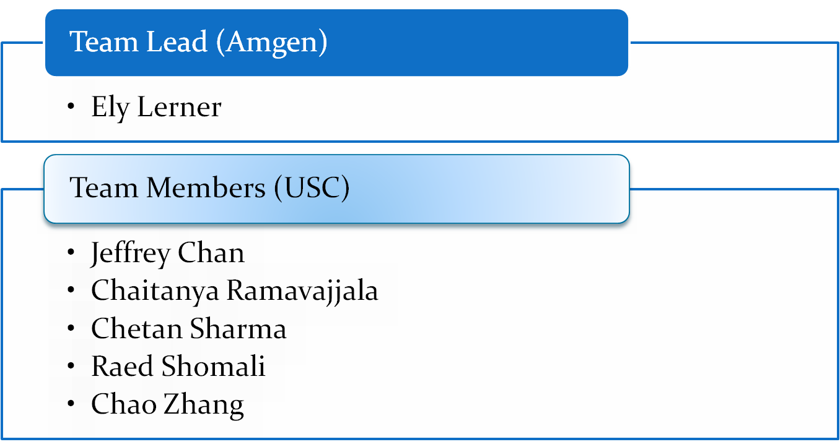
Team CC

Slide 3

Schedule / Milestones
Define web services interface - Complete
JavaScript function for re-writing page – In progress [DEMO]
Web service function JavaScript - In progress [DEMO]
Parallel Steps:
  Captioning user interface JavaScript - In progress [DEMO]
  Flash player - In progress [DEMO]
  Backend implementation – In progress [DEMO]
JavaScript roll into Firefox extension - April 14th

Slide 4
PDR Comment review
“The biggest hurdle to tagging photos/videos is users’ lack of participation. What do you want to do to entice captioning?” – We are trying to make CC as easy and as integrated as possible to driver community adoption.
“Get user feedback on which version is better and use that rating to prioritize.” – This is a good idea, and we will implement it in this version if time permits, or in the next version if not.

Slide 5
End-Game Strategy
We plan to deliver a working system that satisfies all requirements laid out in the PDR; with the possible exception of SOAP webservices and user logins which will be considered stretch goals.

Slide 6

Q & A

