Slide 1

Community Captioner

Slide 2
Team CC
Team Lead (Amgen)
Team Members (USC)
Ely Lerner
Jeffrey Chan
Chaitanya Ramavajjala
Chetan Sharma
Raed Shomali

Slide 3
Concept
Our project concept is an open source, community-driven online video closed captioning tool. This tool will help hearing impaired people experience the wealth of online “Web 2.0” media content available today with no captions. We are going to scope the project to YouTube given the timeframe but it would be ideal to eventually allow captioning of all types of media so our backend application will be written with this in mind.

Slide 4
Phase A Summary
"Our project is a community-driven web media captioning tool. The goal is to aid the hearing-impaired community to fully experience “Web 2.0” video content currently available online. It is a challenging mission to us because the team does not have a lot of experience with manipulating FLV media. However, we are confident because we have a creative, thoughtful, and intelligent team. Along with good design, we are in the process of extensive research on the subject with a strong motivation to succeed."

Slide 5
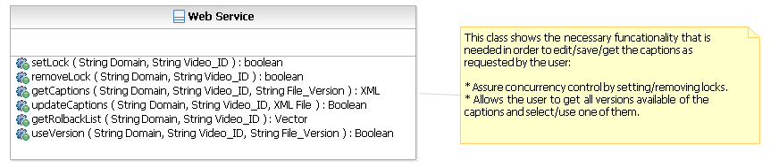
Software Architecture: Class Diagram

Slide 6
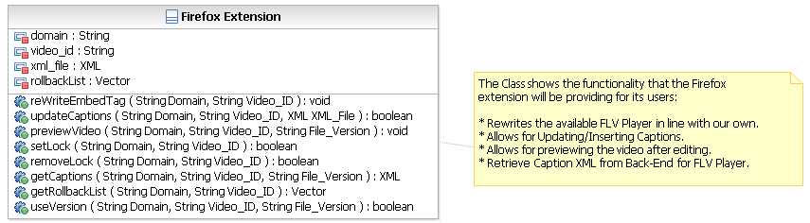
Software Architecture: Class Diagram

Slide 7
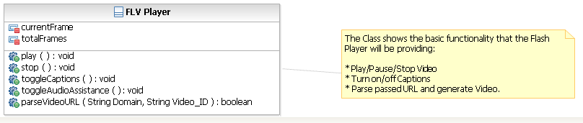
Software Architecture: Class Diagram

Slide 8
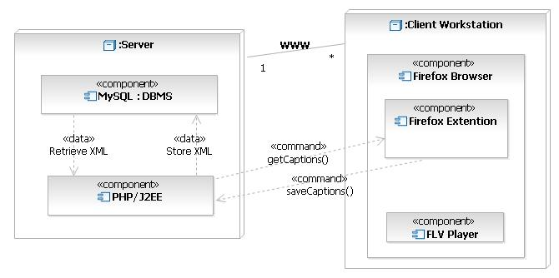
Software Architecture: Deployment Diagram

Slide 9
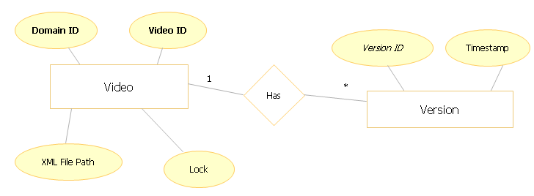
Software Architecture: Database Diagram

Slide 10
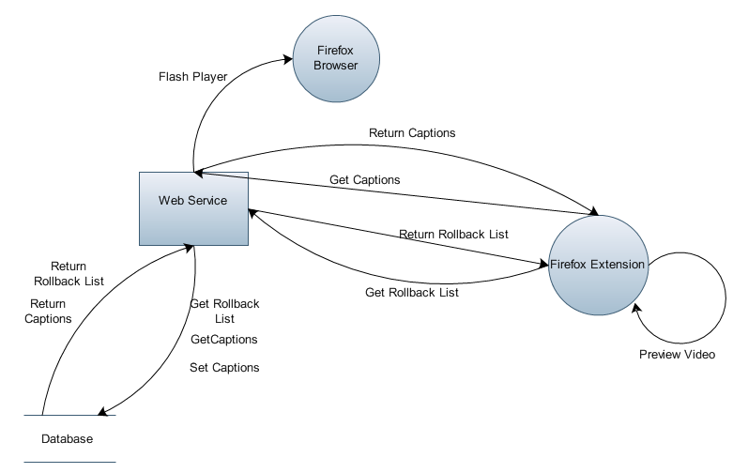
Software Architecture: Data Flow Diagram
Indicates the data flow pertaining to
Retrieving captions
Retrieving rollback list
Preview the captioned video
Writing the Flash Player on the Browser (Website)
Setting the Captions

Slide 11
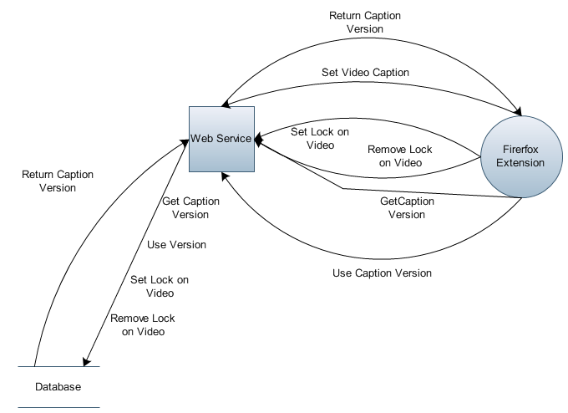
Software Architecture: Data Flow Diagram
Indicates the data flow pertaining to
Acquiring the lock on the caption
Releasing the lock on the caption
Resetting a caption to its previous version.
Retrieving a version of the caption

Slide 12
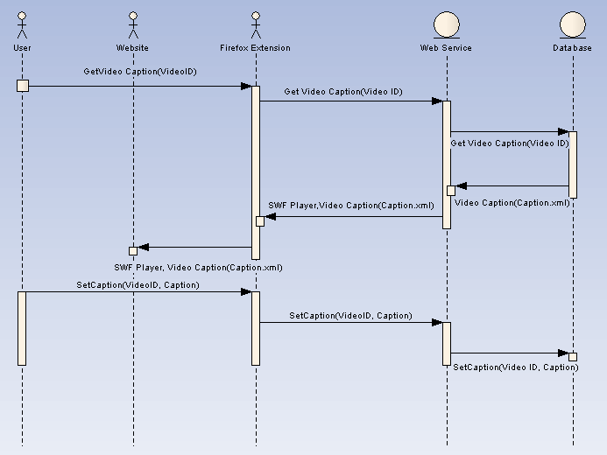
Software Architecture: Sequence Diagram
Get captions for a video.
Write the Flash player on the website and play the video.
Save the caption.

Slide 13
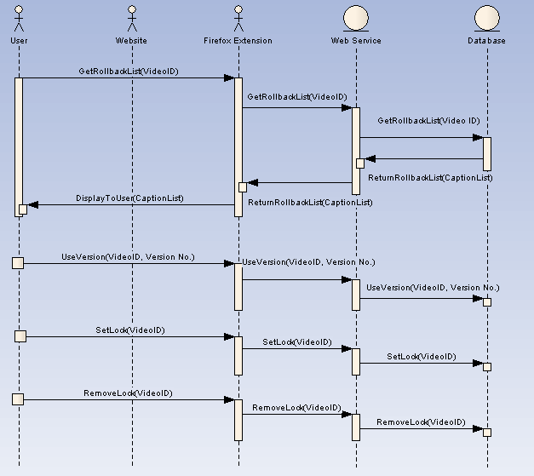
Software Architecture: Sequence Diagram
Get Rollback list for a caption.
Reset a caption to a previous version (UseVersion)
Acquire Lock on a caption
Release Lock on a caption

Slide 14
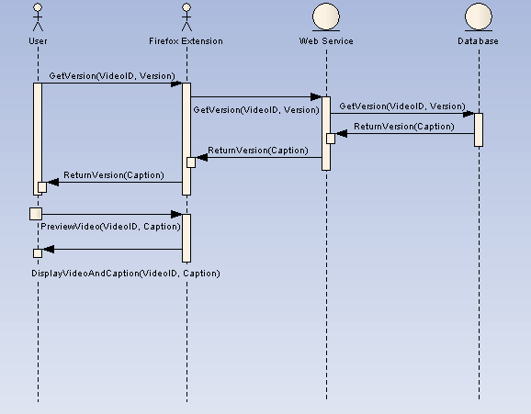
Software Architecture: Sequence Diagram
Get previous version of a caption
Preview Video after captioning.

Slide 15
Requirements Document
The Back-End System:
Store, retrieve, modify, and delete captioned videos correctly.
Display the captioned videos where the videos are located.
Assure caption synchronization.
Presents its functionality via Web Services.
Assure that only one user can work on captioning a specific video at a given time.
Retrieve a list of previous versions.
Revert to a previous version.
Not allow for automated spamming.

Slide 16
Requirements Document
The Front-End System:
Load Videos
Fast-forward in the video
Rewind in the video
Allow entry of captions
Submit captions
Preview the current caption changes with the video.

Slide 17
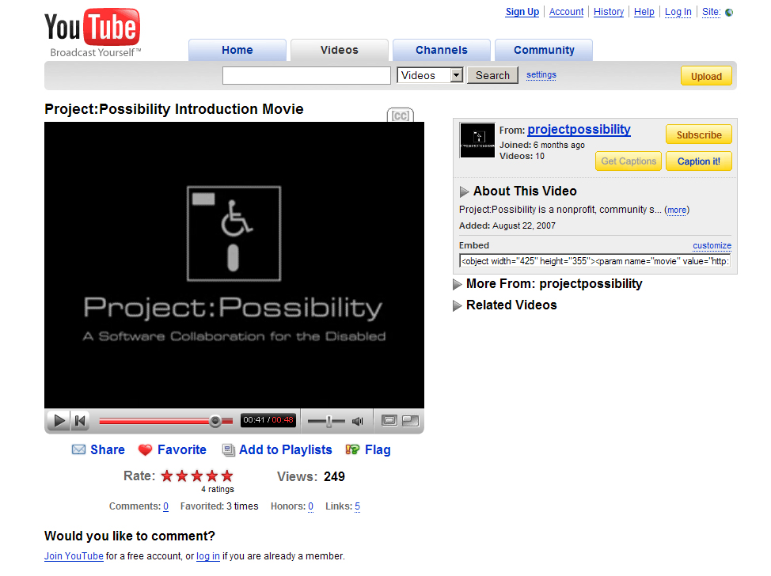
User Interface

Slide 18


Slide 19
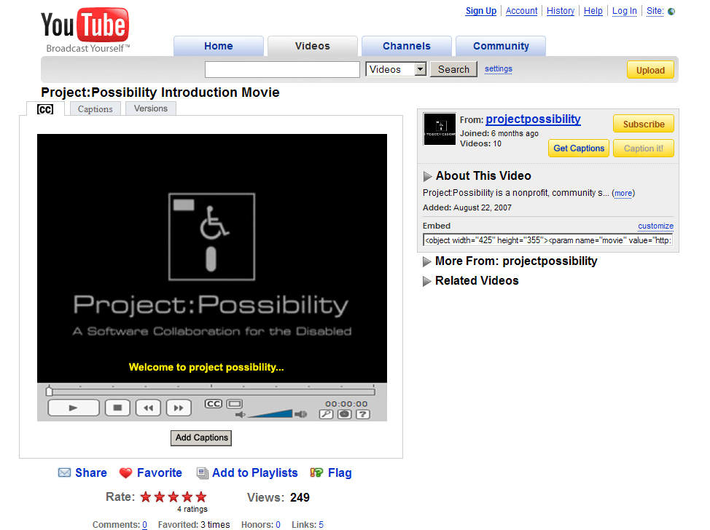

Slide 20
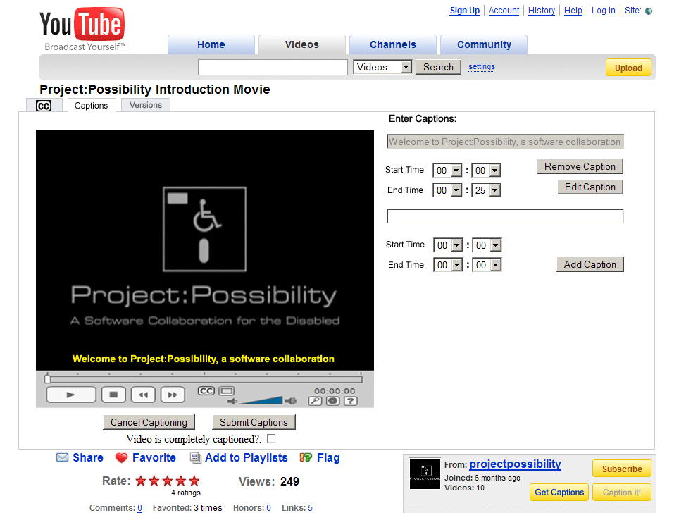

Slide 21
Schedule / Milestones
Define web services interface - March 15th
JavaScript function for re-writing page - March 17th
Web service function JavaScript - March 20th
Parallel Steps:
Captioning user interface JavaScript - April 1st
Flash player - April 9th
Backend implementation - April 9th
JavaScript roll into Firefox extension - April 14th

Slide 22

Q & A

Slide 23
Backup Slides

Slide 24
Risks
Being able to overlay captions to videos that reside on remote domains. -Flex seems to be able to do this.
The ability to control Flash videos through a SWF player. –We now plan to write our own FLV player.
The possibility that a video could have multiple video_id's associated with it. –Still being investigated, may not be an issue. If it is, checksums are a possibility
The possibility that users may store incorrect captions. –We have decided on an open and free environment and rely on the community for quality control. Version rollback will also be available.

