Slide 1

Community Captioner

Slide 2
Team CC
Team Lead (Amgen)
Team Members (USC)
Ely Lerner
Jeffrey Chan
Chaitanya Ramavajjala
Chetan Sharma
Raed Shomali

Slide 3
Concept
Our project concept is an open source, community-driven online video closed captioning tool. This tool will help hearing impaired people experience the wealth of online “Web 2.0” media content available today with no captions. We our most likely going to scope the project to YouTube given the timeframe but it would be idea to eventually allow captioning of all types of media so our backend application will be written with this in mind.

Slide 4
Phase A Summary
"Our project is a community-driven web media captioning tool, it's important because the hearing-impaired community cannot fully experience much of the “Web 2.0” video content currently available online, it's difficult because the team does not have a lot of experience with manipulating FLV media, and we are confident we can do it because we have a strong team, good design, are in the process of extensive research on the subject, and have a strong motivation to succeed."

Slide 5
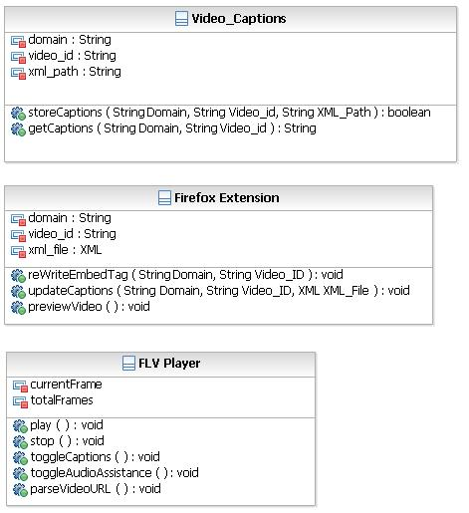
SA: Class Diagram
Database:
It stores information as XML keyed by Domain name and Video ID.
Web Services:
Stores and Retrieves Captions.
Extension:
Rewrites the available FLV Player in line with our own.
Allows for Updating/Inserting Captions.
Allows for previewing the video after editing.
Retrieve Caption URL from Back-End for FLV Player.
FLV Player
Allows viewing of Video along with Captions.

Slide 6
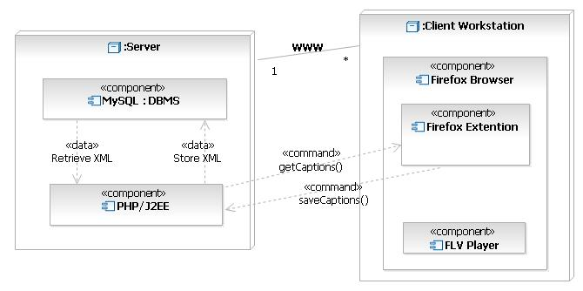
SA: Deployment Diagram

Slide 7
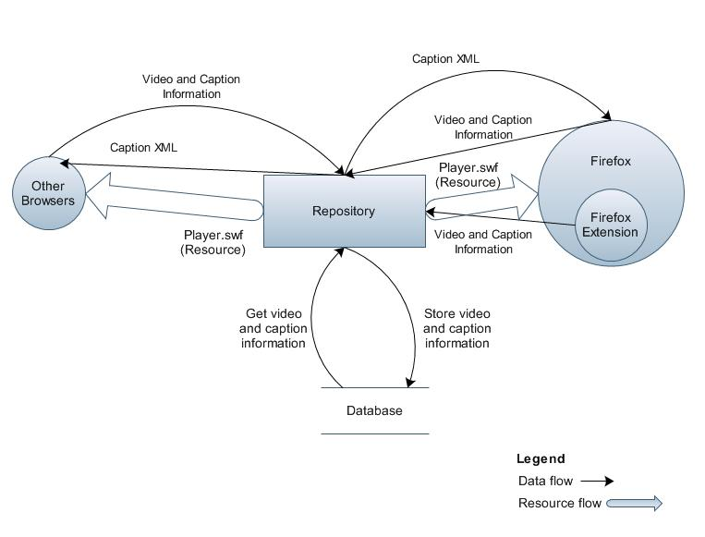
SA: DFD

Slide 8
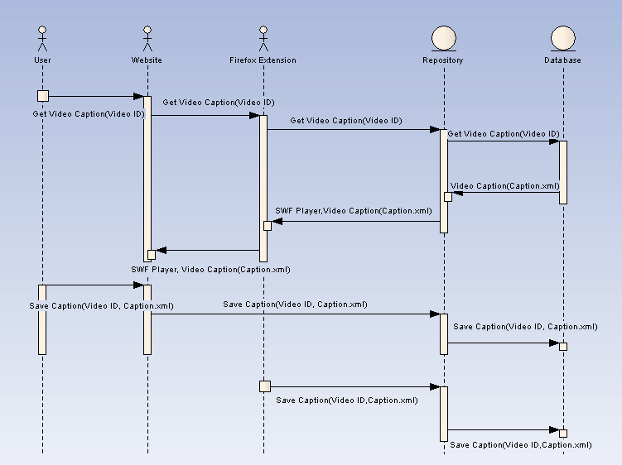
SA: Sequence Diagram

Slide 9
Requirements Document
The Back-End System:
Store, retrieve, modify, and delete captioned videos correctly.
Display the captioned videos where the videos are located.
Assure caption synchronization.
Not allow for automated spamming.
Presents its functionality via Web Services.
Assure that only one user can work on captioning a specific video at a given time.
Store previous caption versions.
Retrieve a list of previous versions.
Revert to a previous version.

Slide 10
Requirements Document
The Front-End System:
Load Videos
Fast-forward in the video
Rewind in the video
Allow entry of captions
Submit captions
Preview the current caption changes with the video.

Slide 11
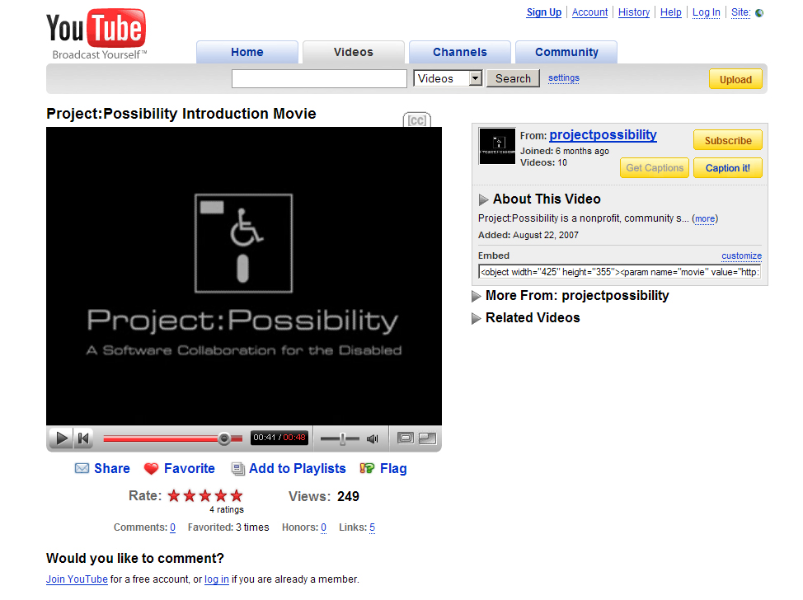
User Interface

Slide 12


Slide 13
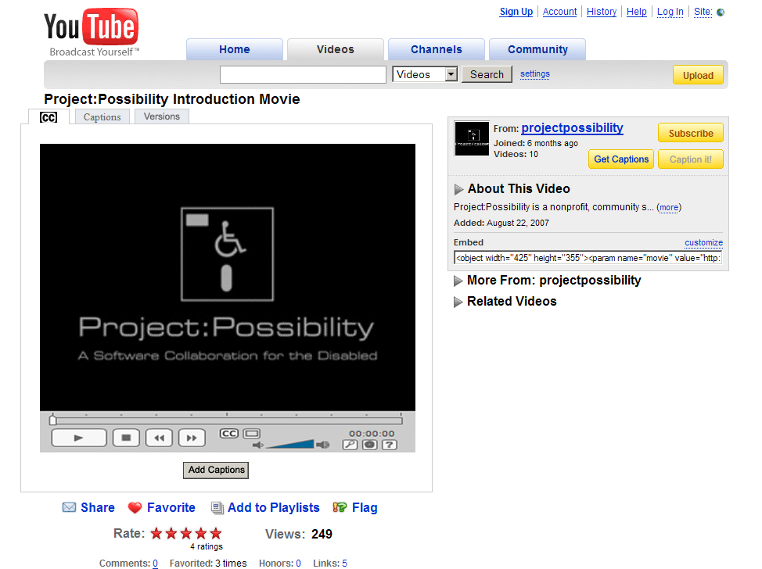

Slide 14
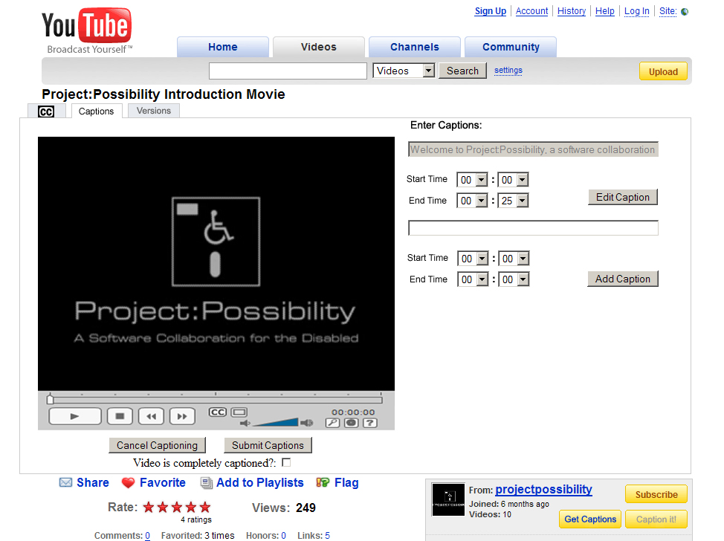

Slide 15
Schedule / Milestones
Define web services interface - March 15th
JavaScript function for re-writing page - March 17th
Web service function JavaScript - March 20th
Parallel Steps:
Captioning user interface JavaScript - April 1st
FLV player - April 9th
Backend implementation - April 9th
JavaScript roll into Firefox extension - April 14th

Slide 16

Q & A

