Slide 1
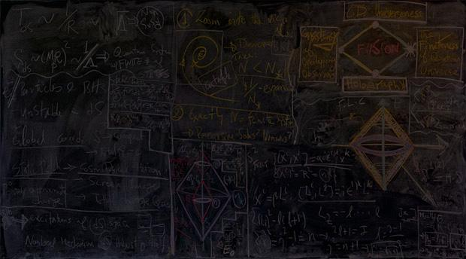

Project BoxSand
GROUP 6
COMPUTER SCIENCE 461: SENIOR CAPSTONE: MAY 2018
Notes:
Script: https://docs.google.com/document/d/1e77_HuOqJf0FLFlk4v6PNqWt2e4y5IzF0lHx8ZyXpTM/edit#

Slide 2
What is Project BoxSand?

Slide 3
WHAT IS PROJECT BOXSAND?
An open source Learning Module System that will be used by students to learn course material and complete online homework through an all-in-one online learning environment. The main goal of BoxSand is to improve student performance by providing access to free and open source resources all in one place.

Slide 4
PURPOSE AND GOALS - SPRING TERM
Stabilize the BoxSand site.
Implement the final design decisions and feature tweaks to make the OpenStax code our own.
Apply the user tracking feature to the whole site.

Slide 5
Progress of the Project

Slide 6

CURRENT PROGRESS OF THE PROJECT
Plan for Implementation
Develop Understanding of Project Requirements
Research potential solutions and methods of achieving the goals
Create initial plan for implementation
Phase One of Implementation
Formulate a development space
Begin development of the site
Phase Two of Implementation
Wrap up development for this cycle of the project
Prepare project for use by the next development team

Slide 7
CURRENT PROGRESS OF THE PROJECT - Class Stuff
Poster
Off to the printers
Registration
Expo Demonstration
Video to be played on loop
Finishing touches on the documentation

Slide 8
CURRENT PROGRESS OF THE PROJECT - Demo

Slide 9
Thank you for watching.

