Slide 1
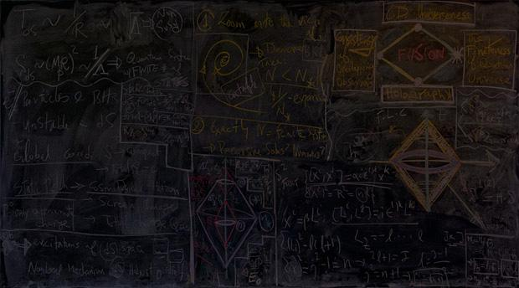

Project BoxSand
GROUP 6
COMPUTER SCIENCE 461: SENIOR CAPSTONE: FEBRUARY 2018
Notes:
Script: https://docs.google.com/document/d/1POseT0n9t8uPwH8diqIuwwQSYiVDA2TTlUJn2LD82uw/edit?usp=sharing

Slide 2
What is Project BoxSand?

Slide 3
WHAT IS PROJECT BOXSAND?
An open source Learning Module System that will be used by students to learn course material and complete online homework through an all-in-one online learning environment. The main goal of BoxSand is to improve student performance by providing access to free and open source resources all in one place.

Slide 4
PURPOSE AND GOALS - FOR THE YEAR
Develop long-term and overarching development goals and procedures for future project development.
Create an initial proof of concept for site functionality demonstration and future feature integration. This entails a website that...
Provides access to the OpenStax Physics textbook within the site and allows an instructor to assign reading from this textbook.
Provides a homework system where an instructor can provides questions, assign a value to the question, and create an assignment out of a grouping of questions.
Provides a way for students to complete the assigned homework and reading.
Provides a way for an instructor to download a gradebook of scores.

Slide 5
PURPOSE AND GOALS - WINTER TERM
Establish a working model of the site utilizing the foundation laid down by the people at OpenStax.
Craft and mold the OpenStax foundation to meet the Project Boxsand specific requirements

Slide 6
Progress of the Project

Slide 7

CURRENT PROGRESS OF THE PROJECT
Plan for Implementation
Develop Understanding of Project Requirements
Research potential solutions and methods of achieving the goals
Create initial plan for implementation
Phase One of Implementation
Formulate a development space
Begin development of the site
Phase Two of Implementation
Wrap up development for this cycle of the project
Prepare project for use by the next development team

Slide 8
CURRENT PROGRESS OF THE PROJECT - SAM
Exercises database
Open source textbooks
Account verification through email
Authentication through the Oregon State University login system (CAS)

Slide 9
STUMBLING BLOCKS - SAM
OpenStax code base - extremely large and has a huge amount of dependencies
Familiarity with Ruby on Rails
OpenStax and their willingness to work with us

Slide 10
NEXT STEPS - SAM
Tracking system
Where a user clicks on the website
How much time they spend on particular pages
How much time they spend watching videos or looking at simulations
How long a user spends on a particular homework problem
Style of the OpenStax website
Professor posted modules for students

Slide 11
CURRENT PROGRESS OF THE PROJECT - MAX
Accounts
Tutor
Exercise (and Books)
Tracking
Development processes + docs
Production deployments + docs
Style + Branding

Slide 12
STUMBLING BLOCKS - MAX
Keeping code changes that are temporary out of long term code commits
HTTPS/SSL
Redis connection refusals
Action Mailer setup for testing
API documentation and keys
Multi-homed deployments and testing scalability
Removing unused features from partner codebases
CNX archive and database issues
Postgres user auth
Webpack and SASS/SCSS
Pattern Library/UX updating

Slide 13
NEXT STEPS - MAX
Accounts
Tutor
Exercises + Books
Tracking
Deployment processes
Auditing
Testing Suites

Slide 14
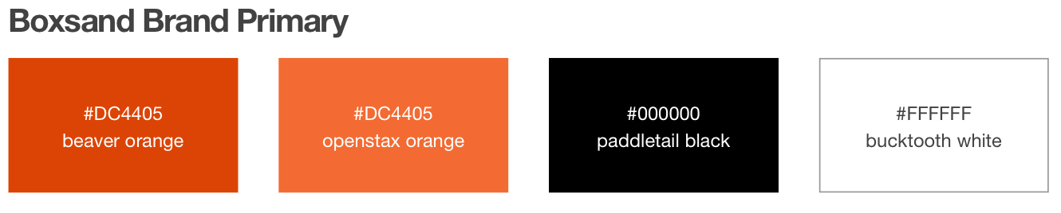
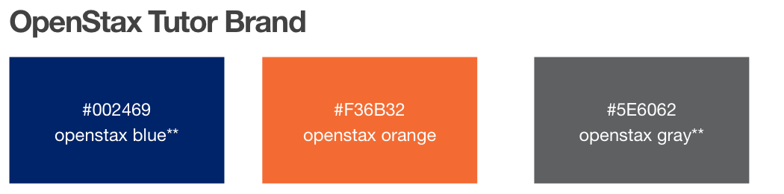

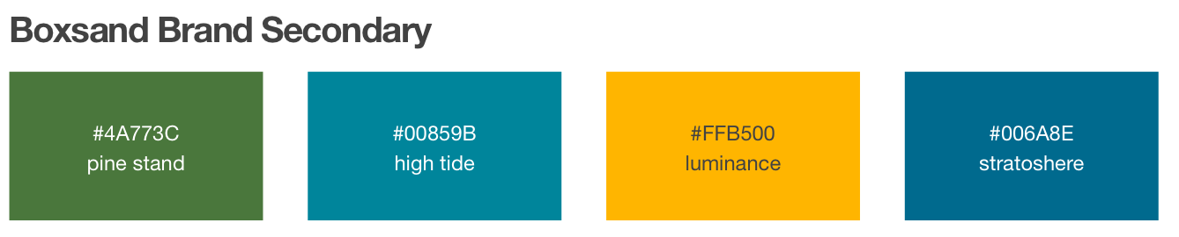

CURRENT PROGRESS OF THE PROJECT - ANYA
First Draft of the Style Guide
Logo Concept Design

Slide 15
CURRENT PROGRESS OF THE PROJECT - ANYA
Cognitive Walkthrough
Development of goals
Perform the walkthrough

Slide 16
STUMBLING BLOCKS - ANYA
Getting feedback on the current direction of the style guide.
Changes in process for implementing the style decisions.

Slide 17
NEXT STEPS - ANYA
Receive Feedback from Client
Send out first drafts to client for feedback
Receive and analyze feedback
Implement Style Decisions
Run Cognitive Walkthrough
Develop Goals
Run walkthrough
Analyze results

Slide 18
Thank you for watching.

