Slide 1
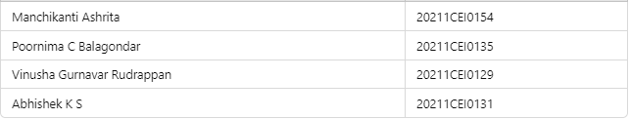
Financial Causality Detection
PSCS184 Capstone Project
VIVA - VOCE
Batch Number: G-9
Student Name | Roll Number
Under the Supervision of,
Dr. Joe Arun Raja
Associate Professor
School of Computer Science and Engineering
Presidency University
Name of the Program: B.Tech
Name of the HoD: Dr. Gopal Krishna Shyam
Name of the Program Project Coordinator: Dr. Sudha P
Name of the School Project Coordinators: Dr. Sampath A K / Dr. Abdul Khadar A / Mr. Md Zia Ur Rahman

Slide 2
Introduction of our Project
Financial causality detection plays a significant role in analyzing financial disclosures and reports. By understanding cause-effect relationships within financial texts, businesses, regulators, and investors can make informed decisions. This task involves both extractive and generative approaches to Question Answering (QA) for detecting causal effects in financial data.
Extractive QA focuses on finding exact answers from the text, while generative QA can generate creative and abstract answers by forming deeper inferences from the data. By implementing Natural Language Processing (NLP) techniques with models like RoBERTa and GPT-2, we can automate the process of detecting causal relationships in both English and Spanish datasets.
The task involves preprocessing text using language models like SpaCy for tokenization, RoBERTa for extractive QA, and GPT-2 for generative QA.

Slide 3
Literature Review
“Deep Learning. MIT Press.”
Author : Goodfellow, I., Bengio, Y., & Courville, A.
Algorithm Used:
Deep Neural Networks (DNNs): The book covers a wide range of deep learning architectures such as Convolutional Neural Networks (CNNs), Recurrent Neural Networks (RNNs), and generative models like Generative Adversarial Networks (GANs).
Drawbacks:
Computationally Expensive: Training deep networks requires a lot of computational power and memory.
Overfitting: Deep networks can easily overfit, especially when trained on small datasets.

Slide 4
Literature Review
“Attention is All You Need.”
Author : Vaswani, A., Shazeer, N., Parmar, N., et al.
Algorithm Used:
Transformer Architecture: Introduces the transformer model based purely on attention mechanisms, eliminating the need for recurrent layers. The core concept is the self-attention mechanism, which enables the model to focus on different parts of the input sequence dynamically.
Drawbacks:
Scalability: Transformers have quadratic complexity with respect to sequence length due to the self-attention mechanism, making them computationally expensive for long sequences.
Memory Consumption: The self-attention mechanism consumes large amounts of memory, especially for long input sequences.

Slide 5
Literature Review
“BERT: Pre-training of Deep Bidirectional Transformers for Language Understanding.”
Author : Devlin, J., Chang, M. W., Lee, K., & Toutanova, K.
Algorithm Used:
BERT (Bidirectional Encoder Representations from Transformers): A pre-trained language model using bidirectional transformers that capture context from both directions of a sentence.
Drawbacks:
Computational Cost: Fine-tuning BERT on specific tasks requires a lot of computational resources, including GPUs or TPUs.
Inference Speed: BERT models are slow during inference due to their deep layers and the bidirectional nature of their architecture.

Slide 6
Research Gaps Identified
In the context of building a Financial Causality Detection system using extractive and generative QA models, there are several potential research gaps and areas for improvement that could be identified:
Handling Ambiguity in Financial Text
Gap: Financial disclosures often contain ambiguous or highly technical language that can be hard to interpret accurately. Current models like BERT or GPT-2, while powerful, may struggle with such complexity and subtlety.
Research Focus: Developing more domain-specific models or fine-tuning existing models on large financial datasets to better capture the nuances of financial jargon, context, and causality.

Slide 7
Proposed Methodology
Data Preprocessing: Collect and clean financial disclosure documents in English and Spanish, focusing on aligning bilingual data and removing noise.
Hybrid QA Approach: Combine extractive QA (using models like BERT) to find specific causal statements with generative QA (using models like GPT) for generating nuanced causal explanations.
Causal Relation Detection: Use NLP techniques to detect causal cues (e.g., "because," "due to") and financial impact within the disclosures.
Fine-Tuning: Fine-tune the models on financial datasets for better understanding of domain-specific causal relationships.

Slide 8
Objectives
Develop a hybrid QA system that detects causal relationships from financial disclosures using extractive and generative models.
Ensure the system works for both English and Spanish languages.
Automate the analysis of financial disclosures to reduce manual effort and improve accuracy.
Provide both verbatim extractive answers and creative generative answers for complex causal relationships.
Improve scalability by enabling the system to analyze large datasets efficiently.

Slide 9
Methodology/Modules
Text Preprocessing:
Use SpaCy to tokenize and clean the input text.
Preprocess input context based on language selection (English or Spanish).
Extractive QA:
Use RoBERTa (deepset/roberta-base-squad2) for extractive question-answering to find exact matches from the context.
Generative QA:
Use GPT-2 to generate creative answers for questions that require abstract inferences.
Hybrid Approach:
Combine the extractive and generative answers to provide a complete understanding of the causal relationship.

Slide 10
System design and Implementation
Frontend (User Interface)
A web-based interface where users can input financial disclosures and ask questions.
The frontend will:
Allow users to upload financial text (disclosures, reports).
Ask specific questions related to causality.
Select the language (English/Spanish).
Display both extractive and generative answers to the users.
Backend (API and Logic Layer)
This is where the core logic resides, such as:
Running the extractive and generative QA models.
Detecting causal relationships in the financial disclosures.
Returning the results to the frontend.

Slide 11
Architecture
User Interface:
Users input financial documents and ask questions via a web interface.
Choose language (English/Spanish).
Preprocessing Module:
Preprocesses text using SpaCy for tokenization and language-specific cleaning.
QA System:
Extractive QA: Uses RoBERTa to extract exact answers from the text.
Generative QA: Uses GPT-2 to generate creative answers.

Slide 12
Hardware/software components
Hardware:
CPU: 2.4 GHz (Quad-Core or higher)
Memory: Minimum 16GB RAM
Disk: Minimum 256GB SSD
GPU (Optional for faster inference): NVIDIA GPU with CUDA support
Software:
Python 3.x
Django 3.x
PyTorch for deep learning
SpaCy for text preprocessing
Hugging Face’s transformers library for QA models

Slide 13
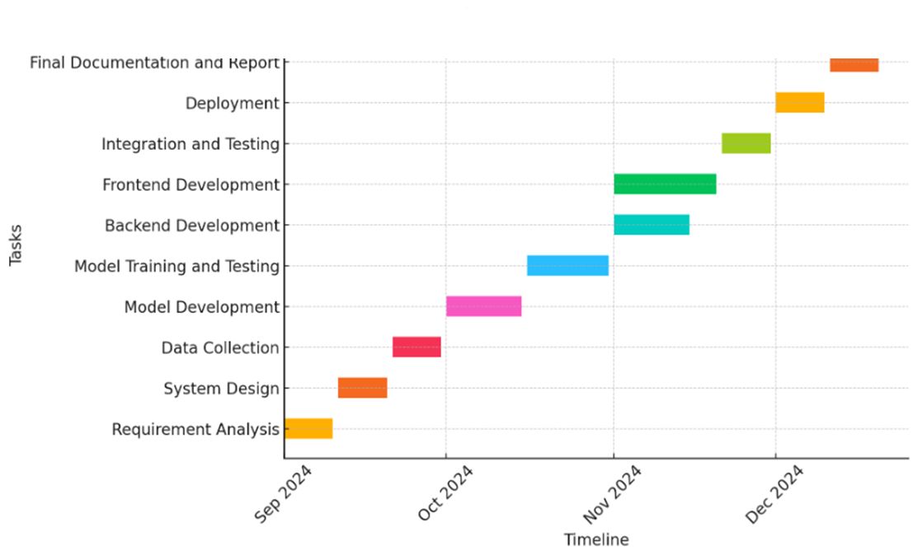
Timeline of Project

Slide 14
Expected Outcomes
Improved Efficiency: The system will automate financial causality detection, reducing manual effort.
Multilingual Support: Support for both English and Spanish will expand the system’s applicability in diverse markets.
Accurate Causal Detection: The hybrid approach will provide both accurate extractive answers and insightful generative answers.
Scalability: The system will be capable of analyzing large financial datasets efficiently, making it suitable for enterprise-level applications.

Slide 15
Conclusion
The proposed financial causality detection system offers an innovative hybrid QA approach that combines extractive and generative models to uncover cause-effect relationships in financial disclosures. By leveraging state-of-the-art NLP techniques like RoBERTa and GPT-2, the system provides both exact and creative insights into financial data, making it a valuable tool for businesses, regulators, and financial analysts. The solution’s multilingual capability further enhances its usability across different regions and languages, making it a comprehensive solution for financial analysis.

Slide 16
References
Goodfellow, I., Bengio, Y., & Courville, A. (2016). Deep Learning. MIT Press.
Vaswani, A., Shazeer, N., Parmar, N., et al. (2017). Attention is All You Need. Advances in Neural Information Processing Systems, 30, 5998-6008.
Devlin, J., Chang, M. W., Lee, K., & Toutanova, K. (2019). BERT: Pre-training of Deep Bidirectional Transformers for Language Understanding. NAACL-HLT.
Radford, A., Wu, J., Child, R., Luan, D., Amodei, D., & Sutskever, I. (2019). Language Models are Unsupervised Multitask Learners. OpenAI Blog.
Rajpurkar, P., Jia, R., Liang, P. (2018). Know What You Don't Know: Unanswerable Questions for SQuAD. Proceedings of the 56th Annual Meeting of the Association for Computational Linguistics.

Slide 17
Publication Details

Slide 18

Thank You

