Slide 1






Privacy-Preserving Wi-Fi CSI-Based Fall Detection System with Edge Neural Inference and Event-Driven Agentic Voice Interaction for Rule-Based Caregiver Escalation
Research Methodology Review - I
SDG Goals :
Group Number : 6
Mentor Name :Dr. Mrs. Gresha Bhatia
Team Members :
1. Neha Mankani
2. Shraddha Bhagwat
3. Shambhavi Patil
4. Supriya Nayak

Slide 2
Content
Research Problem Formulation
Novelty & Research Contribution
Literature Review & Research Gap Analysis
Research Methodology / Experimental Design
Modern Tool Usage
Result Analysis & Validation
Quality of Figures, Tables, etc.
Manuscript Organization & Technical Writing
References & Their Relevance
SDG / Societal / Practical Relevance
Student Contribution & Research Presentation

Slide 3
Research Problem Formulation
Falls are a major cause of injury among elderly people living alone — existing detection options each fall short:
Wearable devices
Must be worn and charged regularly; often left unused, especially by people with cognitive or motor impairments.
Camera-based systems
Raise privacy concerns and are unsuitable for private areas such as bathrooms and bedrooms.
Wi-Fi sensing systems
Avoid both problems, but prior art mostly stops at detection — no interaction with the person, no escalation procedure.
Problem statement
Design a low-cost, privacy-preserving system that detects falls from Wi-Fi CSI without wearables or cameras, and responds to a detected fall in the person’s own language under predictable safety rules.

Slide 4
Novelty & Research Contribution
1
Single-antenna, amplitude-only sensing
One receiving antenna on a low-cost ESP32; amplitude of 52 fixed subcarriers, no phase and no multi-antenna processing.
2
FallGuardNet — compact edge network
21,571 parameters, trained by knowledge distillation; in-network periodicity and stillness scores separate falls from walking/running; runs on Raspberry Pi 5.
3
Detection → complete escalation loop
Event-driven agentic voice layer: creates an incident, speaks in the preferred language, interprets the reply, asks follow-ups, handles silence.
4
LLM proposes, rules decide
The language model supplies only a recognised intent; a rule-based safety-policy controller decides. Delivery and acknowledgement are tracked; context is retained.
Contribution: a contactless, camera-free system that both detects a fall and manages the response. As far as the applicants are aware, these features are not disclosed together in prior patents [1]–[4].

Slide 5
Literature Review & Research Gap Analysis
Prior art | Approach | Limitation | How Sannidhi addresses it
[1] US 10,531,817 B2 Peking Univ. | ≥2 RX antennas, phase difference, hand-made features, one-class SVM | Needs multi-antenna hardware and phase; weak on walking/running; no interaction | Single antenna, amplitude only; learned features + periodicity/stillness scores; voice follow-up
[2] CN 112346050 B Tsinghua Univ. | Body speed from CSI fed to a trained fall model | Outputs detection only; no escalation; edge execution not described | Runs locally on Raspberry Pi 5; detection event drives the agentic escalation layer
[3] US 2024/0112559 A1 Google LLC | Radar fall detection, speaker prompt, spoken reply, alert | Dedicated radar hardware; no rule-based escalation, clarification, ack tracking or context memory | Commodity Wi-Fi; rule-based controller; clarify / timeout paths; delivery tracking; incident store
[4] US 8,217,795 B2 Carlton-Foss | Wearable accelerometer alerts a console or call centre | Must be worn and charged; bare alert; no interaction | Contactless, no camera; asks the person; alerts caregiver with incident context
Research gap: no prior art combines single-antenna CSI sensing, edge inference and a safety-controlled, multilingual voice escalation loop.

Slide 6
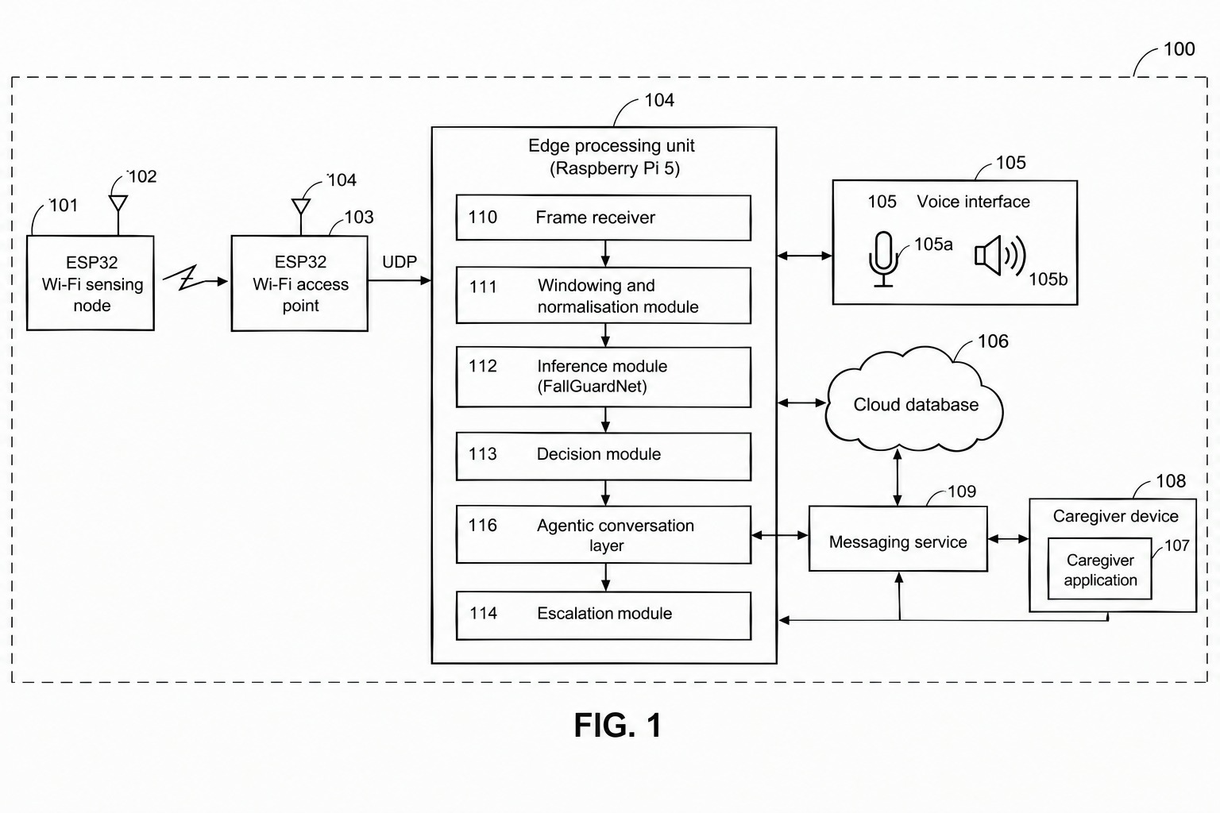
Research Methodology / Experimental Design (1/3)
1. Data Sensing & Collection
The sensing unit captures relevant signals from the surrounding environment.
The collected data is transmitted to the processing unit through a communication interface.
System architecture and signal pipeline
2. Data Processing & Pre-processing
The received data is collected, organized, and pre-processed for further analysis.
Signal processing and normalization are performed to improve the quality and consistency of the input.
3. Intelligent Analysis & Decision
The processed data is analyzed by an intelligent computational model.
Based on the analysis, the system identifies relevant events and generates an appropriate decision.
4. Communication & Response
The decision is communicated to the user or concerned personnel through the available interface.
The system can store relevant information and generate alerts or responses when required.
FIG. 1 – System block diagram (from provisional specification)

Slide 7
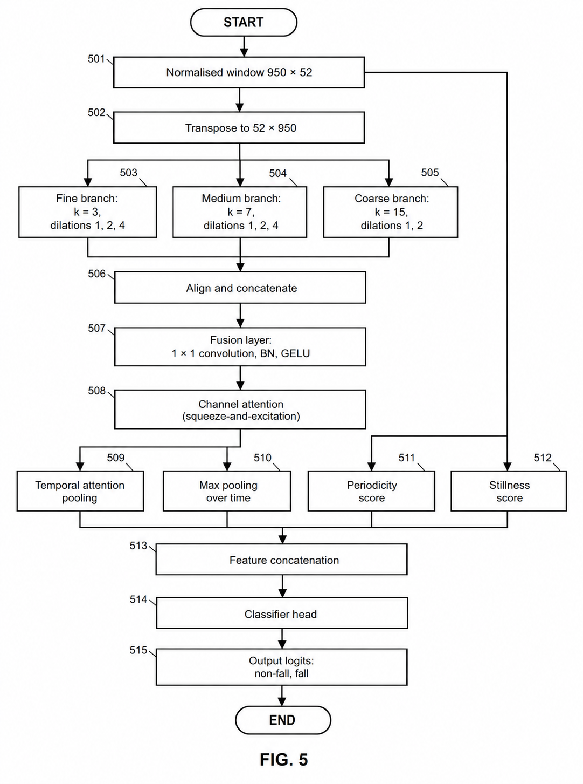
Research Methodology / Experimental Design (2/3)
FallGuardNet architecture and knowledge-distillation training
Multi-resolution temporal network
Three parallel dilated depthwise-separable 1-D conv branches: fine (k=3), medium (k=7), coarse (k=15)
Fusion layer → squeeze-and-excitation channel attention → temporal attention + max pooling
Periodicity score (high for walking/running) and stillness score (calm after an abrupt event)
21,571 trainable parameters
Training by knowledge distillation
Teacher: 18-layer residual CNN (~11 M parameters), then frozen
Loss = α · KL(T=4) + (1–α) · class-weighted cross-entropy, α = 0.7
Seven activities (arm wave, fall, jump, run, squat, turn, walk) → binary label; augmentation by time reversal / shift, scaling, noise
Student exported to ONNX for the edge unit
FIG. 5 – FallGuardNet

Slide 8
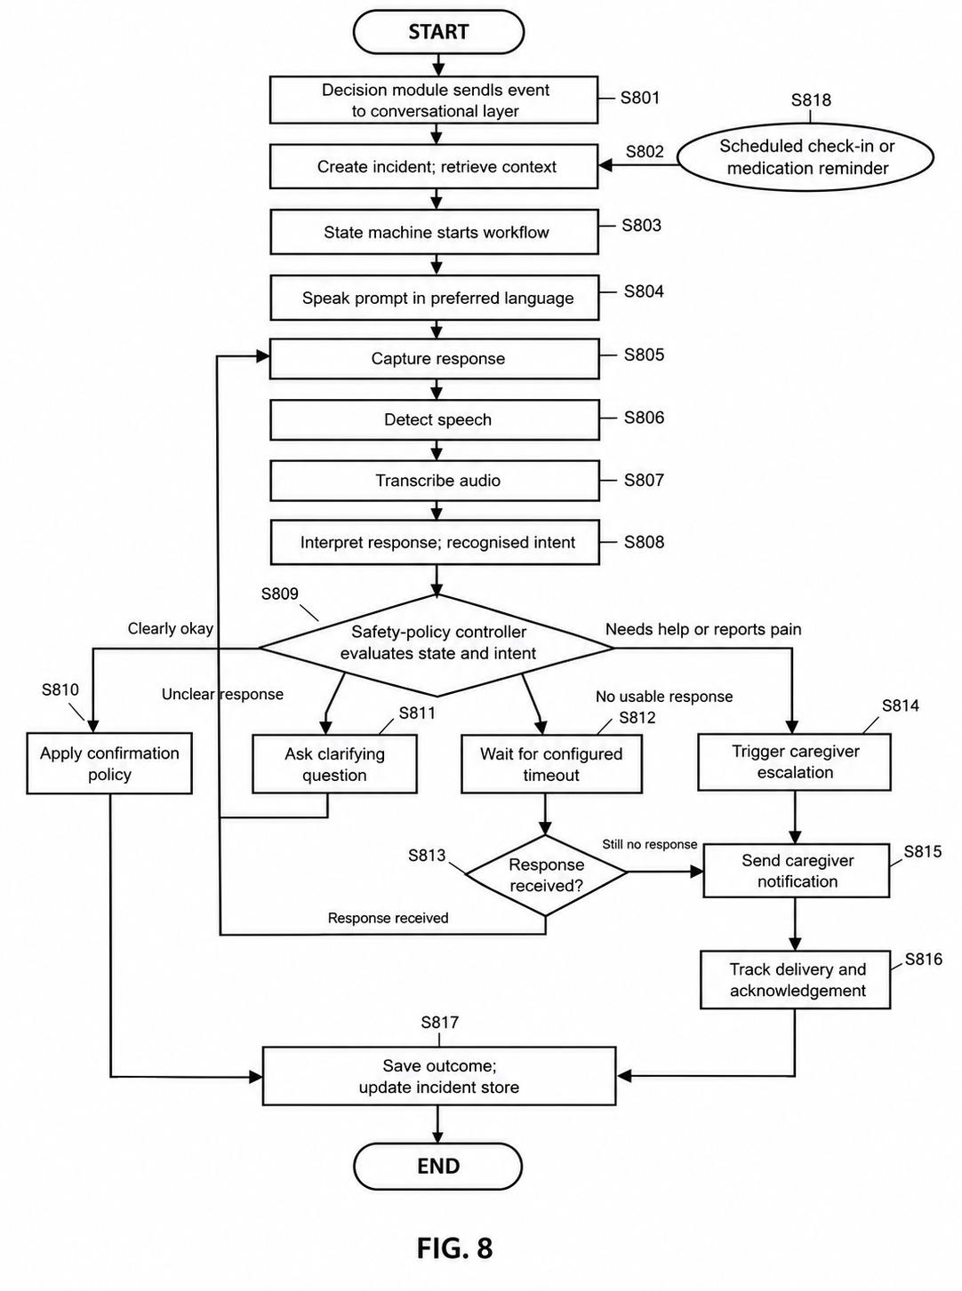
Research Methodology / Experimental Design (3/3)
Agentic conversational layer and safety-controlled escalation
Voice loop (all can run locally)
Speak prompt (TTS) → detect speech (VAD) → transcribe (STT) → interpret intent (LLM)
State machine tracks the incident; incident store keeps language, contacts, history
Safety-policy controller → 4 outcomes
Clearly okay → confirmation policy, resolve
Unclear → clarifying question
No response → timeout, then escalate
Needs help / pain → escalate directly
Escalation module
Notifies caregiver with time, summary, fall probability; tracks delivery and acknowledgement
FIG. 8 – Incident workflow

Slide 9
Modern Tool Usage
Layer | Tool / technology | Purpose
Sensing node | ESP32 + Wi-Fi CSI callback | Low-cost, single-antenna CSI capture
Edge unit | Raspberry Pi 5 | Runs inference, decision and conversational layer
Inference | FallGuardNet via ONNX runtime | Real-time fall / non-fall classification
Event interface | FastAPI (alt.: MQTT, serial) | Passes the fall event to the conversational layer
Voice detection | Silero VAD | Finds speech segments; skips silence
Speech-to-text | faster-whisper | Transcribes the reply in the person’s language
Interpretation | Qwen2.5-1.5B-Instruct via Ollama | Maps varied replies to a recognised intent
Control logic | Python state machine (LangGraph optional) | Conversation state and rule-based safety policy
Speech synthesis | Piper | Spoken prompts in the preferred language
Storage | SQLite / MongoDB; cloud database | Incident store, profiles, schedules; sensor heartbeat
Speech, language and synthesis models run on the edge unit — audio and transcripts need not leave the home; the voice loop works offline.

Slide 10
Result Analysis & Validation
Held-out test split: 60 non-fall + 10 fall recordings
 | Pred. non-fall | Pred. fall
Actual non-fall | 60 | 0
Actual fall | 2 | 8
97.1%
Accuracy
100%
Precision
80%
Recall
100%
Specificity
0.889
F1 score
Preliminary
small test set
No false alarms; 2 of 10 falls missed. Larger ESP32-captured test data is needed to confirm recall.

Slide 11
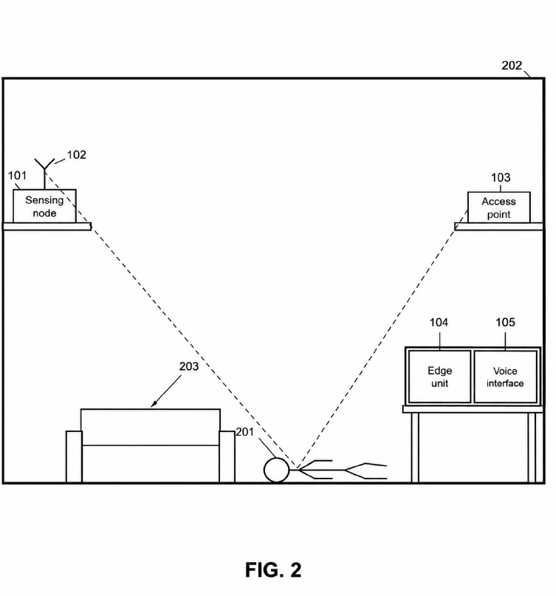
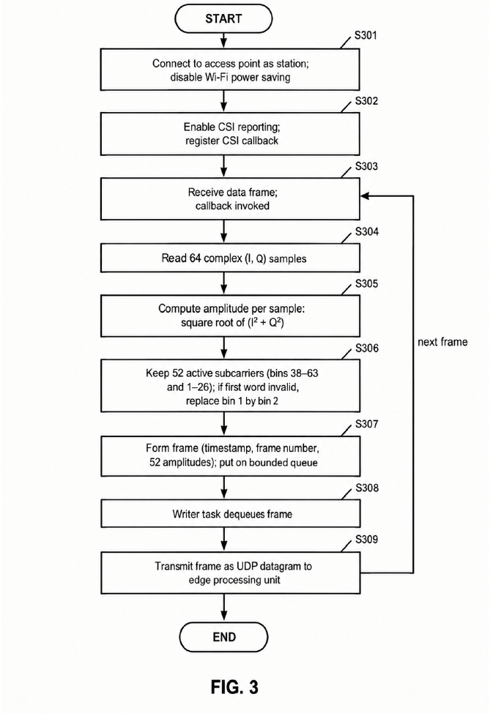
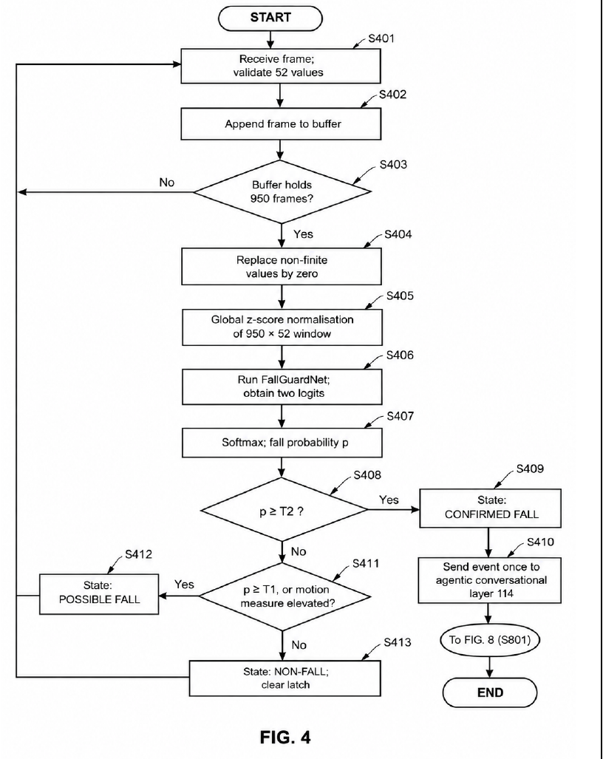
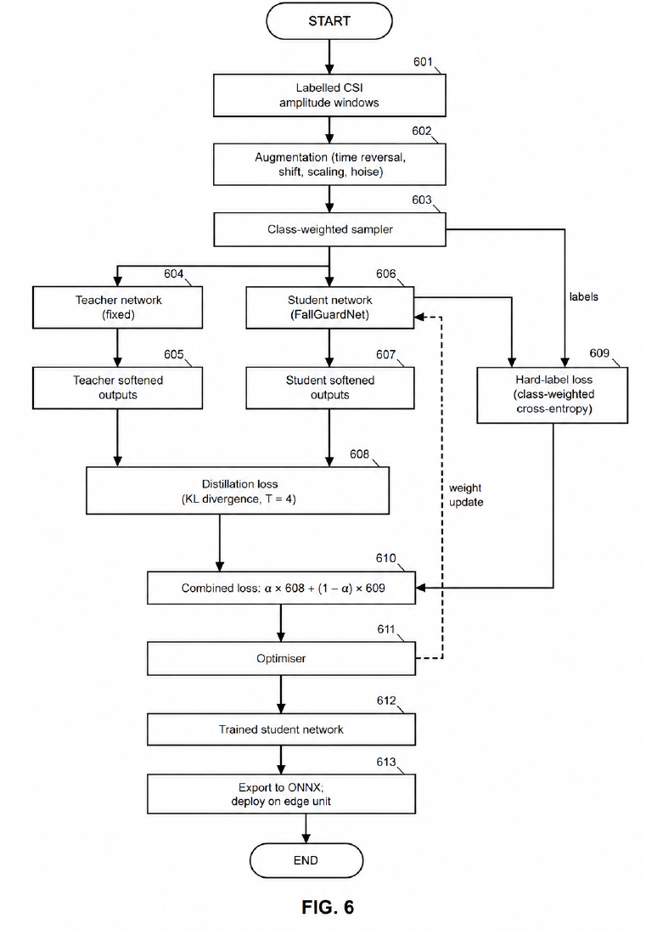
Quality of Figures, Tables, etc.
FIG. 2 – Example room deployment
FIG. 3 – CSI acquisition flow
FIG. 4 – Window processing & state decision
FIG. 6 – Distillation training
9
numbered drawings (FIG. 1–9)
2
tables: tools, model comparison
100–710
reference numerals across figures
S301–S818
step labels in flow charts

Slide 12
Manuscript Organization & Technical Writing
Provisional Specification — Form 2, The Patents Act 1970 and Patents Rules 2003
Title & applicants
Field of the invention
Background
Objects
1
2
3
4
Novelty vs. prior art [1]–[4]
Detailed description (13 parts, FIG. 1–9)
Further embodiments
Abstract & references
5
6
7
8
Technical-writing practices
Each prior-art limitation is stated first, then how the invention overcomes it
Consistent reference numerals tie text to figures
Embodiments marked illustrative, not limiting; parameters given as examples
Description flow
System overview → sensing node → windowing → network → training → decision → conversational layer → workflow → safety rules
Ends with example tools (Table 1) and experimental results (Table 2, FIG. 9)

Slide 13
References & Their Relevance
Ref. | Category | Why it matters to Sannidhi
[1] Peking Univ., US 10,531,817 B2 | Wi-Fi CSI, multi-antenna | Closest CSI baseline; we remove the multi-antenna / phase requirement and add interaction
[2] Tsinghua Univ., CN 112346050 B | Wi-Fi CSI, trained model | Shows CSI + learned model is known; we add edge execution and a full escalation procedure
[3] Google LLC, US 2024/0112559 A1 | Radar + spoken interaction | Closest on post-fall interaction; we use commodity Wi-Fi and a rule-based controller separate from the language model
[4] J. Carlton-Foss, US 8,217,795 B2 | Wearable accelerometer | Represents the wearable category we avoid (wear/charge burden, no interaction)
Coverage: all four references are patent documents spanning the three existing approaches — Wi-Fi CSI, radar, and wearables — so the novelty argument is checked against each category.

Slide 14
SDG / Societal / Practical Relevance
SDG 3
SDG 9
SDG 10
Good Health & Well-being
Faster help after a fall for elderly people living alone; routine check-ins and medication reminders.
Industry, Innovation & Infrastructure
Low-cost commodity hardware (ESP32, Raspberry Pi 5) and compact edge AI instead of dedicated radar.
Reduced Inequalities
Contactless — nothing to wear or charge; spoken interaction in regional languages, not only English.
Practical relevance
No camera
Privacy-preserving; usable in bedrooms and bathrooms
Local processing
Audio and transcripts can stay on the device; works offline
Caregiver context
Alert with time, summary, fall probability; delivery tracked
Sensor heartbeat
Caregiver app shows the sensor is online

Slide 15
Student Contribution & Research Presentation
Team deliverables
Provisional patent specification: field, prior-art novelty analysis, detailed description, 9 figures
FallGuardNet design, distillation training and edge deployment
ESP32 CSI acquisition and windowing pipeline
Agentic voice layer with rule-based escalation
Benchmark against 7 baseline models
Next steps
Validate on a larger ESP32-captured test set (current test: 10 fall recordings)
Train baseline classifiers on public datasets (UT-HAR, FallDeFi, CSI-Bench)
Address hardware domain shift between Intel 5300 NIC datasets and ESP32 subcarriers; cWGAN-GP domain adaptation planned
Inventors / team
Neha Mankani
Shraddha Bhagwat
Shambhavi Patil
Supriya Nayak
Mentors: Dr. Mrs. Gresha Bhatia · Dr. Mrs. Priya R.L. · Dr. Mrs. Saylee Gharge — VESIT, Chembur, Mumbai

Slide 16
References
[1] United States Patent No. US 10,531,817 B2, “Fall Detection Method and System,” Peking University.
[2] Chinese Patent No. CN 112346050 B, “Fall detection method and system based on Wi-Fi device,” Tsinghua University, granted 28 June 2024.
[3] United States Patent Application Publication No. US 2024/0112559 A1, “Privacy-Preserving Radar-Based Fall Monitoring,” Google LLC, published 4 April 2024.
[4] United States Patent No. US 8,217,795 B2, “Method and system for fall detection,” J. Carlton-Foss, granted 10 July 2012.

