Slide 1
Partnership Analysis & Level Classification
By:
Abraham Serrano
Prasanna Rajendra
Supervisor:
Robin Donatello
Kelsey Kyllonen

Slide 2
Outline
Abstract
Quarto
Proposed methodology
Results
Next Step

Slide 3
Introduction
CHC(Center for Healthy Communities) has subcontractors who partner with local organizations for calfresh outreach
These subcontractors report to CHC on activities
Wanted to see if we could determine a subcontractor's level of participation in the contract based on the descriptions they listed for their partnership activities

Slide 4
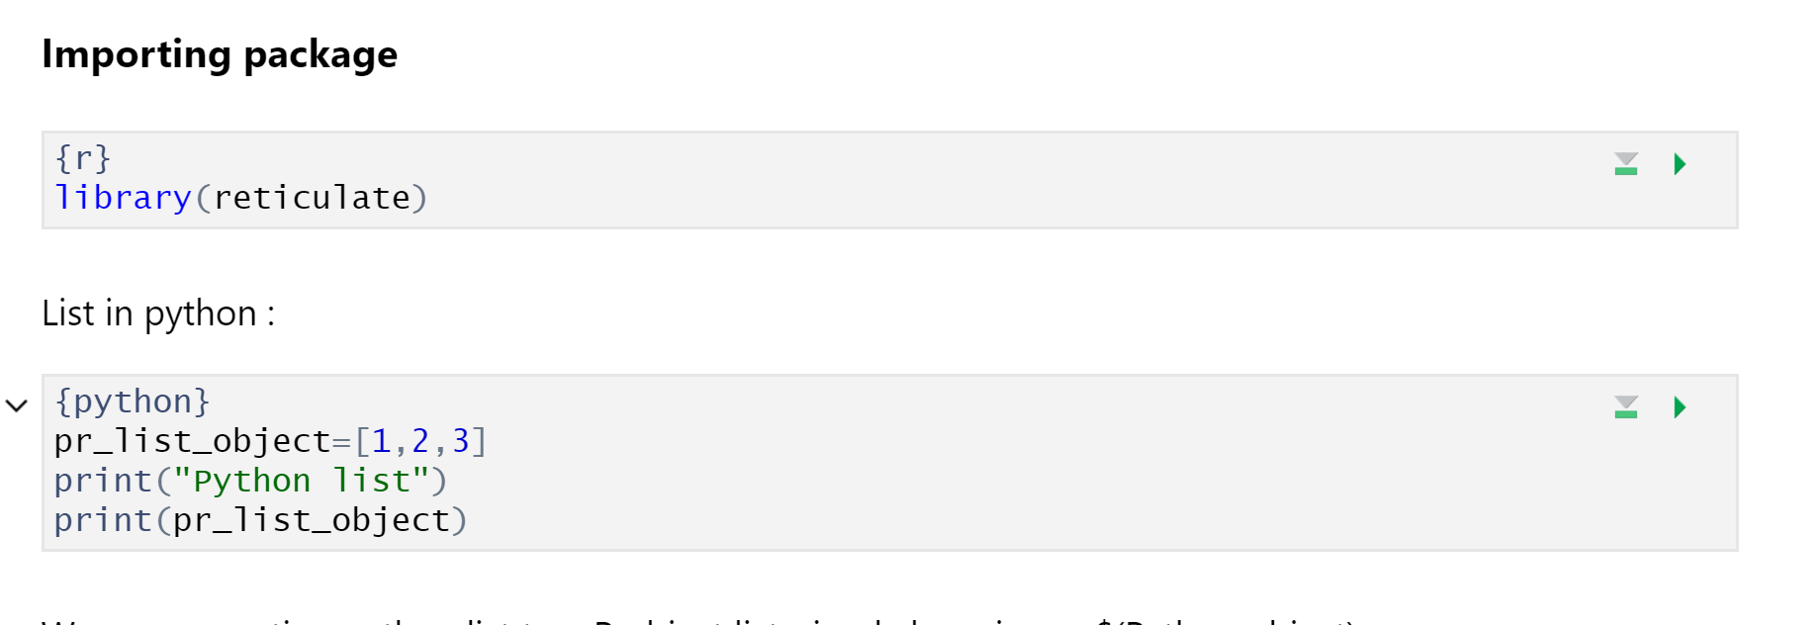
QuartoDoc
Main usage for language flexibility
Reticulate package

Slide 5
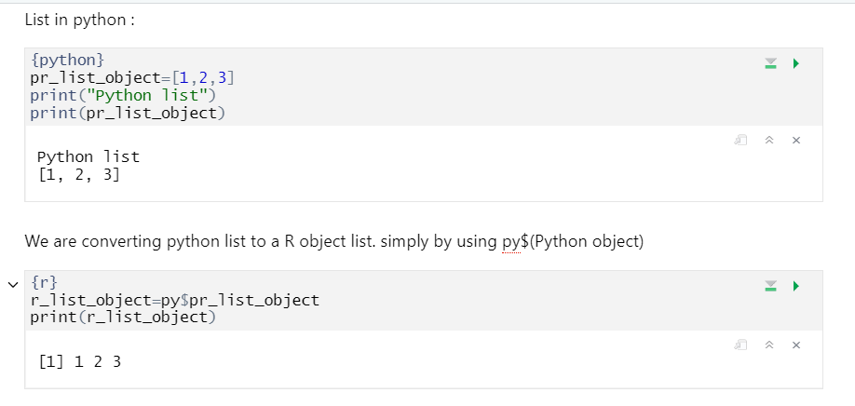
Python and R Communication
Reticulate package in R can convert python container to R

Slide 6
Branches Diverge
In R,
We did Text Preprocessing
Created DTM
Performed LDA
In Python ,
Multi Class Model Decision Tree
Data Preprocessing on Numerical and Categorical Features

Slide 7
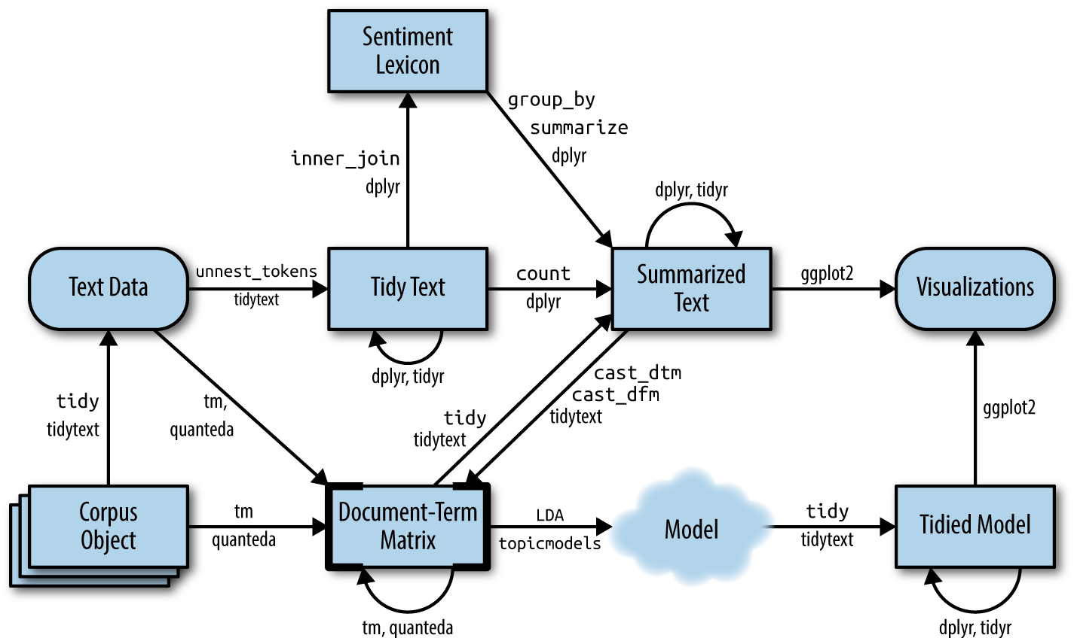
In R
Create LDA Model
Python df -> R df
R df -> Document Term Matrix
Document Term Matrix -> LDA Model

Slide 8
Next Steps:
Get topic probabilities for number of topics I (the user) want
Visualizing the model
- This flowchart shows the last steps

Slide 9

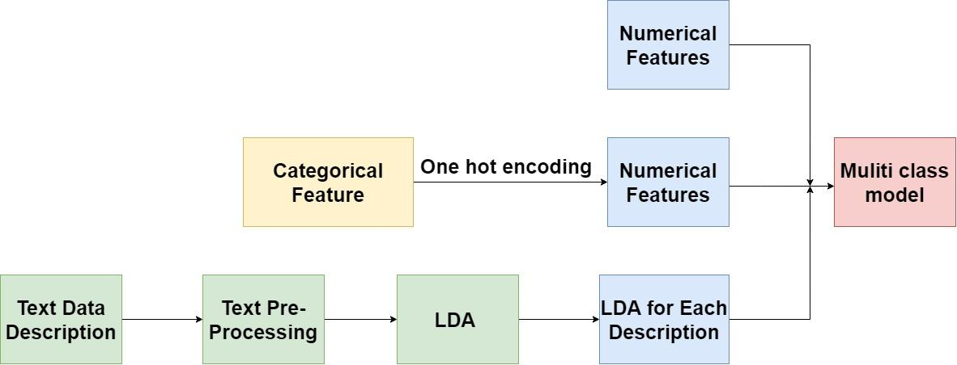
Proposed methodology

Slide 10
Processing Data
Numeric data:
Numeric data will be directly passed to the multi-class model
Categorical data:
All the categorical data will be converted into each new dummy column by one hot encoding.
Text Data:
Will perform LDA on the text data will divide into 4 clusters , will use the gamma value of each cluster as a new feature for out model
After all the data is converted into numeric, using Decision Tree to perform Multi-Label Classification

Slide 11
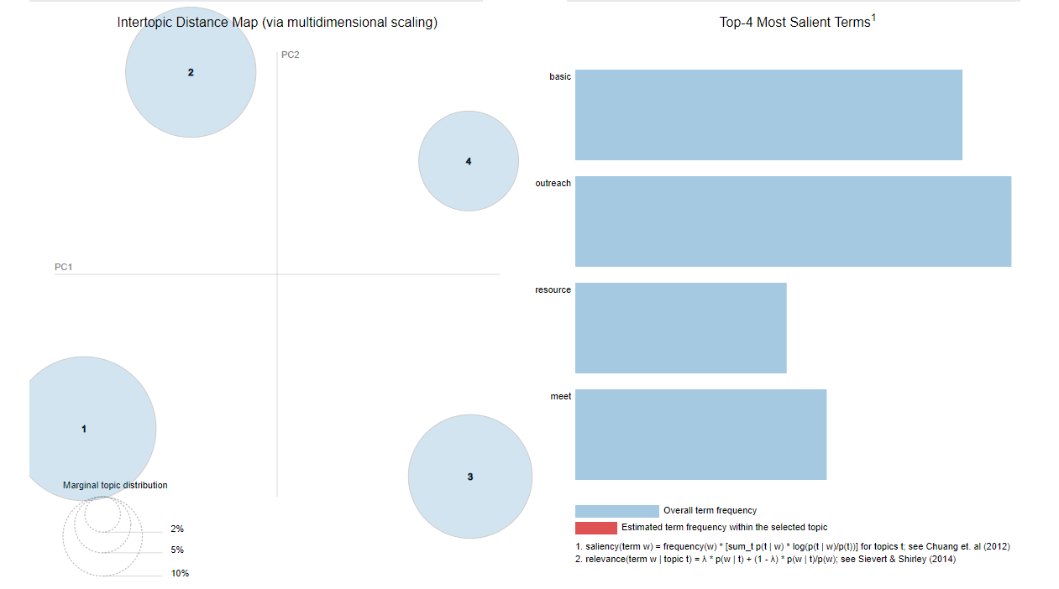
Results

Slide 12
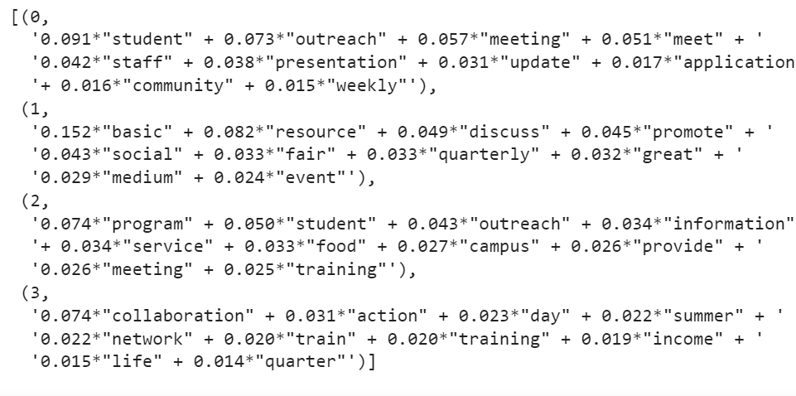
LDA Values for each Topic

Slide 13
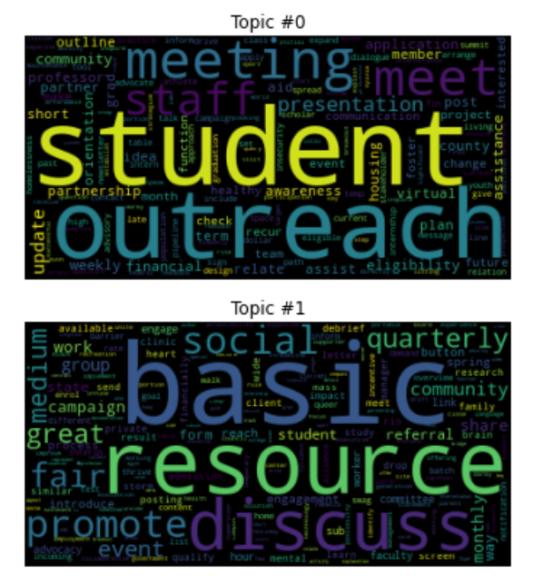
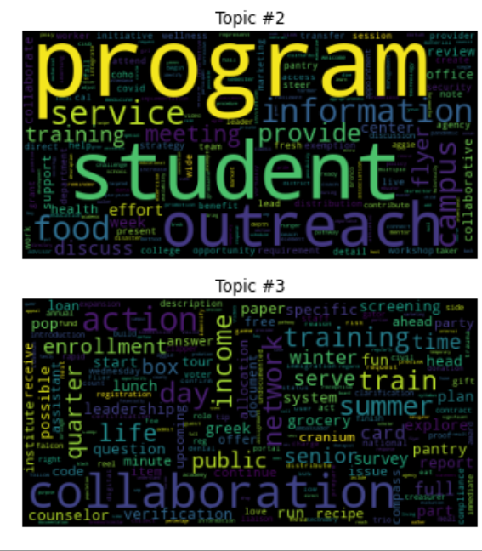
Word Cloud

Slide 14
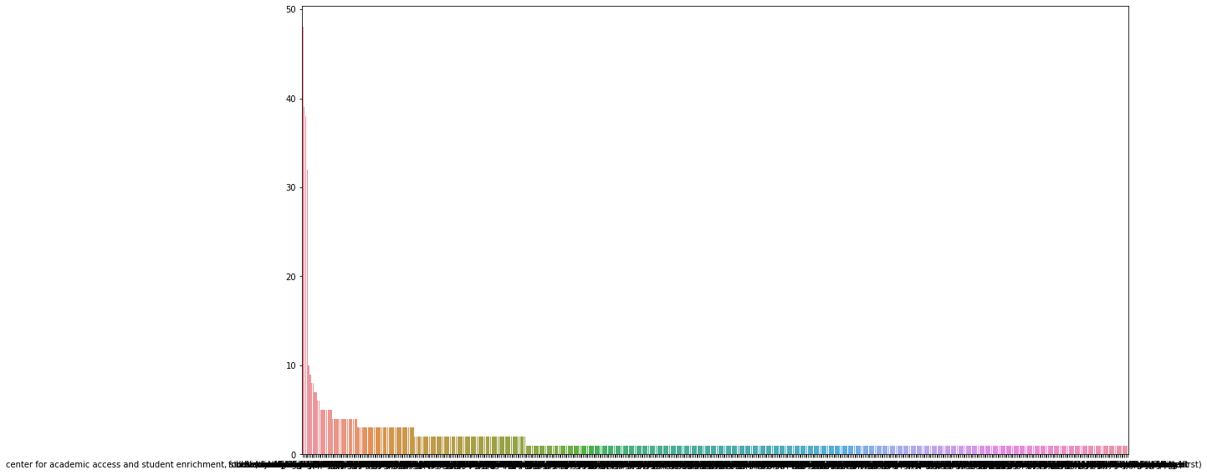
Next Step
We can do some research on Partner feature since the distribution is not normal.
Once we get the Label data ready we can Grid CV over different parameters to find best fit algorithm

Slide 15
Thank you !!!

