Slide 1
Timesheet Insights Using R
Mason McBride

Slide 2
Guiding Questions
1. How long did I work?
2. When did I work?
3. Where did I work?
4. For whom did I work?

Slide 3
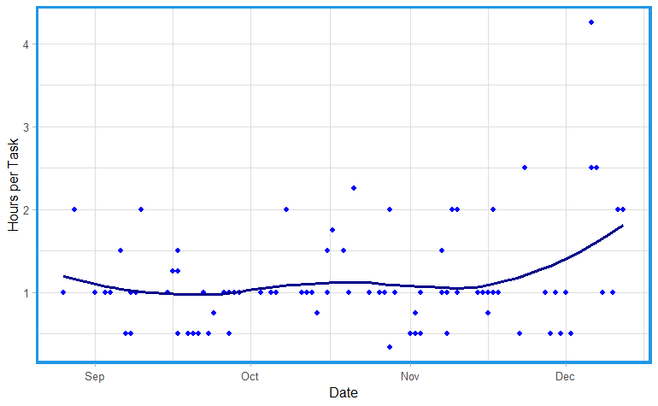
1. How long did I work?

Slide 4
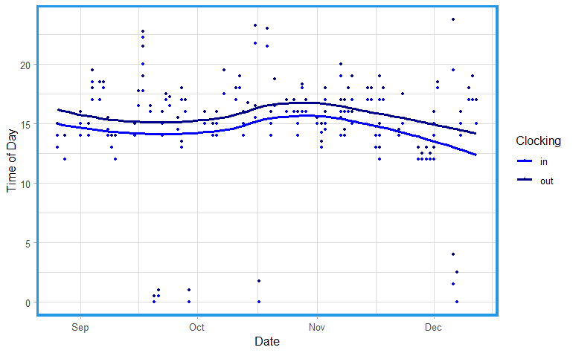
2. When did I work?

Slide 5
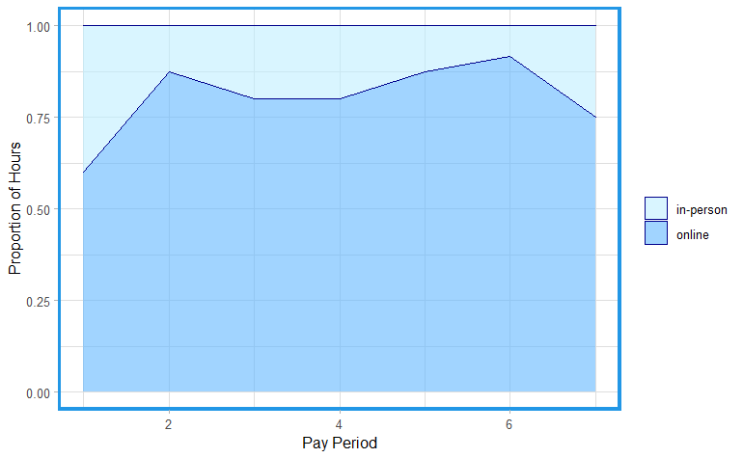
3. Where did I work?

Slide 6
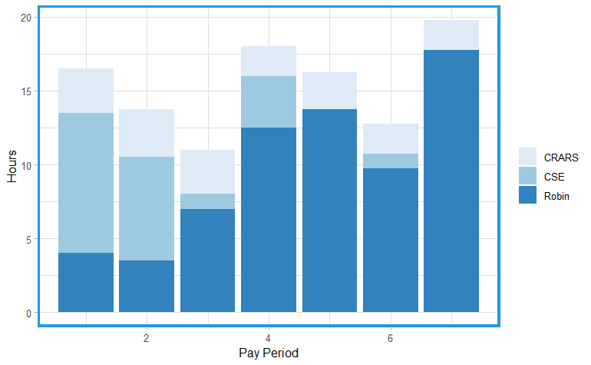
4. For whom did I work?

