Slide 1
CFO Health Check
Displaying and Comparing Data
Miguel Velazquez Campos

Slide 2
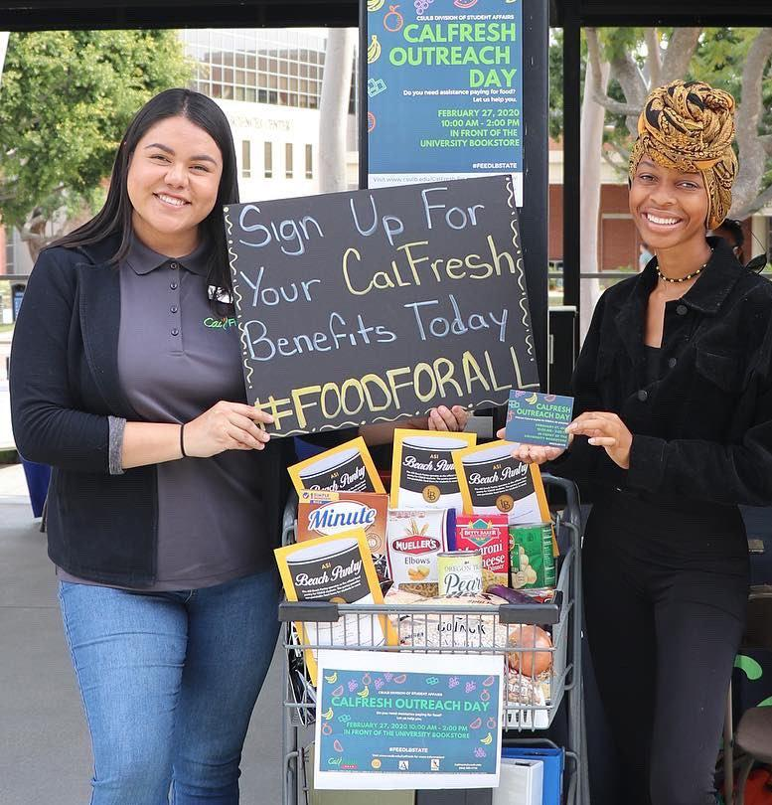
CalFresh Outreach
Creates awareness for Californians who may be eligible for CalFresh Food benefits.
Staff help promote the program, walk people through the application, and ensure they know how to use and maintain their benefits.

Slide 3
Subcontractors
CHC is a prime contractor with the California Department of Social Services.
CHC helps fund campuses and community-based organizations to increase application assistance for CalFresh Food.

Slide 4
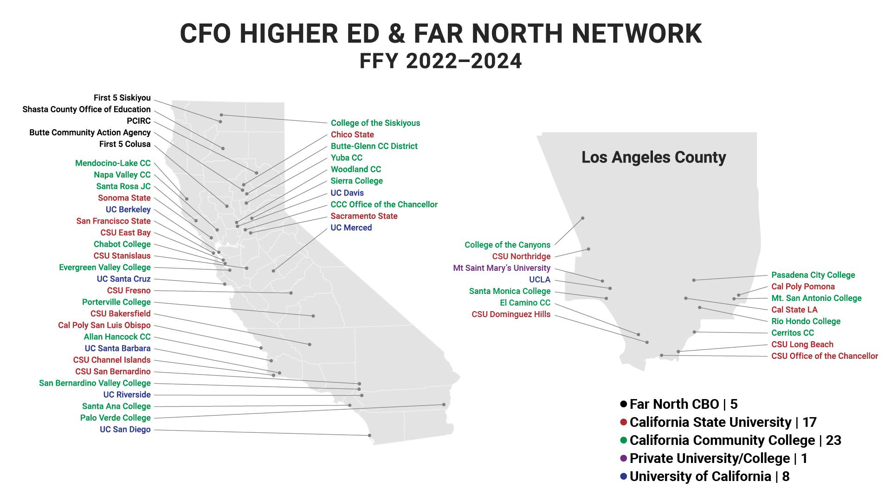

Slide 5
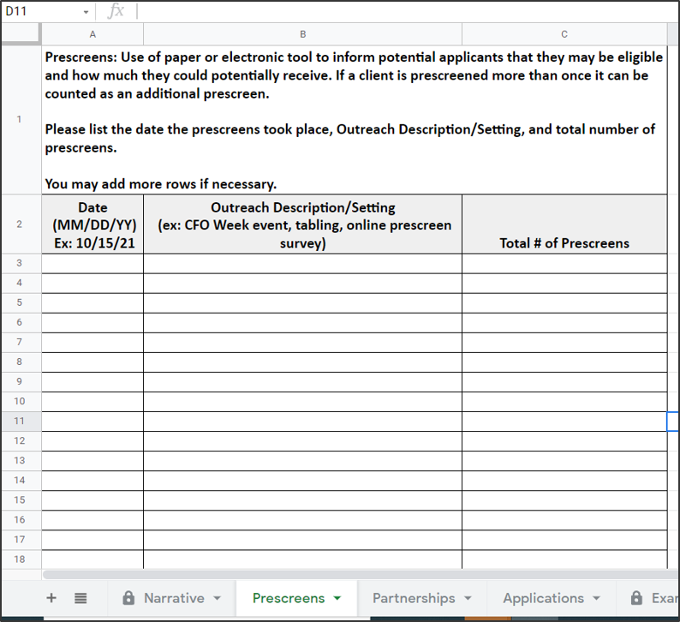
Reporting
Program Reporting:
Scope of Work Activity Logs
Due at specific quarters (date)
Prescreens, Applications, Partnerships, Source, etc.

Slide 6
Why is reporting important?
Reporting ensures that the contractor is working correctly.
Allows funders see if the programs are being used. Thus funding for the programs continues.
Natalie Jensen,
Reporting & Contract Requirements Lead
CHC CSU, Chico

Slide 7
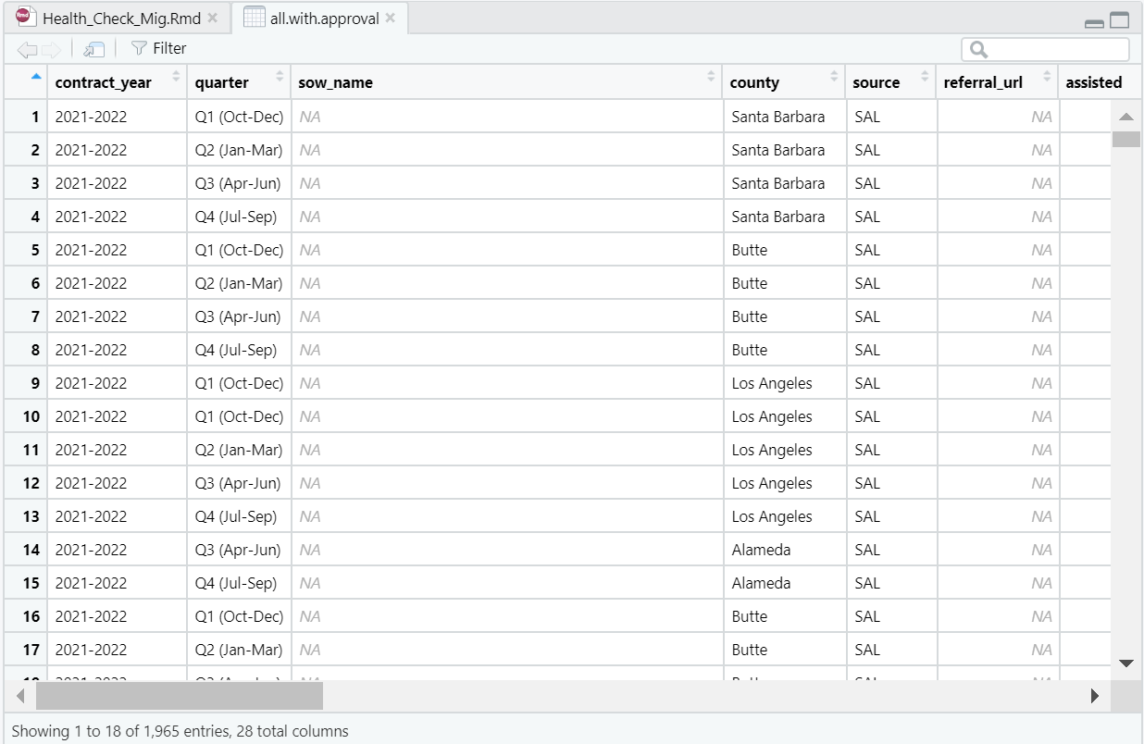

Slide 8
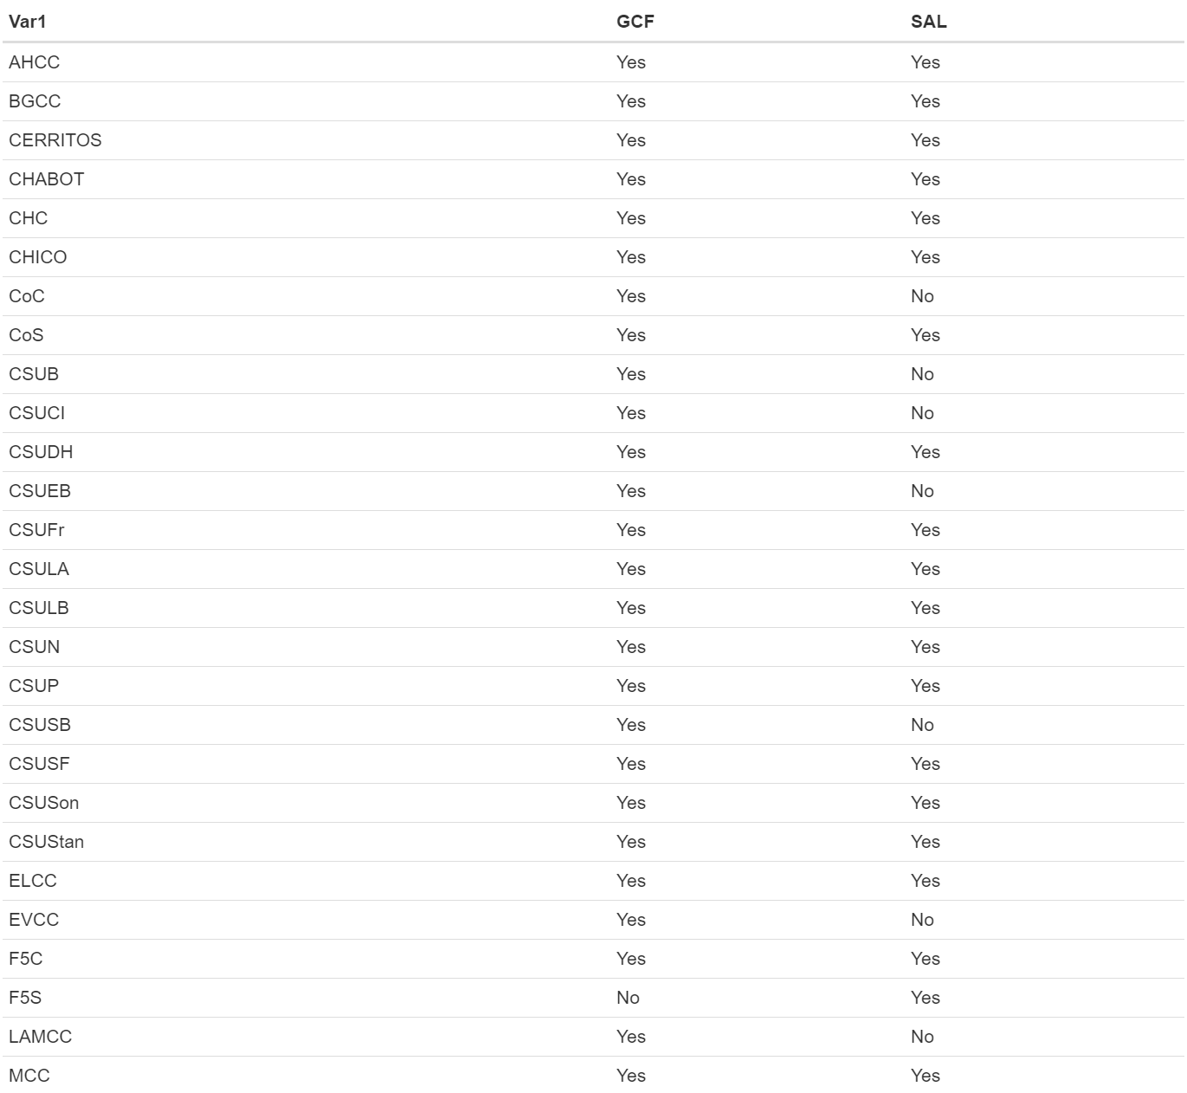
Subcontractor Entries for GCF & SAL
Does each subcontractor have a GCF & SAL entry?

Slide 9
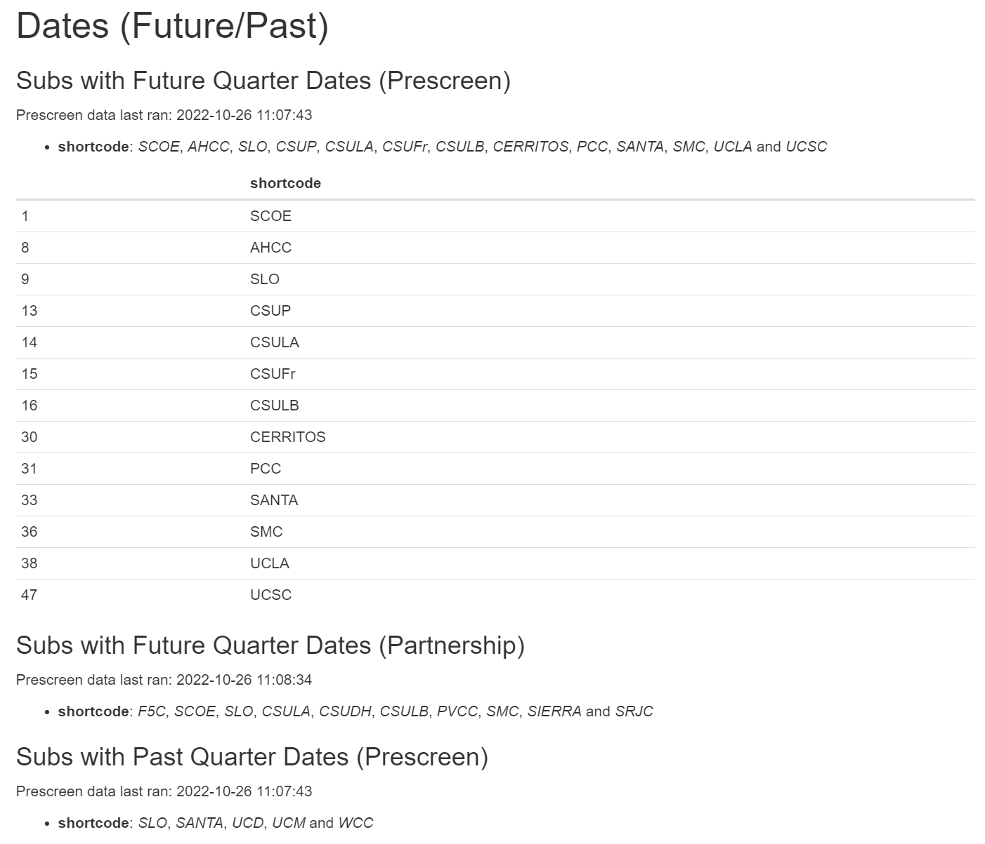
Dates (Future/Past)
Does each subcontractor have the right dates for the current quarter?

Slide 10
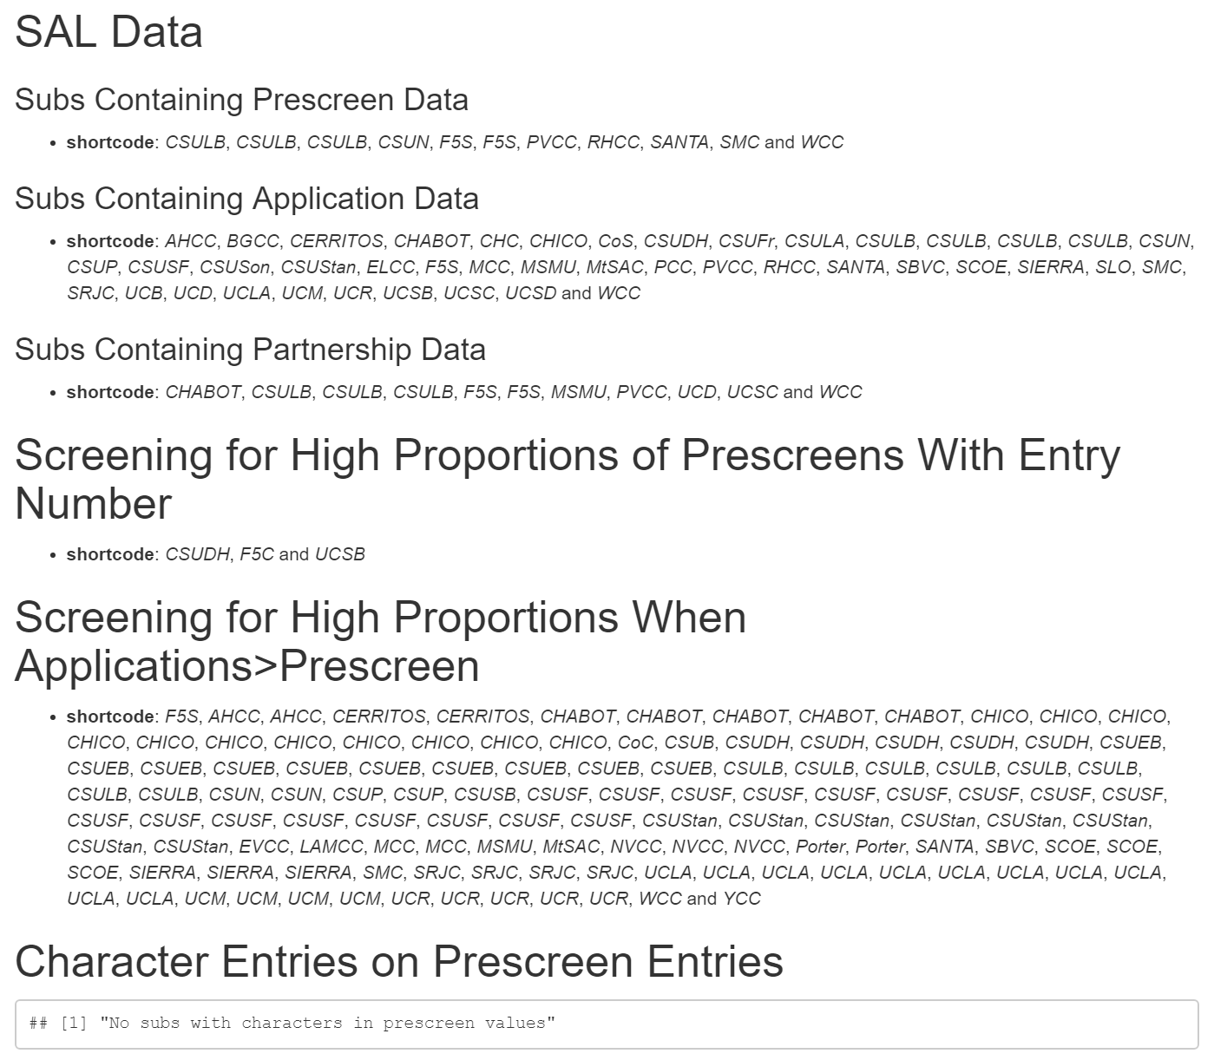
SAL Data
High Proportions Entries
Character Entries

Slide 11
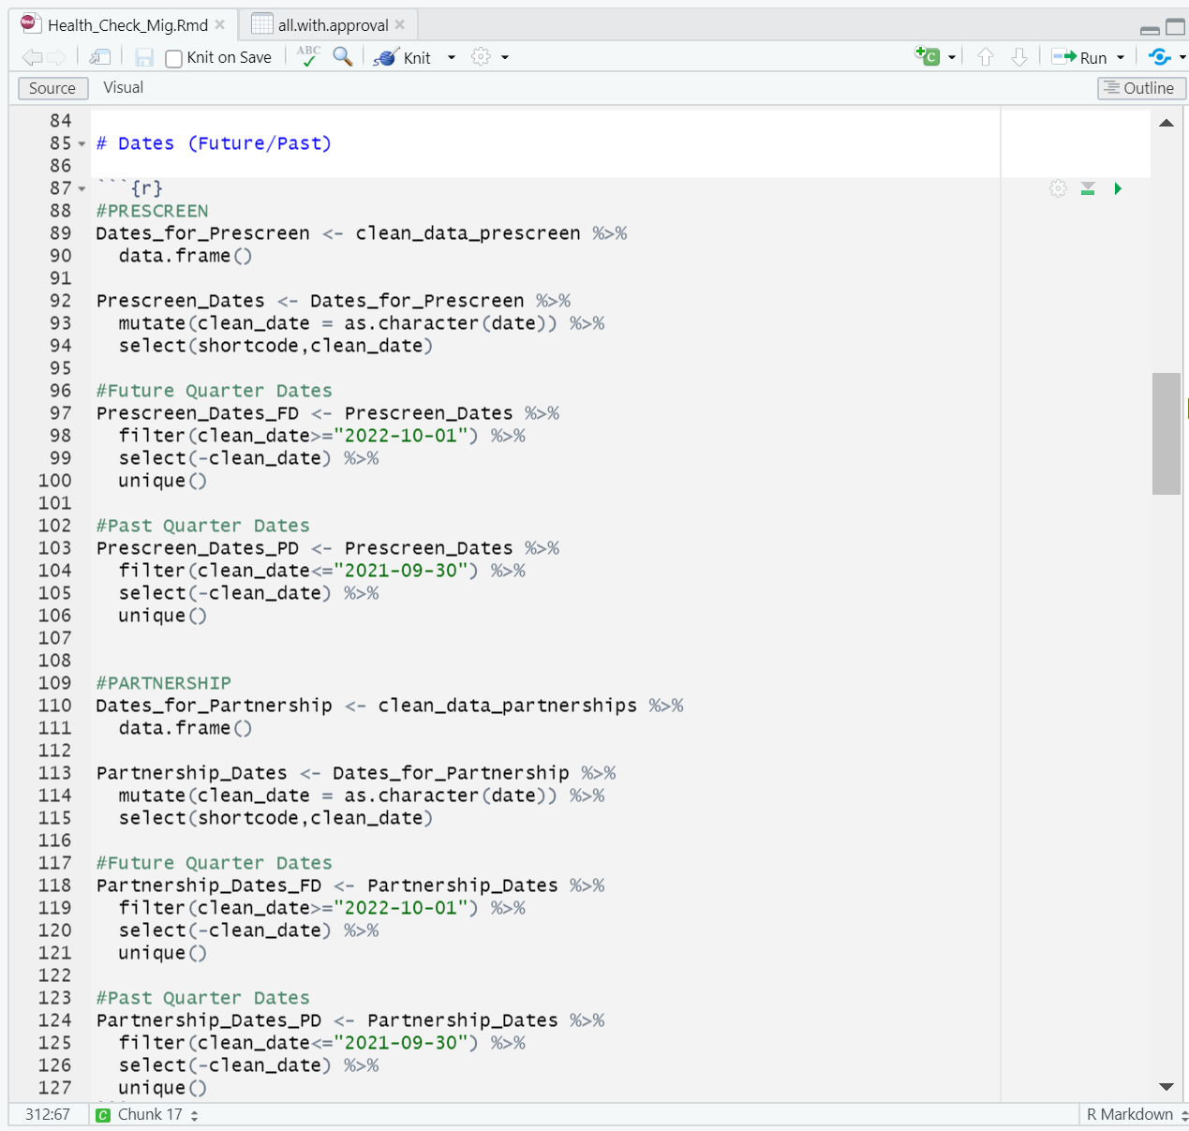
Learning Goals
Developed coding skills
Practice Communication
Understand Problem/Find Solution

