Slide 1

NSC Lost Enrollment
Jasmine Cisneros, Kyle Machura
Notes:
Good afternoon everyone,
My name’s Kyle, I’m a Junior here at Chico State. The majors I’m currently pursuing are Business Analytics and Management Information Systems
(Jasmine Introduces herself)
Our project involved working with a data set provided by the National Student ClearingHouse.

Slide 2

IRSA Data Project
Research Questions:
“What’s contained within the NSC’s dataset?”
“When students withdraw from Chico State, are they transferring to another school or dropping out entirely?”
“If they are transferring, where are they going?”
“Do students who temporarily drop from Chico State return to finish their degree?”
Notes:
We used the NSC’s data set to answer some initial research questions posed by IRSA staff:
“What’s contained within the NSC’s dataset?”
"When students leave Chico State without a degree, are they transferring to another school or dropping out entirely?“
“Assuming they are transferring, where are they going?“
“Do students who temporarily drop from Chico State return to finish their degree?”

Slide 3
National Student ClearingHouse
Founded: July 2, 1993 Herndon, Virginia
Current President and CEO: Ricardo Torres
NSC’s Mission Statement:
“To serve the education and workforce communities and all learners with access to trusted data and related services and insights. By leading student data reporting and exchange, we affirm our commitment to empowering lifelong learners every day."
Notes:
The NSC is a Non profit organization Founded on July 2, 1993 in Herndon, Virginia by the higher education community
Current President and CEO: Ricardo Torres
NSC’s Mission statement:
“To serve the education and workforce communities and all learners with access to trusted data and related services and insights. By leading student data reporting and exchange, we affirm our commitment to empowering lifelong learners every day."
The NSC captures data from 97% of enrollments at Title IV degree-granting institutions.
Which accounts for over 99% participation from public institutions compared to private institutions. Out of the proportion of participation from private colleges:
96% comes from nonprofit
87% comes from for-profit
Overall, 84% of all Title IV institutions contribute data to the NSC.
The 16% of non-participating institutions account for only 3% of the student population.
The NSC holds stewardship of this data and uses it solely in accordance with FERPA-compliant agreements with each institution.
I’m going to hand it off to Jasmine to talk about the results.

Slide 4
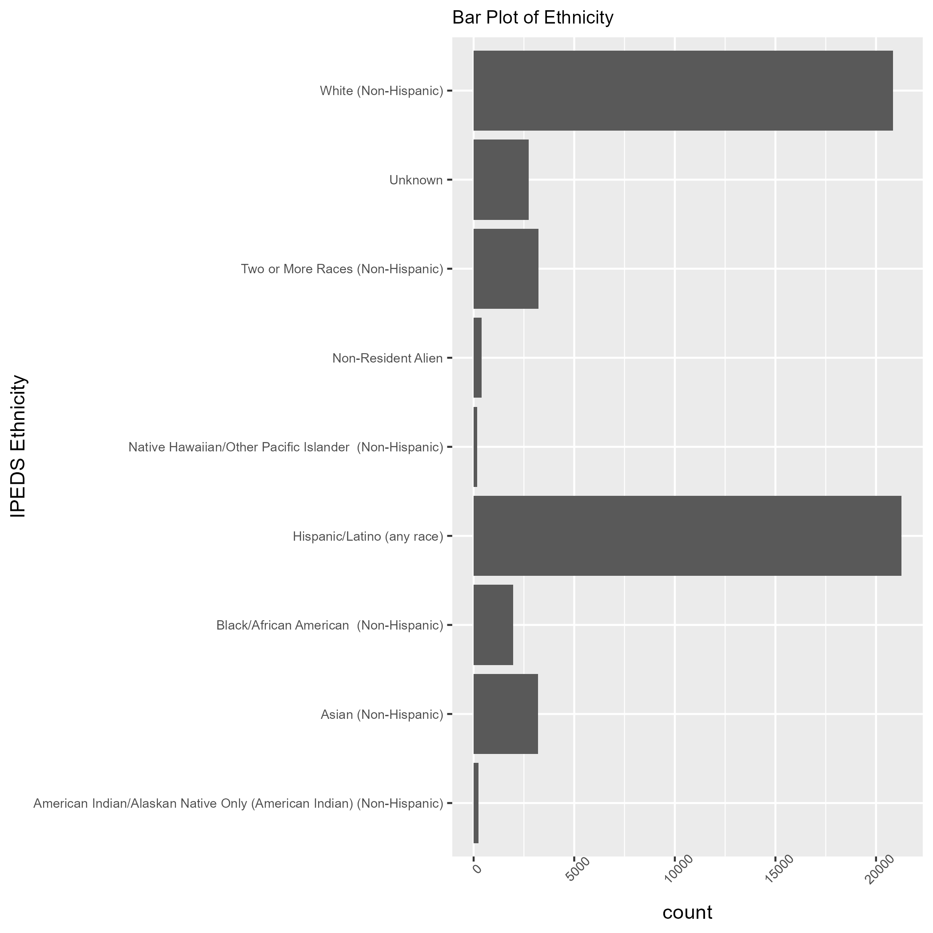
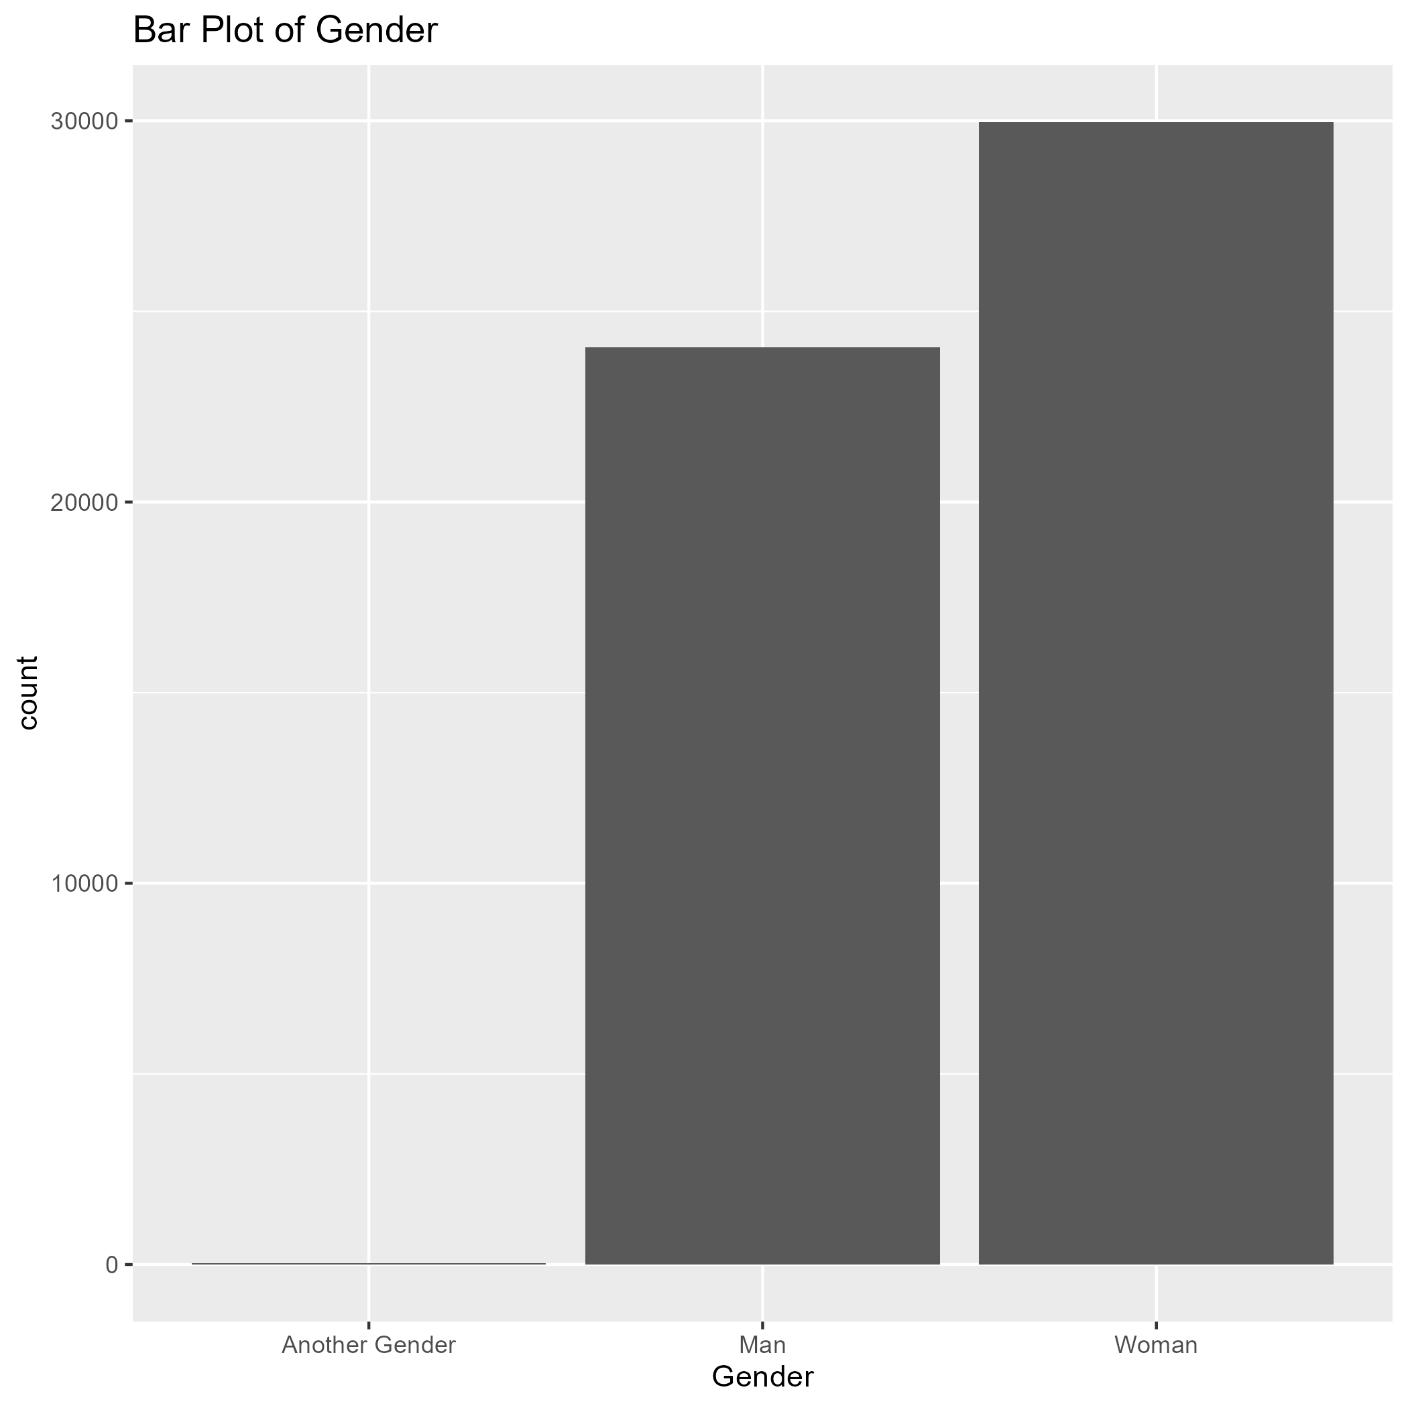
What is in the NSC Data Set ?
Notes:
Data set is from Fall 2016 – Spring 2024
Contains information about the students such as class level, enrollment status, major, if they graduated
When exploring the data, I first looked at the demographics
Gender and ethnicity

Slide 5
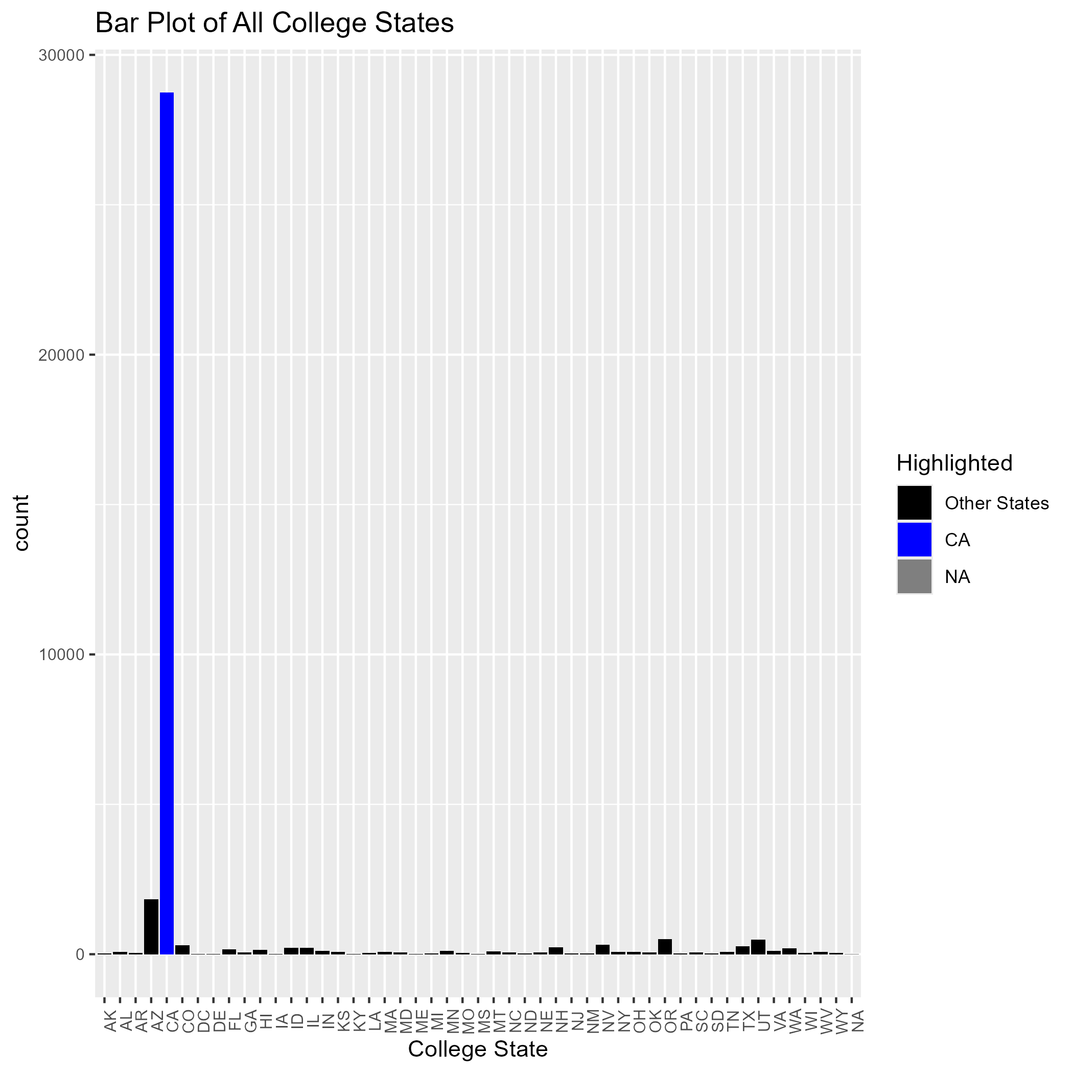
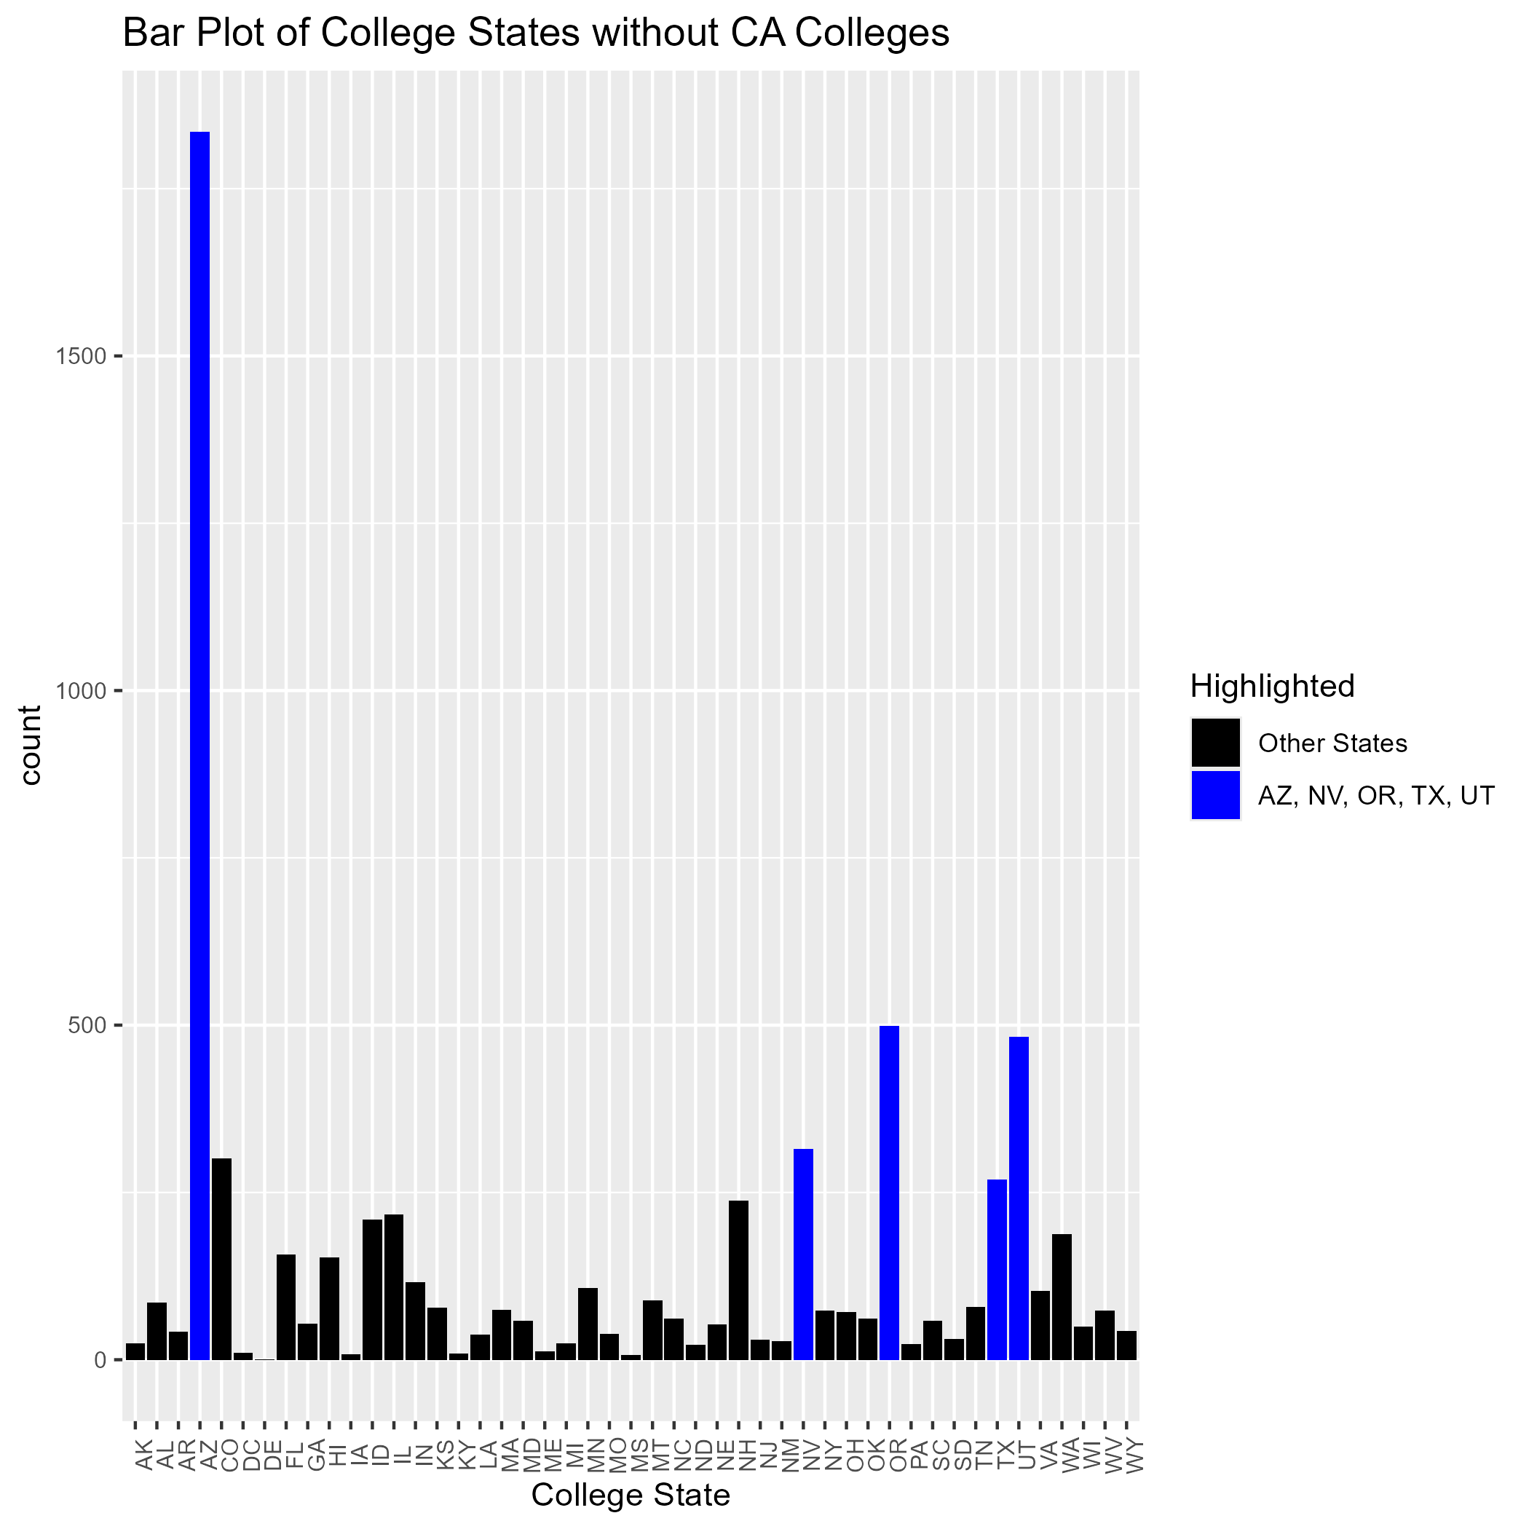
College States
Notes:
Then, I looked at the college states b/c one of the questions we wanted to answer was where they are going
Here we see CA has a lot of students, taking out CA we see…

Slide 6
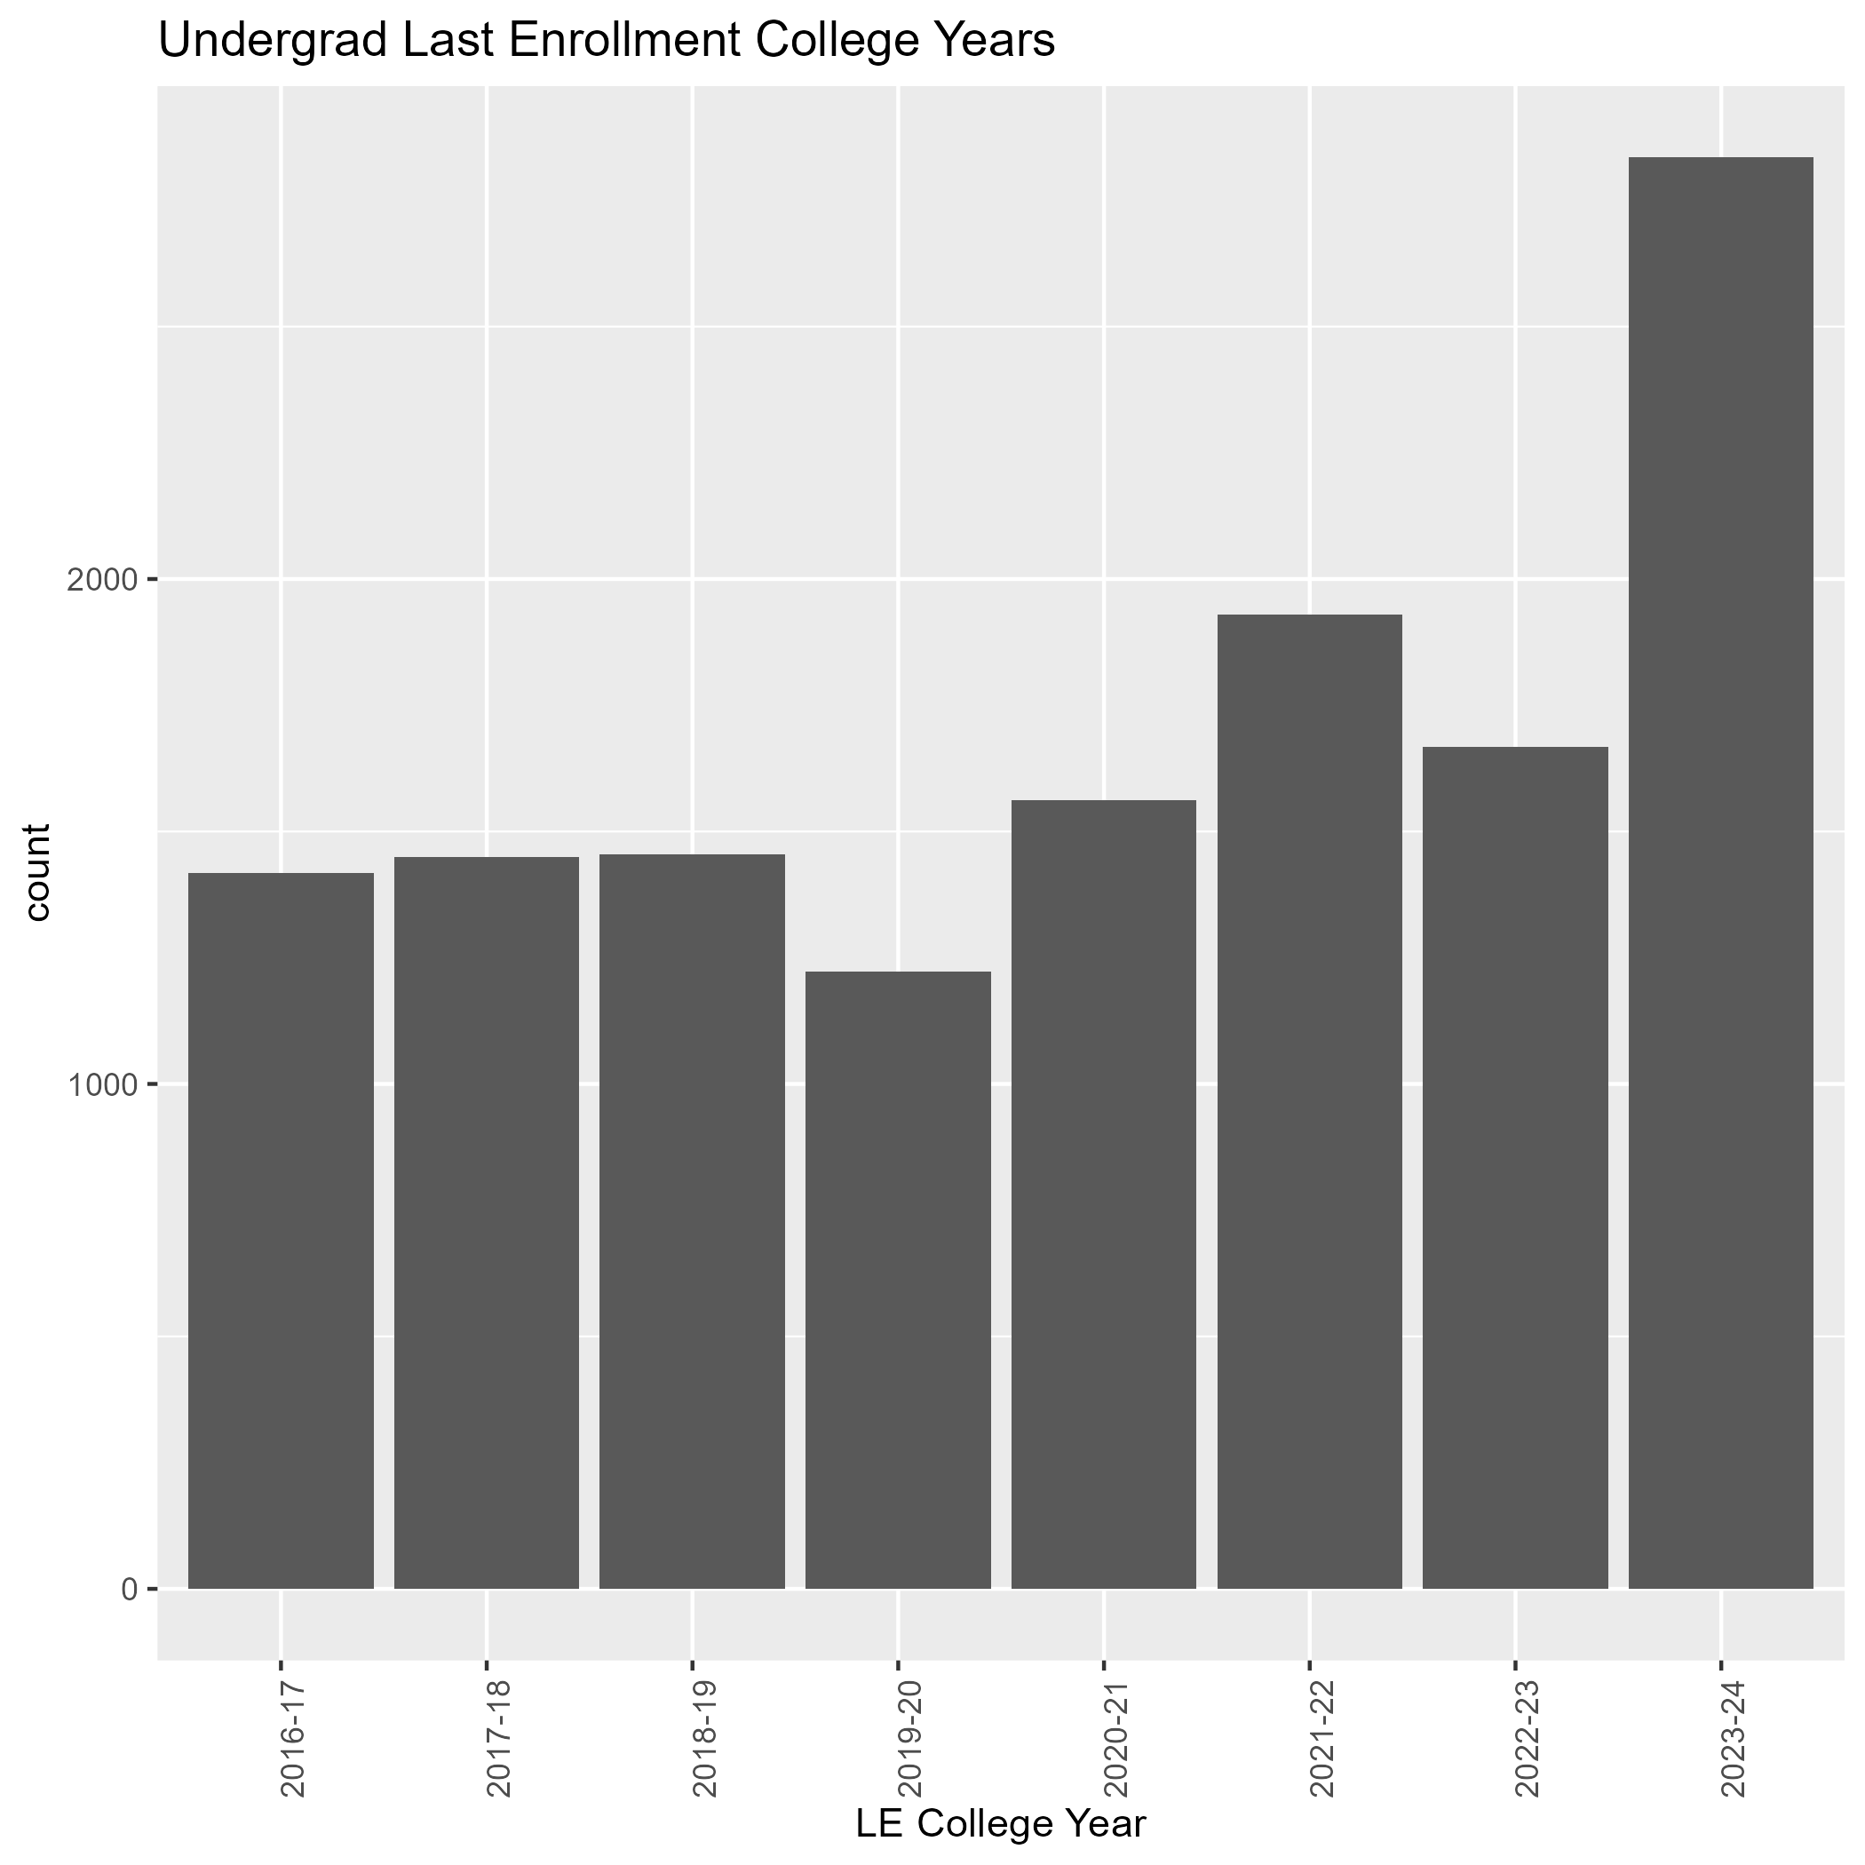
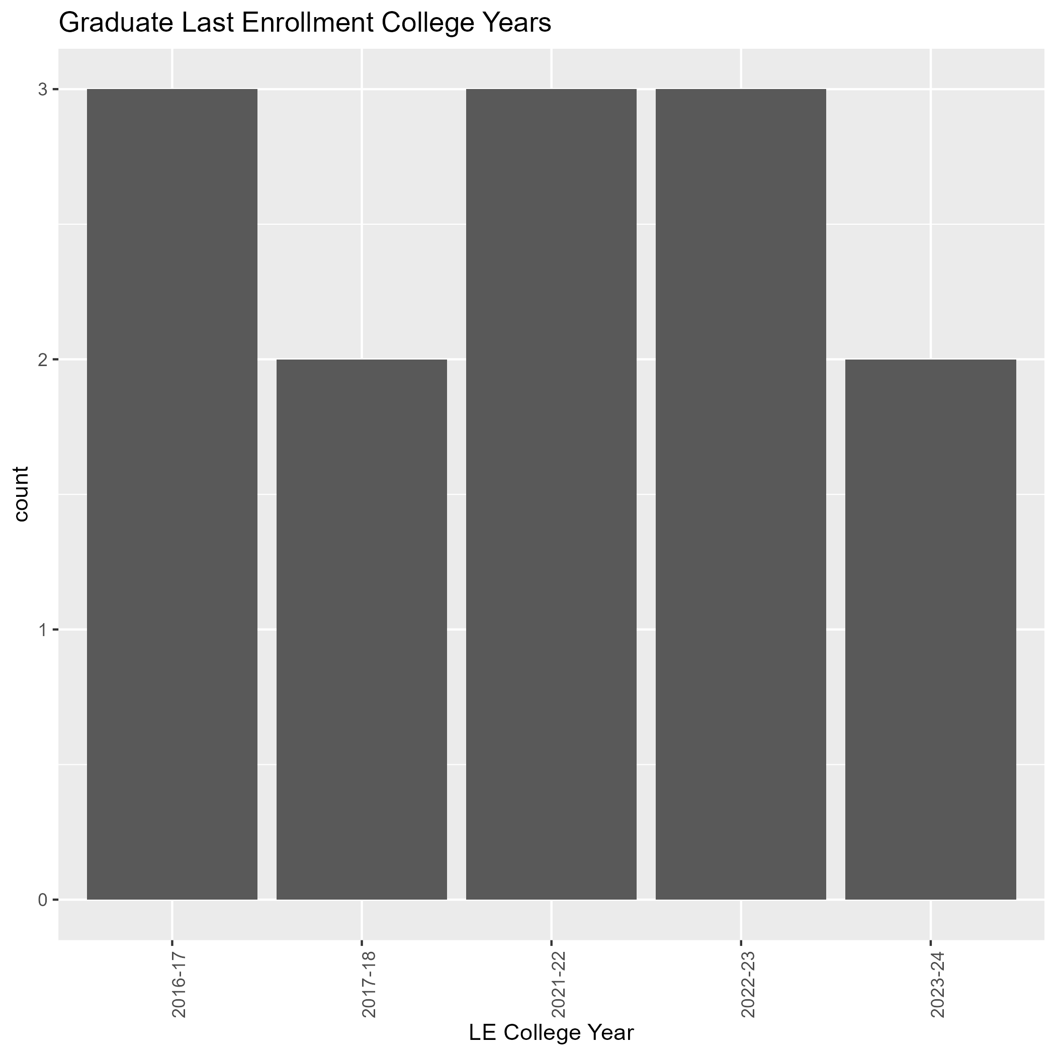
Undergrad Students and Grad Students
Notes:
After looking at college states, I looked into the students’ last enrollment at Chico State
Looking at grads and undergrads there was a lot more undergrads transferring than grads.
So, focused on undergrads

Slide 7
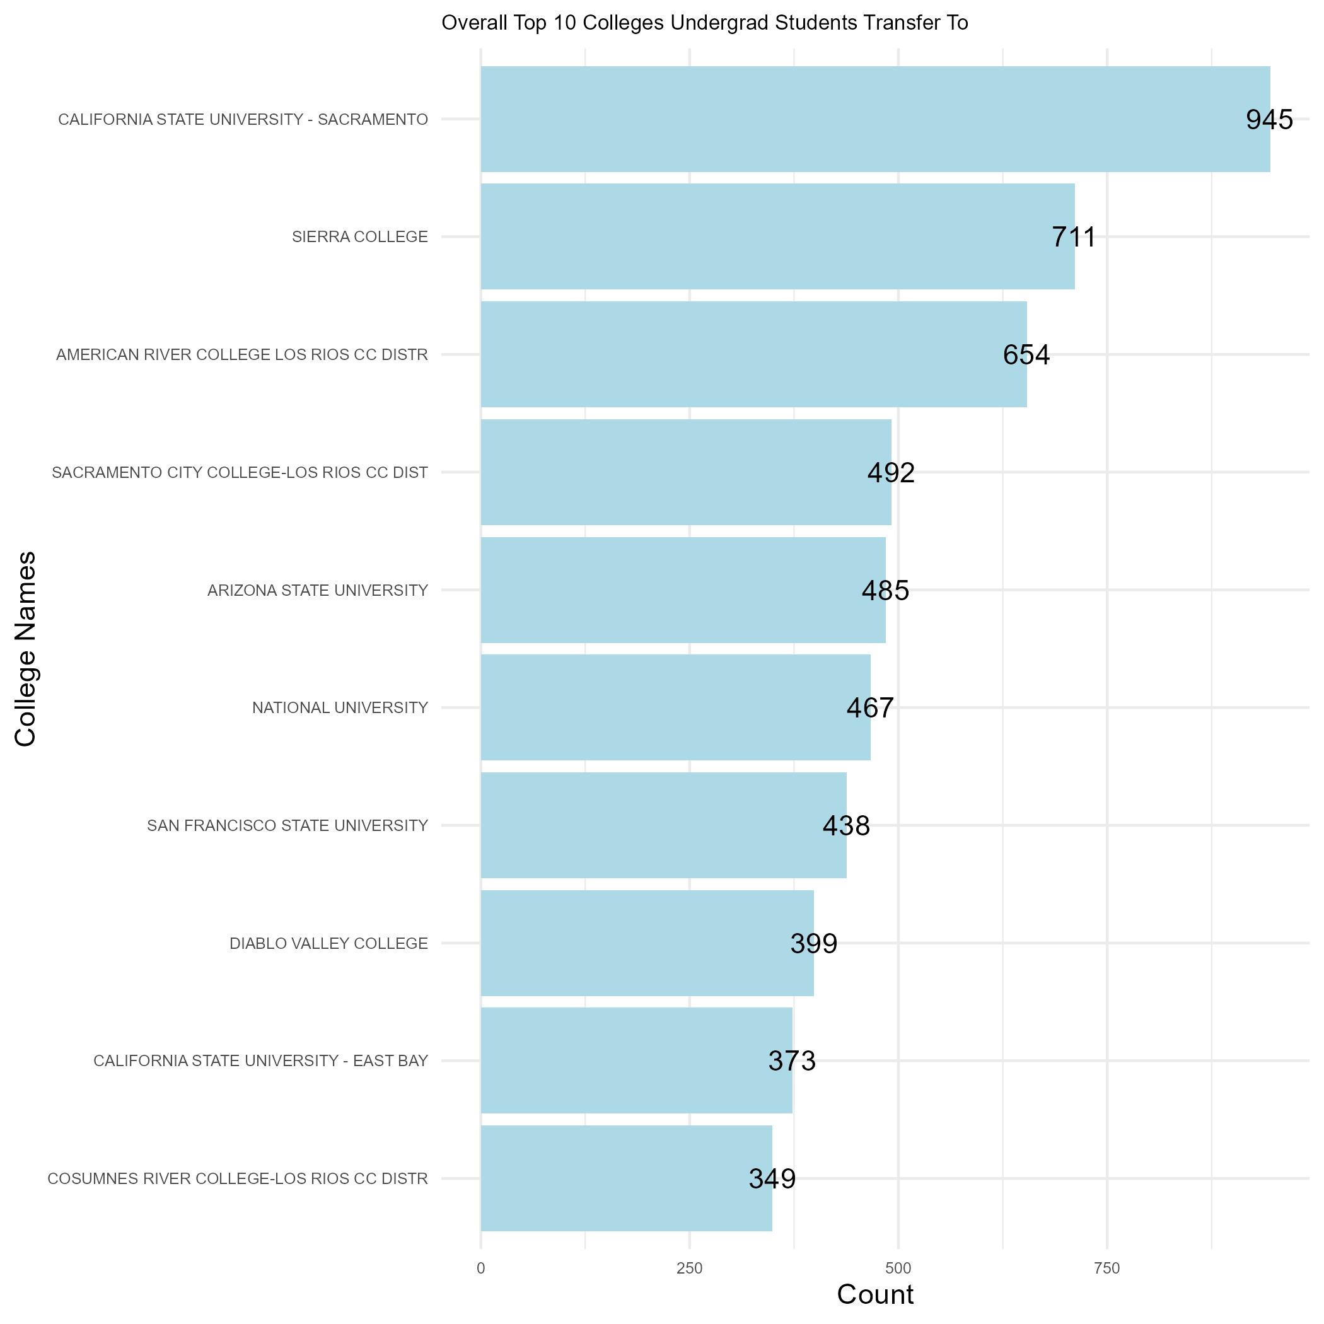
Where do Students Transfer ?
Notes:
Finally get to where students transfer, we have the top colleges students are going to from Fall 2016 – Spring 2024
Looked at UC and CSU colleges because of curiosity
San Luis Named

Slide 8
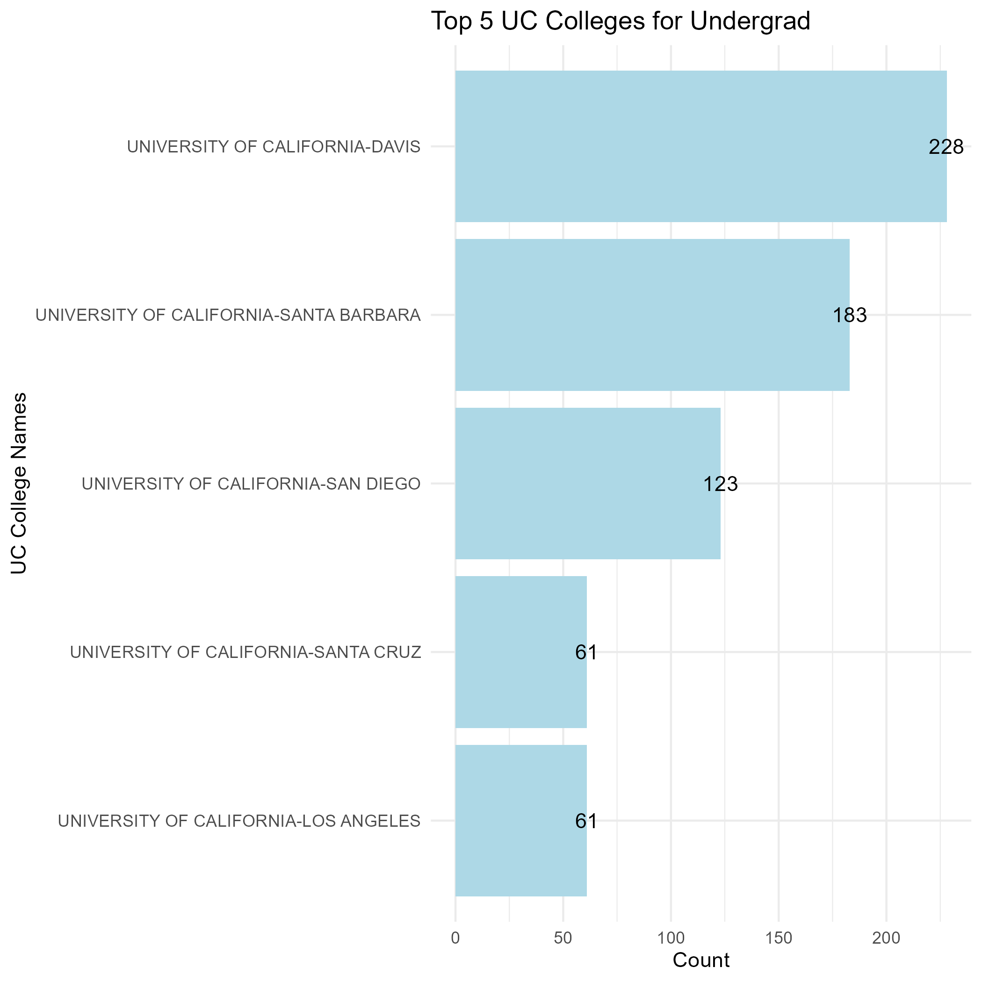
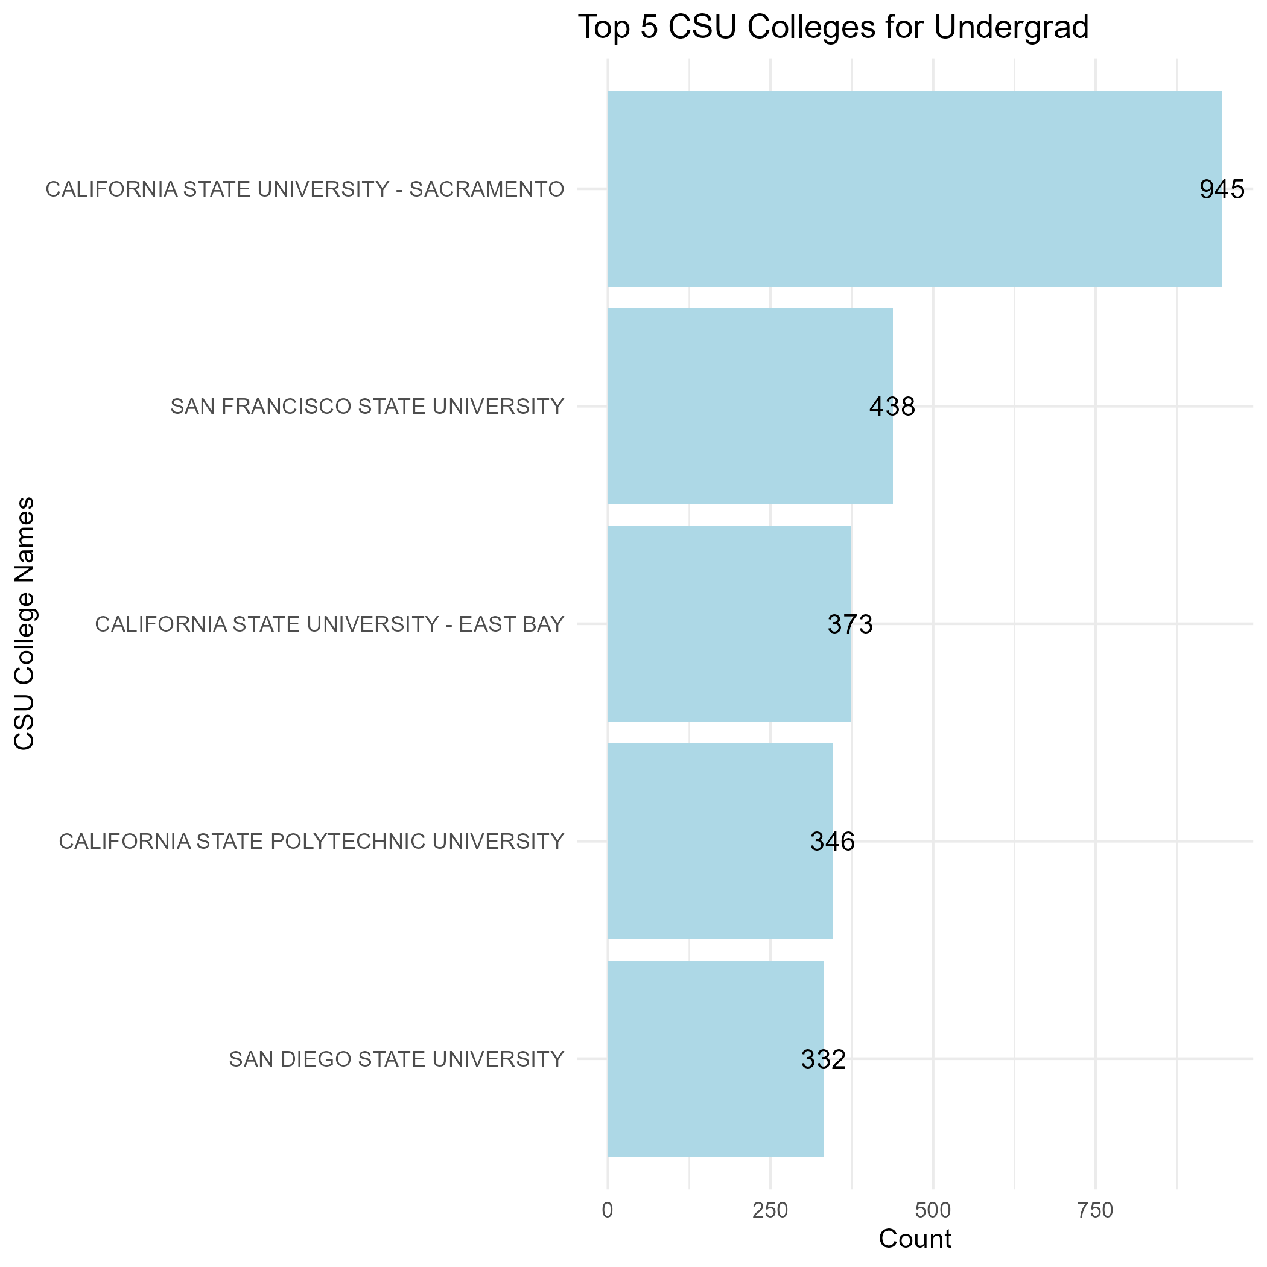
UC and CSU Transfers
Notes:
Finally get to where students transfer, we have the top colleges students are going to from Fall 2016 – Spring 2024
Looked at UC and CSU colleges because of curiosity
San Luis Named

Slide 9
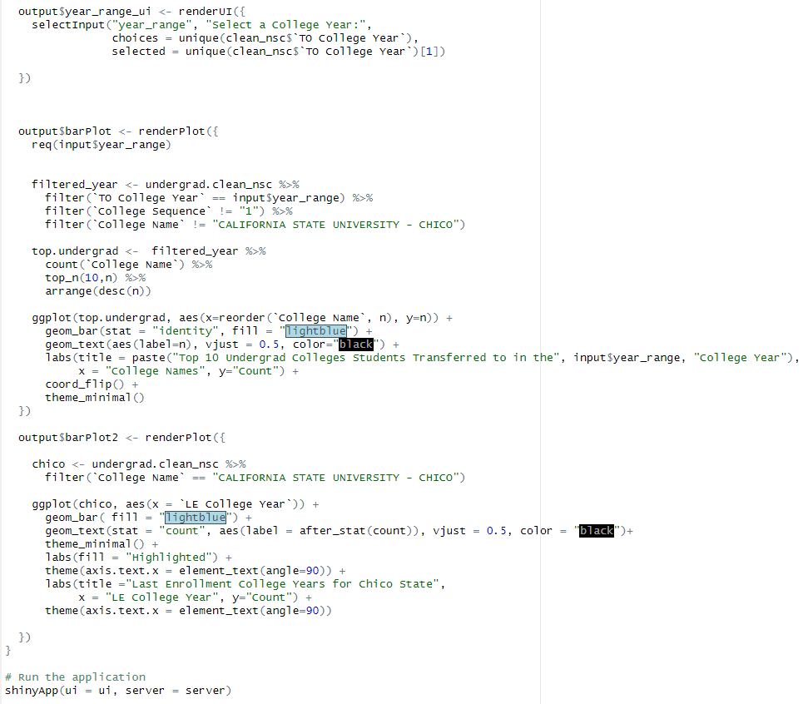
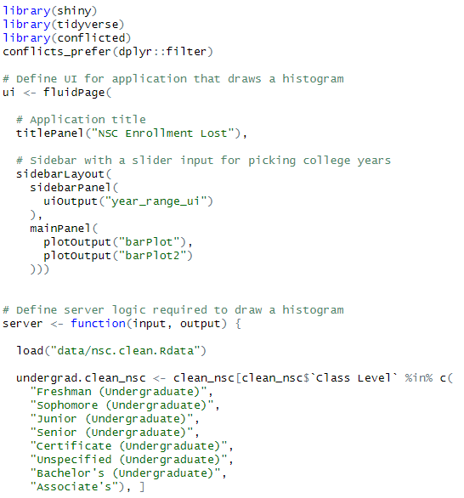
Shiny App Code
Notes:
Shiny app lets you pick a college year and see what the top colleges were for that year
We have the code here

Slide 10
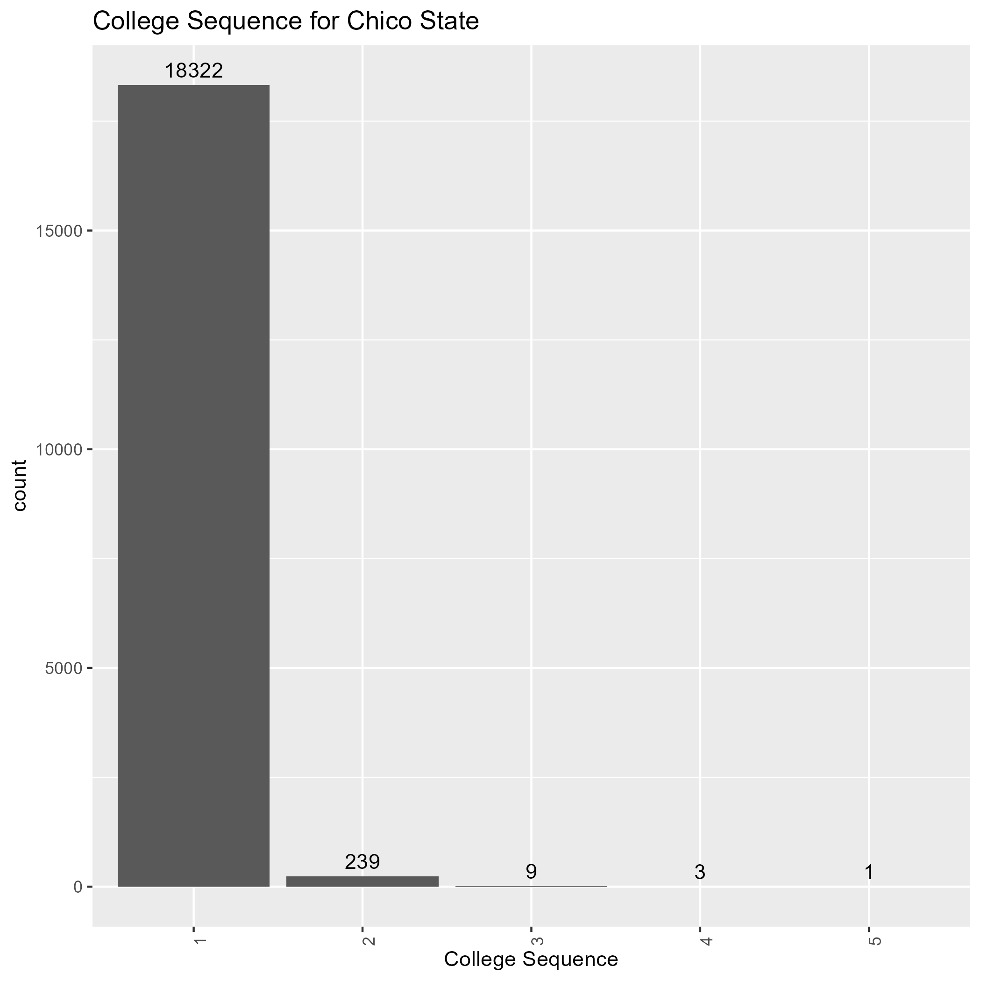
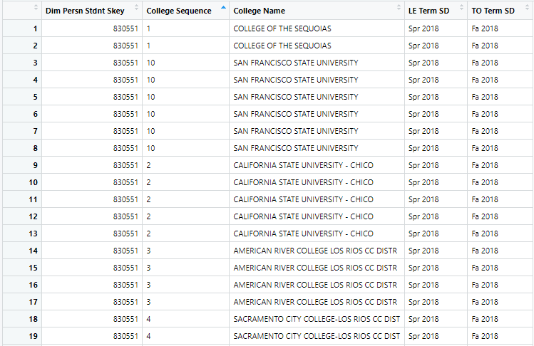
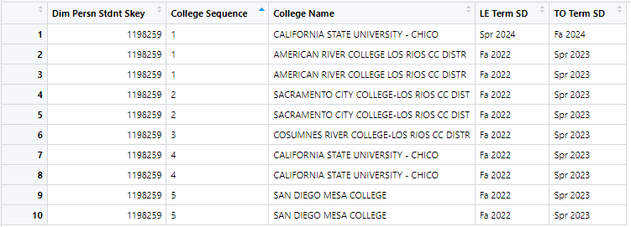
Variable Complications
Notes:
When looking at the sequence for the one student who had a sequence of 10, I discovered the sequences are a bit off.
We have another example below someone left and came back to Chico twice, according to the sequence

Slide 11
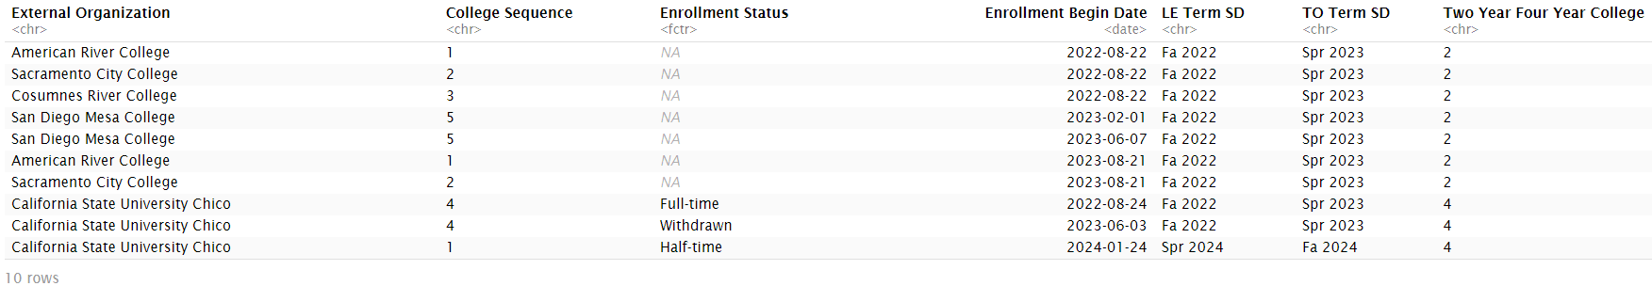
Enrollment Discrepancies
4th question diverges:
If a student is simultaneously enrolled in multiple colleges apart from Chico State, which institution is considered their primary college?
If Chico State is not the primary institution, and the student stops taking courses, would they be classified as withdrawn?
If so, would that student be considered lost enrollment, even though CSU Chico was never their primary college?
Notes:
When trying to research cases of students who had withdrawn from Chico State for a period of time before returning, it was discovered that a student's sequence doesn't align with the actual order of schools they attended.
The database records the student's first instance of enrollment at a particular institution, assigning it a number.
This number remains constant even if a student enrolled in various other institutions between their first enrollment date and the date they return to that institution
We initially assumed that students attending Chico State are primarily enrolled at this university.
However, as the example above demonstrates, there are instances where students are enrolled at multiple colleges within a given term. When looking at the beginning enrollment dates, we see that this individual is enrolled at four different colleges at the same time for the 2022 Fall semester. If we were to only pay attention to the “college sequence” column, then we would assume that this person attended those schools one after the other. Therein lies the discrepancy since relying solely on college sequence would be misleading.
This discovery shifts the focus of our 4th original question from:
"Do students who temporarily withdraw from Chico State return to finish?"
diverging into several new inquiries:
If a student is simultaneously enrolled in multiple colleges apart from Chico State, which institution is considered their primary college?
If Chico State is not the primary institution, and the student stops taking courses, would they be classified as withdrawn?
If so, would that student be considered lost enrollment, even though CSU Chico was never their primary college?
Another significant challenge we encountered was enrollment discrepancies when identifying true gaps in enrollment.
Attempting to map student sequences based on beginning enrollment dates proves problematic, as term structures vary widely across institutions (e.g., semester, quarter, trimester).
Without proper context, a lengthy gap between enrollment dates could easily be mistaken for an actual withdrawal rather than a simple difference in start dates.
Furthermore, students may take a 1-2 year gap without being considered "lost," if they went on planned academic leave or received a PELL grant, although the relevant data is unavailable to us at the moment.

Slide 12
Future Recommendations
Improve data’s usability
PELL grant and Accademic leave columns
Primary or secondary institution column
Answer stakeholder’s questions:
"Out of the proportion of students considered lost, how many of them obtained a degree elsewhere?“
"Out of that population of students, how many earned a degree in the same major?“
Notes:
After consulting with a stakeholder from enrollment management, we identified several key takeaways to improve the data's usability.
Adding columns to determine if students are PELL grant recipients and if they have declared planned academic leave would help refine the number of students truly fitting our definition of "lost."
Including a column that specifies whether Chico State is a student's primary or secondary institution would clarify cases of simultaneous enrollment.
Another valuable takeaway from our stakeholder conversation was the formulation of several follow-up questions:
"Out of the proportion of students considered lost, how many of them obtained a degree elsewhere?“
"Out of that population of students, how many earned a degree in the same major?“
Given the narrow window for retaining students, enrollment management must quickly determine whether a student has chosen to enroll elsewhere or will not be enrolling at all for the upcoming term.
Being able to make this distinction would enable a more focused and individualized marketing strategy aimed at retaining these students.

Slide 13
Thank You
Notes:
That concludes our presentation, we hope you’ve learned as much as we did.

