Slide 1
OVP and RAD Lab Data Development
Presented By: Linda Figueroa & Cristobal Sanchez

Slide 2
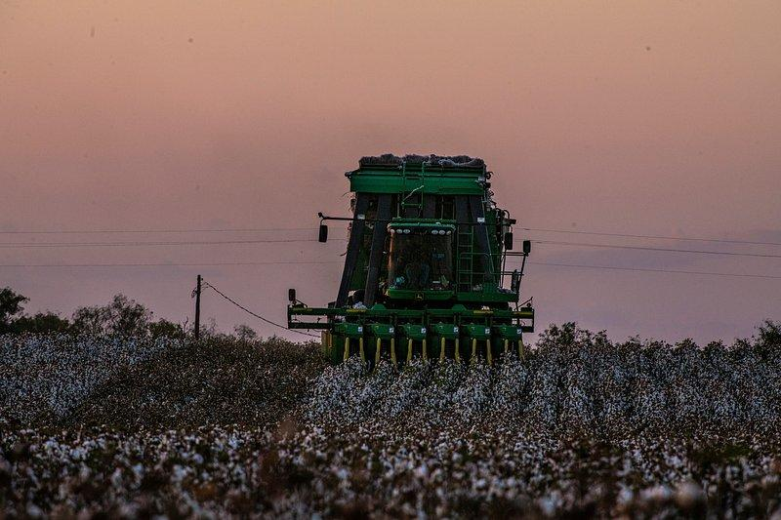
Background
The Center for Regenerative Agriculture and Resilient Systems (CRARS) at CSU Chico.
Regenerative Agriculture Demonstration Lab (RAD-Lab)
hands-on experience in soil sampling
analysis
data assessment
Organic Vegetable Project (OVP)
education
community food access
research on farming practices and new vegetables.
Notes:
Focuses on regenerative farming techniques.
Supports research, education, and farmer collaboration.
Aims to enhance soil fertility, water management, and carbon capture.

Slide 3
Outline
1
2
3
4
5
6
Introduction
Mural Diagram
Data Management
OVP Data
RAD Lab Data
Conclusion

Slide 4
Introduction
Objectives
Data management processes
The importance of standardized sheets
OVP data transfer
RAD Lab data transfer/protocol
Soil data visualization
Notes:
Transition: Introduce the first topic, giving a sense of how the presentation will flow.

Slide 5
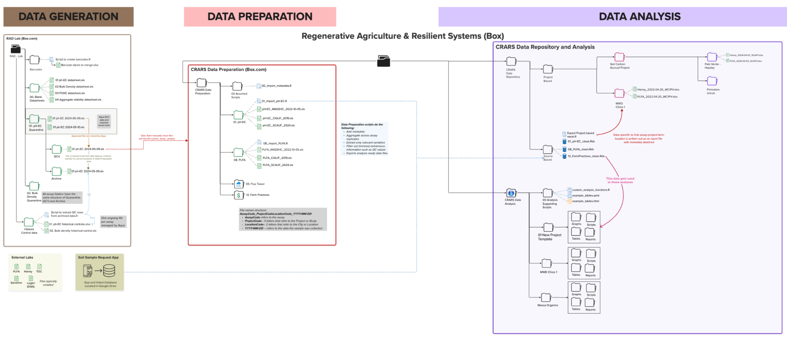
Mural Diagram

Slide 6
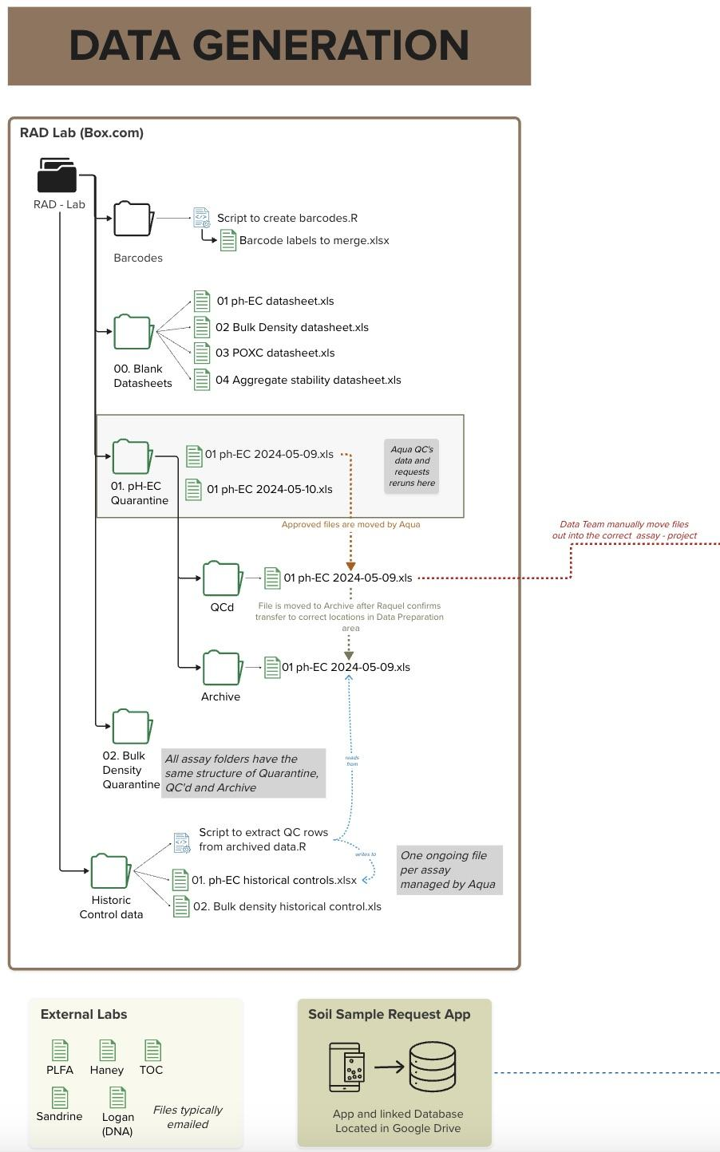

Slide 7
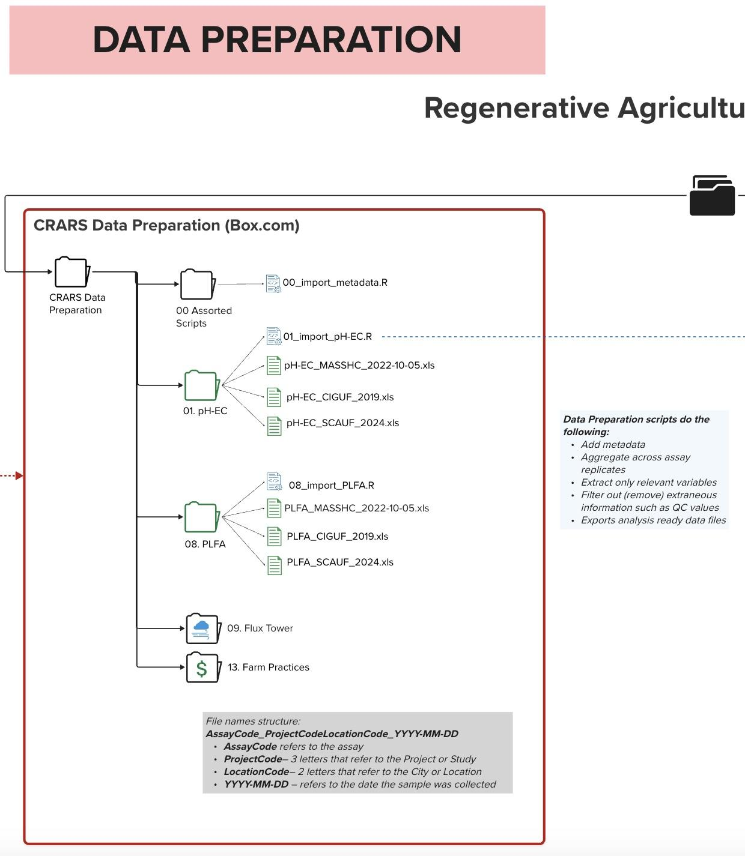

Slide 8
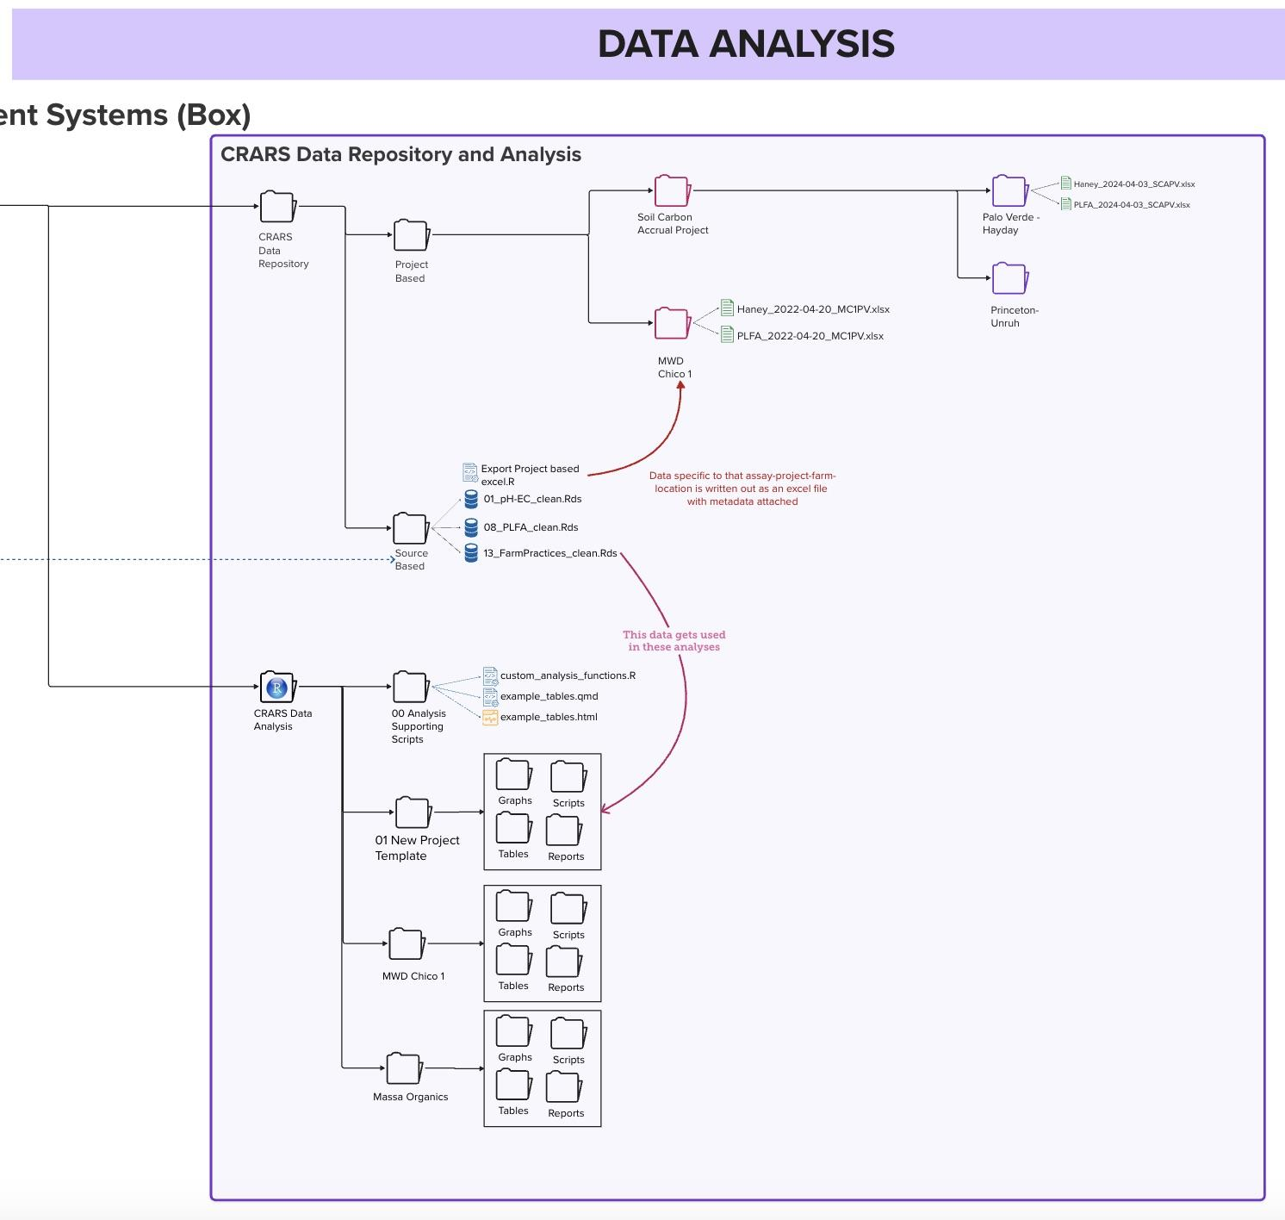

Slide 9
Importance of Data Management
Standardized Datasheets
Ensures consistency and accuracy.
Reduces errors and confusion.
Protocol (No R Scripts)
Easier for everyone, no coding needed.
Helps students connect with data and learn the process.
Overall Management
Organizes data to spot trends and issues.
Focuses on key, relevant info for research.

Slide 10
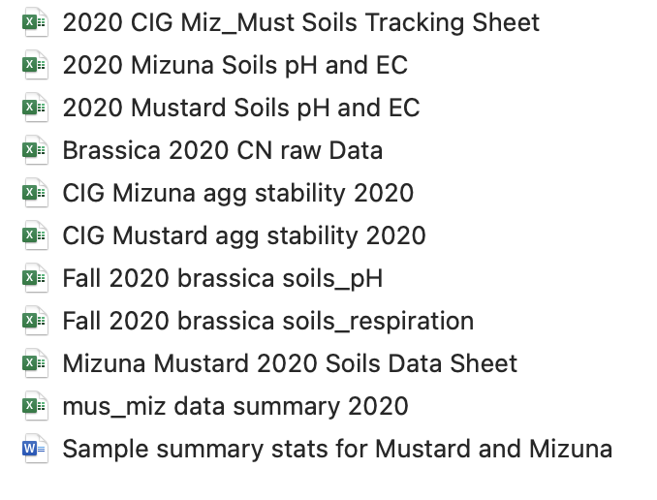
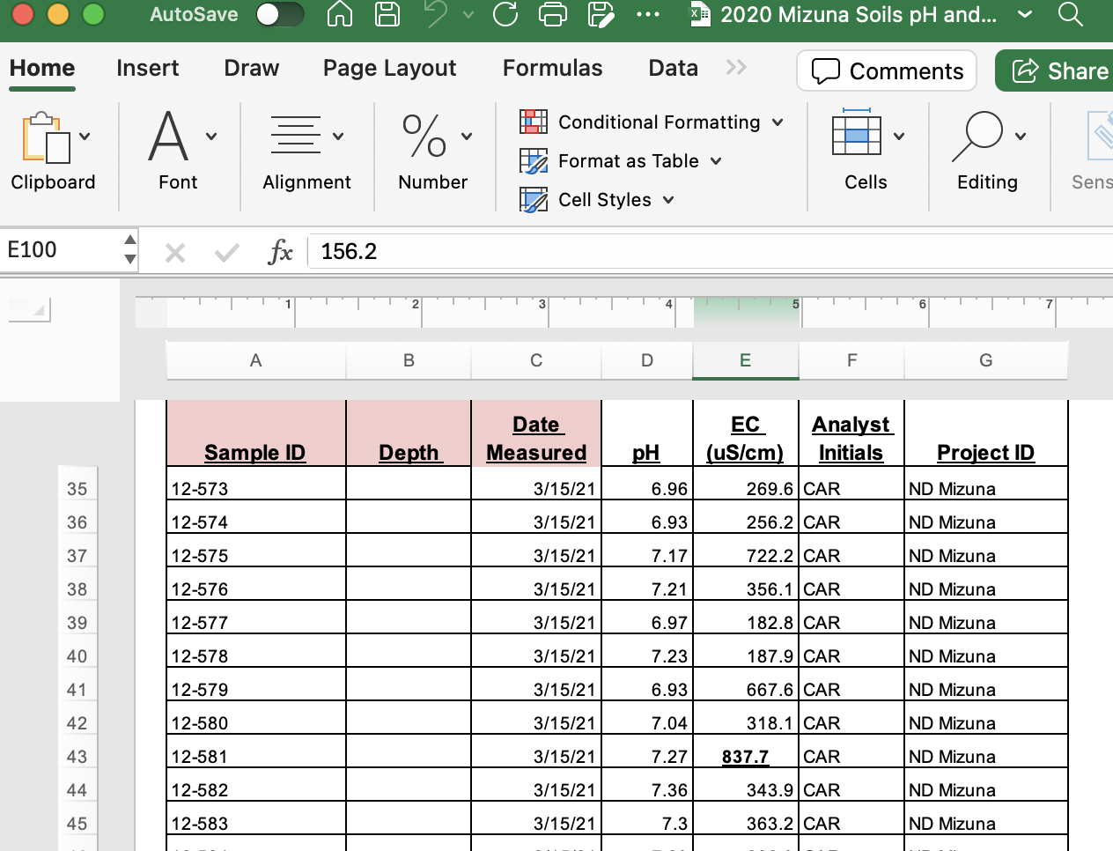
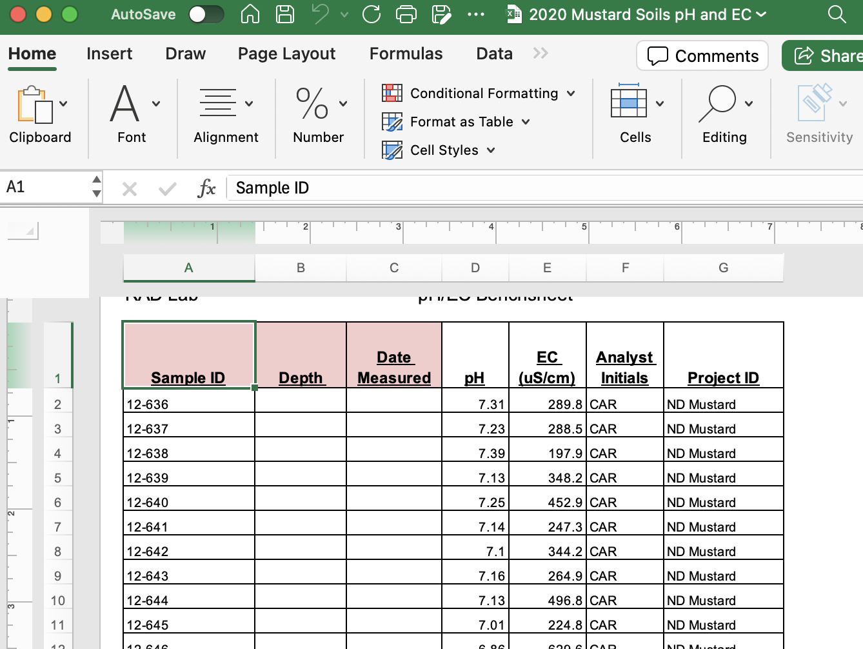
OVP Data Cleaning and Preparation
Old Versions of the Data Sheets

Slide 11
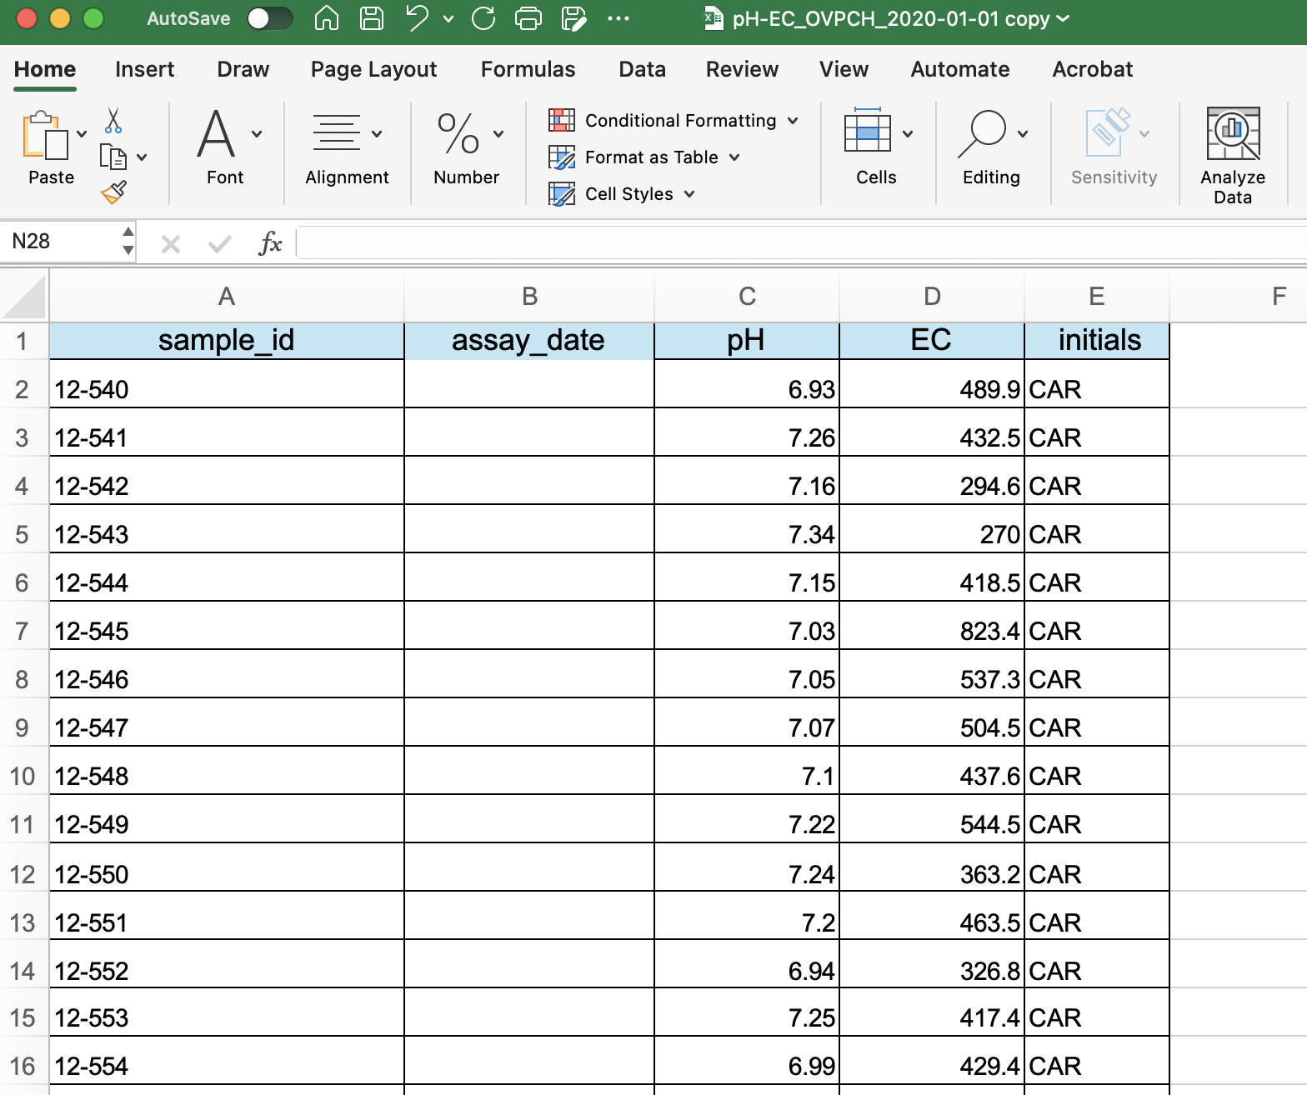
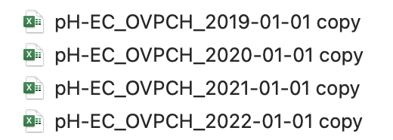
OVP Data Cleaning and Preparation Cont.
New Versions of the Data Sheets
Notes:
Explain why it is important to have the new datasheets(standardized sheets)

Slide 12
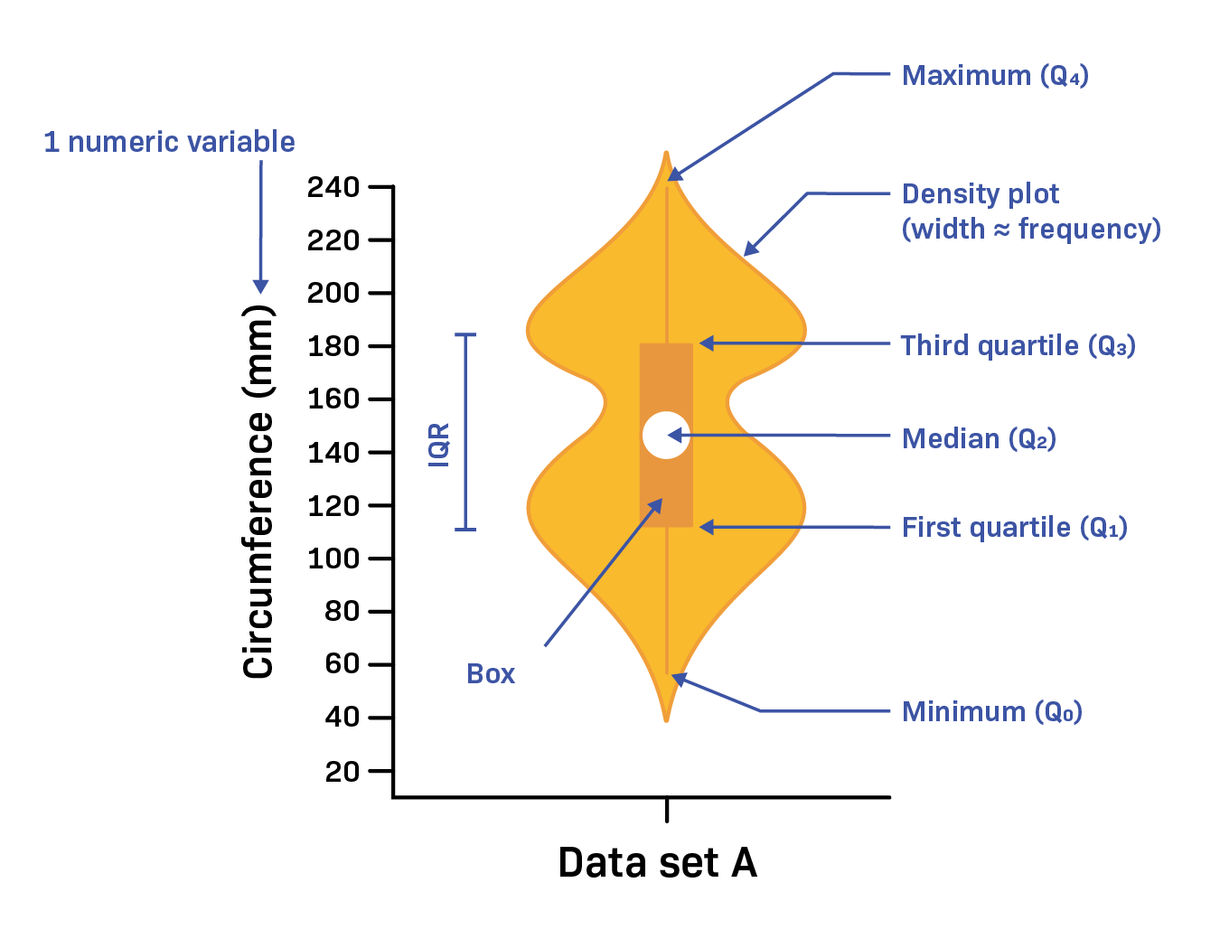
OVP – Soil Data Visualization
Simplifies Complex Data
Identifies Patterns
Improves Communication
Facilitates Comparison
Engages the Audience
Notes:
Interquartile range (IQR) is a measure of statistical dispersion, or how spread out the data is.
Boxplot:
The box represents the interquartile range (IQR), which contains the middle 50% of the data.The line inside is the median.
Whiskers extend to the range within 1.5 times the interquartile range (IQR), and points outside are outliers.
Violin Plot:
The violin shows the data distribution, with wider sections indicating more data points and narrower sections fewer. It provides a smoothed view of the data's density.
Simplifies Complex Data: Makes complicated information easier to understand at a glance.
Identifies Patterns: Helps spot trends, outliers, and relationships quickly.
Improves Communication: Makes it easier to explain data to others, even without technical knowledge.
Facilitates Comparison: Allows quick comparisons between different data sets or time periods.
Engages the Audience: Visuals are more engaging and hold attention better than raw numbers.

Slide 13
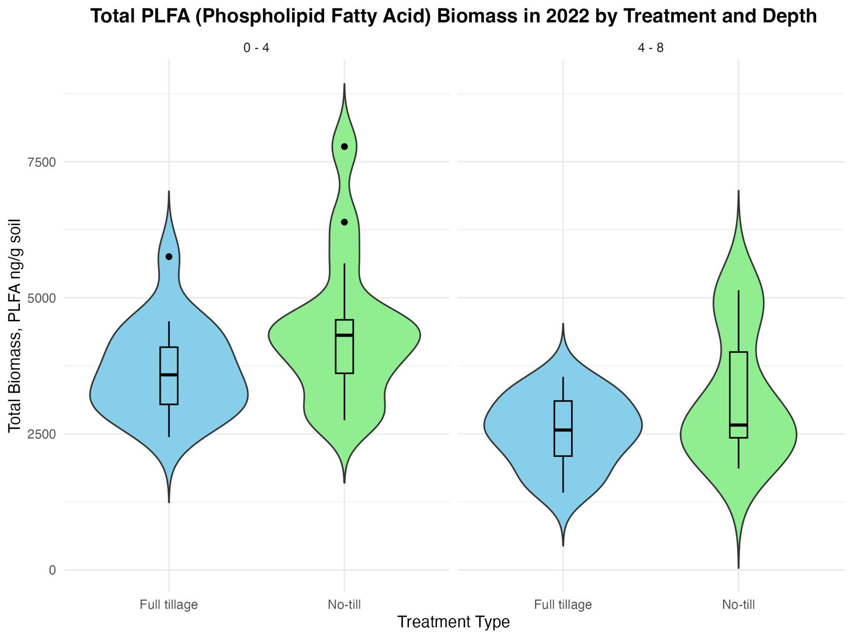
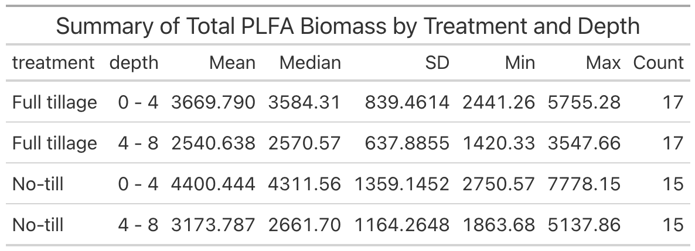
No significant effect (p = 0.84956).
Notes:
there is no evidence to suggest that the effect of treatment on microbial biomass differs across depths.
PLFA biomass is important for regenerative farming practices as it serves as a key indicator of soil microbial health, diversity, and activity, reflecting nutrient cycling, organic matter decomposition, carbon sequestration, and soil resilience, all of which are vital for long-term soil fertility and sustainability.

Slide 14
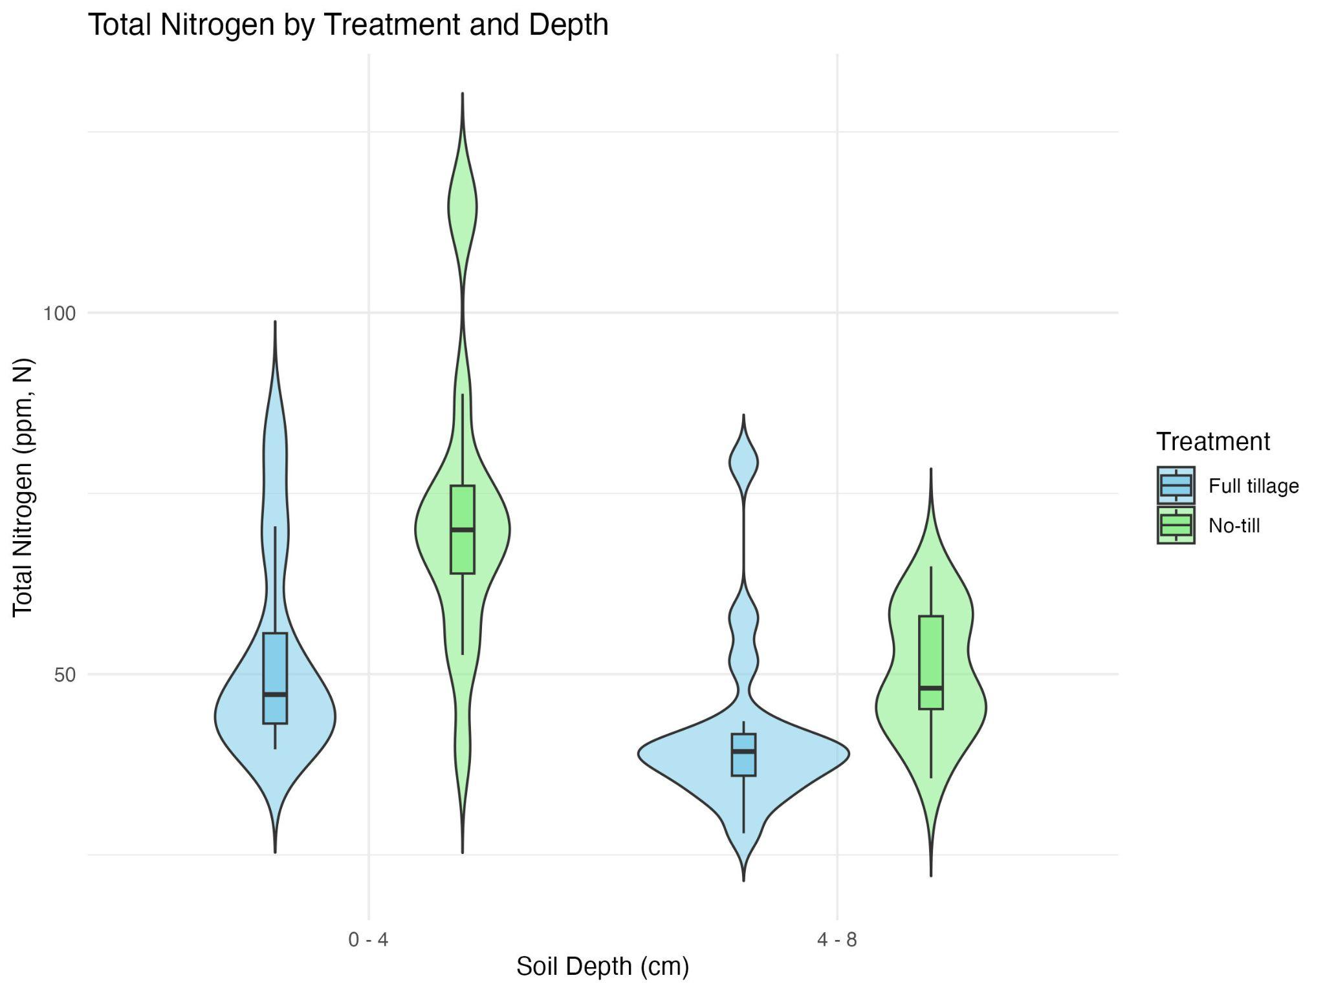
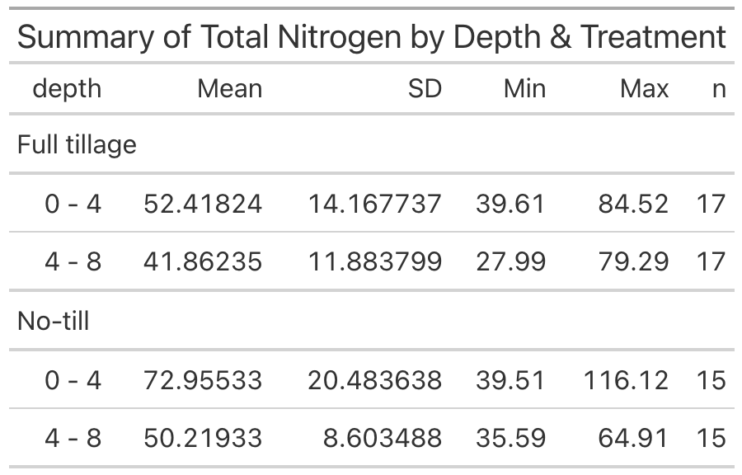
Depth (p < 0.001)
Treatment (p < 0.001)
Notes:
The ANOVA results show that both depth (p < 0.001) and treatment (p < 0.001) have highly significant effects on total nitrogen levels.
total nitrogen → reservoir for both organic and inorganic nitrogen (supporting long-term soil health, microbial activity, and nutrient cycling.)
Nitrogen supports healthy plant development, enhances photosynthesis, and contributes to strong root systems.

Slide 15
Haney Test (Year : 2022 ; Crop: Lettuce )
The Haney Test is a soil health test that helps us understand how well soil is functioning. It measures: biological activity, nutrient availability, and the quality of organic matter in the soil.
The data for the Haney test was provided by an external lab, and samples were collected from the University Farm at CSU, Chico. The assays in this dataset weren’t conducted in the RAD lab.
Notes:
The Haney test looks at a lot of different factors, including various nutrients and soil characteristics.
The data we have is specifically for the OVP lettuce crop in 2022, so it’s limited to just that one crop and year.

Slide 16
Haney Test Composite Score Variables
(Year : 2022 ; Crop: Lettuce )
Variables looked at:
Soil Health
Nutrient Value
What are these?
Composite score as determined by the Haney test conducted by external lab.
Used to grab a quick gauge of the soil health and give an estimated value of the content of soil samples per acre.

Slide 17
Haney Test Composite Score Variables
(Year : 2022 ; Crop: Lettuce )
Soil Health:
Composite score which tries to analyze:
Soil respiration
WEOC (Water Extractable Organic Carbon)
WEON (Water Extractable Organic Nitrogen)
Goal: Attempt to give a rough calculation of overall soil health to samples. (Not to be used alone)
Baseline: A desired starting score of 7 A score of 15 is considered good.
Notes: Most samples do not go above 30. Ranges [0-50].
Nutrient Value
Attempt to estimate the monetary value (U.S. dollar per acre) of the nutrients present in the soil.
Soil nutrient level (e.g., nitrogen, phosphorus, potassium) are multiplied by market price of corresponding fertilizer used for crops.
(Information found form Ward Labs Test Description)

Slide 18
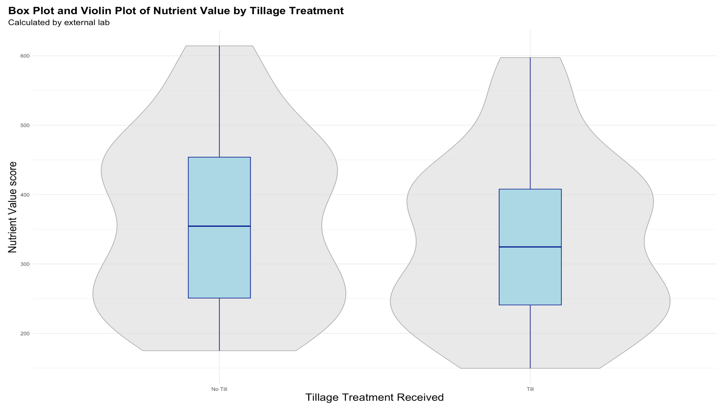
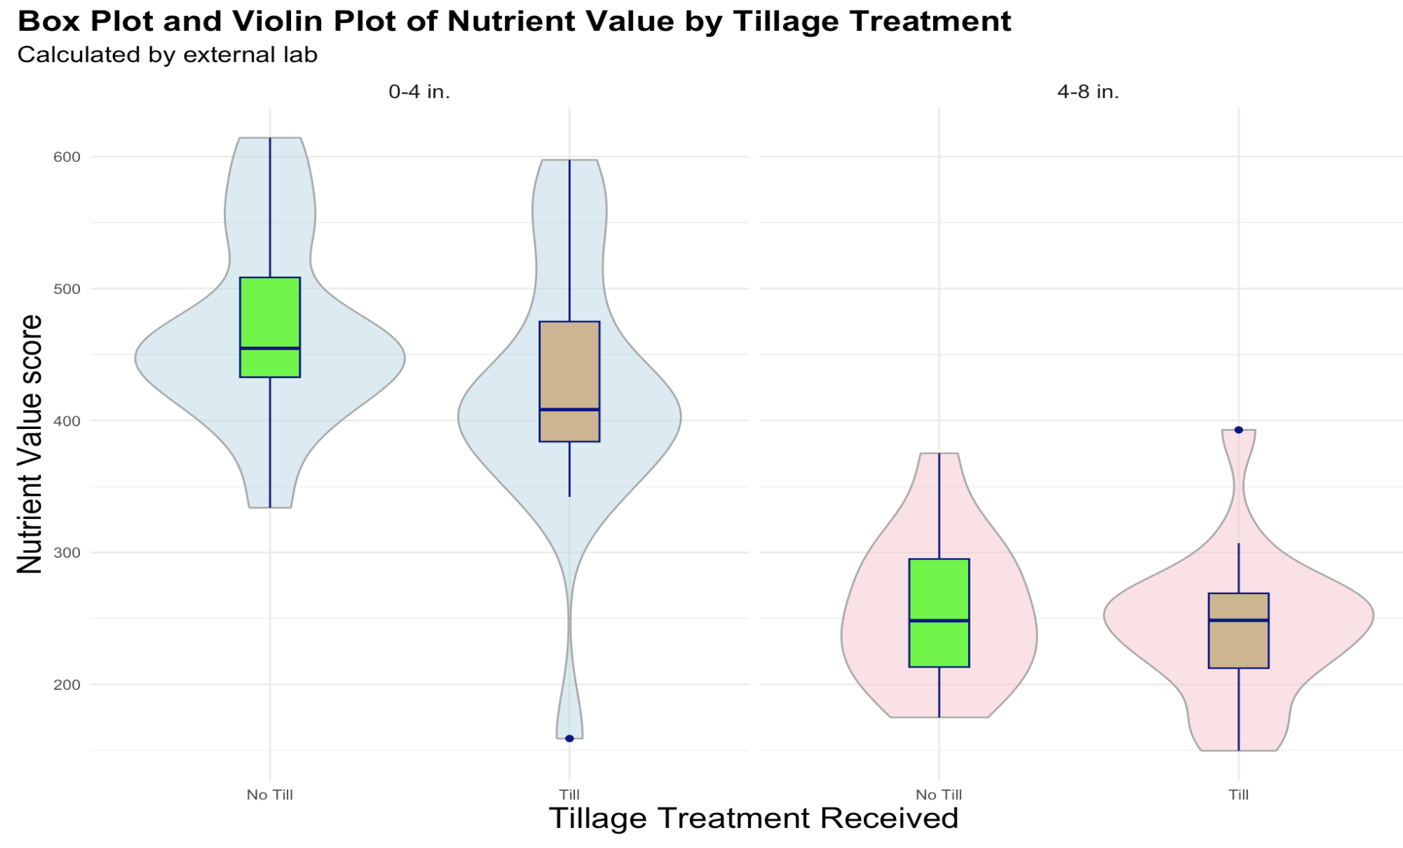

Slide 20
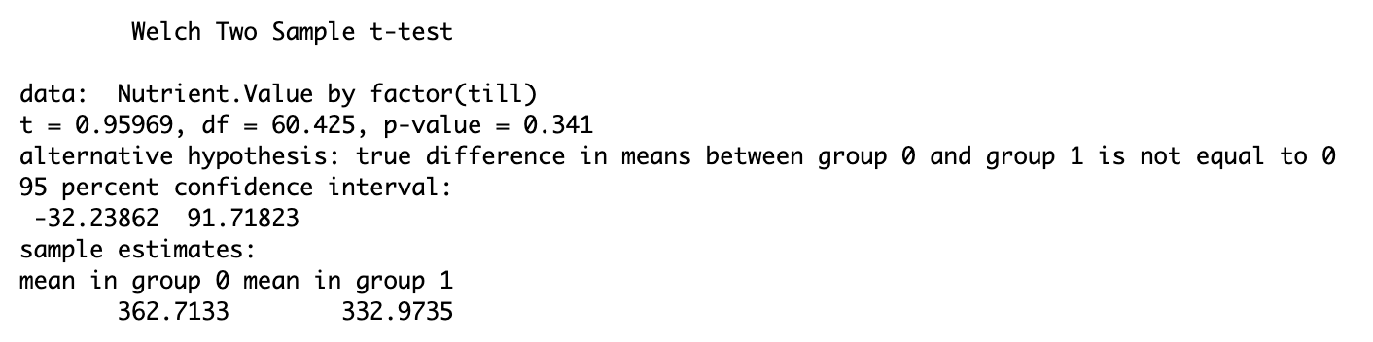
Nutrient Value by Treatment
Similar findings to before, no the means between nutrient the nutrient values score show not to be significant under the (P-Value < 0.05) threshold.
Relatively low data makes this difficult to trust numbers alone. (Many assumptions of t-test violated)
However, using visuals, we can perhaps infer there may be more value in non-tilled soil at the surface levels.
Notice a P-Value of 0.341.

Slide 21
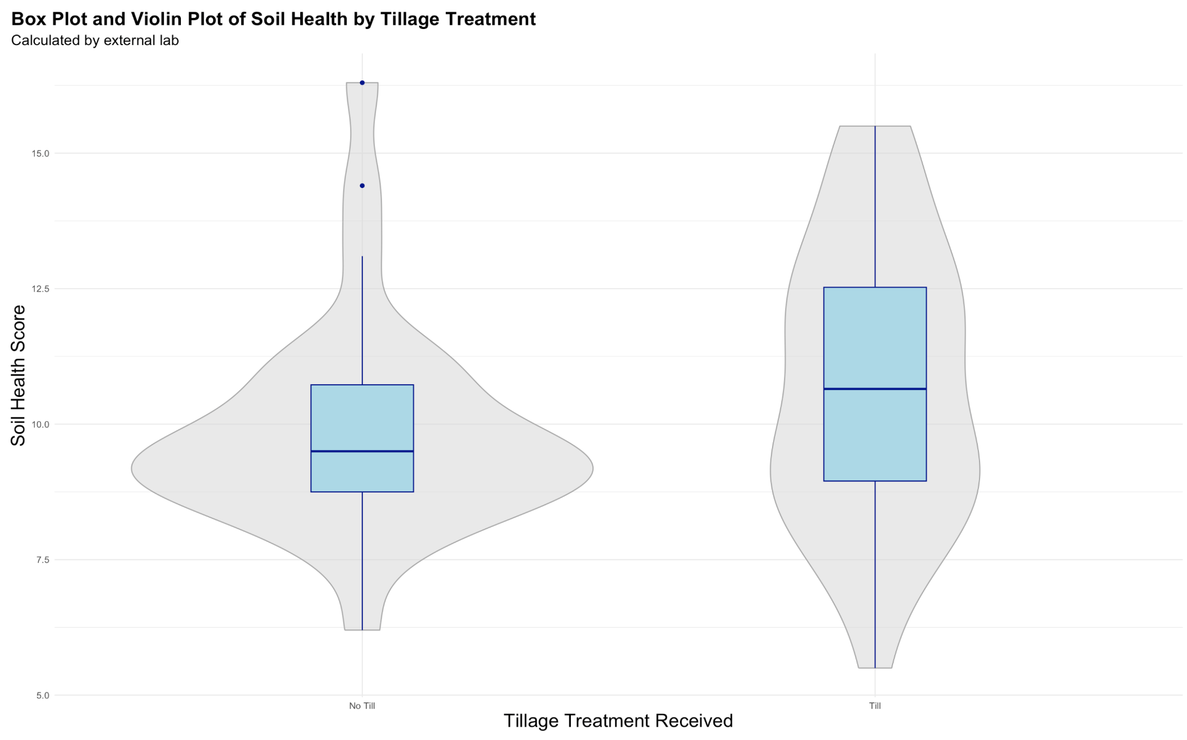

Slide 22
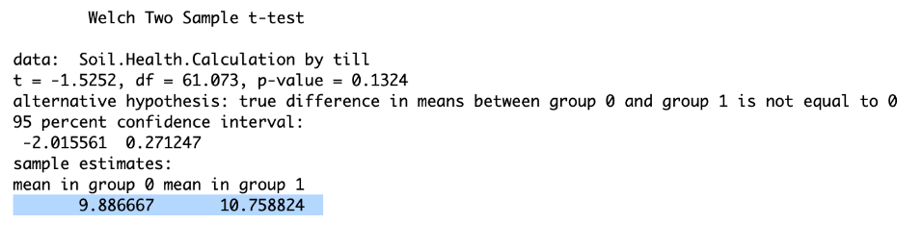
Tillage and Soil Health
The average soil health calculation means lie very closely to each other.
Slightly lower health score in no tilled soils samples.
Larger variance of scores across tilled samples.
T-test suggests there is not enough evidence to say there is a meaningful difference across solid health scores.

Slide 23
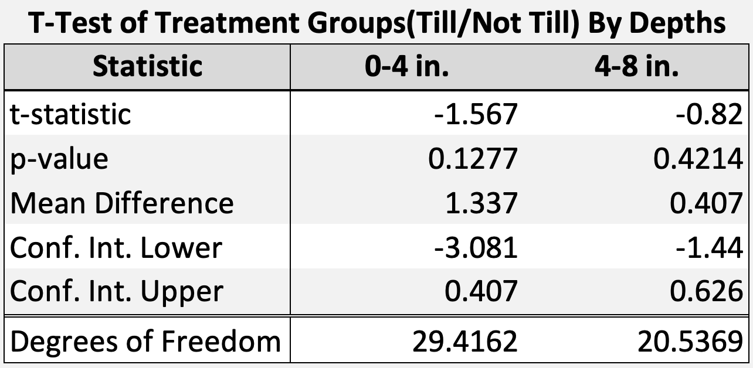
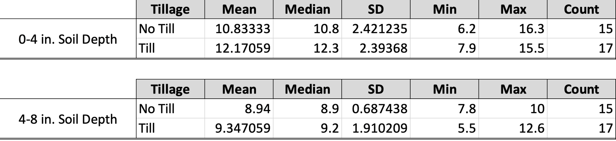
Separating by Depth and Treatment; We get better estimates of what is going on.
Yet, still no significant difference in soil health between conventional farming practices and regenerative.
(at a P-Value = 0.1)
Summary Table for Samples Soil Health Levels

Slide 24
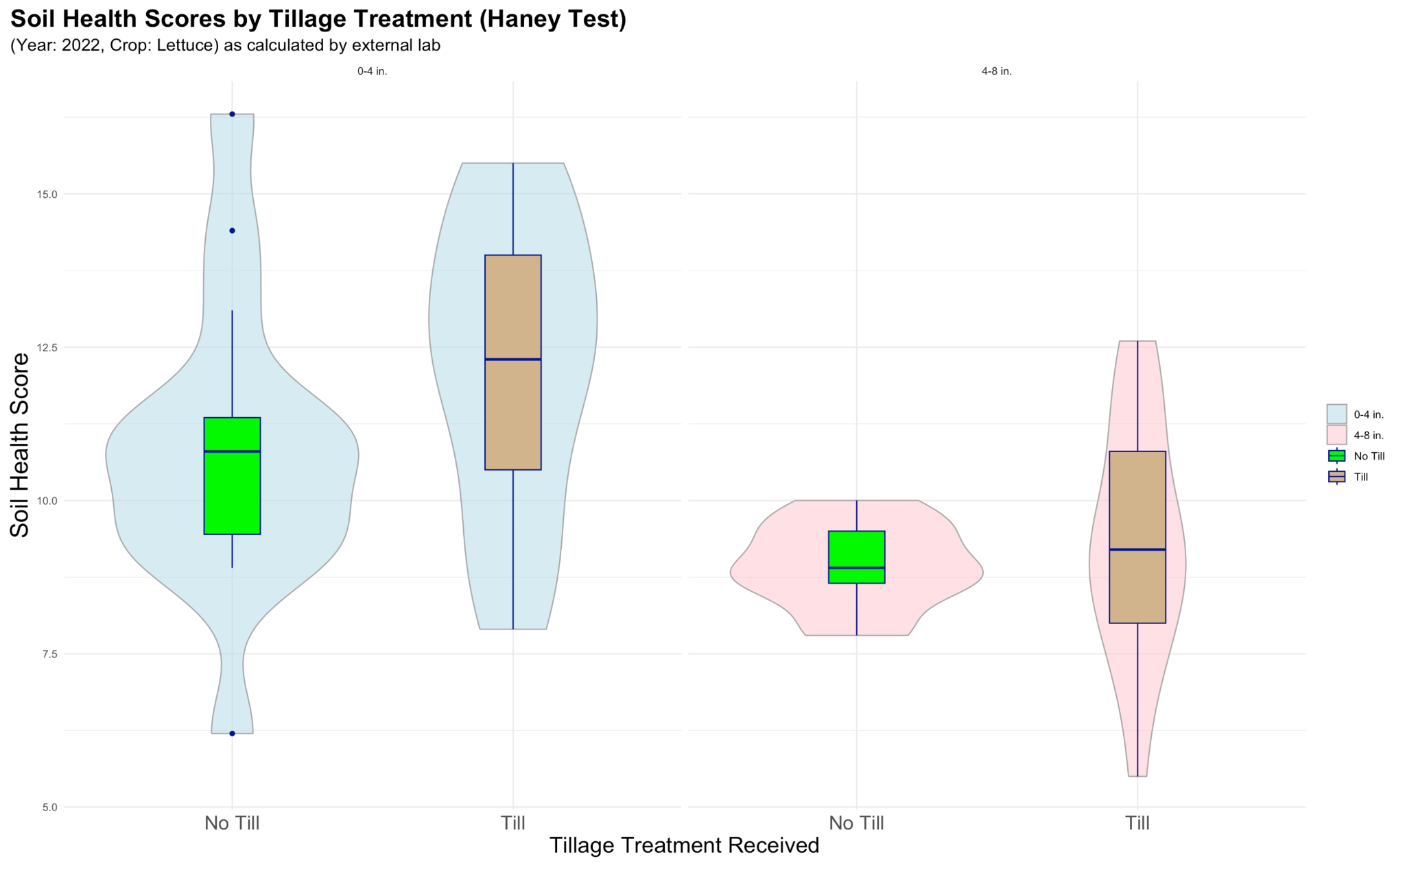
T-test :
P-val ≈ 0.12771
T-test :
P-Val ≈ 0.42137

Slide 25
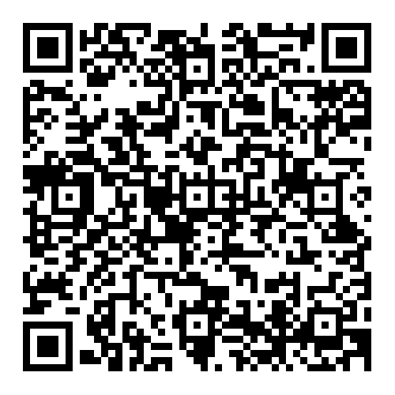
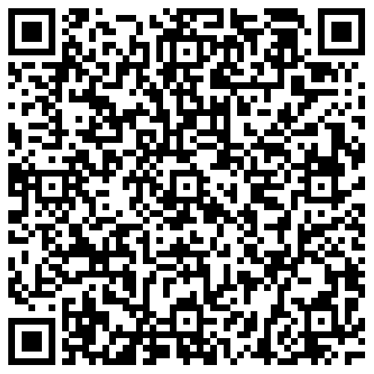
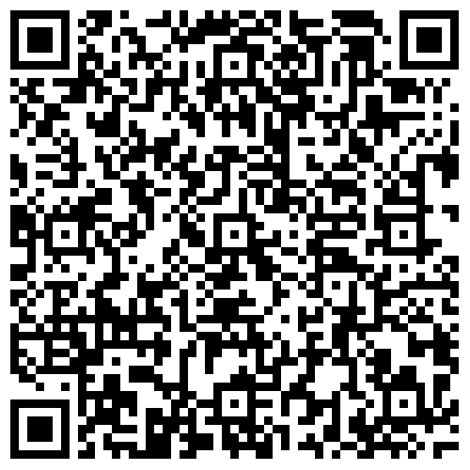
RAD Lab Data Transfer
Aggregate Stability
C:N
pH
Transferring Data From RAD Lab Data Repository → CRARS Data Repository

Slide 26


Conclusion
Key Takeaways:
Standardized datasheets ensure accuracy and reduce errors.
Clear protocols support smooth OVP and RAD Lab data transfers.
Visuals make complex soil data easy to understand and share.
Allowing students in various labs to easily transfer data.
Acknowledgments
Thanks to the CRARS and Project DAFANH!
Notes:
To wrap up, here are the key takeaways from our work on data management, transfer, and visualization

