Slide 1


INDEX
01
INDEX
CONTENTS
Introduction
General Overview
Real Time Analysis
Technical Overview
Tech Stack
Project Highlights
Future Planning
Team Members
PAGES
2
3
4
5
6
7
8
9

Slide 2



INTODUCTION
Motivation behind the Project: -
Tourism is one of the most important sectors in our country. Tourists are attracted by our rich culture and heritage and generates a huge revenue and also the Government gets foreign exchange from it. This gives the country to open up to the world and can exchange their cultures and build up a better community. The language is a problem for the locals and the tourists and sometimes lack of knowledge makes them lose interests over time in the world famous heritages and guides are more often interested in earning rather than taking the tourists on a tour. If we can overcome this problem we can build a better world and can promote this sector and exchanging culture will lead to the growth of our National Interests in UN.
02

Slide 3




GENERAL OVERVIEW
03
Objectives
The main objective of our project is to make a tour guide application. The motive is to minimize the barriers of the language between the locals and the tourists. Over time we had faced a lot of problem when we visit any kind of heritages, we either don’t get a proper tour guide or the guide sometimes lack knowledge of the foreign language or knows a little about the place. It is also observed that sometimes local-guides does not show proper places and do it casually and takes the extra profit from the foreign who is unaware of the tricks of the guides which was under his sleeves all the time.
So, this app will tell about the famous tourist attractions with proper information and with language preference without any extra cost. This will help the tourism industry to grow a lot and will generate a revenue for the government. It will also grow the interest of the tourist to visit the place more often and would like to know more about the place. It can also help the students who are on educational tour with the usage of this app and can promote education on a higher level. It will enrich the them about the heritages which they had read only in books but now can visualise with proper information at the same time.
Problems Faced:-
1) Guides nowadays have less knowledge of the heritages.
2) Tourist often lose their interests on the heritages sites.
3) Problems arise with language problems.
4) Tour and travel companies provide a guide with a lot of extra cost and guides are sometimes not up to the mark.
5) Even local guides charges an extra cost and separately charges cost for the translators.
6) Schools sometimes cannot afford an guide for an extra charge and it would prove beneficiary for the school cutting down the extra expenditure.
T
O
U
R
I
S
T
-
G
U
I
D
E
R
A
P
P

Slide 4

REAL TIME ANALYSIS
04
Why this project in the first place? This is the first question that arises in everyone’s mind. While explaining this question we need to go for the real time scenario. It has been observed many a times that the tourists has lost their interest in many historical and heritage places due to the tourist who has communication problem or lack of knowledge. Sometimes the travel companies does profit much more just by hiring non-professional guides or the local guides. So this affects the tourism sector. This can be solved by this app.
The solution is quite simple and i.e. by using this app. Now the question arises- “Why and How?”. So, first analysing the Why part we can give a small real time example. Supposedly, there is a foreigner tourist so now there is a language barrier as the guide might now know the foreign language so there comes the translator to solve this problem but many times it has been observed that the guide incorrectly guide the tourist and give wrong information and improper explanation on the place. So this results in the loss of interest of the tourist. Here comes our app to rescue from this situation. So now we need to explain the How part.
The app will work on tourist’s preference and it’s a website form so it will not occupy the permanent memory space of the device. It will use a VPA voice as well as text assistant to explain the information of the place. We will try to accommodate a algorithm approach how to roam and proceed further in a particular place. Say we are in “The Great Indian Museum” the app will try to give a algorithmic approach to visit from one department to another say pre-historic department to Egyptian Civilization Department. When in a city it will give the possibilities of the tourist places in a city. Now the tourist comes to Birla Mandir, the user needs to select the tourist choice of that place and the information will come on the website or app on the screen along with voice format if the user’s want. Then the algorithmic approach will start with voice and text support.
So this approach with online tourist guide app will increase the profit of tourism sector and might bring a revolutionary thing in the tourism sector.

Slide 5
TECHNICAL OVERVIEW
05
Determine the location by calculating longitudes and latitude(Reverse Geocoding)
Front-End
(ANGULAR / REACT)
SEND
DATA-SET
& MODEL ON HERITAGES
JYTHON
Fetching all the tourist attractions of that particular place fetched from user’s location by using the trained data-set.
FETCH
INTEGRATION
REQUEST OR RESPONSE
DEPLOYMENT
Fetching user’s details from the user database that is registered and its language’s details.
Databases
(H2 as testing database and later on MongoDB or MySQL
Front-End
Cloud Deployment
(NETLIFY)
DATABASE
Fetching all the details about the tourist attraction in a sequential manner selected by the user from the fetched list of tourist attraction from the particular place.
CONTINUOUS INTEGRATION
& BINDING **
SEND
FETCH
Giving a documentation of the details on the web and telling it with the language preference of the user’s choice.
FETCH
SEND
VPA with Python preferably
[ VPA – Virtual Personal Assistant ]
INTEGRATION
JYTHON
BACK-END (Using Spring Boot with JAVA + Integration with Python for VPA and ML with Jython)
DEPLOYMENT
BaaS with Heroku/Firebase (Backend as a service will provide the back-end to be hosted on cloud and act as a server).
DATA-SET & MODEL ON HERITAGES – PREDICTION-SET
USER’S DETAIL & PREFERRED LANGUAGE- DATABASE
** (AS FAR AS PLANNED AND OVERVIEW CAN BE CHANGED IN FUTURE IF REQUIRED FOR BETTER EFFICIENCY)
Database and Back-end together will constitute the Server.
**Data binding must take place in smooth functionality in this project flow.
SERVER

Slide 6
TECH STACK
06
TECH STACK
TITLE: - TOURIST GUIDER APP WITH VIRTUAL PERSONAL ASSISTANT (VPA)
TECHNOLOGY USED: -
SPRING BOOT WITH JAVA. (BACK-END)
ANGULAR / REACT (FRONT-END) → TO GIVE A USER’S VIEW FOR THE BACK-END
HEROKU / FIREBASE → DEPLOYMENT OF BACK-END IN CLOUD SERVER. [ACTING AS A SERVER PART]
NETLIFY → DEPLOYMENT OF THE FRONT-END AS A CLOUD SERVER.
PYTHON → DEVELOPMENT OF THE VIRTUAL PERSONAL ASSISTANT AND MACHINE LEARNING PREDICTION SET.
JYTHON → INTEGRATING PART BETWEEN PYTHON AND SPRING BOOT WITH JAVA AND SUCCESSFULLY BINDING IT.

Slide 7
PROJECT HIGHLIGHTS
07
The project is still ongoing as the planning is still in the process and this presentation is just the first step towards this project. The project architecture may changed a bit later with respect to planning.
We have tried to brief the whole project with some points below: -
A prediction set of tourist places with respect to cities is needed to be done as API might give random places and difficult to manipulate so customized API is a better approach by Python.
VPA with Python will give the voice assistant approach with the main Back-End part.
Spring Boot with JAVA will build REST API Endpoints and the whole database part comprised of the User’s data part
Integrating the Machine Learning with Python and VPA with Python with the Spring Boot in JAVA with Jython Dependency which is totally a new approach in this project.
Front-End part will be done on either Angular or React.
The final approach is to connect the Back-end part with Front-End part.
The Deployment of this project steps are as follows: -
The Back-End needs to be hosted in either Heroku or Firebase most preferably which will act as a Server in our project.
The Front-End will be hosted in the cloud mostly Netlify as an independent entity
The final step of this deployment is to connect both the clouds and then host it in the GitHub.
** Testing of individual module will also be done. (Junit Testing or Selenium Testing will be used in this Project)

Slide 8
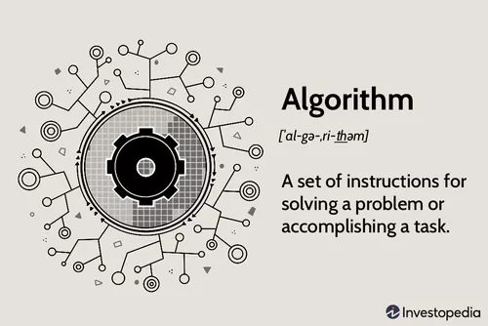
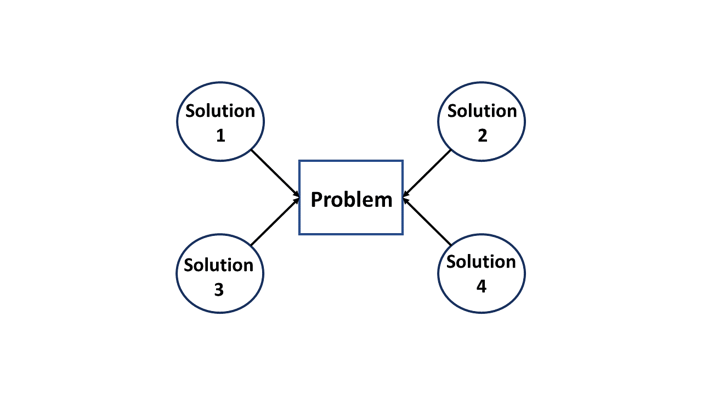
FUTURE PLANNING
08
We also decided to do some modifications in this project. The modification is ALGORITHMIC APPROACH.
This is a modification we would like to introduce in this project that the tourist will get a proper guide to visit from where and what should be the proper way to visit places and to how to properly know the place. Lets bring up the same example mentioned before: -
Say we have visited to the Great Indian Museum and the app has been activated and have fetched the proper location and information. Now we need to give a proper guide how to roam in that particular place in a proper and systematic manner. So an algorithm comes on the website to go in a systematic manner but that completely depends on user’s selection whether to follow the algorithm or not. If the user is in the place we mentioned and select the Algorithm To Follow then it might suggest to visit first the pre-historic periods then the Evolution of Human which is present in the same storey. Then it suggests to go to visit human civilization and many more procedures.
So this is the whole new algorithmic approach which is kind of enhancement and have not been used in any kind of website. So we would like to give this try if it gets a success or not.

Slide 9
Team Members of the Project: -
Mriganka Paul – mriganka56 (GitHub ID)
Collaborators: -
Arpan Ghosh
Supratim Majumder
Ankita De
Shreedatri Banerjee
Oishe Chakraborty

