Slide 1
Project Globus
Group Management System
COSC 4730 Final Presentation
Jesse Miller
Kelsey Crea
Taylor Olson

Slide 2
Introduction
User Interface
Login/Group Creation
Whiteboard
Calendar/Events
Google Drive
Database Issues

Slide 3
User Interface
Target Audience is very broad
Simple, easy to use
Blue and gray theme

Slide 4
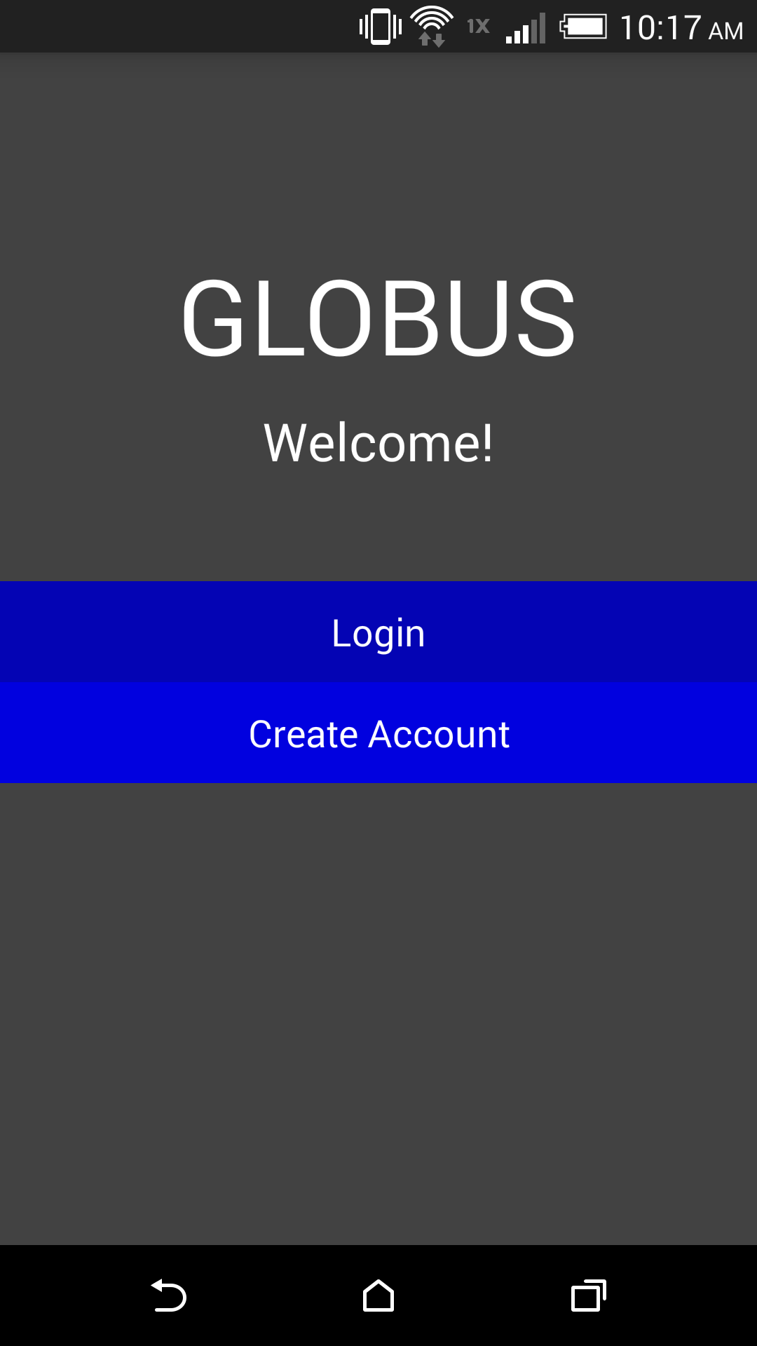
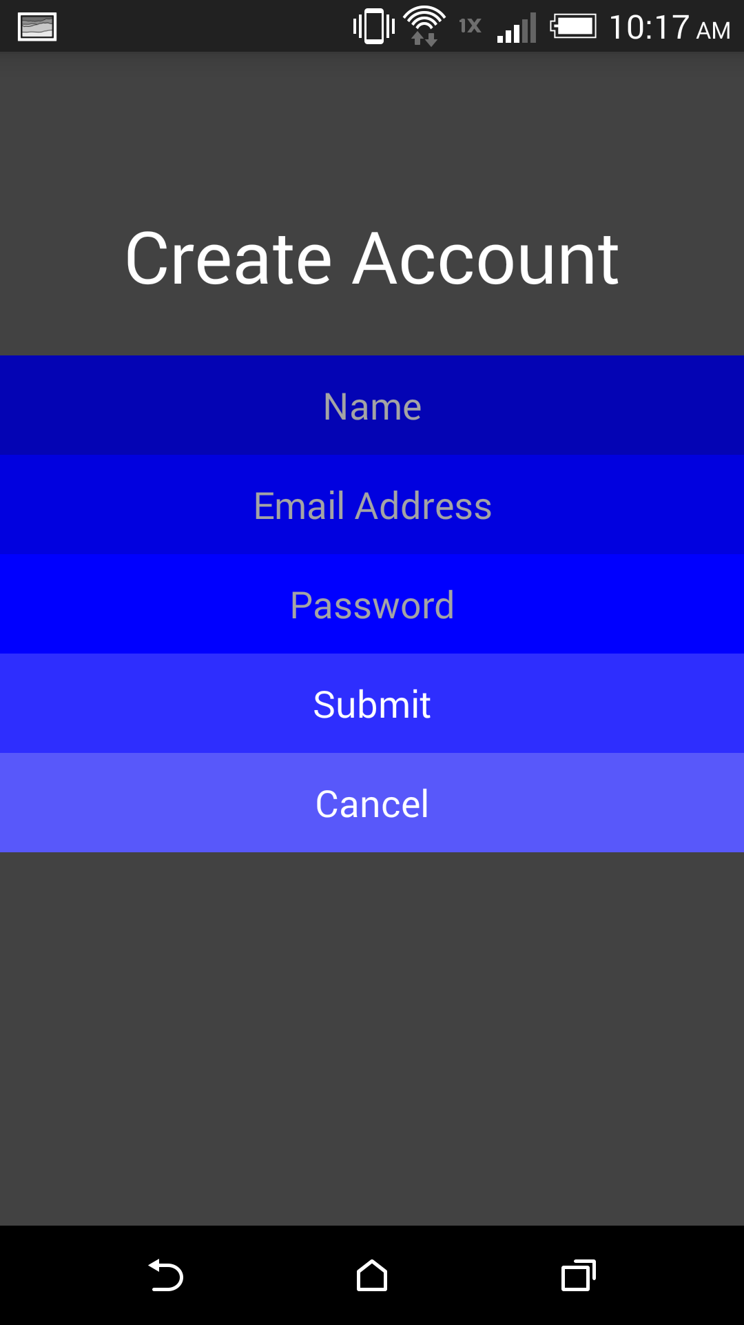
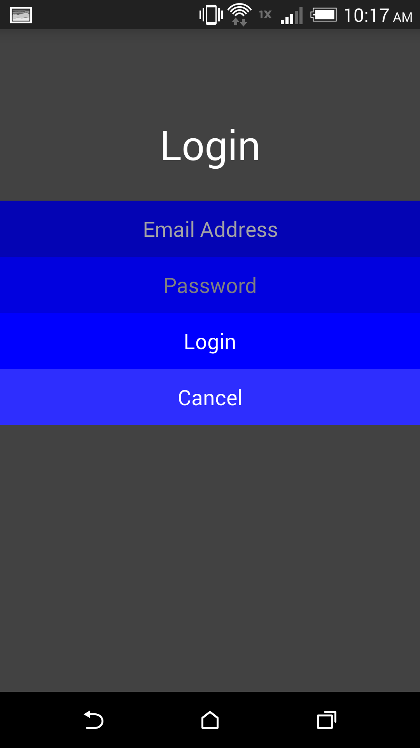
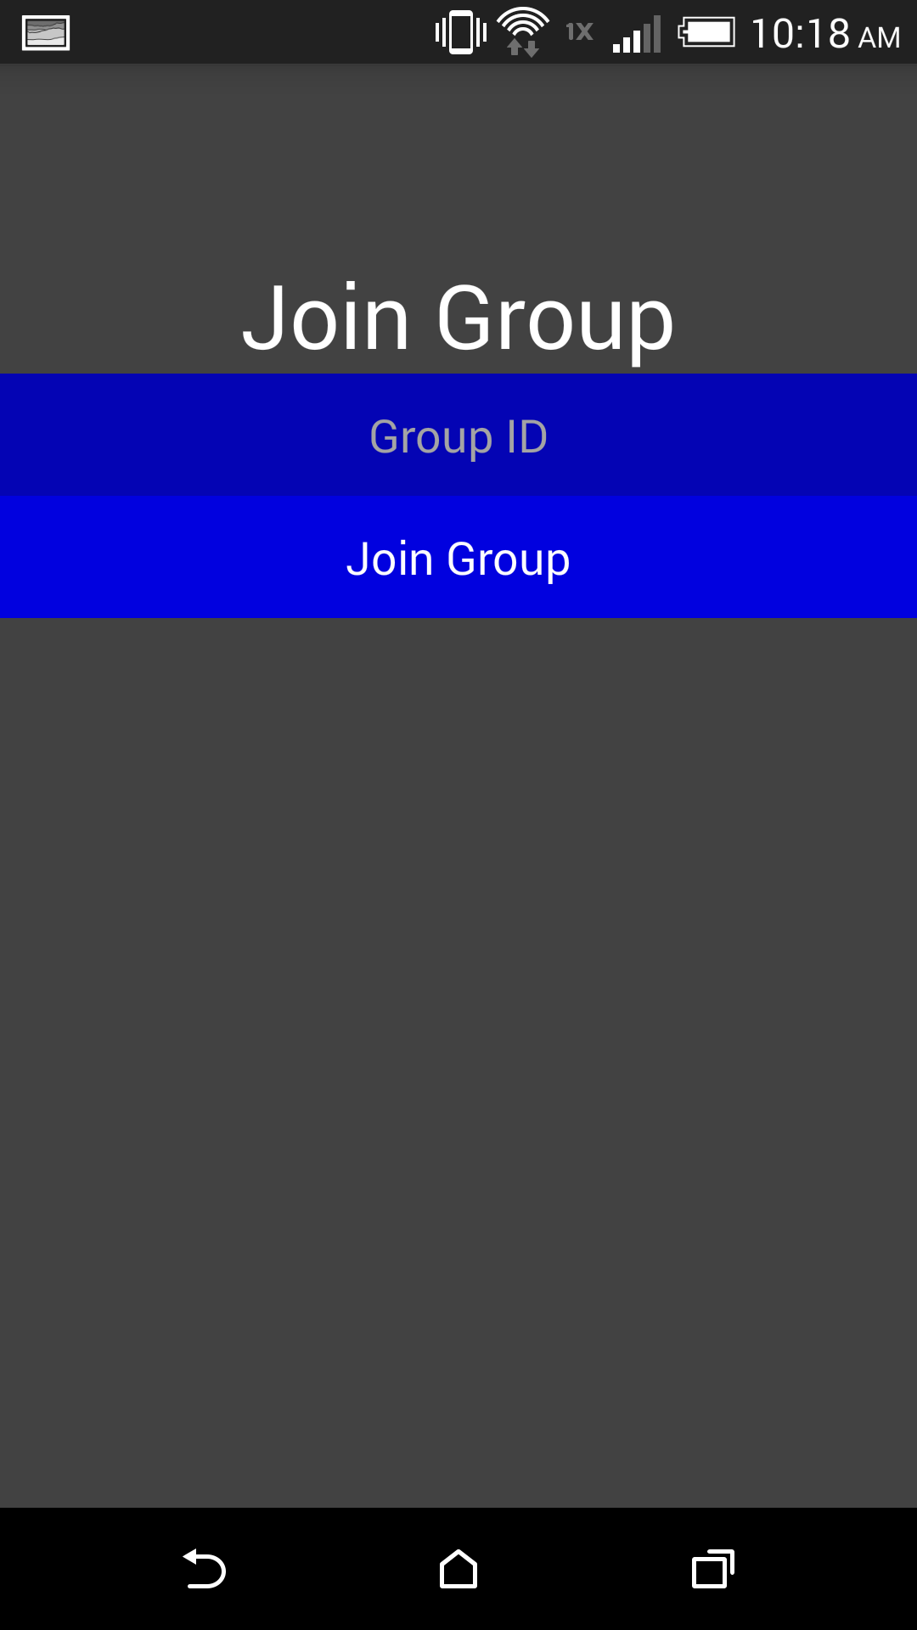
Login/Group Creation

Slide 5
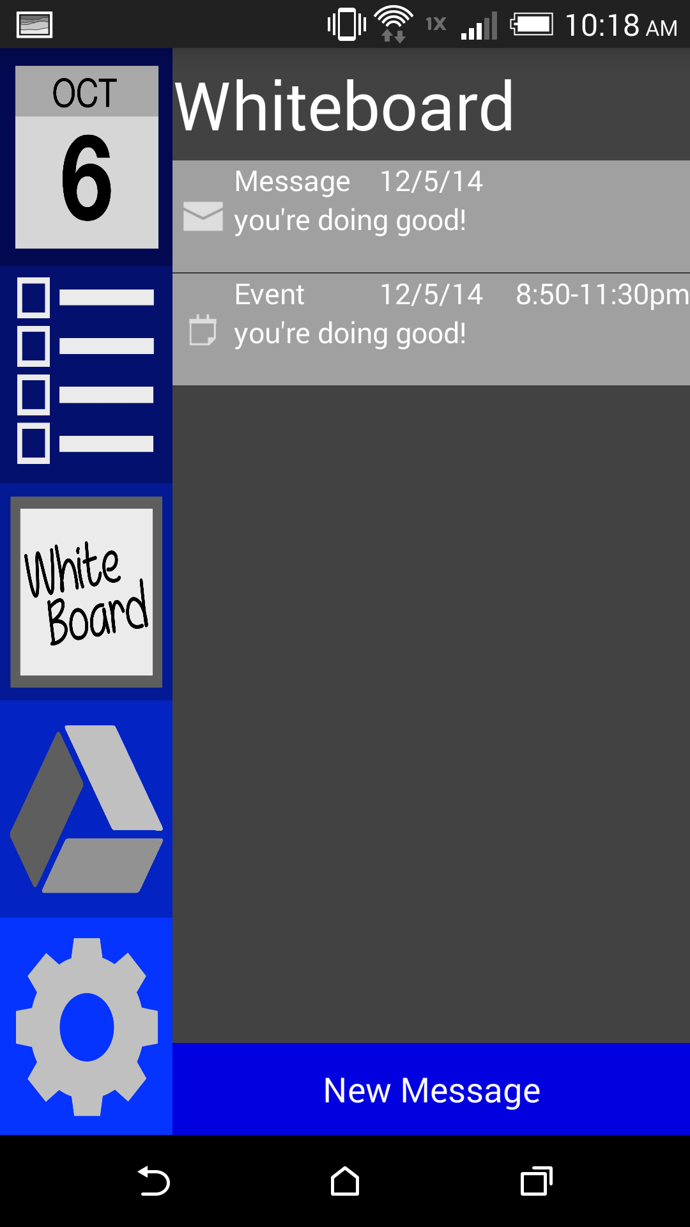
Whiteboard
Main Screen
Similar to “Facebook Wall”
Static easy-to-use Navigation

Slide 6
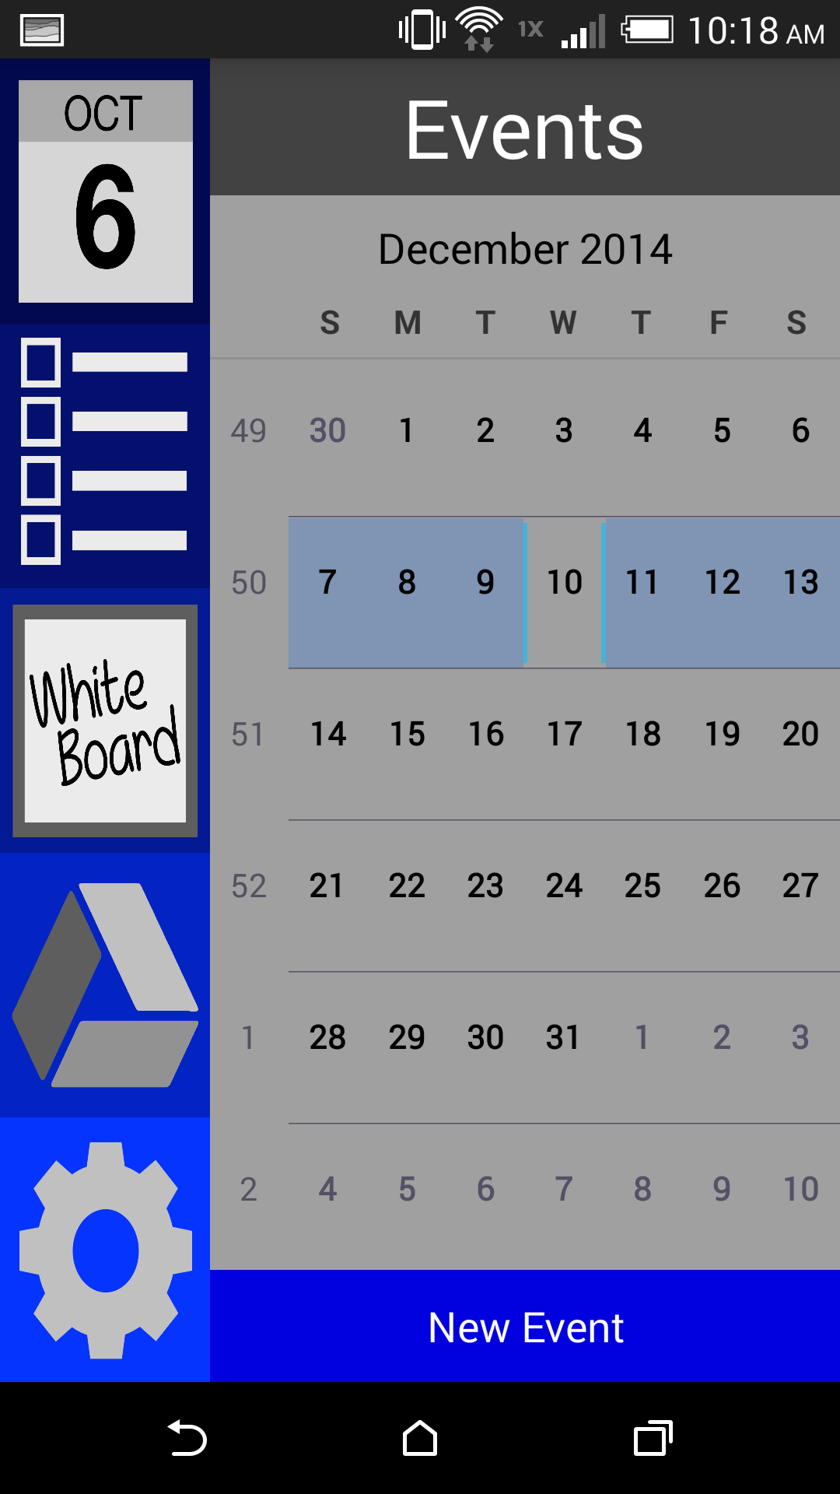
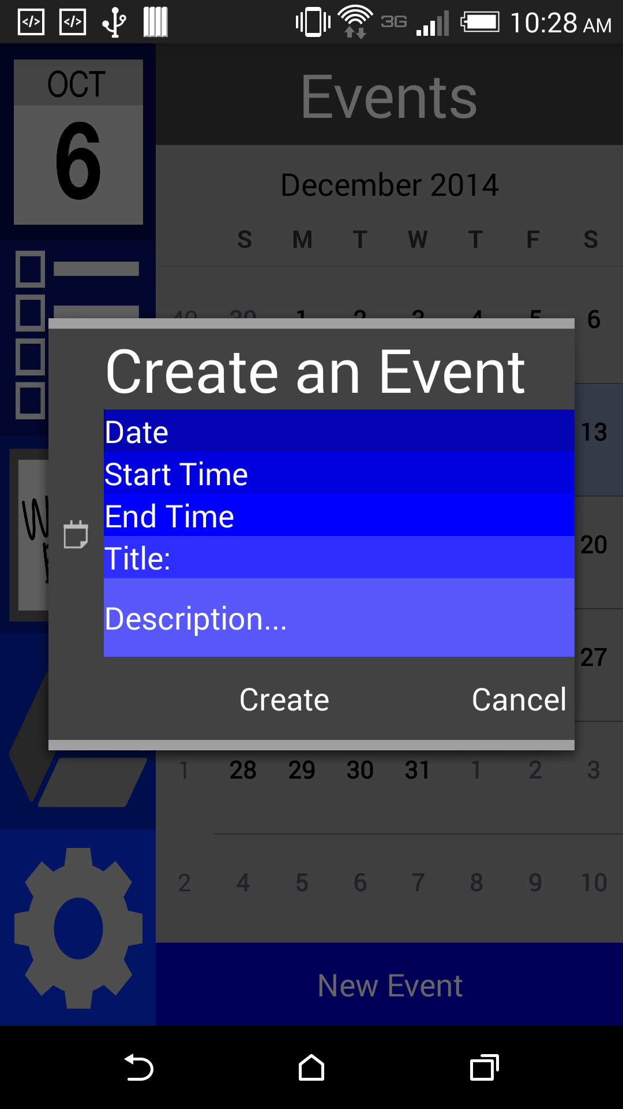
Calendar/Events

Slide 7
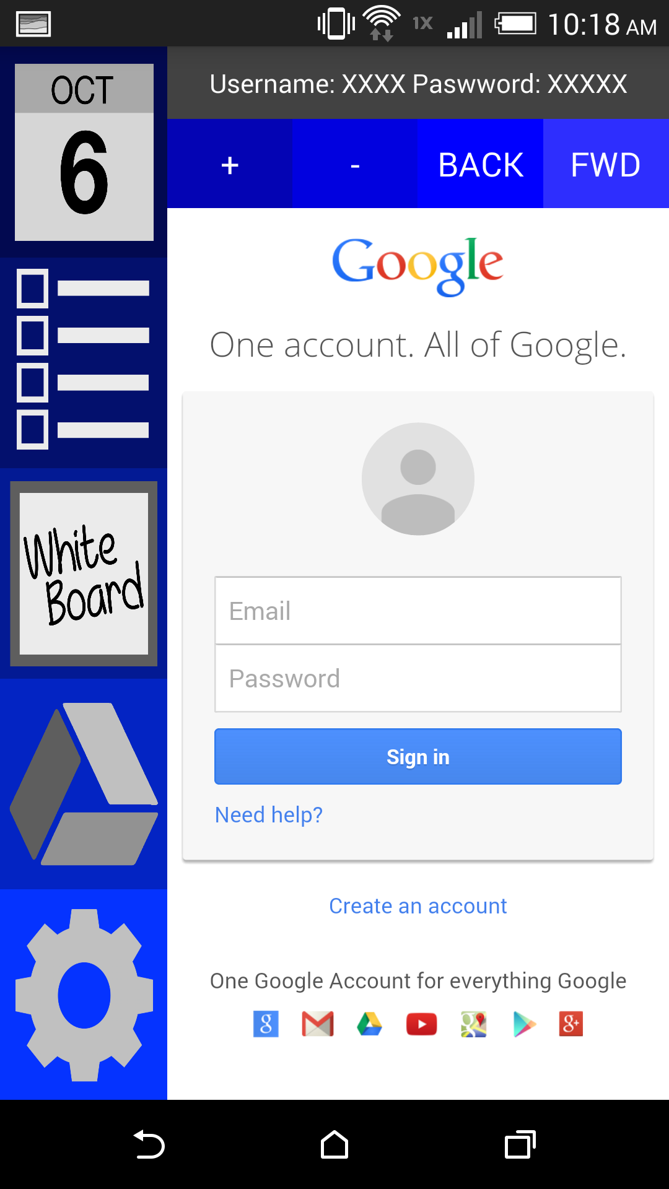
Google Drive
Google Drive WebView
FUTURE: Will include group’s credentials for Google Drive easy to view.

Slide 8
Database Issues
Attempted to create server database.
Android wouldn’t allow connection
Struggle with local database

Slide 9
Questions?

