Slide 1
Multi-Agent Deep Reinforcement Learning for Coverage Maximization
Roopam Taneja
(22125030)
Vraj Tamakuwala
(22114098)
Supervisor
Prof. Rajdeep Niyogi
Department of Computer Science and Engineering
IIT Roorkee

Slide 2
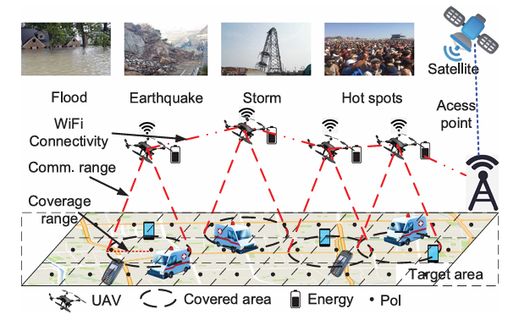
Motivation
Unmanned Aerial Vehicles (UAVs) are a promising technology for providing flexible and on-demand communication coverage in areas lacking ground infrastructure.
Their rapid deployment, high mobility, and elevated line-of-sight communication capabilities make them ideal for scenarios such as disaster response, large-scale events, and rural area connectivity.
Multi-UAV navigation coverage scenario [1]

Slide 3
Motivation (contd.)
Recent research has focused on Deep Reinforcement Learning [3] methods to enable UAVs to learn control policies from environmental interactions.
However, deploying multiple UAVs introduces new challenges.
These include:
maximizing long-term area coverage,
ensuring fairness among service points (hereafter referred to as Points of Interest or PoIs),
conserving limited battery energy,
maintaining inter-UAV connectivity.

Slide 4
Timeline and Milestones
Evaluated system performance on coverage, fairness, and energy metrics
Studied foundational RL concepts: MDPs, Q-Learning, Policy Gradients
Explored value-based, policy-based, and actor-critic methods
Jan
Focused on MARL, MADDPG, and CTDE paradigm
Learned about cooperation, non-stationarity, and credit assignment in multi-agent systems
Environment and Architecture Design
Designed a custom 2D grid environment simulating UAV navigation
Defined reward functions balancing coverage, fairness, and energy
Integrated CNN for spatial feature encoding
March
Implemented MADDPG with centralized critics and decentralized actors
Incorporated Conditional Value at Risk (CVaR) to guide agents towards risk-averse behaviours
Ran multiple training episodes with detailed logging
April
Visualized state transitions, training dynamics, and agent coordination
Dec
Literature Review
Multi-Agent Deep RL Study
Feb
Results, Analysis and Visualization
Implementation and Training

Slide 5
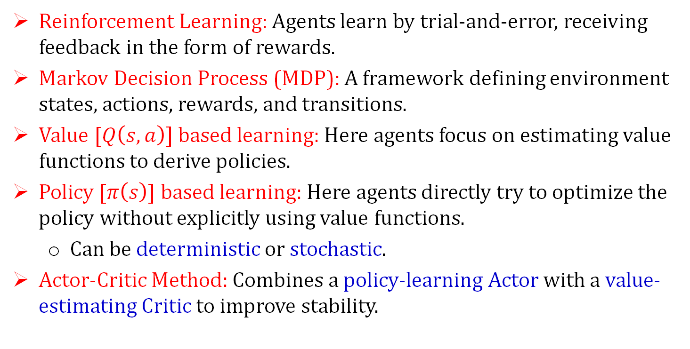
Background Concepts
Reinforcement Learning: Agents learn by trial-and-error, receiving feedback in the form of rewards.
Markov Decision Process (MDP): A framework defining environment states, actions, rewards, and transitions.
Value [$Q\left(s,a\right)]$ based learning: Here agents focus on estimating value functions to derive policies.
Policy [$π\left(s\right)$] based learning: Here agents directly try to optimize the policy without explicitly using value functions.
Can be deterministic or stochastic.
Actor-Critic Method: Combines a policy-learning Actor with a value-estimating Critic to improve stability.

Slide 6
Background Concepts (contd.)
DDPG (Deep Deterministic Policy Gradient): Learns deterministic policies for continuous control tasks using deep neural networks.
Multi-Agent RL (MARL): A subfield of RL where multiple agents learn simultaneously in a shared environment.
Can be Cooperative or Competitive.
Centralized Training Decentralized Execution (CTDE Paradigm):
Critic uses global information during training.
Actor uses only local observations at runtime.
MADDPG: Extends DDPG to multi-agent setups using centralized training and decentralized execution.
Conditional Value at Risk (CVaR): A risk-averse measure that trains agents to avoid poor performance cases.

Slide 7
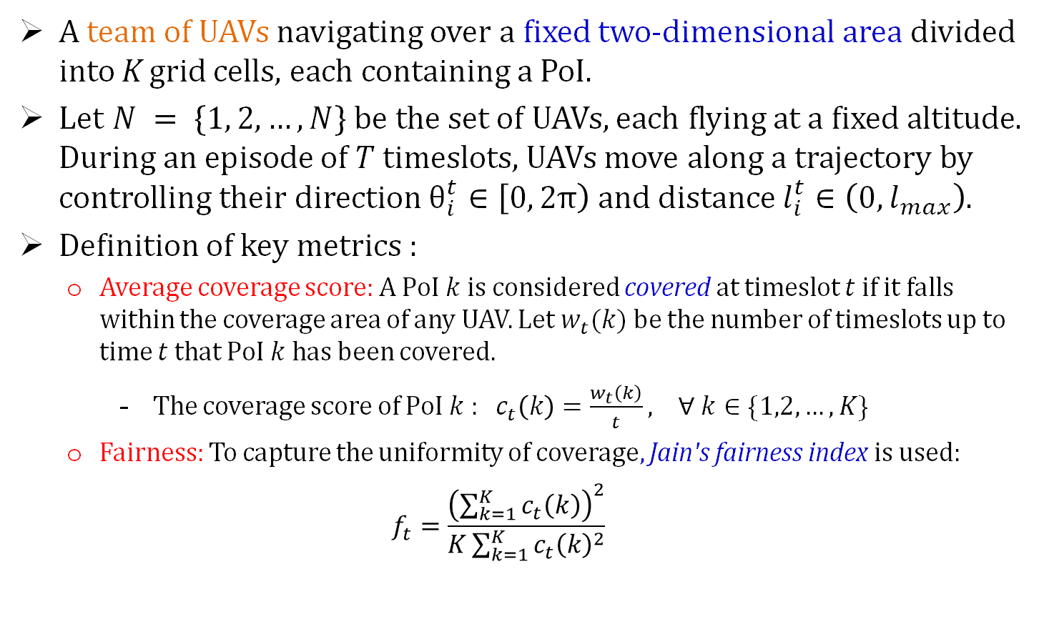
Problem Statement
A team of UAVs navigating over a fixed two-dimensional area divided into K grid cells, each containing a PoI.
Let $N = \{1, 2, …, N\}$ be the set of UAVs, each flying at a fixed altitude. During an episode of $T$ timeslots, UAVs move along a trajectory by controlling their direction $θ_{i}^{t}∈\left[0, 2π\right)$ and distance $l_{i}^{t}∈\left(0,l_{max}\right)$.
Definition of key metrics :
Average coverage score: A PoI $k$ is considered covered at timeslot $t$ if it falls within the coverage area of any UAV. Let $w_{t}(k)$ be the number of timeslots up to time $t$ that PoI $k$ has been covered.
The coverage score of PoI $k$ : $c_{t}\left(k\right)=\frac{w_{t}\left(k\right)}{t}, ∀ k∈\{1,2,…,K\}$
Fairness: To capture the uniformity of coverage, Jain's fairness index is used:
$$f_{t}=\frac{{\left(\sum_{k=1}^{K}{c_{t}\left(k\right)}\right)}^{2}}{K\sum_{k=1}^{K}{c_{t}{\left(k\right)}^{2}}}$$

Slide 8
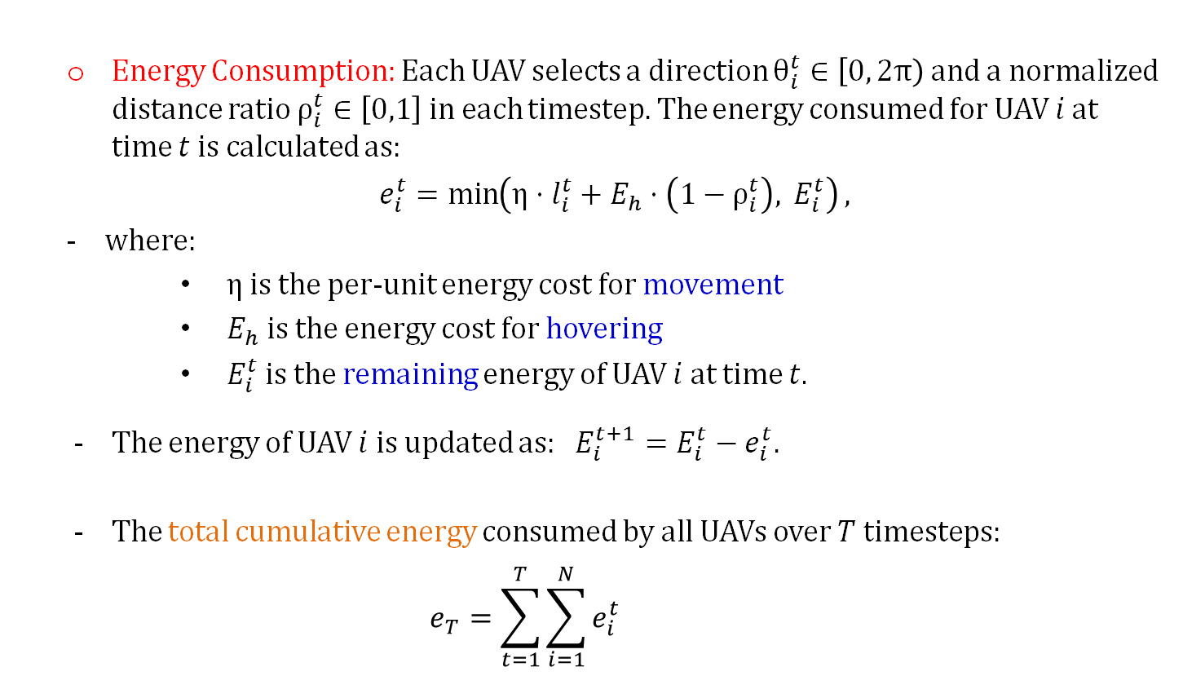
Problem Statement (contd.)
Energy Consumption: Each UAV selects a direction $θ_{i}^{t}∈\left[0, 2π\right)$ and a normalized distance ratio $ρ_{i}^{t}∈\left[0,1\right]$ in each timestep. The energy consumed for UAV $i$ at time $t$ is calculated as:
$e_{i}^{t}=\min\left(η⋅l_{i}^{t}+E_{h}⋅\left(1−ρ_{i}^{t}\right), E_{i}^{t}\right),$
where:
$η$ is the per-unit energy cost for movement
$E_{h}$ is the energy cost for hovering
$E_{i}^{t}$ is the remaining energy of UAV $i$ at time $t$.
The energy of UAV $i$ is updated as: $E_{i}^{t+1}=E_{i}^{t}−e_{i}^{t}.$
The total cumulative energy consumed by all UAVs over $T$ timesteps:
$$e_{T}=\sum_{t=1}^{T}{\sum_{i=1}^{N}{e_{i}^{t}}}$$

Slide 9
Proposed Solution
This work builds on the framework proposed in [1], where UAVs are controlled using a Multi-Agent Deep Deterministic Policy Gradient (MADDPG) network.
In contrast to centralized models of controlling all UAVs jointly, we adopt a distributed approach where each UAV is modeled as an independent learning agent.
We extend the core algorithm by incorporating Convolutional Neural Networks (CNNs) for spatial encoding, and Conditional Value at Risk (CVaR) as a risk-averse training criterion along with the MADDPG network.
Through this combination, we aim to improve long-term communication coverage by enabling cooperation among UAVs while accounting for fairness and energy efficiency in highly dynamic environments.

Slide 10
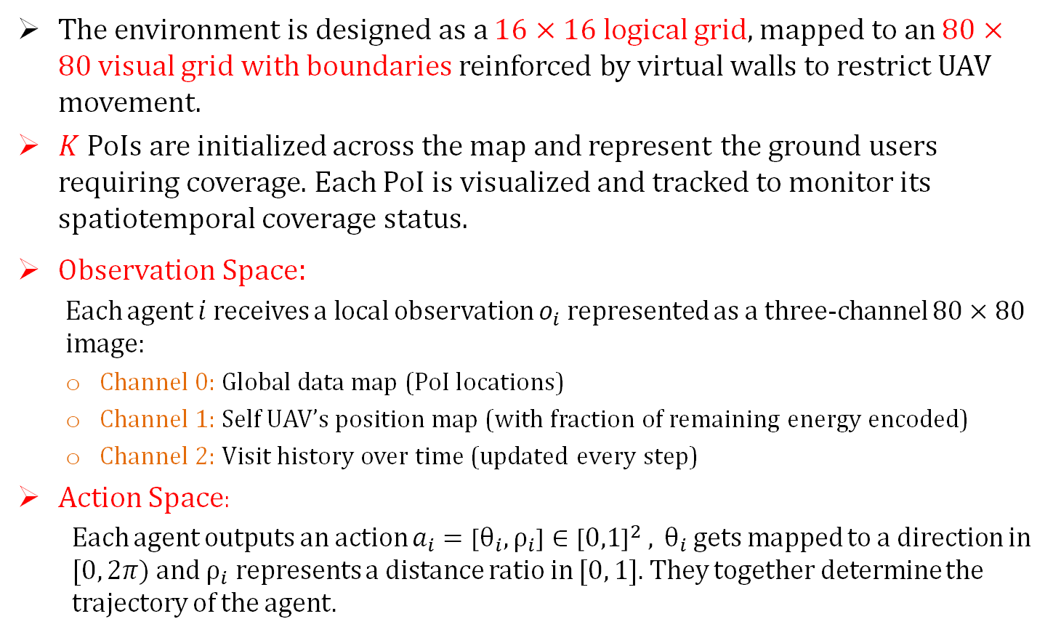
Environment Structure
The environment is designed as a $16×16$ logical grid, mapped to an $80×80$ visual grid with boundaries reinforced by virtual walls to restrict UAV movement.
$K$ PoIs are initialized across the map and represent the ground users requiring coverage. Each PoI is visualized and tracked to monitor its spatiotemporal coverage status.
Observation Space:
Each agent $i$ receives a local observation $o_{i}$ represented as a three-channel $80×80$ image:
Channel 0: Global data map (PoI locations)
Channel 1: Self UAV’s position map (with fraction of remaining energy encoded)
Channel 2: Visit history over time (updated every step)
Action Space:
Each agent outputs an action $a_{i}=\left[θ_{i},ρ_{i}\right]∈{\left[0,1\right]}^{2}$ ,$θ_{i}$ gets mapped to a direction in $[0, 2π)$and $ρ_{i}$ represents a distance ratio in $[0, 1]$. They together determine the trajectory of the agent.

Slide 11
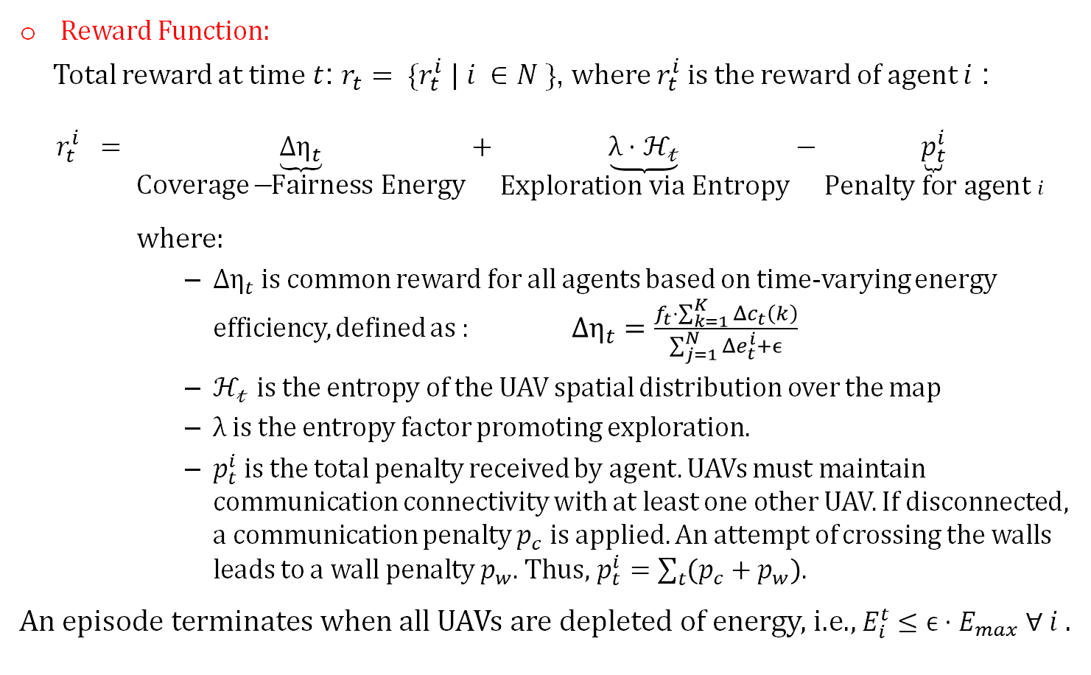
Environment Structure (contd.)
Reward Function:
Total reward at time $t$: $r_{t}= \{r_{t}^{i} | i ∈N \}$, where $r_{t}^{i}$is the reward of agent $i$ :
$$r_{t}^{i} = \underset{\text{Coverage}\text{−}\text{Fairness} \text{Energy}}{\underbrace{Δη_{t}}}+\underset{\text{Exploration} \text{via} \text{Entropy}}{\underbrace{λ⋅ℋ_{𝓉}}}−\underset{\text{Penalty} \text{for} \text{agent} i}{\underbrace{p_{t}^{i}}}$$
where:
$Δη_{t}$ is common reward for all agents based on time-varying energy efficiency, defined as : $Δη_{t}=\frac{f_{t}⋅\sum_{k=1}^{K}{Δc_{t}\left(k\right)}}{\sum_{j=1}^{N}{Δe_{t}^{i}}+ϵ}$
$ℋ_{𝓉}$ is the entropy of the UAV spatial distribution over the map
$λ$ is the entropy factor promoting exploration.
$p_{t}^{i}$ is the total penalty received by agent. UAVs must maintain communication connectivity with at least one other UAV. If disconnected, a communication penalty $p_{c}$ is applied. An attempt of crossing the walls leads to a wall penalty $p_{w}$. Thus, $p_{t}^{i}=\sum_{t}{\left(p_{c}+p_{w}\right)}$.
An episode terminates when all UAVs are depleted of energy, i.e., $E_{i}^{t}≤ϵ⋅E_{max} ∀ i$ .

Slide 12
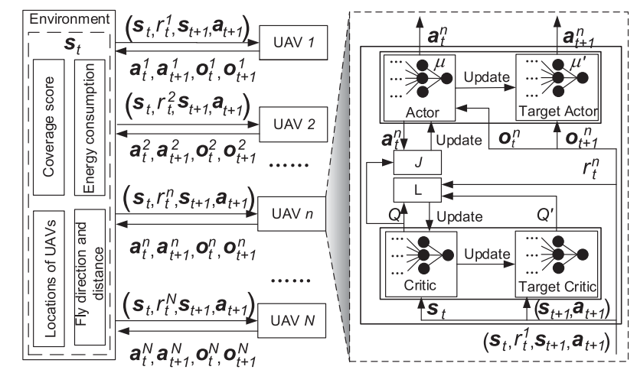
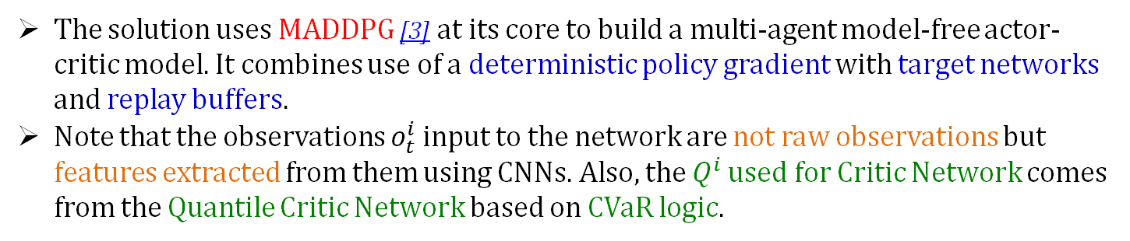
Solution Architecture
Architecture of MADDPG Network [1]
The solution uses MADDPG [3] at its core to build a multi-agent model-free actor-critic model. It combines use of a deterministic policy gradient with target networks and replay buffers.
Note that the observations $o_{t}^{i}$ input to the network are not raw observations but features extracted from them using CNNs. Also, the $Q^{i}$ used for Critic Network comes from the Quantile Critic Network based on CVaR logic.

Slide 13
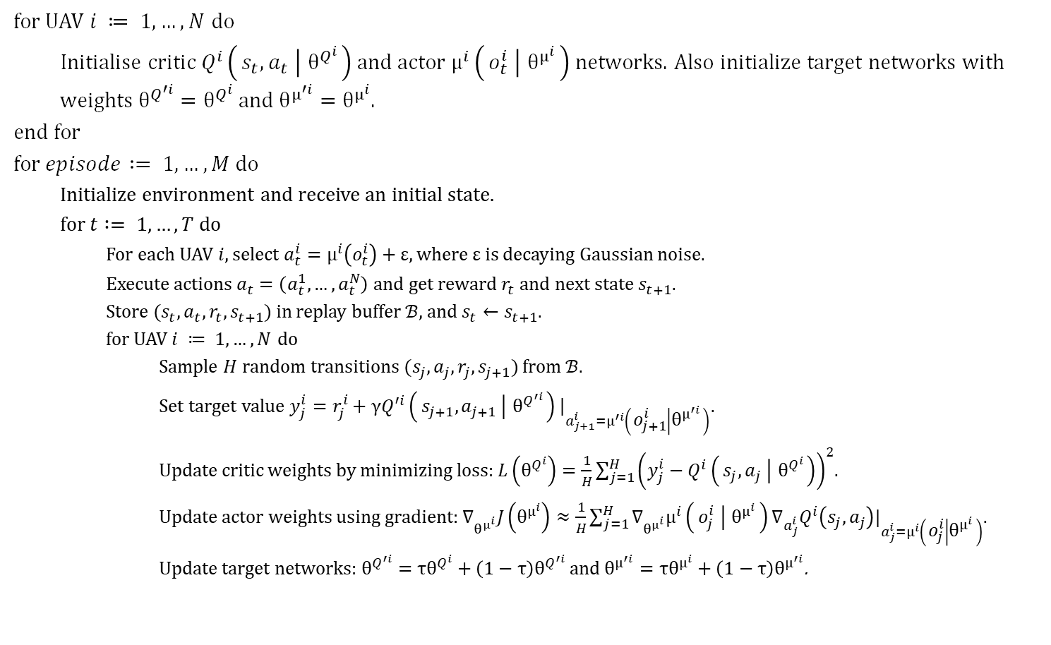
Training Algorithm
for UAV $i ≔ 1, …, N$ do
Initialise critic$Q^{i}\left(s_{t}, a_{t} ∣ θ^{Q^{i}}\right)$ and actor $μ^{i}\left(o_{t}^{i} ∣ θ^{μ^{i}}\right)$ networks. Also initialize target networks with weights $θ^{Q^{′i}}=θ^{Q^{i}}$ and $θ^{μ^{′i}}=θ^{μ^{i}}$.
end for
for $episode := 1, …, M$ do
Initialize environment and receive an initial state.
for $t := 1,…,T$ do
For each UAV $i$, select $a_{t}^{i}=μ^{i}\left(o_{t}^{i}\right)+ε$, where $ε$ is decaying Gaussian noise.
Execute actions $a_{t}=\left(a_{t}^{1},…,a_{t}^{N}\right)$ and get reward $r_{t}$ and next state $s_{t+1}$.
Store $(s_{t}, a_{t}, r_{t}, s_{t+1})$ in replay buffer $ℬ$, and $s_{t}←s_{t+1}$.
for UAV $i ≔ 1, …, N$ do
Sample $H$ random transitions $(s_{j}, a_{j}, r_{j}, s_{j+1})$ from $ℬ$.
Set target value $y_{j}^{i}=r_{j}^{i}+γQ^{′i}\left(s_{j+1},a_{j+1} ∣ θ^{Q^{′i}}\right){\left.​\right|}_{a_{j+1}^{i}=μ^{′i}\left(o_{j+1}^{i} ∣ θ^{μ^{′i}}\right)}$.
Update critic weights by minimizing loss: $L\left(θ^{Q^{i}}\right)=\frac{1}{H}\sum_{j=1}^{H}{{\left(y_{j}^{i}−Q^{i}\left(s_{j},a_{j} ∣ θ^{Q^{i}}\right)\right)}^{2}}$.
Update actor weights using gradient: $∇_{θ^{μ^{i}}}J\left(θ^{μ^{i}}\right)≈\frac{1}{H}\sum_{j=1}^{H}{∇_{θ^{μ^{i}}}μ^{i}\left(o_{j}^{i} ∣ θ^{μ^{i}}\right)∇_{a_{j}^{i}}Q^{i}\left(s_{j},a_{j}\right)|_{a_{j}^{i}=μ^{i}\left(o_{j}^{i} ∣ θ^{μ^{i}}\right)}}$.
Update target networks: $θ^{Q^{′i}}=τθ^{Q^{i}}+\left(1−τ\right)θ^{Q^{′i}}$ and $θ^{μ^{′i}}=τθ^{μ^{i}}+\left(1−τ\right)θ^{μ^{′i}}$.

Slide 14
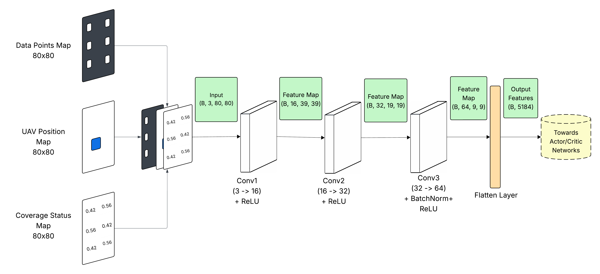
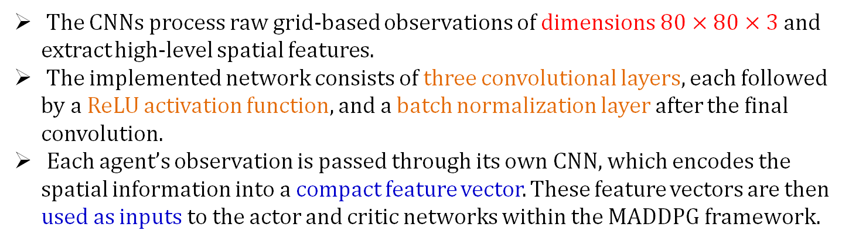
CNN based Spatial Encoding
Architecture of CNN Network
The CNNs process raw grid-based observations of dimensions $80×80×3$ and extract high-level spatial features.
The implemented network consists of three convolutional layers, each followed by a ReLU activation function, and a batch normalization layer after the final convolution.
Each agent’s observation is passed through its own CNN, which encodes the spatial information into a compact feature vector. These feature vectors are then used as inputs to the actor and critic networks within the MADDPG framework.

Slide 15
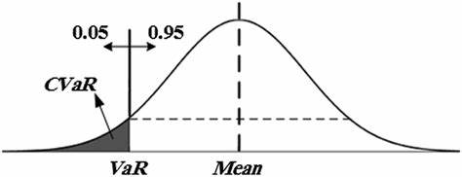
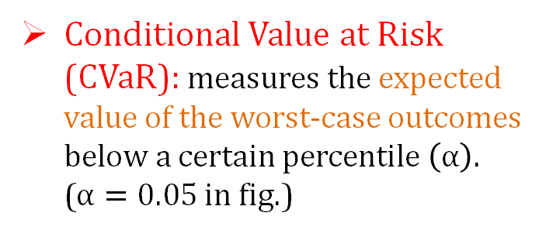
Risk Averse RL
A branch of RL that focuses on optimizing policies while minimizing risk rather than just maximizing expected rewards.
Conditional Value at Risk (CVaR): measures the expected value of the worst-case outcomes below a certain percentile $\left(α\right)$. ($α=0.05$ in fig.)
CVaR compared with VaR [2]
Why required?
We observed early in training that some agents accumulated high rewards while others failed to cover PoIs and energy was being used inefficiently in edge-case trajectories.
CVaR helps ensure fair and conservative learning, not just high average scores.

Slide 16
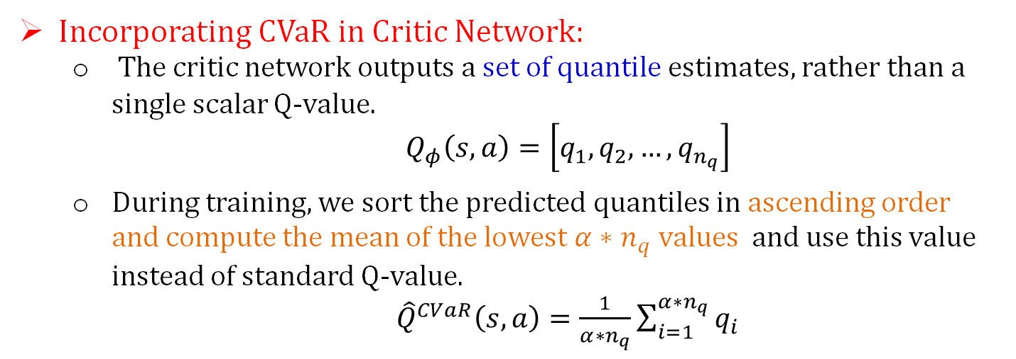
Risk Averse RL (contd.)
Incorporating CVaR in Critic Network:
The critic network outputs a set of quantile estimates, rather than a single scalar Q-value.
$Q_{φ}\left(s,a\right)=\left[q_{1},q_{2},…,q_{n_{q}}\right]$
During training, we sort the predicted quantiles in ascending order and compute the mean of the lowest $α∗n_{q}$values and use this value instead of standard Q-value.
${\hat{Q}}^{CVaR}\left(s,a\right)=\frac{1}{α∗n_{q}}\sum_{i=1}^{α∗n_{q}}{q_{i}}$
Observed impact:
Improved fairness stability — agents spread more uniformly.
Fairness vs. Energy tradeoff became more consistent across training
Agents avoided risky regions or redundant overlaps, saving energy.

Slide 17



Results and Analysis
State Visualization:
Initial State: Shows the initial start position of all the UAVs at the start of training, which remains fixed at the start of each episode.
Mid-Training Episode: Captures the positions of UAVs and their corresponding covered regions (shown by the green region).
Heatmap: Illustrates the spatial distribution of UAV coverage. Areas with higher intensity indicate regions that have received better coverage.
Initial state of all UAVs
Mid-Training Episode Image
Coverage Heatmap

Slide 18
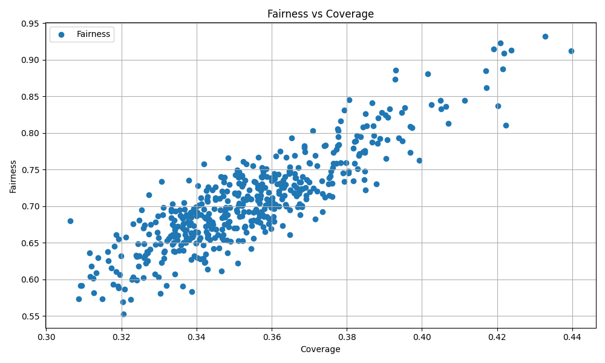
Results and Analysis (contd.)
Fairness vs Coverage
Almost linear and positively correlated trend
Cooperation among agents is self-emergent, not manually coded.
A high coverage inherently encourages agents to distribute themselves more evenly, minimizing neglected zones.
The learning algorithm promotes balanced distribution of service across the area.

Slide 19
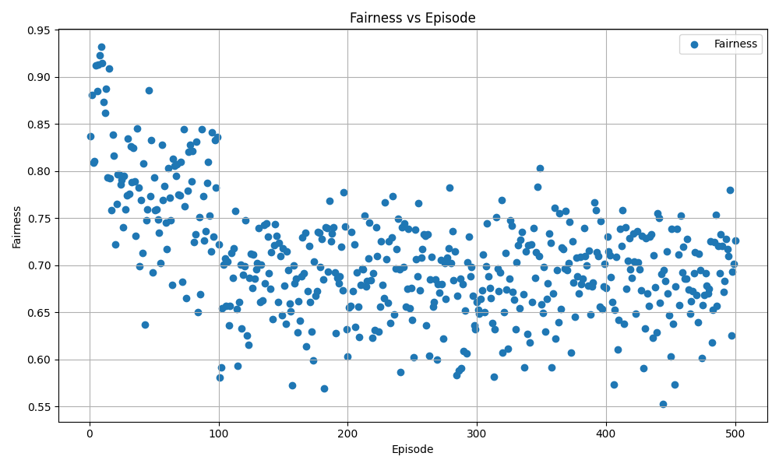
Results and Analysis (contd.)
Fairness vs Episodes
A hockey stick curve—starting with high fairness in initial episodes (peaking around 0.95), followed by a flat tail averaging around 0.70.
A high fairness initially is due to random exploration which later reduces due to CVaR based risk-averse policy learning.
This strategic risk aversion leads to stabilizing behaviour but may overlook less-visited PoIs, causing fairness to plateau.

Slide 20
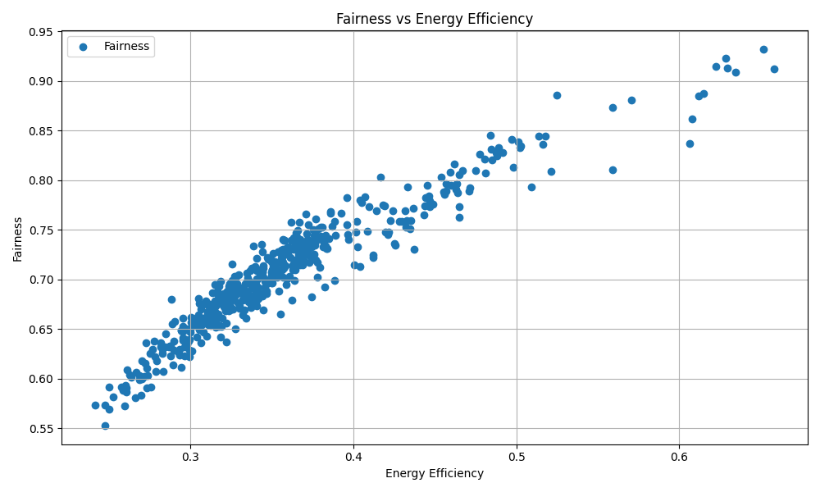
Results and Analysis (contd.)
Fairness vs Energy Efficiency
As fairness improves, agents begin to conserve energy more consistently.
The learning reinforces that a fair coordination avoids redundant flight, hence saving energy.
Our multi-objective reward function successfully aligns fairness with energy awareness.

Slide 21
Conclusion
Project Summary
A decentralized multi-UAV system using MADDPG with CNNs and CVaR, aimed at maximizing coverage, maintaining fairness, and ensuring energy efficiency.
Designed a custom 2D environment and implemented a robust multi-objective reward scheme under the CTDE paradigm.
Key Outcomes
Achieved decentralized coordination among agents through centralized critics and local actors.
Achieved stable learning with strong performance across various metrics.
Demonstrated the viability of deep multi-agent reinforcement learning in partially observable, constrained environments replicating real-world scenarios.
GitHub Link: https://github.com/Project-Group-LBP/LBP

Slide 22
Thanks

Slide 23
References
[1] Chi Harold Liu, Xiaoxin Ma, Xudong Gao, and Jian Tang. Distributed energy-efficient multi-uav navigation for long-term communication coverage by deep reinforcement learning. IEEE Transactions on Mobile Computing, 19(6):1274–1286, 2020. URL https: //ieeexplore.ieee.org/document/8676325
[2] CVaR vs. VaR: Key Differences and Their Role in Risk Management. Accounting Insights. URL CVaR vs VaR: Key Differences and Their Role in Risk Management - Accounting Insights
[3] Ryan Lowe, Yi Wu, Aviv Tamar, Jean Harb, Pieter Abbeel, and Igor Mordatch. Multiagent actor-critic for mixed cooperative-competitive environments. URL [1706.02275] Multi-Agent Actor-Critic for Mixed Cooperative-Competitive Environments

